Slide 1
U-SQL Introduction
Saveen Reddy
Big Data @ Microsoft
2017/02/03

Slide 2
Language Overview

Slide 3
Fundamentals
Familiar SQL concepts
SELECT … FROM … WHERE
GROUP BY … HAVING
OVER & Window Functions
U-SQL expressions are C# expressions
Operate on Unstructured and Structured data
U-SQL Catalog & Databases for sharing code and storing schematized data partitioned for high throughput queries
Reuse existing.NET assemblies

Slide 4
Extensibility
Use .NET code to define custom
Types
Functions
Operators
Combiners (Joins)
Reducers & Aggregates
Extractors
Outputters

Slide 5
Advanced Analytics
Built-in Cognitive support for image processing and text analysis
Use U-SQL to create Massively distributed programs using Python and R

Slide 6
Basics

Slide 7
Simple Example
@rows =
EXTRACT name string,
id int
FROM “/data.csv”
USING Extractors.Csv( );
OUTPUT @rows
TO “/output.csv”
USING Outputters.Csv();
Rowsets
EXTRACT for files
OUTPUT
Schema
Types
Inputs & Outputs
Keywords are UPPERCASE

Slide 8
Inputs & Outputs

Slide 9
Reading from WASB and ADLS
// WASB (requires setting up a WASB DataSource in ADLS)
@rows =
EXTRACT name string, id int
FROM “wasb://…/data..csv”
USING Extractors.Csv( );
// ADLS (absolute path)
@rows =
EXTRACT name string, id int
FROM “adl://…/data..csv”
USING Extractors.Csv( );
// ADLS (relative to default ADLS for an ADLA account)
@rows =
EXTRACT name string, id int
FROM “/…/data..csv”
USING Extractors.Csv( );
Default Extractors
Extractors.Csv( )
Extractors.Tsv( )

Slide 10
Multiple Inputs: Explicit List
@rows =
EXTRACT name string, id int
FROM
“/file1.tsv”,
“/file2.tsv”,
“/file3.tsv”
USING Extractors.Csv( );

Slide 11
OUTPUT
@rows =
EXTRACT name string, id int
FROM “adl://…/data..csv”
USING Extractors.Csv();
OUTPUT @rows
TO “/data.tsv”
USING Outputters.Csv();
Default Outputters
Outputters.Csv( )
Outputters.Tsv( )

Slide 12
Handling Header rows
@rows = EXTRACT
Name string,
Id int, FROM “/file.tsv” USING Extractors.Tsv(skipFirstNRows:1);
OUTPUT @data
TO "/output/docsamples/output_header.csv"
USING Outputters.Csv(outputHeader:true);
Specify the number of rows to skip

Slide 13
Parameters

Slide 14
Example
@rows =
EXTRACT <schema>
FROM “adl://…/data..csv”
USING Outputters.Csv();
DECLARE @inputfile string = “adl://…/data..csv”
@rows =
EXTRACT <schema>
FROM @inputfile
USING Outputters.Csv();

Slide 15
parameters
DECLARE @a string = "Hello World";
DECLARE @b int = 2;
DECLARE @c dateTime = System.DateTime.Parse("1979/03/31");
DECLARE @d dateTime = DateTime.Now;
DECLARE @e Guid = System.Guid.Parse("BEF7A4E8-F583-4804-9711-7E608215EBA6");
DECLARE @f byte [] = new byte[] { 0, 1, 2, 3, 4};
Parameters begin with @

Slide 16
Creating RowSets in a Script

Slide 17
Creating Constant Rowsets in Script
@departments =
SELECT * FROM
(VALUES
(31, "Sales"),
(33, "Engineering"),
(34, "Clerical"),
(35, "Marketing")
) AS
D( DepID, DepName );

Slide 18
Escaping IDs

Slide 19
Escaping IDs
@b =
SELECT [Order Number], Part
FROM @a;
The # goes away in U-SQL

Slide 20
Transforming Data

Slide 21
Projection
@output =
SELECT
Start,
Region,
Duration + 1.0 AS Duration2
FROM @searchlog;

Slide 22
Filtering with WHERE
@output =
SELECT
Start,
Region,
Duration
FROM @searchlog
WHERE Region == "en-gb";

Slide 23
Refining RowSets

Slide 24
Refining
@output =
SELECT
Start,
Region,
Duration
FROM @searchlog;
@output =
SELECT *
FROM @output
WHERE Region == "en-gb";

Slide 25
Logical operators

Slide 26
Logical operators
@output =
SELECT Start, Region, Duration
FROM @searchlog
WHERE (Duration >= 60) OR NOT (Region == "en-gb");
// NOTE: && and || perform short-circuiting
@output =
SELECT Start, Region, Duration
FROM @searchlog
WHERE (Duration >= 60) || !(Region == "en-gb");

Slide 27
Filtering on Dates
@output =
SELECT Start, Region, Duration
FROM @searchlog
WHERE
Start >= DateTime.Parse("2012/02/16")
AND Start <= DateTime.Parse("2012/02/17");

Slide 28
Testing for Membership with IN
rs =
SELECT
FirstName,
LastName,
JobTitle
FROM People
WHERE
JobTitle IN ("Engineer", "Designer“, “Writer”);

Slide 29
Numbering Rows
@rs1 =
SELECT
ROW_NUMBER() OVER ( ) AS RowNumber,
Start,
Region
FROM @searchlog
ORDER BY Start;

Slide 30
Numbering Rows

Slide 31
Numbering Rows
@rs1 =
SELECT
ROW_NUMBER() OVER ( ) AS RowNumber,
Start,
Region
FROM @searchlog
ORDER BY Start;

Slide 32
C# Expressions

Slide 33
Methods on Types
@output =
SELECT
Region.ToUpper() AS NewRegion
FROM @searchlog;
@output=
SELECT
Start,
Region,
Start.DayOfYear AS StartDayOfYear
FROM @searchlog;

Slide 34
Casting Types
@output=
SELECT
Start,
Region,
((double) Duration) AS DurationDouble
FROM @searchlog;

Slide 35
WHERE with Calculated Columns

Slide 36
Filtering on Calculated Columns
// INCORRECT SYNTAX
@output =
SELECT Start, Region, Duration/60.0 AS DurationInMinutes
FROM @searchlog
WHERE DurationInMinutes >= 20;
// INCORRECT SYNTAX
output =
SELECT Start, Region, Duration/60.0 AS DurationInMinutes
FROM @searchlog
HAVING DurationInMinutes >= 20;

Slide 37
Filtering on Calculated Columns
// OPTION 1
@output =
SELECT Start,
Region,
Duration/60.0 AS DurationInMinutes
FROM @searchlog
WHERE Duration/60.0 >= 20;
// OPTION 2
@output =
SELECT Start,
Region,
Duration/60.0 AS DurationInMinutes
FROM @searchlog;
@output =
SELECT *
FROM @output
WHERE DurationInMinutes >= 20;

Slide 38
Parameters

Slide 39
Text
DECLARE @text1 string = "Hello World";
DECLARE @text2 string = @"Hello World";
DECLARE @text3 char = 'a';
DECLARE @text4 string = "BEGIN" + @text1 + "END";
DECLARE @text5 string = string.Format("BEGIN{0}END", @text1);

Slide 40
Numeric
DECLARE @numeric1 sbyte = 0;
DECLARE @numeric2 short = 1;
DECLARE @numeric3 int = 2;
DECLARE @numeric4 long = 3L;
DECLARE @numeric5 float = 4.0f;
DECLARE @numeric6 double = 5.0;
DECLARE @unumeric1 byte = 0;
DECLARE @unumeric2 ushort = 1;
DECLARE @unumeric3 uint = 2;
DECLARE @unumeric4 ulong = 3L;

Slide 41
Datetime
DECLARE @d1 DateTime = System.DateTime.Parse("1979/03/31");
DECLARE @d2 DateTime = DateTime.Now;

Slide 42
Other
DECLARE @misc1 bool = true;
DECLARE @misc2 Guid = System.Guid.Parse("BEF7A4E8-F583-4804-9711-7E608215EBA6");
DECLARE @misc4 byte [] = new byte[] { 0, 1, 2, 3, 4};

Slide 43
Notes
// User-defined code is not supported
DECLARE myName string = MyHelper.GetMyName();

Slide 44
Sorting

Slide 45
A working Example
// List the sessions in increasing order of Duration
@output =
SELECT *
FROM @searchlog
ORDER BY Duration ASC
FETCH FIRST 3 ROWS;
// This does not work (ORDER BY requires FETCH)
@output =
SELECT *
FROM @searchlog
ORDER BY Duration ASC;

Slide 46
You can sort on output
OUTPUT @output
TO @"/Samples/Output/SearchLog_output.tsv"
ORDER BY Duration ASC
USING Outputters.Tsv();

Slide 47
Grouping & Aggregation

Slide 48
Example
// NO GROUP BY
@output =
SELECT
SUM(Duration) AS TotalDuration
FROM @searchlog;
// WITH GROUP BY
@output =
SELECT
Region,
SUM(Duration) AS TotalDuration
FROM searchlog
GROUP BY Region;

Slide 49
HAVING
// find all the Regions where the total dwell time is > 200
@output =
SELECT
Region,
SUM(Duration) AS TotalDuration
FROM @searchlog
GROUP BY Region
HAVING TotalDuration > 200;

Slide 50
OTHER
@output =
SELECT
Region,
COUNT() AS NumSessions,
SUM(Duration) AS TotalDuration,
AVG(Duration) AS AvgDwellTtime,
MAX(Duration) AS MaxDuration,
MIN(Duration) AS MinDuration
FROM @searchlog
GROUP BY Region;

Slide 51
Filtering Aggregated Values
// Option 1
@output =
SELECT
Region,
SUM(Duration) AS TotalDuration
FROM @searchlog
GROUP BY Region;
@output2 =
SELECT *
FROM @output
WHERE TotalDuration > 200;
// Option 2
@output =
SELECT
Region,
SUM(Duration) AS TotalDuration
FROM @searchlog
GROUP BY Region
HAVING SUM(Duration) > 200;

Slide 52
Breaking Apart and Merging Columns

Slide 53
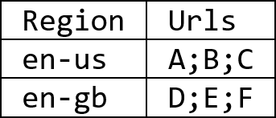
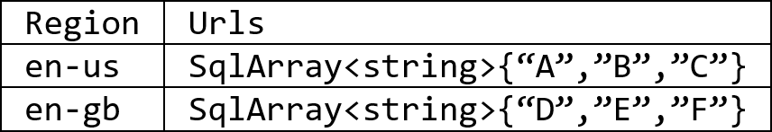
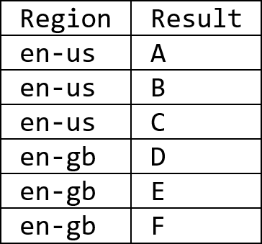
Column -> Rows
ARRAY TYPE
@a = SELECT Region, Urls FROM @searchlog;
@b = SELECT
Region,
SqlArray.Create(Urls.Split(';')) AS UrlTokens
FROM @a;
@c = SELECT
Region,
Token AS Url
FROM @b
CROSS APPLY EXPLODE (UrlTokens) AS r(Token);
@a
@b
CROSS APPLY EXPLODE
@c

Slide 54
Rows -> Columns
@d = SELECT Region,
ARRAY_AGG<string>(Url).ToArray() AS UrlArray
FROM @c
GROUP BY Region;
@e = SELECT Region,
string.Join(";", UrlArray) AS Urls
FROM @c;
@c
@d
@e

Slide 55
Combining Data with JOINS and Set Theoretic Operations

Slide 56
File Sets

Slide 57
EXTRACT every file in a folder
@rs =
EXTRACT
user string,
id string,
suffix string
FROM
"/input/{suffix}"
USING Extractors.Csv();
The value for the column named “suffix”
Comes from here (it is the filename)

Slide 58
Using DateTime
@rs =
EXTRACT
user string,
id string,
date DateTime
FROM
"/input/{date:yyyy}/{date:MM}/{date:dd}/dat.txt"
USING Extractors.Csv();
Date column comes from pattern
Multiple uses of same column
4-digit Year
2-digit month
2-digit day

Slide 59
Use WHERE to filter File Sets
@rs =
EXTRACT
user string,
id string,
date DateTime,
suffix string
FROM
"/input/{date:yyyy}/{date:MM}/{date:dd}/{suffix}"
USING Extractors.Csv();
@rs =
SELECT * FROM @rs
WHERE date >= System.DateTime.Parse(“2016/1/1”) AND
date < System.DateTime.Parse(“2016/2/1”);
Use normal C# expressions to constrain the fileset

Slide 60
Catalog

Slide 61
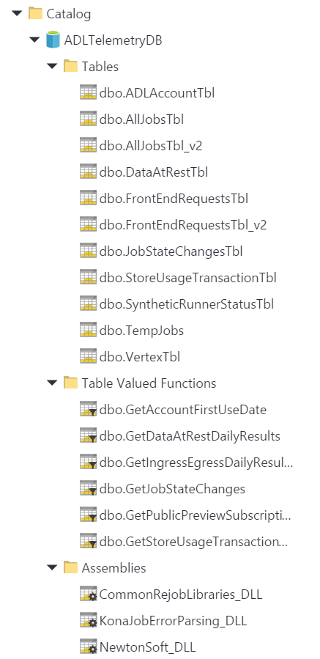
Every VC will have a “Catalog”
Each Catalog contains N Databases
Tables
Table-Valued Functions
Assemblies

Slide 62
U-SQL Tables
Create and Fill a Table with Partitioned Data
CREATE TABLE Customers(
OrderId int,
Customer string,
Date DateTime,
Amount float,
INDEX index1
CLUSTERED (Customer)
PARTITIONED BY (Date)
DISTRIBUTED BY HASH (id) INTO 4
);
INSERT INTO Customers
SELECT * FROM @rows;
A higher level replacement for Structured Streams
Discoverable in the U-SQL Catalog
Schematized
Data Distributions within Partitions
RANGE, HASH, DIRECT HASH, ROUND ROBIN
No need to worry about managing SSTREAM files.
Future:
handle schema updates via ALTER TABLE
After frequent table insertions rebuild with ALTER TABLE REBUILD
3. CLUSTERED Within in each distribution (from 2) keep rows that have the same value for Customer column together
1. PARTITIONED Physically partition into files by Date column
Partition (file)
Distribution 1
Cluster A
Cluster B
Distribution 2
2. DISTRIBUTED Distribute out the rows into at most 4 buckets inside each file (from 1) based on a HASH of the Id column
Cluster B
Cluster C
Cluster D

Slide 63
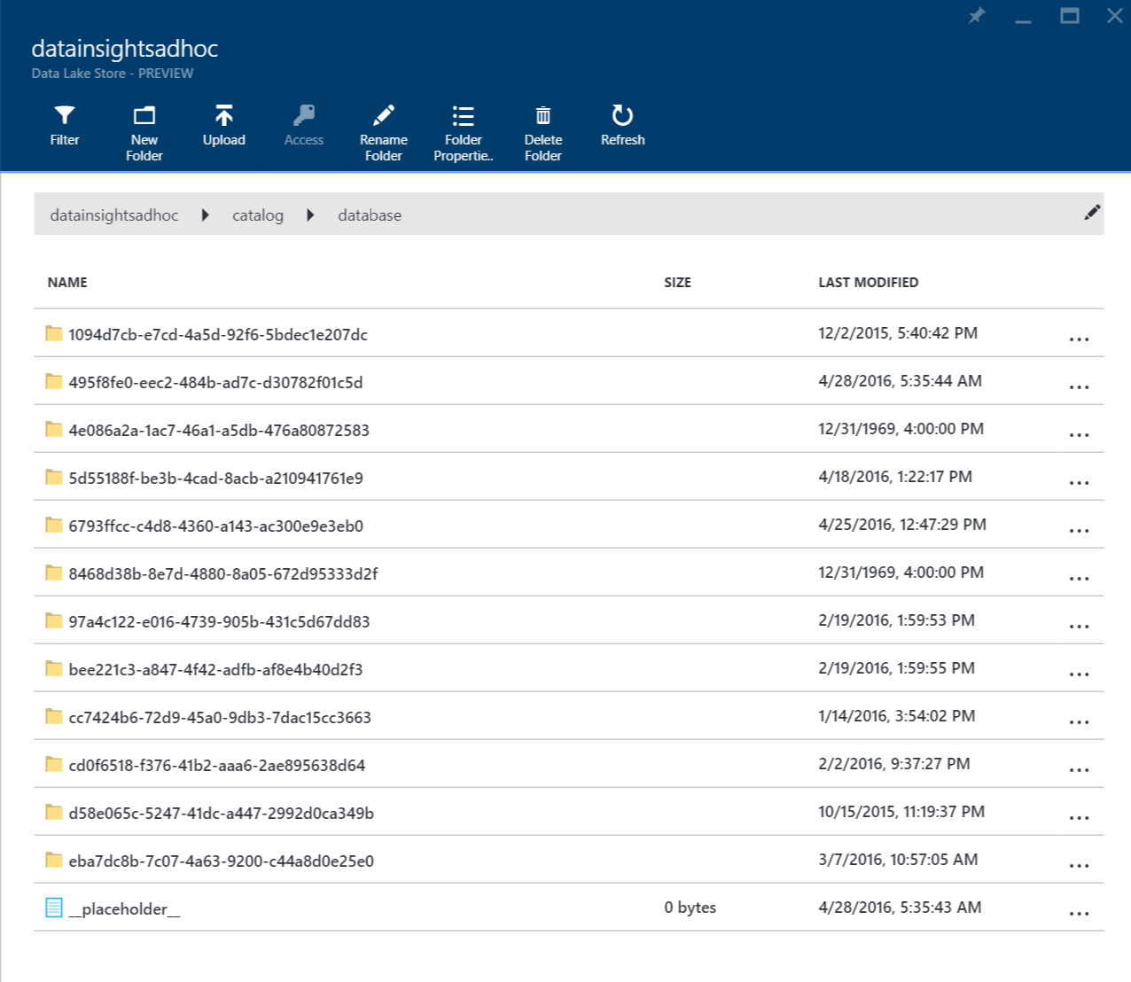
Underneath the covers a U-SQL Table is a set of structured streams
Don’t read or write to these files directly. LEAVE THE CATALOG FOLDER ALONE
Files under “/catalog/database”

Slide 64
Managing a Database
CREATE DATABASE MyDB;
DROP DATABASE MyDB;

Slide 65
Creating a Table-Valued Function (1)
CREATE FUNCTION MyDB.dbo.GetData()
RETURNS @rows TABLE
(
Name string,
Id int
)
AS
BEGIN
@rows = EXTRACT
Name string,
Id int, FROM “/file.tsv” USING Extractors.Tsv();
RETURN;
END;
Identify rowset that will contain result
A Single concept that replaces Scope views & functions
Discoverable
Schematized
Schema
Assign the previously identified rowset

Slide 66
Creating a Table-Valued Function (2)
CREATE FUNCTION MyDB.dbo.GetData()
RETURNS @rows AS
BEGIN
@rows = EXTRACT
Name string,
Id int, FROM “/file.tsv” USING Extractors.Tsv();
RETURN;
END;
Schema comes from RowSet

Slide 67
Reading From
// A Table
@rs = SELECT * FROM MyDB.dbo.Customers;
// A Table valued Function
@rs = SELECT * FROM MyDB.dbo.GetData();

Slide 68
Using C# Code
CREATE ASSEMBLY MyCode
FROM @"/DLLs/Helpers.dll";
Upload Assembly first then CREATE ASSEMBLY
(places it in catalog)
Enable using this assembly with CREATE ASSEMBLY
REFERENCE ASSEMBLY MyCode;
@rows = SELECT
OrdersDB.Helpers.Normalize(Customer) AS CustN,
Amount AS Amount
FROM @orders;
Call method

Slide 69
BACKUP

Slide 70
Already Know SQL?

Slide 71
String Stuff
String begins with …
WHERE Customer.StartsWith( “Contoso” )
String contains
WHERE CustomerName.Contains( “Contoso )

Slide 72
UDOs

Slide 73
UDOs
Extractors
Outputters
Processors
Reducers
Aggregates (special kind of Reducer)

