Slide 1
SMALL LANGUAGE MODELS FROM FIRST PRINCIPLES
What they are • How they are built • How to make them reliable • When to walk away

Slide 2

Four Numbers Describe Any Model
Ask for these before you ask anything else.
1. Total Parameters
3. Context Window
Example:
Example:
Governs memory footprint and rough capability ceiling. The headline number in the name.
How much you can put in one call. The working memory for prompt plus output.
2. Active Parameters
4. Precision
Example:
Example: (4 bit)
Governs generation speed on mixture of experts models. Active parameters set your speed.
Bytes per parameter. This is the real memory bill and decides if it fits your laptop.

Slide 3
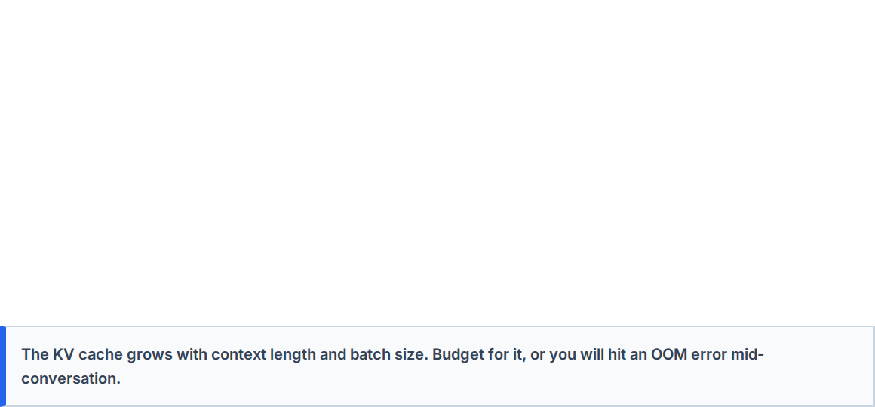
The Memory Bill, In One Formula
Precision | Bytes per Parameter | Memory for 3B Model
FP16 or BF16 | 2 | ~ 6 GB
8 bit | 1 | ~ 3 GB
4 bit | 0.5 | ~ 1.7 GB

Slide 4









Four Axes of Model Types
Confusing these axes is the most common source of bad model decisions.
1. Architecture
2. Role
3. Lineage
Dense (the safe default), Mixture of Experts (speed of a small model, RAM of a large one), Hybrid (Mamba/SSM), or Nested.
Base (raw weights), Instruct (tuned to follow instructions), Reasoning, Embedding, or Multimodal.
From Scratch (pretrained), Distilled (trained to imitate a larger teacher), or Pruned (cut and repaired).

Slide 5
Making SLMs Reliable
Architecture beats parameters. The compounding problem and the four fixes.

Slide 6
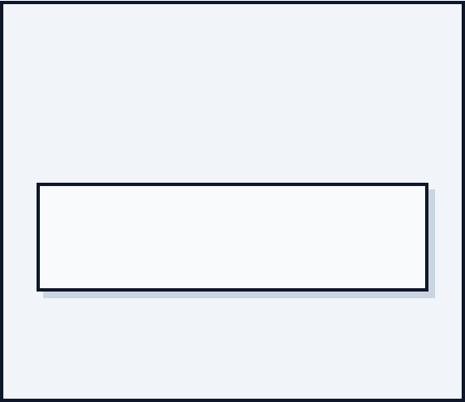


The Compounding Problem
Ten Steps, 90% Success
The Four Fixes (In Order)
If your agent takes 10 sequential steps, and each tool call succeeds 90% of the time, what is your true success rate?
■
Decompose: Cut steps (N). Checkpoint between segments.
■
Constrain: Force grammar/schema at decode time.
■
Verify: Validate every step mechanically.
■
Route: Send easy majority to the small model, escalate failures.

Slide 7
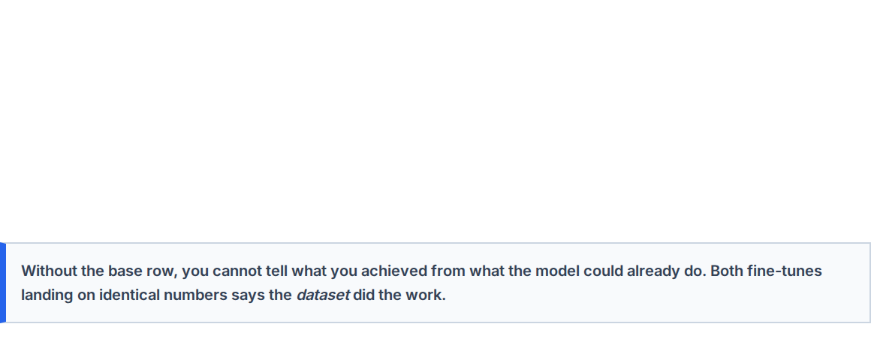
The Column That Makes It Honest
Always measure the base model on the identical set before claiming any improvement.
Model | Task A | Task B | Overall
Smaller model, base | 2% | 30% | 18%
Smaller model, fine-tuned | 98% | 95% | 97%
Larger model, fine-tuned | 98% | 95% | 97%

Slide 8
Advanced Track
Evaluation that holds up, MoE traps, and memory management as a first-class design input.

Slide 9
The Four Ways an Eval Quietly Lies
Leakage: Scores climb, production does not. Fix: Split by episode, hold out whole units, check for near duplicates.
Easy Set: Everything passes, no signal between models. Fix: Stratify by difficulty, keep a deliberately nasty 20%.
Proxy Drift: The metric improves while the product gets worse. Fix: State what the proxy misses, review examples by hand regularly.
Unequal Conditions: One model handicapped by the harness. Fix: Standardize decoding params, template, and token budget.

Slide 10





Validate the Judge
An unvalidated judge is an opinion with a decimal point. Prefer mechanical checks first.
Measure Agreement
Control Biases
Pin the Version
Label 50 cases by hand. Measure agreement between judge and human. Below ~80%, the judge is not usable as a gate.
Position bias, length bias, and self-preference. Randomize order, strip style, and use a judge from a different family.
A judge that silently upgrades invalidates historical scores. Report judged numbers with the judge named, like an instrument.

Slide 11
Mixture of Experts (MoE) Trade-offs
What Happens Per Token
Where It Wins and Loses
A router picks top of experts. The rest sit idle but resident in memory.
■
Wins: You have memory, need throughput, have a broad task mix, or run one deployment for varied work.
■
Compute: Scales with active experts.
■
Memory: Scales with ALL experts.
■
Loses: Memory-constrained edge, high concurrency on one host, fine-tuning, or very narrow single tasks.
A 30B total / 3B active MoE generates like a 3B, but needs the RAM of a 30B.

Slide 12

Where the Memory Actually Goes
Weights are only the part you budgeted for.
W
KV
OH
WEIGHTS
CACHE
OVERHEAD
Params × Bytes
Grows with Ctx × Batch
Transients & Fragmentation

Slide 13
Seven Memory Levers (In Order)
Cheapest and least damaging first. Reach for the top levers before quantizing further.
Lever | Effect | Cost / Impact
1. Cut actual context sent | Linear reduction in cache | None, usually improves quality
2. Lower context limit | Caps worst-case allocation | Long inputs truncate (guard them)
3. Quantize KV cache (8-bit) | Roughly halves cache | Small, usually acceptable quality hit
4. Reduce concurrency | Linear reduction | Throughput falls
5. Quantize weights further | Reduces weight memory | Quality falls, must measure it

Slide 14
THE ADVANCED CHECKLIST
1. Golden set composed by slice, with provenance. 2. Mechanical checks before judged ones; validate the judge. 3. Error bars on reported numbers; compare paired cases. 4. Size memory for weights + cache + concurrency. 5. Prompts versioned with model ID and decoding params.
Questions?

