Slide 1


Material Design Lite
Alexander Kasheverov, DataArt

Slide 2


About me

Slide 3
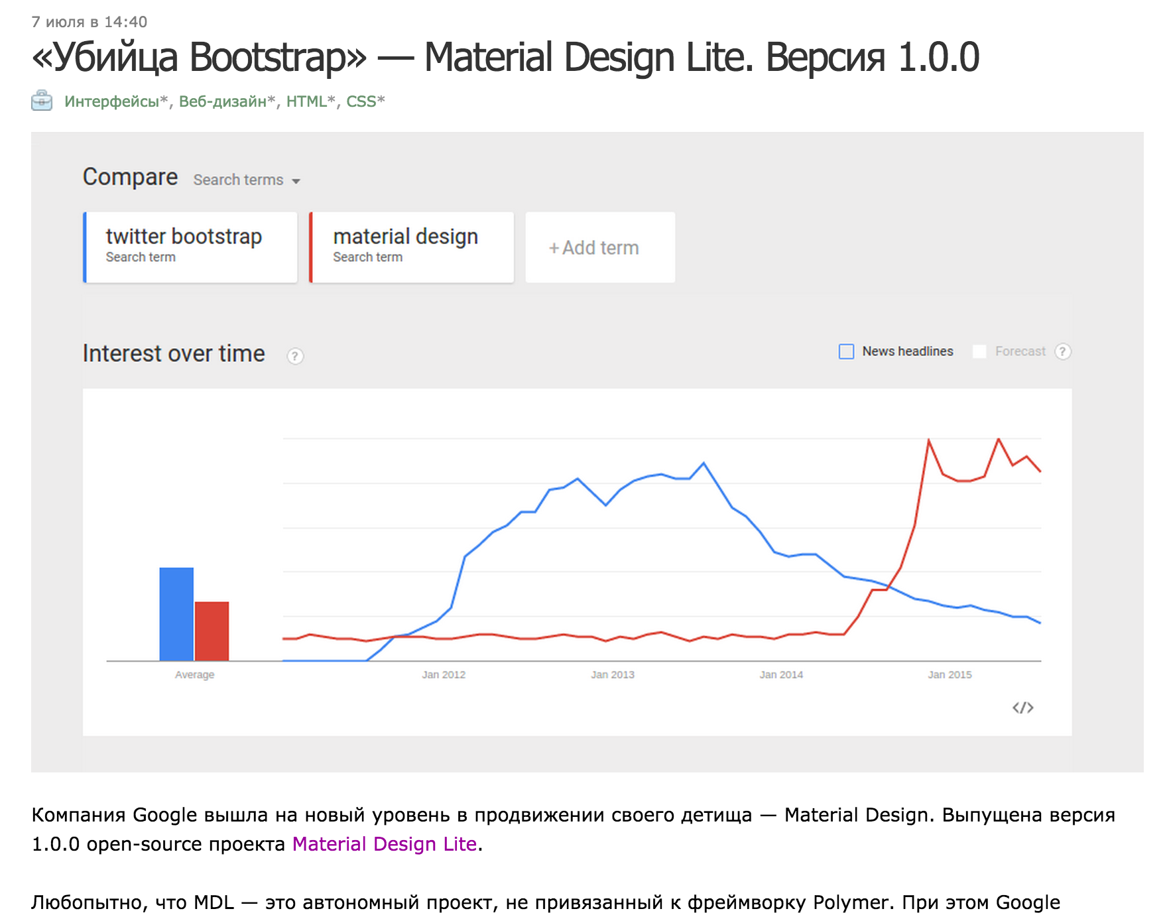
About topic

Slide 4
MDL Overview
15 June 2014 - Material Design announced
7 Apr 2014 - The first commit by @addyosmany
6 Jul 2015 - MDL v1.0.0 released
Only vanilla JavaScript
Apache 2 license
Looks like Polymer Paper Elements, isn’t it?

Slide 5
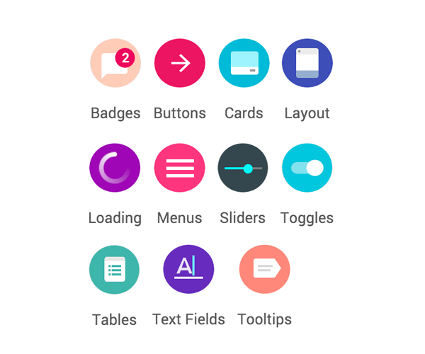
MDL is

Slide 6

Using

Slide 7

Using

Slide 8
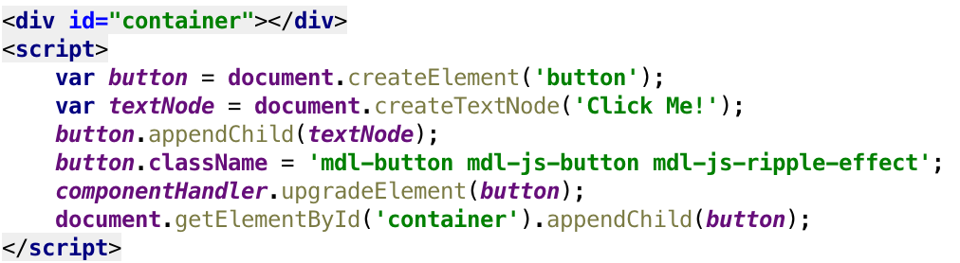
Using

Slide 9
Using
In general, follow these basic steps to use an MDL component in your HTML page:
Start with a standard HTML element, such as <button>, <div>, or <ul>
Add one or more MDL-specific CSS classes to the element

Slide 10
Examples

Slide 11
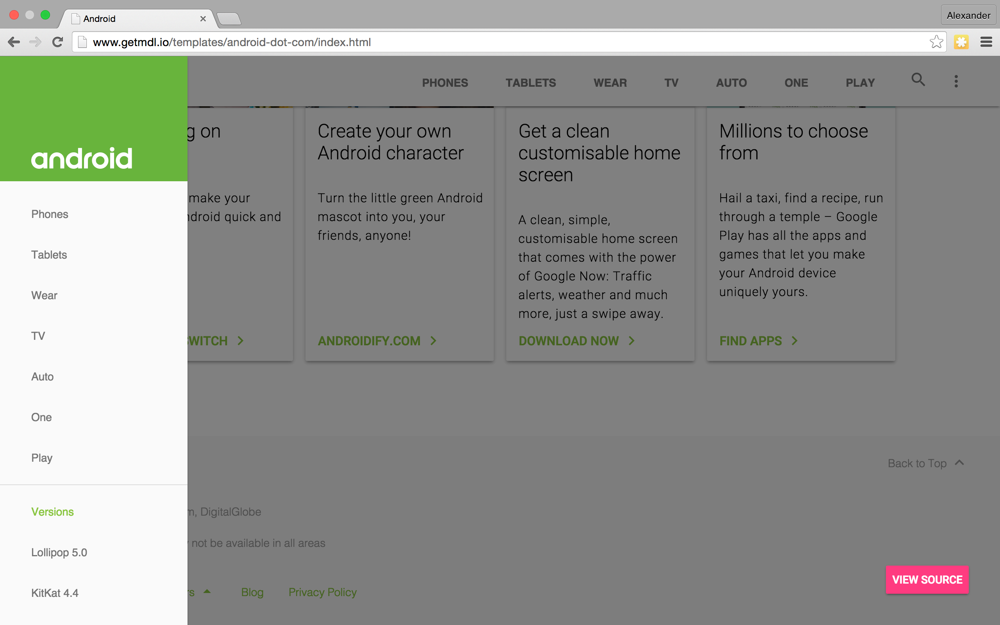

Slide 12
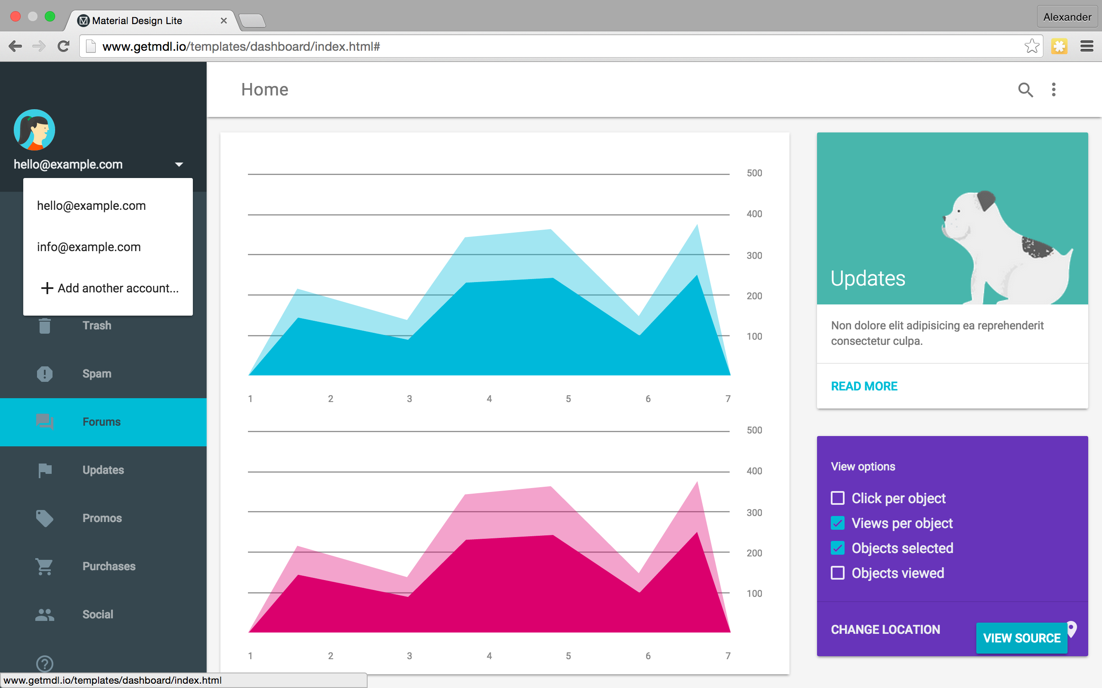

Slide 13
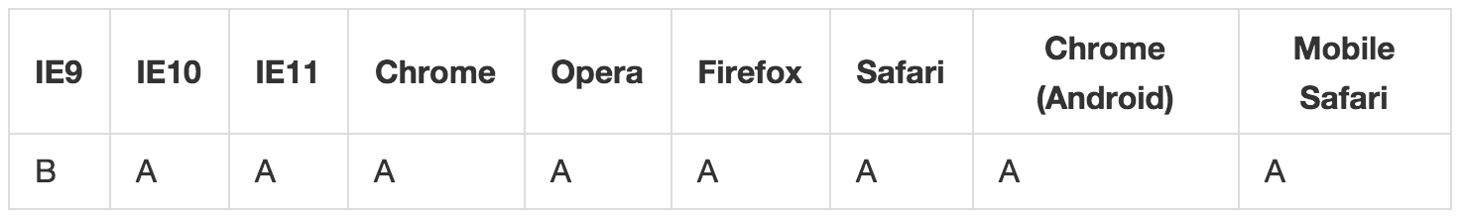
Browser Support
A - fully supported, B - gracefully degraded

Slide 14
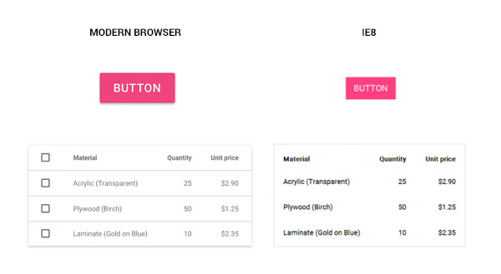
Browser Support

Slide 15
Installation

Slide 16
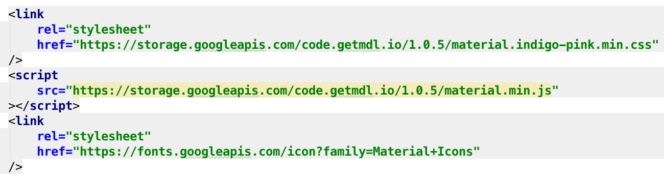
Installation

Slide 17
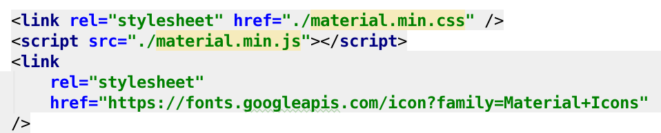
Installation

Slide 18
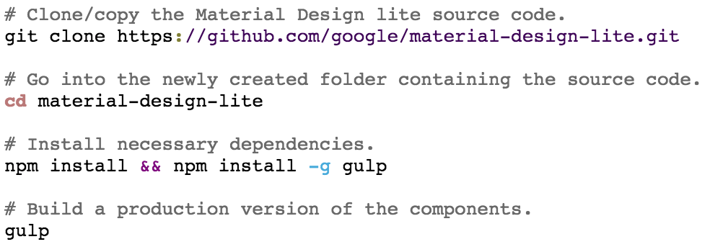
Installation

Slide 19
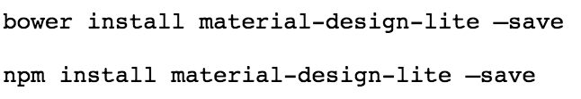
Installation

Slide 20
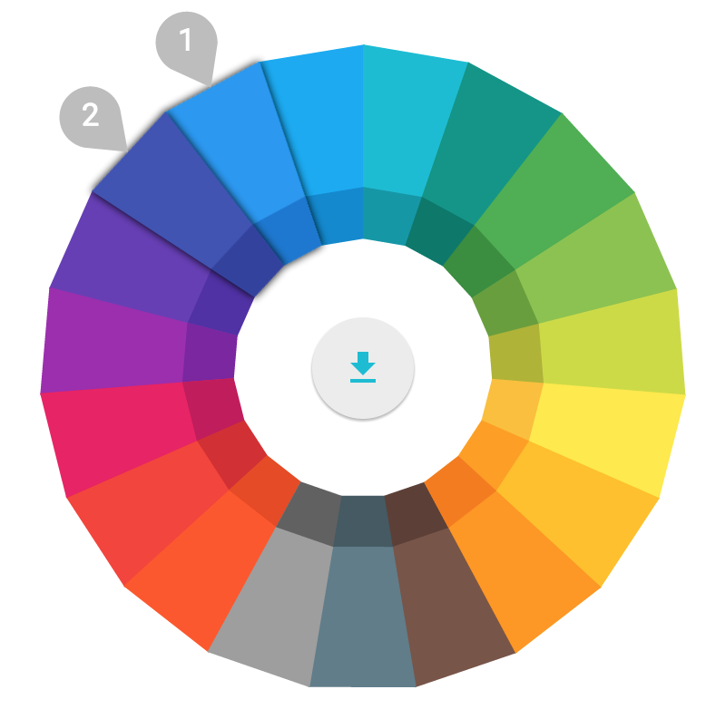
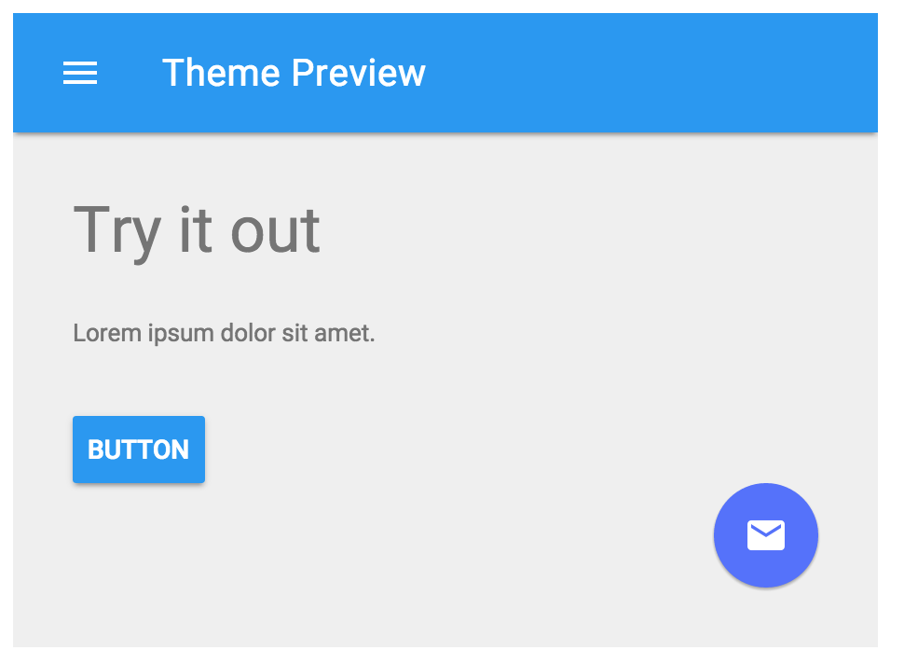
Theme Customization

Slide 21
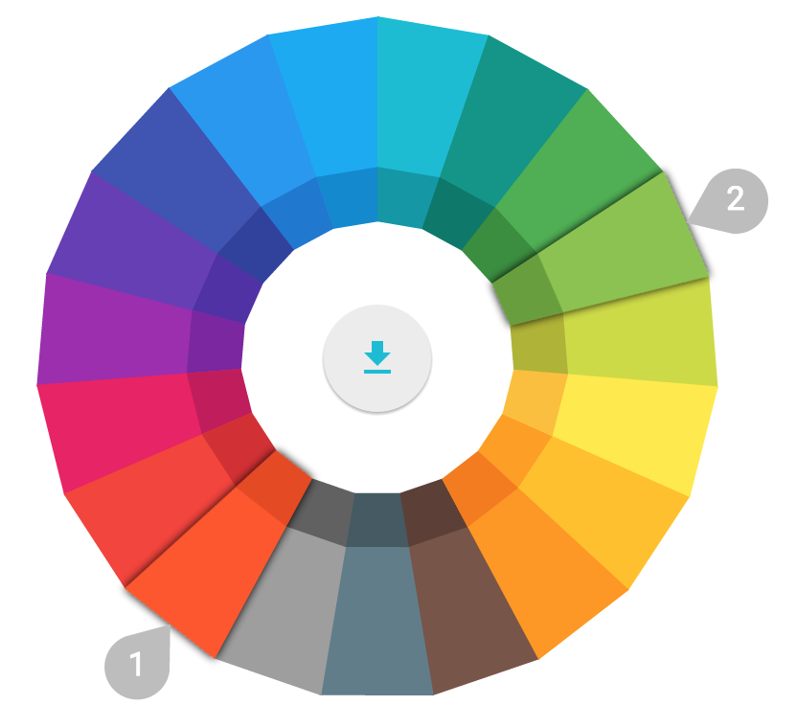
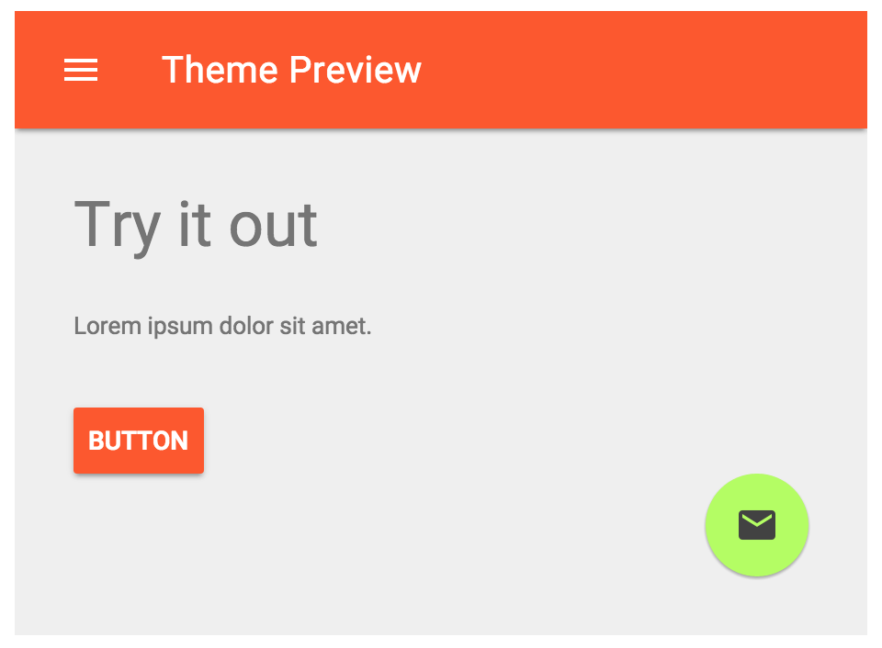
Theme Customization

Slide 22
Pros & Cons
No dialog
No datepickers
No sticky footer
No select/dropdown
Plenty of issues
Material design
Material design
Adaptive
Ecosystem
Good help
Progressive Enhancement
Developer-oriented

Slide 23
Live Examples

Slide 24
MDL vs Bootstrap
Support IE10+
Github starts 15,049
Material Design!
Developer-oriented
Support IE8+
Github stars 87,283
Using-oriented
Huge community

Slide 25
MDL vs Bootstrap
Material Design can replace many parts of Bootstrap. However, it does not intend to feature-match everything Bootstrap offers.

Slide 26
Conclusion
Material Design Lite is focused on delivering a vanilla CSS/JS/HTML library of components.
We are not a framework.
If you are building a single-page app and require features like two-way data-binding, templating, CSS scoping and so forth, we recommend trying out the excellent Polymer project.

Slide 27
Questions
Почему кнопка при нажатии поднимается?

