Slide 1
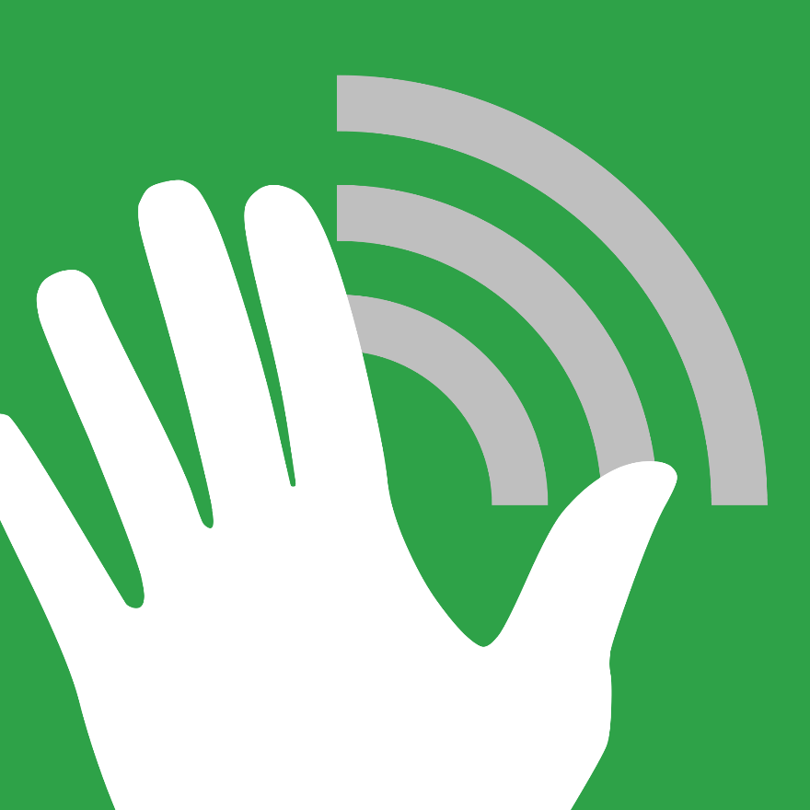
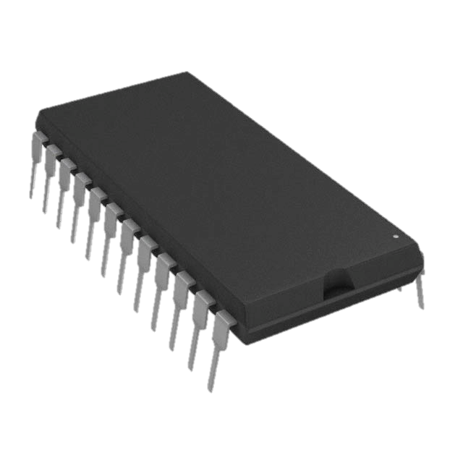
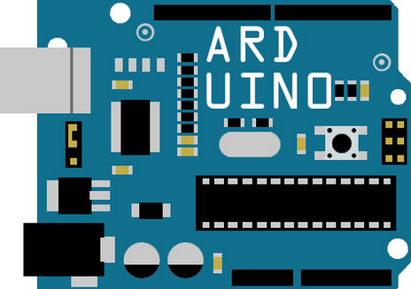

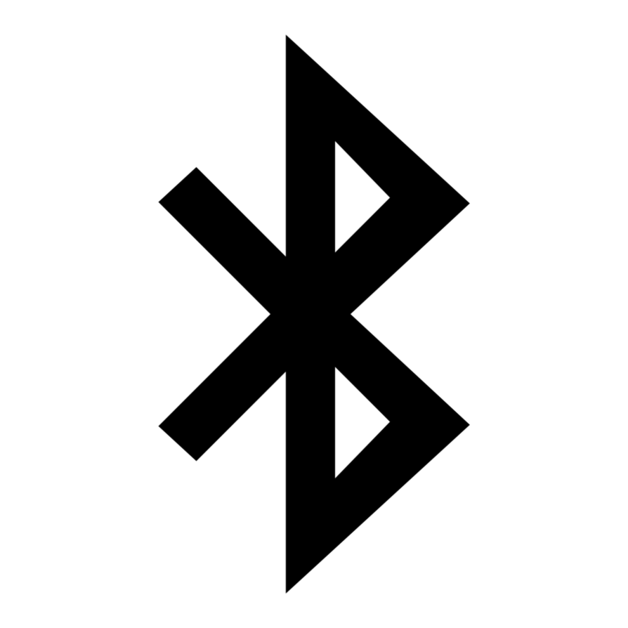
MAKING SENSE
Creating a New Way to Feel the World
F
Sensors
Multiplexers
Arduino
Se
Sensors on the glove pick up the temperature and forces at the glove’s surface.
Several Multiplexers then combine these signals and send them to the Arduino.
The Arduino microcontroller uses the signals to calculate the forces and
temperature at the glove surface.
Making
Sense
Bluetooth
Android App
Display
A Bluetooth Arduino shield is used to send the temperature and force data to an Android phone or tablet. The Android Application takes the temperature and force data and uses it to determine what to display. The Display can be calibrated to display real-time force and temperature data or to provide alerts when extreme conditions are present.
BMES

