Slide 1
Dieharder Again: Testing Modern Random Number Generators
Kashev Dalmia
and David huang

Slide 2
Motivation
Random numbers have a wide range of applications (simulation, cryptography, gaming, etc.)
Quality of PRNGs is hard to quantify and depends on application
Potentially important metrics include: randomness, predictability, memory and speed performance

Slide 3
Dieharder Testing Framework
Suite of tests to evaluate the randomness of a sequence of generated numbers
Compares distribution of generated sequence to expected distributions
Test results are probabilistic in nature but provide a rough guideline on the quality of a generator
Low quality generators are easily caught

Slide 4

Kolmogorov-Smirnov Test
Provides a quantifiable method to determine the quality of a distribution fit
Test statistic D is the maximum between the empirical distribution function and the fitted distribution

Slide 5
Linear Congruent
Sequence defined by the formula for a line: X_{n+1} = (aX_{n} + c) mod m
Popular parameter sets include MINSTD and RANDU
Strengths: Lightweight, stores little state, fast and easy to compute
Weaknesses: Short period, outputs are planar and of poor quality

Slide 6
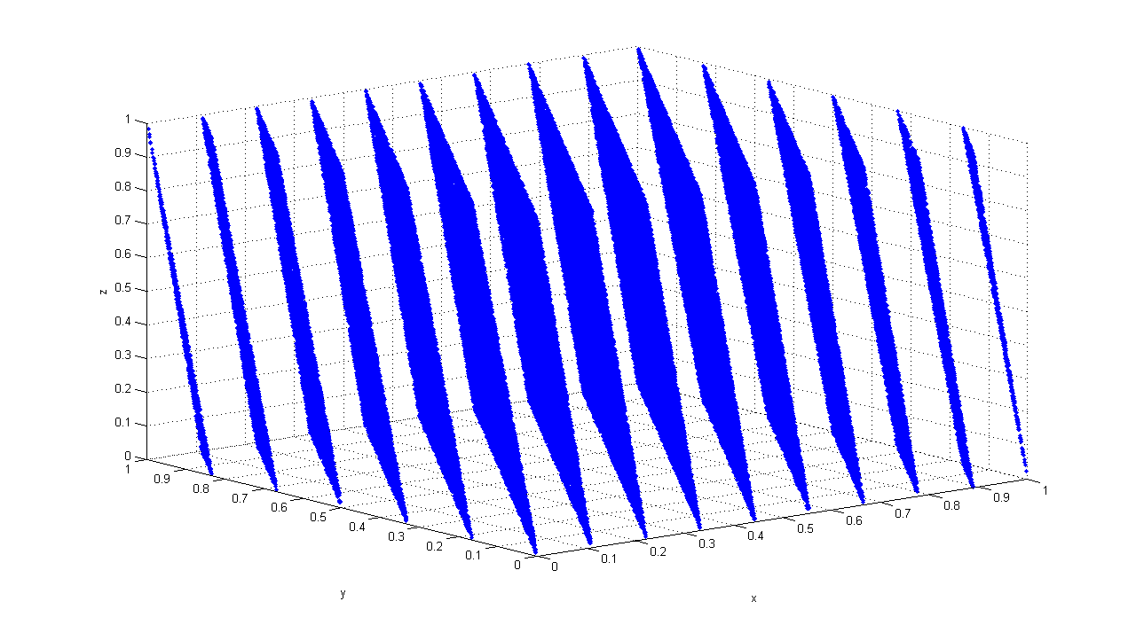
Linear Congruent
Overall outputs appear to be uniformly distributed
Strong correlation between consecutive outputs
Plotting consecutive outputs as ordered triples in 3-space reveals planar pattern

Slide 7
Xorshift
In general, sequence produced by shifting and XORing together past values
Strengths: Stores relatively little state, fast performance, good period to performance ratio, generally high quality outputs
Weaknesses: Overall short period length

Slide 8
Lagged Fibonacci
Has the general form: X_{n} = (X_{n−r} * X_{n−s}) mod m, 0 < s < r
r and s are lag parameters and determine the size of the state space and * can be any operation
Strengths: Generally fast performance, flexible
Weaknesses: Stores a sizeable amount of state, output quality highly dependent on seeding method and parameter selection

Slide 9
Lagged Fibonacci
Subtract with Carry variant has form: X_{n} = (X_{n−r} - X_{n−s} – c_{n-1}) mod m, 0 < s < r
c_{n} = 1 if X_{n−r} - X_{n−s} – c_{n-1} ≥ 0, or 0 otherwise
Additional state information allows for a greater period than conventional Lagged Fibonacci generators
RANLUX variant further improves the quality of the output by discarding a number of values at regular periods, at the cost of performance

Slide 10
Multiply with Carry
Has the general form: X_{n+1} = (aX_{n−r} + c_{n}) mod m
In practice, Complementary Multiply with Carry is used: X_{n+1} = (b - 1) - (aX_{n−r} + c_{n}) mod m
Period heavily dependent on parameter selection
Proofs regarding periods are easier on the complementary variant while not sacrificing other benefits of the generator
Strengths: Very long period, relatively fast, high quality outputs
Weaknesses: Stores a fair amount of state, difficult to seed

Slide 11


Mersenne Twister
Underlying state sequence has form: X_{k+n} = X_{k+m} ⊕(X^{u}_{k} | X^{l}_{k+1})A
A is a matrix of form: [ ]
Effectively a linear feedback shift register (LFSR) with transformed inputs on each XOR operation
The expression (X^{u}_{k} | X^{l}_{k+1})A concatenates two previous masked values, performs a right-shift, and applies an XOR mask on each bit

Slide 12
Mersenne Twister
Results produced by a tempering function on the state: y := x ⊕ (x >> u) y := y ⊕ ((y << s) · b) y := y ⊕ ((y << t) · c) y := y ⊕ (y >> l)
This is done to ensure equidistributed outputs
In practice, sequences are generated in batches and outputs are produced upon request using the tempering function

Slide 13
Mersenne Twister
Strengths: Very large period, high quality equidistributed outputs
Weaknesses: Complex and slow, requires a great deal of memory to store state, difficult to seed

Slide 14
Results

Slide 15
Conclusion
The Mersenne Twister is currently the most widely adopted generator type, despite its slower performance
New cutting-edge generators (WELL, SFMT, etc.) help address some of the problems of MT but have yet to be widely adopted
Like most engineering problems, the choice of RNG may depend heavily on the application but MT seems to fit for most contexts

