Slide 1
Dieharder Again: Testing Modern Random Number Generators
Kashev Dalmia & David Huang

Slide 2

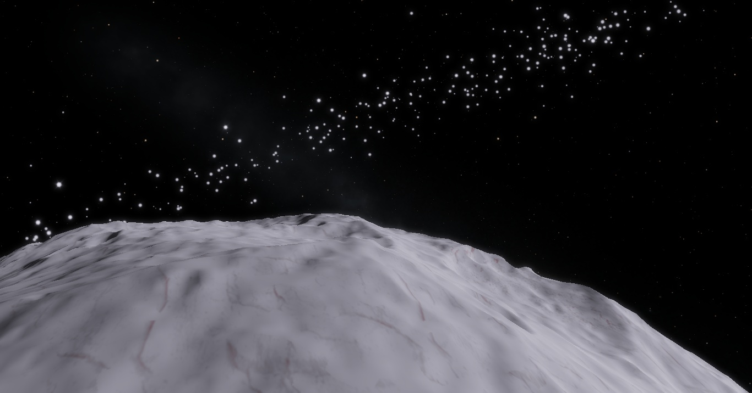
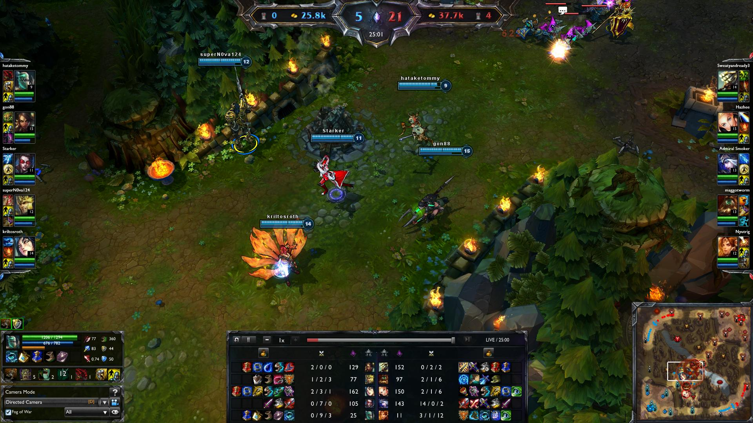
Why Study Random Numbers?
Simulation, Cryptography, Gaming & More
Quality Is Hard to Determine
Important Metrics:
Randomness
Predictability
Memory Usage
Speed

Slide 3
Why Test RNGs?

Slide 4
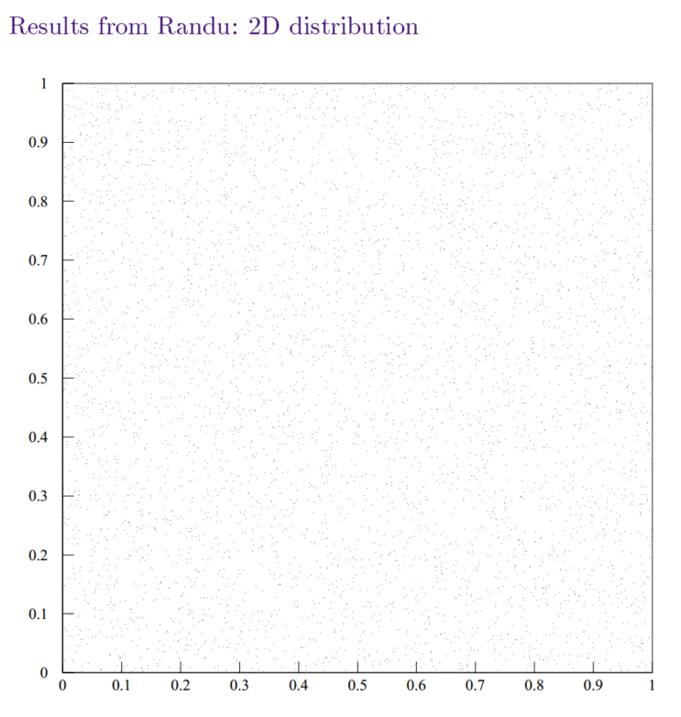
Example: RANDU
source: http://perso.ens-lyon.fr/eric.thierry/Perf2014/randu-issue.pdf

Slide 5
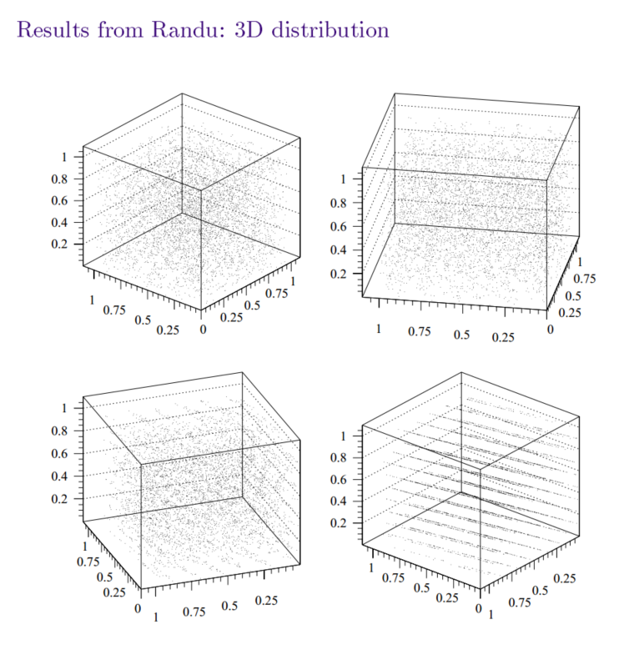
Example: RANDU
source: http://perso.ens-lyon.fr/eric.thierry/Perf2014/randu-issue.pdf

Slide 6
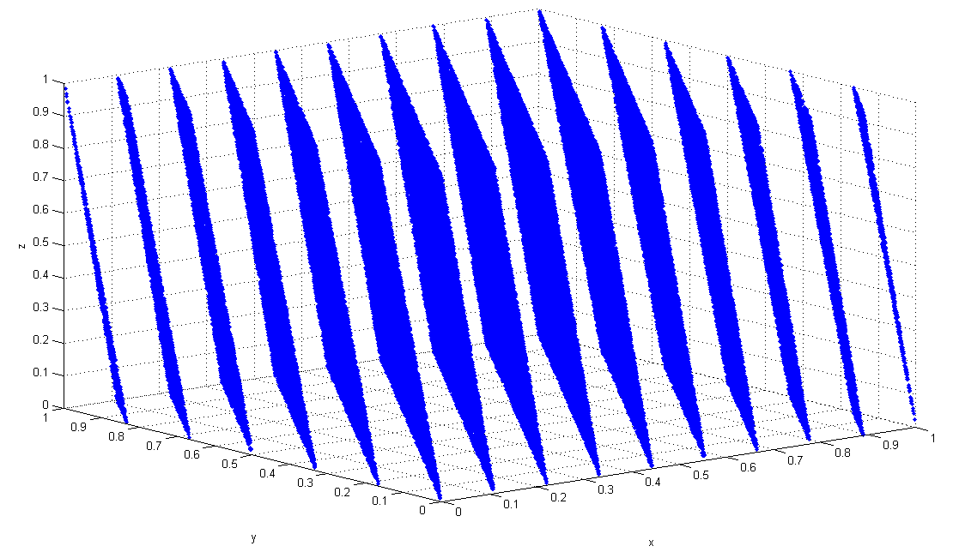
RANDU is Bad.
source: http://commons.wikimedia.org/wiki/File:Randu.png

Slide 7
Testing RNGs

Slide 8

Dieharder: A RNG Testing Framework
Suite of Randomness Tests
Incorporates tests from Diehard, NIST, and more
Low quality generators easily caught (RANDU)
Available in Ubuntu Repositories
Easy to interface with

Slide 9
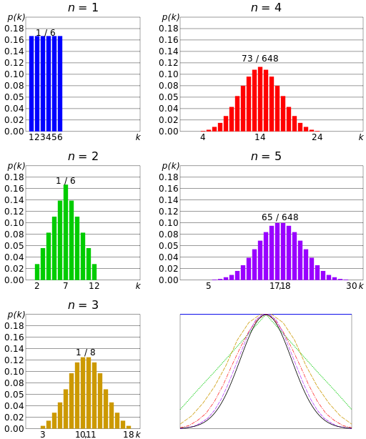
How Dieharder Works
Example: Rolling a die and summing the result, repeatedly.
This creates a P-Value.
source: http://commons.wikimedia.org/wiki/File:Dice_sum_central_limit_theorem.svg

Slide 10
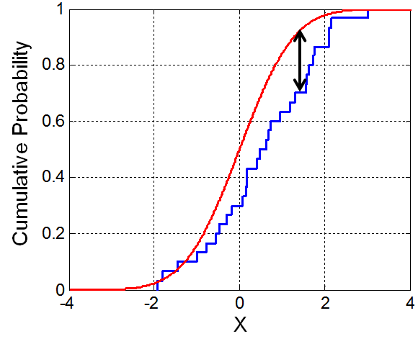

Kolmogorov-Smirnov Testing
How close are our empirical P-values to a perfect uniform distribution?
source: http://commons.wikimedia.org/wiki/File:KS_Example.png

Slide 11
Kinds of Tests in Dieharder
Birthday Test – see if random Birthday distances in a year are exponentially distributed.
Flip a Coin and ensure the coin is fair.
Play games of Craps and ensure the average number of wins is distributed correctly.
Throw away every n bits of output and ensure the remaining bits are uniformly distributed by summing them and ensuring a normal distribution.
Count Runs of zeros and ones and ensure uniformity.

Slide 12
Kinds of RNGs

Slide 13
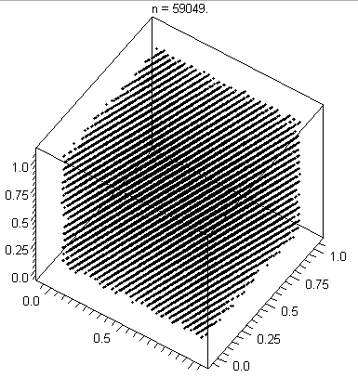
Linear Congruential
MINSTD, RANDU
Strengths: lightweight, small state, easy to understand
Weaknesses: short period, poor quality planar output
X_{n+1} = (aX_{n} + c) mod m
source: http://commons.wikimedia.org/wiki/File:Lcg_3d.gif

Slide 14
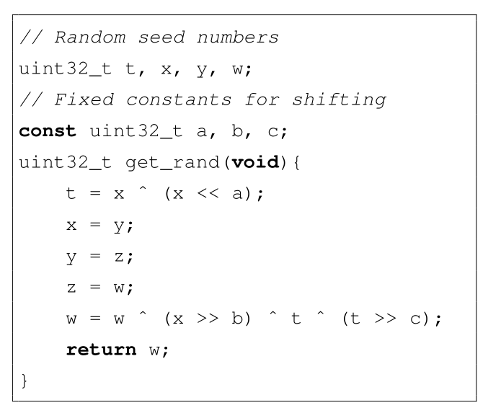
Xorshift
Shift and XOR together past values
Strengths: fast, small state, good period to performance ratio, somewhat good quality.
Weaknesses: relatively short period, hard to chose parameters, some question of quality.

Slide 15
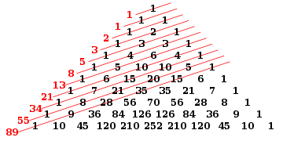
Lagged Fibonacci
X_{n} = (X_{n−r} * X_{n−s}) mod m, 0 < s < r
Strengths: Flexible, can be fast
Weaknesses: significantly more state, output quality dependent on seeding, parameter selection

Slide 16
Lagged Fibonacci – Subtract With Carry & RANLUX
X_{n} = (X_{n−r} - X_{n−s} – c_{n-1}) mod m, 0 < s < r
c_{n} = 1 if X_{n−r} - X_{n−s} – c_{n-1} ≥ 0, or 0 otherwise
RANLUX: reduce correlation, increase quality by discarding certain amount of output
Causes considerable slowdown.

Slide 17
[Complementary] Multiply With Carry
X_{n+1} = (aX_{n−r} + c_{n}) mod m
X_{n+1} = (b - 1) - (aX_{n−r} + c_{n}) mod m
Period heavily dependent on parameter selection
Proofs regarding period, seeding, parameter selection simpler in complementary version
Huge periods possible with good speed.
Strengths: long periods, fast, high quality output
Weaknesses: Somewhat large state

Slide 18

Mersenne Twister
Most common RNG in use
C++, Python, MATLAB, R, PHP, More
Strengths: Very large period, extremely high quality, equidistributed output
Weaknesses: complex operation and seeding, relatively slow, large state

Slide 19
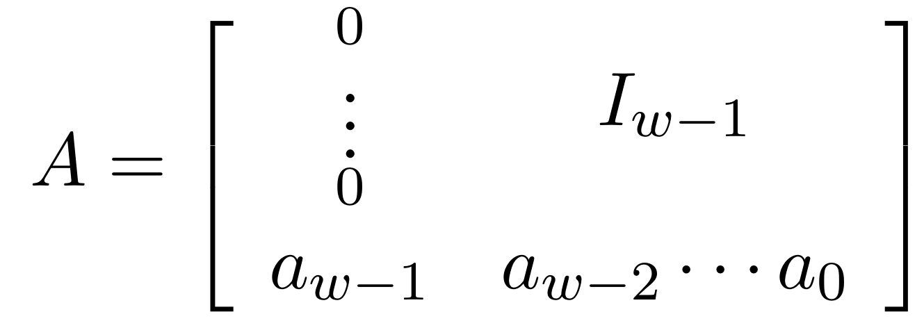

Mersenne Twister Algorithm
X_{k+n} = X_{k+m} ⊕(X^{u}_{k} | X^{l}_{k+1})A,
Effectively a linear feedback shift register (LFSR) with transformed on each XOR operation
(X^{u}_{k} | X^{l}_{k+1})A concatenates two previous masked values, performs a right-shift, and applies an XOR mask on each bit

Slide 20
Mersenne Twister Algorithm, continued
Tempering function on the state:
Ensures equidistribution in output, to d = 623
In practice, sequence is created in batch, then output is generated on request using the tempering function
y := x ⊕ (x >> u) y := y ⊕ ((y << s) · b) y := y ⊕ ((y << t) · c) y := y ⊕ (y >> l)

Slide 21
Results

Slide 22
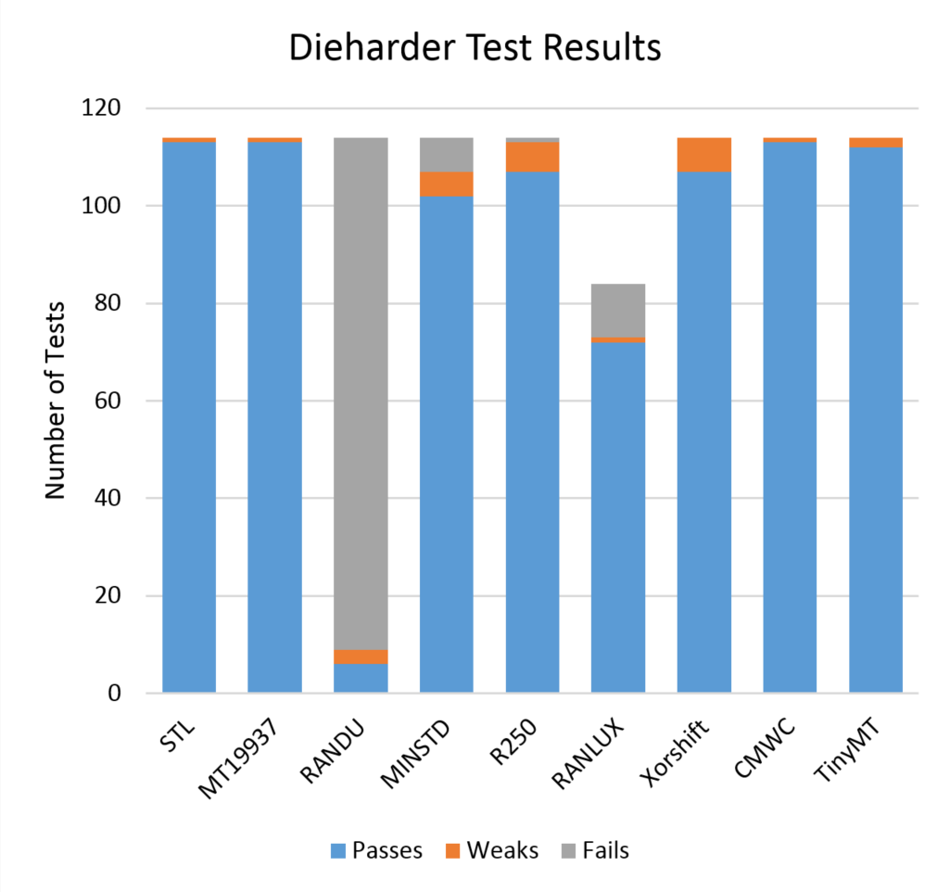
Dieharder Test Results
RANLUX incomplete because running a full run would take ~100 hours.
RANDU terrible.
Everything else is about the same amount of good, with the best possible parameters.

Slide 23
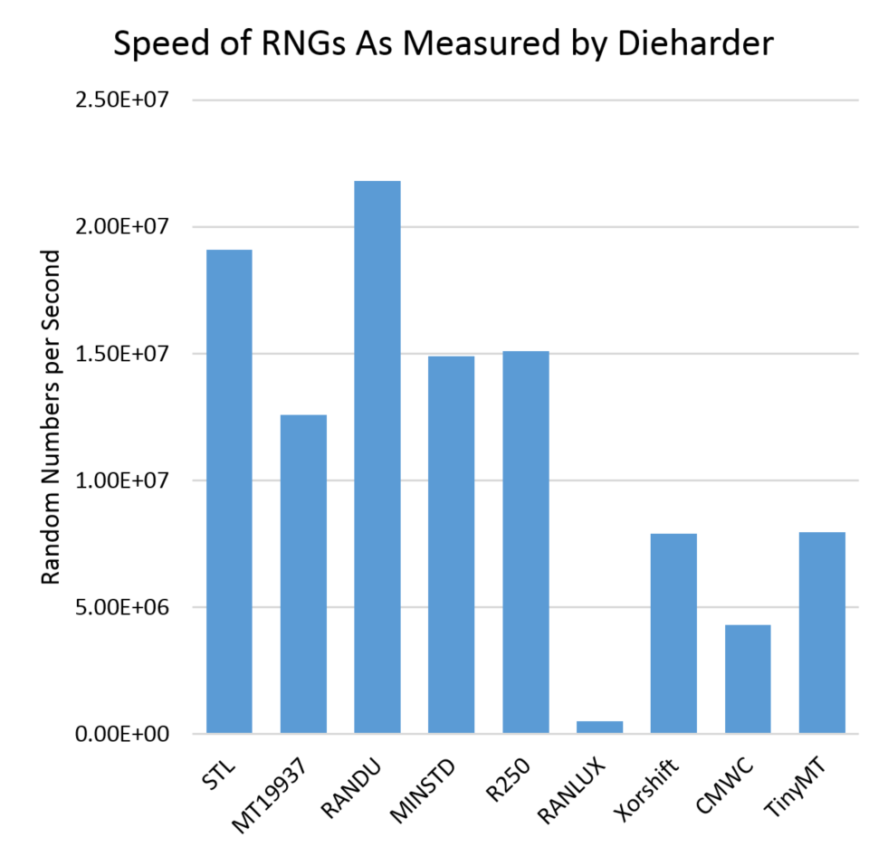
Dieharder Speed Results
RANLUX is extremely slow.
RANDU is fast but it’s unusable, remember?
CMWC would be faster if we made a smaller version that might now pass as many tests.
We couldn’t make our MT as fast as the C++ STL. Go figure.

Slide 24
Conclusion

Slide 25
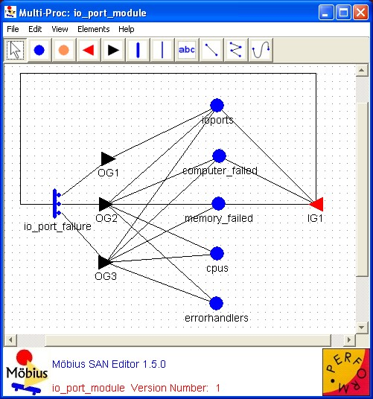
What Should I Use?
Mersenne Twister is the common, easiest choice
…despite there being potentially faster generators out there
New Generators being developed to address MT problems (have not seen adoption)
WELL
SFMT
System Designer must decide!
Mobius, a simulator which uses RNGS

Slide 26
Thank You! Questions?

