Slide 1
Dieharder Again: Testing Modern Random Number Generators
Kashev Dalmia
and David huang

Slide 2
Motivation
Random numbers have a wide range of applications (simulation, cryptography, gaming, etc.)
Quality of PRNGs is hard to quantify and depends on application
Potentially important metrics include: randomness, predictability, memory and speed performance

Slide 3
Dieharder Testing Framework
Suite of tests to evaluate the randomness of a sequence of generated numbers
Compares distribution of generated sequence to expected distributions
Test results are probabilistic in nature but provide a rough guideline on the quality of a generator
Low quality generators are easily caught

Slide 4
Linear Congruent
Sequence defined by the formula for a line: X_{n+1} = (aX_{n} + c) mod m
Popular parameter sets include MINSTD and RANDU
Strengths: Lightweight, stores little state, fast and easy to compute
Weaknesses: Short period, outputs are planar and of poor quality

Slide 5
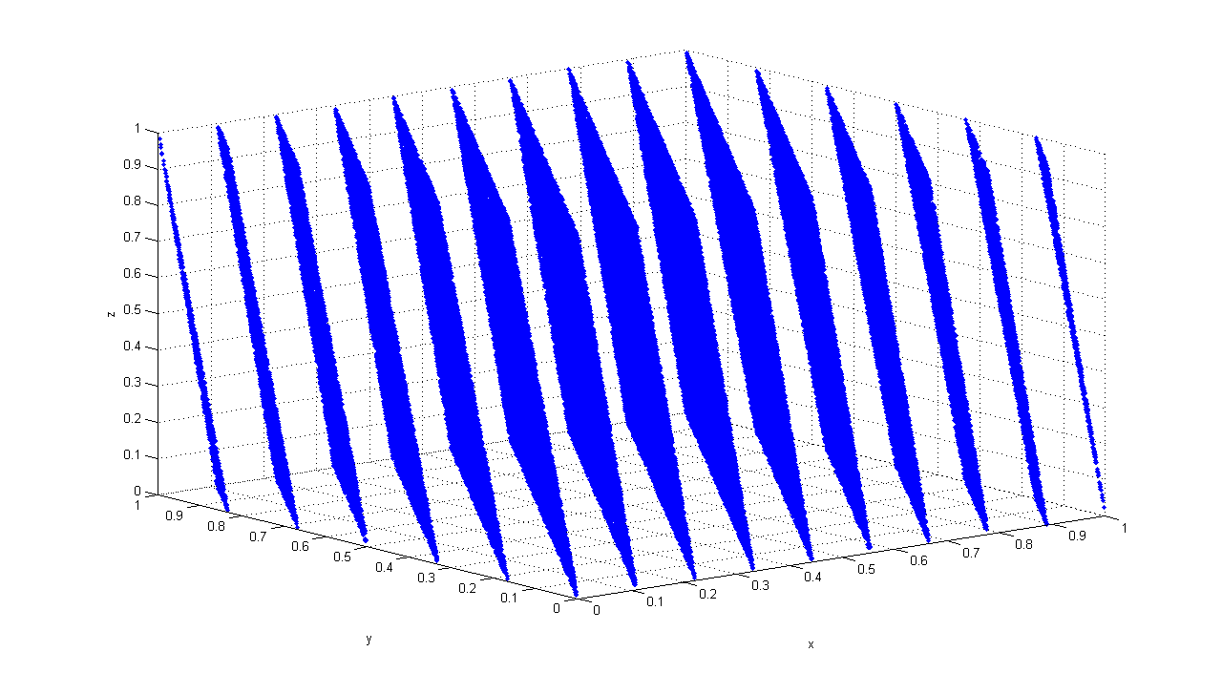
Linear Congruent
Overall outputs appear to be uniformly distributed
Strong correlation between consecutive outputs
Plotting consecutive outputs as ordered triples in 3-space reveals planar pattern

Slide 6
Xorshift
In general, sequence produced by shifting and XORing together past values
Strengths: Stores relatively little state, fast performance, good period to performance ratio, generally high quality outputs
Weaknesses: Overall short period length

Slide 7
Lagged Fibonacci
Has the general form: X_{n} = (X_{n−r} * X_{n−s}) mod m, 0 < s < r
r and s are lag parameters and determine the size of the state space and * can be any operation
Strengths: Generally fast performance, flexible
Weaknesses: Stores a sizeable amount of state, output quality highly dependent on seeding method and parameter selection

Slide 8
Lagged Fibonacci
Subtract with Carry variant has form: X_{n} = (X_{n−r} - X_{n−s} – c_{n-1}) mod m, 0 < s < r
c_{n} = 1 if X_{n−r} - X_{n−s} – c_{n-1} ≥ 0, or 0 otherwise
Additional state information allows for a greater period than conventional Lagged Fibonacci generators
RANLUX variant further improves the quality of the output by discarding a number of values at regular periods, at the cost of performance

Slide 9
Multiply with Carry
Has the general form: X_{n+1} = (aX_{n−r} + c_{n}) mod m
In practice, Complementary Multiply with Carry is used: X_{n+1} = (b - 1) - (aX_{n−r} + c_{n}) mod m
Period heavily dependent on parameter selection
Proofs regarding periods are easier on the complementary variant while not sacrificing other benefits of the generator
Strengths: Very long period, relatively fast, high quality outputs
Weaknesses: Stores a fair amount of state, difficult to seed

Slide 10


Mersenne Twister
Underlying state sequence has form: X_{k+n} = X_{k+m} ⊕(X^{u}_{k} | X^{l}_{k+1})A
A is a matrix of form: [ ]
Effectively a linear feedback shift register (LFSR) with transformed inputs on each XOR operation
The expression (X^{u}_{k} | X^{l}_{k+1})A concatenates two previous masked values, performs a right-shift, and applies an XOR mask on each bit

Slide 11
Mersenne Twister
Results produced by a tempering function on the state: y := x ⊕ (x >> u) y := y ⊕ ((y << s) · b) y := y ⊕ ((y << t) · c) y := y ⊕ (y >> l)
This is done to ensure equidistributed outputs
In practice, sequences are generated in batches and outputs are produced upon request using the tempering function

Slide 12
Mersenne Twister
Strengths: Very large period, high quality equidistributed outputs
Weaknesses: Complex and slow, requires a great deal of memory to store state, difficult to seed

Slide 13
Results

Slide 14
Conclusion

