Slide 1
Meet Up Live
Presented by
Aditya Shastri
Kashfia Rahman

Slide 2
Abstract
Java based application.
Used meetup.com API to get information of events.
XML parsing and extracting required information and formatted storing.
Member check-in option provided through “Meetuplive”.

Slide 3
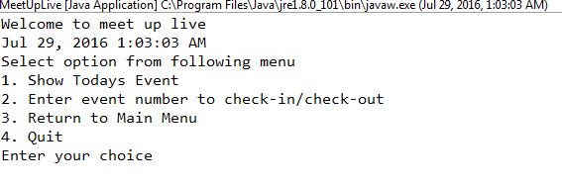
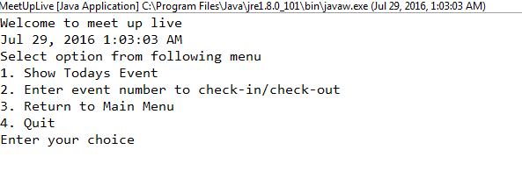
A walk through the Meetuplive

Slide 4
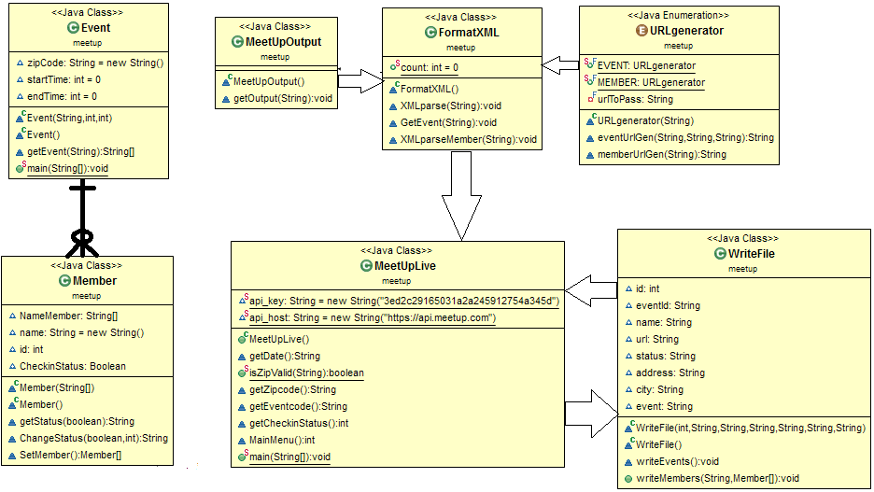
Class Diagram

Slide 5
Important Libraries we have used:
Working with API :Java.net.URL, java.net.URLConnection
Enum: An enum type is a special data type that enables for a variable to be a set of predefined constants.
XML parsing
DocumentBuilderFactory
DocumentBuilder
Document
Node
Element:The Element interface represents an element in an HTML or XML document.
4. File read and Write
java.io.File
java.io.Writer
java.io.BufferedWriter
java.io.BufferedReader

Slide 6
Thank you
Any Questions?

