Slide 1
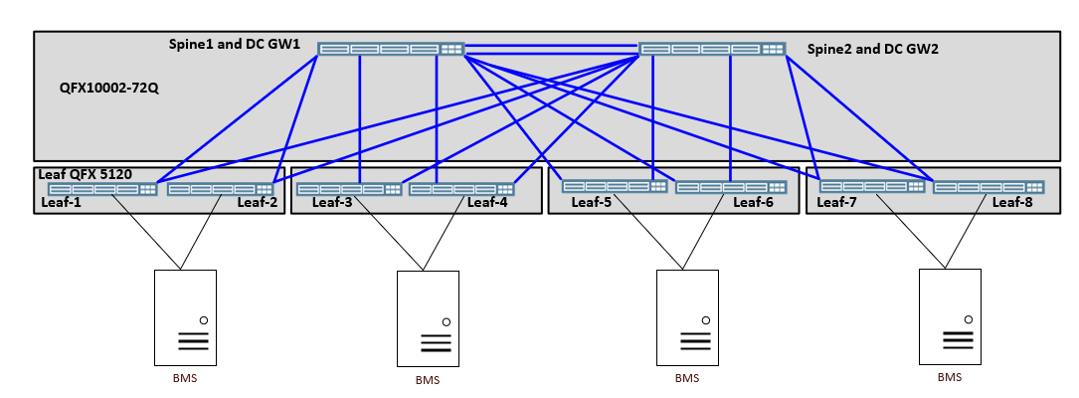
eBGP based underlay

Slide 2
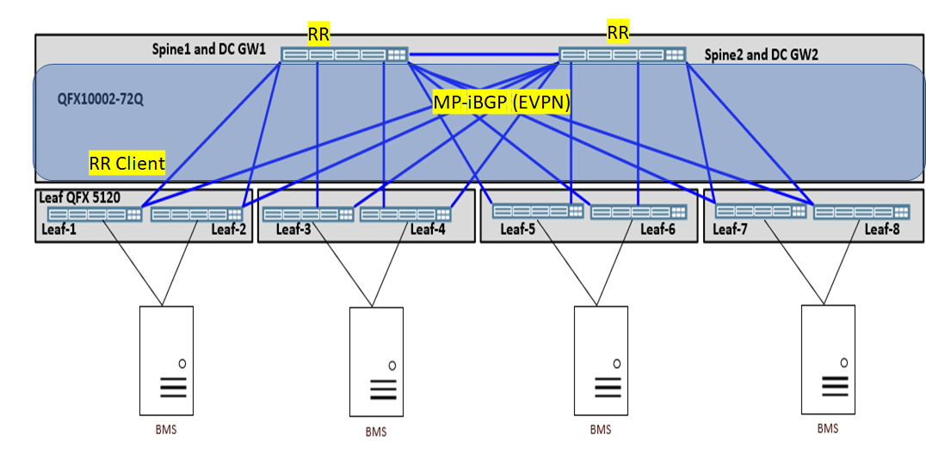
MP-iBGP Based Overlay

Slide 3
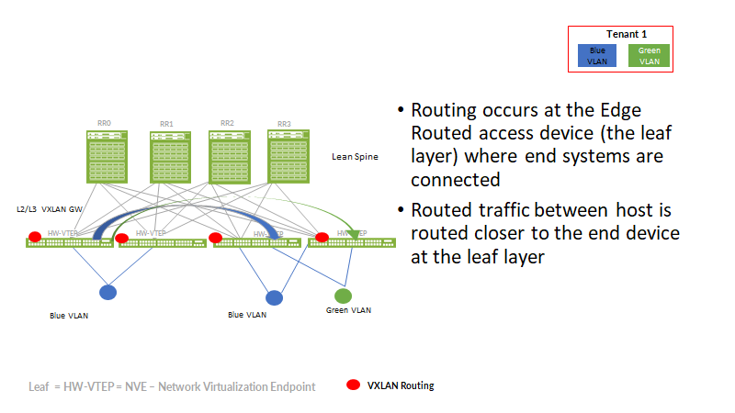
Edge Routing Bridging Model

Slide 4
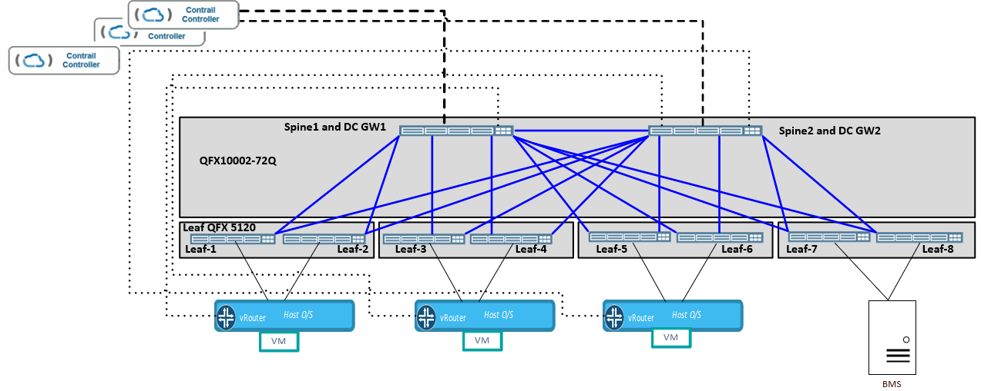
Underlay-Overylay Logical Connectivity
Each Canonical Contrail Controller (left top corner of below diagram) will establish MP-iBGP session with both DC-gateways (i.e QFX10002-72Q) for extension of Overlay Virtual Networks (VN) to the DC-gateways.
Each Canonical Contrail vRouter (shown on bottom of below diagram) will establish MPLSoUDP tunnels with both DC-gateways for transportation of overlay VN traffic

Slide 5
Tenant Connectivity Towards North
North / Core Network
Inter AS Option “A” from DC-gateways towards North
Tenant-1
Tenant-n
MPLSoUDP Tunnels
Tenant-1
Tenant-n
DC-gateway/ Spine layer
(IP Fabric- EVPN-VxLAN between spine and leaf )
Leaf Layer (trunk port toward hypervisor)
Tenant-1
Tenant-n
SDN layer
5

Slide 6
SRIOV Tenant Connectivity Towards North
North / Core Network
Inter AS Option “A” from DC-gateways towards North
Tenant-1
Tenant-n
Tenant-1
Tenant-n
DC-gateway/ Spine layer
(IP Fabric- EVPN-VxLAN between spine and leaf )
Leaf Layer (trunk port toward hypervisor)
Tenant-1
Tenant-n
Hypervisor layer

