Slide 1
Employee salary prediction using machine learning
Presented By:
1. Mohd Kashif ( BSc Computer Science )

Slide 2
OUTLINE
Problem Statement
System Development Approach
Algorithm & Deployment (Step by Step Procedure)
Result
Conclusion
Future Scope
References

Slide 3
Problem Statement
IN TODAY'S JOB MARKET, JOB SEEKERS AND PROFESSIONALS OFTEN LACK RELIABLE INSIGHTS INTO EXPECTED SALARY RANGES BASED ON THEIR SKILLS, QUALIFICATIONS, AND EXPERIENCE. SALARY EXPECTATIONS VARY GREATLY ACROSS INDUSTRIES, ROLES, LOCATIONS, AND DEMOGRAPHICS, MAKING IT DIFFICULT TO SET REALISTIC SALARY GOALS OR PREPARE FOR NEGOTIATIONS

Slide 4
System Approach
System requirements
Python
VS Code
Streamlit for Web App development
Library required to build the model
pandas, numpy,
scikit- learn
lightgbm
matplotlib, seaborn
streamlit
joblib, flask

Slide 5
Algorithm & Deployment
Algorithm Used: A Random Forest Regressor was chosen for salary prediction due to its accuracy, ability to handle both categorical and numerical data, and resistance to overfitting.
Input Features: Age, Gender, Education Level, Job Title, Years of Experience
Development Workflow:
Data Preprocessing: Used pandas and scikit-learn for cleaning and encoding data.
Model Training: Trained a Random Forest model and saved it as model.pkl using joblib.
Web App Backend: Built using Flask to handle user input and serve predictions.
Frontend: Created with HTML and CSS, with dynamic content rendered using Jinja2 templates.
Deployment: Optional hosting via platforms like Render, integrated with GitHub for updates.

Slide 6
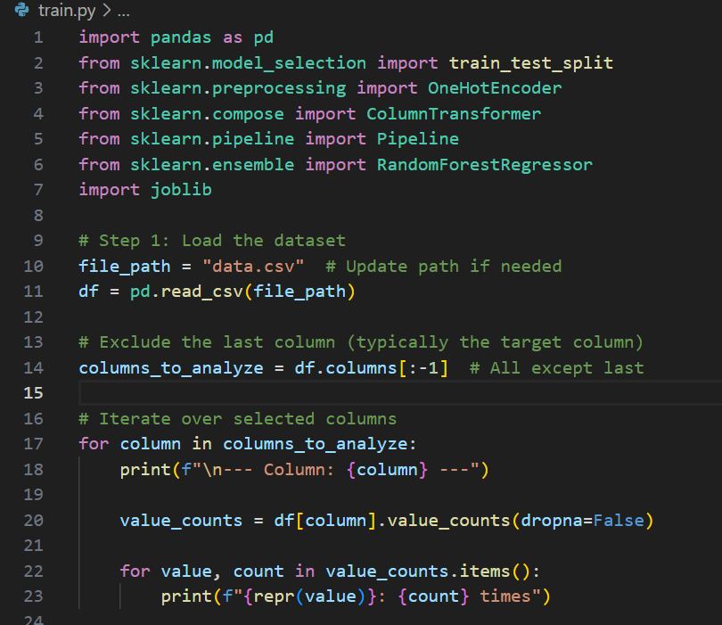
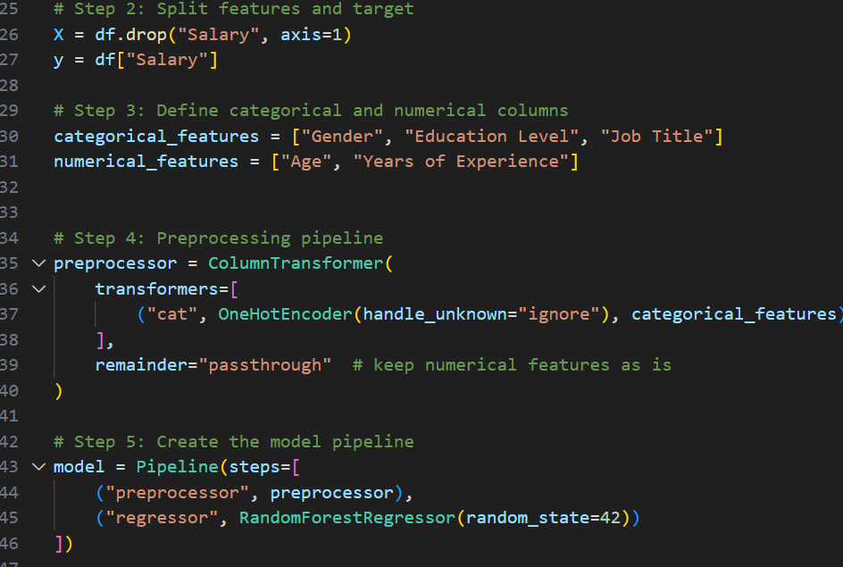
Result
Train.py

Slide 7
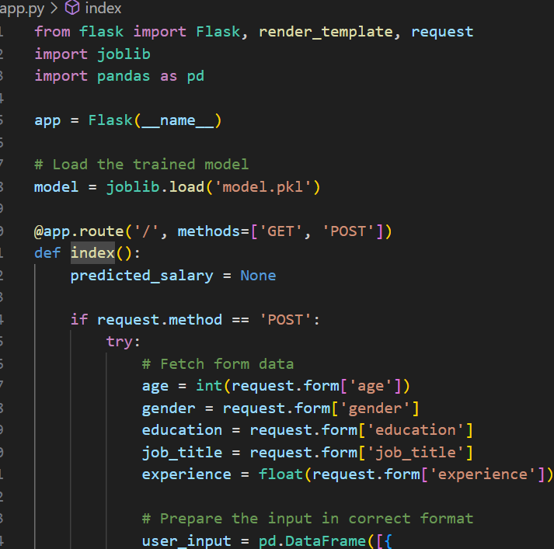
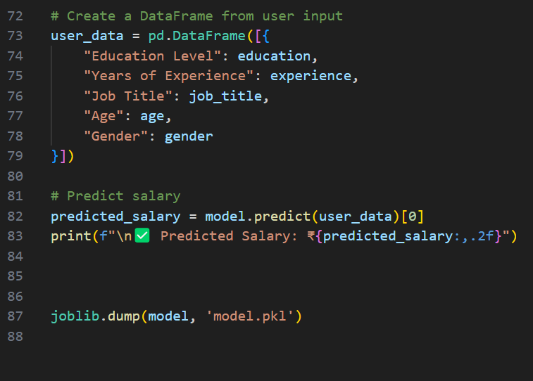
app.py

Slide 8
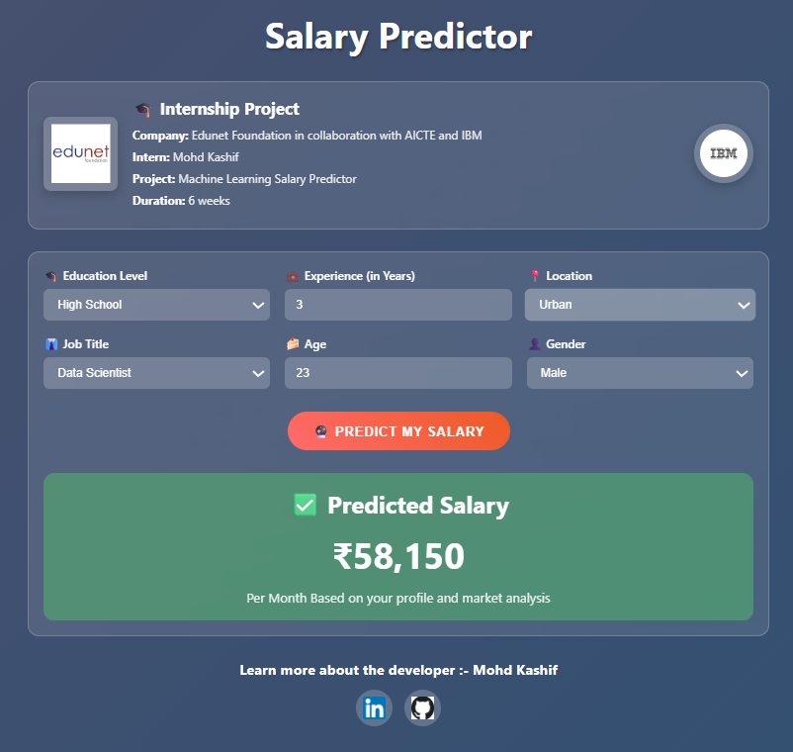
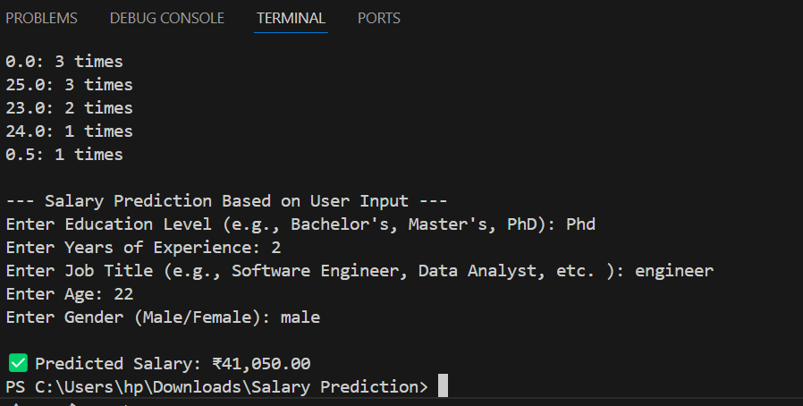
RESULT
Web View
Demo

Slide 9
RESULT
Git hub link: https://github.com/kashif7230/salary-prediction

Slide 10
Conclusion
The Machine Learning Salary Predictor Web Application successfully demonstrates the practical application of machine learning techniques in solving real-world problems. By leveraging historical salary data and a Random Forest regression model, the system is capable of accurately predicting monthly salaries based on key input features such as education level, years of experience, job title, age, and gender.
The project combines the power of data science with web development to create an interactive and user-friendly interface that makes complex machine learning predictions accessible to non-technical users. The integration of Flask as a backend framework, along with a clean HTML/CSS frontend, enables smooth user interaction and real-time predictions.
Overall, this project not only fulfills its objective of providing salary insights to users but also deepens understanding of the complete ML workflow — from data preprocessing and model training to deployment and user interaction. It can be further enhanced with features like industry-specific salary prediction, data visualization, and a database-backed user management system.

Slide 11
References
Dataset Sources Salary data used for training was sourced from platforms like Kaggle, Glassdoor, Payscale, or provided by the internship program.
Python Libraries Core tools included pandas for data handling, scikit-learn for model training, joblib for saving the model, and Flask for building the web application.
Web Development Resources HTML and CSS were supported by references from W3Schools and MDN Web Docs. Flask used the Jinja2 templating engine for dynamic content.
Deployment & DevOps Deployment was optionally handled via platforms like Render and automated using GitHub Actions for CI/CD.

Slide 12
THANK YOU

