Slide 1


Uncovering Educational Disparities
in Sri Lanka
Analyzing the school level factors influencing student performance across different regions and schools .

Slide 2
Overview
01
Background of the study
06
Results & Discussion
02
Problem Statement
07
Recommendation
03
Literature Review
08
Conclusion
04
Methodology
09
Q&A
05
Data Visualizations
10
References

Slide 3
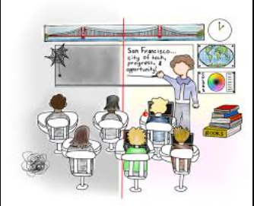
Background of the Study
Importance of Education in National Development
Education plays a critical role in shaping a country’s future.
Sri Lanka has a high literacy rate but faces disparities in education quality.
Educational Disparities in Sri Lanka
Wide gaps in student performance across different provinces.
National vs. provincial school differences in resources and teacher availability.
Research Aim
To analyse the relationship between educational resources and student performance.
To provide recommendations for improving educational equity in Sri Lanka.

Slide 4
Problem Statement
Educational Disparities in Sri Lanka
Despite Sri Lanka’s high literacy rate, significant inequalities exist in student performance across different provinces.
Rural schools often lack essential resources, while urban schools have better infrastructure and teacher availability.
Key Challenges Identified
Unequal distribution of school facilities (IT labs, libraries, science labs).
Shortage of qualified teachers, especially in provincial schools.
Limited access to digital learning tools and modern education technologies.
Impact on Students
Students from underprivileged regions struggle with lower academic performance.
The gap in educational quality affects long-term career opportunities and socioeconomic mobility.
Research Gap
Existing studies do not fully quantify the impact of school resources on student performance.
Lack of data-driven insights to inform policy changes for equitable education.
Research Objective
To analyse the key school-level factors affecting student performance in Sri Lanka.
To provide data-driven recommendations for improving educational equity across provinces.

Slide 5

Literature Review
📌 Educational Disparities in Sri Lanka
Research shows significant differences in student performance across provinces due to variations in school resources and teaching quality.
The Western Province consistently outperforms rural areas due to better infrastructure and teacher availability (Gunasekara & Balasubramanian, 2020).
📌 Impact of School Infrastructure on Student Performance
Schools with better facilities (libraries, science labs, IT labs) report higher academic achievements (IJSTR, 2020).
Rural schools lack proper resources, leading to lower student engagement and outcomes.
📌 Role of Teachers in Academic Success
Teacher quality and availability are strong predictors of student performance (ResearchGate, 2022).
Schools with more qualified teachers show better results, particularly in science and math subjects.
📌 Technology and Digital Learning in Education
ICT integration in schools is limited due to infrastructure gaps and lack of teacher training (ERIC, 2021).
Access to IT labs significantly improves students' learning outcomes (Pierson, 2014).
📌 Research Gap Identified
While existing studies highlight the importance of resources and teachers, they do not quantitatively analyze their impact using data-driven models.
This research aims to bridge the gap by applying machine learning (Random Forest) to assess key determinants of student performance.

Slide 6

Data Collection
Methodology
Data obtained from:
Ministry of Education
Department of Census and Statistics
Data collected on:
Student performance (Grade 5, O/L, A/L exam results)
School infrastructure (IT labs, libraries, science labs)
Teacher availability (national vs. provincial schoolteachers)

Slide 7
Key Variables
Methodology
Variable | Type | Description
Province | Categorical | Name of the province
Grade 5 Results | Target (Numerical) | Students passing Grade 5 exam
O/L Results | Target (Numerical) | Students passing O/L exam
A/L Results | Target (Numerical) | Students passing A/L exam
Number of IT Labs | Feature (Numerical) | Availability of IT labs
Number of Libraries | Feature (Numerical) | Availability of libraries
Number of Science Labs | Feature (Numerical) | Availability of science labs
Numbers of Teachers | Feature (Numerical) | Teacher availability (National vs. Provincial)

Slide 8
Data Cleaning & Preprocessing
Methodology
Our analysis on Education facilities in Sri Lanka began with an initial dataset containing 10 rows and 08 columns, which had no missing values, allowing us to bypass a significant part of the cleaning process.
The study uses a Random Forest Regression model for data analysis, This model was chosen because it effectively captures complex relationships and nonlinear patterns between school-level factors and student performance. By using this approach, we can identify which factors have the most significant impact on educational outcomes
Data ANALYSIS

Slide 9
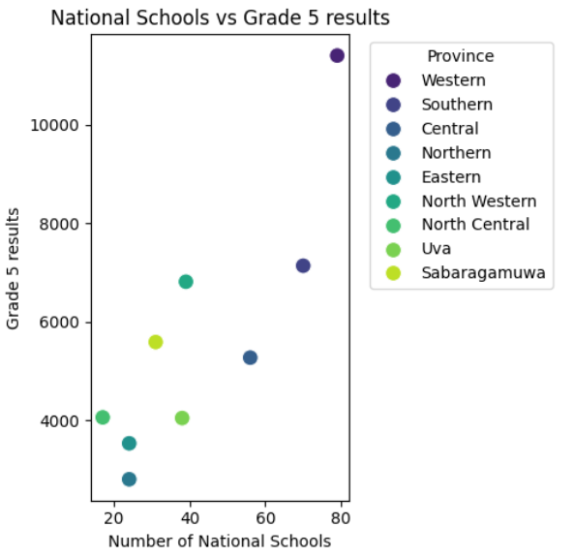
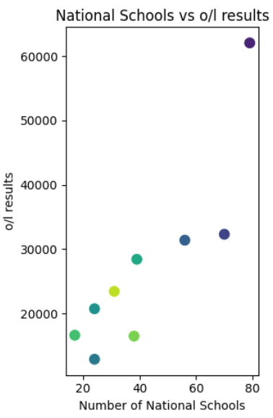
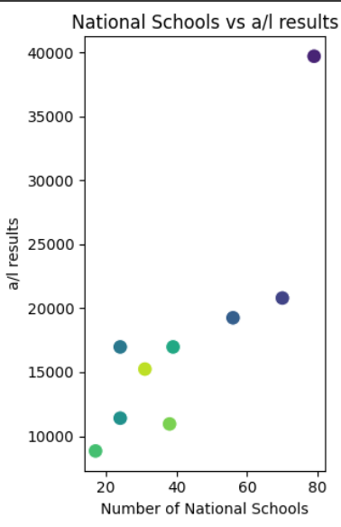
Data Visualizations
Correlation Between National Schools and Student Performance
The analysis reveals a positive relationship between the number of national schools and student performance across Grade 5, O/L, and A/L levels. Provinces with more national schools, like the Western Province, show superior academic results, while regions with fewer schools, such as North Central and Sabaragamuwa, display varying outcomes. These findings highlight the importance of equitable resource allocation and infrastructure development to bridge regional disparities and enhance overall educational success.

Slide 10
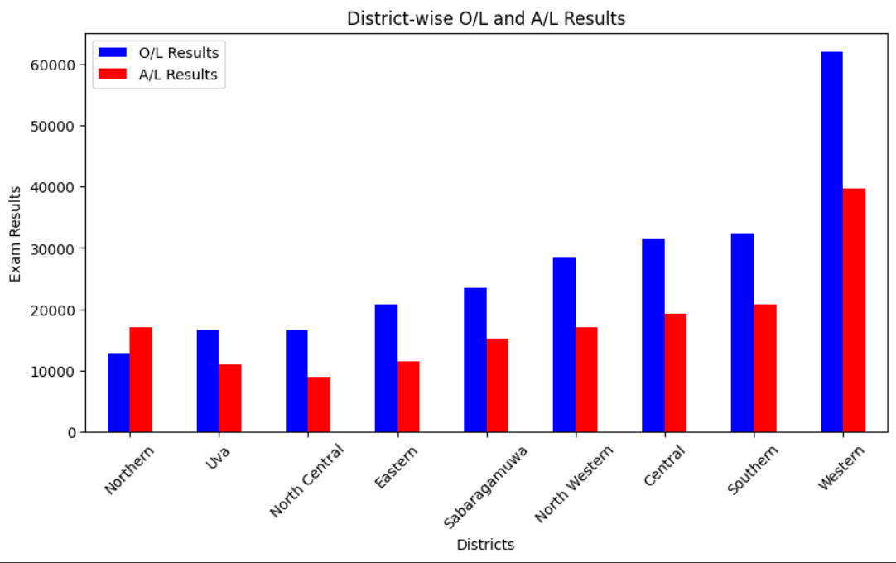
Data Visualizations
District-Wise Comparison of O/L and A/L Performance
The analysis reveals regional disparities in student performance, with the Western Province achieving the highest results in both O/L and A/L exams. Generally, O/L performance surpasses A/L, except in the Northern Province, where A/L results are slightly higher. These trends highlight the need for targeted interventions to support underperforming districts and promote educational equity across regions.

Slide 11
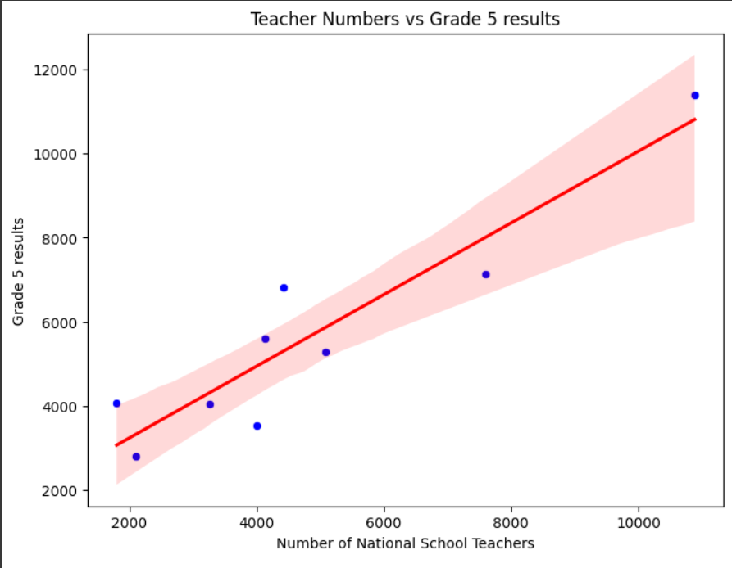
Data Visualizations
Correlation Between National Schoolteachers and Grade 5 Performance
The analysis shows a positive relationship between the number of national schoolteachers and Grade 5 examination results. The regression line highlights this trend, with most data points following an upward trajectory. However, some regions deviate from the predicted values, suggesting that while teacher availability is a key factor, other elements such as infrastructure, teaching quality, and socioeconomic conditions may also influence student performance.

Slide 12
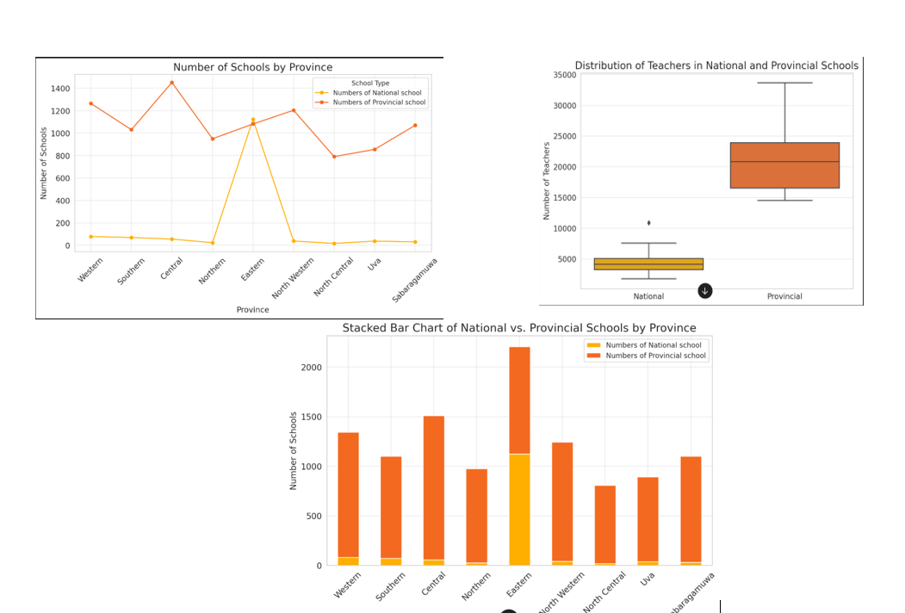
Data Visualizations
Teacher Distribution in Provincial vs. National Schools
Provincial schools show wider teacher distribution, reflecting disparities in allocation. National schools have a lower median but some large institutions. Highlights the need for balanced teacher distribution policies.
Provincial vs. National Schools Distribution
Provincial schools outnumber National schools, especially in the Eastern Province. Highlights the need for balanced resource allocation for equitable education access.

Slide 13
Discussion
Interpretation of Findings
Significant disparities in academic achievement between provinces in Sri Lanka.
Colombo district shows higher performance due to better school infrastructure, more
qualified teachers, and greater access to educational facilities.
Rural and backward areas have lower student performance due to lack of resources.
Implications for Policymakers
Investment in school infrastructure across all provinces could lead to improved student performance.
Addressing teacher shortages and improving teacher training in rural areas is crucial.
Enhancing access to digital learning resources and IT infrastructure is necessary to bridge the urban-rural education divide.

Slide 14
Recommendations & Policy Suggestions
Improving Infrastructure and Teacher Distribution | Increasing Digital Education Initiatives | Strategies for Reducing Regional Disparities
Prioritize investment in school buildings and facilities, especially in rural areas. Implement policies to recruit and retain qualified teachers in underperforming provinces. | Expand access to IT labs and digital learning resources. Promote technology-driven education programs to enhance learning outcomes | Develop targeted programs to support underdeveloped regions. Encourage public-private partnerships to invest in educational resources and infrastructure.

Slide 15

Conclusion
Summary of Key Findings
Significant regional differences in student performance due to varying levels of infrastructure, teacher availability, and digital resources.
Colombo district consistently performs better due to better resources and facilities.

Slide 16
Conclusion
Final Thoughts on Addressing Educational Inequality
Ensuring equal access to quality education is crucial for the country's development.
Policymakers must prioritize investments in educational resources to bridge the gap between urban and rural areas.
Long-term commitment to improving education will lead to a more knowledgeable and skilled workforce.

Slide 17
Q & A

Slide 18





TEAM MEMBERS
D/ADC/23/0036
MBSD Fernando
D/ADC/23/0026
DMS Baddewithana
D/ADC/23/0009
MAW Sammani
D/ADC/23/0022
HK Ahamat

Slide 19
Thank You!

