Slide 1



Garbage Classification

Slide 2

Learning Objectives
Understand the role of AI in smart waste management.
Preprocess and augment image data for classification.
Build and fine-tune a CNN using EfficientNetV2B2.
Handle class imbalance and improve model accuracy.
Evaluate model using key performance metrics.
(Optional) Deploy the model using Streamlit or Gradio.
GOAL
Source :
www.freepik.com/

Slide 3
Tools and Technology used
Technologies :
Python
TensorFlow & Keras
EfficientNetV2B2 (Pre-trained CNN)
NumPy
Pandas (Data handling)
Matplotlib,
Seaborn (Visualization) , Scikit-learn
Tools :
VS Code (optional)
Git & GitHub (for version control)
Streamlit / Gradio (for deployment)

Slide 4
Methodology
Collected Dataset – Images of various garbage types ( e.g. plastic, glass , cardboard, paper, metal , trash).
Preprocessed Data – Resized, normalized, augmented, and balanced.
Built Model – Used EfficientNetV2B2 with transfer learning.
Trained Model – Used Adam optimizer and early stopping.
Evaluated Performance – Accuracy, precision, recall, F1-score.
(Optional) Deployed – Streamlit/Gradio for user interaction.

Slide 5
Problem Statement:
Waste segregation is a critical step in efficient recycling and environmental sustainability.
However, manual garbage classification is time-consuming, error-prone, and often unsafe.
This project addresses the need for an automated garbage classification system using EfficientNetV2B2 to enable faster, more reliable waste sorting.
One major challenge is handling class imbalance in the dataset, which affects model performance and fairness.

Slide 6
Solution:
To solve the problem of inefficient and unsafe manual waste sorting, I developed an AI-based garbage classification system.
By leveraging EfficientNetV2B2 and transfer learning, the model learns complex features from garbage images with high accuracy.
This approach enables quick and reliable classification of waste into categories like plastic, metal, glass, cardboard, metal , trash.
The system minimizes the need for large datasets by reusing learned features from pre-trained models.
It is optimized for real-world use, with the option to deploy through a simple interface for real-time predictions.
This solution promotes faster, safer, and smarter waste management, contributing to environmental sustainability.

Slide 7
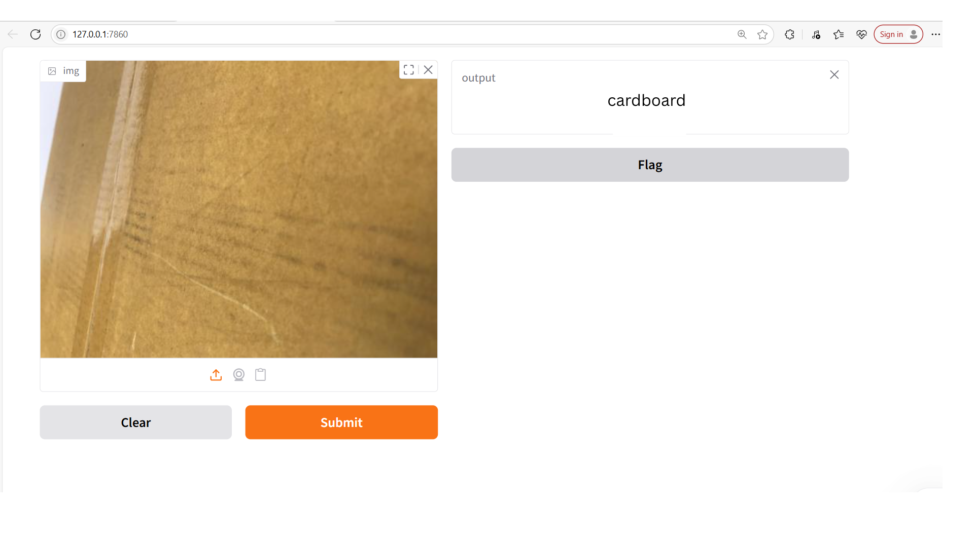
Screenshot of Output:

Slide 8
Conclusion:
Achieved high accuracy in classifying different types of waste using EfficientNetV2B2.
Leveraged transfer learning to reduce training time and improve performance.
Addressed dataset limitations through preprocessing and class balancing techniques.
Enabled real-time prediction for practical and scalable deployment.
Contributed to smarter, safer, and more sustainable waste management solutions.

