Slide 1
TRAVEL PLANNER AGENT
IBM INTERNSHIP PROJECT
Presented By ;
Student name : Kashifa Shah
College Name & Department : Medicaps University , Btech - CS

Slide 2
OUTLINE
Problem Statement
Technology used
Wow factor
End users
Result
Conclusion
Git-hub Link
Future scope
IBM Certifications

Slide 3
PROBLEM STATEMENT
The Challenge - A Travel Planner Agent is an AI-powered assistant that helps users plan trips efficiently and intelligently. It uses real-time data to suggest destinations, build itineraries, and recommend transport and accommodation options.
Solutions: By understanding user preferences, budgets, and constraints, it tailors personalized travel plans. Integrated with maps, weather updates, and local guides, it ensures a smooth travel experience. The agent can also manage bookings, alert users to changes, and optimize schedules on the go. This smart assistant transforms complex travel planning into a seamless, enjoyable process.

Slide 4
TECHNOLOGY USED
IBM cloud lite services
Natural Language Processing (NLP)
Retrieval Augmented Generation (RAG)
IBM Granite model

Slide 5
IBM CLOUD SERVICES USED
IBM Cloud Watsonx AI Studio
IBM Cloud Watsonx AI runtime
IBM Cloud Agent Lab
IBM Granite foundation model

Slide 6
WOW FACTORS
Instant Itinerary Generation tailored to user preferences, budget, and travel style.
Real-time local recommendations for food, attractions, and events using location awareness.
Smart travel planning with dynamic route optimization and weather-aware scheduling.
Language and cultural assistant for smooth communication and local etiquette tips.
Budget tracking and deal alerts to help users save while maximizing experiences.

Slide 7
END USERS
Frequent travelers
First-time or infrequent travelers
Solo travelers and digital nomads
Budget-conscious travelers
Travel agencies and tour operators
Corporate travel managers
Students and study-abroad travelers

Slide 8
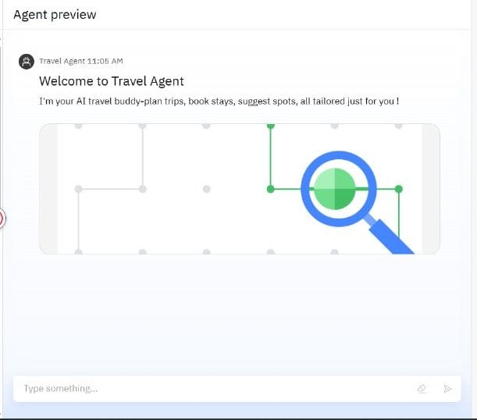
RESULTS

Slide 9
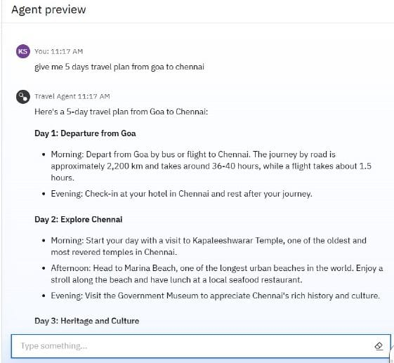
RESULTS

Slide 10
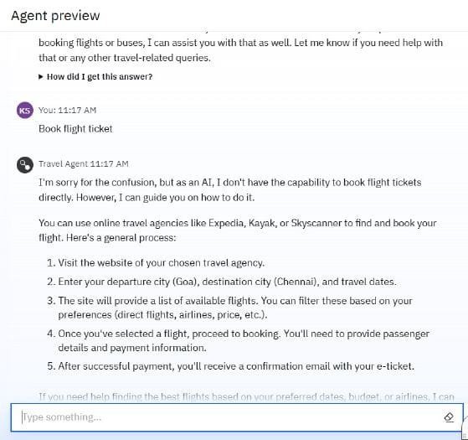
RESULTS

Slide 11
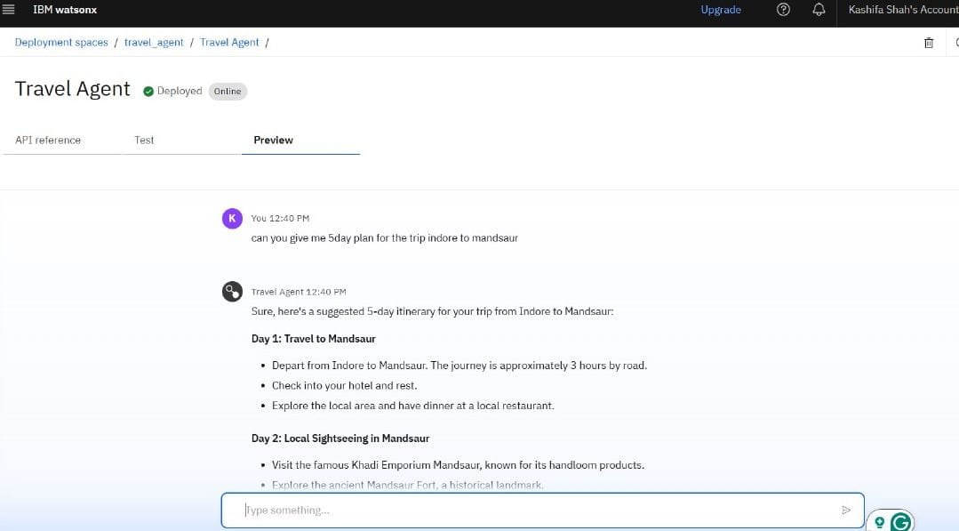
RESULTS
Deployed AI Agent

Slide 12
CONCLUSION
The Travel AI Agent streamlines trip planning through intelligent automation and personalization.
It enhances user experience with real-time recommendations, itinerary generation, and budget optimization.
It caters to diverse user groups, from solo travelers to corporate planners.
It reduces the time, stress, and complexity involved in organizing travel.
The agent demonstrates how AI can transform the travel industry by making travel more accessible, efficient, and enjoyable.

Slide 13
FUTURE SCOPE
Integration with AR/VR for virtual destination previews
Voice assistant and multilingual support
Real-time travel companion features
Hyper-personalization through AI learning
Integration with airlines, hotels, and local service providers

Slide 14
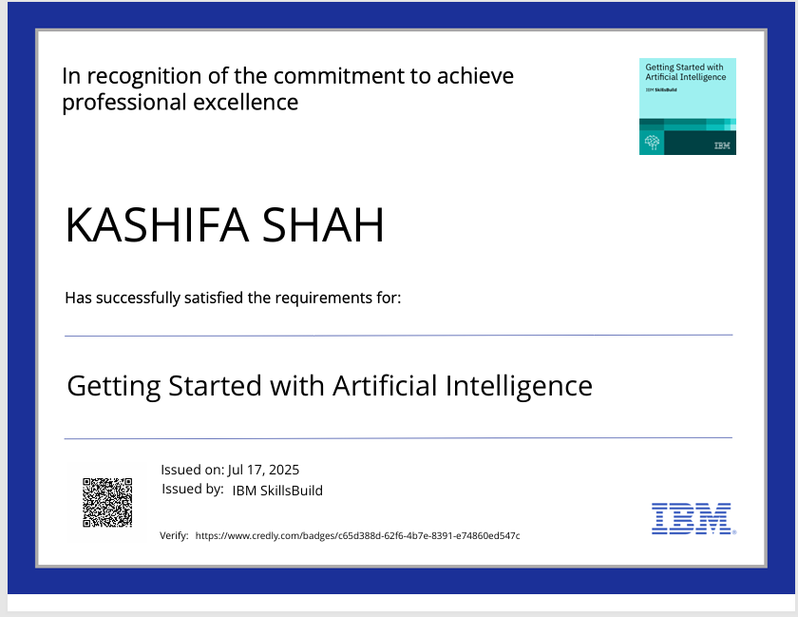
IBM CERTIFICATIONS
Getting started with Ai

Slide 15
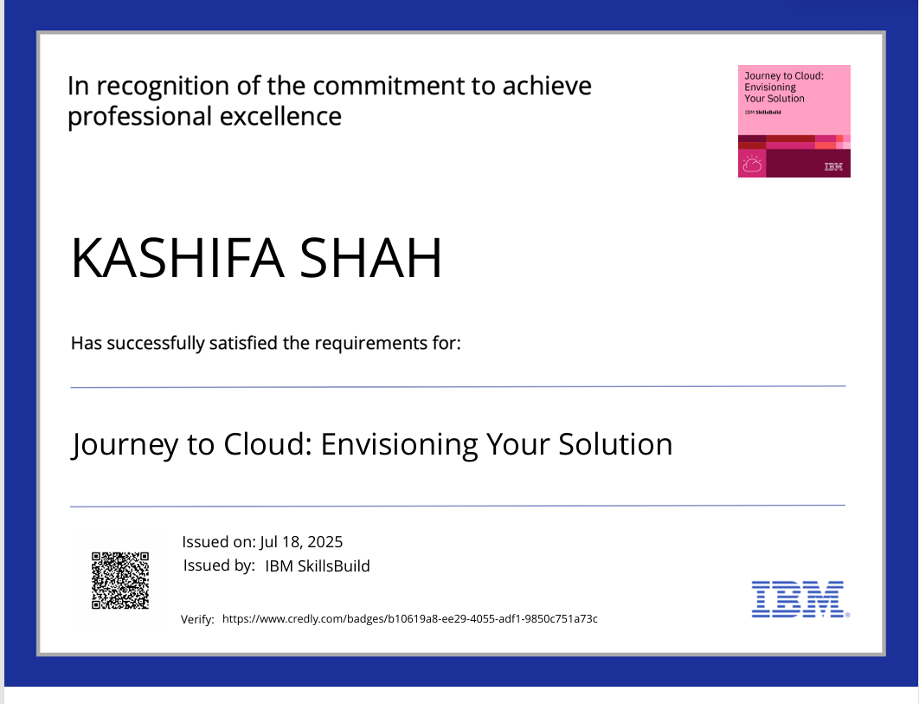
IBM CERTIFICATIONS
Journey to cloud

Slide 16
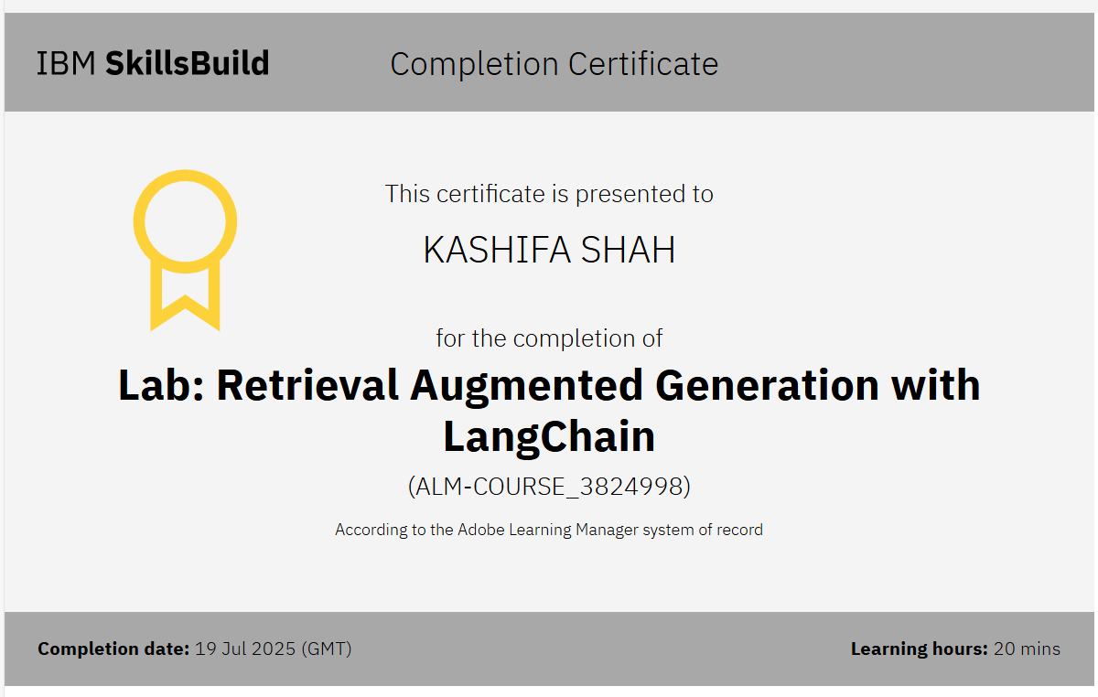
IBM CERTIFICATIONS

Slide 17
GITHUB LINK
Github Link : https://github.com/kashifashah1/Travel-AI-Agent

Slide 18
THANK YOU

