Slide 1

How to Raise an invoice?

Slide 2

Mandatory Information
For all batch trainers, one day post batch completion, please download the invoice from Learning Management System dashboard(teach.edureka.co).
Incase of other commitments, please obtain a blank invoice form your Edureka Point of Contact.
Check/Fill the given details in the invoice: Invoice will be rejected ifany of these details are missing/incorrect.
Name:
Complete Postal address:
PAN Card # :
Bank Account #:
Bank Branch:
IFSC Code :
Bank Name
Alternate contact numbers:
SIGN THE INVOICE (Digital Signatures are accepted),
ATTACH a “Cancelled Cheque leaf” image and send the invoice to “instructorpayments@edureka.co”

Slide 3
Please Note:
Prerequisite: For batch trainers, always verify if your digital agreement (“Signed on each page”) has been shared with the Talent Acquisition Team before you email any invoices.
If Batch Trainer’s Ratings are below 50% or for every Class Cancellation, there will be a deductions of 20% in the total payout (as per agreement)
Invoices received between 01st to 15th will be cleared by 22nd-25th of the Present month.
Invoices received between 16th to 31st will be cleared by 12th-15th of Next month.
Payments are done Exclusive of GST or TDS to be deducted as per Income Tax Law i.e. 10% TDS Deduction of the “total batch cost”(Variables included). This implies “ad-hoc extra classes are unpaid”.
Please verify having received an auto-generated acknowledgment email within 24 hours of sending the invoice to instructorpayments@edureka.co If not, please re-send the invoice.
For any changes and modifications in the invoice kindly reach out to ops@edureka.co

Slide 4
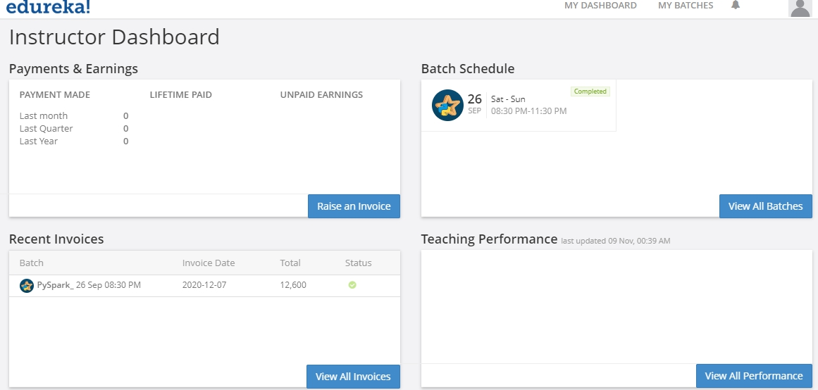
Step 1: From the “MyDASHBOARD” tab in the portal: teach.edureka.co
Step 2: Please visit “View All Invoices”

Slide 5
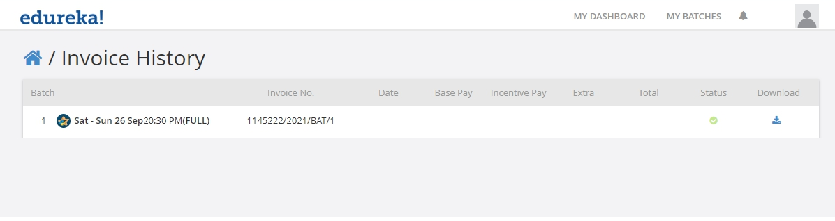
Step 3: Download your invoice from here (Invoice History page)
Step 4: Ensure that you “type” in the correct details in the invoice
Step 5: Along with a cancelled cheque, digitally sign and send the invoice to:
instructorpayments@edureka.co
Step 6: Please verify if you have received an automated acknowledgement from this id in 24 hours.

Slide 6
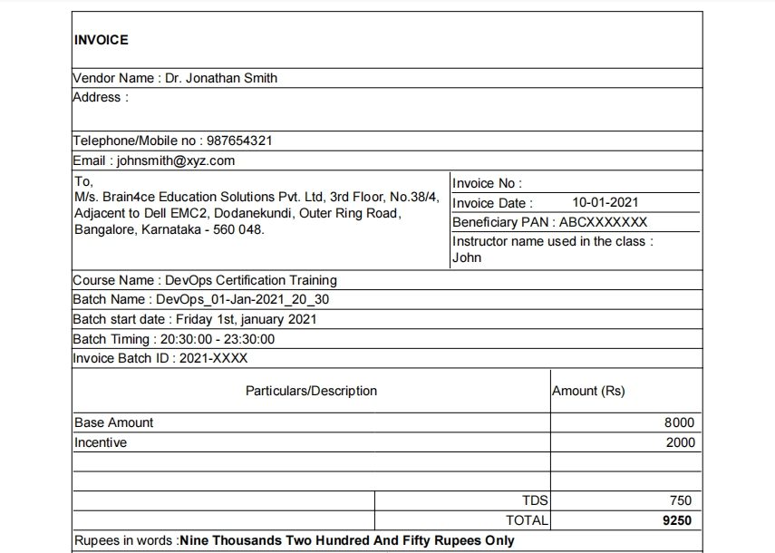
Sample Invoice
Check/Fill the given details in the invoice:Invoice will be rejected if any of these details
are missing/incorrect.
1.Name
2.Address
3.Email id
4.Edureka Address (Refer image)
5.Complete Postal address:
6.Contact/Alternate contact number
7.Invoice number (If not auto-generated, Fill
manually with a serial number of choice)
8.Invoice Date
9.PAN Number of the beneficiary
10. Name used during training(Display name)
11. Course name
12. Batch Title (refer survey email, if received)
13. Batch Start Date
14. Commercial details as shown (Incentives are
as per instructor agreement)

Slide 7
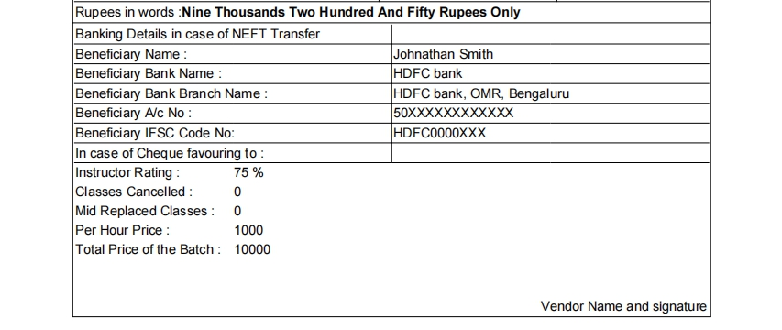
15. Banking Details (if NEFT is used)
16. Cheque receiver’s details
17. Beneficiary name:
18. Bank Name:
19. Bank Account #:
20. Bank Branch:
21. IFSC Code :
22. Bank Name
23. Instructor Ratings
24. Per Hr Course Fee (in INR)
25. Course Duration (in hours)
26. Class Cancellation (Number of classes)
27. Total Deduction (in INR)
Please Note: Total Deduction = 20% of the entire batch commercials (if Ratings < 50%, or as given in the agreement)
Please Note: Every single class cancellation will lead to 20% reduced commercials, without exception.

Slide 8




