Slide 1
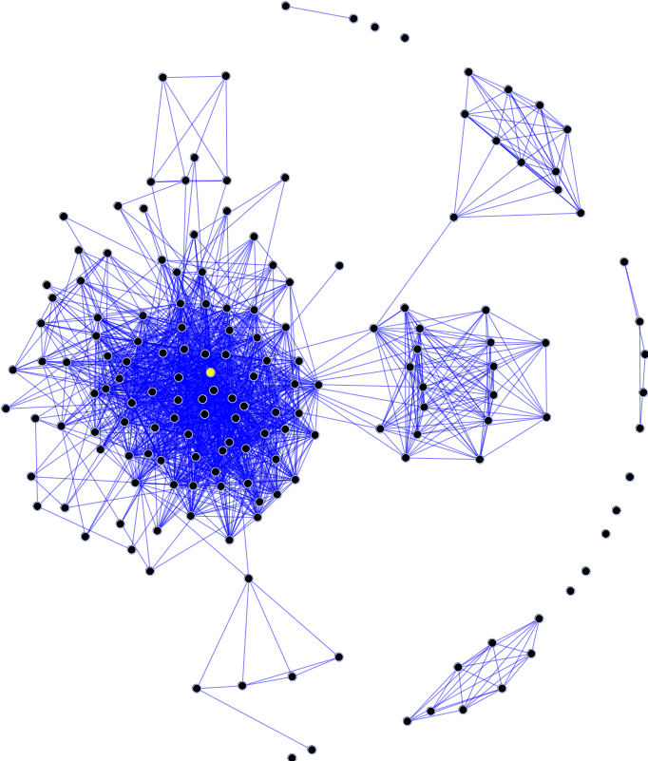

RankIT Search Engiue
Group Members:
Kashif Khan BSCS-2021-14
Muhammad Faisal BSCS-2021-10
Analysis of Algorithm
Computer Science Department
Namal University Mianwali

Slide 2

Outline
Introduction
Aim and Objectives
Algorithm Design
Algorithm Analysis
Algorithm Code
Results & Findings
Conclusion

Slide 3

Introduction
Area: Search Engine Optimization + page rank
Purpose: Design User-friendly Search Enigue
How: Using, inner space products and other techniques to enhance User Experience.
Applications: Information Retrieval, Polagrism Detection, and Topic Based Search.

Slide 4

Aim and Objectives
Aim: Develop an efficient search engine
Objectives:
Accurate search results
User-friendly interface
Advanced features

Slide 5

Algorithm Design
Web crawling algorithm
Tokenization and stopword removal
Search algorithms
Indexing system
Spell check
Web crawling techniques

Slide 6
Algorithm Analysis
Search accuracy
Response time
Scalability

Slide 7

Program Execution Steps
D1 = “Discover a collection of easy and healthy recepies for everyday cooking”.
D2 = “Explore delicious vegetarian recipies to maintain healthy lifestyle”.
D3 = “Get excess to quick and nutritious recipies that are perfect for busy individuals”.
Step 1: ( Query input from User )
Query: “The Haelthy Recepies”

Slide 8
Program Execution Steps
Step 1: ( Convert to lowercase)
Updated Pages
D1 = “discover a collection of easy and healthy recepies for everyday cooking”.
D2 = “explore delicious vegetarian recipies to maintain healthy lifestyle”.
D3 = “get excess to quick and nutritious recipies that are perfect for busy individuals”.
Updated Query : “the haelthy recepies”

Slide 9
Program Execution Steps
Step 3: ( Remove Stopwords)
Updated Data:
D1 = “discover collection easy healthy recepies everyday cooking”.
D2 = “explore delicious vegetarian recipies maintain healthy lifestyle”.
D3 = “get excess quick nutritious recipies perfect busy individuals”.
Updated Query : “haelthy recepies”

Slide 10
Program Execution Steps
Step 3: ( Tokenization)
D1 = [“discover”, “collection”, “easy”, “healthy”, “recepies”, “everyday”, “cooking”].
D2 = [“explore”, “delicious”, “vegetarian”, “recipies”, “maintain”, “healthy”, “lifestyle”].
D3 = [“get”, “excess”, “quick”, “nutritious”, “recipies”, “perfect”, “busy”, “individuals”].
Updated Query : [“healthy”, “recepies”]

Slide 11

Time complexity
Corpus preparation
keyword extraction, spell check, highlighting the query syntax in content and content analysis
Term frequency calculation
counting the occurrences of keywords
Inverse document frequency
includes analyzing the occurrence of keywords across documents,

Slide 12

Conclusion
Effective in identifying the shortest path with optimal efficiency.
Guarantees the selection of the least costly path for resource optimization.
Potential applications in network routing and transportation planning.

Slide 13

Any Questions
Thank you for your time

