Slide 1
CS401 – Artificial Intelligence Intelligent Agents

Slide 2
Today’s Agenda
Intelligent Agents (Russell and Norvig: Chap. 2)

Slide 3
Acknowledgements
Stuart Russell and Pat Virtue, Berkeley
Jean-Claude Latombe, Stanford University
Richard H. Lathrop, University of California
Svetlana Lazebnik, University of Illinois

Slide 4
Outline
Agents and Environments
Rationality
PEAS (Performance Measure, Environment, Actuators, Sensors)
Environment Types
Agent Types

Slide 5
Intelligent Agents

Slide 6
Agent
An agent is anything that can be viewed as perceiving its environment through sensors and acting upon that environment through actuators
Human Agent:
eyes, ears, and other organs for sensors;
hands, legs, mouth, and other body parts for actuators
Robotic Agent:
cameras and infrared range finders for sensors;
various motors for actuators

Slide 7
Percept to refer to the agent’s perceptual inputs at any given instant.
Percept sequence is the complete history of everything the agent has ever perceived.
An agent’s choice of action at any given instant can depend on the entire percept sequence observed to date, but not on anything it hasn’t perceived.

Slide 8
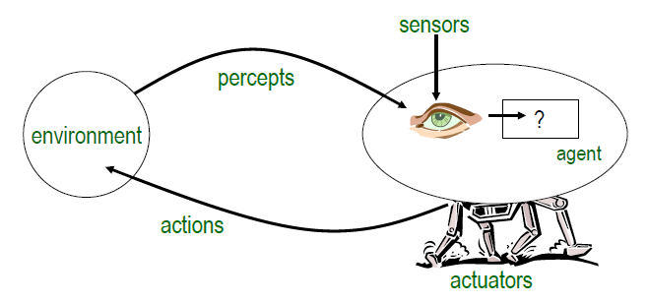
Agent and Environment
The agent function maps from percept histories to actions:
[f: P* → A]
The agent program runs on the physical architecture to produce f
agent = architecture + program

Slide 9
Agent function is an abstract mathematical description.
Agent program is a concrete implementation, running within some physical system.
A table may be used for External characterization of the agent.

Slide 10
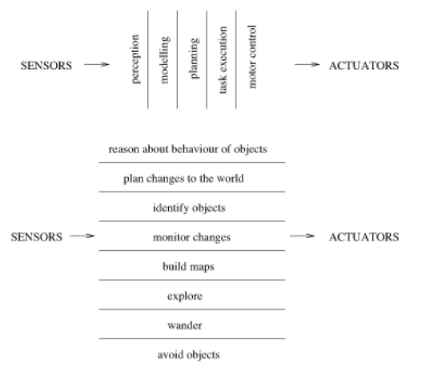
Agent and Environment

Slide 11
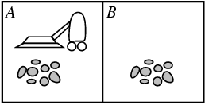
Example: Vacuum-Cleaner Agent
Percepts: Location and Status, e.g., [A,Dirty]
Actions: Left, Right, Clean, NoOp
function Vacuum-Agent(location,status) returns an action
if status = Dirty then return Clean
elseif location = A then return Right
elseif location = B then return Left

Slide 12
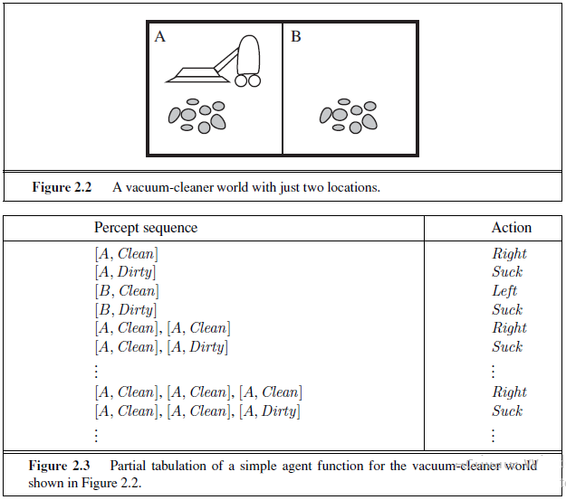

Slide 13
Rational Agent
Rational Agent:
A rational agent is one that does the right thing—conceptually speaking, every entry in the table for the agent function is filled out correctly.
a rational agent should select an action that is expected to maximize its performance measure, based on the evidence provided by the percept sequence and whatever built-in knowledge the agent has.
Performance Measure (Utility Function):
An objective criterion for success of an agent's behavior
e.g., performance measure of a vacuum-cleaner agent could be amount of dirt cleaned up, amount of time taken, amount of electricity consumed, amount of noise generated, etc.

Slide 14
When an agent is plunked down in an environment, it generates a sequence of actions according to the percepts it receives. This sequence of actions causes the environment to go through a sequence of states. If the sequence is desirable, then the agent has performed well.
This notion of desirability is captured by a performance measure that evaluates any given sequence of environment states.

Slide 15
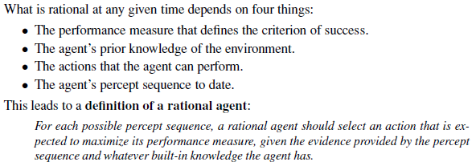
Rationality

Slide 16
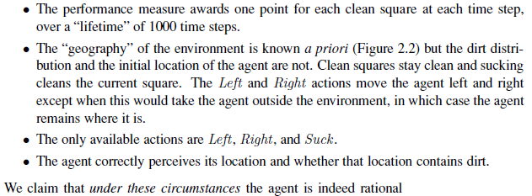

Slide 17
But, what will happen once all the dust has been cleaned?
Is this agent rational?
depends on performance measure and environment’s properties

Slide 18
Careful to distinguish between rationality and omniscience.
An omniscient agent knows the actual outcome of its actions and can act accordingly; but omniscience is impossible in reality.
So Rationality maximizes expected performance.

Slide 19
Rational Agent
Rational is not omniscient
as percepts may not supply all relevant information
Rational is not clairvoyant
as action outcomes may not be as expected
Hence, rational is not necessarily successful

Slide 20
Rational Agent
Properties of rational agents:
Autonomy (they decide);
To the extent that an agent relies on the prior knowledge of its designer rather than on its own percepts, we say that the agent lacks autonomy.
After sufficient experience of its environment, the behavior of a rational agent can become effectively independent of its prior knowledge.
Proactiveness (they try to achieve their goals);
Reactivity (they react to changes in the environment);
Social ability (they negotiate and cooperate with other agents).
A rational agent is said to be autonomous if its behavior is determined by its own percepts & experience (with ability to learn and adapt) without depending solely on built-in knowledge

Slide 21

Task Environment
Before designing an intelligent agent, we must specify its “task environment”:
PEAS:
Performance measure
Environment
Actuators
Sensors

Slide 22
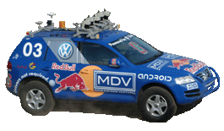
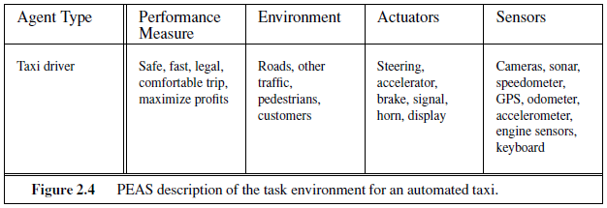
Task Environment
The task of designing a self-driving car

Slide 23
Drive on right side or left?
Sunny, rain, snow, Karachi roads?

Slide 24
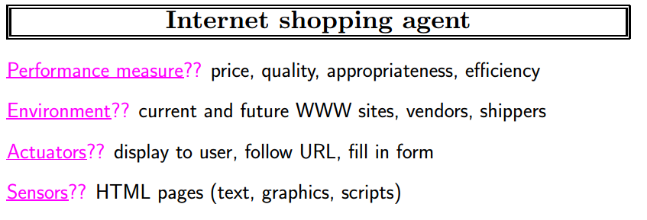

Slide 25
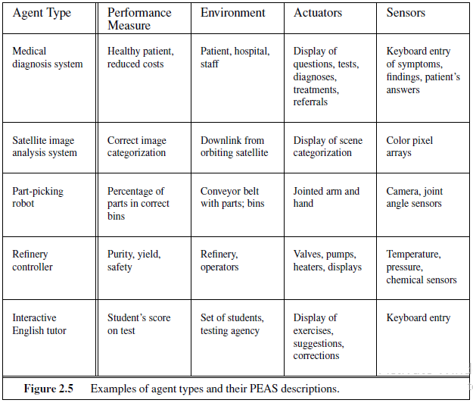

Slide 26
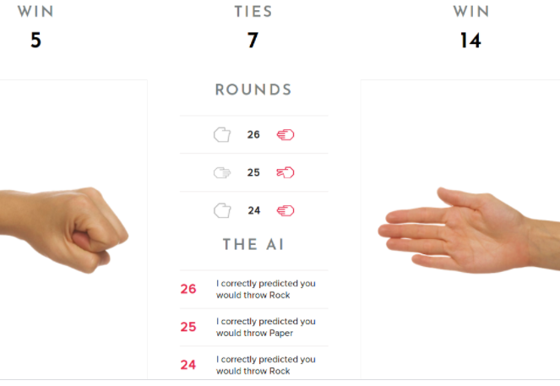

Slide 27
Environment Types
Fully Observable vs. Partially Observable
Deterministic vs. Stochastic
Episodic vs. Sequential
Static vs. Dynamic
Discrete vs. Continuous
Single-agent vs. Multi-agent

Slide 28
Fully Observable vs. Partially Observable
If an agent's sensors give it access to the complete state of the environment at each point in time, then the environment is fully observable
Sensors detect all aspects that are relevant to the choice of action.
fully observable environments are convenient because the agent need not maintain any internal state to keep track of the world.
for example: Chess
a vacuum agent with only a local dirt sensor cannot tell whether there is dirt in other squares
An environment might be partially observable because of noisy and inaccurate sensors or because parts of the state are simply missing from the sensor data
for example: Cards

Slide 29
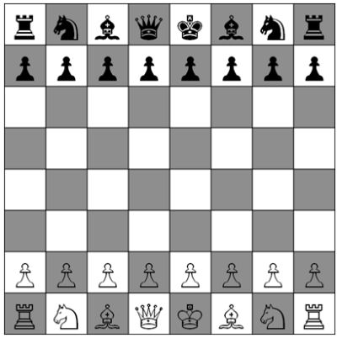

Fully Observable vs. Partially Observable
vs.
Chess
Cards

Slide 30
Single-agent vs. Multi-agent
A single-agent environment is one which consists of only one agent. This means that this one agent does not have to account for other agents in the environment and can be solely concerned only with how its own actions affect the world.
In a multi-agent environment, agents need to account for the actions of other agents.

Slide 31
Agent or Object: The key distinction is whether B’s behavior is best described as maximizing a performance measure whose value depends on agent A’s behavior.
In particular, if the other agents are directly in competition with each other, it is said that the environment is competitive, whereas if the agents are existing in unity, it is said that the environment is cooperative.

Slide 32
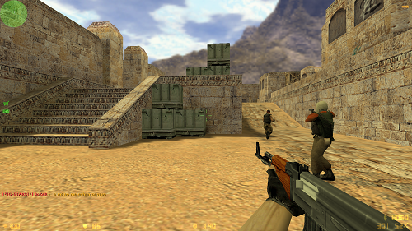

Slide 33
Communication may also be required
Sometimes randomized behavior is rational in competitive environments

Slide 34
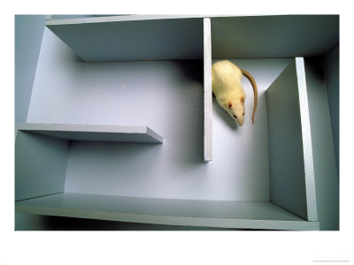
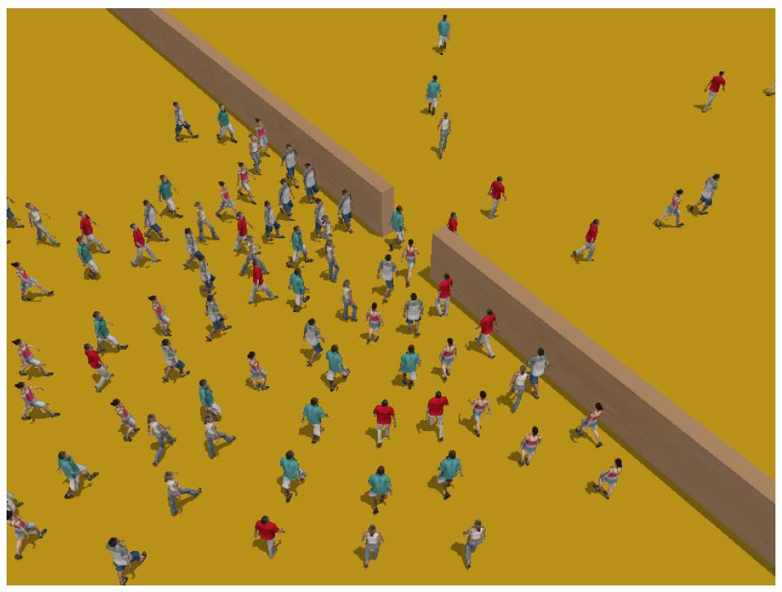
Single-agent vs. Multi-agent
vs.
Maze
Simwalk

Slide 35
Deterministic vs. Stochastic
If the next state of the environment is completely determined by the current state and the action executed by the agent, then the environment is deterministic
If the next state of the environment is uncertain to be determined by the current state and the action executed by the agent, then the environment is stochastic.
"Stochastic” generally implies that uncertainty about outcomes is quantified in terms of probabilities.
A "nondeterministic" environment is one in which actions are characterized by their possible outcomes, but no probabilities are attached to them.

Slide 36
Deterministic vs. Stochastic vs. Strategic
If the environment is deterministic except for the actions of other agents, then the environment is strategic.
Most of real environment is?

Slide 37
Episodic vs. Sequential
In an episodic environment, the agent's experience is divided into atomic episodes
each episode consists of the agent perception and an appropriate action.
crucially, the next episode does not depend on the actions taken in previous episodes.
the choice of action in each episode depends only on the episode itself.
many classification tasks are episodic.
for example: an agent that has to classify emails as spam or non-spam on an incoming emails bases each decision on the current email, regardless of previous decisions; moreover, the current decision doesn't affect whether the next email is spam.

Slide 38
Episodic vs. Sequential
In sequential environment, the current decision could affect all future decisions (also known as Sequential Decision Process-SDP)
In SDP, the agent’s goal is to select optimal actions at each episode in order to win at the end of the SDP (make Pacman moves so as to catch all the ghosts at the end)
This concept is similar to those used by economists, Design a foreign policy now, so as to maximize your profits in the long run, e.g., by the end of 5 years.
Its also similar to how we act, e.g., start saving money in order to start buying a car after 5 years.

Slide 39
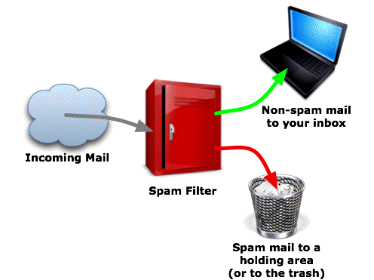
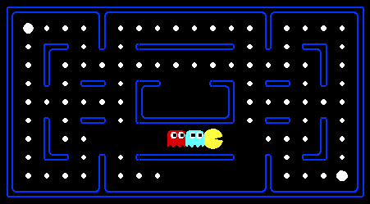
Episodic vs. Sequential
vs.
Spam Filter
Pacman

Slide 40
Static vs. Dynamic
If the environment cannot change while an agent is deliberating, then the environment is static for that agent
Static environments are easy to deal with because the agent need not keep looking at the world while it is deciding on an action, nor need it worry about the passage of time.
If the environment can change while an agent is deliberating, then the environment is dynamic for that agent
Dynamic environments are continuously asking the agent what it wants to do; if it hasn't decided yet, that counts as deciding to do nothing.

Slide 41
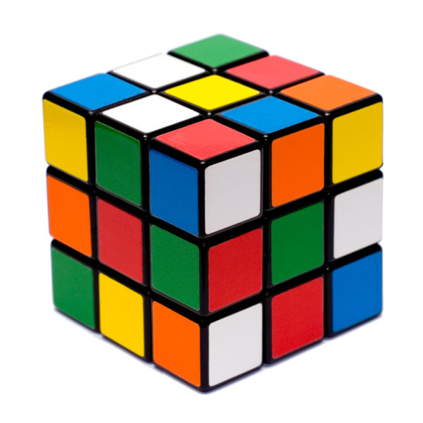
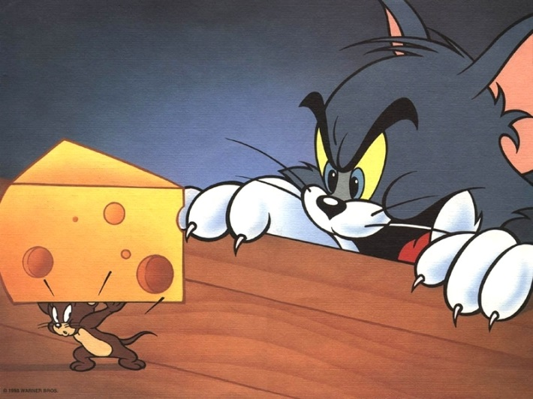
Static vs. Dynamic
vs.
Rubik’s Cube
Tom and Jerry

Slide 42
Crossing the road?

Slide 43
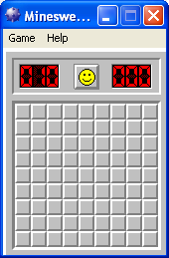
Static vs. Dynamic vs. Semidynamic
If the environment itself does not change with the passage of time but the agent's performance score does, then the environment is semidynamic
for example: Minesweeper

Slide 44
Discrete vs. Continuous
If the number of distinct percepts and actions is limited, the environment is discrete, otherwise it is continuous.
for example: a discrete-state environment such as a chess has a discrete set of percepts and actions.
for example: autonomous car is a continuous-state and continuous-time problem. The speed and location of the car and of the other vehicles sweep through a range of continuous values and do so smoothly over time. Car driving actions are also continuous (steering angles, etc.). Input from digital cameras is discrete, strictly speaking, but is typically treated as representing continuously varying intensities and locations.

Slide 45
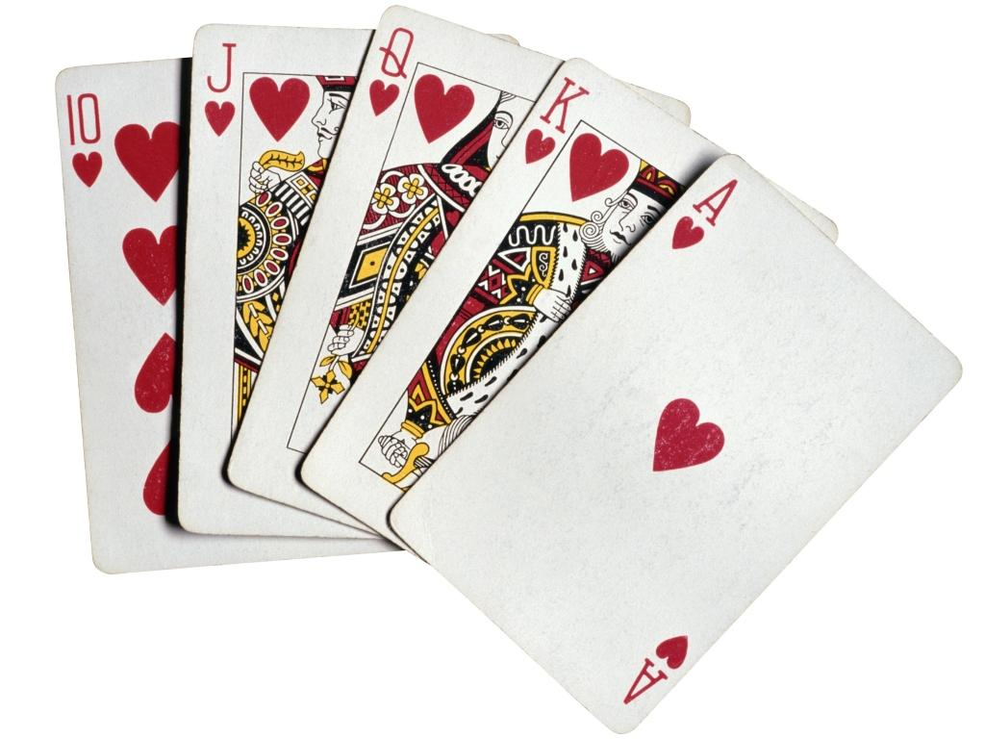
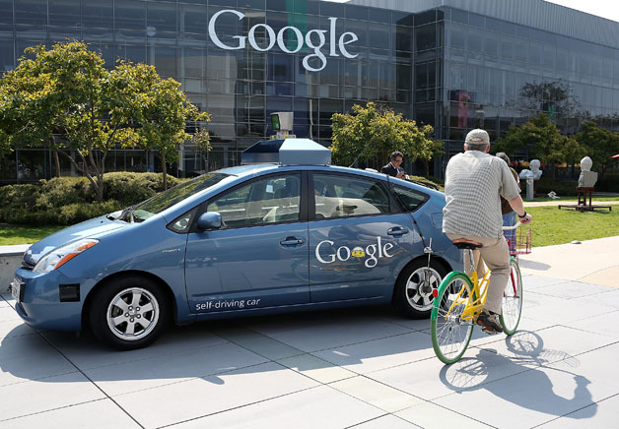
Discrete vs. Continuous
vs.
Poker
Autonomous Car

Slide 46
Known vs. Unknown
This distinction refers not to the environment itself but to the agent’s (or designer’s) state of knowledge about the “laws of physics” of the environment.This distinction refers not to the environment itself but to the agent’s (or designer’s) state of knowledge about the “laws of physics” of the environment.
In a known environment, the outcomes (or outcome probabilities if the environment is stochastic) for all actions are given.
If the environment is unknown, the agent will have to learn how it works in order to make good decisions.

Slide 47
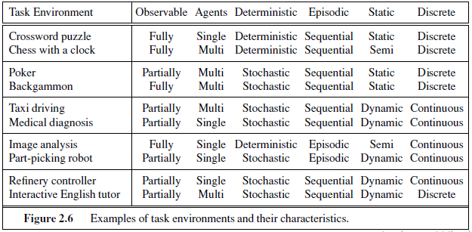

Slide 48
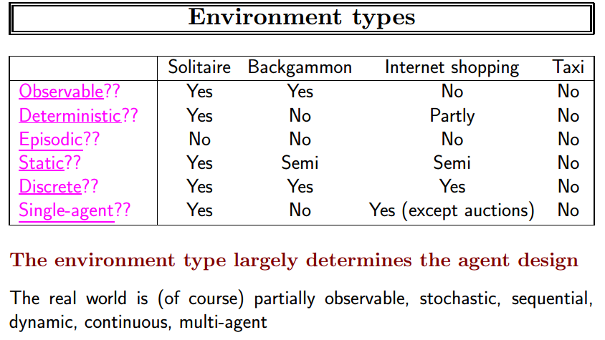

Slide 49
Several of the answers in the tables depend on how the task environment is defined.
A medical-diagnosis system might also have to deal with recalcitrant patients and skeptical staff, so the environment could have a multiagent aspect.

Slide 50
Structure of Agents
An agent program that implements the agent function.
The program will run on some sort of computing device with physical sensors and actuators—we call this the architecture
agent = architecture + program
The architecture must support proposed actions.
The program must take available architecture into account.

Slide 51
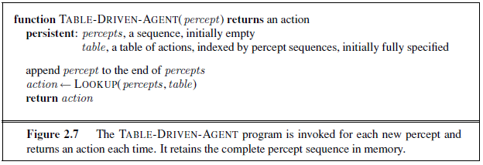

Slide 52
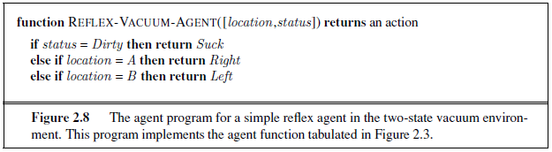
Why the table driven approach is not feasible
Total entries
So

Slide 53
Agent Types
Five basic types in order of increasing generality:
Simple reflex agent
Model-based reflex agent
Goal-based agent
Utility-based agent
Learning agent

Slide 54
1. Simple Reflex Agent
Agents select actions on the basis of the current percept, ignoring the rest of the percept history.
Simple Reflex Agent work as follows:
information comes from sensors - percepts
changes the agents current state of the world
triggers actions through the actuators
The following are some of the characteristics of simple reflex agent:
efficient
no internal representation for reasoning
simple reflex agents are not good for multiple, opposing goals as they have limited applicability.

Slide 55
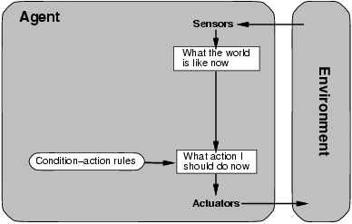
1. Simple Reflex Agent
Fast but too simple
NO MEMORY
Fails if environment
is partially observable

Slide 56
Example: Simple Reflex Taxi Driver Agent
We cannot implement it as a table-lookup: the percepts are too complex.
But we can abstract some portions of the table by coding common input/output associations.
We do this with a list of condition/action rules:
if car-in-front-is-braking then brake
if light-becomes-green then move-forward
if intersection-has-stop-sign then stop

Slide 57
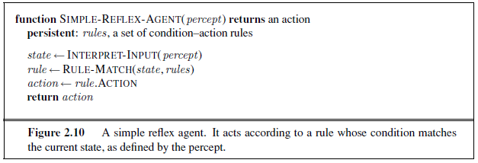
Only if the correct decision can be made on the basis of only the current percept—that is, only if the environment is fully observable.
What happens if the location sensor gets broken?

Slide 58
2. Model-based Reflex Agent
Knowledge about “how the world works”—whether implemented in simple Boolean circuits or in complete scientific theories—is called a model of the world. An agent that uses such a model is called a model-based agent.
Model-based agents differ from simple reflex agents in that such agents maintain some sort of state based on the percept sequence received so far. “Keep track of the part of the world it can’t see now.”
The state is updated regularly based on what the agent senses, and the agent’s actions.
Keeping track of the state requires that the agent has knowledge about how the world evolves, and how the agent’s actions affect the world.

Slide 59
2. Model-based Reflex Agent
Model-based agent works as follows:
information comes from sensors - percepts
based on this, the agent changes the current state of the world
based on state of the world and knowledge (memory), it triggers actions through the actuators

Slide 60
Example: Model-based taxi Driver Agent
Often, the agent must remember some of its percepts to take an action.
e.g.; car in front signals it is turning left.
It must also remember which actions it has taken.
e.g.; loaded/unloaded passenger.
→ it must have internal state.
To update its state the agent needs two kinds of knowledge:
how the world evolves independently from the agent;
e.g.; an overtaking car gets closer with time.
how the world is affected by the agent’s actions.
e.g.; if I turn left, what was to my right is now behind me.

Slide 61
The box labeled “what the world is like now” represents the agent’s “best guess” (or sometimes best guesses)

Slide 62
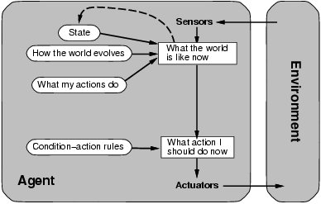
2. Model-based Reflex Agent
description of
current world state
Model the state of the world by:
modeling how the world changes
how it’s actions change the world
This can work even with partial information
It’s is unclear what to do
without a clear goal

Slide 63
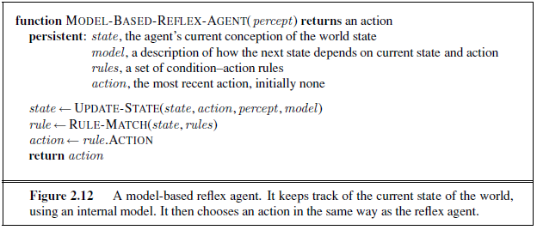

Slide 64
3. Goal-based Agent
The goal-based agent has some goal which forms a basis of its actions.
Goal-based agent work as follows:
information comes from sensors - percepts
changes the agents current state of the world
based on state of the world and knowledge (memory) and goals/intentions, it chooses actions and does them through the actuators.
Goal-based agents are much more flexible in:
responding to a changing environment;
accepting different goals.

Slide 65
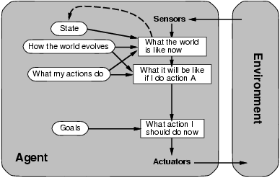
3. Goal-based Agent
Goals provide reason to prefer one action over the other.
We need to predict the future: we need to plan & search

Slide 66
Example: Goal-based Taxi Driver Agent
Knowing about the world is not always enough to decide what to do.
e.g.; what direction do I take at an intersection?
The agent needs goal information.
e.g.; passenger’s destination
Combining goal information with the knowledge of its actions, the agent can choose those actions that will achieve the goal.
A new kind of decision-making is required (“what-if reasoning”).

Slide 67
Sometimes goal-based action selection is straightforward—for example, when goal satisfaction results immediately from a single action.
Sometimes agent has to consider long sequences of twists and turns in order to find a way to achieve the goal.
“Will that make me happy?” = Will my goal be achieved? (From figure)

Slide 68
Reflex vs Goal based
Reflex based: Brakes when it sees brake lights.
Goal based: If the car in front has its brake lights on, it will slow down. Given the way the world usually evolves, the only action that will achieve the goal of not hitting other cars is to brake.

Slide 69
4. Utility-based Agent
Utility based agents provides a more general agent framework. In case that the agent has multiple goals, this framework can accommodate different preferences for the different goals.
Such systems are characterized by a utility function that maps a state or a sequence of states to a real valued utility. The agent acts so as to maximize expected utility

Slide 70
Goals just provide a crude binary distinction between “happy” and “unhappy” states.
More general performance measure should allow a comparison of different world states according to exactly how happy.
Computer scientists use the term utility.

Slide 71
Usefulness
When there are conflicting goals, only some of which can be achieved (for example, speed and safety).
When there are several goals that the agent can aim for, none of which can be achieved with certainty, utility provides a way in which the likelihood of success can be weighed against the importance of the goals

Slide 72
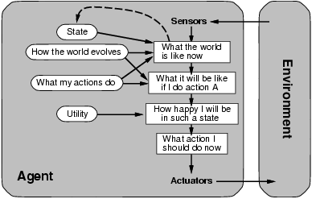
4. Utility-based Agent
Some solutions to goal states are better than others.
Which one is best is given by a utility function.
Which combination of goals is preferred?

Slide 73
Example: Utility-based Taxi Driver Agent
There may be many ways to get to a destination but some may be better than others.
e.g.; this way is faster/cheaper/more comfortable/. . .
A particular configuration of the world, a world state, can be assigned a utility (the quality of being useful) value for the agent.
A sequence of actions is preferred if it leads to a goal state with higher utility value.
A utility function helps the agent’s decision-making in case of
1. conflicting goals (by helping find a trade-off).
e.g.; minimize trip time and also fuel consumption.
2. several possible goals, none of which is achievable with certainty.

Slide 74
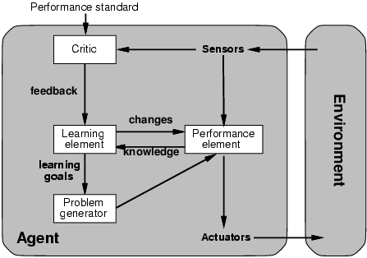
Learning Agent
How does an agent improve over time?
By monitoring it’s performance and suggesting better modeling, new action rules, etc.
Evaluates
current
world
state
changes
action
rules
“old agent”=
model world
and decide on
actions
to be taken
suggests
explorations

Slide 75
Allows the agent to operate in initially unknown environments and to become more competent than its initial knowledge alone might allow.
Performance element, which is responsible for selecting external actions, is what we previously considered to be the entire agent: it takes in percepts and decides on actions.

Slide 76
The critic tells the learning element how well the agent is doing with respect to a fixed
performance standard.
E.g. After the taxi makes a quick left turn across three lanes of traffic, the critic observes the shocking language used by other drivers.

Slide 77
Problem generator is responsible for suggesting actions that will lead to new and informative experiences. The point is that if the performance element had its way, it would keep doing the actions that are best, given what it knows. But if the agent is willing to explore a little and do some perhaps suboptimal actions in the short run, it might discover much better actions for the long run. The problem generator’s job is to suggest these exploratory actions.

Slide 78
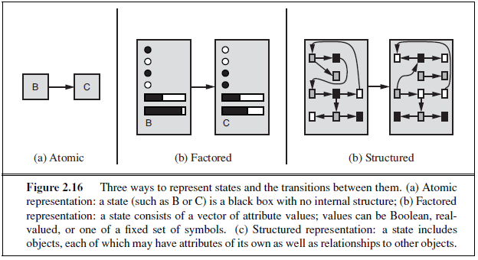
Representation w.r.t. expressiveness

Slide 79
Complete Architecture for Intelligence?
Searching?
Solve the problem of what to do.
Reasoning?
Reason about what to do.
Encoded Knowledge/”Expert Systems”?
Know what to do.
Learning?
Learn what to do.
Modern View: It’s complex & multi-faceted.

Slide 80
References
Slides by Mr. Kashif Khan
http://aima.eecs.berkeley.edu/slides-pdf/

