Slide 1
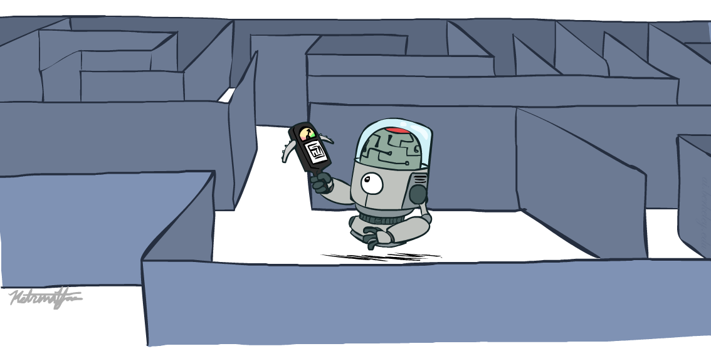
AI2002 – Artificial Intelligence Spring – 2023 Informed Search

Slide 2
Today’s Agenda
Solving Problems by Searching
(Russell and Norvig: Chap. 3 [Section 3.5])

Slide 3
Slides taken from ...
Weng-Keen Wong, Oregonstate

Slide 4
Informed Search
How can we make search smarter?
Use problem-specific knowledge beyond the definition of the problem itself
Specifically, incorporate knowledge of how good a non-goal state is

Slide 5
Best-First Search
Node selected for expansion based on an evaluation function f(n) i.e., expand the node that appears to be the best
The implementation of best-first graph search is identical to that for uniform-cost search except for the use of f instead of g to order the priority queue.
Node with lowest evaluation is selected for expansion
Uses a priority queue
We’ll talk about Greedy Best-First Search and A* Search

Slide 6
Heuristic Function
h(n) = estimated cost of the cheapest path from node n to a goal node
h(goal node) = 0
Contains additional knowledge of the problem

Slide 7
Greedy best-first Search
Evaluation function at node n, f(n) = h(n); (heuristic) = estimate of cost from n to goal e.g., h_{SLD}(n) = straight-line distance from n to Bucharest Greedy best-first search expands the node that appears to have shortest path to goal.
Idea: those nodes may lead to solution quickly.
Similar to depth-first search: It prefers to follow a single path to goal (guided by the heuristic), backing up when it hits a dead-end.

Slide 8
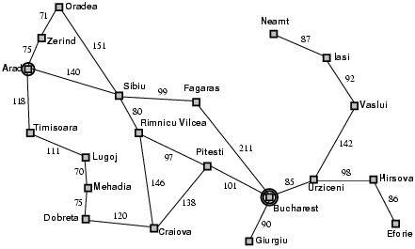
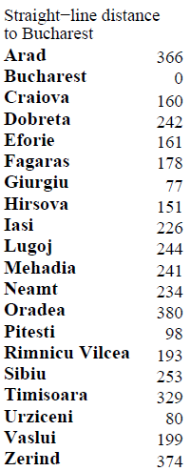
Greedy best-first Search: Example

Slide 9

Greedy best-first Search: Example

Slide 10
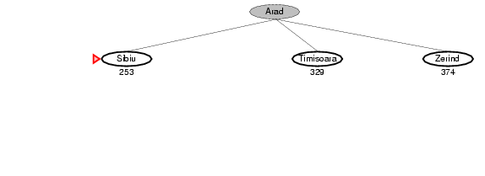
Greedy best-first Search: Example

Slide 11
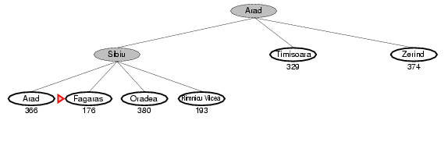
Greedy best-first Search: Example

Slide 12
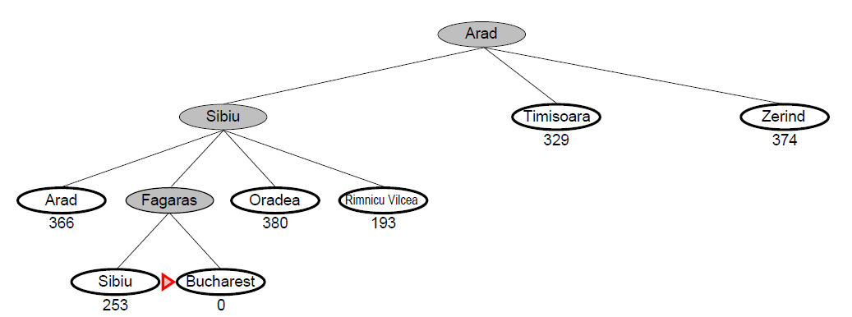
Greedy best-first Search: Example

Slide 13
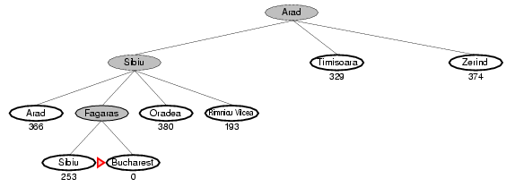
Greedy best-first Search: Example
So, Arad → Sibiu → Fagaras → Bucharest
140 + 99 + 211 = 450
Is it optimal?
What are we ignoring?
Also, consider going from Iasi to Fagaras;
What can happen?

Slide 14
Evaluation of Greedy best-first search
G
This path leads to failure
I

Slide 15
Evaluation of Greedy best-first search
Complete? No – can get stuck in loops, e.g.,
Iasi → Neamt → Iasi → Neamt…
but, complete in finite space with repeated state elimination.
Time? O(b^{m}) (imagine all nodes have same distance estimate to goal)
but a good heuristic can give dramatic improvement → becomes more similar to depth-first search, with reduced branching.
Space? O(b^{m}) → keeps all nodes in memory
Optimal?
How can we fix this?
No!
b: maximum branching factor of the search tree
d: depth of the least-cost solution
m: maximum depth of the state space (may be ∞)

Slide 16
A* Search
A much better alternative to greedy best first search
Evaluation function for A* is:
f(n) = g(n) + h(n)
where g(n) = path cost from the start node to n
If h(n) satisfies certain conditions, A* search is optimal and complete!

Slide 17
A* Search: Example

Slide 18
A* Search: Example
Starting at Arad
f(Arad) = g(Arad,Arad)+h(Arad)=0+366=366

Slide 19

Expand Arad and determine f(n) for each node
f(Sibiu)= g(Arad,Sibiu)+h(Sibiu)=140+253 = 393
f(Timisoara)=g(Arad,Timisoara)+h(Timisoara)=118+329= 447
f(Zerind)=g(Arad,Zerind)+h(Zerind)=75+374 = 449
Best choice is Sibiu

Slide 20
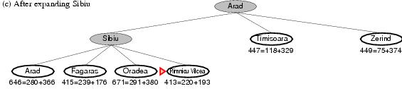
Previous Paths
f(Timisoara)=c(Arad,Timisoara)+h(Timisoara)=118+329= 447
f(Zerind)=c(Arad,Zerind)+h(Zerind)=75+374= 449
Expand Sibiu and determine f(n) for each node
f(Arad)= g(Sibiu,Arad)+h(Arad)=280+366= 646
f(Fagaras)=g(Sibiu,Fagaras)+h(Fagaras)=239+179= 415
f(Oradea)=g(Sibiu,Oradea)+h(Oradea)=291+380= 671
f(Rimnicu Vilcea)=g(Sibiu,Rimnicu Vilcea)+
h(Rimnicu Vilcea)=220+192= 413
Best choice is Rimnicu Vilcea

Slide 21
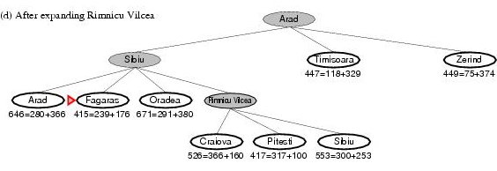
f(Timisoara)=g(Arad,Timisoara)+h(Timisoara)=118+329= 447
f(Zerind)=g(Arad,Zerind)+h(Zerind)=75+374= 449
f(Arad)=g(Sibiu,Arad)+h(Arad)=280+366= 646
f(Fagaras)=g(Sibiu,Fagaras)+h(Fagaras)=239+179= 415
f(Oradea)=g(Sibiu,Oradea)+h(Oradea)=291+380= 671
Expand Rimnicu Vilcea and determine f(n) for each node
f(Craiova)=g(Rimnicu Vilcea, Craiova)+h(Craiova)=360+160= 526
f(Pitesti)=g(Rimnicu Vilcea, Pitesti)+h(Pitesti)=317+100= 417
f(Sibiu)=g(Rimnicu Vilcea,Sibiu)+h(Sibiu)=300+253= 553
Best choice is Fagaras

Slide 22
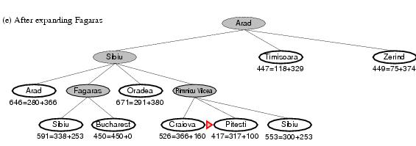
f(Timisoara)=g(Arad,Timisoara)+h(Timisoara)=118+329= 447
f(Zerind)=g(Arad,Zerind)+h(Zerind)=75+374= 449
f(Arad)=g(Sibiu,Arad)+h(Arad)=280+366= 646
f(Fagaras)=g(Sibiu,Fagaras)+h(Fagaras)=239+179= 415
f(Oradea)=g(Sibiu,Oradea)+h(Oradea)=291+380= 671
Expand Rimnicu Vilcea and determine f(n) for each node
f(Craiova)=g(Rimnicu Vilcea, Craiova)+h(Craiova)=360+160= 526
f(Pitesti)=g(Rimnicu Vilcea, Pitesti)+h(Pitesti)=317+100= 417
f(Sibiu)=g(Rimnicu Vilcea,Sibiu)+h(Sibiu)=300+253= 553
Expand Fagaras and determine f(n) for each node
f(Sibiu)=g(Fagaras, Sibiu)+h(Sibiu)=338+253= 591
f(Bucharest)=g(Fagaras,Bucharest)+h(Bucharest)=450+0= 450
Best choice is Pitesti !!!

Slide 23
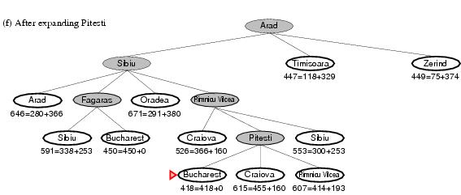
Expand Pitesti and determine f(n) for each node
f(Bucharest)=g(Pitesti,Bucharest)+h(Bucharest)=418+0=418
Best choice is Bucharest !!!
Optimal solution (only if h(n) is admissible)
Note values along optimal path !!

Slide 24
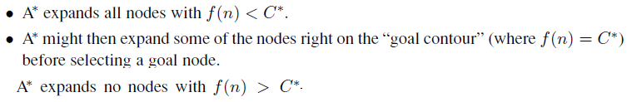
Timisoara is pruned; because h(SLD) is admissible, the algorithm can safely ignore this subtree while still guaranteeing optimality

Slide 25
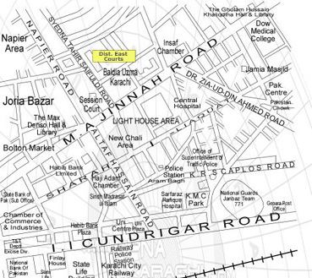
Admissible Heuristic
A* is optimal if h(n) is an admissible heuristic
An admissible heuristic is one that never overestimates the cost to reach the goal
Admissible heuristic = optimistic
Straight line distance is an admissible heuristic because it doesn’t overestimate the actual road distance
Straight Line Distance from IIC Road to MAJ Road = 0.25 Km.
Actual Distance = 1 Km

Slide 26

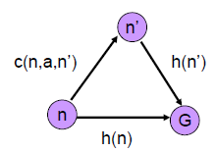
Consistent Heuristic
A heuristic is consistent if, for every node n and every successor n’ of n generated by any action a:
h(n) ≤ c(n, a, n’) + h(n’)
A form of the triangle inequality – each side of the triangle cannot be longer than the sum of the two sides

Slide 27
Consistent Heuristic
Every consistent heuristic is also admissible
A* using GRAPH-SEARCH is optimal if h(n) is consistent
Most admissible heuristics are also consistent.
The tree-search version of A* is optimal if h(n) is admissible, while the graph-search version is optimal if h(n) is consistent.

Slide 28
Consistent Heuristic
If f(n) is consistent, then the values of f(n) along any path are nondecreasing
Proof:
Suppose n’ is a successor of n.
Then g(n’) = g(n) + c(n,a,n’) for some a, and we have:
f(n’) = g(n’) + h(n’)
= g(n) + c(n,a,n’) + h(n’)
≥ g(n) + h(n)
[from definition of consistency: c(n,a,n’)+h(n’)≥ h(n)]
= f(n)
Thus, the sequence of nodes expanded by A* is in nondecreasing order of f(n)
First goal selected for expansion must be an optimal solution since all later nodes will be at least as expensive

Slide 29
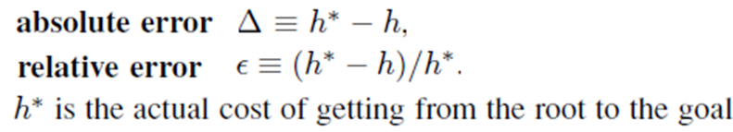
Error of the heuristic

Slide 30

The time complexity of A* depends on the heuristic.
Time complexity of A∗ is exponential in the maximum absolute error O(b^{Δ}).
In the worst case of an unbounded search space, the number of nodes expanded is exponential in the depth of the solution (the shortest path) d: O(b^{d})
A good heuristic allows A* to prune away many of the b^{d} nodes.
If the total number of nodes generated by A* for a particular problem is N and the solution depth is d, then b* is the branching factor that a uniform tree of depth d would have to have in order to contain N + 1 nodes.

Slide 31
A* is Optimally Efficient
Among optimal algorithms that expand search paths from the root, A* is optimally efficient for any given heuristic function
Optimally efficient: no other optimal algorithm is guaranteed to expand fewer nodes than A*
Fine print: except A* might possibly expand more nodes with f(n) = C*
where C* is the cost of the optimal path – tie-breaking
issues
Any algorithm that does not expand all nodes with f(n) < C* runs the risk of missing the optimal solution

Slide 32
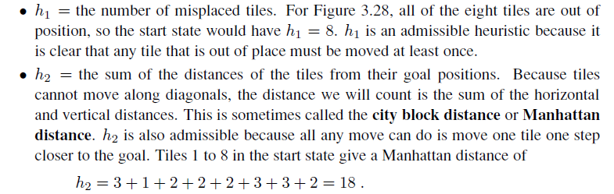
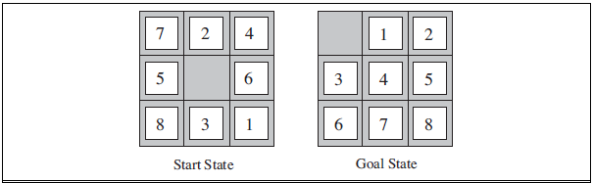
Heuristics

Slide 33
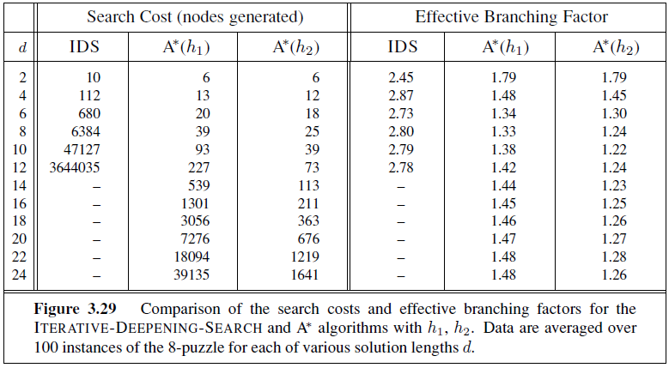
1200 random problems with solution lengths from 2 to 24 (100 for each even number)

Slide 34
Relaxed problems
A problem with fewer restrictions on the actions is called a relaxed problem.
If the rules of the puzzle were changed so that a tile could move anywhere instead of just to the adjacent empty square, then h1 would give the exact number of steps in the shortest solution.
If a tile could move one square in any direction, even onto an occupied square, then h2 would give the exact number of steps in the shortest solution.
The state-space graph of the relaxed problem is a supergraph of the original state space because the removal of restrictions creates added edges in the graph.

Slide 35
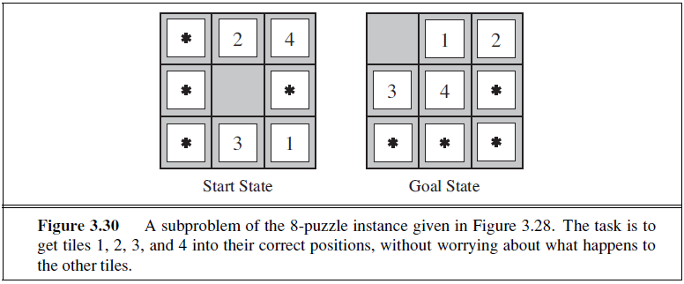
The cost of an optimal solution to a relaxed problem is an admissible heuristic for the original problem.

Slide 36
Generating admissible heuristics from subproblems: Pattern databases
The idea behind pattern databases is to store exact solution costs for every possible subproblem instance.
The choice of 1-2-3-4 is fairly arbitrary; we could also construct databases for 5-6-7-8, for 2-4-6-8, and so on
DISJOINT PATTERN databases:
Use both DB’s, but using only the pattern DB for subset if any of the subset elements are affected.

Slide 37
References
AIMA Edition 3
Muhammad Kashif Khan

