Slide 1
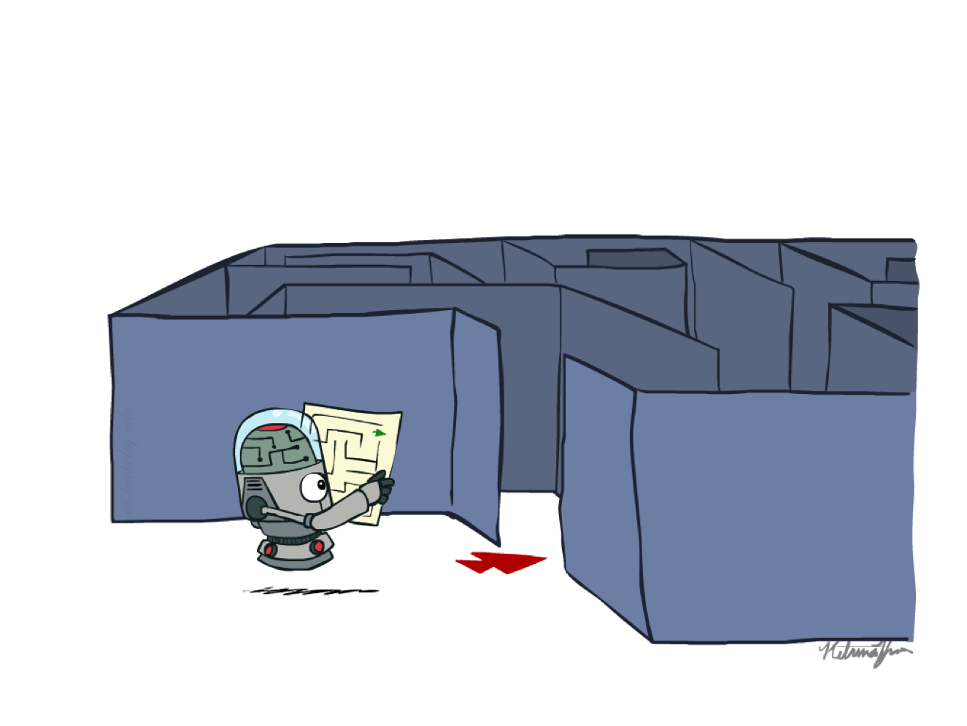
AI 2002 – Artificial Intelligence Spring – 2023 Uninformed Search

Slide 2
Basic Search Strategies

Slide 3
Some terminologies
Expanding a node
applying each legal action to the current state, thereby
Generating a new set of nodes
Expand, Generate …..
Parent of a node
Child of a node
Leaf node -> Node with no children in the tree
FRONTIER: The set of all leaf nodes available for expansion at any given point is called the frontier.

Slide 4
The process of expanding nodes on the frontier continues until either a solution is found or there are no more states to expand.
Search algorithms all share basic structure; they vary primarily according to how they choose which state to expand next, which is called the search strategy.
The frontier separates the state-space graph into the explored region and the unexplored region

Slide 5
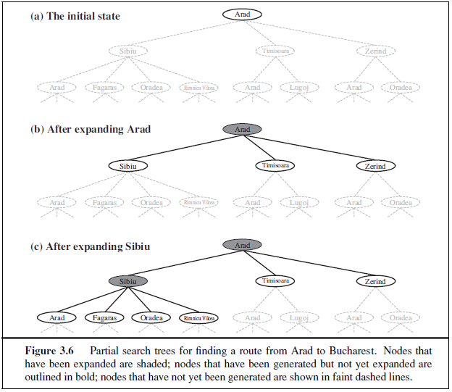

Slide 6
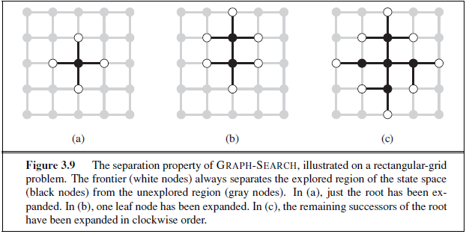

Slide 7
Tree Search vs. Graph Search
Graph Search
Tree Search
Note that some states may be visited multiple times

Slide 8
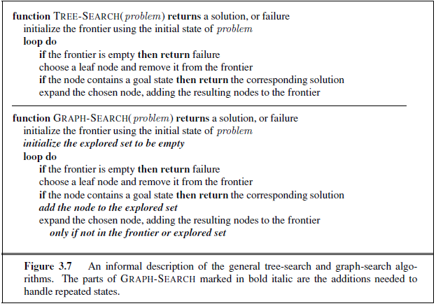

Slide 9
Graph search
Augment the TREE-SEARCH algorithm with a data structure called the explored set.
Newly generated nodes that match previously generated nodes—ones in the explored set or the frontier—can be discarded instead of being added to the frontier.

Slide 10
Search Nodes and States
8
2
3
4
7
5
1
6
8
2
7
3
4
5
1
6
8
2
8
2
8
4
2
8
2
3
4
7
3
4
7
3
7
3
4
7
5
1
6
5
1
6
5
1
6
5
1
6

Slide 11
A node is a bookkeeping data structure used to represent the search tree.
A state corresponds to a configuration of the world.

Slide 12
Search Nodes and States
8
2
3
4
7
5
1
6
8
2
7
If states are allowed to be revisited, the search tree may be infinite even
when the state space is finite
3
4
5
1
6
8
2
8
2
8
4
2
8
2
3
4
7
3
4
7
3
7
3
4
7
5
1
6
5
1
6
5
1
6
5
1
6

Slide 13
Data Structure of a Node
8
2
STATE
3
4
7
PARENT-NODE
5
1
6
BOOKKEEPING
CHILDREN
Action
Right
Depth
5
...
Path-Cost
5
Expanded
yes
Depth of a node N = length of path from root to N
(depth of the root = 0)

Slide 14
Node Expansion
The expansion of a node N of the
search tree consists of:
Evaluating the successor function on STATE(N)
Generating a child of N for each state returned by the function
node generation ≠ node expansion
8
2
3
4
7
5
1
6
N
8
2
8
4
2
8
2
3
4
7
3
7
3
4
7
5
1
6
5
1
6
5
1
6

Slide 15
Performance Measures
Completeness
A search algorithm is complete if it finds a solution whenever one exists
Optimality
A search algorithm is optimal if it returns a minimum-cost path whenever a solution exists
Complexity
It measures the time and amount of memory required by the algorithm
Time Complexity
Space Complexity

Slide 16
Basic Search Strategies

Slide 17
Uninformed vs. Informed Search Strategies
Uninformed (or Blind) search strategies do not exploit state descriptions to order FRONTIER. They only exploit the positions of the nodes in the search tree
→where we systematically explore alternatives
Informed (or Heuristic) strategies exploit state descriptions to order FRONTIER (the most “promising” nodes are placed at the beginning of FRONTIER)
→where we try to choose smartly

Slide 18
Example: Uninformed Search
For an uninformed search, N₁ and N₂ are just two nodes (at some position in the search tree)
8
2
3
4
7
STATE
N₁
5
1
6
1
2
3
1
2
3
4
5
6
4
5
STATE
7
8
N₂
7
8
6
Goal state

Slide 19
Example: Informed Search
For a informed search, counting the number of misplaced tiles, N₂ is more promising than N₁
8
2
3
4
7
STATE
N₁
5
1
6
1
2
3
1
2
3
4
5
6
4
5
STATE
7
8
N₂
7
8
6
Goal state

Slide 20
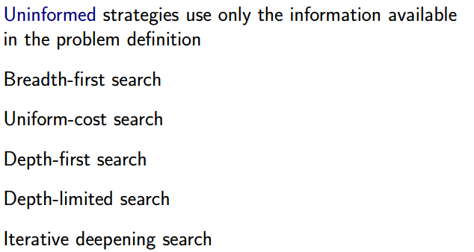

Slide 21
Uninformed Search Strategies
Breadth-first
Bidirectional
Depth-first
Depth-limited
Iterative deepening
Uniform-Cost (variant of breadth-first)
Arc cost = 1
Arc cost
= c(action) ≥ ε > 0

Slide 22
Breadth-first Search
The root node is expanded first, then all the successors of the root node, and their successors and so on
In general, all the nodes are expanded at a given depth in the search tree before any nodes at the next level are expanded
Expand shallowest unexpanded node
Implementation:
frontier = FIFO queue, i.e., put successors at the end
the nodes that are visited first will be expanded first
All newly generated successors will be put at the end of the queue
Shallow nodes are expanded before deeper nodes

Slide 23
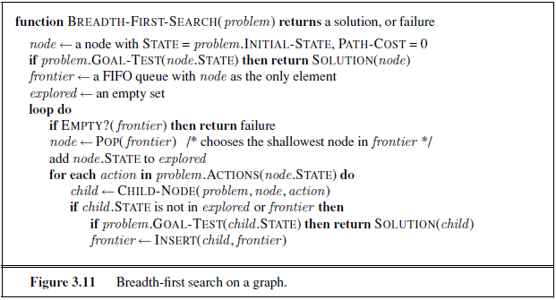

Slide 24
Breadth-first Search
New nodes are inserted at the end of FRONTIER
1
2
3
FRONTIER = [1]
EXPLORED = [ ]
4
5
6
7

Slide 25
Breadth-first Search
New nodes are inserted at the end of FRONTIER
1
FRONTIER = [2,3]
EXPLORED = [1]
2
3
4
5
6
7

Slide 26
Breadth-first Search
New nodes are inserted at the end of FRONTIER
1
FRONTIER = [3,4,5]
EXPLORED = [2,1]
2
3
4
5
6
7

Slide 27
Breadth-first Search
New nodes are inserted at the end of FRONTIER
1
FRONTIER = [4,5,6,7]
EXPLORED = [3,2,1]
2
3
4
5
6
7

Slide 28
Space complexity is dominated by the size of the frontier.
If the algorithm were to apply the goal test to nodes when selected for expansion, rather than when generated, the whole layer of nodes at depth d would be expanded before the goal was detected and the time complexity would be O(b^{d+1}).

Slide 29
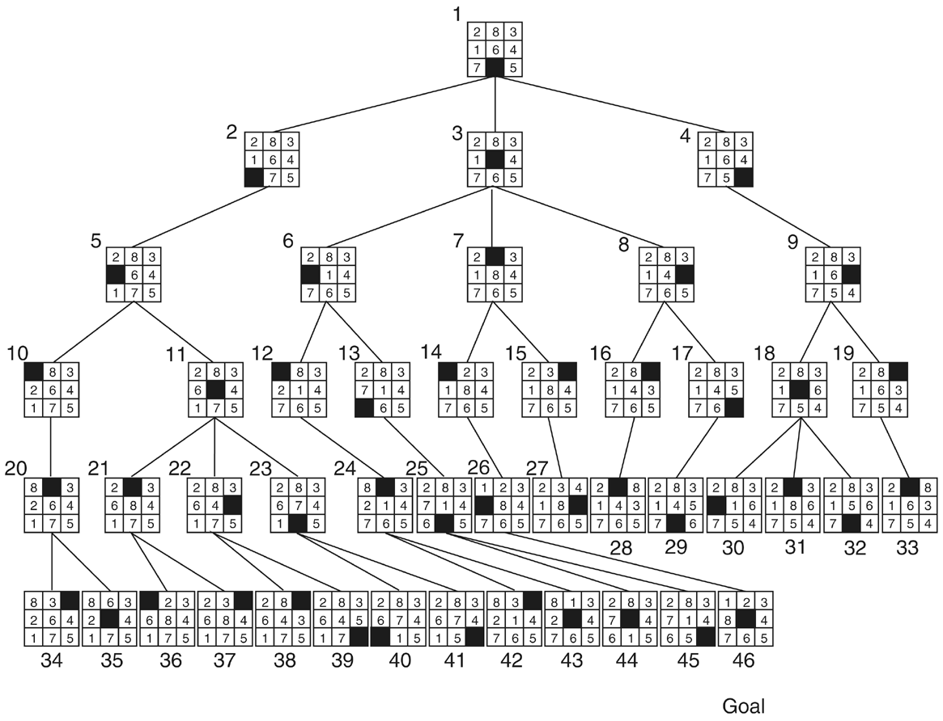
Breadth-first Search: 8-Puzzle

Slide 30
Important Parameters
Maximum number of successors of any state → branching factor b of the search tree
Minimal length (≠ cost) of a path between the initial and a goal state → depth d of the shallowest goal node in the search tree

Slide 31
Evaluation
b: branching factor
d: depth of shallowest goal node
Breadth-first search is:
Complete? Not complete?
Optimal? Not optimal?

Slide 32
Evaluation
b: branching factor
d: depth of shallowest goal node
Breadth-first search is:
Complete
Optimal if step cost is 1
Number of nodes generated: ???

Slide 33
Evaluation
b: branching factor
d: depth of shallowest goal node
Breadth-first search is:
Complete
Optimal if step cost is 1
Number of nodes generated: 1 + b + b² + … + b^{d} = ???

Slide 34
Evaluation
b: branching factor
d: depth of shallowest goal node
Breadth-first search is:
Complete
Optimal if step cost is 1
Number of nodes generated: 1 + b + b² + … + b^{d} = (b^{d+1}-1)/(b-1) = O(b^{d})
→ Time and space complexity is O(b^{d})

Slide 35
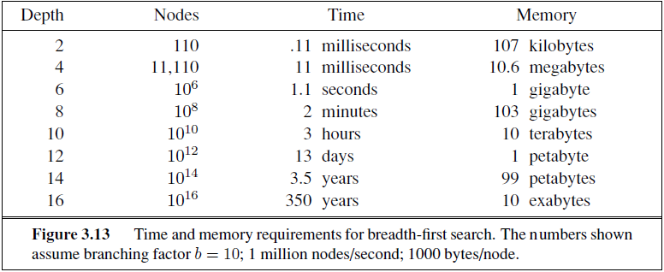

Slide 36
Uniform cost search
When all step costs are equal, breadth-first search is optimal because it always expands the shallowest unexpanded node.
Uniform-cost search expands the node n with the lowest path cost g(n).
When all step costs are equal, uniform-cost search is similar to breadth-first search, except stopping criteria

Slide 37
Uniform-Cost Search
Each arc has some cost c ≥ ε > 0
The cost of the path to each node N is
g(N) = Σ costs of arcs
The goal is to generate a solution path of minimal cost
Implementation:
frontier = PRIORITY queue, i.e., arrange successors by path cost
Equivalent to breadth-first if step costs all equal

Slide 38
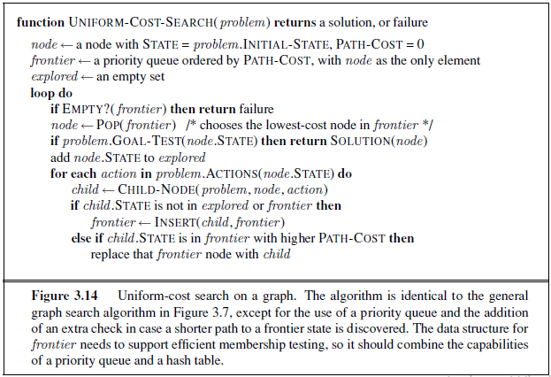
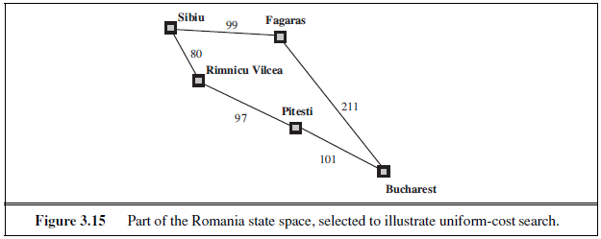

Slide 39
Uniform-Cost Search
The nodes N in the queue FRONTIER are sorted
in increasing g(N)
S
0
A
1
10
A
B
C
S
B
G
1
5
15
5
5
5
G
G
15
C
11
10

Slide 40
Complete?
Optimal?
Uniform-cost search is guided by path costs rather than depths, so its complexity is not easily characterized in terms of b and d.
Worst-case time and space complexity is
C* is cost of optimal solution
Every action cost is at least ‘Epsilon’
Can be much greater than ‘d’, because we might explore large trees of small steps, which might not lead to the solution.
When step costs are equal, O()?

Slide 41
Depth-first Search
Expand deepest unexpanded node
Implementation:
frontier = LIFO queue (stack) , i.e., put successors at front

Slide 42
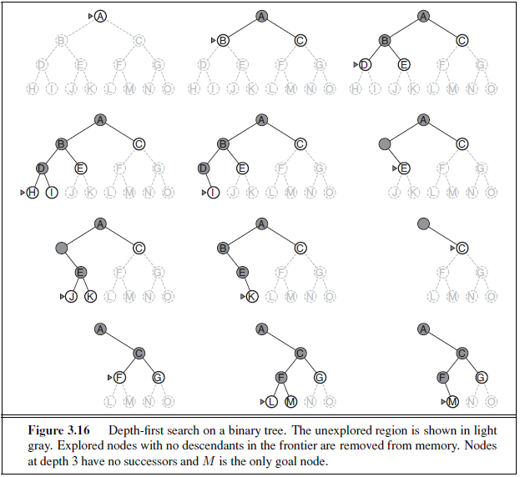

Slide 43
Depth-first Search
New nodes are inserted at the front of FRONTIER
1
2
3
FRONTIER = [1]
4
5

Slide 44
Depth-first Search
New nodes are inserted at the front of FRONTIER
1
2
3
FRONTIER = [2, 3]
4
5

Slide 45
Depth-first Search
New nodes are inserted at the front of FRONTIER
1
2
3
FRONTIER = [4, 5, 3]
4
5

Slide 46
Depth-first Search
New nodes are inserted at the front of FRONTIER
1
2
3
FRONTIER = [8, 9, 5, 3]
4
5
6
7
8
9

Slide 47
Depth-first Search
New nodes are inserted at the front of FRONTIER
1
2
3
FRONTIER = [9, 5, 3]
4
5
6
7
8
9

Slide 48
Depth-first Search
New nodes are inserted at the front of FRONTIER
1
2
3
FRONTIER = [5, 3]
4
5
6
7
8
9

Slide 49
Depth-first Search
New nodes are inserted at the front of FRONTIER
1
2
3
4
5

Slide 50
Depth-first Search
New nodes are inserted at the front of FRONTIER
1
2
3
4
5

Slide 51
Depth-first Search
New nodes are inserted at the front of FRONTIER
1
2
3
4
5

Slide 52
Depth-first Search
New nodes are inserted at the front of FRONTIER
1
2
3
4
5

Slide 53
Depth-first Search
New nodes are inserted at the front of FRONTIER
1
2
3
4
5

Slide 54
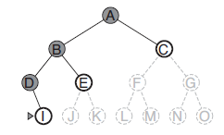
Evaluation
b: branching factor
d: depth of shallowest goal node
m: maximal depth of a leaf node
Depth-first search is:
Complete?
Optimal?

Slide 55
Evaluation
b: branching factor
d: depth of shallowest goal node
m: maximal depth of a leaf node
Depth-first search is:
Complete only for finite search space
Not optimal
Number of nodes generated (worst case): 1 + b + b² + … + b^{m} = O(b^{m})
m is maximum depth of any node.
Time complexity is O(b^{m}) [terrible if m is much larger than d but if solutions are dense, may be much faster than breadth-first]

Slide 56
Space complexity
Depth-first tree search needs to store only a single path from the root to a leaf node, along with the remaining unexpanded sibling nodes for each node on the path. Once a node has been expanded, it can be removed from memory as soon as all its descendants have been fully explored.
Space complexity is O(bm)
[Reminder: Breadth-first requires O(b^{d}) time and space]
We find that depth-first search would require 156 kilobytes instead of 10 exabytes at depth d = 16, a factor of 7 trillion times less space. (ref table 3.13)

Slide 57
Depth-Limited Search
Depth-first with depth cutoff k (depth at which nodes are not expanded)
Depth-first search can be viewed as a special case of depth-limited search with =∞
Three possible outcomes:
Solution
Failure (no solution)
Cutoff (no solution within cutoff)

Slide 58
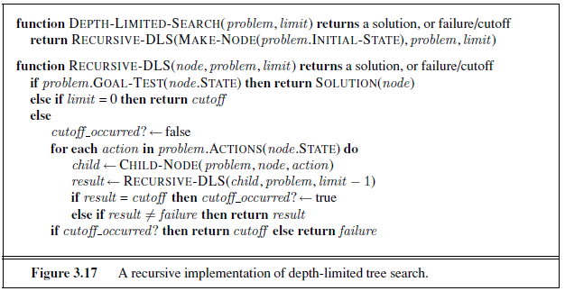

Slide 59
Diameter of the state space
Romania there are 20 cities. Therefore, we know that if there is a solution, it must be of length 19 at the longest, so l = 19 is a possible choice for Depth Limited Search.
But we would discover that any city can be reached from any other city in at most 9 steps. This is known as the diameter of the search space.

Slide 60
Iterative Deepening Search
Provides the best of both breadth-first and depth-first search
Main idea:
Totally horrifying !
IDS
For k = 0, 1, 2, … do:
Perform depth-first search with depth cutoff k
(i.e., only generate nodes with depth ≤ k)

Slide 61
Iterative Deepening

Slide 62
Iterative Deepening

Slide 63
Iterative Deepening

Slide 64
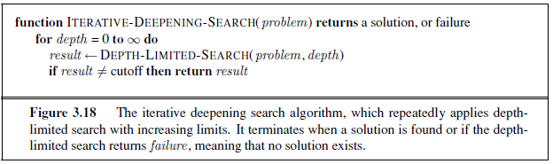

Slide 65
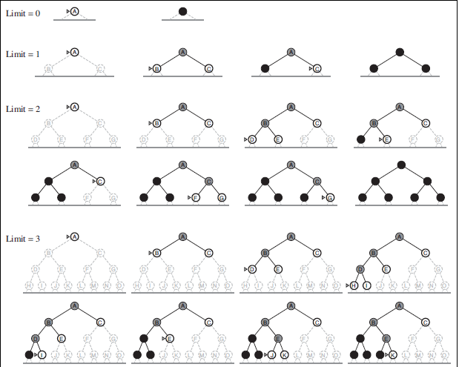

Slide 66
Performance
Iterative deepening search is:
Complete
Optimal if step cost =1
Time complexity is: (d+1)(1) + db + (d-1)b² + … + (1) b^{d} = O(b^{d})
Space complexity is: O(bd)

Slide 67
Calculation
db + (d-1)b² + … + (1) b^{d}
= b^{d} + 2b^{d-1} + 3b^{d-2} +… + db
= (1 + 2b⁻¹ + 3b⁻² + … + db^{-d})×b^{d}
≤ (S_{i=1,…,∞} ib^{(1-i)})×b^{d} = b^{d} (b/(b-1))²

Slide 68
Number of Generated Nodes (Breadth-First & Iterative Deepening)
d = 5 and b = 2
BF | ID
1 | 1 x 6 = 6
2 | 2 x 5 = 10
4 | 4 x 4 = 16
8 | 8 x 3 = 24
16 | 16 x 2 = 32
32 | 32 x 1 = 32
63 | 120
120/63 ~ 2

Slide 69
Number of Generated Nodes (Breadth-First & Iterative Deepening)
d = 5 and b = 10
BF | ID
1 | 6
10 | 50
100 | 400
1,000 | 3,000
10,000 | 20,000
100,000 | 100,000
111,111 | 123,450
123,456/111,111 ~ 1.111

Slide 70
If you are really concerned about repeating the repetition, you can use a hybrid approach that runs breadth-first search until almost all the available memory is consumed, and then runs iterative deepening from all the nodes in the frontier.
In general, iterative deepening is the preferred uninformed search method when the search space is large and the depth of the solution is not known.

Slide 71
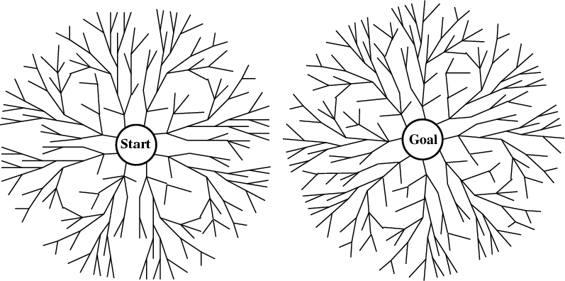
Bidirectional Search
Alternate searching from the start state toward the goal and from the goal state toward the start.
Stop when the frontiers intersect.
Works well only when there are unique start and goal states.
Requires the ability to generate “predecessor” states.
Can (sometimes) lead to finding a solution more quickly.

Slide 72
Bidirectional Search
2 frontier queues: FRONTIER1 and FRONTIER2
s
Time and space complexity is O(b^{d/2}) each << O(b^{d}) if both trees have the same branching factor b

Slide 73
For example, if a problem has solution depth d=6, and each direction runs breadth-first search one node at a time, then in the worst case the two searches meet when they have generated all of the nodes at depth 3. For b=10, this means a total of 2,220 node generations, compared with 1,111,110 for a standard breadth-first search.

Slide 74
Time and Space complexity
O(b^{d/2})
Can work for route finding problem in Romania?
Can work for 8 queens?
Can work for 8 puzzle?

Slide 75
Comparison of Strategies
Breadth-first is complete and optimal, but has high space complexity
Depth-first is space efficient, but is neither complete, nor optimal
Iterative deepening is complete and optimal, with the same space complexity as depth-first and almost the same time complexity as breadth-first

Slide 76
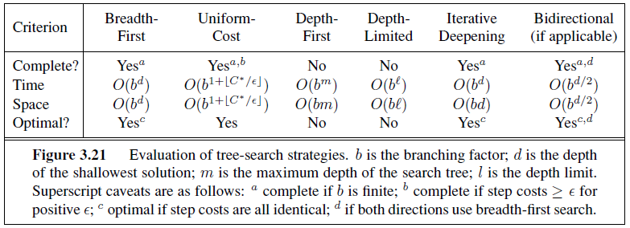

Slide 77
References
Muhammad Kashif Khan
AIMA Edition 3

