Slide 1
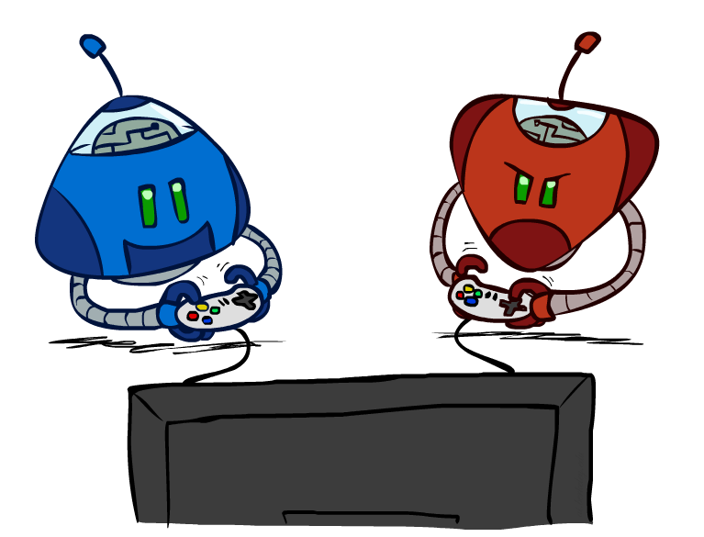
CS401 – Artificial Intelligence Adversarial Search

Slide 2
Today’s Agenda
Adversarial Search
(Russell and Norvig: Chap. 5 [Section 5.1-3])

Slide 3
Slides taken from ...
Jean-Claude Latombe, Stanford University
Richard H. Lathrop, University of California
Pinar Duygulu, Bilkent University
Weng-Keen Wong, Oregon State University
Muhammad Kashif Khan
http://www.hh.se/download/18.70cf2e49129168da0158000143597/aima

Slide 4
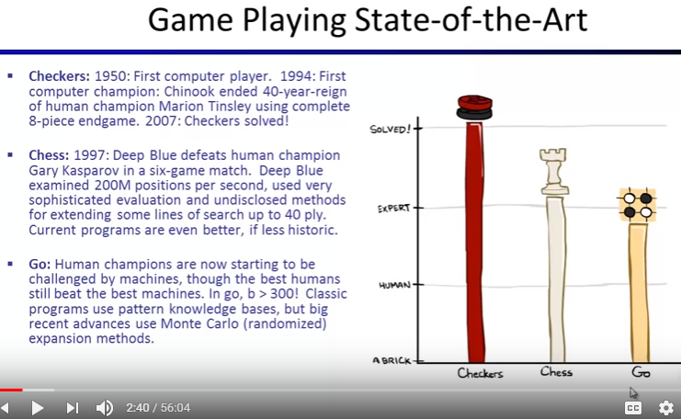

Slide 5
Games
Multiagent environments, in which agent needs to consider the actions of other agents and how they affect its own welfare.
The unpredictability of these other agents can introduce many possible contingencies
There could be competitive or cooperative environments
Competitive environments, in which the agents’ goals are in conflict, giving rise to adversarial search problems—often known as games

Slide 6
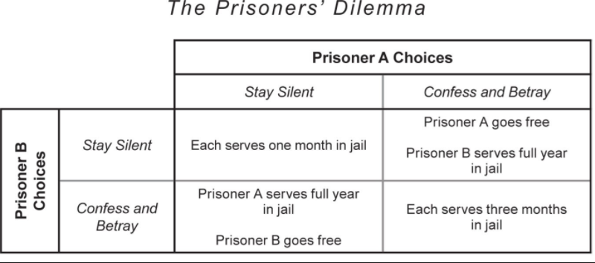

Slide 7
Games
In game theory (economics), any multiagent environment (either cooperative or competitive) is a game provided that the impact of each agent on the other is “significant”
AI games are a specialized kind - deterministic, turn taking, two-player, zero sum, time constrained games of perfect information
In our terminology – deterministic, fully observable environments with two agents whose actions alternate and the utility values at the end of the game are always equal and opposite (+1 and –1)

Slide 8
Games as Search
Two players: MAX and MIN
MAX moves first and they take turns until the game is over
Winner gets reward, loser gets penalty.
“zero-sum” means the sum of the reward and the penalty is a constant.
In game theory and economic theory, a zero-sum game is a mathematical representation of a situation in which each participant's gain or loss of utility is exactly balanced by the losses or gains of the utility of the other participants.
Wikipedia

Slide 9
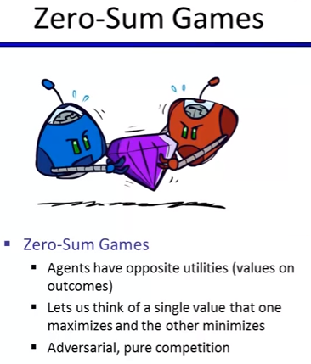

Slide 10
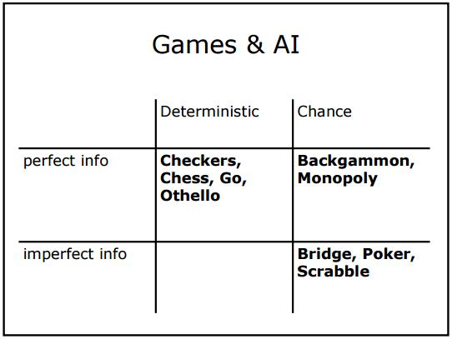

Slide 11
Search versus Games
Search – no adversary
Solution is (heuristic) method for finding goal
Heuristics and CSP techniques can find optimal solution
Evaluation function: estimate of cost from start to goal through given node
Examples: Path Planning, Scheduling, etc.
Games – adversary
Solution is strategy
strategy specifies move for every possible opponent reply
Time limits force an approximate solution
Evaluation function: evaluate “goodness” of game position
Examples: Chess, Checkers, Othello, Backgammon, etc.

Slide 12
Games, like the real world, therefore require the ability to make some decision even when calculating the optimal decision is infeasible. Games also penalize inefficiency severely. Whereas an implementation of A∗ search that is half as efficient will simply take twice as long to run to completion, a chess program that is half as efficient in using its available time probably will be beaten into the ground, other things being equal.

Slide 13
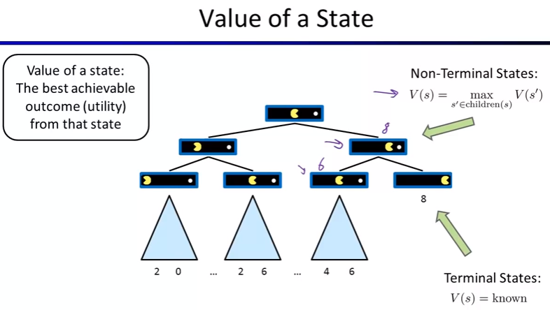

Slide 14
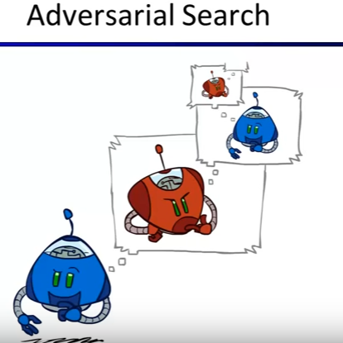

Slide 15
Games as Search
Formal definition as a search problem:
Initial state: Set-up specified by the rules, e.g., initial board configuration of chess.
Player(s): Defines which player has the move in a state.
Actions(s): Returns the set of legal moves in a state.
Result(s,a): Transition model defines the result of a move.
Terminal-Test(s): Is the game finished? True if finished, false otherwise.
Utility function(s,p): Gives numerical value of terminal state s for player p.
e.g., win (+1), lose (-1), and draw (0) in tic-tac-toe.
e.g., win (+1), lose (0), and draw (1/2) in chess.
MAX uses search tree to determine next move.

Slide 16
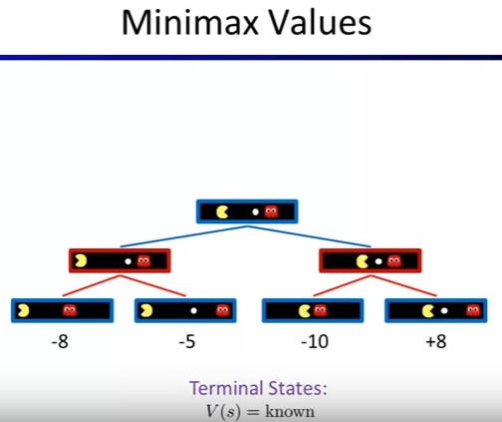

Slide 17
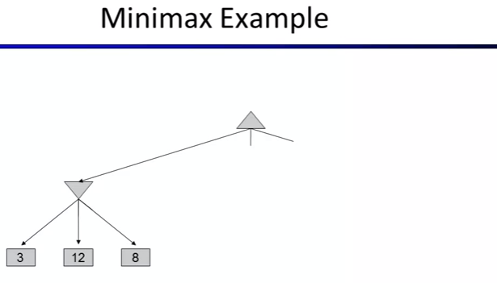

Slide 18
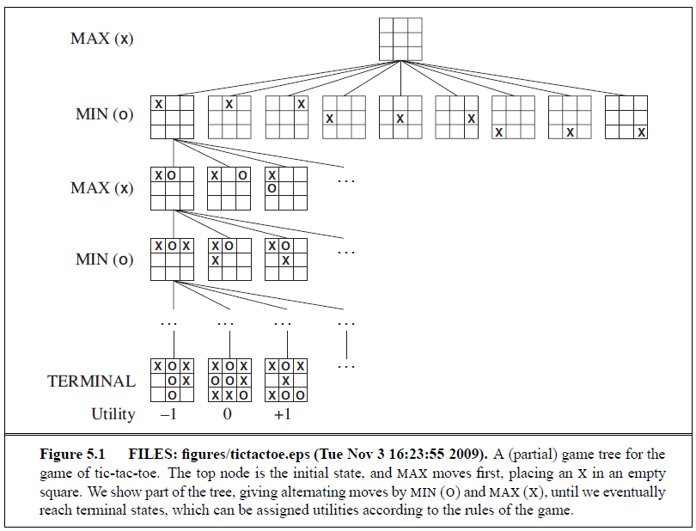
Game tree (2-player, deterministic, turns)
18
How do we search this tree to find the optimal move?

Slide 19
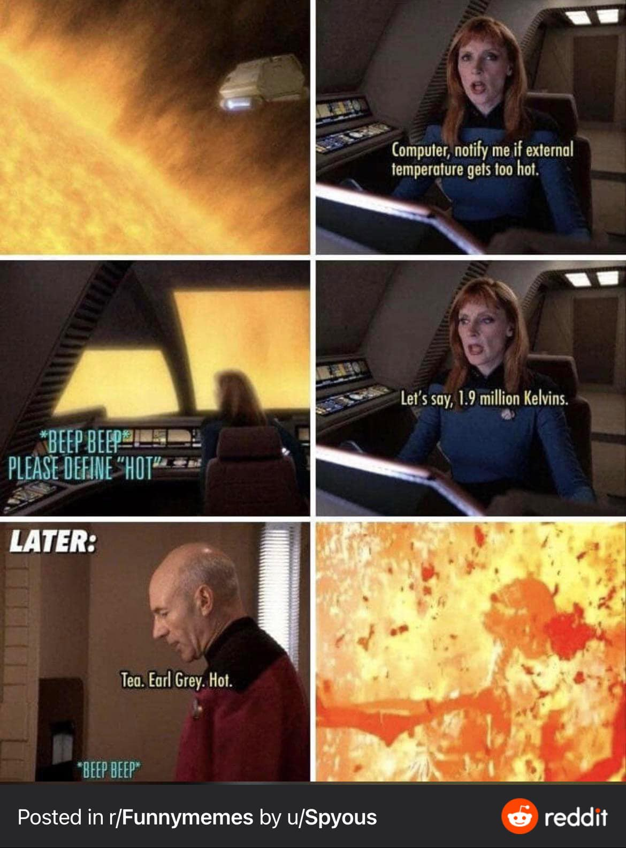

Slide 20
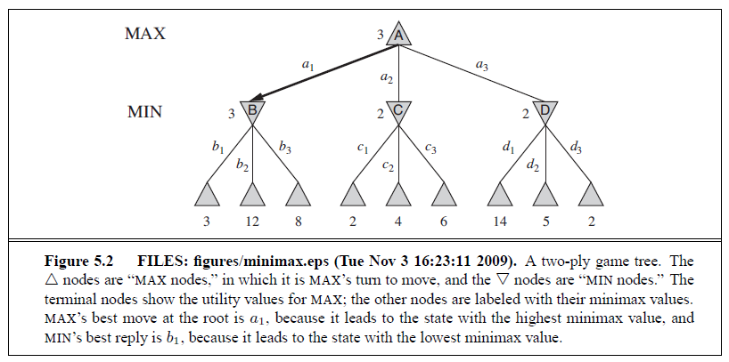
minimax Approach
Perfect play for deterministic games
Idea: choose move to position with highest minimax value
= best achievable payoff against best play
e.g., 2-ply game:
20

Slide 21
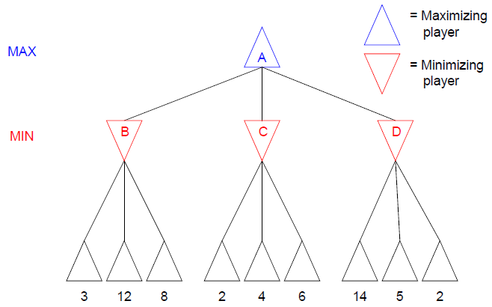
Two-Ply Game Tree
21

Slide 22
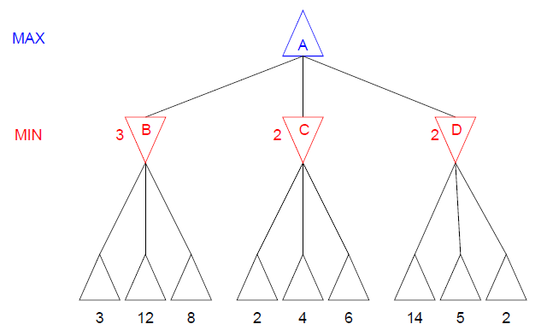
Two-Ply Game Tree

Slide 23
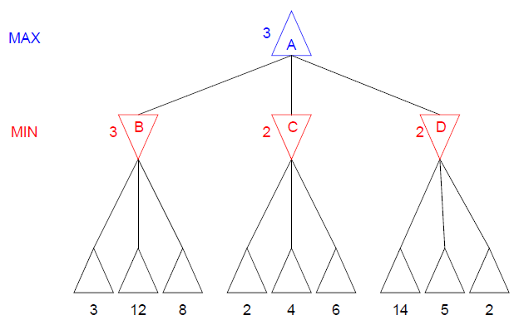
Two-Ply Game Tree

Slide 24
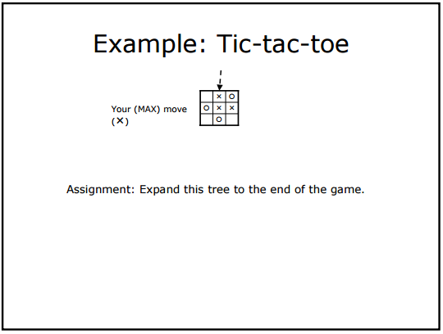

Slide 25
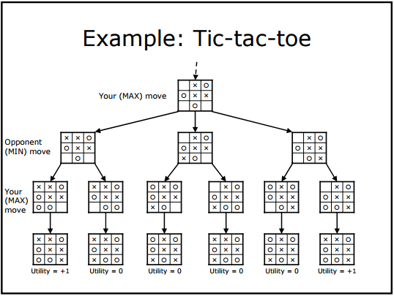

Slide 26
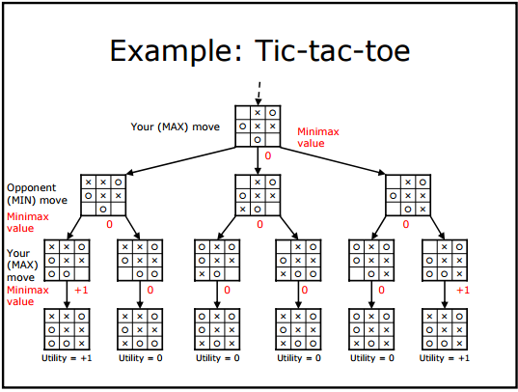

Slide 27
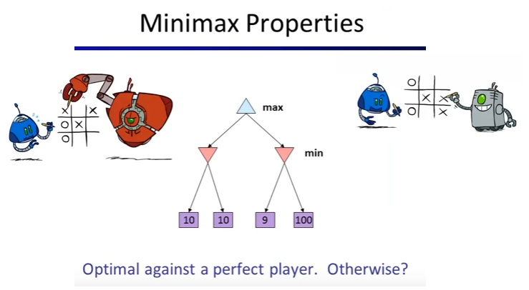

Slide 28
Optimal Strategies
In a normal search problem, the optimal solution would be a sequence of moves leading to a goal state - a terminal state that is a win
In a game, MIN has something to say about it and therefore MAX must find a contingent strategy, which specifies
MAX’s move in the initial state,
then MAX’s moves in the states resulting from every possible response by MIN,
then MAX’s moves in the states resulting from every possible response by MIN to those moves
– …
An optimal strategy leads to outcomes at least as good as any other strategy when one is playing an infallible opponent
28

Slide 29
An Optimal Strategy: minimax Approach
Designed to find the optimal strategy for Max and find best move:
Generate the whole game tree, down to the leaves.
Apply utility (payoff) function to each leaf.
Back-up values from leaves through branch nodes:
a Max node computes the Max of its child values
a Min node computes the Min of its child values
At root: choose the move leading to the child of highest value.
29

Slide 30
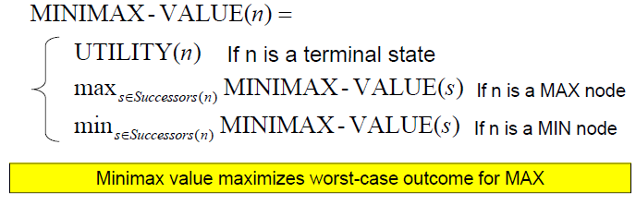
The minimax Value of a Node
The minimax value of a node is the utility for MAX of being in the corresponding state, assuming that both players play optimally from there to the end of the game

Slide 31
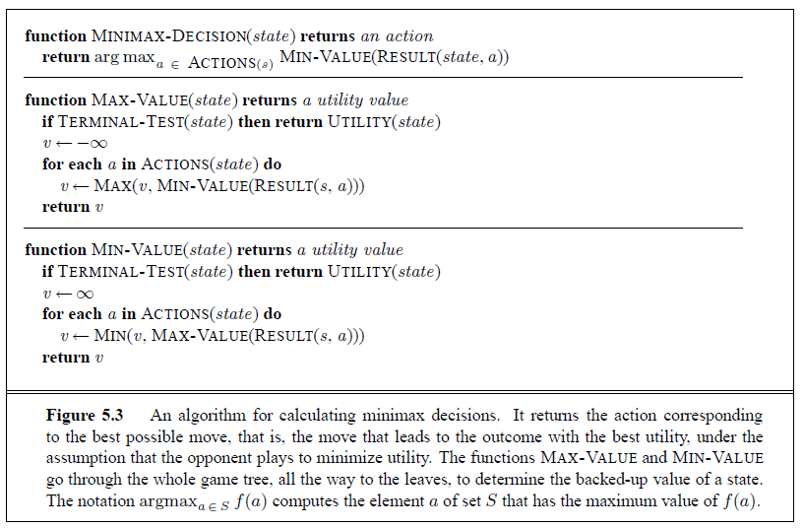
The minimax Algorithm

Slide 32
The minimax Algorithm
Computes minimax decision from the current state
Depth-first exploration of the game tree
Time Complexity O(b^{m}) where b=# of legal moves, m=maximum depth of tree
Space Complexity:
O(bm) if all successors generated at once
O(m) if only one successor generated at a time (each partially expanded node remembers which successor to generate next)

Slide 33
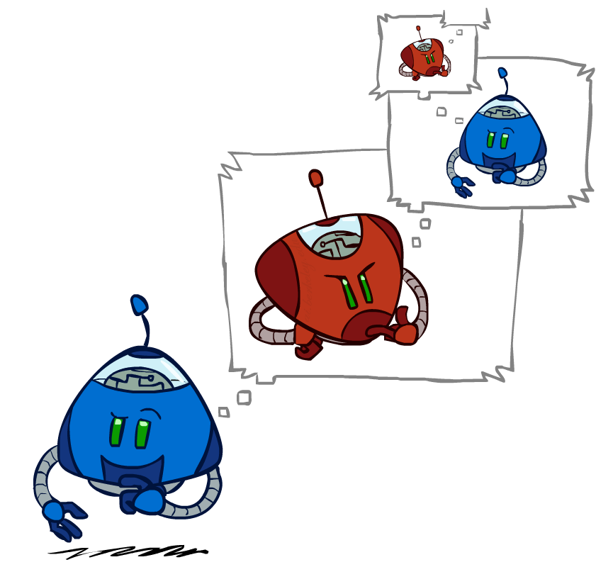
Minimax Efficiency
How efficient is minimax?
Just like (exhaustive) DFS
Complete? Yes (if tree is finite)
Optimal? Yes (against an optimal opponent)
Time: O(b^{m})
Space: O(bm)
Example: For chess, b ≈ 35, m ≈ 100
Exact solution is completely infeasible

Slide 34
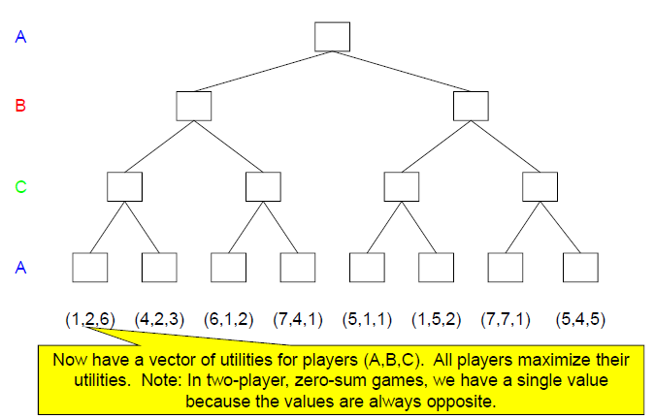
minimax with 3 Players

Slide 35
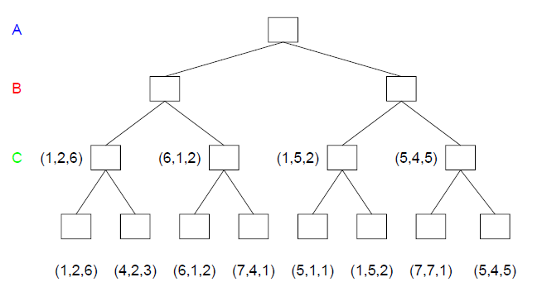
minimax with 3 Players

Slide 36
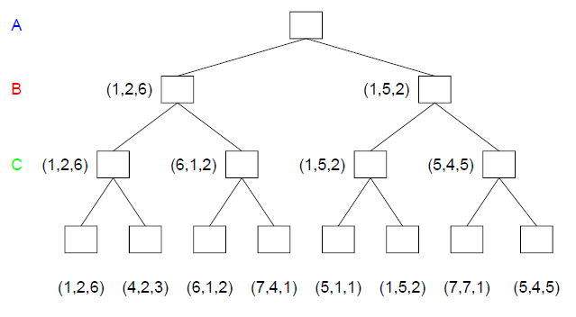
minimax with 3 Players

Slide 37
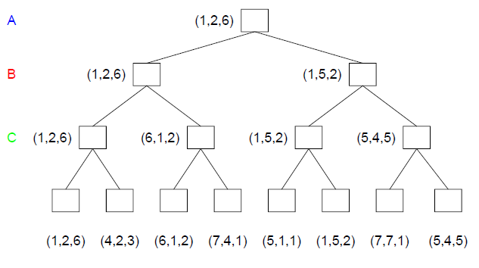
minimax with 3 Players

Slide 38
Subtleties With Multiplayer Games
Alliances can be made and broken
For example, if A and B are weaker than C, they can gang up on C
But A and B can turn on each other once C is weakened
But society considers the player that breaks the alliance to be dishonorable

Slide 39
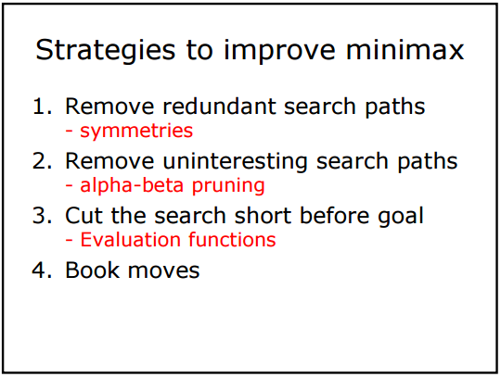

Slide 40
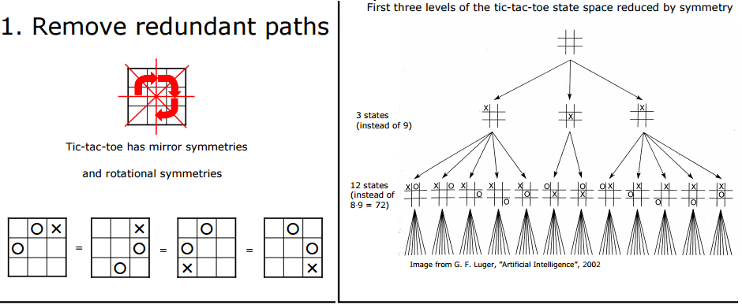

Slide 41
Implementation Details
In games we have the problem of transposition
Transposition means different permutations of the move sequence that end up in the same position.
Results in lots of repeated states
Use a transposition table to remember the states you’ve seen (similar to closed list)

Slide 42
Pruning
Can we improve on the time complexity of O(b^{m})?
Yes if we prune away branches that cannot possibly influence the final decision

Slide 43
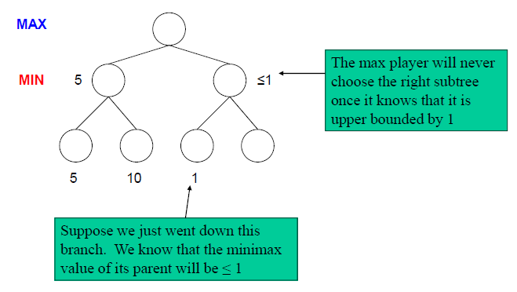
Pruning Intuition (General Case)

Slide 44
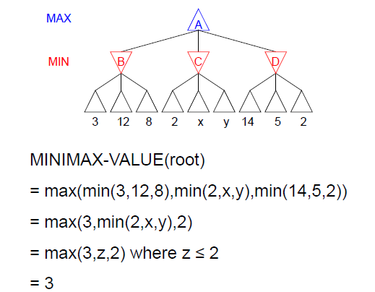
Pruning Example

Slide 45
Pruning Intuition
Remember that minimax search is DFS.
At any one time, we only have to consider the nodes along a single path in the tree
In general, let:
α = highest minimax value of all of the MAX player’s choices expanded on current path
β = lowest minimax value of all of the MIN player’s choices expanded on current path
If at a MIN player node, prune if minimax value of node ≤ α
If at a MAX player node prune if minimax value of node ≥ β

Slide 46
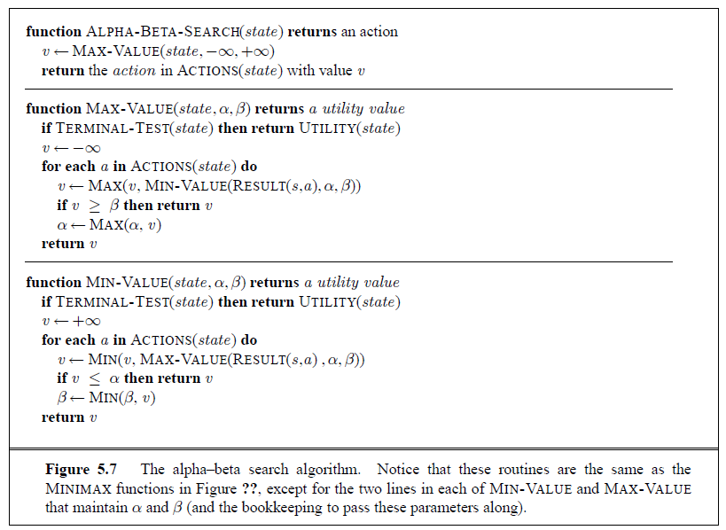
Alpha-Beta Search Algorithm

Slide 47
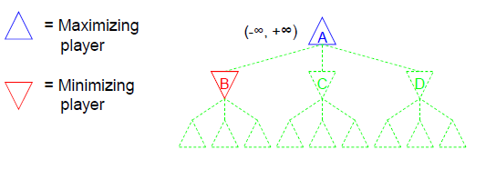
Illustrating the Alpha-Beta Algorithm
In the example to follow, the notation (-∞, +∞) represents the (α, β) values for the corresponding node
This example is intended to illustrate how the actual implementation of Alpha-Beta pruning works

Slide 48
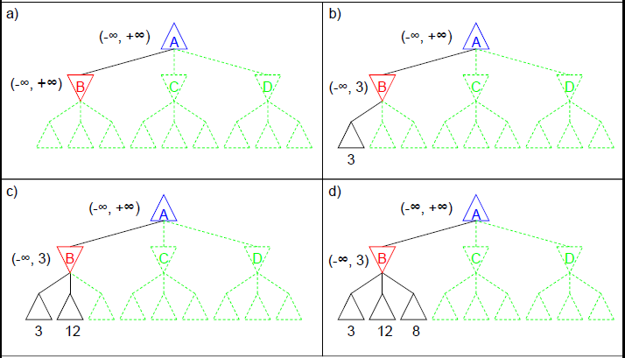
Alpha-Beta Pruning Example

Slide 49
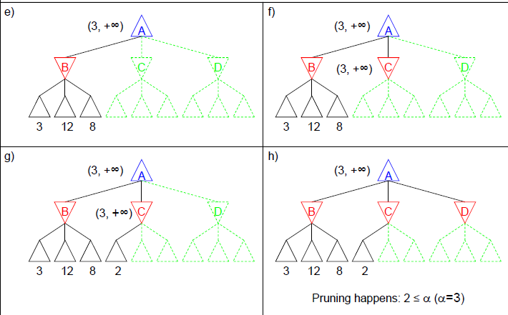
Alpha-Beta Pruning Example

Slide 50
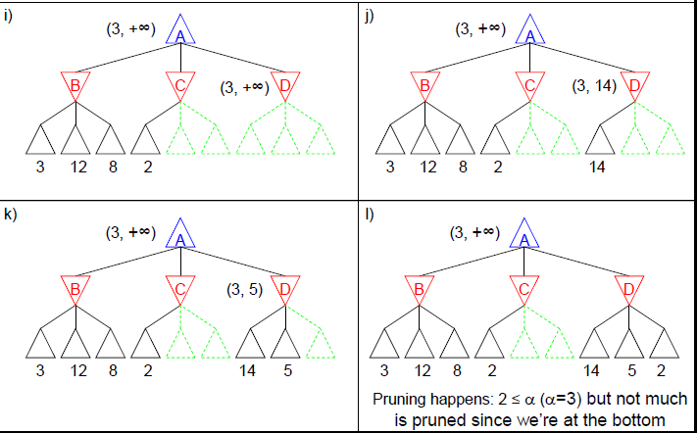
Alpha-Beta Pruning Example

Slide 51
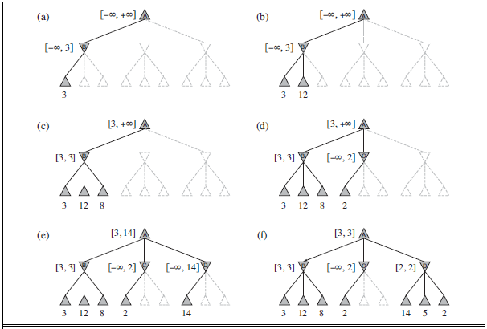

Slide 52
Effectiveness of Alpha-Beta
The effectiveness of alpha–beta pruning is highly dependent on the order in which the states are examined.
In Figure 5.5(e) and (f) (prev. slide) , we could not prune any successors of D at all because the worst successors (from the point of view of MIN) were generated first. If the third successor of D had been generated first, we would have been able to prune the other two.
This suggests that it might be worthwhile to try to examine first the successors that are likely to be best.
If this can be done, then it turns out that alpha–beta needs to examine only O(b^{m/2}) nodes to pick the best move, instead of O(b^{m}) for minimax.
Put another way, alpha–beta can solve a tree roughly twice as deep as minimax in the same amount of time.

Slide 53


Slide 54
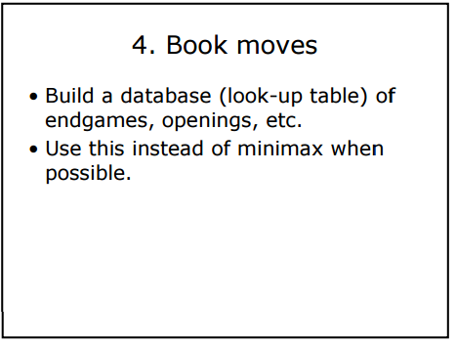

Slide 55
Minimax algorithm generates the entire game search space, whereas the alpha–beta algorithm allows us to prune large parts of it.
However, alpha–beta still has to search all the way to terminal states for at least a portion of the search space.
Claude Shannon’s paper Programming a Computer for Playing Chess (1950) proposed instead that programs should cut off the search earlier and apply a heuristic evaluation function to states in the search, effectively turning nonterminal nodes into terminal leaves.

Slide 56

The suggestion is to alter minimax or alpha–beta in two ways: replace the utility function by a heuristic evaluation function EVAL, which estimates the position’s utility, and replace the terminal test by a cutoff test that decides when to apply EVAL. gives us the following for heuristic minimax for state s and maximum depth d:

Slide 57
Evaluation functions
An evaluation function returns an estimate of the expected utility of the game from a given position.
It should be clear that the performance of a game-playing program depends strongly on the quality of its evaluation function. An inaccurate evaluation function will guide an agent toward positions that turn out to be lost.

Slide 58
First, the evaluation function should order the terminal states in the same way as the true utility function: states that are wins must evaluate better than draws, which in turn must be better than losses.
Second, the computation must not take too long! (The whole point is to search faster.)
Third, for nonterminal states, the evaluation function should be strongly correlated with the actual chances of winning.

Slide 59
Most evaluation functions work by calculating various features of the state—for example, in chess, we would have features for the number of white pawns, black pawns, white queens, black queens, and so on. The features, taken together, define various categories or equivalence classes of states: the states in each category have the same values for all the features.
For example, one category contains all two-pawn vs. one-pawn endgames. Any given category, generally speaking, will contain some states that lead to wins, some that lead to draws, and some that lead to losses.

Slide 60
For example, suppose our experience suggests that 72% of the states encountered in the two-pawns vs. one-pawn category lead to a win (utility +1); 20% to a loss (0), and 8% to a draw (1/2). Then a reasonable evaluation for states in the category is the expected value: (0.72 × +1) + (0.20 × 0) + (0.08 × 1/2) = 0.76.

Slide 61
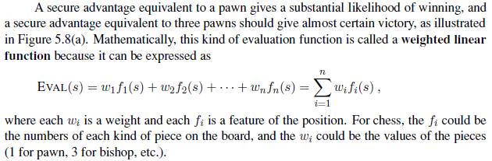
Note that a pair of bishops might be worth slightly more than twice the value of a single bishop, and a bishop is worth more in the endgame (that is, when the move number feature is high or the number of remaining pieces feature is low).

Slide 62

Cutting off the search
The depth d is chosen so that a move is selected within the allocated time. A more robust approach is to apply iterative deepening. (See Chapter 3.) When time runs out, the program returns the move selected by the deepest completed search. As a bonus, iterative deepening also helps with move ordering.

Slide 63
The evaluation function should be applied only to positions that are quiescent—that is, unlikely to exhibit wild swings in value in the near future.
Nonquiescent positions can be expanded further until quiescent positions are reached. This extra search is called a quiescence search; sometimes it is restricted to consider only certain types of moves, such as capture moves, that will quickly resolve the uncertainties in the position.

Slide 64
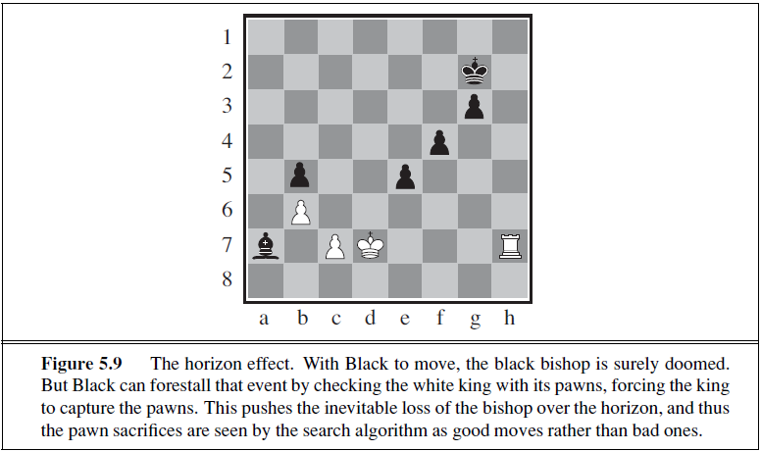
Horizon effect
Loses two pawns to save bishop. (Bishop worth three pawns)

Slide 65
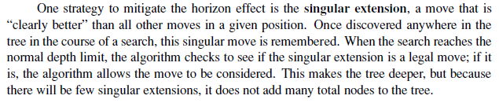
The horizon effect is more difficult to eliminate. It arises when the program is facing an opponent’s move that causes serious damage and is ultimately unavoidable, but can be temporarily avoided by delaying tactics.

Slide 66
Forward Pruning
It is also possible to do forward pruning, meaning that some moves at a given node are pruned immediately without further consideration.
One approach to forward pruning is beam search: on each ply, consider only a “beam” of the n best moves (according to the evaluation function) rather than considering all possible moves.

Slide 67
Unfortunately, this approach is rather dangerous because there is no guarantee that the best move will not be pruned away.
Algorithm is a forward-pruning version of alpha–beta search that uses statistics gained from prior experience to lessen the chance that the best move will be pruned.
Alpha–beta search prunes any node that is provably outside the current (α, β) window. PROBCUT also prunes nodes that are probably outside the window. It computes this probability by doing a shallow search to compute the backed-up value v of a node and then using past experience to estimate how likely it is that a score of v at depth d in the tree would be outside (α, β).

Slide 68
Combining all the techniques described here results in a program that can play creditable chess (or other games). E.g. implement an evaluation function for chess, a reasonable cutoff test with a quiescence search, and a large transposition table.

Slide 69
Search vs Lookup
A human can tell you the general strategy for playing a king-and-rook-versus-king (KRK) endgame: reduce the opposing king’s mobility by squeezing it toward one edge of the board, using your king to prevent the opponent from escaping the squeeze. Other endings, such as king, bishop, and knight versus king (KBNK), are difficult to master and have no succinct strategy description. A computer, on the other hand, can completely solve the endgame by producing a policy, which is a mapping from every possible state to the best move in that state.

Slide 70
What you should know
Be able to draw up a game tree
Know how the Minimax algorithm works
Know how the Alpha-Beta algorithm works
Be able to do both algorithms by hand

