Slide 1

CS401 – Artificial Intelligence Constraint Satisfaction Problems

Slide 2
Acknowledgements
Jean-Claude Latombe, Stanford University
Richard H. Lathrop, University of California
Pinar Duygulu, Bilkent University
Weng-Keen Wong, Oregonstate
Muhammad Kashif Khan

Slide 3
Standard Search Problems
Standard search problems:
State is a black box: arbitrary data structure
Goal test is a black box test on states
Actions are black box data structures
Transition model is a black box function
Consequences:
Have to write new code for every new problem
Have to devise heuristics for each new problem
Cannot just choose actions that achieve the goal!
Solution: formal representation for states, actions, goals

Slide 4
Spectrum of Representations
Search,
Game-Playing
CSPs, Planning,
Propositional Logic,
Bayes Nets, Neural Nets
First-Order Logic,
Databases,
Probabilistic Programs

Slide 5
Constraint Satisfaction Problem (CSP)
Constraint Satisfaction Problem (CSP) is a configuration search problem where:
A state is a factored representation of a set of variables, each of which has a value
Goal condition is represented by a set constraints on possible variable values
A problem is solved when each variable has a value that satisfies all the constraints on the variable.
CSP search algorithms take advantage of the structure of states and use general-purpose rather than problem-specific heuristics to enable the solution of complex problems.
The main idea is to eliminate large portions of the search space all at once by identifying variable/value combinations that violate the constraints.

Slide 6
Defining Constraint Satisfaction Problems
A problem state in a CSP consists of:
Finite set of variables {X₁, X₂, …, X_{n}}
Nonempty domain of possible values for each variable D₁, D₂, …, D_{n}
Finite set of constraints {C₁, C₂, …, C_{m}}
Each constraint relates a subset of variables by specifying the valid combinations of their values
Goal: Assign a value to every variable such that all constraints are satisfied

Slide 7
Defining Constraint Satisfaction Problems
Each constraint C_{i} is a pair <scope, relation>
Scope = Tuple of variables that participate in the constraint.
Relation = List of allowed combinations of variable values.
May be an explicit list of allowed combinations.
May be an abstract relation allowing membership testing and listing.
For example, if X1 and X2 both have the domain {A,B}, then the constraint saying the two variables must have different values can be written as <(X1,X2), [(A,B), (B,A)]> or as <(X1,X2),X1 ≠ X2>.

Slide 8
Defining Constraint Satisfaction Problems
Each state in a CSP is defined by an assignment of values to some or all of the variables:
{Xi = vi, Xj = vj, . . .}.
A partial assignment is one which assigns values to only some of the variables.
A complete assignment is one in which every variable is assigned.
A consistent/legal assignment is one which does not violate any constraints.
A solution to a CSP is a complete and consistent assignment.
All variables are assigned, and none of the assignments violate the constraints.

Slide 9

CSPs Benefits
Standard representation pattern
Generic goal and successor functions
Generic heuristics (no domain specific expertise).
Generic CSP algorithms much faster than standard search
Solve new problems without writing new code

Slide 10
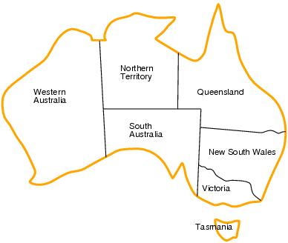
Example Problem: Map Coloring
Variables: 7 variables: {WA, NT, Q, NSW, V, SA, T}
Domains: Each variable has the same domain: D_{i}={red,green,blue}
Constraints: No two adjacent variables have the same value:
e.g.; WA≠NT, WA≠SA, NT≠SA, NT≠Q, SA≠Q, SA≠NSW, SA≠V, Q≠NSW, NSW≠V

Slide 11
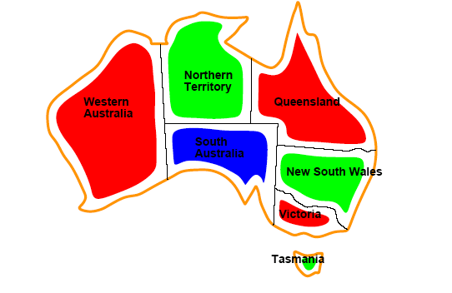

Example Problem: Map Coloring
Solutions are assignments satisfying all constraints, e.g.;
{WA=red,NT=green,Q=red,NSW=green,V=red,
SA=blue,T=green}

Slide 12
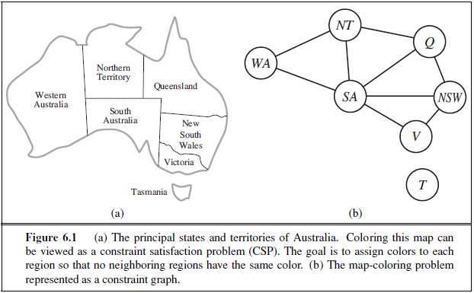
Constraint Graph
It can be helpful to visualize a CSP as a constraint graph, as shown in Figure:
Nodes correspond to variables of the problem
Link connects any two variables that participate in a constraint

Slide 13
Why formulate a problem as a CSP?
CSPs yield a natural representation for a wide variety of problems; if you already have a CSP-solving system, it is often easier to solve a problem using it than to design a custom solution using another search technique.
CSP solvers can be faster than state-space searchers because it can quickly eliminate large swatches of the search space.
For example, once we have chosen {SA=blue} in the Australia problem, we can conclude that none of the five neighboring variables can take on the value blue. Without taking advantage of constraint propagation, a search procedure would have to consider 3⁵ =243 assignments for the five neighboring variables; with constraint propagation we never have to consider blue as a value, so we have only 2⁵ =32 assignments to look at, a reduction of 87%.

Slide 14
Example Problem: Job-Shop Scheduling
Consider a small part of the car assembly, consisting of 15 tasks: install axles (front and back), affix all four wheels (right and left, front and back), tighten nuts for each wheel, affix hubcaps, and inspect the final assembly.
Can represent the tasks with 15 variables:
X = {AxleF, AxleB, WheelRF, WheelLF, WheelRB, WheelLB, NutsRF, NutsLF, NutsRB, NutsLB, CapRF, CapLF, CapRB, CapLB, Inspect}
Whenever a task T1 must occur before task T2, and task T1 takes duration d1 to complete, we add an arithmetic constraint (precedence constraint) of the form:
T1 + d1 ≤ T2

Slide 15
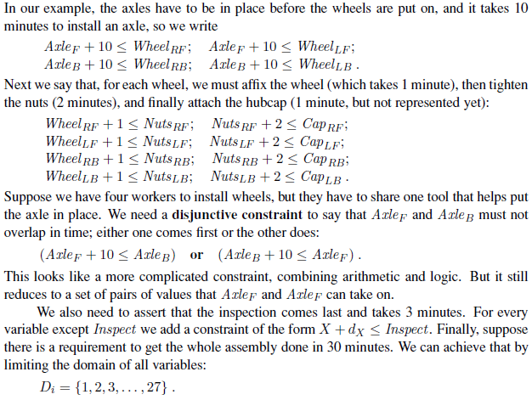

Slide 16
Variations on the CSP Formalism
Discrete variables
finite domains; size d ⇒ O(d^{n}) complete assignments
e.g., Boolean CSPs, incl. Boolean satisfiability (NP-complete)
infinite domains (integers, strings, etc.)
e.g., job scheduling, variables are start/end days for each job
need a constraint language, e.g., StartJob1 + 5 ≤ StartJob3
linear constraints solvable, nonlinear undecidable

Slide 17
Variations on the CSP Formalism
Continuous variables
e.g., start/end times for Hubble Telescope observations
linear constraints solvable in polynomial time by LP methods

Slide 18
Types of Constraints
Unary constraints involve a single variable.
e.g.; SA ≠ green
Binary constraints involve pairs of variables.
e.g.; SA ≠ WA
Higher-order constraints involve 3 or more variables.
Professors A, B,and C cannot be on a committee together
Can always be represented by multiple binary constraints
Inequality constraints on Continuous variables
e.g.; EndJob1 + 5 ≤ StartJob3
Global constraint involve an arbitrary number of variables.
e.g.; Alldiff , which says that all of the variables involved in the constraint must have different values.
Soft constraints: No class at 8 AM

Slide 19
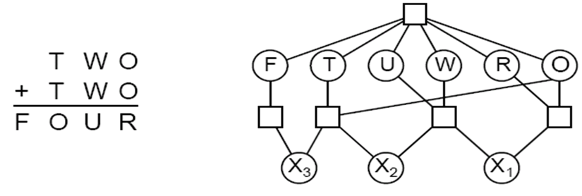
Example Problem: Cryptharithmetic Puzzle
Variables: F T U W R O X1 X2 X3
Domains:{0, 1, 2,3, 4, 5, 6, 7, 8, 9}
Constraints:
alldiff (F, T, U, W, R, O)
O + O = R + 10.X1, etc.

Slide 20
Types of Constraints
Preference constraints indicating which solutions are preferred. (a.k.a soft constraints)
e.g.; In a university class-scheduling problem, there are absolute constraints that no professor can teach two classes at the same time.
But we also may allow preference constraints: Prof. R might prefer teaching in the morning, whereas Prof. N prefers teaching in the afternoon.
A schedule that has Prof. R teaching at 2 p.m. would still be an allowable solution but would not be an optimal one.

Slide 21
Types of Constraints
Preference constraints can often be encoded as costs on individual variable assignments—for example, assigning an afternoon slot for Prof. R costs 2 points against the overall objective function, whereas a morning slot costs 1.
With this formulation, CSPs with preferences can be solved with optimization search methods, either path-based or local.
We call such a problem a constraint optimization problem, or COP.
Linear programming problems do this kind of optimization.

Slide 22
Constraint Propagation: Inference in CSPs
A state (more broadly) is defined:
by a set of assigned variables, their values and
a list of legal and illegal assignments for unassigned variables
Legal and illegal assignments can be represented as:
equations (value assignments) and
disequations (list of invalid assignments)
A = Red, Blue C ≠ Red
Constraints + Assignments
can entail new equations and disequations
A = Red → B ≠ Red

Slide 23
Constraint Propagation: Inference in CSPs
Constraint Propagation:
the process of inferring of new equations and disequations from existing equations and disequations

Slide 24
Constraint Propagation: Local Consistency
Current variable assignments together with constraints restrict remaining legal values of unassigned variables.
The remaining legal and illegal values of variables may be inferred (effect of constraints propagates).
To prevent “blind” exploration we can keep track of the remaining legal values, so we know when the constraints are violated and when to terminate the search.
The key idea is local consistency.
If we treat each variable as a node in a graph and each binary constraint as an arc, then the process of enforcing local consistency in each part of the graph causes inconsistent values to be eliminated throughout the graph.

Slide 25
Types of Local Consistency
There are different types of local consistency, such as:
Node Consistency
Arc Consistency
Path Consistency
K-Consistency

Slide 26
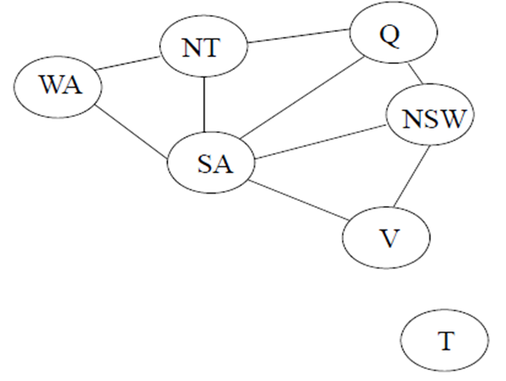
Example Problem: Map Coloring
Note: Problem with binary constraints

Slide 27
Node Consistency
Node consistency infers:
equations (valid assignments) or disequations (invalid assignments) for an individual variable by applying a unary constraint
A single variable (corresponding to a node in the CSP network) is node-consistent if all the values in the variable’s domain satisfy the variable’s unary constraints.
For example, in the variant of the Australia map-coloring problem where South Australians dislike green, the variable SA starts with domain {red , green, blue}, and we can make it node consistent by eliminating green, leaving SA with the reduced domain {red , blue}.

Slide 28
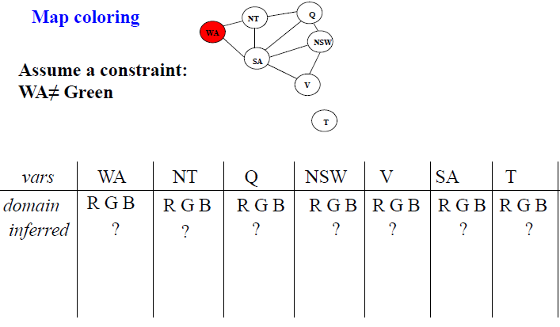
Node Consistency

Slide 29
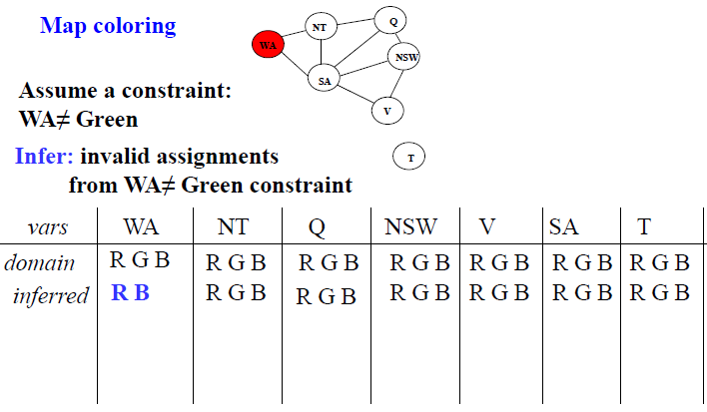
Node Consistency

Slide 30
Arc Consistency
Arc consistency infers:
disequations from the set of equations and disequations defining the partial assignment, and a constraint
equations through the exhaustion of alternatives
A variable in a CSP is arc-consistent if every value in its domain satisfies the variable’s binary constraints.
For example, consider the constraint Y = X² where the domain of both X and Y is the set of digits.
We can write this constraint explicitly as:
<(X, Y ), {(0, 0), (1, 1), (2, 4), (3, 9))}>
To make X arc-consistent with respect to Y , we reduce X’s domain to {0, 1, 2, 3}.
If we also make Y arc-consistent with respect to X, then Y ’s domain becomes {0, 1, 4, 9} and the whole CSP is arc-consistent.

Slide 31
AC-3: The Arc-Consistency Algorithm
function AC-3(csp) returns false if an inconsistency is found
and true otherwise
inputs: csp, a binary CSP with components (X, D, C)
local variables: queue, a queue of arcs, initially all the arcs in csp
while queue is not empty do
(Xi, Xj)← REMOVE-FIRST(queue)
if REVISE(csp, Xi, Xj ) then
if size of Di = 0 then return false
for each Xk in Xi.NEIGHBORS - {Xj} do
add (Xk, Xi) to queue
return true
function REVISE(csp, Xi, Xj ) returns true iff we revise the
domain of Xi
revised ← false
for each x in Di do
if no value y in Dj allows (x ,y) to satisfy the
constraint between Xi and Xj then
delete x from Di
revised ← true
return revised

Slide 32
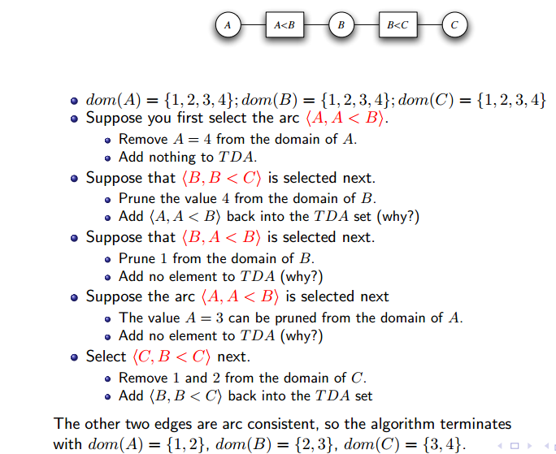
https://www.cs.ubc.ca/~kevinlb/teaching/cs322%20-%202009-10/Lectures/CSP3.pdf

Slide 33
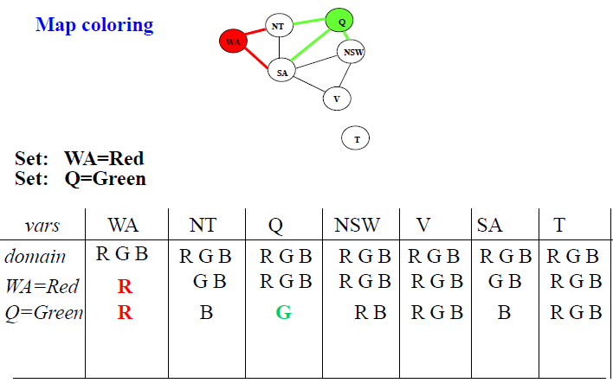
Arc Consistency

Slide 34
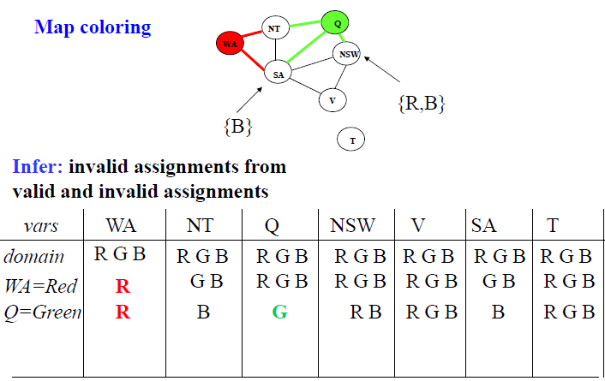
Arc Consistency

Slide 35
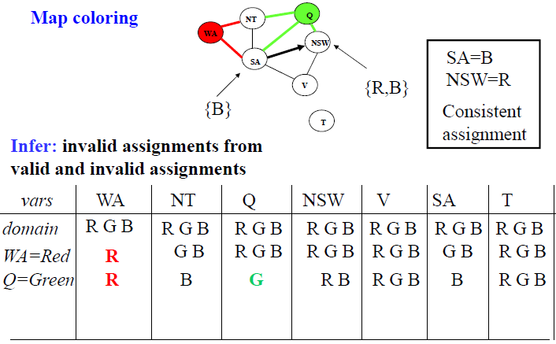
Arc Consistency

Slide 36
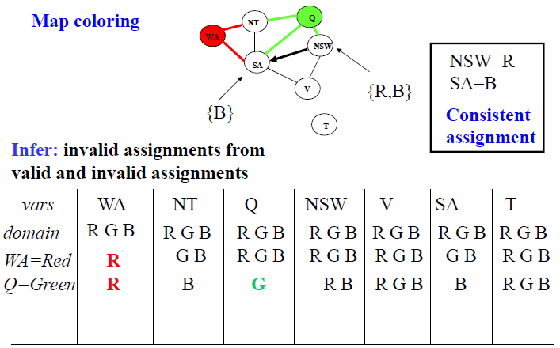
Arc Consistency

Slide 37
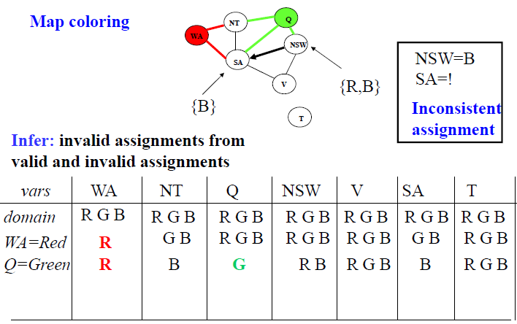
Arc Consistency

Slide 38
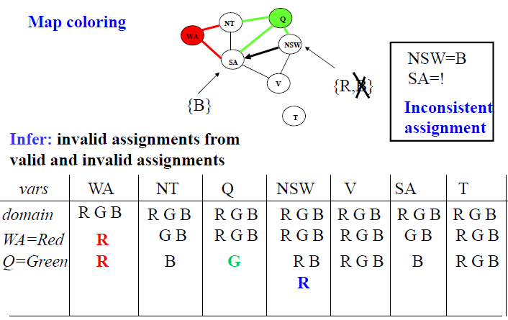
Arc Consistency

Slide 39
Path Consistency
A two-variable set {Xi,Xj} is path-consistent with respect to a third variable Xm if, for every assignment {Xi = a,Xj = b} consistent with the constraints on {Xi,Xj}, there is an assignment to Xm that satisfies the constraints on {Xi,Xm} and {Xm,Xj}.
This is called path consistency because one can think of it as looking at a path from Xi to Xj with Xm in the middle.

Slide 40
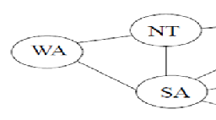
Consider the map-coloring problem on Australia, but with only two colors allowed, red and blue.
Arc consistency can do nothing because every variable is already arc consistent: each can be red with blue at the other end of the arc (or vice versa).
{WA,SA} path consistent with respect to NT.
{WA = red ,SA = blue} and {WA = blue,SA = red}
We can see that with both of these assignments NT can be neither red nor blue (because it would conflict with either WA or SA).
We find it is not possible

Slide 41
K-Consistency
A CSP is k-consistent if, for any set of k − 1 variables and for any consistent assignment to those variables, a consistent value can always be assigned to any kth variable.
For example:
1-consistency says that, given the empty set, we can make any set of one variable consistent.
3-consistency ensures that any instantiation on any pair of variables can be extended to an instantiation involving any third variable without violating any constraint. It is equivalent to path consistency. Similarly, 2-consistency is also known as arc consistency.

Slide 42
Global Constraints
A global constraint is one involving an arbitrary number of variables (but not necessarily all variables).
For example, the Alldiff constraint says that all the variables involved must have distinct values.
Another important higher-order constraint is the resource constraint, sometimes called the atmost constraint.

Slide 43
For example, in a scheduling problem, let P1, . . . , P4 denote the numbers of personnel assigned to each of four tasks.
The constraint that no more than 10 personnel are assigned in total is written as Atmost(10, P1, P2, P3, P4).
We can detect an inconsistency simply by checking the sum of the minimum values of the current domains.
For example, if each variable has the domain {3, 4, 5, 6}, the Atmost constraint cannot be satisfied.

Slide 44
We can also enforce consistency by deleting the maximum value of any domain if it is not consistent with the minimum values of the other domains. Thus, if each variable in our example has the domain {2, 3, 4, 5, 6}, the values 5 and 6 can be deleted from each domain.

Slide 45
Bounds propagation
In an airline-scheduling problem, let’s suppose there are two flights, F1 and F2, for which the planes have capacities 165 and 385, respectively.
The initial domains for the numbers of passengers on each flight are then
D1 = [0, 165] and D2 = [0, 385] .
Now suppose we have the additional constraint that the two flights together must carry 420 people
i.e : F1 + F2 = 420.
Propagating bounds constraints, we reduce the domains to
D1 = [35, 165] and D2 = [255, 385] .

Slide 46
We say that a CSP is bounds consistent if for every variable X, and for both the lower-bound and upper-bound values of X, there exists some value of Y that satisfies the constraint between X and Y for every variable Y.

Slide 47
Example Problem: Sudoku
A Sudoku board consists of 81 squares, some of which are initially filled with digits from 1 to 9.
The puzzle is to fill in all the remaining squares such that no digit appears twice in any row, column, or 3×3 box.
A row, column, or box is called a unit.

Slide 48
Example Problem: Sudoku
A Sudoku puzzle can be considered a CSP with 81 variables, one for each square.
We use the variable names A1 through A9 for the top row (left to right), down to I1 through I9 for the bottom row.
The empty squares have the domain {1, 2, 3, 4, 5, 6, 7, 8, 9} and the prefilled squares have a domain consisting of a single value.
In addition, there are 27 different Alldiff constraints: one for each row, column, and box of 9 squares.
Alldiff (A1,A2,A3,A4,A5,A6, A7, A8, A9)
Alldiff (B1,B2,B3,B4,B5,B6,B7,B8,B9)
・ ・ ・
Alldiff (A1,B1,C1,D1,E1, F1,G1,H1, I1)
Alldiff (A2,B2,C2,D2,E2, F2,G2,H2, I2)
・ ・ ・
Alldiff (A1,A2,A3,B1,B2,B3,C1,C2,C3)
Alldiff (A4,A5,A6,B4,B5,B6,C4,C5,C6)
・ ・ ・

Slide 49
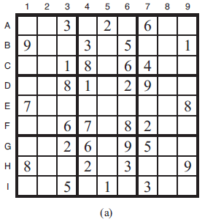
Example Problem: Sudoku

Slide 50
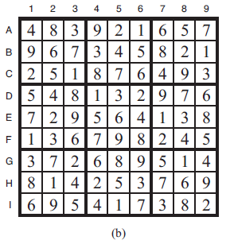
Example Problem: Sudoku

Slide 51
CSP as a Search Problem
Some CSPs are designed to be solved by inference over constraints (i.e., constraint propagation) only.
But many other CSPs cannot be solved by inference alone; there comes a time when we must search for a solution.
In this section we look at backtracking search algorithms that work on partial assignments.
In the next section we look at local search algorithms over complete assignments.

Slide 53
CSP as a Search Problem
We could apply a standard depth-first search (from Chapter 3).
A state would be a partial assignment, and an action would be adding var = value to the assignment.
But for a CSP with n variables of domain size d, we quickly notice something terrible
the branching factor at the top level is nd because any of d values can be assigned to any of n variables. At the next level, the branching factor is (n − 1)d, and so on for n levels.
We generate a tree with n!・d^{n} leaves, even though there are only d^{n} possible complete assignments!

Slide 54
CSP as a Search Problem
The standard depth-first search ignores crucial property common to all CSPs: commutativity.
CSPs are commutative because assigning values to variables, will always reach the same partial assignment regardless of order.
Therefore, we need only consider a single variable at each node in the search tree.
For example, at the root node of a search tree for coloring the map of Australia, we might make a choice between SA=red, SA=green, and SA=blue, but we would never choose between SA=red and WA=blue.
With this restriction, the number of leaves is d^{n}, as we would hope.

Slide 55
Backtracking Search for CSPs
The term backtracking search is used for a depth-first search that chooses values for one variable at a time and backtracks when a variable has no legal values left to assign.
It repeatedly chooses an unassigned variable, and then tries all values in the domain of that variable in turn, trying to find a solution.
If an inconsistency is detected, then BACKTRACK returns failure, causing the previous call to try another value.

Slide 56
Backtracking Search Algorithm
function BACKTRACKING-SEARCH(csp) returns a solution, or failure
return BACKTRACK({ }, csp)
function BACKTRACK(assignment , csp) returns a solution, or failure
if assignment is complete then return assignment
var ← SELECT-UNASSIGNED-VARIABLE(csp)
for each value in ORDER-DOMAIN-VALUES(var , assignment , csp) do
if value is consistent with assignment then
add {var = value} to assignment
inferences ←INFERENCE(csp, var , value)
if inferences ≠ failure then
add inferences to assignment
result ← BACKTRACK(assignment , csp)
if result ≠ failure then
return result
remove {var = value} and inferences from assignment
return failure

Slide 57
Backtracking Search : Example
Assignment = {}

Slide 58
Backtracking Search : Example
X₁
v₁₁
Assignment = {(X₁,v₁₁)}

Slide 59
Backtracking Search : Example
X₁
v₁₁
X₃
v₃₁
Assignment = {(X₁,v₁₁), (X₃,v₃₁)}

Slide 60
Backtracking Search : Example
X₁
v₁₁
Then, the search algorithm
backtracks to the previous variable (X₃) and tries another value
X₃
v₃₁
X₂
Assume that no value of X₂
leads to a valid assignment
Assignment = {(X₁,v₁₁), (X₃,v₃₁)}

Slide 61
Backtracking Search : Example
X₁
v₁₁
X₃
v₃₁
v₃₂
X₂
Assignment = {(X₁,v₁₁), (X₃,v₃₂)}

Slide 62
Backtracking Search : Example
The search algorithm
backtracks to the previous variable (X₃) and tries another value. But assume that X₃ has only two possible values. The algorithm backtracks to X₁
X₁
v₁₁
X₃
v₃₁
v₃₂
X₂
X₂
Assume again that no value of X₂ leads to a valid assignment
Assignment = {(X₁,v₁₁), (X₃,v₃₂)}

Slide 63
Backtracking Search : Example
X₁
v₁₁
v₁₂
X₃
v₃₁
v₃₂
X₂
X₂
Assignment = {(X₁,v₁₂)}

Slide 64
Backtracking Search : Example
X₁
v₁₁
v₁₂
X₃
X₂
v₃₁
v₃₂
v₂₁
X₂
X₂
Assignment = {(X₁,v₁₂), (X₂,v₂₁)}

Slide 65
Backtracking Search : Example
X₁
v₁₁
v₁₂
X₃
X₂
v₃₁
v₃₂
v₂₁
X₂
X₂
The algorithm need not consider
the variables in the same order in
this sub-tree as in the other
Assignment = {(X₁,v₁₂), (X₂,v₂₁)}

Slide 66
Backtracking Search : Example
X₁
v₁₁
v₁₂
X₃
X₂
v₃₁
v₃₂
v₂₁
X₂
X₂
X₃
v₃₂
Assignment = {(X₁,v₁₂), (X₂,v₂₁), (X₃,v₃₂)}

Slide 67
Backtracking Search : Example
X₁
v₁₁
v₁₂
X₃
X₂
v₃₁
v₃₂
v₂₁
The algorithm need
not consider the values
of X₃ in the same order
in this sub-tree
X₂
X₂
X₃
v₃₂
Assignment = {(X₁,v₁₂), (X₂,v₂₁), (X₃,v₃₂)}

Slide 68
Backtracking Search : Example
X₁
v₁₁
v₁₂
X₃
X₂
v₃₁
v₃₂
v₂₁
Since there are only
three variables, the
assignment is complete
X₂
X₂
X₃
v₃₂
Assignment = {(X₁,v₁₂), (X₂,v₂₁), (X₃,v₃₂)}

Slide 69
Backtracking Search for CSPs
In Chapter 3 we improved the poor performance of uninformed search algorithms by supplying them with domain-specific heuristic functions derived from our knowledge of the problem.
It turns out that we can solve CSPs efficiently without such domain-specific knowledge.
Instead, we can add some sophistication to the unspecified functions in the algorithm, using them to address the following questions:
Which variable should be assigned next (SELECT-UNASSIGNED-VARIABLE), and in what order should its values be tried (ORDER-DOMAIN-VALUES)?
What inferences should be performed at each step in the search (INFERENCE)?
When the search arrives at an assignment that violates a constraint, can the search avoid repeating this failure?

Slide 70
Backtracking Search Algorithm
function BACKTRACKING-SEARCH(csp) returns a solution, or failure
return BACKTRACK({ }, csp)
function BACKTRACK(assignment , csp) returns a solution, or failure
if assignment is complete then return assignment
var ← SELECT-UNASSIGNED-VARIABLE(csp)
for each value in ORDER-DOMAIN-VALUES(var , assignment , csp) do
if value is consistent with assignment then
add {var = value} to assignment
inferences ←INFERENCE(csp, var , value)
if inferences ≠ failure then
add inferences to assignment
result ← BACKTRACK(assignment , csp)
if result ≠ failure then
return result
remove {var = value} and inferences from assignment
return failure

Slide 71
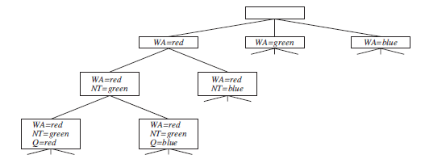
Variable and Value Ordering
var ← SELECT-UNASSIGNED-VARIABLE(csp)
Static Variable Ordering
The simplest strategy for SELECT-UNASSIGNED-VARIABLE is to choose the next unassigned variable in order, {X1,X2, . . .}.
This static variable ordering seldom results in the most efficient search.

Slide 72
Variable and Value Ordering
var ← SELECT-UNASSIGNED-VARIABLE(csp)
Minimum-Remaining-Values (MRV)
After the assignments for WA=red and NT =green, there is only one possible value for SA, so it makes sense to assign SA=blue next rather than assigning Q.
This intuitive idea—choosing the variable with the fewest “legal” values—is called the minimum-remaining-values (MRV) heuristic. It also has been called the “most constrained variable” or “fail-first” heuristic, the latter because it picks a variable that is most likely to cause a failure soon, thereby pruning the search tree.
If some variable X has no legal values left, the MRV heuristic will select X and failure will be detected immediately—avoiding worthless searches through other variables.
The MRV heuristic usually performs better than a random or static ordering, sometimes by a factor of 1,000 or more, although the results vary widely depending on the problem.

Slide 73
Variable and Value Ordering
var ← SELECT-UNASSIGNED-VARIABLE(csp)
Degree Heuristic
The MRV heuristic doesn’t help at all in choosing the first region to color in Australia, because initially every region has three legal colors.
In this case, the degree heuristic comes in handy. It attempts to reduce the branching factor on future choices by selecting the variable that is involved in the largest number of constraints on other unassigned variables.
In map coloring problem, SA is the variable with highest degree, 5; the other variables have degree 2 or 3, except for T, which has degree 0.
In fact, once SA is chosen, applying the degree heuristic solves the problem without any false steps—you can choose any consistent color at each choice point and still arrive at a solution with no backtracking.

Slide 74
Variable and Value Ordering
var ← SELECT-UNASSIGNED-VARIABLE(csp)
Least-Constraining-Value (LCV)
Once a variable has been selected, the algorithm must decide on the order in which to examine its values.
For this, the least-constraining-value heuristic can be effective in some cases.
It prefers the value that rules out the fewest choices for the neighboring variables in the constraint graph.
For example, suppose that in map coloring problem, we have generated the partial assignment with WA=red and NT =green and that our next choice is for Q. Blue would be a bad choice because it eliminates the last legal value left for Q’s neighbor, SA. The least-constraining-value heuristic therefore prefers red to blue.

Slide 75
Interleaving Search and Inference
So far we have seen how AC-3 and other algorithms can infer reductions in the domain of variables before we begin the search.
But inference can be even more powerful in the course of a search: every time we make a choice of a value for a variable, we have a brand-new opportunity to infer new domain reductions on the neighboring variables.
One of the simplest forms of inference is called forward checking.

Slide 76
Forward Checking
Whenever a variable X is assigned, the forward-checking process establishes arc consistency for it.
For each unassigned variable Y that is connected to X by a constraint, delete from Y ’s domain any value that is inconsistent with the value chosen for X.
Because forward checking only does arc consistency inferences, there is no reason to do forward checking if we have already done arc consistency as a preprocessing step.

Slide 77
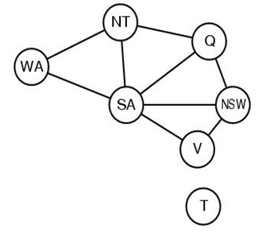
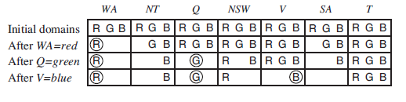
Forward Checking

Slide 78
Forward Checking
There are two important points to notice about this example:
First, notice that after WA=red and Q=green are assigned, the domains of NT and SA are reduced to a single value; we have eliminated branching on these variables altogether by propagating information from WA and Q.
Second, notice that after V =blue, the domain of SA is empty. Hence, forward checking has detected that the partial assignment {WA=red,Q=green, V =blue} is inconsistent with the constraints of the problem, and the algorithm will therefore backtrack immediately.

Slide 79
Forward Checking
For many problems, the search will be more effective if we combine the MRV heuristic with forward checking.
Consider map coloring problem, after assigning {WA=red}. Intuitively, it seems that, that assignment constrains its neighbors, NT and SA, so we should handle those variables next, and then all the other variables will fall into place.
That’s exactly what happens with MRV: NT and SA have two values, so one of them is chosen first, then the other, then Q, NSW, and V in order.
Finally T still has three values, and any one of them works.
We can view forward checking as an efficient way to incrementally compute the information that the MRV heuristic needs to do its job.

Slide 80
Intelligent backtracking
The simple backtracking algorithm is called ‘chronological backtracking’. We revise the most recent assignment.
Want to assign Q, NSW, V , T, SA, WA, NT
Suppose we have generated the partial assignment {Q=red, NSW =green, V =blue, T =red}.
Now try SA (will fail).
Backtrack to ?
Does backtracking T solve the problem?

Slide 82
A more intelligent approach to backtracking is to backtrack to a variable that might fix the problem—a variable that was responsible for making one of the possible values of SA impossible.
Keep track of a set of assignments that are in conflict with some value for SA. The set (in this case {Q=red ,NSW =green, V =blue, }), is called the conflict set for SA.
The backjumping method backtracks to the most recent assignment in the conflict set.
Whenever forward checking based on an assignment X =x deletes a value from Y ’s domain, it should add X =x to Y ’s conflict set. If the last value is deleted from Y ’s domain, then the assignments in the conflict set of Y are added to the conflict set of X.

Slide 83
Conflict-directed backjumping
Suppose our assignment is WA=red ,NSW =red, T =red, and then assign NT, Q, V , SA.
No assignment can work for these last four variables, so eventually we run out of values to try at NT.
Assume Backjumping cannot work, because NT does have values consistent with the preceding assigned variable.
We know, however, that the four variables NT, Q, V , and SA, taken together, failed because of a set of preceding variables, which must be those variables that directly conflict with the four.

Slide 84
conf (Xi) ← conf (Xi) ∪ conf (Xj) −{Xi} .
Suppose {WA=red ,NSW =red T =red} and then assign NT, Q, V , SA.
SA fails, and its conflict set is (say) {WA,NT,Q}.
We backjump to Q, Q's conflict set is {NT,NSW}
Q absorbs the conflict set from SA (minus Q itself) -> the new conflict set is {WA,NT,NSW}.
We backtrack to NT, the most recent of these.
NT's conflict set is {WA}, so {WA,NT,NSW} − {NT} = {WA,NSW}.
Now the algorithm backjumps to NSW

Slide 85
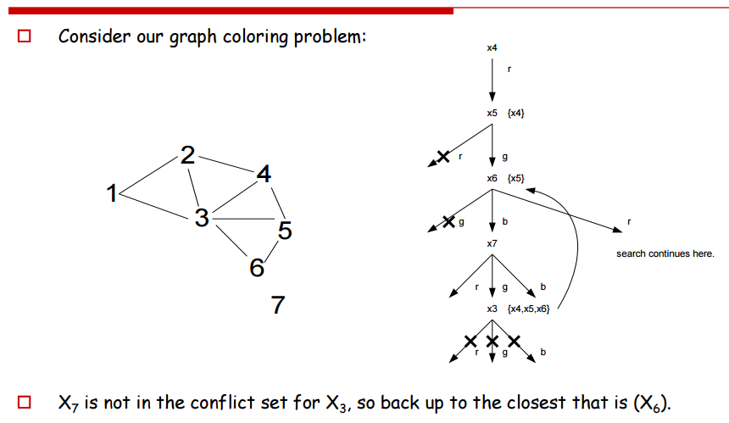

Slide 86
Local search for CSP
Local search algorithms turn out to be effective in solving many CSPs.
Use a complete-state formulation: the initial state assigns a value to every variable, and the search changes the value of one variable at a time.
Local search can easily be extended to constraint optimization problems (COPs). In that case, all the techniques for hill climbing and simulated annealing can be applied to optimize the objective function.
The initial guess violates several constraints. The point of local search is to eliminate the violated constraints.

Slide 87
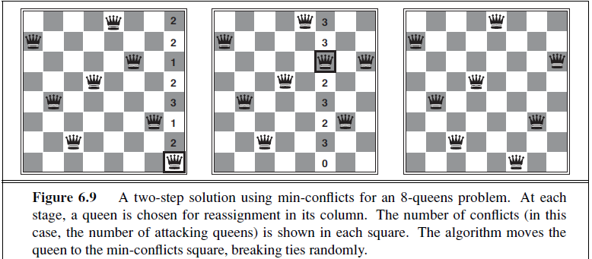

Slide 88
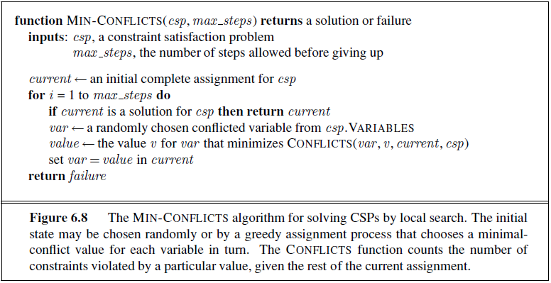
Local search for CSP

Slide 89
For example, it has been used to schedule observations for the Hubble Space Telescope, reducing the time taken to schedule a week of observations from three weeks (!) to around 10 minutes.

Slide 90
Constraint Weighting
Help concentrate the search on the important constraints.
Each constraint is given a numeric weight, Wi, initially all 1.
At each step of the search, the algorithm chooses a variable/value pair to change that will result in the lowest total weight of all violated constraints.
The weights are then adjusted by incrementing the weight of each constraint that is violated by the current assignment.

Slide 91
Structure of Problems
We examine ways in which the structure of the problem, as represented by the constraint graph, can be used to find solutions quickly

Slide 92
Structure of Problems
Try to divide problem into subproblems.
If assignment Si is a solution of CSPi, then I Si is a solution of Ui CSPi.
Suppose each CSPi has c variables from the total of n variables, where c is a constant. Then there are n/c subproblems, each of which takes at most d^{c} work to solve.
total work is O(d^{c}n/c), which is linear in n;
without the decomposition, the total work is O(d^{n}),
A constraint graph is a tree when any two variables are connected by only one path.
The key is a new notion of consistency, called directed arc consistency or DAC. A CSP is defined to be directed arc-consistent under an ordering of variables X1,X2, . . . ,Xn if and only if every Xi is arc-consistent with each Xj for j > i.

Slide 93
There are two primary ways to do this, one based on removing nodes and one based on collapsing nodes together.

Slide 94
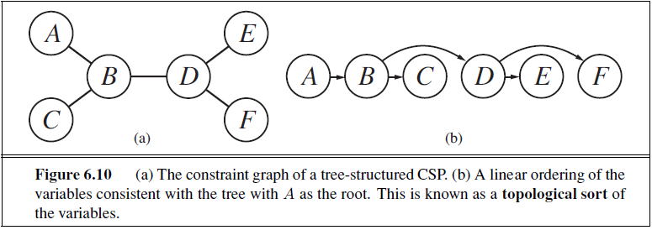

Slide 95
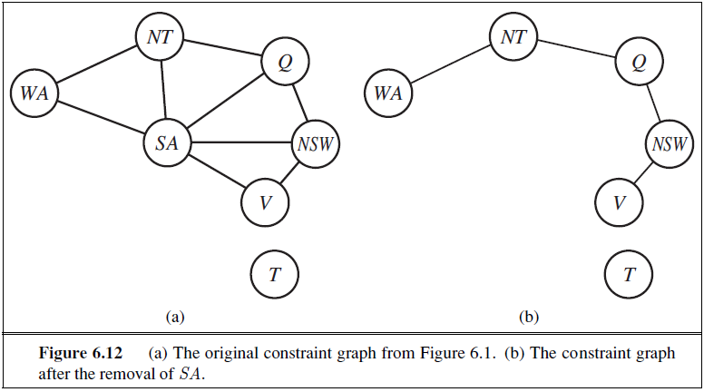

Slide 96
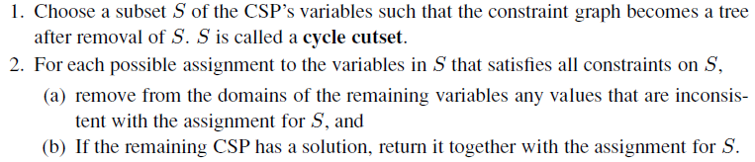
If the cycle cutset has size c, then the total run time is O(d^{c} ・ (n − c)d²): we have to try each of the d^{c} combinations of values for the variables in S, and for each combination we must solve a tree problem of size n − c.

Slide 97
Tree decomposition approach
A tree decomposition must satisfy the following three requirements:
Every variable in the original problem appears in at least one of the subproblems.
If two variables are connected by a constraint in the original problem, they must appear together (along with the constraint) in at least one of the subproblems.
If a variable appears in two subproblems in the tree, it must appear in every subproblem along the path connecting those subproblems.

Slide 98
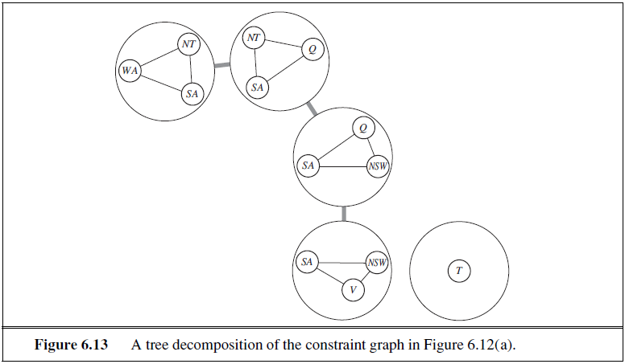

Slide 99
Problem
There are five MWF graduate CS classes and three instructors who will be teaching these classes.
An instructor can only teach one class at a time.
The classes are:
Class 1 - Algorithms: meets from 8:00-9:00am
Class 2 - Intro to AI: meets from 8:30-9:30am
Class 3 - Databases: meets from 9:00-10:00am
Class 4 - Operating Systems: meets from 9:00-10:00am
Class 5 - Machine Learning: meets from 9:30-10:30am
and the instructors are:
Professor A, who is available to teach Classes 3 and 4.
Professor B, who is available to teach Classes 2, 3, 4, and 5.
Professor C, who is available to teach Classes 1, 2, 3, 4, 5.

Slide 100
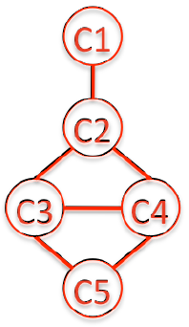
Solution
Formulate this as a CSP problem in which there is one variable per class. State the variables and their domains, and the constraints. Constraints should be unary or binary and specified formally and precisely, but may be implicit rather than explicit.
C1: {C}, C2: {B,C}, C3: {A,B,C}, C4: {A,B,C}, C5: {B,C}
C1 ≠ C2, C2 ≠ C3, C3 ≠ C4, C4 ≠ C5, C2 ≠ C4, C3 ≠ C5
Draw the constraint graph associated with your CSP.

Slide 101
Applications of CSP
CSP techniques are widely used
Applications include:
Crew assignments to flights
Management of transportation fleet
Flight/rail schedules
Job shop scheduling
Task scheduling in port operations
Design, including spatial layout design
Radiosurgical procedures

Slide 102
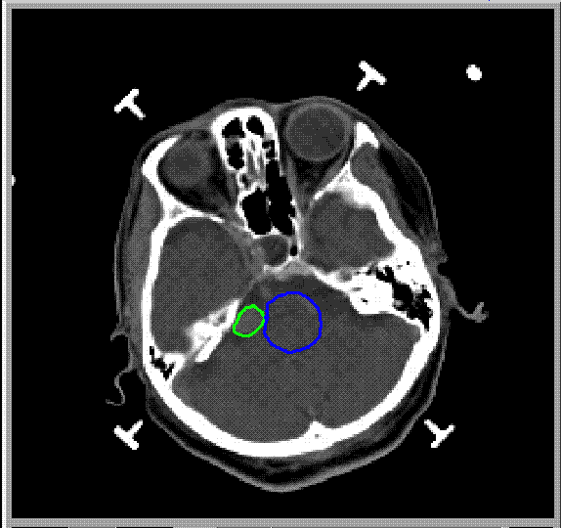
Radiosurgery
Minimally invasive procedure that uses a beam of radiation as an ablative surgical instrument to destroy tumors
Tumor = bad
Critical structures
= good and sensitive
Brain = good

Slide 103


Problem
Burn tumor without damaging healthy tissue

Slide 104

The CyberKnife
linear accelerator
robot arm
X-Ray
cameras

Slide 105
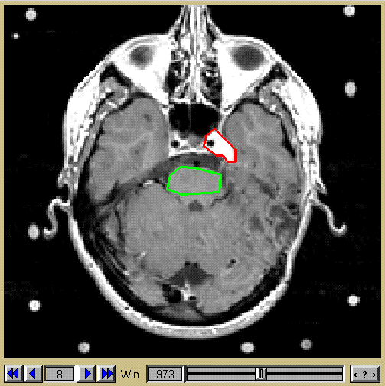

Inputs
1) Regions of interest
Notes:
I changed title

Slide 106
Inputs
2) Dose constraints
Dose to tumor
Tumor
Falloff of dose around tumor
Dose to critical
structure
Critical
Falloff of dose in critical structure

Slide 107
Beam Sampling

Slide 108
Constraints
2000 ≤ Tumor ≤ 2200
2000 ≤ B2 + B4 ≤ 2200
2000 ≤ B4 ≤ 2200
2000 ≤ B3 + B4 ≤ 2200
2000 ≤ B3 ≤ 2200
2000 ≤ B1 + B3 + B4 ≤ 2200
2000 ≤ B1 + B4 ≤ 2200
2000 ≤ B1 + B2 + B4 ≤ 2200
2000 ≤ B1 ≤ 2200
2000 ≤ B1 + B2 ≤ 2200
T
B1
T
B2
C
B4
0 ≤ Critical ≤ 500
0 ≤ B2 ≤ 500
B3
2000 < Tumor < 2200
2000 < B2 + B4 < 2200
2000 < B4 < 2200
2000 < B3 + B4 < 2200
2000 < B3 < 2200
2000 < B1 + B3 + B4 < 2200
2000 < B1 + B4 < 2200
2000 < B1 + B2 + B4 < 2200
2000 < B1 < 2200
2000 < B1 + B2 < 2200
2000 < Tumor < 2200
2000 < B4
2000 < B3
B1 + B3 + B4 < 2200
B1 + B2 + B4 < 2200
2000 < B1

Slide 109
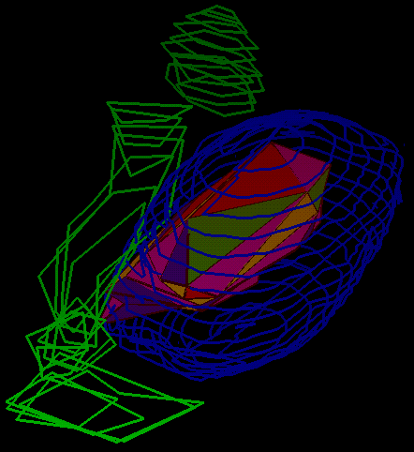
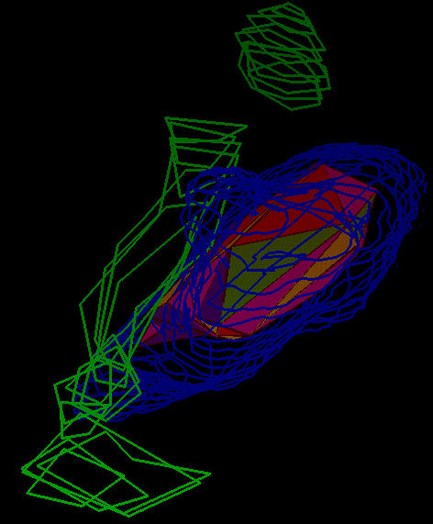
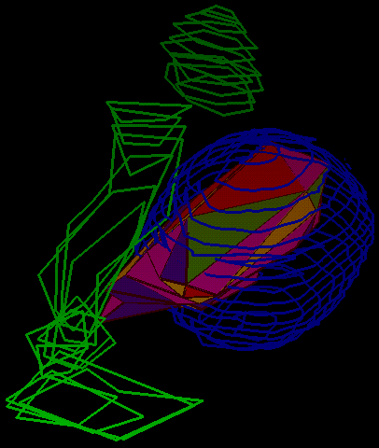
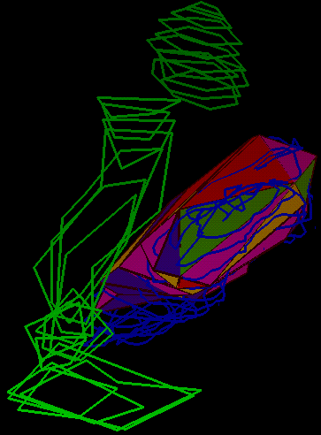
Case Results
50% Isodose Surface
80% Isodose
Surface
LINAC system
Cyberknife

Slide 110


