Slide 1
Probability and Uncertainty
This lecture: Chapter 13

Slide 2
Outline
Representing uncertainty is useful in knowledge bases.
Probability provides a framework for managing uncertainty
Review of basic concepts in probability.
Emphasis on conditional probability and conditional independence
Using a full joint distribution and probability rules, we can derive any probability relationship in a probability space.
Number of required probabilities can be reduced through independence and conditional independence relationships
Probabilities allow us to make better decisions.
Decision theory and expected utility.
Rational agents cannot violate probability theory.

Slide 3
You will be expected to know
Basic probability notation/definitions:
Probability model, unconditional/prior and conditional/posterior probabilities, factored representation (= variable/value pairs), random variable, (joint) probability distribution, probability density function (pdf), marginal probability, (conditional) independence, normalization, etc.
Basic probability formulae:
Probability axioms, product rule, Bayes’ rule.
How to use Bayes’ rule:
Naïve Bayes model (naïve Bayes classifier)

Slide 4
The Problem: Uncertainty
We cannot always know everything relevant to the problem before we select an action:
Environments that are non-deterministic, partially observable
Noisy sensors
Some features may be too complex to model
For Example: Trying to decide when to leave for the airport to make a flight
Will I get me there on time?
Uncertainties:
Car failures (flat tire, engine failure) (non-deterministic)
Road state, accidents, natural disasters (partially observable)
Unreliable weather reports, traffic updates (noisy sensors)
Predicting traffic along route (complex modeling)
A purely logical agent does not allow for strong decision making in the face of such uncertainty.
Purely logical agents are based on binary True/False statements, no maybe
Forces us to make assumptions to find a solution --> weak solutions

Slide 5
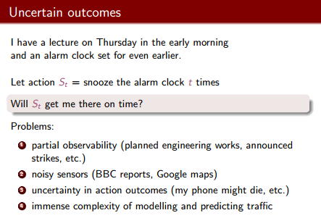

Slide 6
Leave home 90 minutes (Plan A90) before the flight departs and driving at a reasonable speed. Even though the airport is only about 5 miles.
But, logical taxi agent will not be able to conclude with certainty that “Plan A90 will get us to the airport in time.” Instead, it reaches the weaker conclusion “Plan A90 will get us to the airport in time, as long as the car doesn’t break down or run out of gas, and I don’t get into an accident, and there are no accidents on the bridge, and the plane doesn’t leave early, and no meteorite hits the car, and . . . .”
(A1440 might reasonably be said to get me there on time but I’d have to stay overnight in the airport . . .)

Slide 7
The primary difference is that the decision-theoretic agent’s belief state represents not just the possibilities for world states but also their probabilities.

Slide 8
Handling Uncertainty
• Default or non-monotonic logic:
Based on assuming things are a certain way, unless evidence to the contrary.
Assume my car does not have a flat tire
Assume road ahead is clear, no accidents
Issues: What assumptions are reasonable?
How to retract inferences when assumptions found false?
• Rules with fudge factors:
Based on guesses or rules of thumb for relationships between events.
A25 => 0.3 get there on time
Rain => 0.99 grass wet
Issues: No theoretical framework for combination
• Probability:
Based on degrees of belief, given the available evidence
Solidly rooted in statistics

Slide 9
Toothache ⇒ Cavity
This rule is wrong. Not all patients with toothaches have cavities.
Toothache ⇒ Cavity ∨ GumProblem ∨ Abscess . .
An almost unlimited list of possible problems.
The only way to fix the rule is to make it logically exhaustive: to augment the left-hand side with all the qualifications required for a cavity to cause a toothache.

Slide 10
Trying to use logic to cope with a domain like medical diagnosis thus fails for three main reasons:
Laziness: It is too much work to list the complete set of antecedents or consequents needed to ensure an exceptionless rule and too hard to use such rules.
THEORETICAL • Theoretical ignorance: Medical science has no complete theory for the domain.
PRACTICAL • Practical ignorance: Even if we know all the rules, we might be uncertain about a particular patient because not all the necessary tests have been or can be run.

Slide 11
Propositional Logic and Probability
Their ontological commitments are the same
The world is a set of facts that do or do not hold
Their *epistemological commitments differ
Logic agent believes true, false, or no opinion
Probabilistic agent has a numerical degree of belief between 0 (false) and 1 (true)
*relating to the theory of knowledge, especially with regard to its methods, validity, and scope, and the distinction between justified belief and opinion.

Slide 12
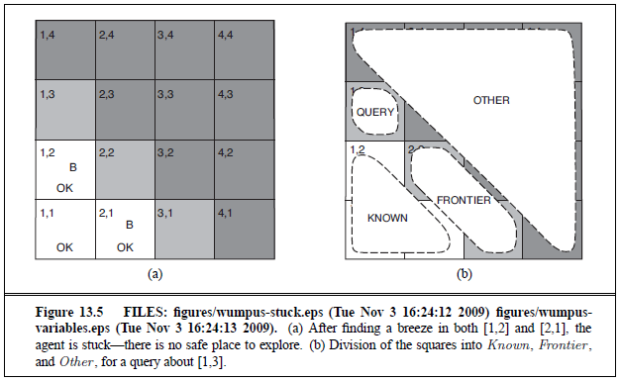
Probabilistic Agents May Make Better Decisions
The Logic Agent has no basis for choosing among [1,3], [2,2], & [3,1].
The Probabilistic Agent can calculate P(P_1,3) = P(P_3,1) ≈ 0.31,
while P(P_2,2) ≈ 0.86 ─ so it will avoid [2,2] and prefer [1,3] or [3,1].
(R&N, section 13.6)

Slide 13
We use utility theory to represent and reason with preferences.
A utility function can account for any set of preferences—quirky or typical, noble or perverse. Note that utilities can account for altruism, simply by including the welfare of others as one of the factors.
Preferences, as expressed by utilities, are combined with probabilities in the general theory of rational decisions called decision theory:
Decision theory = probability theory + utility theory

Slide 14
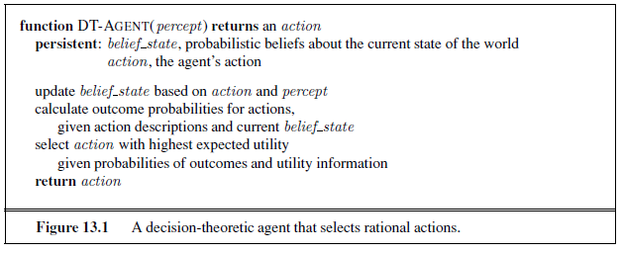
The fundamental idea of decision theory is that an agent is rational if and only if it chooses the action that yields the highest expected utility, averaged over all the possible outcomes of the action. This is called the principle of maximum expected utility (MEU).

Slide 15
In probability theory, the set of all possible worlds is called the sample space. The possible worlds are mutually exclusive and exhaustive—two possible worlds cannot both be the case, and one possible world must be the case.

Slide 16
Probability
P(a) is the probability of proposition “a”
e.g., P(it will rain in London tomorrow)
The proposition a is actually true or false in the real-world
Any agent that holds degrees of beliefs that contradict these axioms will act irrationally in some cases
Rational agents cannot violate probability theory.
Acting otherwise results in irrational behavior.

Slide 17

The Greek letter Ω (uppercase omega) is used to refer to the sample space, and ω (lowercase omega) refers to elements of the space, that is, particular possible worlds.

Slide 18

The probability associated with a proposition is defined to be the sum of the probabilities of the worlds in which it holds:

Slide 19
When rolling fair dice, we have P(Total =11) = P((5, 6)) + P((6, 5)) = 1/36 + 1/36 = 1/18.
P(Total =11) are called unconditional or prior probabilities (and sometimes just “priors” for short); they refer to degrees of belief in propositions in the absence of any other information.
Most of the time, however, we have some information, usually called evidence, that has already been revealed. It is called Conditional or posterior probability (or just “posterior” for short).
E.g. first die already showing a 5

Slide 20
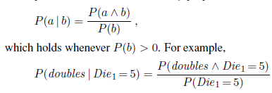
Conditional probabilities are defined in terms of unconditional probabilities as follows:

Slide 21
Product rule
Can rewrite eq on previous slide as
P(a ∧ b) = P(a | b)P(b)
Called Product rule.

Slide 22
Probability
Probabilities can be subjective:
Agents develop probabilities based on their experiences:
Two agents may have different internal probabilities of the same event occurring.
Probabilities of propositions change with new evidence:
P(party tonight) = 0.15
P(party tonight | Friday) = 0.60

Slide 23

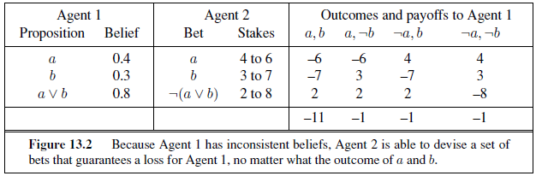

Slide 24
Random Variables
Variables in probability theory are called random variables
Random Variable:
Basic element of probability assertions
Similar to CSP variable, but values reflect probabilities not constraints.
Variable: A
Domain: {a₁, a₂, a₃} <-- events / outcomes
Types of Random Variables:
Boolean random variables = { true, false }
e.g., Cavity (= do I have a cavity?)
Discrete random variables = One value from a set of values
e.g., Weather is one of <sunny, rainy, cloudy ,snow>
Continuous random variables = A value from within constraints
e.g., Current temperature is bounded by (10°, 200°)
Domain values must be exhaustive and mutually exclusive:
One of the values must always be the case (Exhaustive)
Two of the values cannot both be the case (Mutually Exclusive)

Slide 25
Random Variables
For Example: Flipping a coin
Variable = R, the result of the coin flip
Domain = {heads, tails, edge} <-- must be exhaustive
P(R = heads) = 0.4999 }
P(R = tails) = 0.4999 } -- must be exclusive
P(R = edge) = 0.0002 }
Shorthand is often used for simplicity:
Upper-case letters for variables, lower-case letters for values.
e.g. P(a) ≡ P(A = a)
P(a|b) ≡ P(A = a | B = b)
P(a, b) ≡ P(A = a, B = b)
Two kinds of probability propositions:
Elementary propositions are an assignment of a value to a random variable:
e.g., Weather = sunny; Cavity = false (abbreviated as ¬cavity)
Complex propositions are formed from elementary propositions and standard logical connectives :
e.g., Cavity = false ∨ Weather = sunny
P(cavity | ￢toothache ∧ teen) = 0.1 .

Slide 26
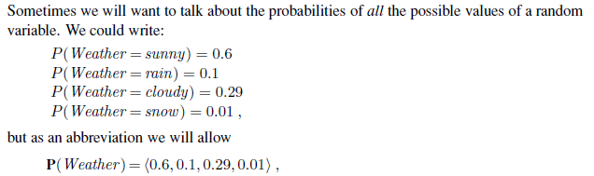
where the bold P indicates that the result is a vector of numbers, and where we assume a predefined ordering sunny, rain, cloudy, snow on the domain of Weather.
We say that the P statement defines a probability distribution for the random variable Weather .

Slide 27
Probability Density Function
For continuous variables, it is not possible to write out the entire distribution as a vector, because there are infinitely many values. Instead, we can define the probability that a random variable takes on some value x as a parameterized function of x. For example, the sentence.
P(NoonTemp =x) = Uniform_{[18C,26C]}(x)
expresses the belief that the temperature at noon is distributed uniformly between 18 and 26 degrees Celsius. We call this a probability density function.

Slide 28

Saying that the probability density is uniform from 18C to 26C means that there is a 100% chance that the temperature will fall somewhere in that 8C-wide region and a 50% chance that it will fall in any 4C-wide region, and so on.

Slide 29
Distributions on multiple variables
P(Weather , Cavity) denotes the probabilities of all combinations of the values of Weather and Cavity.
This is a 4×2 table of probabilities called the joint probability distribution of Weather and Cavity.
We can also mix variables with and without values; P(sunny, Cavity) would be a two-element vector giving the probabilities of a sunny day with a cavity and a sunny day with no cavity

Slide 30
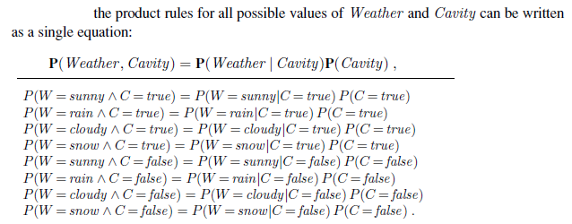

Slide 31
A possible world is defined to be an assignment of values to all of the random variables under consideration.
For example, if the random variables are Cavity, Toothache, and Weather , then there are 2×2×4=16 possible worlds.

Slide 32
Concepts of Probability
Unconditional Probability (AKA marginal or prior probability):
P(a), the probability of “a” being true
Does not depend on anything else to be true (unconditional)
Represents the probability prior to further information that may adjust it (prior)
Conditional Probability (AKA posterior probability):
P(a|b), the probability of “a” being true, given that “b” is true
Relies on “b” = true (conditional)
Represents the prior probability adjusted based upon new information “b” (posterior)
Can be generalized to more than 2 random variables:
e.g. P(a|b, c, d)
Joint Probability :
P(a, b) = P(a ˄ b), the probability of “a” and “b” both being true
Can be generalized to more than 2 random variables:
e.g. P(a, b, c, d)

Slide 33
Full joint probability distribution
If the variables are Cavity, Toothache, and Weather , then the full joint distribution is given by P(Cavity, Toothache, Weather ).
This joint distribution can be represented as a 2×2×4 table with 16 entries.

Slide 34
Probability axioms
0 ≤ P(a) ≤ 1
P(NOT(a)) = 1 – P(a) => Σ_{A} P(A) = 1
P(A OR B) = P(A) + P(B) – P(A AND B)
Inclusion-Exclusion principle

Slide 35
Inference using Full Joint Distribution
Probabilistic inference—that is, the computation of posterior probabilities for query propositions given observed evidence.
We use the full joint distribution as the “knowledge base” from which answers to all questions may be derived.

Slide 36
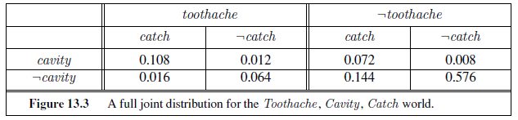
cavity ∨ toothache hold in six possible worlds.
P(cavity ∨ toothache) = 0.108 + 0.012 + 0.072 + 0.008 + 0.016 + 0.064 = 0.28

Slide 37
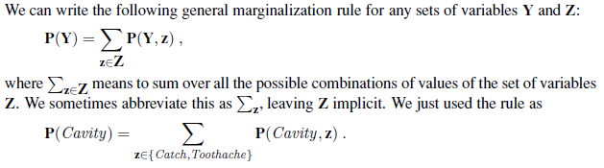
Marginalization, or Summing out
Extract the distribution over some subset of variables or a single variable.
For example, adding the entries in the first row gives the unconditional or marginal probability of cavity.
P(cavity) = 0.108 + 0.012 + 0.072 + 0.008 = 0.2 .

Slide 38

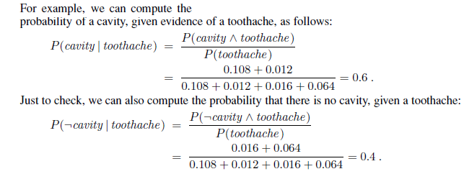
Conditioning
In most cases, we are interested in computing conditional probabilities of some variables, given evidence about others. A variant of marginalization rule involves conditional probabilities instead of joint probabilities, using Product Rule:

Slide 39

Normalization
1/P(toothache) can be viewed as a normalization constant for the distribution P(Cavity | toothache), ensuring that it adds up to 1. We can also use the notation:
We can calculate P(Cavity | toothache) even if we don’t know the value of P(toothache).
Makes the computation easier and to allow us to proceed when some probability assessment (such as P(toothache)) is not available.

Slide 40

In general, we can say:
Let E be the list of evidence variables (just Toothache in the example), let e be the list of observed values for them, and let Y be the remaining unobserved variables (just Catch in the example). The query is P(X | e) and can be evaluated as:
where the summation is over all possible ys (i.e., all possible combinations of values of the unobserved variables Y).
Together the variables X, E, and Y constitute the complete set of variables for the domain.

Slide 41
For a domain described by n Boolean variables, Full joint distribution requires an input table of size O(2^{n}) and takes O(2^{n}) time to process the table.
In a realistic problem we could easily have n > 100, making O(2^{n}) impractical

Slide 42
Independence
Formal Definition:
2 random variables A and B are independent iff:
P(a, b) = P(a) P(b), for all values a, b
Informal Definition:
2 random variables A and B are independent iff:
P(a | b) = P(a) OR P(b | a) = P(b) OR P(a ∧ b)=P(a)P(b), for all values a, b
P(a | b) = P(a) tells us that knowing b provides no change in our probability for a, and thus b contains no information about a.
Also known as marginal independence, as all other variables have been marginalized out.
In practice true independence is very rare:
“butterfly in China” effect
Conditional independence is much more common and useful

Slide 43
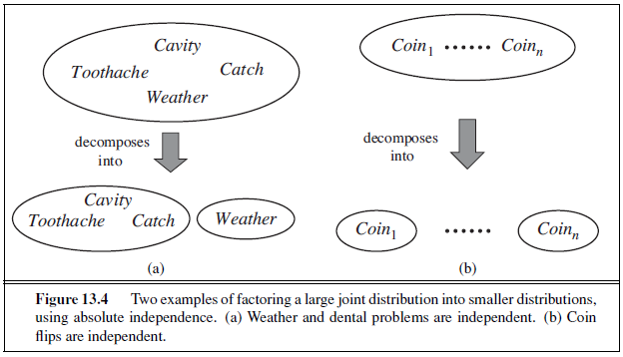
Independence assertions are usually based on knowledge of the domain and they can dramatically reduce the amount of information necessary to specify the full joint distribution
For example, the full joint distribution on the outcome of n
independent coin flips, P(C1, . . . ,Cn), has 2n entries, but it can be represented as the product of n single-variable distributions P(Ci).

Slide 44
Conditional Independence
Formal Definition:
2 random variables A and B are conditionally independent given C iff:
P(a, b|c) = P(a|c) P(b|c), for all values a, b, c
Informal Definition:
2 random variables A and B are conditionally independent given C iff:
P(a|b, c) = P(a|c) OR P(b|a, c) = P(b|c), for all values a, b, c
P(a|b, c) = P(a|c) tells us that learning about b, given that we already know c, provides no change in our probability for a, and thus b contains no information about a beyond what c provides.

Slide 45
Using the Product Rule
Applies to any number of variables:
P(a, b, c) = P(a, b|c) P(c) = P(a|b, c) P(b, c)
Factoring: (AKA Chain Rule for probabilities)
By the product rule, we can always write:
P(a, b, c, … z) = P(a | b, c, …. z) P(b, c, … z)
Repeatedly applying this idea, we can write:
P(a, b, c, … z) = P(a | b, c, …. z) P(b | c,.. z) P(c| .. z)..P(z)
This holds for any ordering of the variables (next slide)

Slide 46
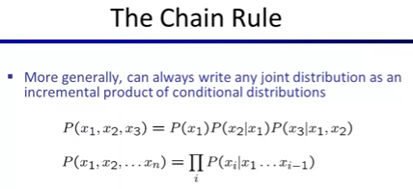

Slide 47
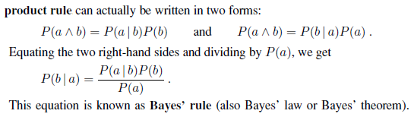
Bayes’ Rule
With normalization:
P(Y |X) = α P(X | Y )P(Y )

Slide 48
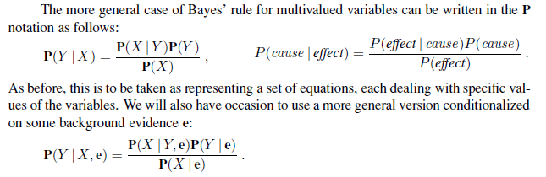
The conditional probability P(effect | cause) quantifies the relationship in the causal direction, whereas P(cause | effect) describes the diagnostic direction.

Slide 49
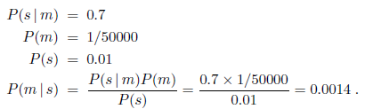
For example, a doctor knows that the disease meningitis causes the patient to have a stiff neck, say, 70% of the time. The doctor also knows some unconditional facts: the prior probability that a patient has meningitis is 1/50,000, and the prior probability that any patient has a stiff neck is 1%.
So,
Thus, to use this approach we need to estimate P(s | ￢m) instead of P(s). There is no free lunch—sometimes this is easier, sometimes it is harder.

Slide 50
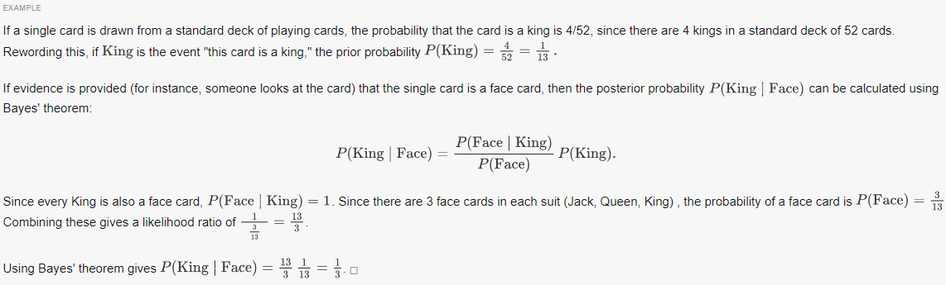

Slide 51
Using Bayes’ Rule
For Example: Determine probability of Meningitis given a Stiff_Neck
Given:
P(Stiff_Neck | Meningitis) = 0.5 }
P(Meningitis) = 1/50,000 } -- From medical databases
P(Stiff_Neck) = 1/20 }
Need to find P(meningitis | stiff neck):
P(M|S) = P(S|M) P(M) / P(S) [Bayes’ Rule]
= [ 0.5 * 1/50,000 ] / [1/20] = 1/5,000
10 times more likely to have meningitis given a stiff neck
Applies to any number of variables:
Any probability P(X|Y) can be rewritten as P(Y|X) P(X) / P(Y), even if X and Y are lists of variables.
P(a | b, c) = P(b, c | a) P(a) / P(b, c)
P(a, b | c, d) = P(c, d | a, b) P(a, b) / P(c, d)

Slide 52
Combining Evidence
What happens when we have two or more pieces of evidence?
We can use full joint distribution table
Or, reformulate using Bayes’ rule:
P(Cavity | toothache ∧ catch)
= α P(toothache ∧ catch | Cavity) P(Cavity) .
We need to know the conditional probabilities of the conjunction (toothache∧catch) for each value of Cavity. Solution does not scale up.
If there are n possible evidence variables (X rays, diet, oral hygiene, etc.), then there are 2^{n} (cavity, not cavity) possible combinations of observed values for which we would need to know conditional probabilities.

Slide 53
We use conditional independence if possible
-> P(a, b|c) = P(a|c) P(b|c),
P(toothache ∧ catch | Cavity) = P(toothache | Cavity)P(catch | Cavity)
If steel probe catches, it is likely due to cavity, which causes toothache.
So toothache and catch are independent, given the presence or the absence of a cavity. Each is directly caused by the cavity, but neither has a direct effect on the other.

Slide 54
Original query was:
P(Cavity | toothache ∧ catch)
= α P(toothache ∧ catch | Cavity) P(Cavity) .
So plug in the values for P(toothache ∧ catch | Cavity):
P(Cavity | toothache ∧ catch)
= α P(toothache | Cavity) P(catch | Cavity) P(Cavity) .

Slide 55
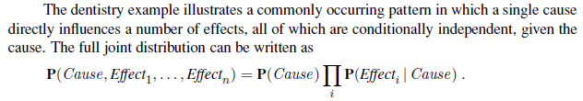

Slide 56
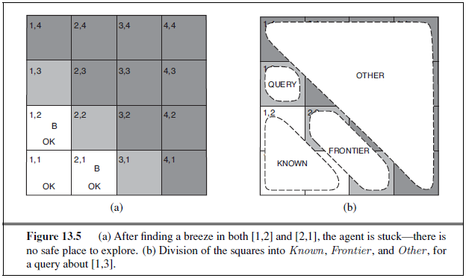
The Wumpus world revisited
(1) a pit causes breezes in all neighboring squares, and
(2) each square other than [1,1] contains a pit with probability 0.2.

Slide 57
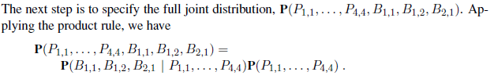
The first term is the conditional probability distribution of a breeze configuration, given a pit configuration; its values are 1 if the breezes are adjacent to the pits and 0 otherwise.
The second term is the prior probability of a pit configuration.

Slide 58

Each square contains a pit with probability 0.2, independently of the other squares; hence,

Slide 59
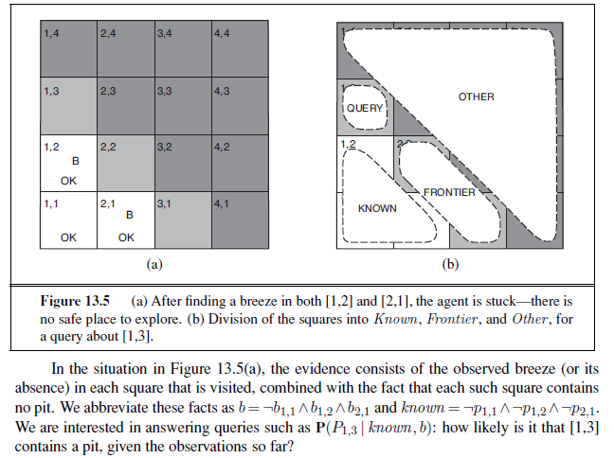

Slide 60
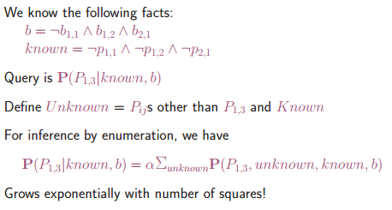
If we use full joint distribution, there are 12 unknown squares; hence the summation contains 2¹² =4096 terms.

Slide 61
Aren’t some squares irrelevant? How could [4,4] affect whether [1,3] has a pit? So lets divide the unknown squares into frontier and others.
Let Frontier be the pit variables (other than the query variable) that are adjacent to visited squares. In this case just [2,2] and [3,1].
Other be the pit variables for the other unknown squares; in this case, there are 10 other squares.

Slide 62

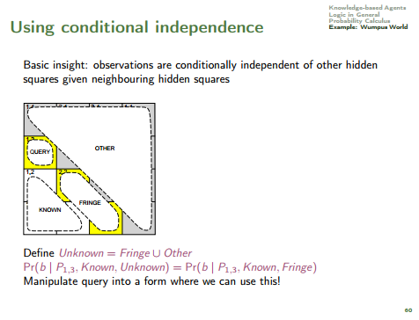
The key insight is that the observed breezes are conditionally independent of the other variables, given the known, frontier, and query variables.
To use the insight, we manipulate the query formula into a form in which the breezes are conditioned on all the other variables, and then we apply conditional independence.
We had eq:
Where y were variables not in evidence.

Slide 63
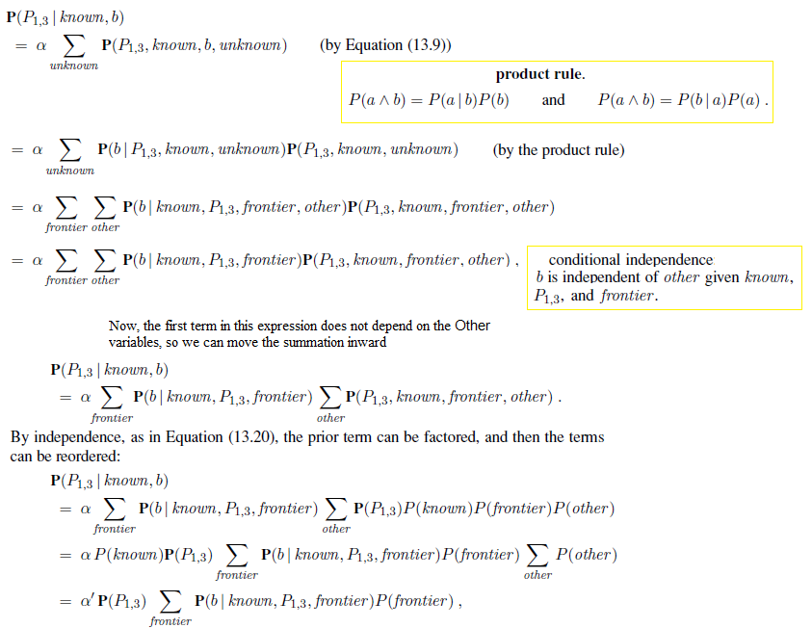



Slide 64
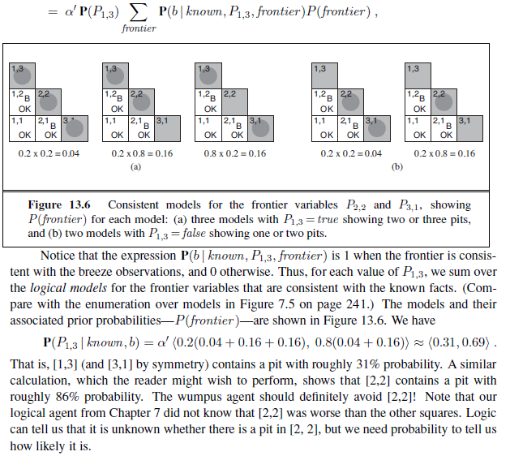
fron

Slide 65
Summary of Probability Rules
Product Rule:
P(a, b) = P(a|b) P(b) = P(b|a) P(a)
Probability of “a” and “b” occurring is the same as probability of “a” occurring given “b” is true, times the probability of “b” occurring.
e.g., P( rain, cloudy ) = P(rain | cloudy) * P(cloudy)
Sum Rule: (AKA Law of Total Probability)
P(a) = Σ_{b} P(a, b) = Σ_{b} P(a|b) P(b), where B is any random variable
Probability of “a” occurring is the same as the sum of all joint probabilities including the event, provided the joint probabilities represent all possible events.
Can be used to “marginalize” out other variables from probabilities, resulting in prior probabilities also being called marginal probabilities.
e.g., P(rain) = Σ_{Windspeed} P(rain, Windspeed)
where Windspeed = {0-10mph, 10-20mph, 20-30mph, etc.}
Bayes’ Rule:
P(b|a) = P(a|b) P(b) / P(a)
Acquired from rearranging the product rule.
Allows conversion between conditionals, from P(a|b) to P(b|a).
e.g., b = disease, a = symptoms
More natural to encode knowledge as P(a|b) than as P(b|a).

Slide 66
Decision Theory: Why Probabilities are Useful
We can use probabilities to make better decisions!
For Example: Deciding whether to operate on a patient
Given:
Operate = {true, false}
Cancer = {true, false}
A set of evidence e
So far, agent’s degree of belief is p(Cancer = true | e).
Which action to choose?
Depends on the agent’s preferences:
How willing is the agent to operate if there is no cancer?
How willing is the agent to not operate when there is cancer?
Preferences can be quantified by a Utility Function, or a Cost Function.

Slide 67
Utility Function / Cost Function
Utility Function:
Quantifies an agent’s utility from (happiness with) a given outcome.
Rational agents act to maximize expected utility.
Expected Utility of action A = a, resulting in outcomes B = b:
Expected Utility = ∑_{b} P(b|a) * Utility(b)
Cost Function:
Quantifies an agent’s cost from (unhappiness with) a given outcome.
Rational agents act to minimize expected cost.
Expected Cost of action a, resulting in outcomes o:
Expected Cost = ∑_{b} P(b|a) * Cost(b)

Slide 68
Decision Theory: Why Probabilities are Useful
Utility associated with various outcomes:
Operate = true, Cancer = true: utility = 30
Operate = true, Cancer = false: utility = -50
Operate = false, Cancer = true: utility = -100
Operate = false, Cancer = false: utility = 0
Expected utility of actions:
P(c) = P(Cancer = true) <-- for simplicity
E[utility(Operate = true)] = 30 P(c) – 50 [1-P(c)]
E[utility(Operate = false)] = -100 P(c)
Break even point?
30 P(c) – 50 + 50 P(c) = -100 P(c)
P(c) = 50/180 ≈ 0.28
If P(c) > 0.28, the optimal decision (highest expected utility) is to operate!

Slide 69
Putting It All Together
Full joint distributions can be difficult to obtain:
Vast quantities of data required, even with relatively few variables
Data for some combinations of probabilities may be sparse
Determining independence and conditional independence allows us to decompose our full joint distribution into much smaller pieces:
e.g., P(Toothache, Catch, Cavity)
= P(Toothache, Catch|Cavity) P(Cavity)
= P(Toothache|Cavity) P(Catch|Cavity) P(Cavity)
All three variables are Boolean.
Before conditional independence, requires 2³ probabilities for full specification:
--> Space Complexity: O(2^{n})
After conditional independence, requires 3 probabilities for full specification:
--> Space Complexity: O(n)

Slide 70
Conclusions…
Representing uncertainty is useful in knowledge bases.
Probability provides a framework for managing uncertainty.
Using a full joint distribution and probability rules, we can derive any probability relationship in a probability space.
Number of required probabilities can be reduced through independence and conditional independence relationships
Probabilities allow us to make better decisions by using decision theory and expected utilities.
Rational agents cannot violate probability theory.

