Slide 1
Some ML Algorithms

Slide 2
Linear Regression
Most commonly used to express linear relationship between two variables
Outcome variable (response variable, dependent variable, label)
Predictor (Independent variable, explanatory variable, feature)
Can also be used when there is a linear relationship between one variable and several other variables

Slide 3
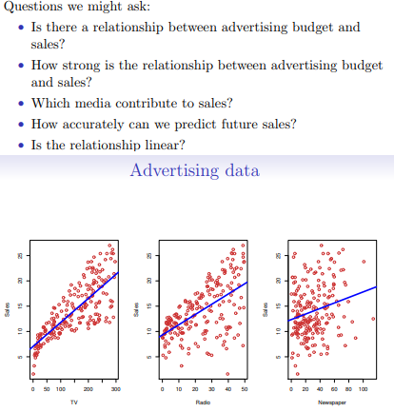
Good starting point for many problems (first assumption)

Slide 4
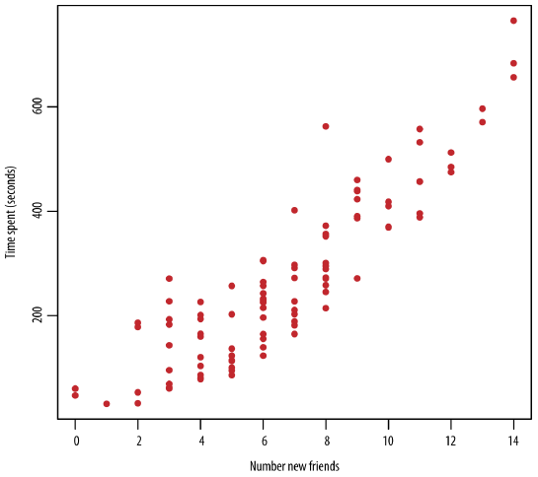
Writing Model
There is no deterministic relation here BUT It is obvious there is some association between the two variables.
There are two important things we want to capture in a model:
TREND and VARIATION

Slide 5
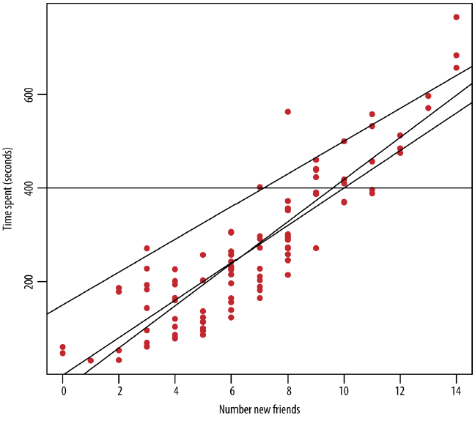
Writing Model
Which line is the BEST fit?
y = β₀ +β₁x
Now your job is to find best values of β₀ and β₁ -> MODEL FITTING

Slide 6
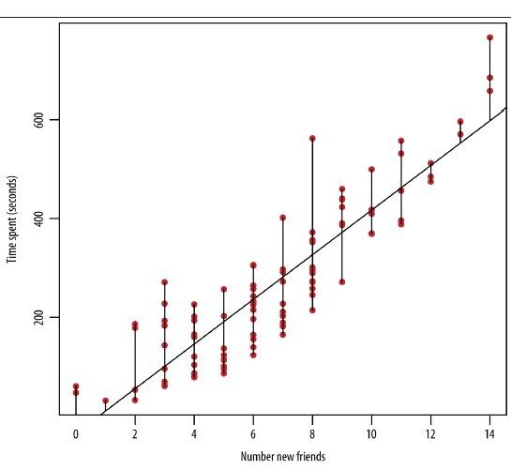
Fitting the Model
You have to find the optimal line.
But what is the meaning of optimal?
LEAST SQUARE ESTIMATION:
Minimizes the sum of squares of differences between approximated y’ and actual y

Slide 7
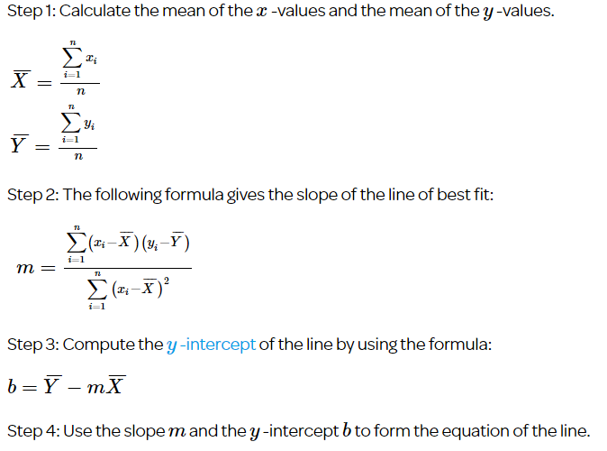

Slide 8
Last year, five randomly selected students took a math aptitude test before they began their statistics course. The Statistics Department has three questions.
What linear regression equation best predicts statistics performance, based on math aptitude scores?
If a student made an 80 on the aptitude test, what grade would we expect her to make in statistics?
How well does the regression equation fit the data?

Slide 9
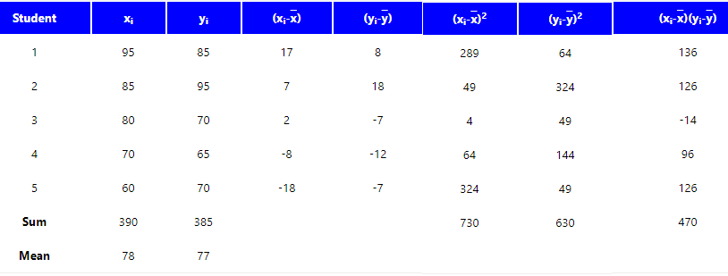

Slide 10
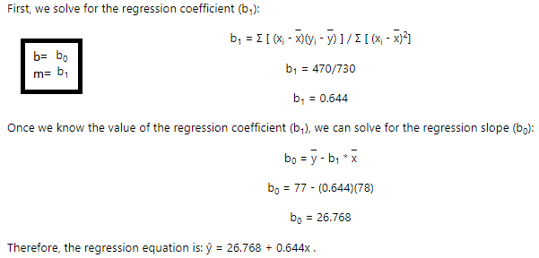

Slide 11
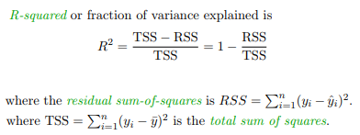
R² (Coefficient of Determination)
It is interpreted as the proportion of the variance in the dependent variable that is predictable from the independent variable.
A coefficient of determination equal to 0.48 indicates that about 48% of the variation in statistics grades (the dependent variable) can be explained by the relationship to math aptitude scores (the independent variable). This would be considered a good fit to the data, in the sense that it would substantially improve an educator's ability to predict student performance in statistics class.

Slide 12
from sklearn.metrics import r2_score
y_true = [1, 2, 3, 4]
y_pred = [5, 6, 7.2, 8.3]
print(r2_score(y_true, y_pred))

Slide 13
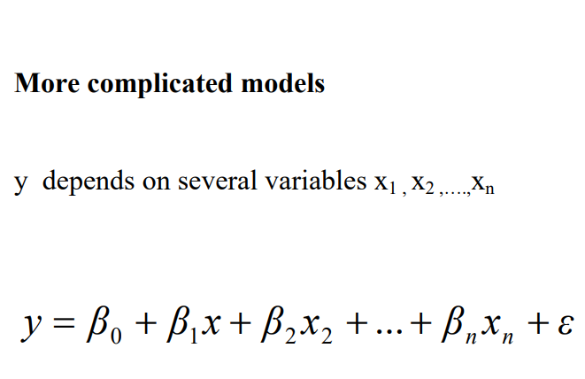

Slide 14
K-Means
Unsupervised learning → where we dont provide the algorithm WHAT is the RIGHT answer?
The goal is to segment or categorize data automatically
K-means make K groups of data points in d-dimensions
Where d is the number of parameters

Slide 15
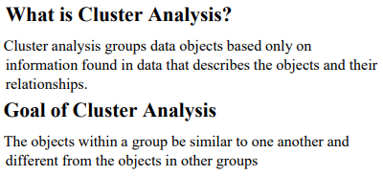

Slide 16
K-Means Algorithm
We may need to try different values for k before we arrive at a natural grouping
1. Initially, randomly pick k centroids (or points that will be the center of your clusters). Try to make them near the data but different from one another.
2. Then assign each data point to the closest centroid. (‘Closeness’ is measured by Euclidean distance, cosine similarity, correlation, etc.)
3. Move the centroids to the average location of the data points assigned to it.
4. Repeat the preceding two steps until the assignments don’t change, or change very little.

Slide 17
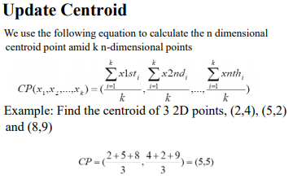

Slide 18
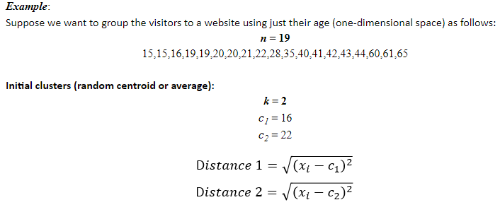

Slide 19
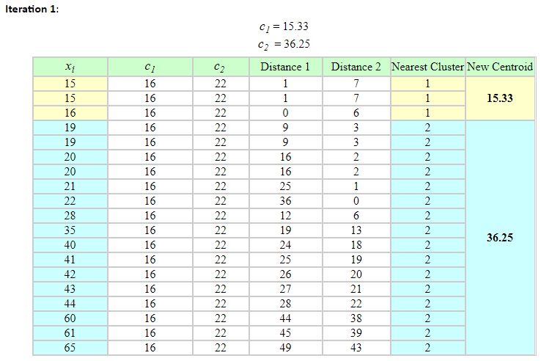

Slide 20
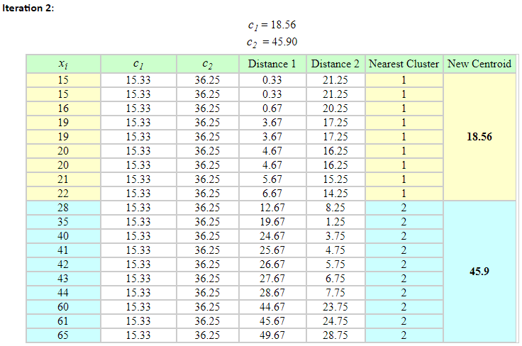

Slide 21
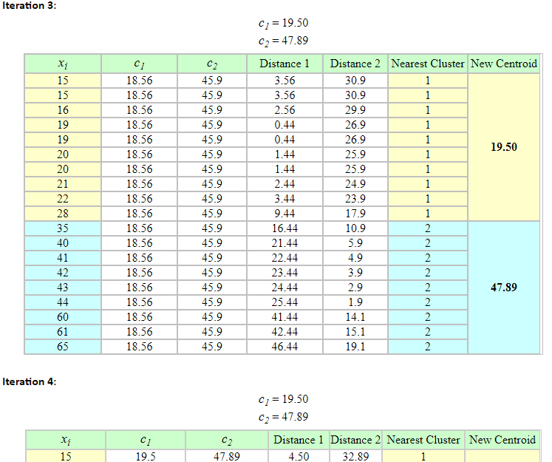

Slide 22
Issues with K-Means
Choosing k is more an art than a science
A single unique solution can fail to exist
Sometimes the clustering makes no sense (This is the BIGGEST problem)

Slide 23
