Slide 1
Entity Types, Entity Sets, Attributes,and Keys
Entity Types, Entity Sets, Keys, and Value Sets
Entity Types and Entity Sets
Entity: each record is a real world object having real world existence
Entity type:
collection of entities having common attributes.
Each entity type in the database is described by its name and attributes.
Entity set:
collection of one or more entities
Entity type is the super set of all possible entity sets
Attributes : properties that describes an entity
Domain: set of permissive value for an attribute
Entity type (describes schema or intension)
Employee table
ID | NAME | Email
1 | Mohammad | m@gmail.com
2 | Ahmed | a@gmail.com
3 | Khan | k@gmail.com
Entity

Slide 2
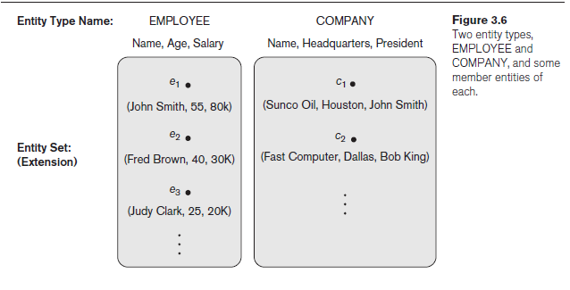
Entity Types, Entity Sets, Attributes, and Keys
Entity Types, Entity Sets, Keys, and Value Sets
Entity Types and Entity Sets

Slide 3
Entity Types, Entity Sets, Attributes, and Keys
Entity Types, Entity Sets, Keys, and Value Sets
Representation in ER:
An entity type in rectangular box enclosing the entity type name.
Attribute names in ovals and are attached to their entity type by straight lines.
Composite attributes are attached to their component attributes by straight lines.
Multivalued attributes in double ovals.

Slide 4
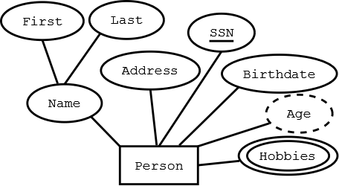

Entity Types, Entity Sets, Attributes, and Keys
Key attribute
Entity Types, Entity Sets, Keys, and Value Sets
Key Attributes of an Entity Type
key or uniqueness constraint on attributes:
applied on the entities of an entity type
that uniquely identifies an entity
it is a constraint that prohibits any two entities from having the same value for the key attribute at the same time.
Such an attribute is called a key attribute, and its values can be used to identify each entity uniquely.
For example:
the Name attribute is a key of the COMPANY entity type as no two companies are allowed to have the same name.
The SSN (Social Security number) is a key attribute for PERSON entity type
In ER diagrammatic notation, each key attribute has its name underlined inside the oval.

Slide 5
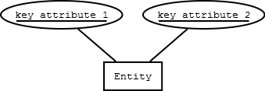
Entity Types, Entity Sets, Attributes, and Keys
Entity Types, Entity Sets, Keys, and Value Sets
Key Attributes of an Entity Type
Sometimes several attributes together form a key, meaning that the combination of the attribute values must be distinct for each entity.
If a set of attributes possesses this property, the proper way to represent this in the ER model that we describe here is to define a composite attribute and designate it as a key attribute of the entity type.

Slide 6
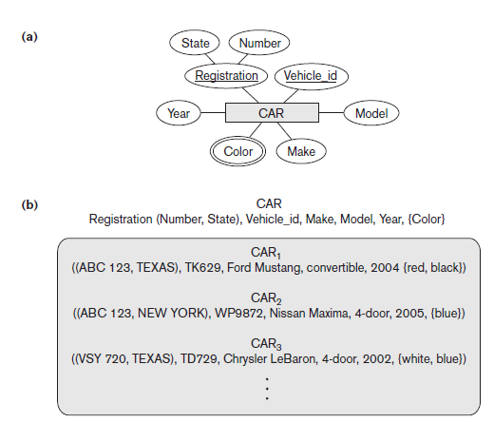
Entity Types, Entity Sets, Attributes, and Keys
Entity Types, Entity Sets, Keys, and Value Sets
Key Attributes of an Entity Type
Some entity types have more than one key attribute.
For example,
each of the Vehicle_id and Registration attributes of the entity type CAR (Figure 3.7) is a key in its own right.
The Registration attribute is an example of a composite key formed from two simple component attributes, State and Number, neither of which is a key on its own.
An entity type may also have no key, in which case it is called a weak entity type
In our diagrammatic notation, if two attributes are underlined separately, then each is a key on its own.

Slide 7
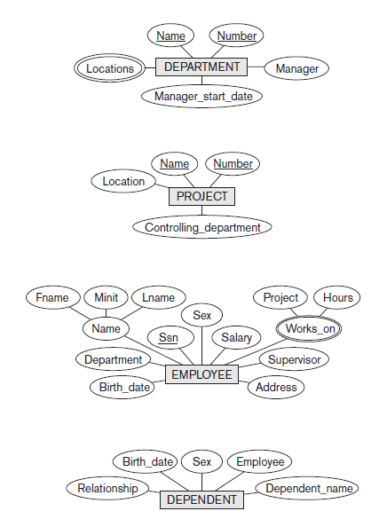
Entity Types, Entity Sets, Attributes, and Keys
Initial Conceptual Design of the COMPANY Database
We can now define the entity types for the COMPANY database, based on the requirements.
1. An entity type DEPARTMENT with attributes:
Name ->KEY ATTRIBUTE
Number -> KEY ATTRIBUTE
Locations, -> MULTI VALUED ATTRIBUTE
Manager,
Manager_start_date.

Slide 8
Entity Types, Entity Sets, Attributes, and Keys
Initial Conceptual Design of the COMPANY Database
We can now define the entity types for the COMPANY database, based on the requirements.
2. An entity type PROJECT with attributes:
Name -> KEY ATTRIBUTE
Number -> KEY ATTRIBUTE
Location
Controlling_department.

Slide 9
Entity Types, Entity Sets, Attributes, and Keys
Initial Conceptual Design of the COMPANY Database
We can now define the entity types for the COMPANY database, based on the requirements.
3. An entity type EMPLOYEE with attributes:
Name ->composite attribute
Ssn -> KEY ATTRIBUTE
gender,
Address,
Salary,
Birth_date,
Department,
Supervisor.
Works_on ->multivalued attribute

Slide 10
Entity Types, Entity Sets, Attributes, and Keys
Initial Conceptual Design of the COMPANY Database
Another requirement is that: an employee can work on several projects, and the database has to store the number of hours per week an employee works on each project.
It can be represented by a multivalued composite attribute of EMPLOYEE called Works_on with the simple components (Project, Hours).
Alternatively, it can be represented as a multivalued composite attribute of PROJECT called Workers with the simple components (Employee, Hours).

Slide 11
Entity Types, Entity Sets, Attributes, and Keys
Initial Conceptual Design of the COMPANY Database
We can now define the entity types for the COMPANY database, based on the requirements.
4. An entity type DEPENDENT with attributes
EmployeeNo,
Dependent_name,
Gender,
Birth_date,
Relationship (to the employee).

Slide 12
Entity Types, Entity Sets, Attributes, and Keys
Initial Conceptual Design of the COMPANY Database

Slide 13
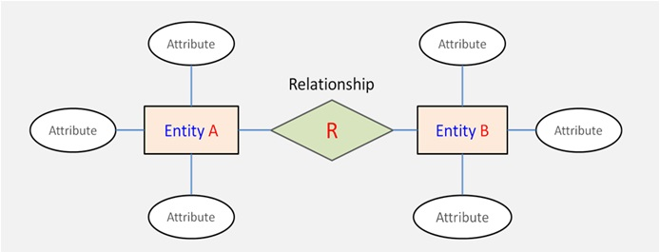
Relationship Types, Relationship Sets, Roles, and Structural Constraints
Relationship Types, Sets, and Instances
A relationship type R among n entity types E1, E2, . . . , En defines a set of associations among entities from these entity types.
Each of the entity types E1, E2, . . . , En is said to participate in the relationship type R.

Slide 14
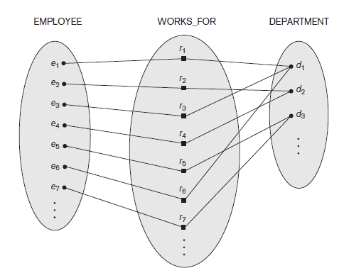
Relationship Types, Relationship Sets, Roles, and Structural Constraints
Relationship Types, Sets, and Instances
For example:
Consider a relationship type WORKS_FOR
between the two entity types EMPLOYEE and DEPARTMENT,
which associates each employee with the department for which the employee works.
Each relationship instance in the relationship set WORKS_FOR associates one EMPLOYEE entity and one DEPARTMENT entity.
In ER diagrams,
Relationship types are displayed as diamond-shaped boxes,
which are connected by straight lines to the rectangular boxes representing the participating entity types.
The relationship name is displayed in the diamond-shaped box.

Slide 15
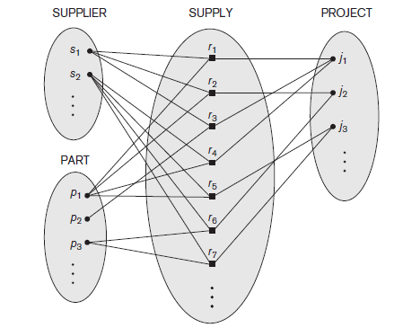
Relationship Types, Relationship Sets, Roles & Structural Constraints
Relationship Degree, Role Names, and Recursive Relationships
Degree of a Relationship Type
degree of a relationship type = No. of participating entities.
Degree of WORKS_FOR relationship = 2.
Binary: A relationship type of degree two
Ternary: A relationship type of degree three
An example of a ternary relationship is SUPPLY, where each relationship instance associates three entities
a supplier s,
a part p,
and a project j
whenever s supplies part p to project j.

Slide 16

Relationship Types, Relationship Sets, Roles, and Structural Constraints
Relationship Degree, Role Names, and Recursive Relationships
Relationships as attributes
It is sometimes easy to think of binary relations as attributes in an entity set
As we have done in the following diagram.

Slide 17
Relationship Types, Relationship Sets, Roles, and Structural Constraints
Relationship Degree, Role Names, and Recursive Relationships
Role Names and Recursive Relationships
Each entity type that participates in a relationship type plays a particular role in the relationship.
role name: mentions the role that a participating entity from the entity type plays in each relationship instance, and it helps to explain what the relationship means.
For example, in the WORKS_FOR relationship type, EMPLOYEE plays the role of employee/ worker and DEPARTMENT plays the role of department/employer.

Slide 18
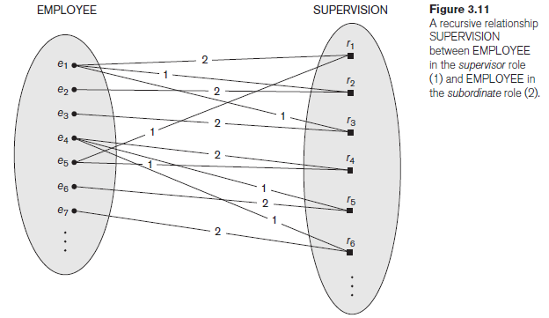
Relationship Types, Relationship Sets, Roles, and Structural Constraints
Relationship Degree, Role Names, and Recursive Relationships
Role Names and Recursive Relationships
In some cases, the same entity type participates more than once in a relationship type in different roles.
In such cases the role name becomes essential for distinguishing the meaning of the role that each participating entity plays.
Such relationship types are called recursive relationships or self-referencing relationships.
The SUPERVISION relationship type relates an employee to a supervisor, where both employee and supervisor entities are members of the same EMPLOYEE entity set. Hence, the EMPLOYEE entity type participates twice in SUPERVISION: once in the role of supervisor (or boss), and once in the role of supervisee (or subordinate).

Slide 19
Relationship Types, Relationship Sets, Roles, and Structural Constraints
Relationship Degree, Role Names, and Recursive Relationships
Role Names and Recursive Relationships
In Figure 3.11
the lines marked ‘1’ represent the supervisor role
The lines marked ‘2’ represent the supervisee role
hence,
e1 supervises e2 and e3, and works under e5
e4 supervises e6 and e7, and works under e5
e5 supervises e1 and e4.
In this example, each relationship instance must be connected with two lines, one marked with ‘1’ (supervisor) and the other with ‘2’ (supervisee).

Slide 20
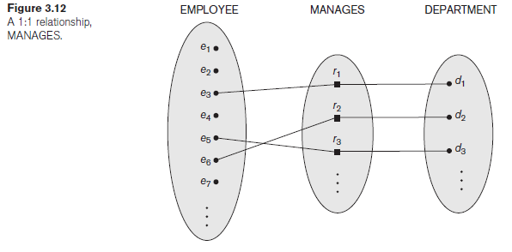
Relationship Types, Relationship Sets, Roles, and Structural Constraints
Binary Relationship constraints
Cardinality Ratios for Binary Relationships
The possible cardinality ratios for binary relationship types are 1:1, 1:N, N:1, and N:N.
Requirement: an employee can manage at most one department and a department can have at most one manager.
An example of a 1:1 binary relationship
MANAGES which relates a department entity to the employee who manages that department.

Slide 21
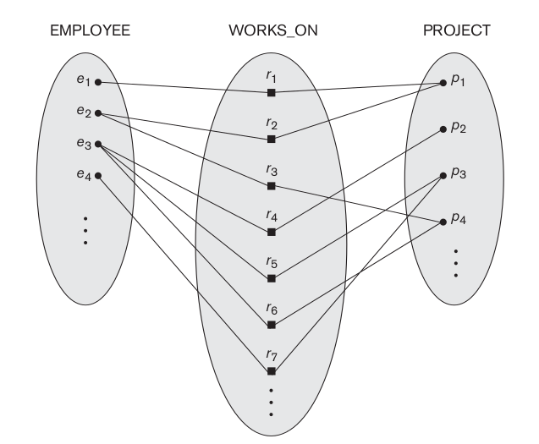
Relationship Types, Relationship Sets, Roles, and Structural Constraints
Binary Relationship constraints
Cardinality Ratios for Binary Relationships
Requirement: an employee can work on several projects and a project can have several employees.
The relationship type WORKS_ON is of cardinality ratio N:N
e2 is working on p1 and p4
p4 has 2 employees e2 and e3

Slide 22
Relationship Types, Relationship Sets, Roles, and Structural Constraints
Binary Relationship constraints
Type 2:Participation Constraints and Existence Dependencies
The participation constraint specifies whether the existence of an entity depends on its being related to another entity via the relationship type.
This constraint specifies the minimum number of relationship instances that each entity can participate in
Sometimes called as the minimum cardinality constraint.
There are two types of participation constraints
Total
Partial.

Slide 23
Relationship Types, Relationship Sets, Roles, and Structural Constraints
Binary Relationship constraints
Participation Constraints and Existence Dependencies
If a company policy states that
Requirement: every employee must work for a department
Then An employee entity can exist only if it participates in at least one WORKS_FOR relationship instance.
Thus, the participation of EMPLOYEE in WORKS_FOR is called total participation, meaning that every entity in the total set of employee entities must be related to a department entity via WORKS_FOR.

Slide 24
Relationship Types, Relationship Sets, Roles, and Structural Constraints
Binary Relationship constraints
Participation Constraints and Existence Dependencies
Total participation is also called existence dependency.
Requirement: It is not expected that every employee manages a department,
so the participation of EMPLOYEE in the MANAGES relationship type is partial,
meaning that some or part of the set of employee entities are related to some department entity via MANAGES, but not necessarily all.
structural constraints of a relationship type = cardinality ratio + participation constraints,
In ER diagrams, total participation (or existence dependency) is displayed as a double line connecting the participating entity type to the relationship, whereas partial participation is represented by a single line.

