Slide 2
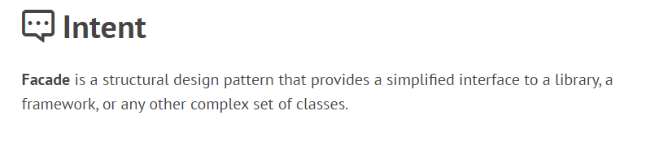
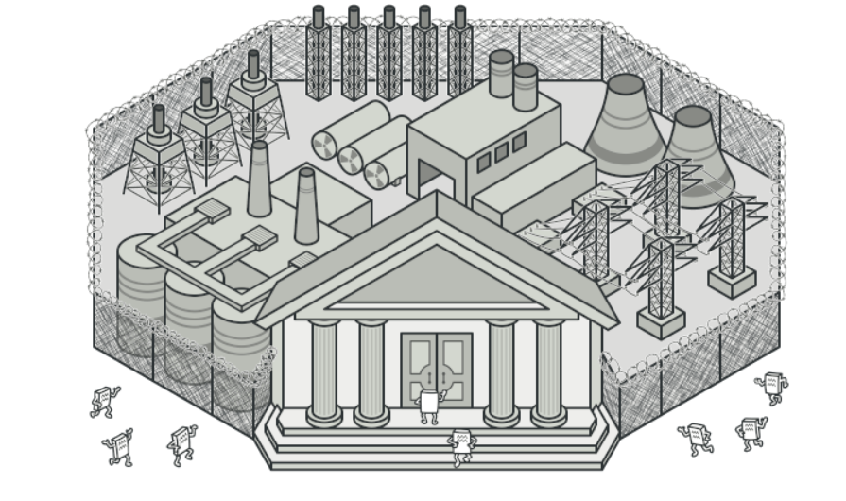

Slide 3
The Facade pattern basically says that you should simplify your methods so that much of what is done is in the background.
In technical terms you should decouple the client from the sub components needed to perform an operation.

Slide 4




Façade Design Pattern
Facade pattern hides the complexities of the system and provides an interface to the client using which the client can access the system.
This type of design pattern comes under structural pattern as this pattern adds an interface to existing system to hide its complexities.
This pattern involves a single class which provides simplified methods required by client and delegates calls to methods of existing system classes.

Slide 5
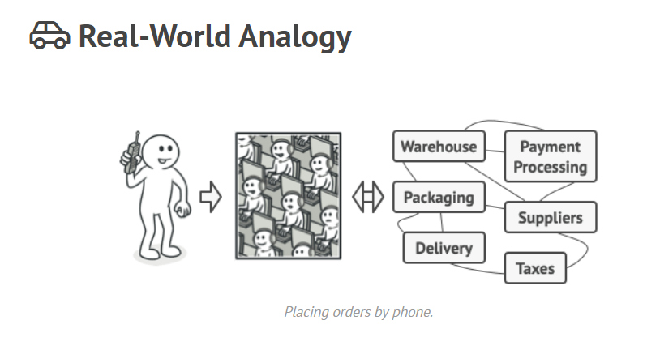

Slide 6
Consider an order fulfillment process of an e-commerce store. When a user places an order for a product, the following services complete the process:
Inventory service: Checks the warehouse database running on Oracle for the availability of the product.
Payment service: Connects with a payment gateway to process the order payment.
Shipping service: Connects with an external logistic web service to ship the product from the warehouse to the user’s address.

Slide 7
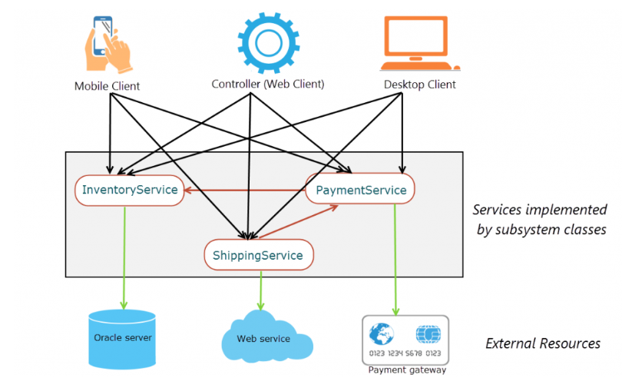

Slide 8
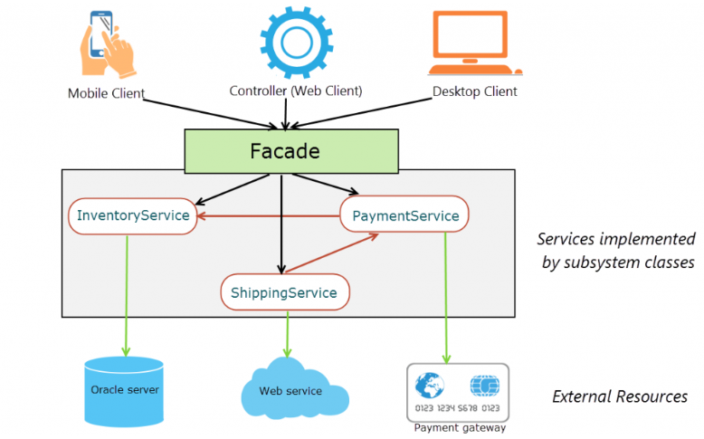
With a facade, this is how different clients interact with the order fulfillment process.

Slide 9
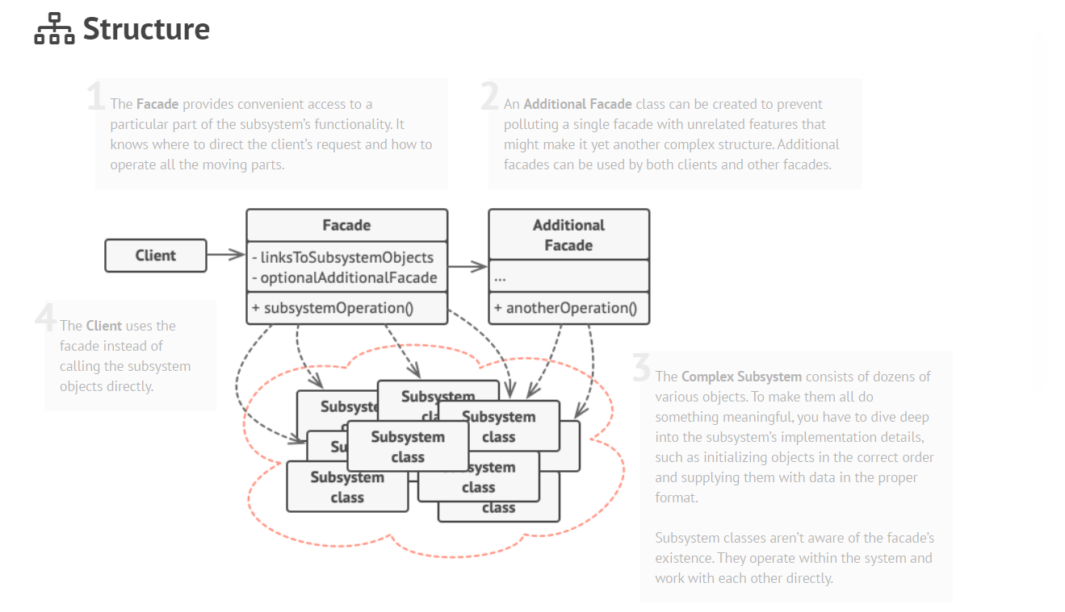

Slide 10

Use the Facade pattern when you need to have a limited but straightforward interface to a complex subsystem.
Use the Facade when you want to structure a subsystem into layers.

Slide 11

Check whether it’s possible to provide a simpler interface than what an existing subsystem already provides. You’re on the right track if this interface makes the client code independent from many of the subsystem’s classes.
Declare and implement this interface in a new facade class. The facade should redirect the calls from the client code to appropriate objects of the subsystem. The facade should be responsible for initializing the subsystem and managing its further life cycle unless the client code already does this.
To get the full benefit from the pattern, make all the client code communicate with the subsystem only via the facade. Now the client code is protected from any changes in the subsystem code. For example, when a subsystem gets upgraded to a new version, you will only need to modify the code in the facade.
If the facade becomes too big, consider extracting part of its behavior to a new, refined facade class.

Slide 12


You can isolate your code from the complexity of a subsystem.
A facade can become a god object coupled to all classes of an app.

Slide 13

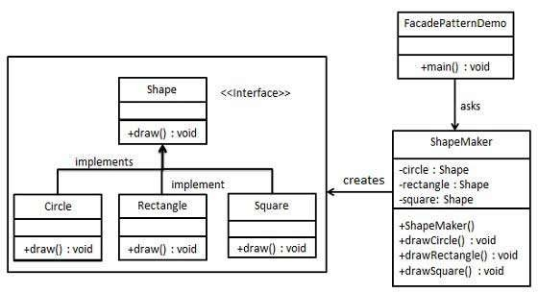
Implementation
We are going to create a Shape interface and concrete classes implementing the Shape interface. A facade class ShapeMaker is defined as a next step.
ShapeMaker class uses the concrete classes to delegate user calls to these classes. FacadePatternDemo, our demo class, will use ShapeMaker class to show the results.

Slide 14

Step 1
Create an interface.
Shape.java
public interface Shape { void draw();
}

Slide 15

Step 2
 Create concrete classes implementing same interface.
public class Rectangle implements Shape { @Override
public void draw() {
System.out.println("Rectangle::draw()"); }
}
public class Square implements Shape {
@Override
public void draw() { System.out.println(“Square ::draw()"); }
}
public class Circle implements Shape { @Override
public void draw() { System.out.println(“Circle::draw()"); }
}
Rectangle.java
Square.java
Circle.java

Slide 16
Step 3
public class ShapeMaker { private Shape circle; private Shape rectangle; private Shape square;
Create a facade class.
ShapeMaker.java
public ShapeMaker() {
circle = new Circle(); rectangle = new Rectangle(); square = new Square();
}
public void drawCircle(){ circle.draw();
}
public void drawRectangle(){ rectangle.draw();
}
public void drawSquare(){ square.draw();
}
}

Slide 17

Step 4
Use the facade to draw various types of shapes.
FacadePatternDemo.java
public class FacadePatternDemo { public static void main(String[] args) {
ShapeMaker shapeMaker = new ShapeMaker();
shapeMaker.drawCircle(); shapeMaker.drawRectangle(); shapeMaker.drawSquare();
}
}

Slide 18

Step 5
 Verify the output.
Circle::draw() Rectangle::draw() Square::draw()

