Slide 1
Software Analysis and Design (CS:3004)
Entity Control and Boundary Classes

Slide 2
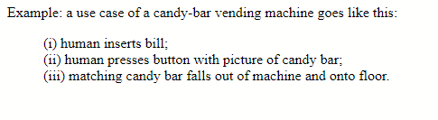
Use cases
When someone wants a machine built, they tell us how they want the machine to behave when they use it. They give us examples, and we develop the machine's structure and control from the examples.
An example behavior is called a use case.

Slide 3
A use case describes behavior from the user's perspective. But there is also behavior that occurs from the
machine's perspective. When we include the latter into the use case, we have a use-case realization that gives
us big clues how to build the machine that has the desired behavior.
For the candy machine, the use-case realization might go like this:
human inserts bill
The machine's bill slot rolls the bill under a scanner that checks the authenticity and the value of the bill.
The value is transmitted to the machine's money controller which enables the appropriate buttons for the candy bars.
The bill drops in the money box.
human presses button with picture of candy next to it
The button-press event notifies the button's controller for the selected candy bar.
The button's controller tells the data base to subtract the price of the bar from the amount deposited,
and it also tells the candy-bar bin to release one bar (which it does --- we hope!)
A signal is sent to the change-box controller to issue coins for change (which it does --- we hope!)
Signals are sent to all button controllers to tell them to disable the buttons next to the pictures of the candy bars.
matching candy bar falls out of machine and onto floor
The realization talks about entity objects, both hard(ware) and soft(ware); multiple controllers for money and buttons and
change; and buttons and pictures of the view (boundary entities).
With enough use cases documented and realized, we can design a machine that does the behaviors.
When this technique is applied to a software system, it helps us design the class diagram that lets us build the system.

Slide 4
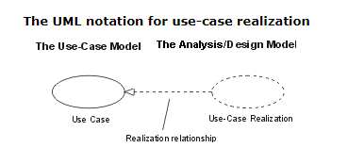
Use Case Realization
A use-case realization represents how a use case will be implemented in terms of collaborating objects. The realizations reside within the design
The reason for separating the use-case realization from its use case is that doing so allows the requirements, in the form of use cases, to be managed separately from the design, in the form of realizations.

Slide 5
According to RUP the Use Case Realization task creates the Analysis Model consisting of Boundary classes, Control classes and Entity classes diagrammed in Class Diagrams, and in interaction diagrams (Sequence and communication Diagrams).
These Models are LOGICAL models describing white box inner workings of the system (as opposed to the use cases that treat the system as a Black box.
The Design Model - that is often created by adding details and modifying the Analysis Model - represents the PHYSICAL description of the system to be done.

Slide 6
One major difference between the Analysis Model and the Design Model, is that the Design Model contain implementation language specific information, whereas the Analysis Model does not.
Use Cases are the WHAT, the functional requirements. Use Case Realizations are the HOW, the solution (at the logical level)
Each use case realization will define the physical design in terms of classes and collaborating objects which support the use case. Therefore, each use case realization typically is made up of a class diagram and a number of interaction diagrams, most commonly sequence diagrams, showing the collaboration or interaction between physical objects.

Slide 7
ECB(Robustness Analysis):
The Robustness Analysis is a practice that originated with Ivar Jacobson’s Objectory Method. (also called Jacobson’s diagram)
This involves analyzing the narrative text of use cases, identifying the first-guess set of objects that will participate in those use cases, and classifying these objects based on the roles they play.
Robustness analysis helps you to bridge the gap from Use Cases and Domain Classes.

Slide 8
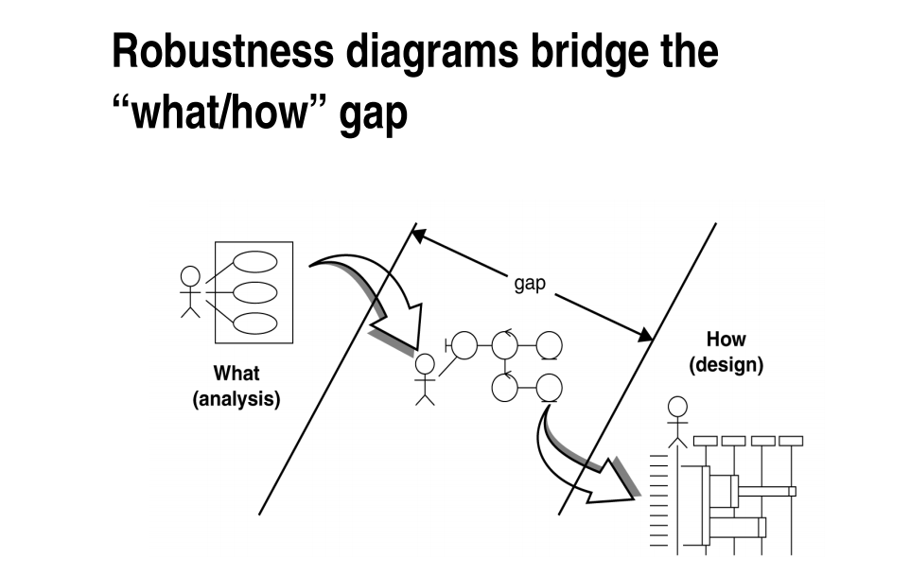

Slide 9
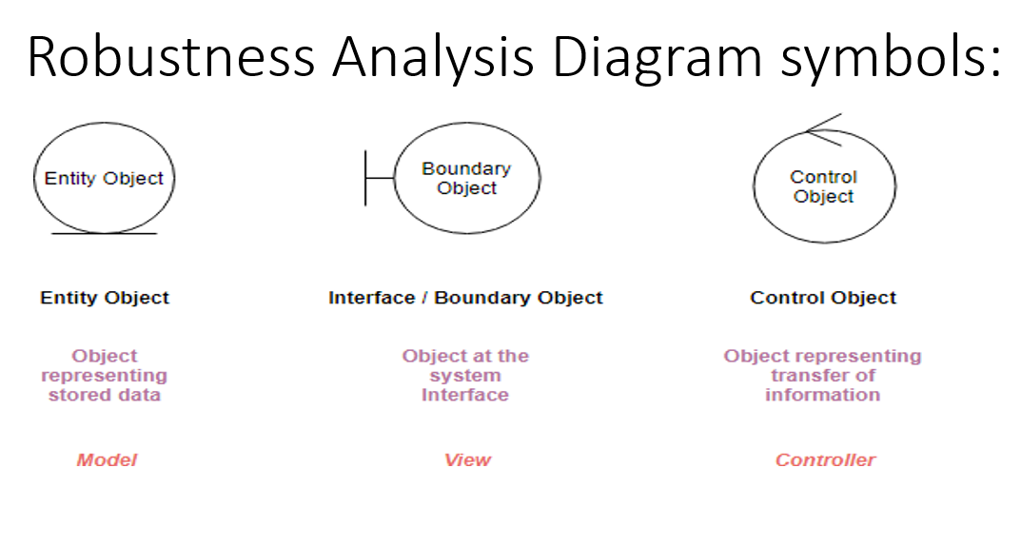
ECB partitions the system into three types of classes: entities, controls, and boundaries.
entity, control, and boundary are official UML class stereotypes. UML has some special icons to represent them.

Slide 10
Boundary object (or interface object) is what actors use in communicating with the system. The HTML, CSS, etc. which makes up the look and feel of the application
Entity object The persistent data that we keep in the data store. Entities are objects representing system data: Customer, Product, Transaction, Cart, etc.
Control objects (also known as controllers in MVC), which serve as the “glue” between boundary objects and entity objects. The code that does the thinking and decision making

Slide 11
What Is an Analysis Class?
A class that represents initial data and behavior requirements, and whose software and hardware- oriented details have not been specified

Slide 12
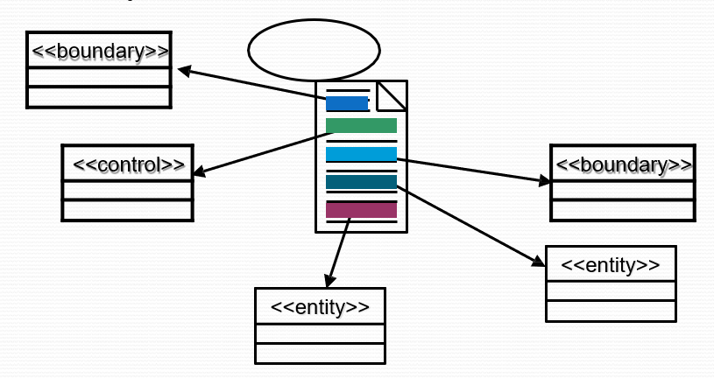
Find Classes From Use-Case Behavior
The complete behavior of a use case has to be distributed to analysis classes
We must ‘identify’ these classes – identify, name, and briefly describe in a few sentences.

Slide 13
Discovering Classes
Analysis classes represent an early conceptual model for ‘things in the system which have responsibilities and behaviors’.
Analysis classes are used to capture a ‘first-draft’, rough- cut of the object model of the system.
Analysis classes handle primary functional requirements, interface requirements, and some control - and model these objects from the problem domain perspective.

Slide 14
Kinds of Analysis Classes
Three things likely to change in a system:
The boundary between the system and its actors (interfaces…)
The information a system uses (data), and
The control logic of the system (who does what)
So, we isolate the different kinds of analysis classes

Slide 15
Candidate Entity Classes
Sometimes there is a need to model information about an actor within the system. This is not the same as modeling the actor (actors are external. by definition). These classes are sometimes called “surrogates”.
For example, a course registration system maintains information about the student which is independent of the fact that the student also plays a role as an actor of the system.
 This information about the student that is stored in a ‘Student’ class is completely independent of the ‘actor’ role the student plays; the Student class (entity) will exist whether or not the student is an actor to the system.

Slide 16
Classes can be stereotyped (categorized) as
Control
Boundary
Entity.
These stereotypes are used to increase the semantic meaning of the classes and their usage in modeling situations.
These stereotypes are not found in the core of the UML specification. Rather, they are common stereotypes implemented in many UML tools and used during the design and analysis phase. They are based on the model-view-controller concept, where the entity is the model, the control is the controller, and the boundary is the view.

Slide 17
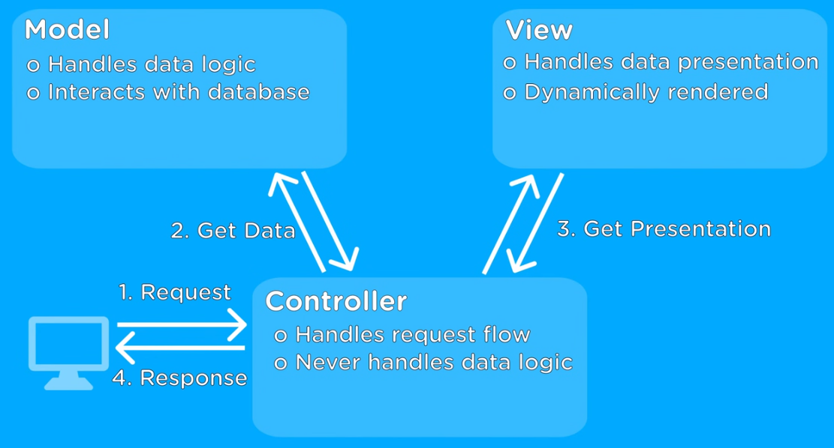
Model(entity) , Controller(control), View(boundary)

Slide 18
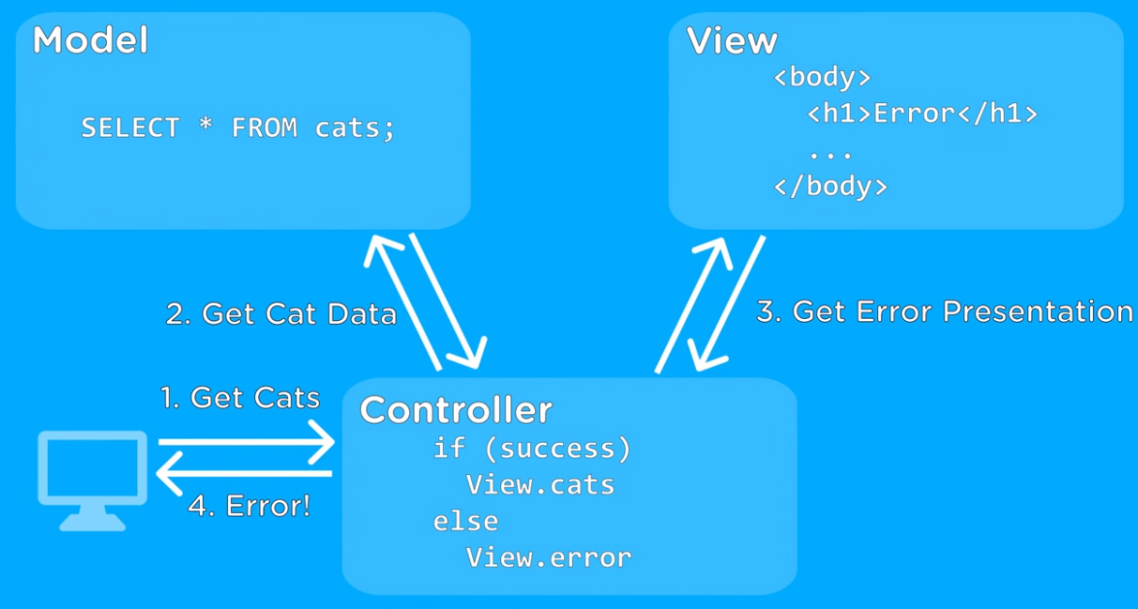
Model(entity) , Controller(control), View(boundary)

Slide 19
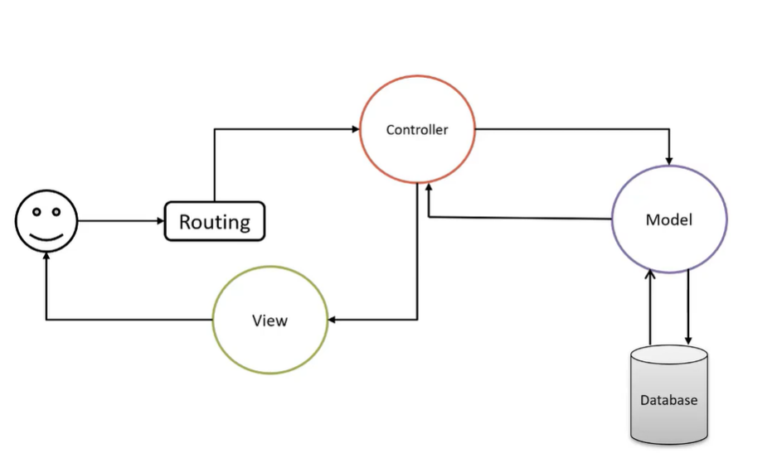

Slide 20
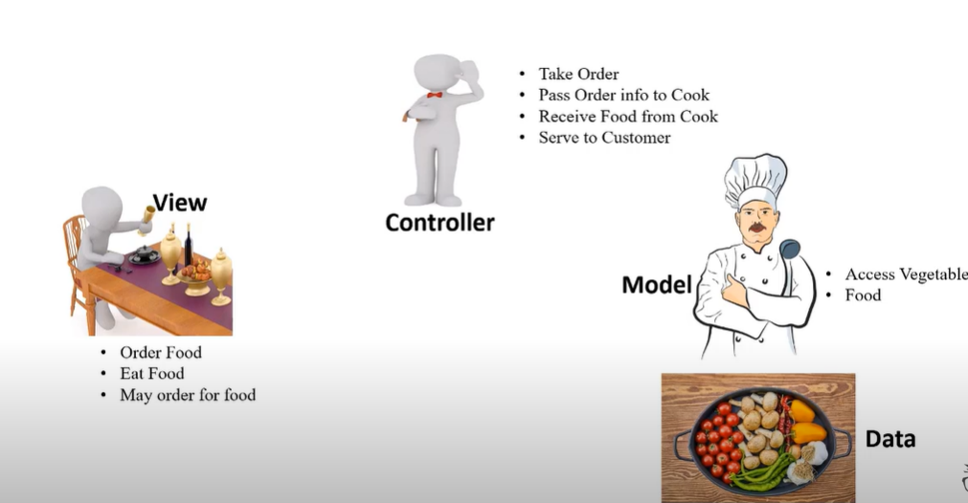

Slide 21
Several Types of Boundary Classes
User interface classes –
Classes that facilitate communication with human users of the system Menus, forms, etc. User interface classes.
System interface classes :
Classes which facilitate communications with other systems.
These boundary classes are responsible for managing the dialogue with the external system, like getting data from an existing database system or flat file.
Provides an interface to that system for this system
Device Interface Classes
Provide an interface to devices which detect external events – like a sensor or …
One boundary class per use case/actor pair

Slide 22
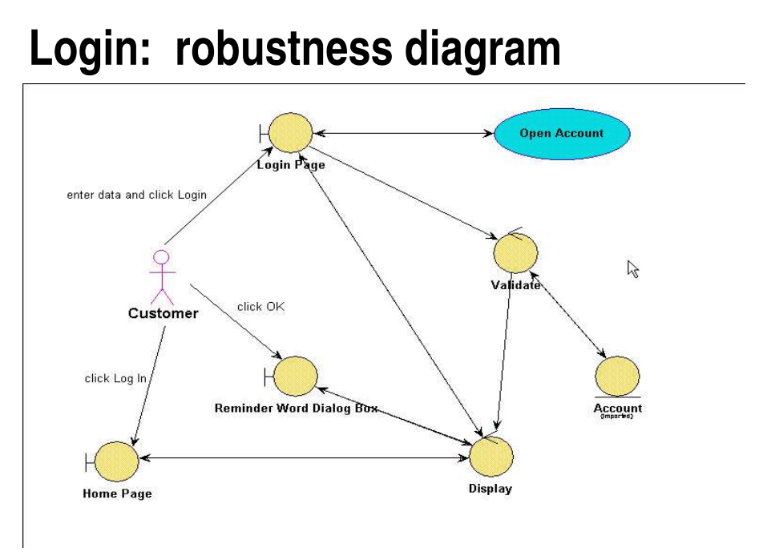
Robustness Analysis Diagram at a Glance:
Suppose we have the following simple use case description in textual format:
Login: use case text
Basic Course: The Customer enters his or her user ID and password, and then clicks the Log In button. The system validates the login information against the persistent Account data, and then returns the Customer to the Home Page.

Slide 23
Robustness Diagram – 4 Connection Rules
Keep in mind that both boundary objects and entity objects are nouns and that controllers are verbs. Nouns can’t talk to other nouns, but verbs can talk to either nouns or verbs.
Here I listed the four basic connection rules which should always be mind:
Actors can only talk to boundary objects.
Boundary objects can only talk to controllers and actors.
Entity objects can only talk to controllers.
Controllers can talk to boundary objects and entity objects, and to other controllers, but not to actors.

Slide 24
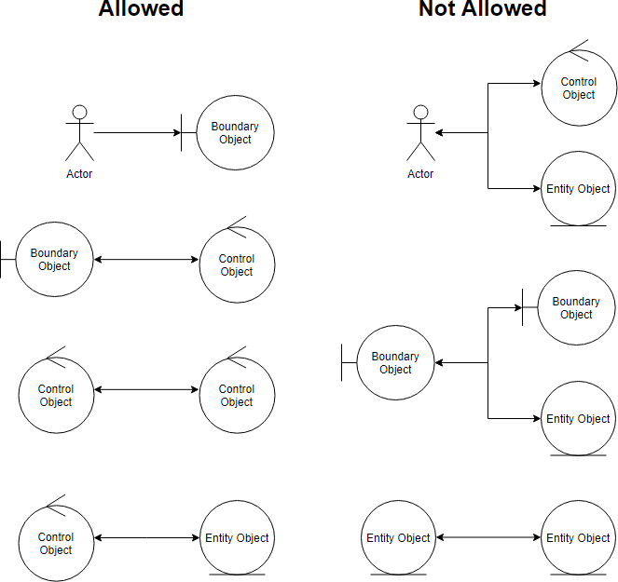
Robustness Analysis Diagram connection rules:

Slide 25
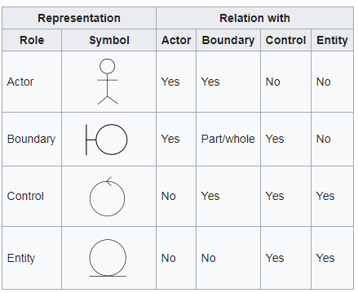
Robustness Analysis Diagram connection rules:

Slide 26
Use case ID | UC103
Use case Name | Search Products
Actors | Customer
Description | Search for products based on some criteria
 | The customer wants to browse among products or the customer would like to search for certain products
Precondition | Customer starts web browser
Postcondition | Search results meeting the criteria are displayed
Normal Flow | Customer visits the application home page Customer clicks the search button Search page is displayed by the system Customer enters search criteria The system validates the criteria provided The system looks up the catalog to find the products that meet the criteria Search results page is displayed with the product fulfilling the criteria
Alternative flows | Refine Search Results The following steps are added: Customer refines search results by providing additional criteria Step 5-7 are re-executed
Exceptions | In step 5, if search criteria is invalid or even missing then Step 3 (display search page) will be executed along with some hints on valid criteria Step 6, if no products found meet the criteria then Step 3 (display search page) will be executed along with the error message “Product not found”
Included | None
Notes and issues | None

Slide 27
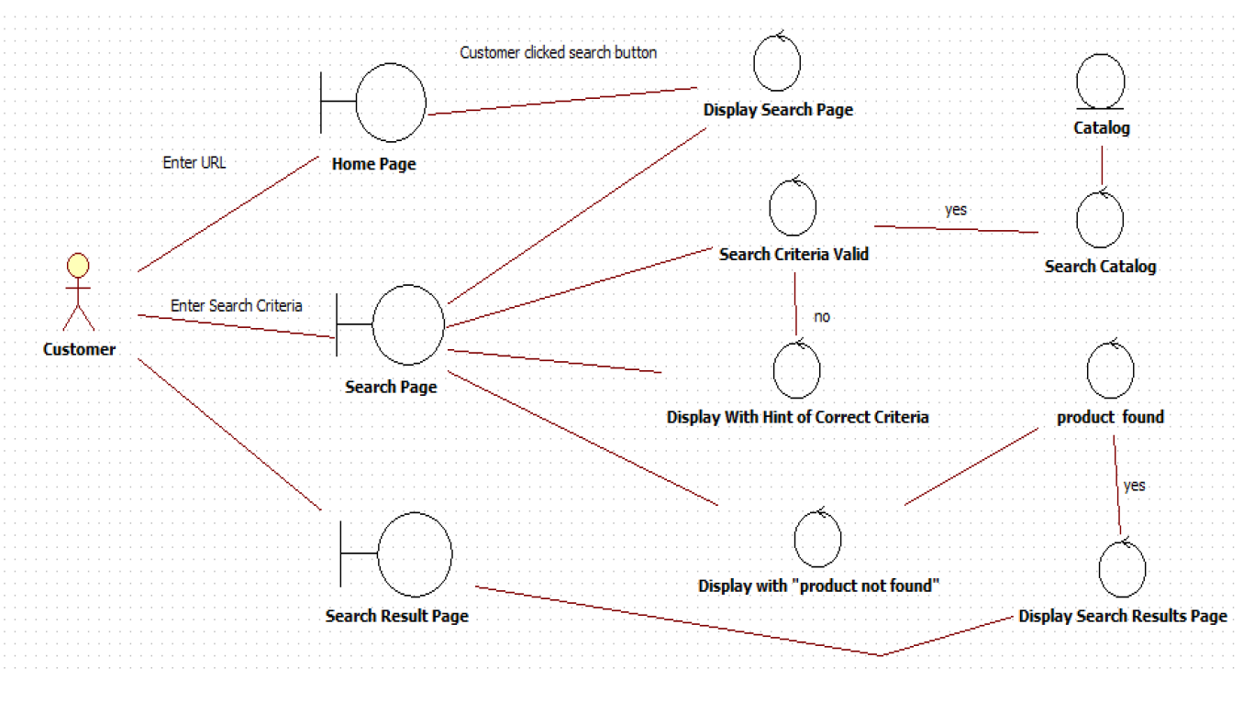
Robustness Diagram

Slide 28
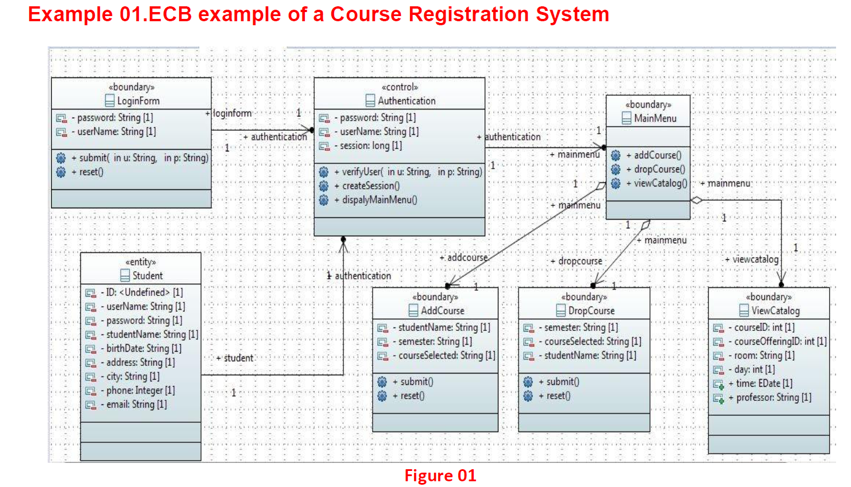

Slide 29
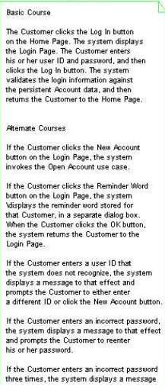
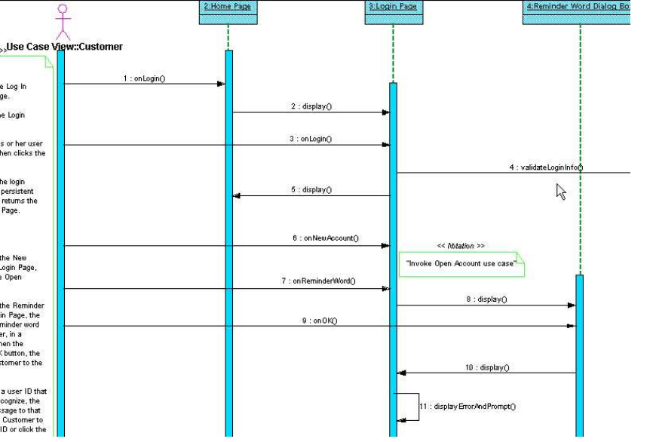
Login Sequence diagram:

Slide 30
Edit Shopping Cart use case text:
Basic Course:
On the Shopping Cart Page, the Customer modifies
the quantity of an Item in the Shopping Cart, and then presses the
Update button. The system stores the new quantity, and then
computes and displays the new cost for that Item.
Alternate Course:
If the Customer changes the quantity of the Item
to 0, the system deletes that Item from the Shopping Cart.

Slide 31
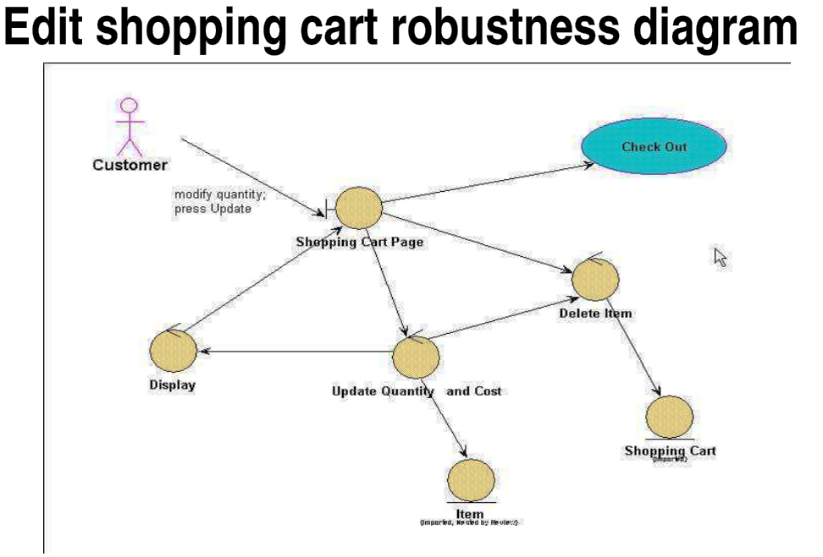

Slide 32
Five Steps for Creating Robustness Analysis:
You perform robustness analysis for a use case by walking through the use case text.
One sentence at a time, and drawing the actors, the appropriate boundary, entity objects and controllers, and the connections among the various elements of the diagram.
You should be able to fit the basic course and all of the alternate courses on one diagram.
Anyone who reviews a robustness diagram should be able to read a course of action in the use case text, trace his finger along with the associations on the diagram, and see a clear match between text and picture.

Slide 33
