Slide 1


Continuous Testing
11 November 2022
Famidha Thurab
Notes:
V2021_01
1

Slide 2
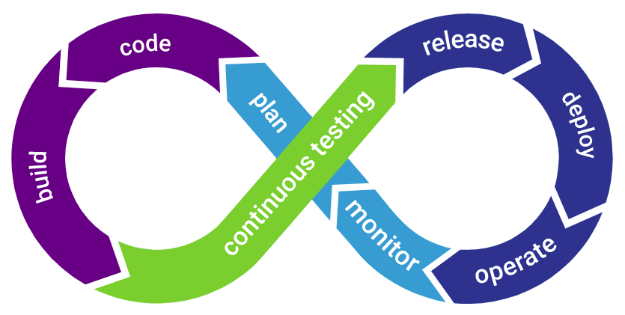
Continuous Testing
Continuous testing (CT) is a software development process in which applications are tested continuously throughout the entire software development life cycle (SDLC). The goal of CT is to evaluate software quality across the SDLC, providing critical feedback earlier and enabling higher-quality and faster deliveries.
Notes:
1

Slide 3
Benefits of CT
Continuous testing offers many benefits. At a higher level, it removes the roadblocks that can happen when performing testing in a single step. With continuous testing, code is automatically tested as soon as it is integrated. This directly supports DevOps and the goal of delivering high-quality software, faster.
Additionally, CT helps save developer time and effort because they no longer have to wait for QA teams to finish testing before fixing their code.
A more overarching benefit of CT is that it reduces risk. With CT, software is checked many more times and in many more ways throughout its entire life cycle, instead of once during a specific phase of the SDLC. This enables more visibility into and more opportunities to discover areas of weakness.
Notes:
1

Slide 4
Automation Testing
“Test automation is the use of special software (separate from the software being tested) to control the execution of tests and the comparison of actual outcomes with predicted outcomes.”
Notes:
1

Slide 5
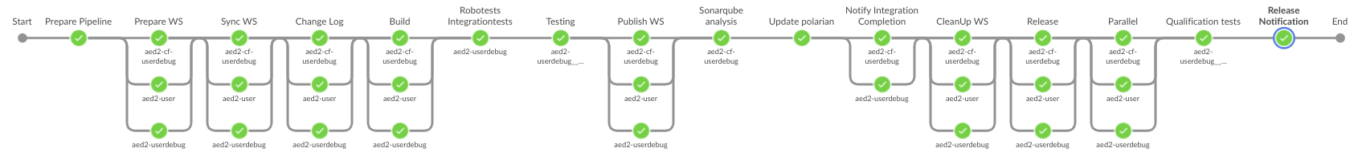
CT in SDLC
Notes:
1

Slide 6
Types of Testing
Unit Tests
Integration Tests
System Tests
Acceptance Tests
Performance Tests
Monkey Tests
Notes:
1

Slide 7
Unit Test
Unit testing is a software development process in which the smallest testable parts of an application, called units, are individually and independently scrutinized for proper operation.
Notes:
1

Slide 8
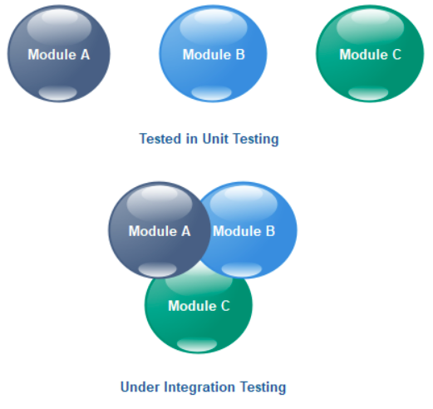
Integration Tests
Integration testing is the second level of the software testing process comes after unit testing. In this testing, units or individual components of the software are tested in a group. The focus of the integration testing level is to expose defects at the time of interaction between integrated components or units.
Notes:
1

Slide 9
System Tests
System Testing is a type of software testing that is performed on a complete integrated system to evaluate the compliance of the system with the corresponding requirements.
In system testing, integration testing passed components are taken as input.
The goal of integration testing is to detect any irregularity between the units that are integrated together.
System testing detects defects within both the integrated units and the whole system.
The result of system testing is the observed behavior of a component or a system when it is tested.
Notes:
1

Slide 10
Acceptance Testing
Acceptance Testing is the last phase of software testing performed after System Testing and before making the system available for actual use.
It is a formal testing according to user needs, requirements and business processes conducted to determine whether a system satisfies the acceptance criteria or not and to enable the users, customers or other authorized entities to determine whether to accept the system or not.
Notes:
1

Slide 11
Performance Testing
A software testing process used for testing the speed, response time, stability, reliability, scalability, and resource usage of a software application under a particular workload. The main purpose of performance testing is to identify and eliminate the performance bottlenecks in the software application.
Notes:
1

Slide 12
Monkey Testing
Monkey testing is a technique in software testing where the user tests the application by providing random inputs and checking the behavior (or trying to crash the application). Mostly this technique is done automatically where the user enters any random invalid inputs and checks the behavior.
Notes:
1

Slide 13
Software Qualification Test
The SQT test process in Automative SPICE (Software Process Improvement and Capability dEtermination) helps your organization to ensure that the integrated software meets the software requirements.
The expectation is that you already have software requirements, so the goal is to check against these requirements and determine if they are fully met and correctly implemented.
The purpose of the Software Qualification Test Process is to ensure that the integrated software is tested to provide evidence for compliance with the software requirements.
Notes:
1

Slide 14
AOSP Test Levels (CI)
Verify
when a developer pushes a change to Gerrit as an active change, the Jenkins job starts verifying the change (download the change, build, and test)
Devel
When a change is merged, devel starts automatically. This is a clean build, and the scope of testing is higher than that of verify pipeline.
Snapshot
Master pipeline starts based on a successful devel manifest
Notes:
1

Slide 15
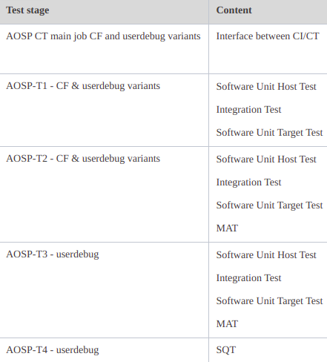
AOSP Test Levels (CT)
Notes:
1

Slide 16
AOSP Test Level (CI & CT)
Verify (T1)
Devel (T2)
Snapshot (T3 & T4)
Notes:
1

Slide 17
Android (gradle) App Testing
we categorize App tests in to two categories, namely
Host Tests
Target Tests
Host Tests are unit tests which runs on your local development machine or on a test server. These tests do not require a real device or emulator, rather runs on a local JVM.
Target Tests are those tests which runs on a an Android device, either physical or emulated. These tests may include instrumented unit tests, integration tests, end-to-end tests etc.
Notes:
1

Slide 18
Android Compatability Test
Android compatibility is a process by which Google tries to control the release of incompatible devices to the market. Prior to their release to the market each and every android device must pass the android compatibility tests and get certified by Google. Hence regular executions of android compatibility tests are required.
The CTS includes the following types of test cases:
Unit tests test atomic units of code within the Android platform; e.g. a single class, such as java.util.HashMap.
Functional tests test a combination of APIs together in a higher-level use-case.
Notes:
1

Slide 19
CT Pipeline
Notes:
1

Slide 20
Flashing
Flashing an android means installing any OS or some other kind of programs like the Recovery etc.
Flashing is generally done either from the device’s recovery mode or using any other dedicated computer softwares (Flasher Tools) or by ADB.
Notes:
1

Slide 21
Simulatix
Software application which mimics MIB behavior by simulating data/resources through viwi services.
MIB - management information base - is a database used for managing the entities in a communication network.
Notes:
1

Slide 22
Polarion
Polarion is an Application Lifecycle Management (ALM) Tool
Test Management
Requirements Management
Change and Configuration Management
Planning
Etc.
Operates on a Browser-based UI (User friendly, platform independent)
Work Items
Test Runs
Plans/Backlogs
Documents and Reporting
Bookmarks and favorites
Views, switching between projects and servers
Notes:
1

Slide 23





© Elektrobit 2021 | Confidential information

