Slide 1


HealthCare Performance Dashboard

Slide 2
Project Team
Kashinath Konade Sujana Billava

Slide 3
Data Requirement
Operator Module Analytics
Physician Module Analytics
Examples of operational insights may include:
Resource management (e.g., bed occupancy rates, equipment utilization)
Financial tracking (e.g., cost per patient, revenue cycle efficiency)
Operational performance (e.g., average wait times, throughput analysis)
Patient experience (e.g., satisfaction scores, complaint resolution times)
Examples of clinical insights may include:
Patient outcomes (e.g., recovery rates, readmission statistics)
Treatment efficacy (e.g., protocol adherence, intervention success rates)
Quality measures (e.g., infection rates, adverse event tracking)
Resource optimization (e.g., diagnostic test utilization, procedure scheduling)advanced

Slide 4
Dashboard Requirement
Interactive visualization of key performance indicators
Role-specific views for physicians and operators
Real-time performance tracking and trend analysis
Customizable data displays and reporting tools
GenAI-Powered Digital Assistant
Conversational interface for natural language queries
Intelligent analysis of performance metrics
Contextual explanations of trends and anomalies
Personalized insights based on user role and preferences

Slide 5
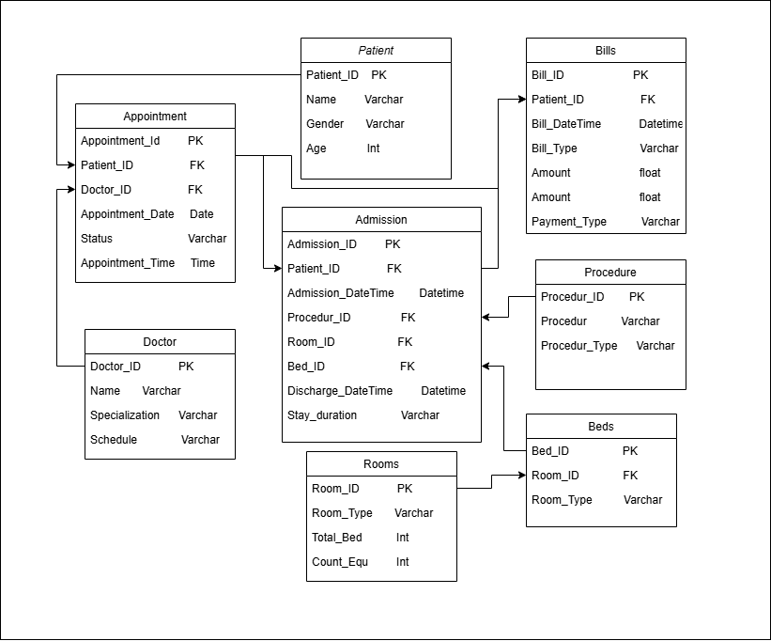
Data Set Architecture
Based on requirement Create this Architecture using draw.io
Table Name:
Appointment
Admission
Patient
Procedure
Doctor
Rooms
Beds
Bills

Slide 6



Dataset Creation for Advanced Healthcare Analytics
Define key areas of focus:
Operator Module Analytics: Resource management, financial tracking, operational performance, patient experience.
Physician Module Analytics: Patient outcomes, treatment efficacy, quality measures, resource optimization.
Explain how ChatGPT can be used:
Generating Python code snippets for dataset creation.
Drafting schemas for simulated or real-world healthcare datasets.
Example workflow:
Input: Prompt ChatGPT with dataset requirements.
Output: Code for creating structured data, such
Steps in Python Implementation:
Install necessary libraries like pandas, numpy, faker ect.
Use Python to create structured datasets (e.g., patient records, shift schedules).
Perform checks to ensure the dataset adheres to domain requirements (e.g., correct date formats, valid patient IDs).
Save the dataset in CSV, Excel, or a database format for further analysis.

Slide 7
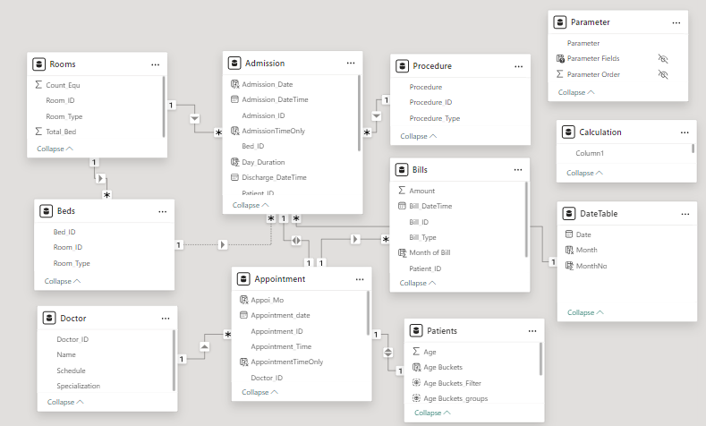
Power BI Desktop
Create Relationship between Tables

Slide 8
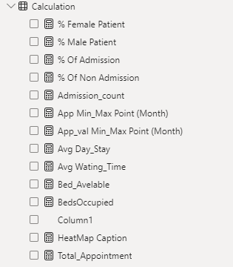
Power BI Desktop
Created DAX Functions :
% Female Patient: Percentage of female patients.
% Male Patient: Percentage of male patients.
% Of Admission: Percentage of patients admitted.
% Of None Admission: Percentage of patients not admitted.
Admission_count: Total number of admissions.
App Min_Max Point (Month): Minimum or maximum appointment values by month.
App_val Min_Max Point (Month): Minimum or maximum appointment values (likely numeric).
Avg Day_Stay: Average length of stay for admitted patients.
Avg Waiting_Time: Average patient wait time.
Bed_Available: Count of available beds.
BedsOccupied: Count of beds currently occupied.
HeatMap Caption: Label or annotation for a heatmap visualization.
Total_Appointment: Total number of appointments.

Slide 9
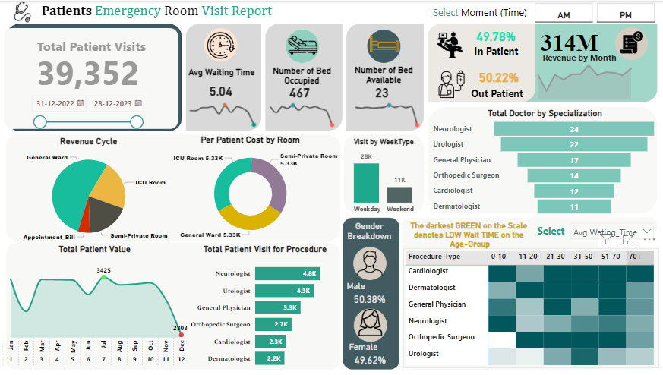
Power BI Dashboard

Slide 10
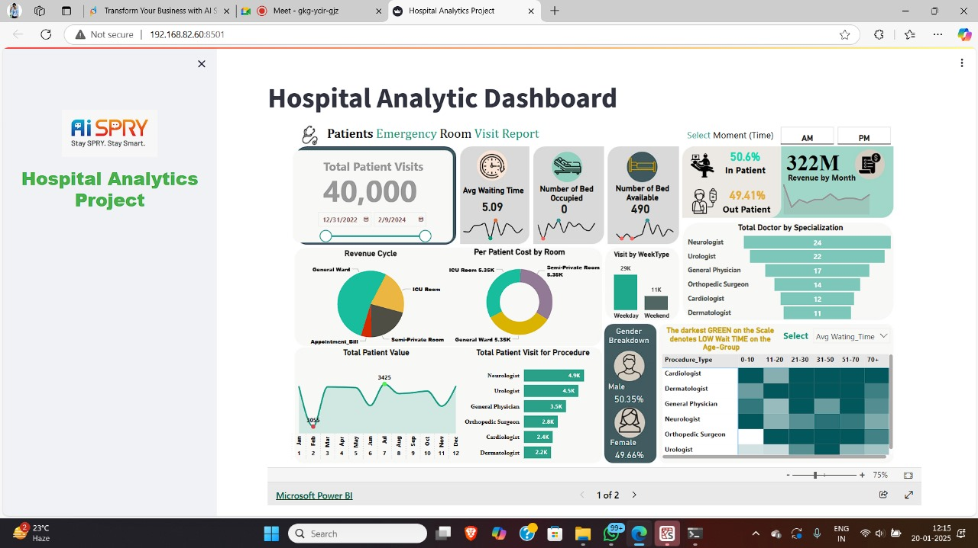
Embed Report to Streamlit

Slide 11
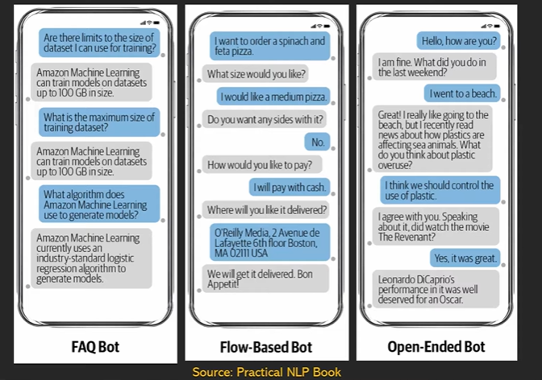
Research About Chat Bot
Types of Chat Bot

Slide 12
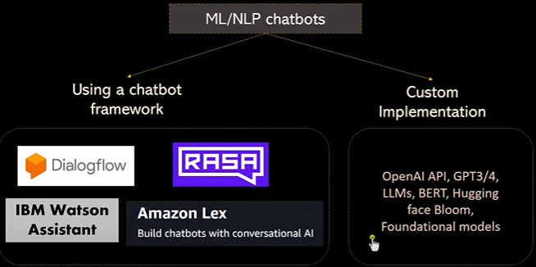
Research About Chat Bot

