Slide 1
VLSI SYSTEM DESIGN-BECE303L
PROJECT REVIEW
TITLE
Binary subtractor circuit design using different approaches to trade-off delay and area.
TEAM MEMBERS
HARI KISHORE K S
NIZSAANTH NOBEL A
KANIISHK SELVAKUMAR
NITHISH SARAN

Slide 2
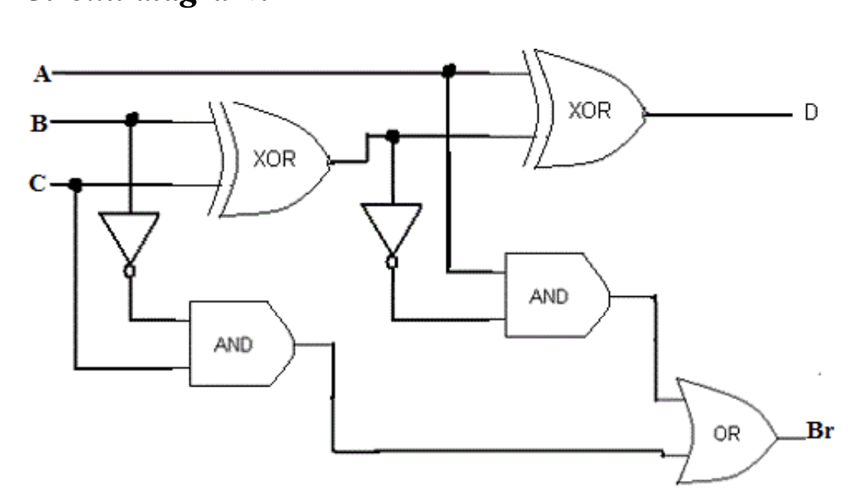
1-BIT BINARY SUBTRACTOR DIAGRAM

Slide 3
SUBTRACTOR CIRCUIT
RIPPLE BORROW SUBTRACTOR
A Ripple Borrow Subtractor (RBS) is a binary subtractor that computes the borrow sequentially from one stage to the next, similar to the Ripple Carry Adder (RCA) in addition. This design is simple and requires minimal area but suffers from higher propagation delay due to the sequential nature of borrow computation.

Slide 4
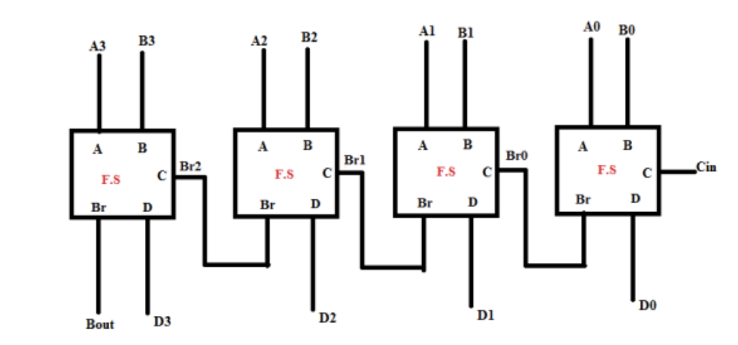
Ripple Borrow Subtractor

Slide 5
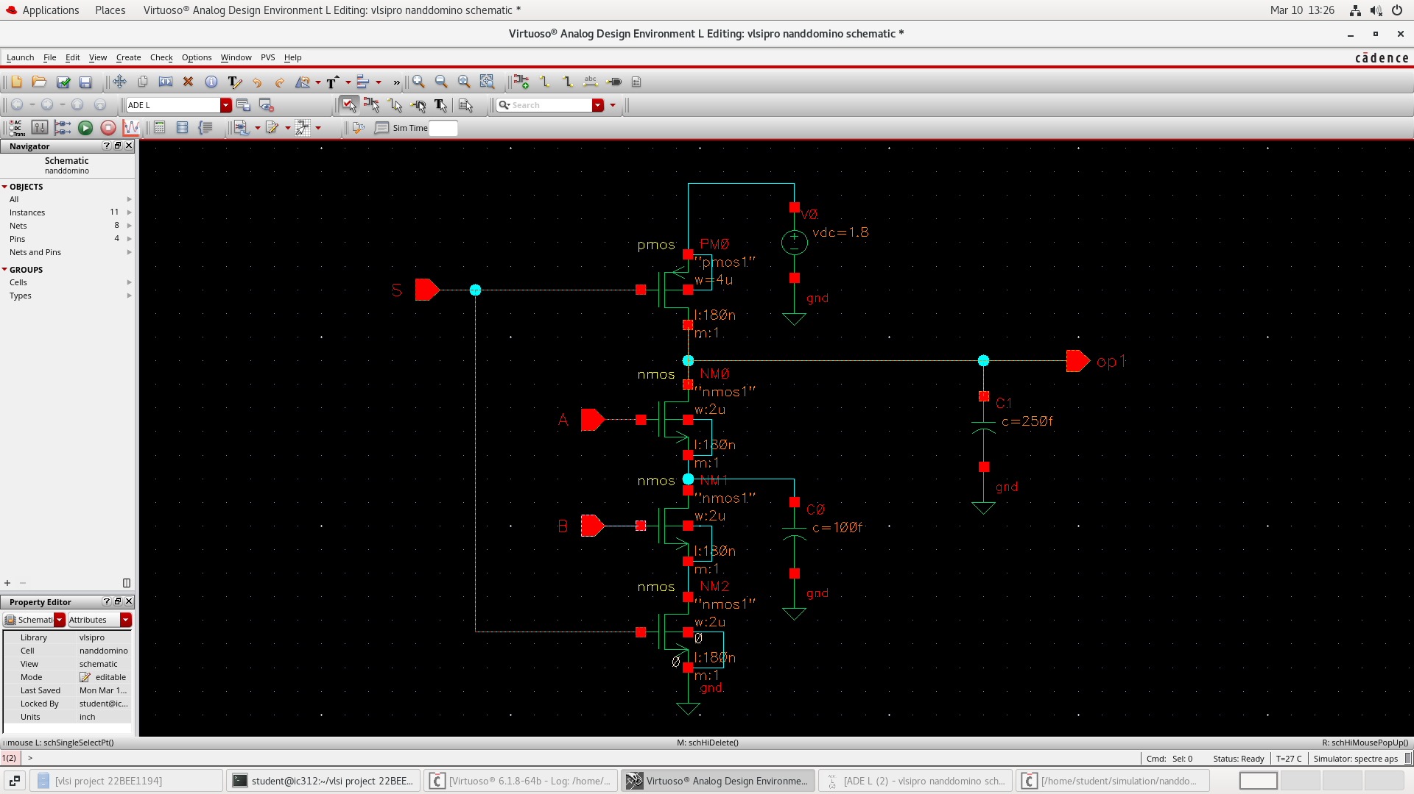
CADENCE CIRCUIT DIAGRAM - NAND
domino nand.png

Slide 6
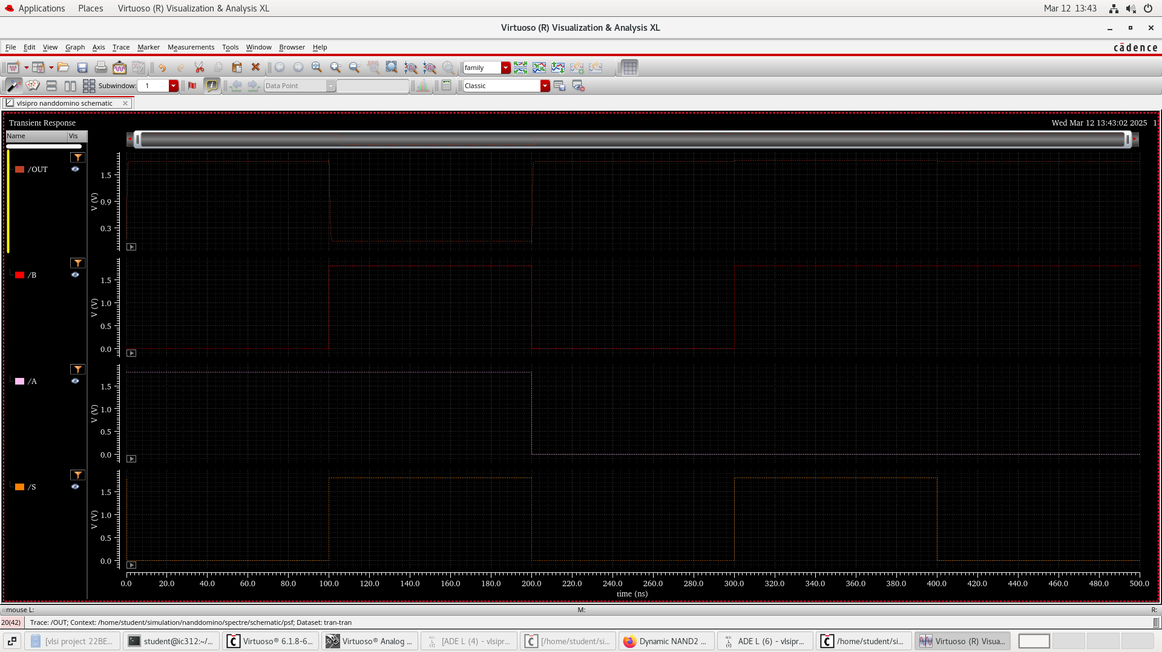
CADENCE CIRCUIT DIAGRAM – NAND OP

Slide 7
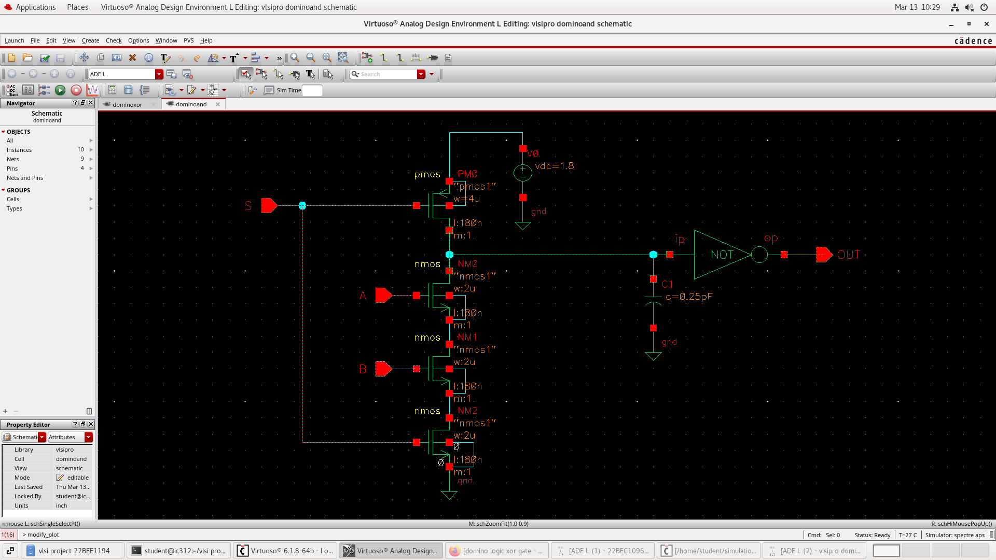
CADENCE CIRCUIT DIAGRAM - AND

Slide 8
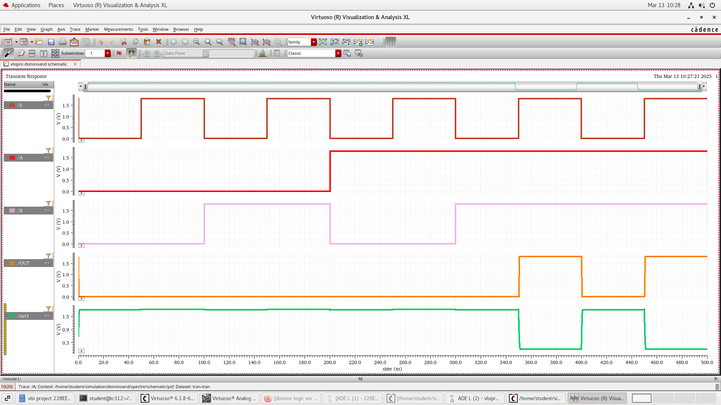
CADENCE CIRCUIT DIAGRAM – AND OP

Slide 9
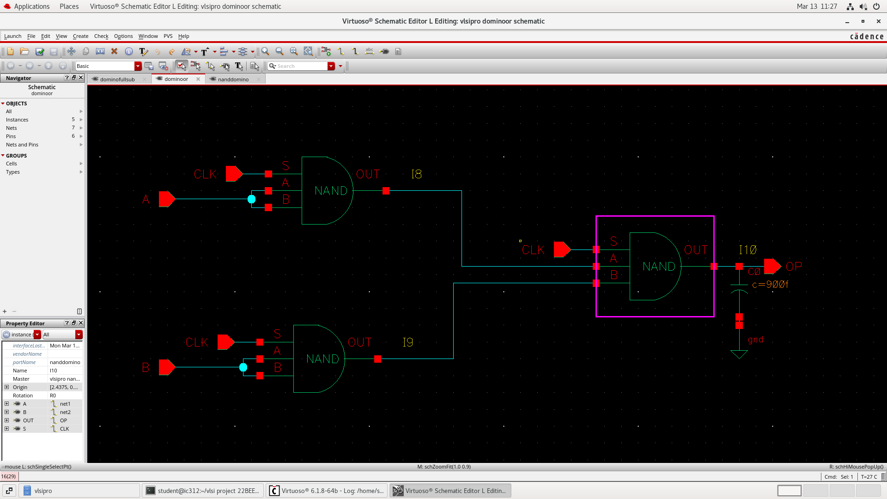
CADENCE CIRCUIT DIAGRAM - OR

Slide 10
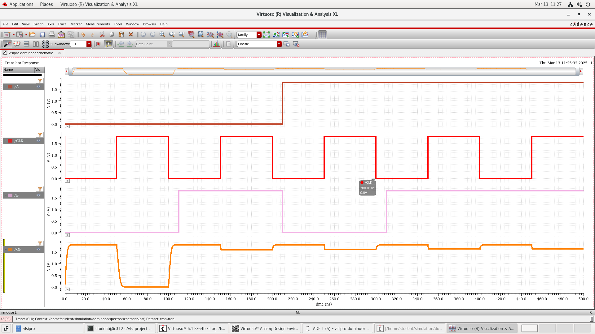
CADENCE CIRCUIT DIAGRAM – OR OP

Slide 11
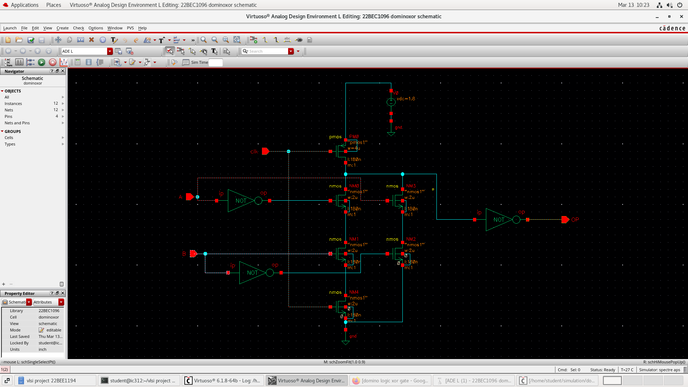
CADENCE CIRCUIT DIAGRAM - XOR

Slide 12
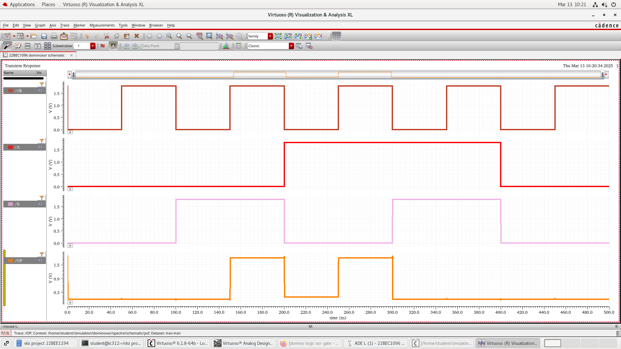
CADENCE CIRCUIT DIAGRAM – XOR OP

Slide 13
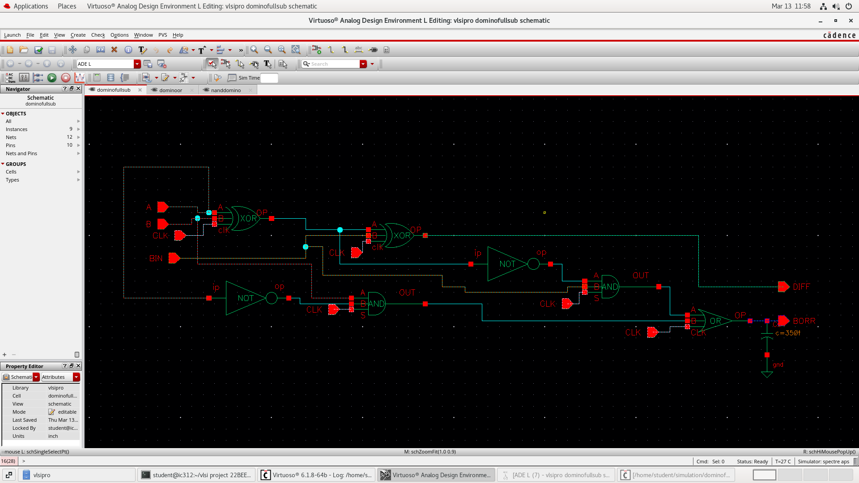
CADENCE CIRCUIT DIAGRAM – FULL SUBTRACTOR

Slide 14
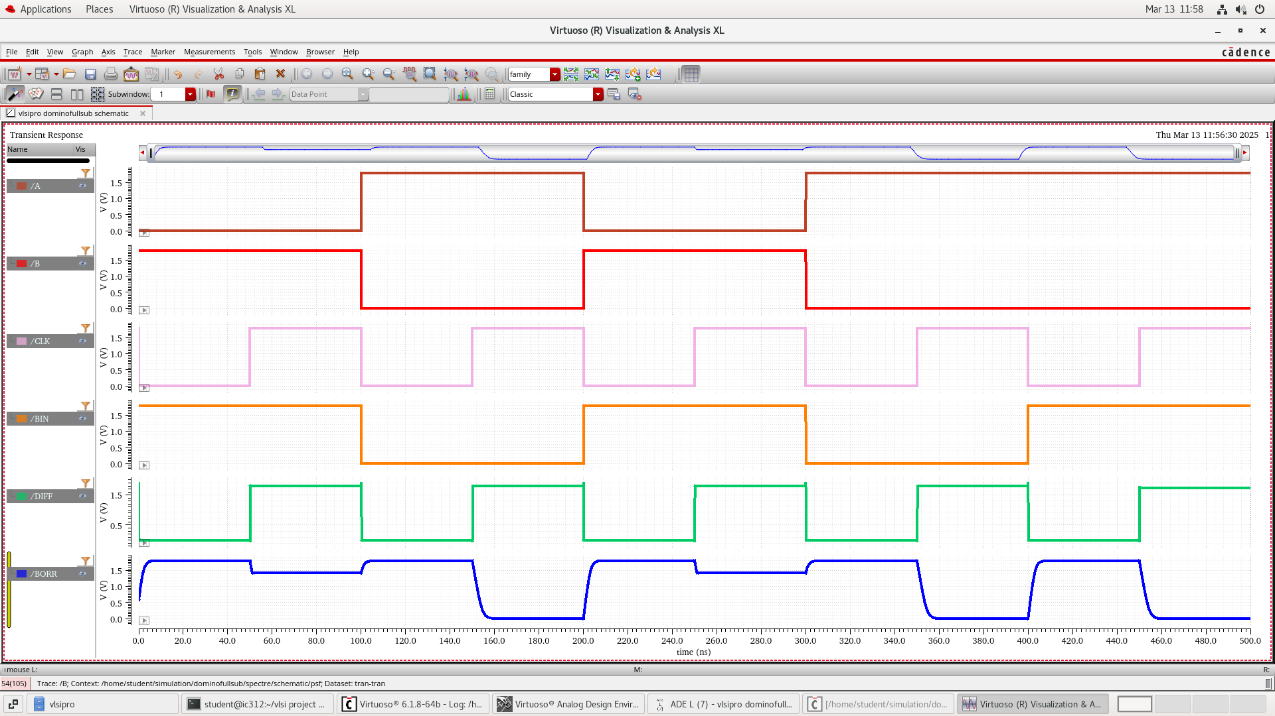
CADENCE CIRCUIT DIAGRAM – FULL SUBTRACTOR OP

Slide 15
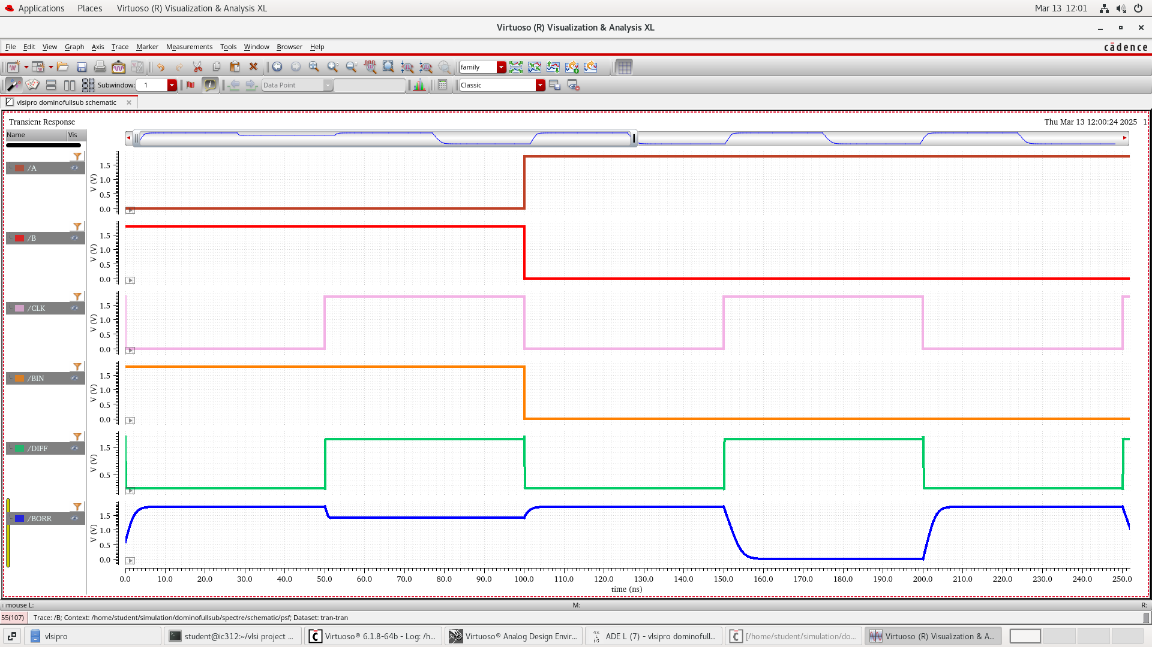
CADENCE CIRCUIT DIAGRAM – FULL SUBTRACTOR OP 1

Slide 16
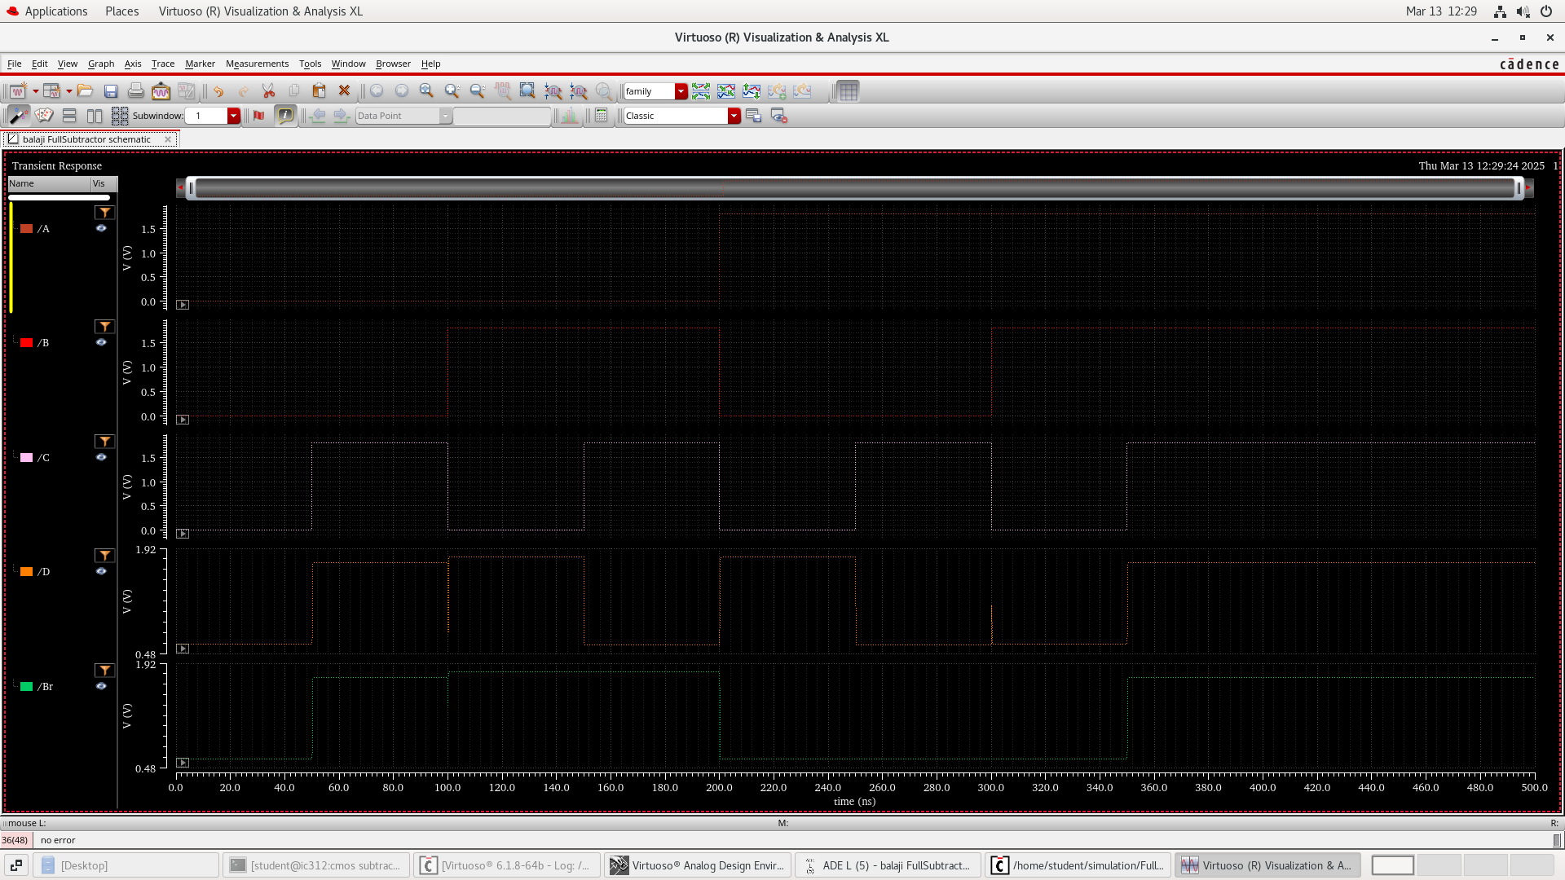
PSEDUO NMOS FULL SUBTRACTOR OUTPUT

Slide 17
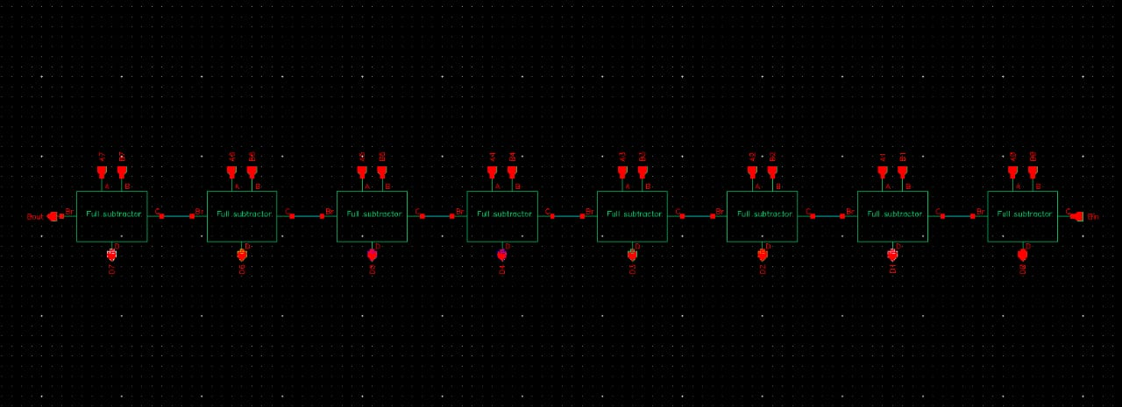
PSEDUO NMOS FULL SUBTRACTOR 8-BIT CIRCUIT

Slide 18
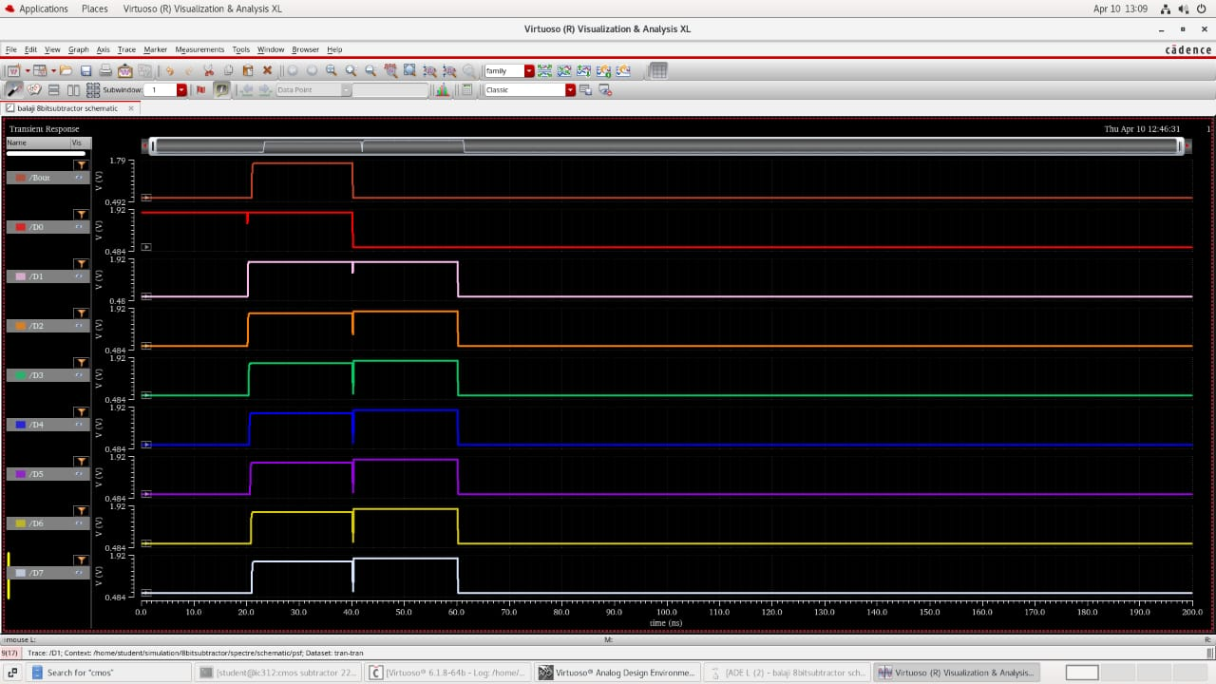
PSEDUO NMOS 8-BIT FULL SUBTRACTOR CIRCUIT OUTPUT :

Slide 19
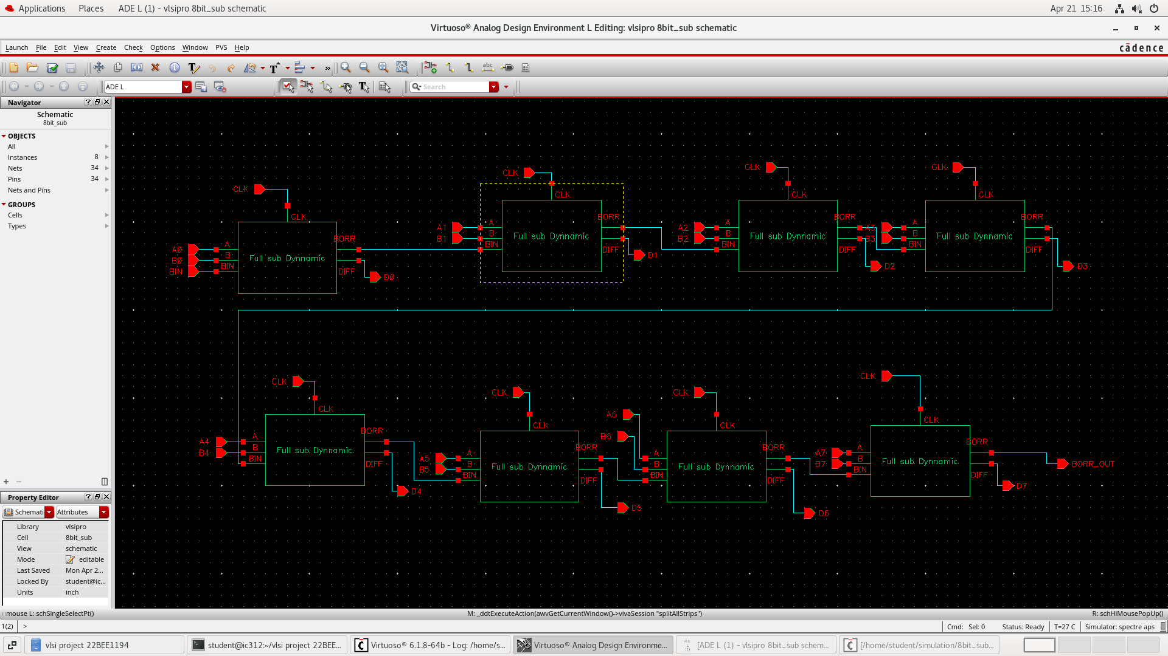
DYNAMIC LOGIC FULL SUBTRACTOR 8-BIT CIRCUIT

Slide 20
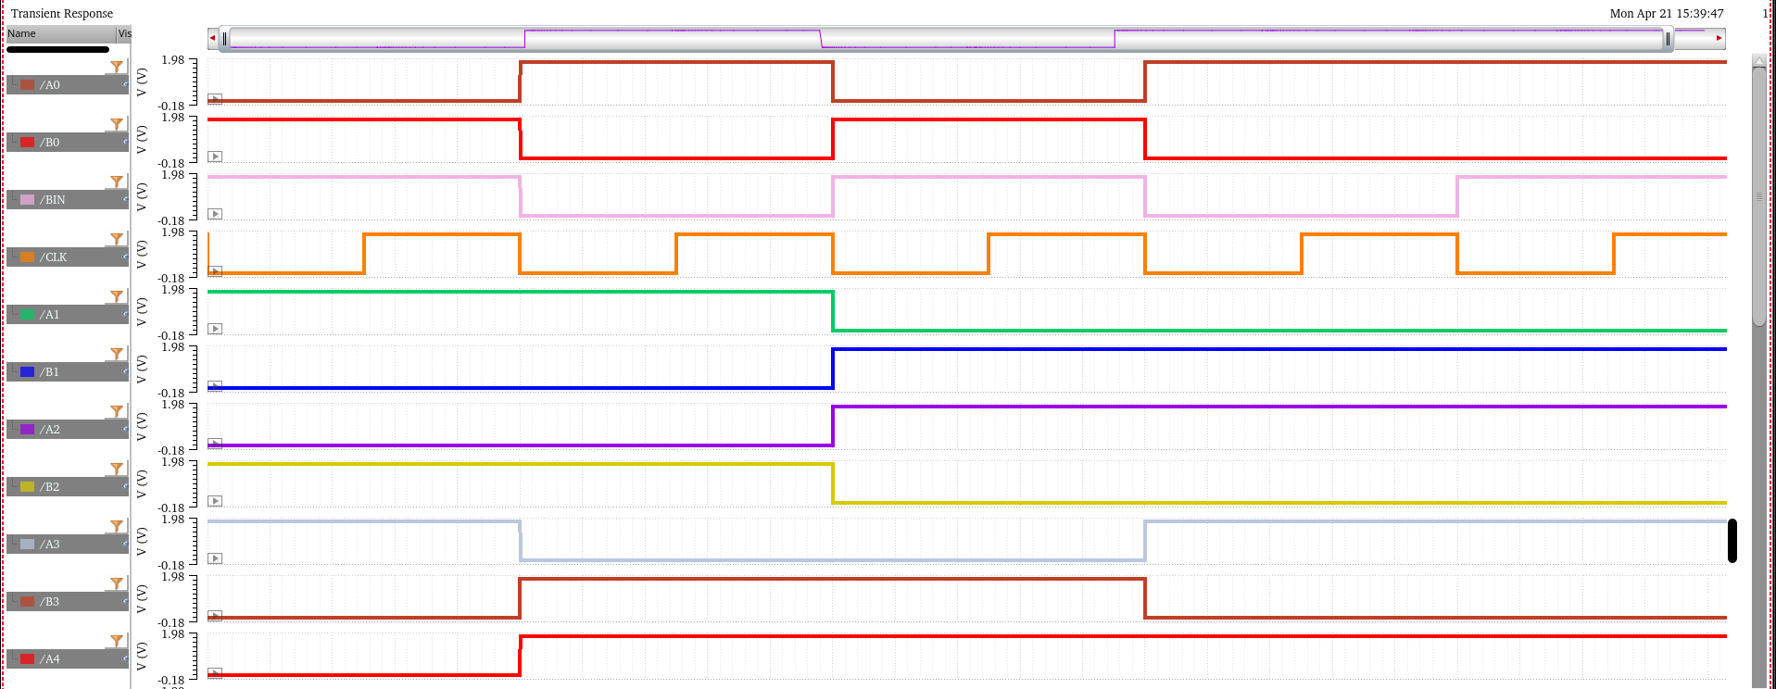
DYNAMIC LOGIC FULL SUBTRACTOR 8-BIT OUTPUT

Slide 21
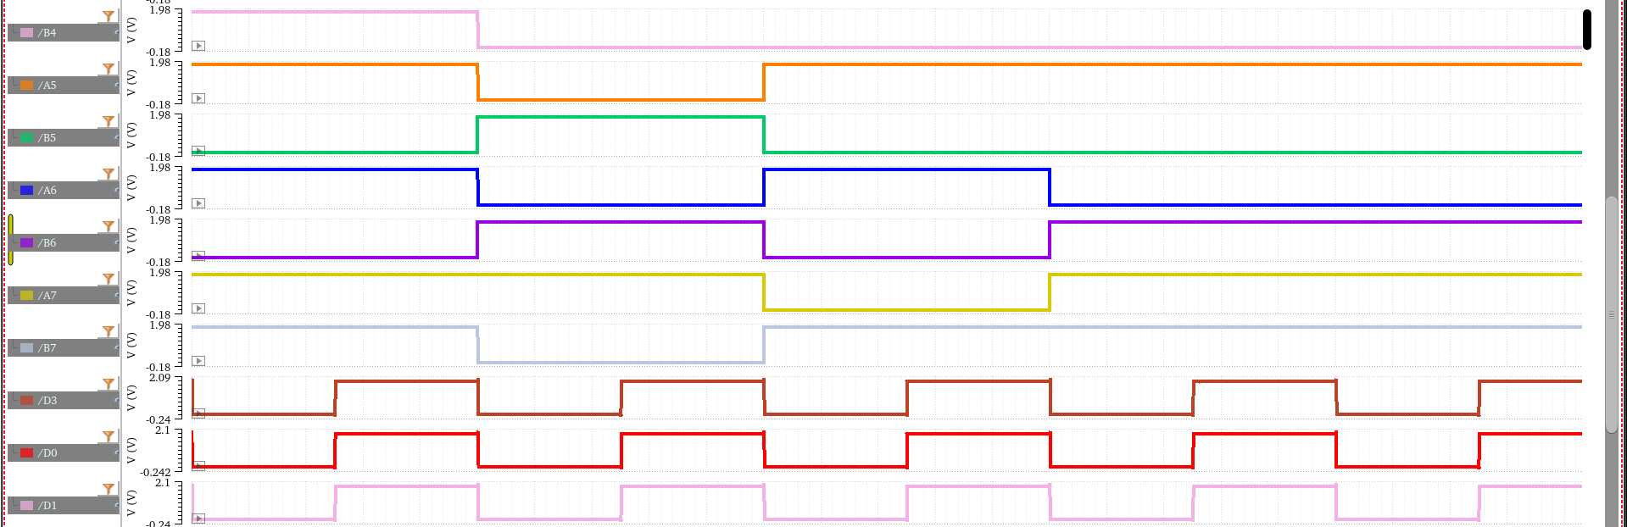
DYNAMIC LOGIC FULL SUBTRACTOR 8-BIT OUTPUT

Slide 22
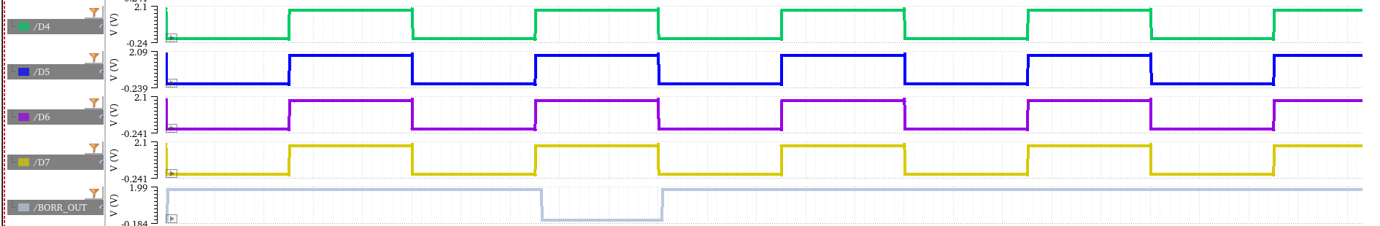
DYNAMIC LOGIC FULL SUBTRACTOR 8-BIT OUTPUT

Slide 23


POWER CALCULATION OF 8-BIT FULL SUBTARCTOR CIRCUIT (Dynamic logic) :
DELAY CALCULATION OF 8-BIT FULL SUBTARCTOR CIRCUIT(dynamic logic) :
Bit 0 input to difference output delay

Slide 24




POWER CALCULATION OF 8-BIT FULL SUBTARCTOR CIRCUIT (Pseudo NMOS):
Bit 0 input to borrow output delay
DELAY CALCULATION OF 8-BIT FULL SUBTARCTOR CIRCUIT (Pseudo NMOS):
Bit 0 input to difference output delay
Bit 0 input to borrow output delay

Slide 25
PAPER REFFERED
https://www.ijera.com/papers/Vol3_issue5/LO3519791983.pdf
https://www.google.com/url?sa=t&source=web&rct=j&opi=89978449&url=https://sbmicro.org.br/sforum-eventos/sforum2001/godoi.pdf&ved=2ahUKEwiik5PI07CLAxUVSmwGHeYmN0UQFnoECCgQAQ&sqi=2&usg=AOvVaw2oc2btt1uS-tOxObN9qhbn

Slide 26
THANK YOU

