Slide 1
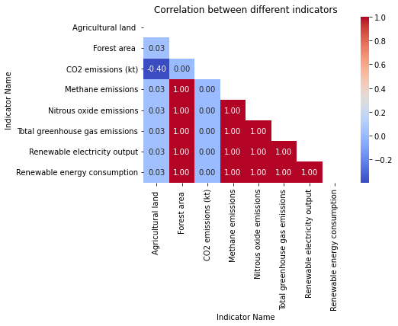
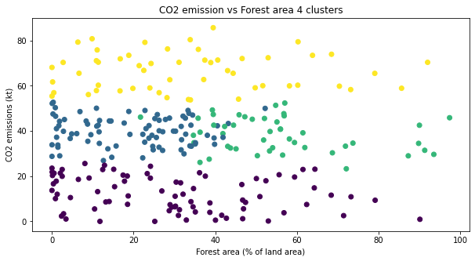
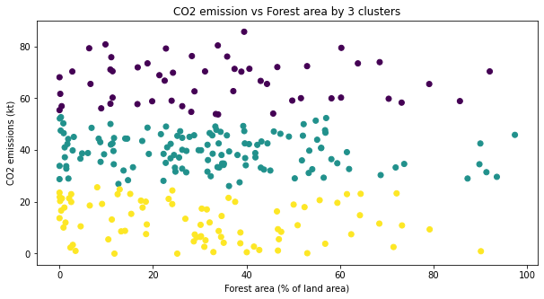
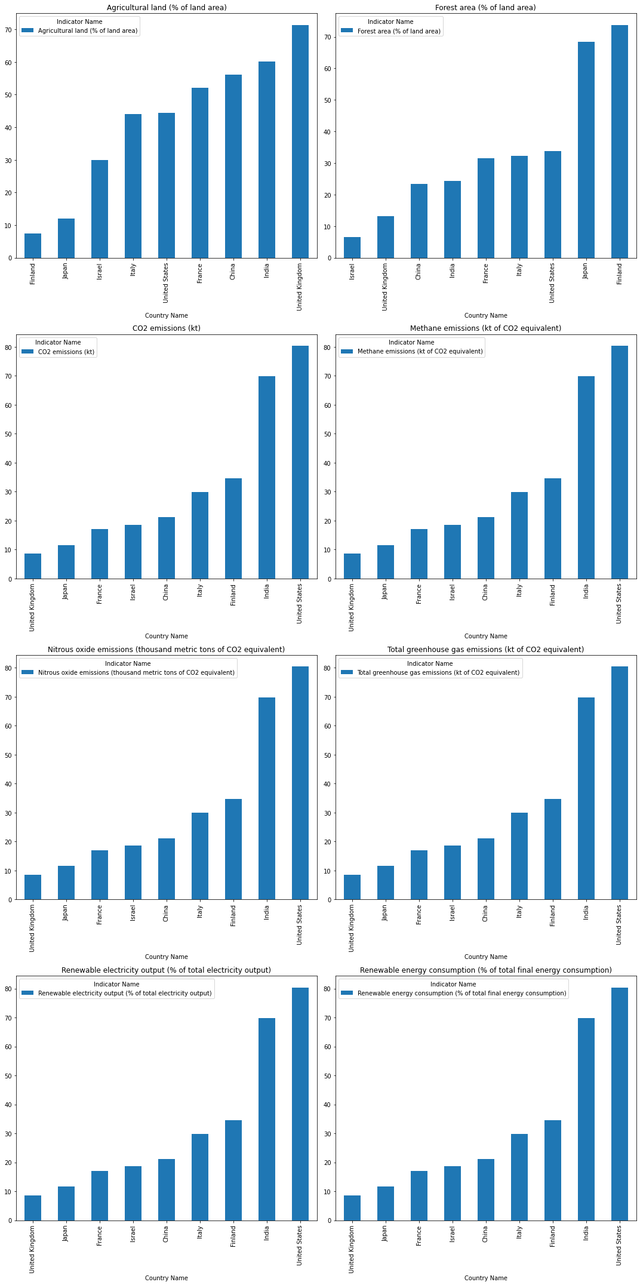
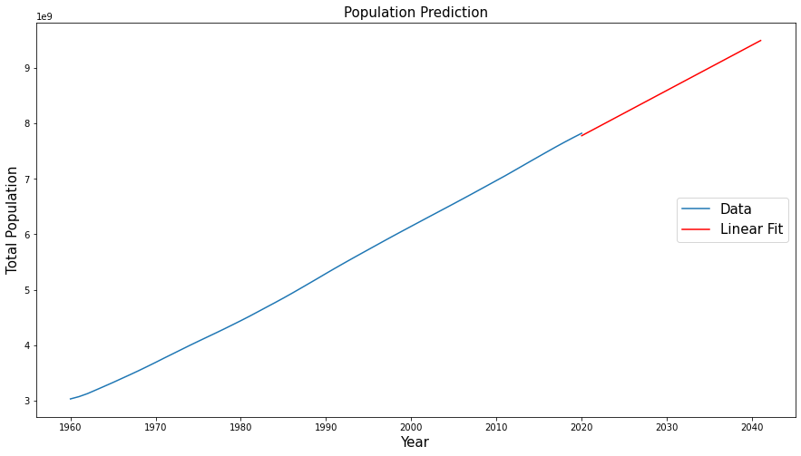
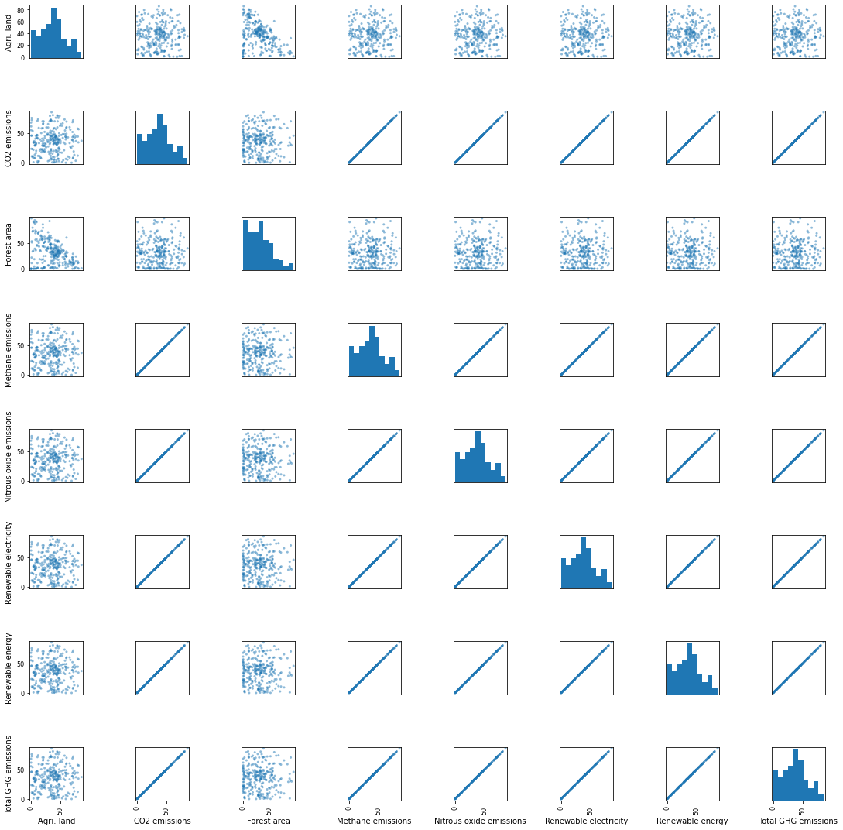
Analyzing Climate change effects on different countries
Kashir Waseem (22031825) - University Of Hertfordshire
Abstract
In this Project we are going to analyze climate change effect on different countries. Using the data from the World Bank, We examine the trends and patterns of climate change different Indicator like CO2 emission, Methane emission, Agriculture Land, Forest Area etc by countries and region. Our Findings suggest that some countries reduced their carbon footprints, some still have high level of emission.
This show that the green house emission and co2 have directly relation with each other and renewable electricity output and renewable energy consumption also have directly relationship
Introduction
Clustering and fitting
Climate change is a major environmental concern caused by human being. In this study, We analyzed eight indicators of climate change, which includes Agriculture land, forest area, co2 emission, methane emission, nitrous oxide emission, greenhouse emission, renewable electricity and renewable energy. The result of this study highlights the importance of these indicator as a cause of climate change which now days very effective for some countries. These insights will help the policymakers to implements solution to decrease the impact of these indicators
Cluster 0: Countries with very low forest area and very high CO2 emissions, including China and the United States.
Cluster 1: Countries with low forest area and high CO2 emissions, including India.
Cluster 2: Countries with moderate forest area and moderate CO2 emissions, including Italy, France, and the United Kingdom.
Cluster 3: Countries with high forest area and low to moderate CO2 emissions, including Finland and Japan.
Comparison
Finland has the highest forest area among all which indicate that it has less co2 emission. China and USA contribute the most in the co2 emission and the greenhouse emission they also have less forest land which indicate that they setup industries work on GDP of their country
The dataset we have is until 2020 we fit our model up to 2020 for the parameter of population of the world and predict that for year 2040 and we see that out prediction shows that world population will be around 9.5 billion
Distribution
Conclusion
The Relationship between different indicator by correlation diagram and scatter matrix it shows that agriculture land has some different impact with other indicators
In the conclusion, Our analysis shows that how population of world is increasing day by day and in near future it will increase more to as the population increase so to meet the every person requirement and need the industries setup due to which deforesting is occur in most of the countries of the world and that's why now a days CO2 emits more in some countries, As co2 and other gases plays very important role in the climate change hence to mitigate that forest is too much important as our analysis shows that Finland produce very less co2 because they have huge land for forest. It is essential to action at national level and individual level to reduce green house emission gas and promote sustainable practices to mitigate the effect which cause climate change.
Source code
https://github.com/kashir123/Assignment-3-Clustering-and-data-fitting.git

