Slide 1

Decentralized Document Verification System Using Blockchain and IPFS
Team Number: E1
Guide : Ms. Uma Hiremath
Sl.No. | Name | USN | Roll No.
1 | Kashiram O | 01FE21BCS006 | 501
2 | Anushree M | 01FE21BCS364 | 531
3 | Triveni M | 01FE21BCS171 | 532
4 | Srithan M S | 01FE21BCS016 | 503

Slide 2
Introduction
The project leverages blockchain technology to secure and verify educational credentials, ensuring authenticity and reducing fraud in the educational sector.
Each credential is recorded in an immutable ledger, preventing counterfeit certificates from circulating.
Initial verification is conducted by educational institutions, followed by checks from accreditation bodies, adding an extra layer of security.
This initiative supports SDG 4, specifically Target 4.3, by improving access to quality education, enhancing transparency, and boosting trust in educational qualifications.
It promotes a more efficient and reliable education system.

Slide 3
Problem Statement
Design a Blockchain-Based System for Decentralized Document Verification System and IPFS

Slide 4
Objectives
1.To design a decentralized document verification system using blockchain and IPFS.
2. To securely store the hash of documents on the Ethereum blockchain to ensure their integrity and authenticity.
3. To use IPFS for decentralized storage of actual document data, ensuring availability and security.
4. To develop a web application with a user-friendly interface for document upload and verification.
5. To ensure that documents are encrypted before being uploaded to IPFS.

Slide 5
Description about Project and Workflow
Develop a decentralized document verification system using Ethereum blockchain and IPFS for secure and tamper-proof data storage and retrieval.
Encrypt documents before storing on IPFS; store their hashes on Ethereum for verification.
React.js-based web app with MetaMask integration for easy document upload and verification.
Utilize IPFS for secure, redundant, and fault-tolerant document storage.
Users encrypt and upload documents via web interface, generating a unique CID. Document hashes are stored on Ethereum. -
Users enter CID to fetch and decrypt documents from IPFS, verify integrity against Ethereum-stored hashes. This system ensures secure, user-friendly, and tamper-proof document verification with robust data integrity and availability.

Slide 6
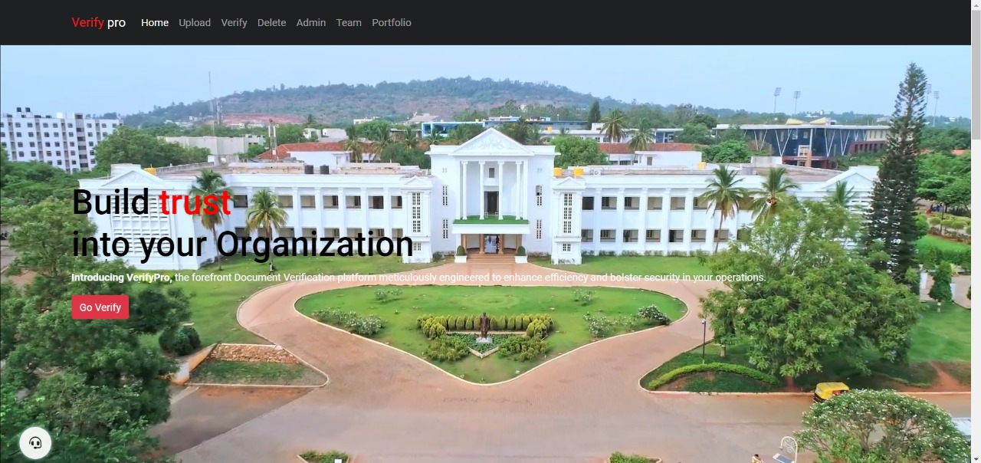
Results and WebPage

Slide 7
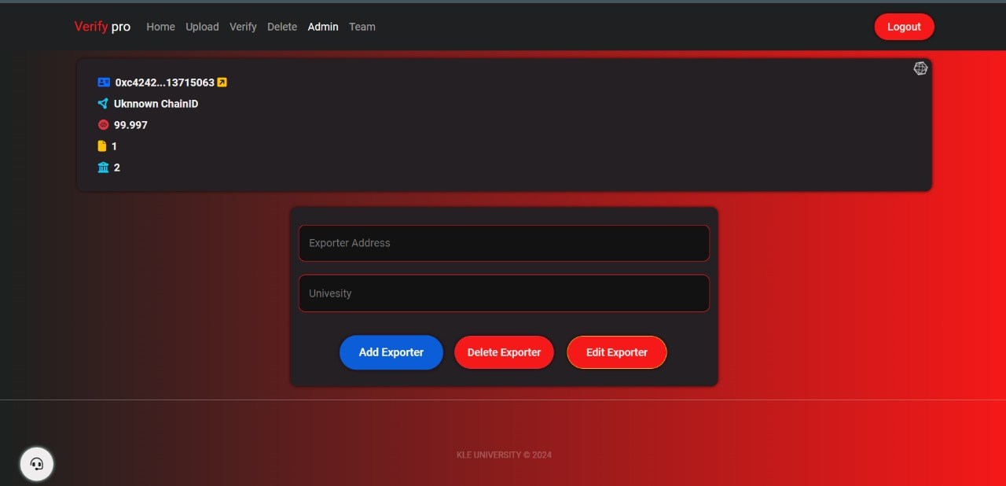

Results and WebPages(State Government)

Slide 8
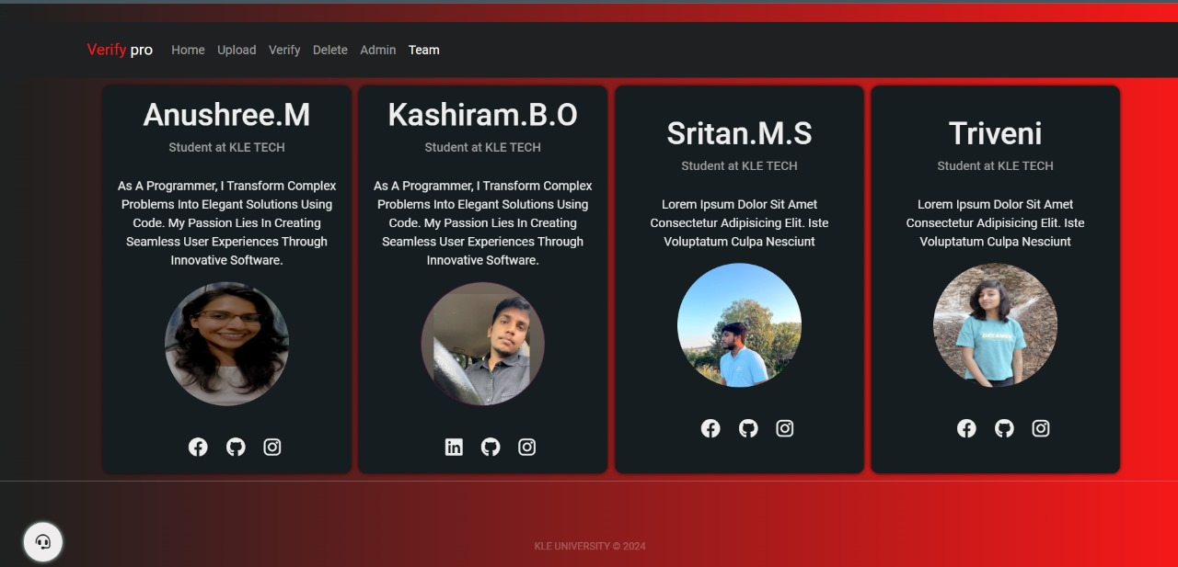
Results and WebPages(State Government)

Slide 9
Results and WebPages(State Government)

Slide 10
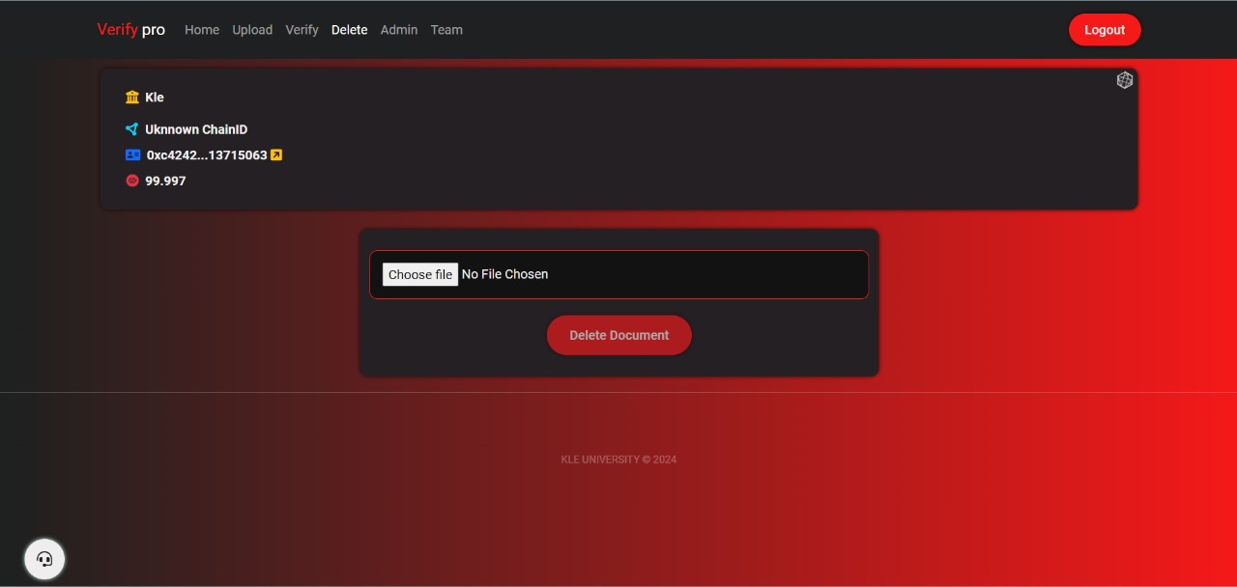
Results and WebPages(State Government)

Slide 11
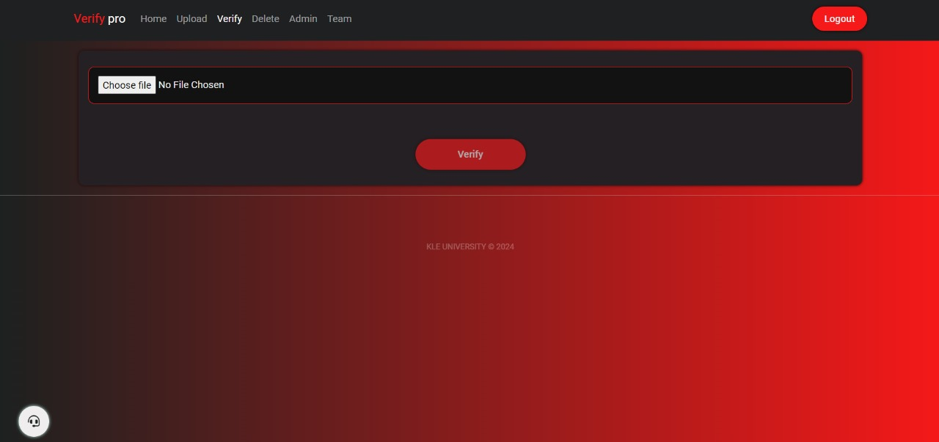

Slide 12
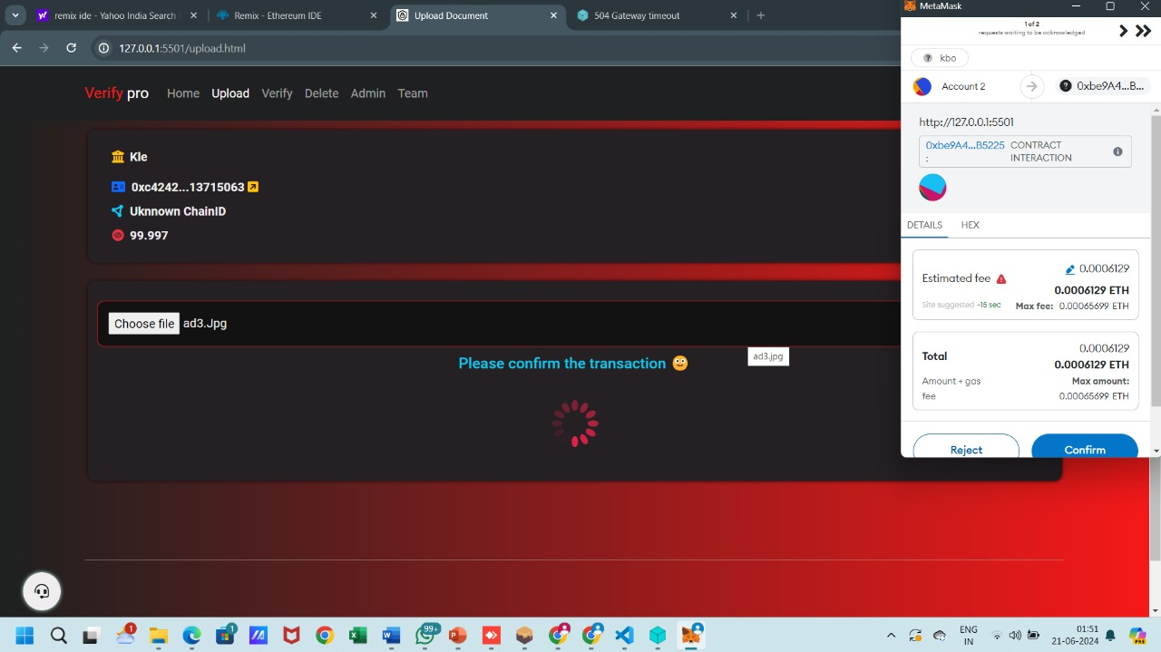

Slide 13
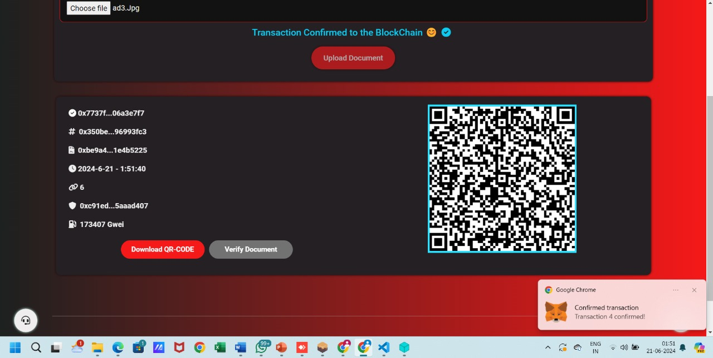

Slide 14
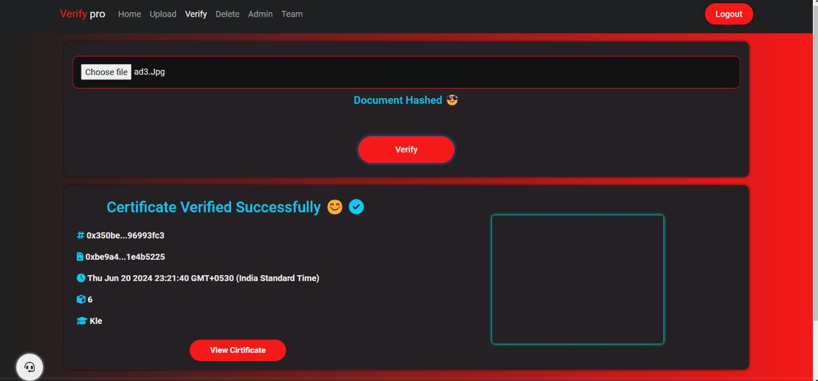

Slide 15
Conclusion
1. Blockchain and IPFS technologies provide an effective solution for secure and decentralized document verification, ensuring integrity and authenticity through immutable storage of document hashes.
2. The decentralized storage by IPFS guarantees the availability and security of documents, preventing tampering and enhancing trust in document authenticity.
3. The user-friendly interface allows easy document upload and verification, making the system accessible across various domains, including finance, healthcare, and education.

Slide 16
References
[1] Smith, J., Doe, J., Zhang, W. (2023). Blockchain-Based Secure Document Verification in Academic Institutions. *IEEE Transactions on Education*. https://doi.org/10.1109/TE.2023.1234567.
[2] Patel, A., Singh, R., Kim, M. (2022). Decentralized Healthcare Record Management Using IPFS and Blockchain. *Journal of Medical Systems, 46*(8). https://doi.org/10.1007/s10916-022-16543-9.
[3] Lee, D., Garcia, M., Chen, L. (2023). Enhancing Supply Chain Transparency and Traceability with Blockchain and IPFS. *International Journal of Production Research, 61*(7), 2135-2150. https://doi.org/10.1080/00207543.2023.1789456.

Slide 17
References
[4] Kumar, R., Jackson, E., Wong, P. (2022). A Blockchain and IPFSBased Secure Voting System. *Computers Security, 119*, 102573. https://doi.org/10.1016/j.cose.2022.102573.
[5] Johnson, M., El-Haj, R., Lin, K. (2023). Decentralized Identity Management Using Blockchain and IPFS. *IEEE Access, 11*, 45567-45578. https://doi.org/10.1109/ACCESS.2023.3245687.
[6] Silva, C., Patel, M., Yamamoto, K. (2022). A Secure and Transparent Blockchain-Based Land Registry System. *Land Use Policy, 114*, 105216. https://doi.org/10.1016/j.landusepol.2022.105216.

Slide 18
THANK YOU

