Slide 1
BT208
TRANSPORT PHENOMENON IN BIOPROCESSES
L-01
Dr. Souptick Chanda
Department Of Biosciences and Bioengineering
Indian Institute of Technology, Guwahati

Slide 2
BT 208 – Syllabus (pre mid-sem)
Introduction to rheology: Definition of transport processes. Basic and derived units and nomenclature. Dimensionless numbers and Dimensional analysis.
Aspects of rheology. Newton's Law. Non-Newtonian fluids and rheology of fermentation broths. Viscosity measurement. Case study.
Fluid flow in pipes: Predicting flow characteristics in pipe systems. Laminar flow and Hagen-Poiseuille equation. Calculating heads in a pipework system. Bernoulli equation. Case study: Bernoulli design problem. Pumping of Liquids (pumps classification, NPSH, cavitation, characteristic curve), Compressor. Flow and pressure measurement.
Fluid flow in packed-bed and Fluidized bed columns: Flow through porous media. Darcy's Law and Carman-Kozeny equation. Determining column porosity. Estimating pressure drops in packed beds. Effect of particle shape. Concept of wall support and effects of compressible media. Concept of critical velocity.

Slide 3
BT 208 – Textbooks and References (pre mid-sem)
Introduction to Fluid mechanics by Fox, Pritchard and McDonald, (Wiley)
Transport Phenomena by Bird, Stewart and Lightfoot, (Wiley)

Slide 4
BT 208 – Course Evaluation
Quiz/Oral – 30%
Written – 60%
Tutorial + Attendance – 10%

Slide 5
Transport Phenomenon
Transport phenomenon is any of the phenomena involving the movement of various entities, such as momentum, mass or energy, through a medium, fluid or solid, by virtue of nonuniform conditions existing within the medium.
Why Transport Phenomenon?
No unifying theory at the beginning with regards to Chemical Engineering
All industries or plants were studied separately in early 1900s
A scientific ‘paradigm’ was required
Paradigm started with unit operations (First paradigm - Systematization)
First textbook on Transport Phenomenon by Bird, Stewart and Lightfoot (1960)
Study of momentum, mass or energy transfer (Second paradigm – Deep fundamental knowledge)
Transport Phenomenon borrows heavily from a lot of different subjects
With an understanding of Transport Phenomenon, any unit operation can be explained/modelled or new technologies be developed.

Slide 6
Transport Phenomenon
What are the Transport Phenomena?
Subject of Transport Phenomena broadly include:
Fluid mechanics – transport of momentum
Heat Transfer – transport of energy
Mass transfer – transport of mass of various chemical species
In this course, we will try to use Transport Phenomena for Bioprocess applications.
Pre- mid semester: Transport of momentum

Slide 7
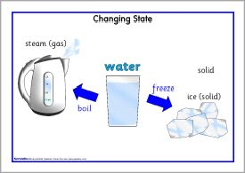
States of Matter
There are three states of matter:
Solid
Liquid
Gas
As shown in the figure, the three states of same substance are Ice (solid), Water(Liquid) and Steam (Gas).
When we apply some force on the solid, it resists deformation. Thus, there is the shape change of the solid only when there is exceedance of some specified amount of shear force(force causing shape change) .
Unlike solid, there is continuously deformation in the liquids and gases, even by a small amount of application of force. The liquids and gases are classified as fluids.
Thus, fluid can be defined as a substance which continuously deform under the action of shear force. The term Rheology is used to describe and assess the deformation and flow behaviour of materials, especially fluid.

Slide 8
Fluid as a continuum
Continuum: A continuous sequence in which adjacent elements are not perceptibly different from each other, but the extremes are quite distinct. (Oxford Dictionary)
Continuum mechanics is a branch of mechanics that deals with the mechanical behaviour of materials modelled as a continuous mass rather than as discrete particles.
Fluid as a continuum: All properties (e.g., P) vary smoothly from point to point and also in time:
i.e. P = P(x,y,z,t)

Slide 9
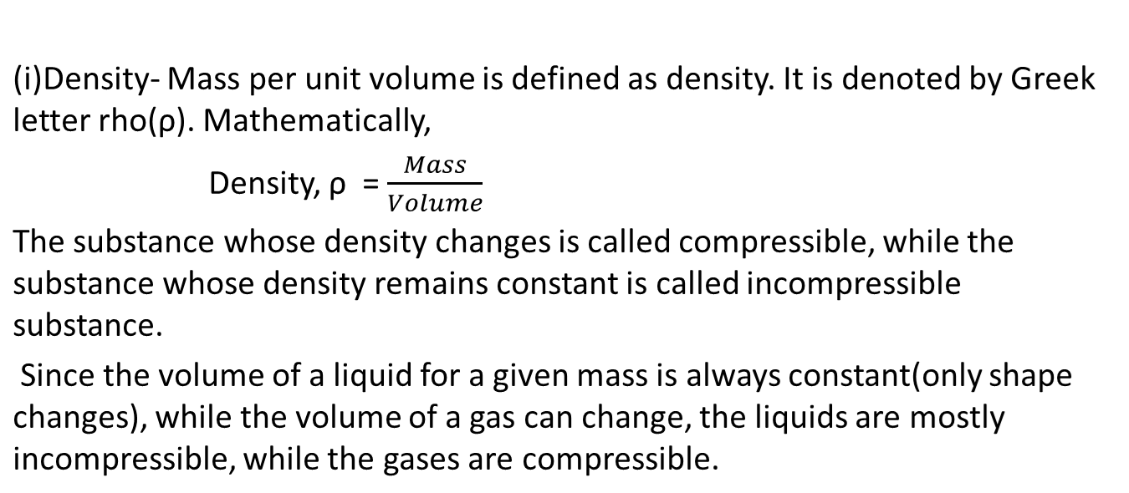
Fluid Properties

Slide 10
Fluid Properties cont…
Atmospheric pressure, also known as barometric pressure (after the barometer), is the pressure within the atmosphere of Earth. Its value is 101,325 Pa.
Pressure measured with reference to the atmospheric pressure is called Gauge pressure.
(iii) Temperature- Temperature is related to internal energy contained within a matter. It expresses hot and cold. It is the source of the occurrence of heat, a flow of energy, when a body is in contact with another that is colder.
Temperature is measured with a thermometer. Thermometers are calibrated in various temperature scales . The most common scales are the Celsius scale (formerly called centigrade, denoted °C), the Fahrenheit scale(denoted °F), and the Kelvin scale (denoted K).

Slide 11
Viscosity
Viscosity can be categorized as transport property of a fluid. It is a measure of resistance to the flow of fluid. It describes the internal friction of a moving fluid acting between one layer to another layer. As the viscosity of a fluid increases, flow speed decreases.
It expresses interaction between fluid layers that can transfer momentum between them.
In Liquids continuous breaking/reforming of interaction between molecules takes place, while in gases the random motion of molecules between layers is the cause of temperature.

Slide 12
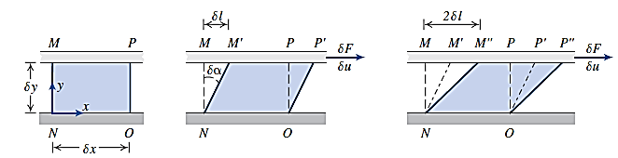






Viscosity
Shear stress
Shear rate = velocity gradient

Slide 13


How to specify shear stress
Surface area on which the shear stress is acting, i.e. the y-plane
y
Fluid
x
Shear stress acting on y-plane, but in x direction

Slide 14
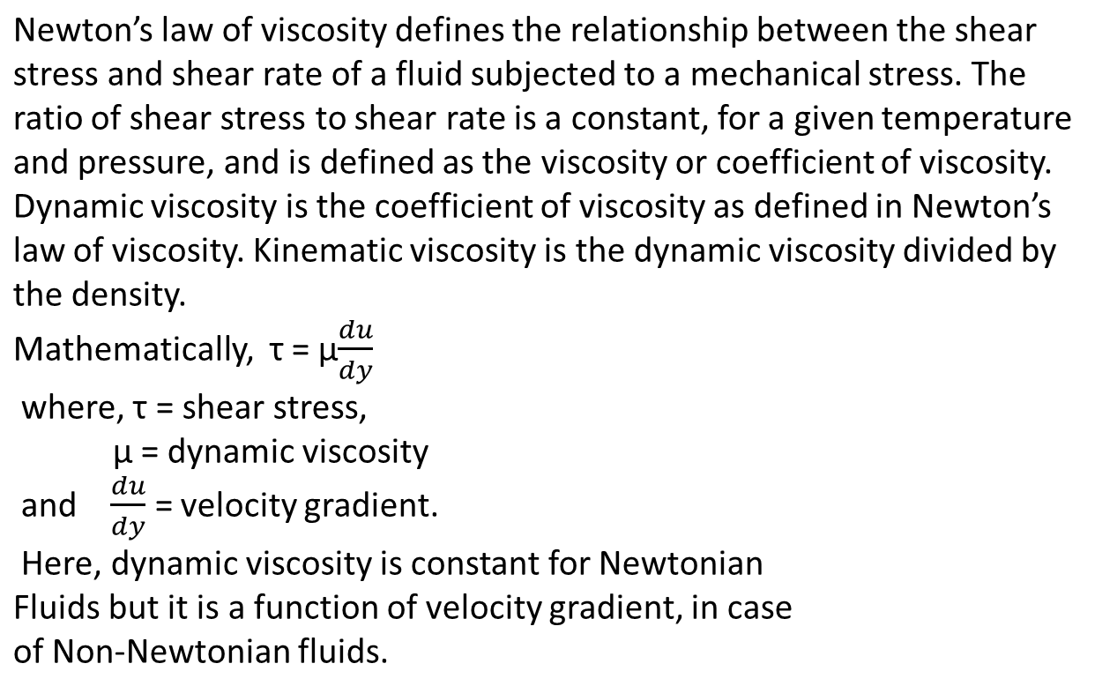
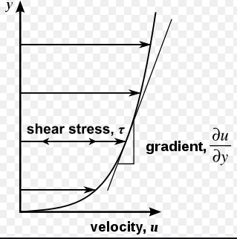
Newton’s Law of Viscosity
y
Shear stress distribution for above parabolic velocity profile
Kinematic viscosity: υ = µ/ρ
x

Slide 15
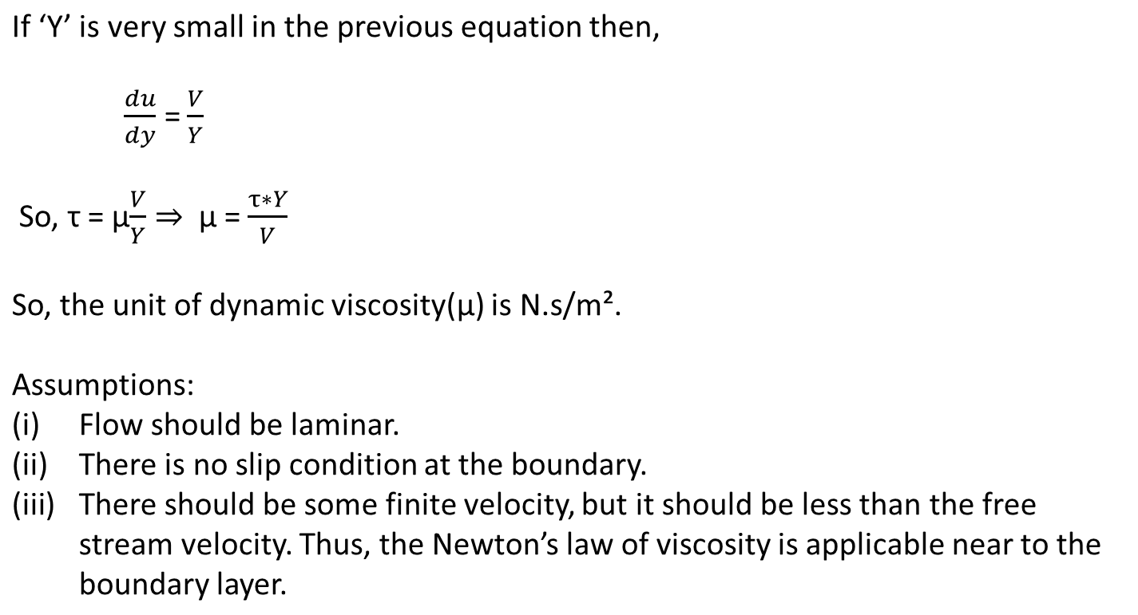

Newton’s Law of Viscosity cont…
Under application of a shear force F, two solids of different shear modulus will deform differently in magnitude. But two fluids of different viscosity will have different deformation rate.
(poise in CGS system)
Time dependence unlike solid

Slide 16
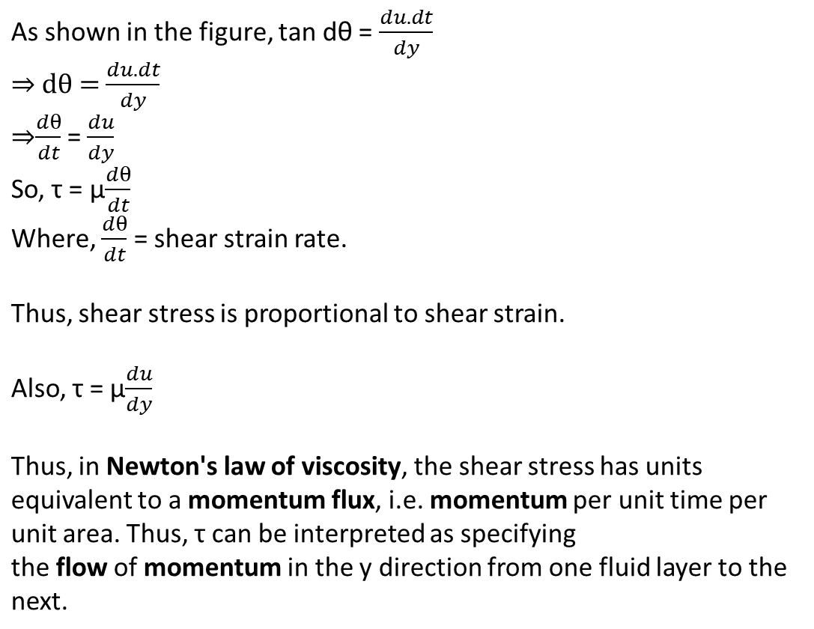
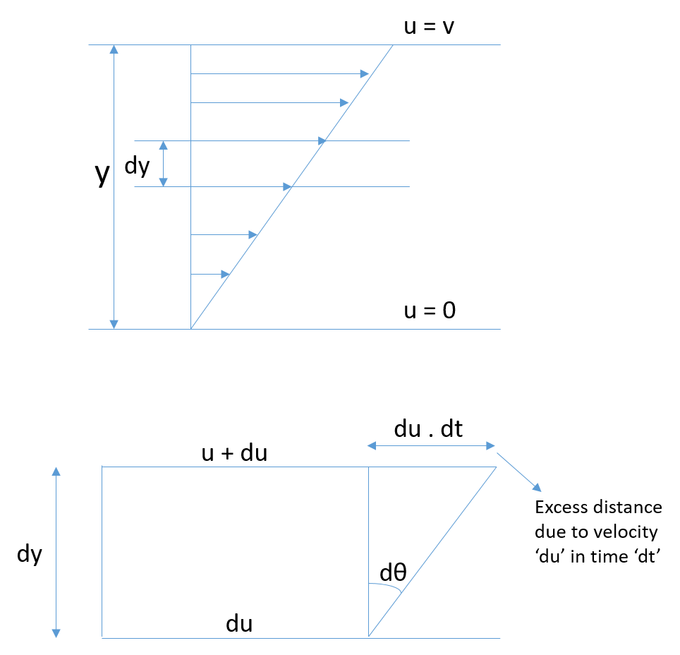
Newton’s law of Viscosity cont…

Slide 17
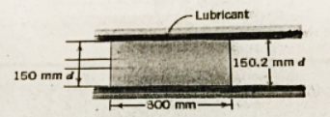
Problem 1:
A piston is reciprocating inside a cylinder as shown in the figure. The lubricant has a kinematic viscosity of 2.8*10⁻⁵ m²/s and SG of 0.92. If the mean velocity of the piston is 6 m/s, approximately what is the power dissipated due to friction?

Slide 18
Given: The kinematic viscosity: υ = 2.8*10⁻⁵ m²/s; specific gravity SG = 0.92; Mean velocity V = 6 m/s.
Assumption: Linear velocity profile; negligible end effects.
Find: Power P_{f} dissipated due to friction based on Newton’s law of viscosity.
Hint:
Dynamic viscosity: µ = υ*ρ; where ρ = SG*(ρ of water)
Shear stress τ = µ*(V/Y); where Y = 0.1 mm
Shear force F = τ*A; where A is the surface area of the cylinder
Power dissipated due to friction: P_{f} = F*V

Slide 19
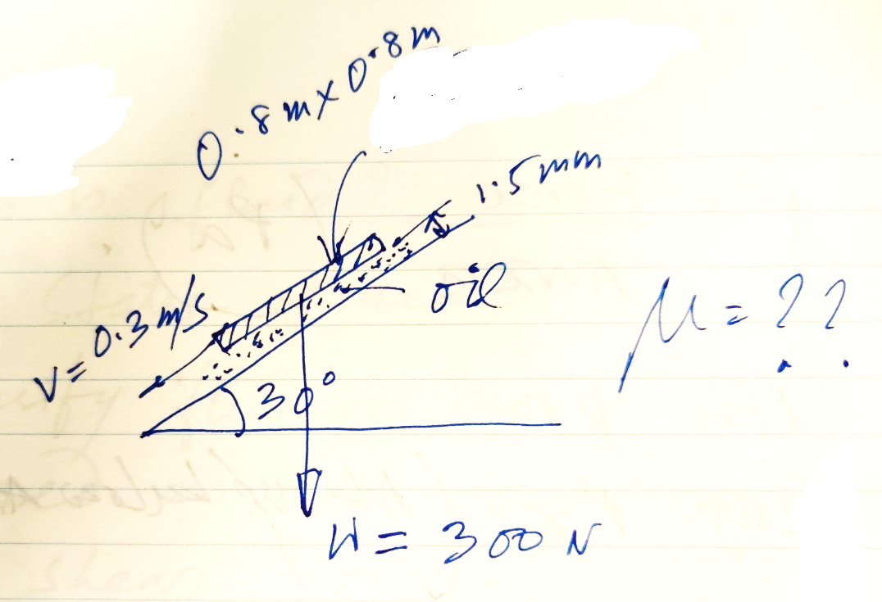
Problem 2:
Find out dynamic viscosity of the oil if the plate of weight W = 300N comes down the slant surface with a constant velocity V = 0.3 m/s.
Hint:
Assume ‘thin’ film of oil.
Find out Shear force acting on the oil surface from free body diagram of the plate.
Find out shear stress acting on the oil film.
Find out viscosity using Newton’s law.

Slide 20
Newtonian versus Non-Newtonian fluids
The fluids which follows the Newton’s law of viscosity are called as Newtonian fluids while the fluids which do not follow the Newton’s Law of viscosity are called non-Newtonian fluids.
The flow behavior or viscosity of Newtonian fluids only changes with changes in temperature and it is independent of the rate of shear. Thus, viscosity of Newtonian fluids remain constant at a particular temperature. The viscosity of Newtonian fluids will remain a constant no matter how fast they are forced to flow through pipe or channel. Some examples of Newtonian fluids include water, organic solvents etc.
The viscosity is a function of velocity gradient in case of Non-Newtonian fluids. The viscosity of non-Newtonian fluids can change when it is forced to move. Ketchup, for example, becomes runnier when shaken and is thus a non-Newtonian fluid. Many salt solutions, toothpaste, shampoo, blood etc. are examples of non-Newtonian fluids.

Slide 21
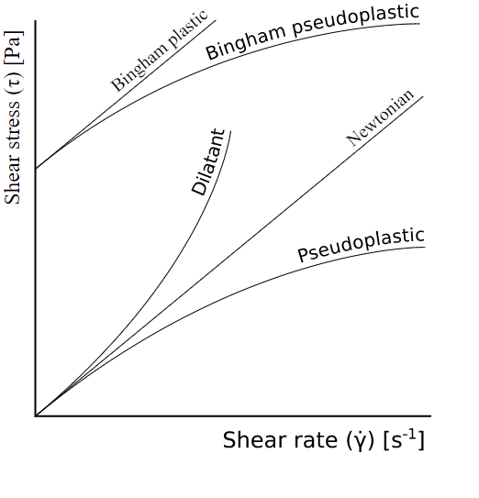
Newtonian versus Non-Newtonian fluids cont…
In a Newtonian fluid, the relation between the shear stress and the shear rate is linear, passing through the origin, the constant of proportionality being the coefficient of viscosity. In a non-Newtonian fluid, the relation between the shear stress and the shear rate is different. Some fluid can even exhibit time-dependent viscosity. Therefore, a constant coefficient of viscosity cannot be defined.
The figure on the right shows the shear stress vs shear rate plot of Newtonian fluids and different types of non-Newtonian fluids. It is called Rheological diagram.

Slide 22
Newtonian versus Non-Newtonian fluids cont…
Newtonian fluids are normally comprised of small isotropic (symmetric in shape and properties) molecules that are not oriented by flow. However, it is also possible to have Newtonian behavior with large anisotropic molecules. For example, low concentration protein or polymer solutions might display a constant viscosity regardless of shear rate. It is also possible for some samples to display Newtonian behavior at low shear rates with a plateau known as the zero shear viscosity region.
Non-Newtonian behaviour of fluids can be caused by several factors, all of them related to structural reorganization of the fluid molecules due to flow.

