Slide 1
BT208
TRANSPORT PHENOMENON IN BIOPROCESSES
L-02
Dr. Souptick Chanda
Department Of Biosciences and Bioengineering
Indian Institute of Technology, Guwahati

Slide 2
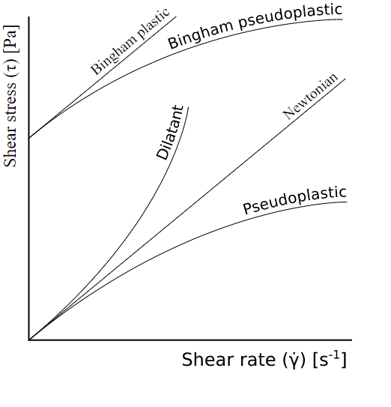
Types of non-Newtonian fluids – Time independent
Different types of non-Newtonian fluids based on shear stress behaviour are -
Bingham Plastic
Bingham pseudoplastic
Dilatant or Shear Thickening fluid
Pseudoplastic or Shear Thinning fluid
(i) Bingham Plastic –
These are fluids that require a minimum threshold stress to be applied before they flow. These are strictly non-Newtonian, but once the flow starts they behave essentially as Newtonian fluids. A great example of this kind of behaviour is toothpaste.

Slide 3
Types of non-Newtonian fluids – Time independent
(ii) Bingham pseudoplastic –
They are just like Bingham plastics except that they thin out with a higher shear rate. For example, mayonnaise (thick cold sauce) will not flow from a bottle until it is squeezed. The harder we squeeze it, the thinner it will come out.
(iii) Dilatant or Shear thickening fluid-
A fluid is shear thickening if the viscosity of the fluid increases as the shear rate increases. A common example of shear thickening fluid is a mixture of cornstarch (finely grained maize flour) and water (also called Oobleck). People can run over this kind of solutions and yet, they will sink if they stand still.
(iv) Pseudoplastic or shear thinning fluid –
Fluids are shear thinning if the viscosity decreases as the shear rate increases. Common examples include ketchup, paints and blood.

Slide 4
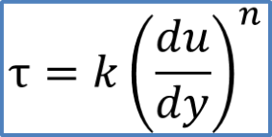
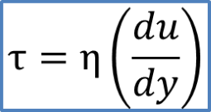
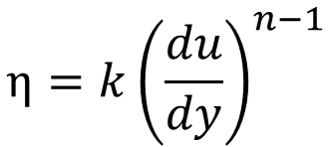
Non-Newtonian fluids: mathematical expression
The shear stress to shear rate behaviour of non-Newtonian fluids can be expressed mathematically as follows:
Where k is called the consistency index and n is known as flow behaviour index (n > 0). The above expression can be rewritten as follows:
where

Slide 5
Non-Newtonian fluids: mathematical expression
n = 1
Flow behaviour index (n > 0)
n > 1
n < 1

Slide 6
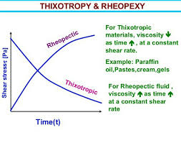
Types of non-Newtonian fluids – Time dependent
On the basis of time dependence behaviour, non-Newtonian fluids can be categorized as:
Thixotropic fluids
Rheopectic fluids
(i) Thixotropic fluids -
For these types of fluids, viscosity increases with time, i.e. longer stirring yields a thinner fluid. Leave them and they will thin out. For example, nail polish will thin out the longer we shake the bottle.
(ii) Rheopectic fluids -
Its viscosity decreases with time, i.e. longer stirring yields a thinner fluid. Leave them and they will thicken. For example, Cream will thicken the longer we stir it.

Slide 7
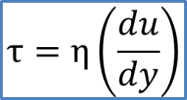
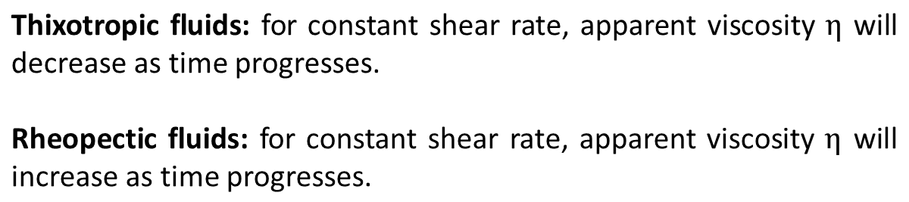
Types of non-Newtonian fluids – Time dependent

Slide 8
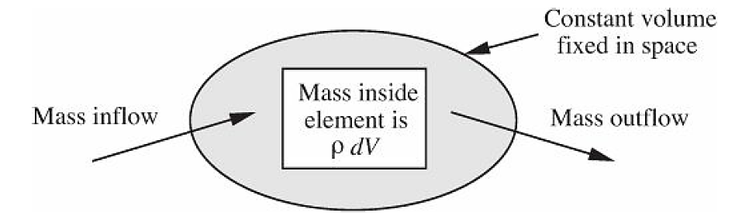
Conservation of Mass (Continuity Equation)
A differential mass balance or conservation of mass, also known as the continuity equation, is readily derived by accounting for the change of mass inside the fixed, constant-volume element dV.
Assuming that dV is sufficiently small so that at any instant the density ρ is uniform within it, its mass becomes ρdV.
Control volume for differential mass balance

Slide 9



Conservation of Mass
Due to fluid flow, there will be transfer of mass into and from the element, the local mass flux being ρv. The net rate of outflow of mass per unit volume is (divergence). Equating the net rate of inflow of mass (the negative of the outflow) to the rate of accumulation in the element:
…………………….(1)
Cancellation of the constant volume dV and rearrangement gives:
……………………..(2)
v stands for velocity, whereas V means volume

Slide 10
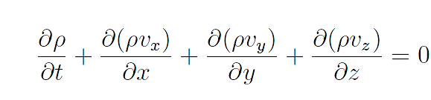
Conservation of Mass
Expanding the equation (2) after applying the ‘del’ operator, the differential mass balance or continuity equation appears as:
……….(3)
The equation states that the density and velocity components cannot change arbitrarily, but are always constrained in their variations so that mass is conserved. Therefore, it is also called the conservation of mass equation.

Slide 11


Conservation of Mass
The continuity equation simplifies enormously if the density is constant, which is approximately true for the majority of liquids. Moreover, for incompressible fluids, there is no variation of density in space or time. In this event, Eqn. (2) is reduced to the following form:
……………………………(4)
After applying the ‘del’ operator, the continuity equation becomes,
…………………………(5)

Slide 12
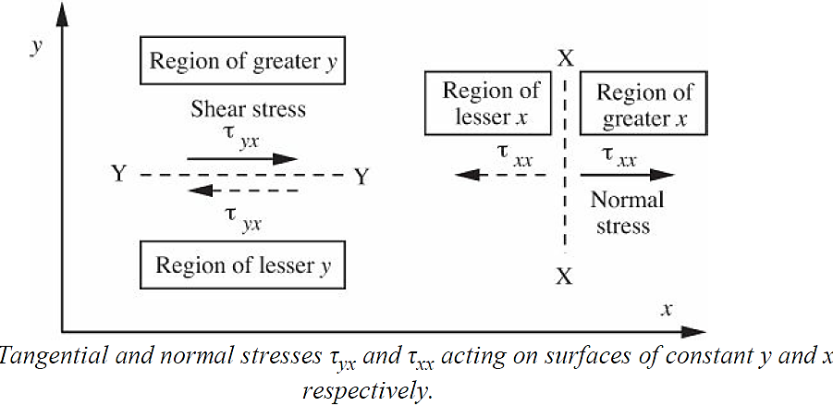
Conservation of Momentum
The momentum balances or conservation of momentum equations can be derived for three coordinate directions. These momentum balances equations are essential in order to comprehend the basic equations of fluid mechanics.

Slide 13
Conservation of Momentum
In the figure, stresses have been represented by the symbol “τ”, with two subscripts.
The first subscript denotes the surface on which the stress acts. For example, the stress τ_{yx} acts on a surface of constant y, whereas τ_{xx} acts on a surface of constant x.
The second subscript denotes the direction of the stress, considered to be positive when exerted by the fluid in the region of greater “first subscript” on the fluid of lesser “first subscript”. For example, τ_{yx} acts in the x direction (corresponding to its second subscript) for the fluid of greater first subscript, y ,(above the line Y-Y) acting on the region of lesser y (below the line Y–Y). Likewise, τ_{xx} also acts in the x direction (corresponding to its second subscript) for the fluid of greater first
subscript, x (to the right of the line X–X), acting on the region of lesser x (to the left of the line X–X).

Slide 14
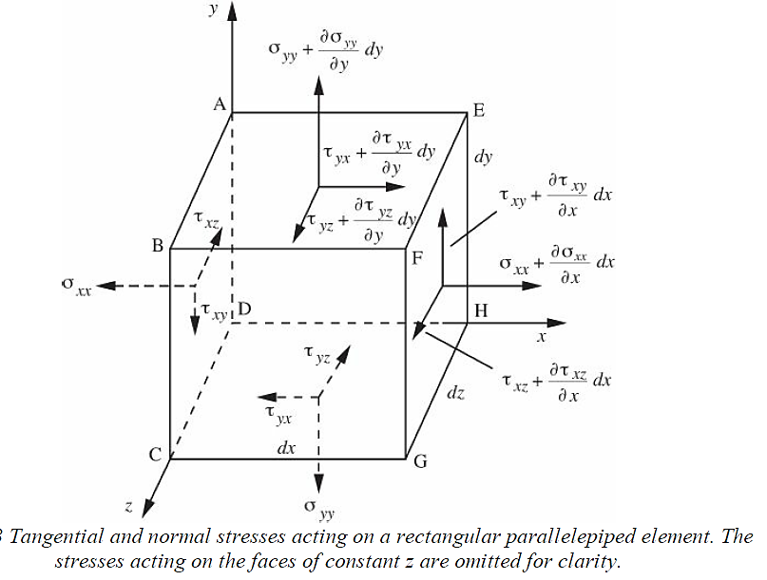
Conservation of Momentum
Stresses are always perfectly balanced across surfaces such as those represented by X-X and Y-Y. Thus, the stress τ_{yx} below the surface Y-Y (shown by the dashed arrow in previous figure) is exactly the same as that above Y–Y, but in the opposite direction. The same can be said for τ_{xx} .

Slide 15

Conservation of Momentum
On the fluid element there are six normal stresses (one for each face) and twelve tangential or shear stresses (two for each face), for a total of eighteen stresses.
The usual symbol τ is used to denote the tangential or viscous shear stresses. However, the normal stresses are denoted by a different symbol,σ(sigma). Normal stresses such as σ_{xx} can be decomposed into two parts, σ_{xx} = -p + τ_{xx} ,namely:
The fluid pressure which, being compressive, acts in the opposite direction to that of the convention, and is given a negative sign, as in –p.
An additional contribution, due to viscous action, such as τ_{xx} .
Stresses change by a differential amount from one face to the opposite face. For example, τ_{yx} , acting in the negative x direction on the bottom face, is augmented to acting in the positive x direction, on the top face.

Slide 16
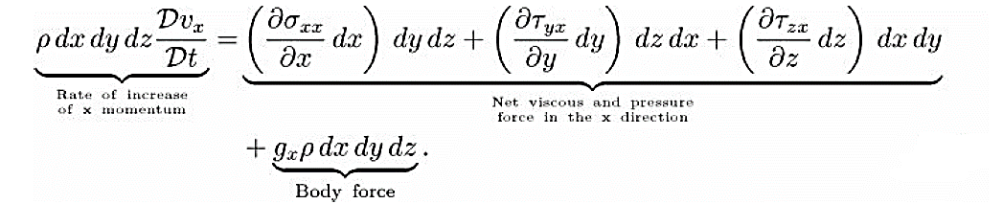
Conservation of Momentum
Let us denote the body forces per unit mass acting in the three coordinate directions as g_{x} , g_{y} , and g_{z} . In the usual case, with the z axis pointing vertically upward, g_{x} = g_{y} = 0, and g_{z} =-g, where g is the gravitational acceleration.
A momentum balance on an element of fixed mass (ρ dx dy dz) that is moving with the fluid, in the x direction gives:
…………………..(6)
Two types of forces: surface and body forces

Slide 17
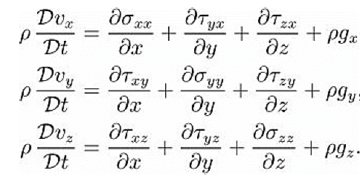
Conservation of momentum
Division of equation (6) by the common volume (dx dy dz), and repetition for the other two coordinate directions gives:
………………(7)
These momentum balance equations, with stress components on the right hand sides, may be useful in circumstances, when special formulas for the stresses are available . These can be useful in case of both Newtonian and non-Newtonian fluids.

Slide 18
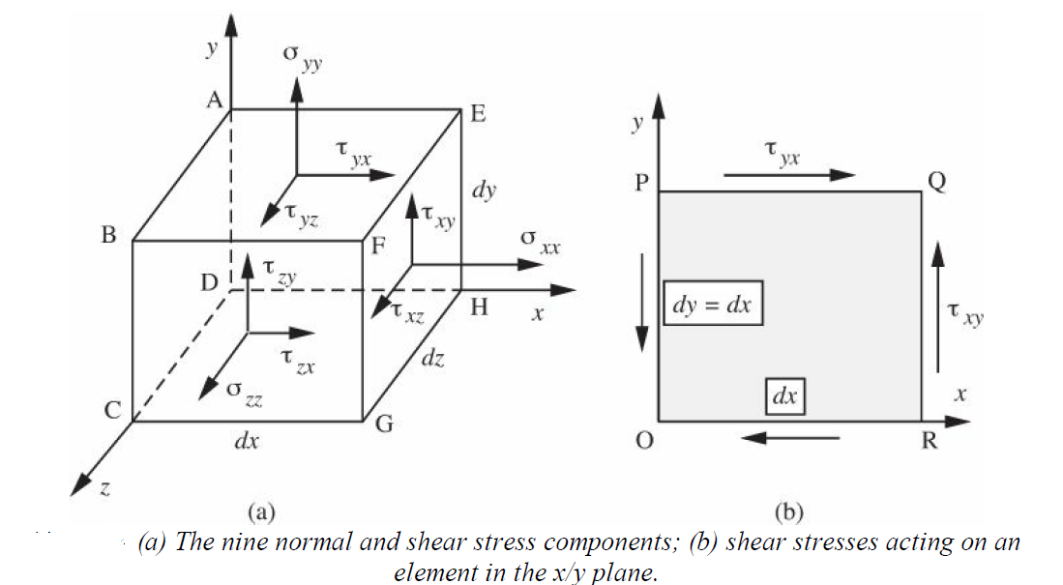
Conservation of Momentum
Newtonian Stress Components in Cartesian Coordinates:

Slide 19
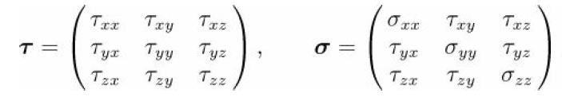
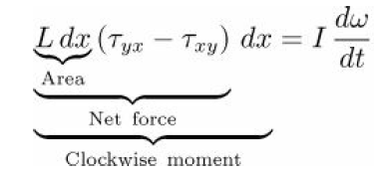
Conservation of Momentum cont…
The assembly of all nine components in the form of a matrix is called a tensor. Thus, both the viscous-stress and the total-stress tensors are expressed as :
……..(8)
Consider a rectangular parallelepiped element of fluid extending for any distance L in the z direction, and whose square cross section dx × dx in the x/y plane (Fig(b)). There are four relevant shear stresses, indicated by the arrows, which, if not in balance, may cause the element to rotate. Equating the net clockwise moment about the origin O to the product of the moment of inertia I of the element times its rate of increase of angular velocity dω/dt:
………(9)

Slide 20
Conservation of Momentum cont…
On the left-hand side, the second dx is the radius arm for multiplying the net force in order to obtain the torque. For the element, I can be shown to be proportional to (dx)^4. Cancellation of (dx)^2 leaves a factor of (dx)^2 on the right-hand side. Since dω/dt remains finite as dx approaches zero, this can only occur if:
τ_{yx} = τ_{xy} …….(10)
Similarly, τ_{zy} = τ_{yz} and τ_{xz} = τ_{zx} . That is, there are only three independent shear – stress components.

Slide 21
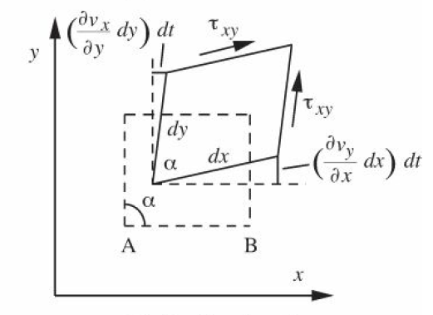
Conservation of Momentum cont…
Basic relation for a Newtonian fluid: Consider first the bottom side AB of the element. The rate at which any point on it moves in the direction depends on the local value of v_{y} , and should this vary with x, then the side will be tilted one way or the other and will no longer be parallel to the x axis. Hence, during the time dt, point B will
have advanced by an amount (∂vy/∂x) dx dt relative to point A, and the side AB will therefore be tilted counterclockwise by an angle (∂vy/∂x) dt. By a similar argument, the left-hand side of the element will be tilted clockwise by an angle (∂υx/∂y) dt. Both of these actions (as drawn) tend to diminish the angle α; summation of the effects and division by dt gives:
Combination of Translation, Rotation and Shear of Newtonian Fluid

Slide 22


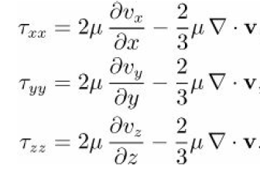
Conservation of Momentum cont…
…………(11)
Also, for Newtonian fluid:
……… (12)
Similar relations can be deduced for the other shear stresses. The normal stresses component due to shear terms can be given by
……..(13)

Slide 23
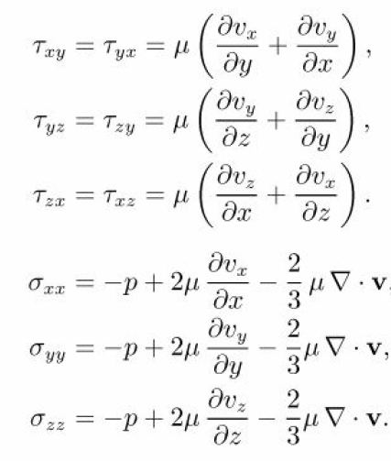
Conservation of Momentum cont…
Thus, all the stress components can be given by:
……………(14)
……………(15)

Slide 24
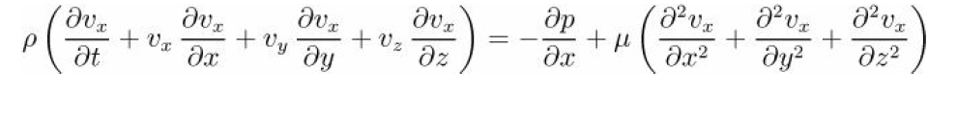
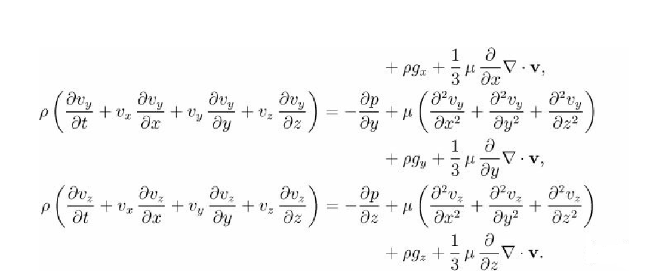
Conservation of Momentum Cont…
The shear and normal stress relations of equations (14) and (15), can be substituted into three momentum balances of equation(7) to get relation for Newtonian fluids.
………..(16)

Slide 25
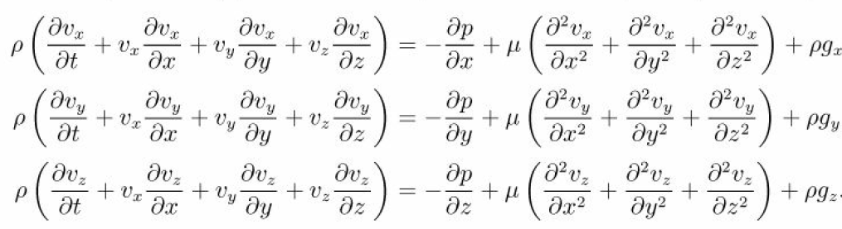
Conservation of Momentum cont…
By neglecting second viscous terms, the momentum balance equations for Newtonian fluids can be simplified to
…………………………(17)
These equations are also called Navier-Stokes equations.

