Slide 1
BT208
TRANSPORT PHENOMENON IN BIOPROCESSES
L-03
Dr. Souptick Chanda
Department Of Biosciences and Bioengineering
Indian Institute of Technology, Guwahati

Slide 2
Types of Viscous Flow
Two broad classes of viscous flow are
Poiseuille Flow
Couette Flow
Poiseuille flow-
In this type of flow, an applied pressure difference causes fluid motion between stationary surfaces.
Couette flow-
In this type of flow, a moving surface drags adjacent fluid along with it and thereby imparts a motion to the rest of the fluid.
Occasionally, it is possible to have both types of motion occurring simultaneously.

Slide 3
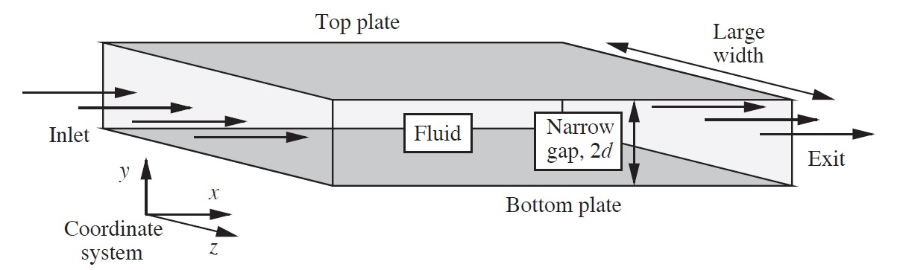
Analysis of Flow Between Parallel Plates
The figure shows the flow of a fluid of viscosity µ, which flows in the x direction between two rectangular plates, whose width is very large in the z direction when compared to their separation in the y direction. Such a situation could occur in a die when a polymer is being extruded at the exit into a sheet, which is subsequently cooled and solidified.

Slide 4
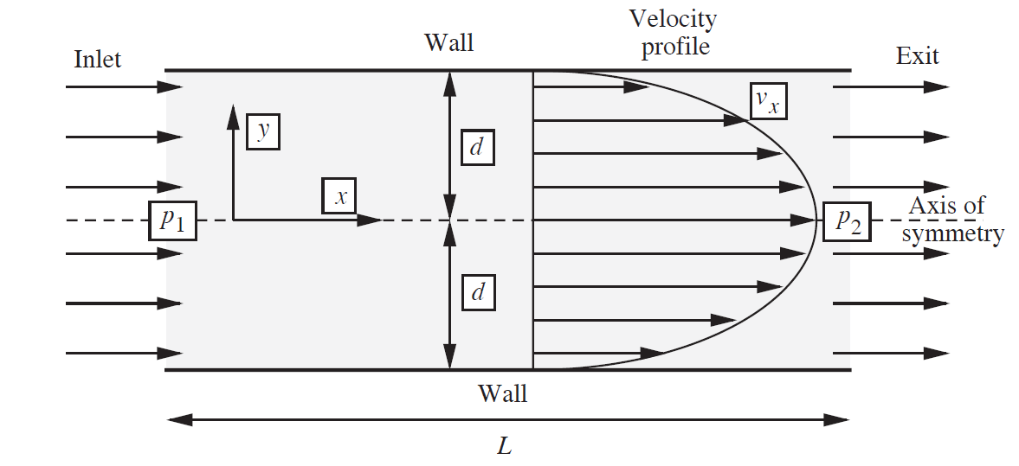
Analysis of Flow Between Parallel Plates cont…
The situation could be analyzed by referring to a cross section of the duct, shown in the below figure, taken at any fixed value of z. Let the depth be 2d (d above and below the centerline or axis of symmetry y = 0), and the length L. Here, the motion is of the Poiseuille type, since it is caused by the applied pressure difference (p₁ – p₂).

Slide 5
Analysis of Flow Between Parallel Plates cont…
Simplifying assumptions-
Flow is steady and Newtonian, with constant density and viscosity.
There is only one nonzero velocity component- that is in the direction of flow , v_{x}. Thus, v_{y} = v_{z} = 0.
(iii) Since, in comparison with their spacing, 2d, the plates extend for a very long distance in the z direction, all locations in this direction appear essentially identical to one another. In particular, there is no variation of the velocity in the z direction.
(iv) Gravity acts vertically downwards; hence g_{y} = -g and g_{x} = g_{z} = 0.
(v) The velocity is zero in contact with the plates, so that v_{x}=0 at
y = +- d (no-slip condition).

Slide 6
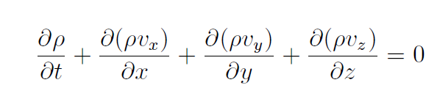
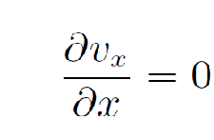
Analysis of Flow Between Parallel Plates cont…
Continuity- General continuity equation is written as
……….……(1)
Which, in view of the constant-density assumption and considering zero velocity component in the y and z direction simplifies to
...............(2)
So v_{x} is independent of the distance from the inlet, and the velocity profile will appear the same for all values of x. Also, there is no variation in velocity in z direction, it follows that v_{x} is a function of y only.

Slide 7
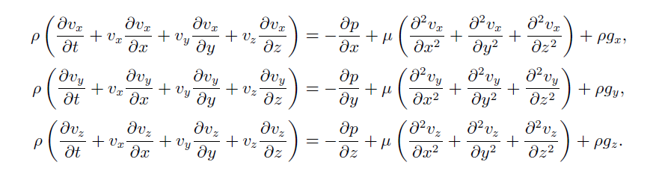
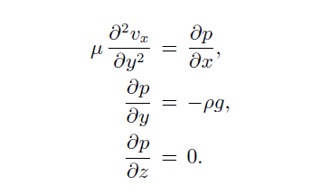
Analysis of Flow Between Parallel Plates cont…
Momentum balances- With the stated assumptions of a Newtonian fluid with constant density and viscosity, the x, y and z momentum balance equation is written as
…………(3)
…………(4)
………….(5)
With the assumptions considered , the above equations simplify enormously, to :
………..(6)
………..(7)
...……..(8)

Slide 8


Analysis of Flow Between Parallel Plates cont…
Pressure distribution: The last of the simplified momentum balances, indicates no variation of the pressure across the width of the system (in the z direction). When integrated, the second simplified momentum balance, predicts that the pressure varies according to :
…………………(9)
Since a partial differential equation is being integrated, in the above equation , we obtain not a constant of integration, but a function of integration, f(x).
Assume that dp/dx is constant, so that the centerline pressure (at y=0) is given by a linear function of the form:
…………….(10)

Slide 9
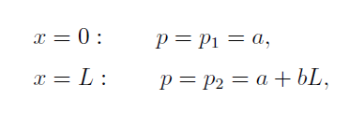

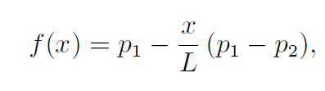

Analysis of Flow Between Parallel Plates cont…
The constants a and b may be determined from the inlet and exit centerline pressures:
………………….(11)
leading to:
………………….(12)
Thus, the centerline pressure declines linearly from p₁ at the inlet to p₂ at the exit:
……………….(13)
So that the complete pressure distribution is
………………..(14)

Slide 10



Analysis of Flow Between Parallel Plates cont…
Thus, the pressure declines linearly, both from the bottom plate to the top plate, and also from the inlet to the exit. In the majority of applications, 2d << L, and
the relatively small pressure variation in the y direction is usually ignored. Thus,
p₁ and p₂, although strictly the centerline values, are typically referred to as the
inlet and exit pressures, respectively.
Velocity profile- Since v_{x} does not depend on x, appearing in simplified momentum balance equation becomes a total derivative, so this equation can be rewritten as:
which is a second-order ordinary differential equation, in which the pressure gradient will be shown to be uniform between the inlet and exit , being given by:
……………………(15)
…………………(16)

Slide 11
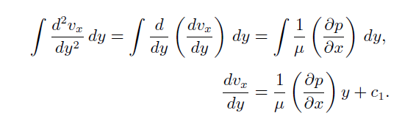
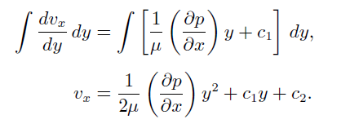
Analysis of Flow Between Parallel Plates cont…
Equation (15) can be integrated twice, in turn, to yield an expression for the velocity. After multiplication through by dy, a first integration gives:
………….(17)
A second integration, of equation (17), yields:
…………..(18)

Slide 12
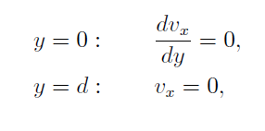


Analysis of Flow Between Parallel Plates cont…
The two constants of integration, c₁ and c₂, are determined by invoking the boundary conditions :
…………….(19)
…………….(20)
leading to:
…………..(21)
Equations (18) and (21) then furnish the velocity profile:
This represents that velocity profile is parabolic in shape.
…………….(22)

Slide 13




Analysis of Flow Between Parallel Plates cont…
Volumetric flow rate – Integration of the velocity profile yields an expression for the volumetric flow rate Q per unit width of the system. The differential flow rate through an element of depth dy is dQ = v_{x}dy, so that:
……(23)
Since from an overall macroscopic balance Q is constant, it follows that is also constant, independent of distance x. The mean velocity is the total flow rater per unit depth:
…….(24)
and is therefore two-thirds of the maximum velocity, , which occurs at the centerline, y=0.

Slide 14


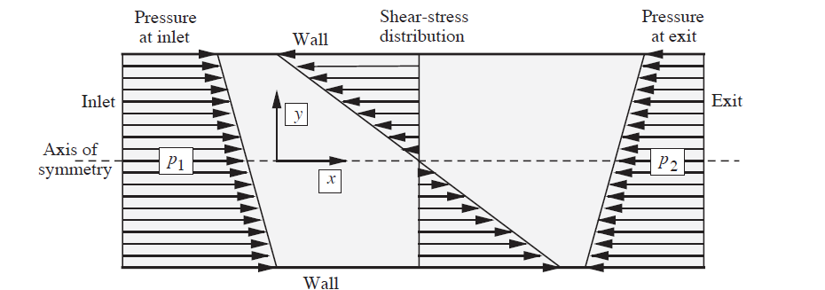
Analysis of Flow Between Parallel Plates cont…
Shear-stress distribution – The shear-stress distribution is given by:
………………..(25)
By substituting for v_{x} and recognizing that v_{y}=0, the shear stress is:
………………. (26)
Pressure and shear-stress distributions

