Slide 1
BT208
TRANSPORT PHENOMENON IN BIOPROCESSES
L-04
Dr. Souptick Chanda
Department Of Biosciences and Bioengineering
Indian Institute of Technology, Guwahati

Slide 2
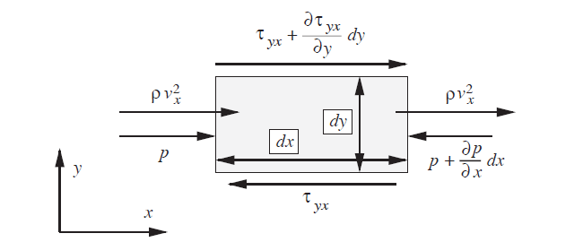
Shell Balance for Flow Between Parallel Plates
The necessary “shell” is in reality a differential element of fluid, as shown in the below figure. The element, which has dimensions of dx and dy in the plane of the diagram, extends for a depth of dz, normal to the plane of the diagram.
If, for the present, the element is taken to be a system that is fixed in space, there are three different types of rate of x-momentum transfer to it:
Momentum balance on a fluid element

Slide 3


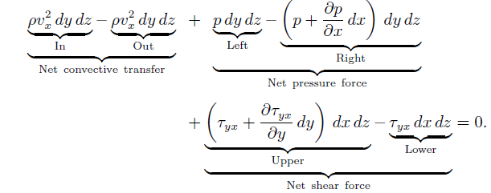
Shell Balance for Flow Between Parallel Plates cont…
(i) A convective transfer of in through the left-hand face, and an identical amount out through the right-hand face. Here, we have implicitly assumed the consequences of the continuity equation, that v_{x} is constant along the duct.
(ii) Pressure forces on the left- and right-hand faces. The latter will be smaller, because is negative in reality.
(iii) Shear stresses on the lower and upper faces. The directions of the arrows conform strictly to the sign convention established.
A momentum balance on the element , which is not accelerating , gives:
…………(27)

Slide 4


Shell Balance for Flow Between Parallel Plates cont…
The usual cancellations can be made in equation (27) resulting in:
…………………….(28)
in which the total derivative recognizes that the shear stress depends only on y and not on x. Substitution for with v_{y}= 0 gives:
………………..…..(29)
The remainder of the development proceeds in the same way as for the flow in rectangular duct.
The convective terms can be sidestepped entirely if the momentum balance is performed on an element that is chosen to be moving with the fluid, in which case there is no flow either into or out of it.

Slide 5
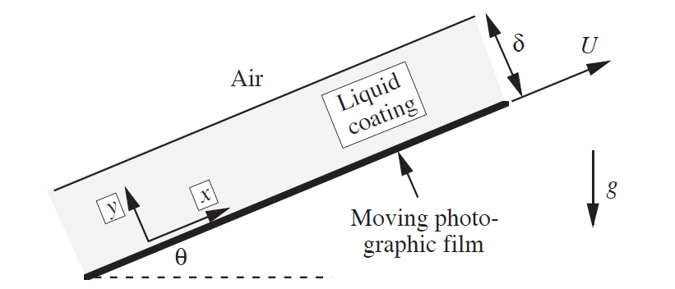
Analysis of Film Flow on a Moving Substrate
The figure shows a flat photographic film that is being pulled up from a processing bath by rollers with a steady velocity U at an angle θ to the horizontal.
As the film leaves the bath, it entrains some liquid, and in this particular experiment it has reached the stage where:
(a) the velocity of the liquid in contact with the film is v_{x} = U at y=0,
(b) the thickness of the liquid is constant at a value δ, and
(c) there is no net flow of liquid (as much is being pulled up by the film as is falling back by gravity).
Note- If the film were to retain a permanent coating , a net upwards flow of liquid would be needed.
Liquid coating on a photographic film

Slide 6



Analysis of Film Flow on a Moving Substrate cont…
Assumptions and continuity-
The flow is steady and Newtonian, with constant density ρ and viscosity µ.
The z direction , normal to the plane of the diagram, may be disregarded entirely. Thus, not only is zero, but all derivatives with respect to z, such as , are also zero.
There is only one nonzero velocity component , namely , that in the direction of motion of the photographic film , . Thus,
(iv) Gravity acts vertically downwards.
Because of the constant-density assumption, the continuity equation simplifies to:
……………(30)

Slide 7

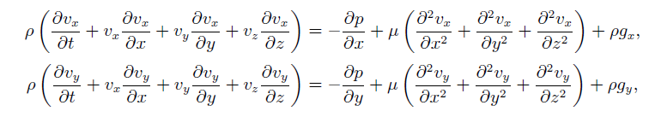
Analysis of Film Flow on a Moving Substrate cont…
But since ,it follows that
………..(31)
so is independent of distance x along the film. Further, does not depend on z; thus the velocity profile depends only on y and will appear the same for all values of x.
Momentum balances- With the stated assumptions of a Newtonian fluid with constant density and viscosity, the x and y momentum balances are:
(32)

Slide 8


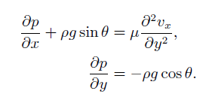


Analysis of Film Flow on a Moving Substrate cont…
Noting that and the momentum balances simplify to:
…………………(33)
…………………(34)
Integration of equation (34), between the free surface at y = δ (where the gauge pressure is zero) and an arbitrary location y (where the pressure is p) gives:
………………..(35)
so that:
………………..(36)
Here, since a partial differential equation is being integrated, a function of integration , f(x) , is again introduced.

Slide 9




Analysis of Film Flow on a Moving Substrate cont…
However, since p=0 at y=δ (the air/liquid interface) for all values of x, the function f(x) must be zero. Hence, the pressure distribution:
……………..(37)
shows that p is not a function of x.
In view of this result, we may now substitute =0 into the x-momentum balance, equation (33) , which becomes:
………………(38)
in which the constant α has been introduced to denote . Here, the second derivative of the velocity now appears as a total derivative, since depends on y only.
A first integration of equation (38) with respect to y gives:
……………….(39)

Slide 10



Analysis of Film Flow on a Moving Substrate cont…
The boundary conditions of zero shear stress at the free surface is now invoked:
………………..(40)
Thus, from equations (39) and (40) at y=δ, the first constant of integration can be determined:
………………..(41)
A second integration, of equation (39) with respect to y, gives:
……………… (42)

Slide 11

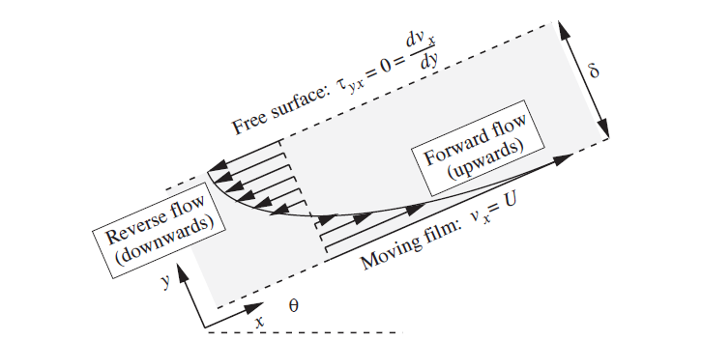
Analysis of Film Flow on a Moving Substrate cont…
The second constant of integration, c₂, can be determined by using the boundary condition that the liquid velocity at y=0 equals that of the moving photographic film. That is, = U at y=0, yielding c₂ = U; thus , the final velocity profile is:
………………..(43)
Velocity profile in thin liquid layer on moving photographic film for the case of zero net liquid flow rate

Slide 12


Analysis of Film Flow on a Moving Substrate cont…
The velocity profile, which is parabolic, consists of two parts :
(i) A constant and positive part, arising from the film velocity, U.
(ii) A variable and negative part, which reduces at increasing distance y from the film and eventually causes it to become negative.
Exactly how much of the liquid is flowing upwards, and how much downwards, depends on the values of the variables U,δ and α. In the case of no net flow of liquid- that is, as much is being pulled up by the film as is falling back by gravity –
………(44)
giving the thickness of the liquid film as:
….…..(45)
The velocity profile for this case of Q=0 is shown in the previous figure.

Slide 13
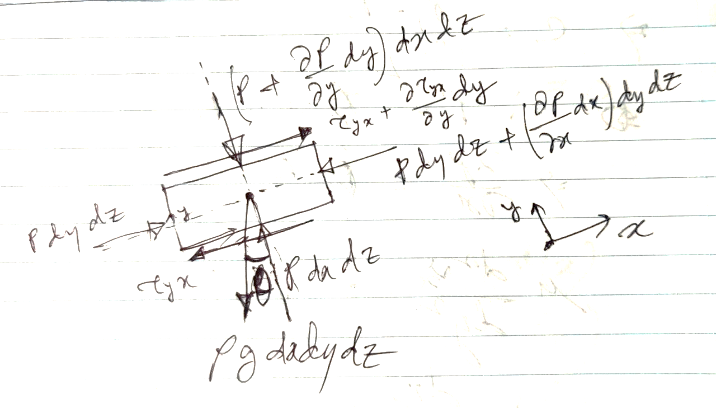
Analysis of Film Flow on a Moving Substrate cont…
Alternative approach: Shell balance principle
Home assignment!

