Slide 1
BT208
TRANSPORT PHENOMENON IN BIOPROCESSES
L-05
Viscous Flow Analysis – Cylindrical Coordinates
Dr. Souptick Chanda
Department Of Biosciences and Bioengineering
Indian Institute of Technology, Guwahati

Slide 2
Viscous Flow Analysis – Cylindrical Coordinates
Several chemical/biochemical/biomedical engineering operations exhibit symmetry about an axis z and involve one or more surfaces that can be described by having a constant radius for a given value of z.
Examples are flow in pipes, extrusion of fibers, and viscometers that involve flow between concentric cylinders, one of which is rotating.
Such cases lend themselves naturally to solution in cylindrical coordinates.

Slide 3
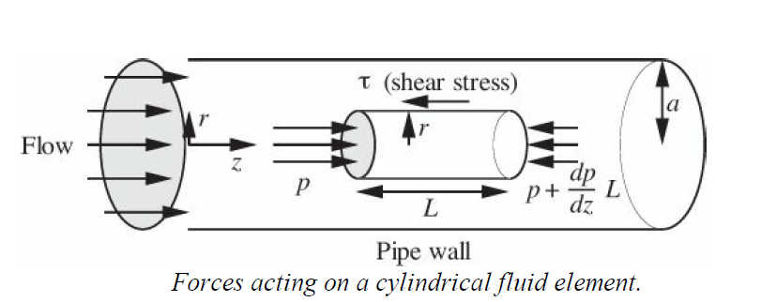
Analysis of Flow in a pipe: Hagen-Poiseuille Eqn.
Consider a moving cylinder of fluid of radius r and length L, in a horizontal cylindrical pipe of radius a. Because of the retarding action of the pipe wall, there will be a shear stress τ exerted to the left on the curved surface of the cylinder by the fluid between it and the pipe wall.

Slide 4

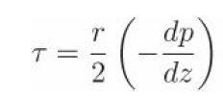
Analysis of Flow in a pipe cont…
Shear Stress- The net pressure force acting on the circular area πr² of the two ends is exactly counterbalanced by the shear stress acting on the curved surface, of area 2πrL . Thus, a steady-state momentum balance to the right gives:
…………(1)
Simplifying,
………..(2)
Since the pressure gradient is readily determined experimentally, above equation may be used for finding the shear stress at any radial location. Since dp/dz is negative , τ is positive.

Slide 5

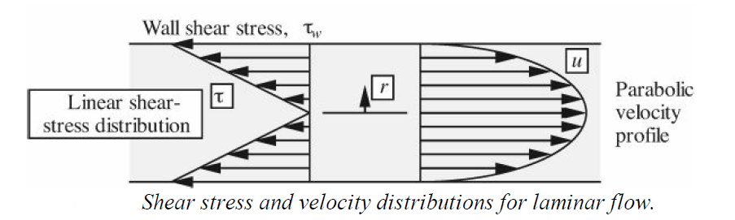
Analysis of Flow in a pipe cont…
Equation (2) predicts a linear variation of τ with r. The shear stress is zero at the centerline, rising to a maximum value of τ_{ω} at the pipe wall.
In the case of laminar flow of a Newtonian fluid, the shear stress is directly proportional to the velocity gradient:
……………………..(3)
in which µ is the viscosity of the fluid.

Slide 6



Analysis of Flow in a pipe cont…
Velocity profile- Elimination of τ between equations (2) and (3) gives:
……………………..(4)
Which integrates to:
……………………..(5)
in which the boundary conditions of u = 0 at r = a reflects a condition of no slip at the pipe wall.
The final expression for the velocity u at any radial location r is:
………………………(6)

Slide 7


Analysis of Flow in a pipe cont…
The pressure gradient can be expressed in terms of the total pressure drop
-Δp over a finite length L, as follows:
……………….(7)
Hence, the velocity profile can also be rewritten as:
…………………(8)
As shown in the right part of the previous figure, the velocity profile is parabolic in shape, and that the velocity is directly proportional to the pressure gradient and inversely proportional to the viscosity.

Slide 8
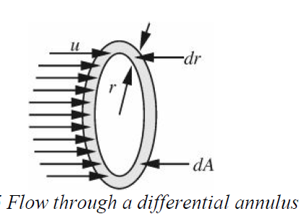
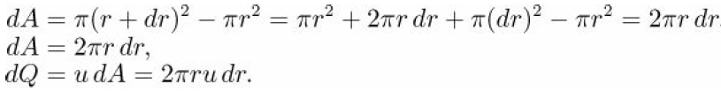
Analysis of Flow in a pipe cont…
Volumetric Flow Rate-The total volumetric flow rate Q is obtained by integration over the cross section of the shape.
Consider the differential annulus of internal
radius r and width dr.
Its area may be obtained in either of two ways:
As the difference in areas between two
Circles of radii r+dr and r, neglecting a term in (dr)² ; or
(b) by “unwinding” the annulus and regarding it as a rectangular strip of length 2πr and width dr. The area dA and the corresponding flow rate dQ through it are:
(9)
(10)

Slide 9
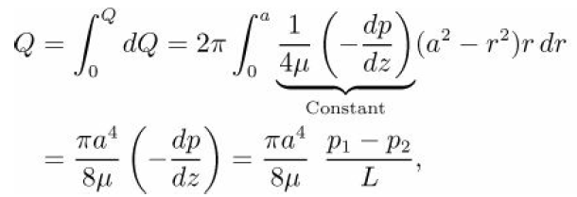
Analysis of Flow in a pipe cont…
The total flow rate is:
……(11)
This relation for pipe flow is know as the Hagen-Poiseuille law.

Slide 10
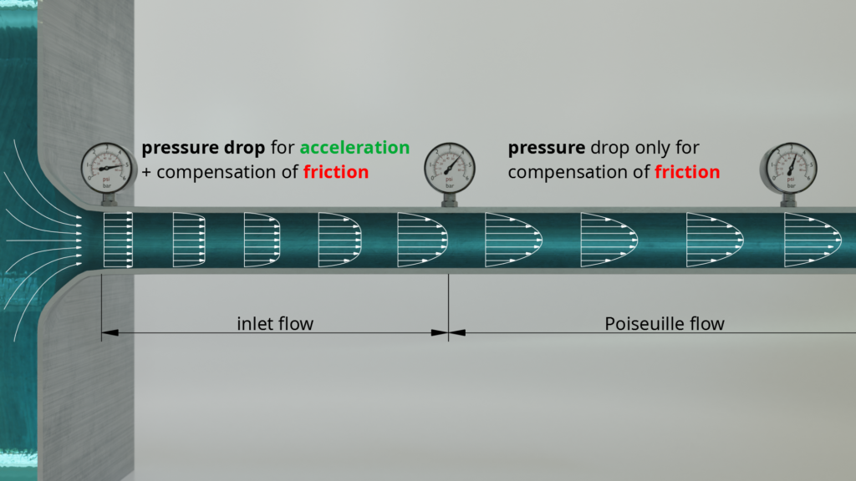
Let’s visualize the flow …
Fully developed flow

