Slide 1
Capstone Project Project : Report Development using Jasper Group - 11 Mentor: Mr. Vijayant Pawar

Slide 2
Index
1.Name of Project.
2.Project Description.
3.Project Scope.
4.Project Team Detail with Roles and Responsibility.
5.Technical detail of project.
a. Language to be used for project.
b. Database to be used for the project.
c. Third party API Detail.
d. Tools to be used.
6.Next deliverable.

Slide 3
1)Name of Project:
Report Development using Jasper
2)Project Description:
Hospital Management System (HMS)
HMS is for computerizing the working in a hospital.
It provide easy and effective storage of information related to patients.
Generates medical history of each registered patient.
Classify the data present using pre-defined parameters and display them in reports.

Slide 4
3)Project Scope:
Help the users in creating report based on pre- defined parameters.
Can help in analysis of the data.
Can be used further to create charts and records.
Make the tasks of finding data of a single patient very convenient.
Reports generated through it can be used for research purposes.

Slide 5
4) Project Team Detail with Roles and Responsibility:
1.Abhishek Pal – U101115FCS271
Email: abhishek.pal@st.niituniversity.in
Contact: 8107107889
Responsibility : Front-end for the web app , Jasper
2.Abhit Gahlot - U101115FCS040
Email: abhit.gahlot@st.niituniversity.in
Contact: 8950050107
Responsibility : Front-end for the web app , Jasper

Slide 6
3.Chinmaya Kumar Bansal - U101115FCS077
Email: chinmaya.k.bansal@st.niituniversity.in
Contact: 9166495625
Responsibility : Back-end for the web app , Jasper
4.Divya Chadha - U101115FCS196
Email: divya.chadha@st.niituniversity.in
Contact: 9711252001
Responsibility : Back-end, JSP(Server connection with back-end), Jasper
5.Kashish Chaurasia - U101115FCS107
Email: kashish.chaurasia@st.niituniversity.in
Contact: 8290784910
Responsibility : JSP(Server connection with back-end), jdbc(oracle connection), oracle for the database, Jasper

Slide 7
5)Technical detail of project.
Language to be used for project.
Front-end:
HTML, CSS, Bootstrap, Javascript, Ajax, Jquery
Back-end:
JAVA , JSP
Database :
SQL
b. Database to be used for the project : ORACLE
c. Third party API Detail : JDBC
d. Tools to be used:
Sublime Text, SQL(Oracle DB), JaspeReports-5.6.0-project, Jaspersoft BI, Eclipse IDE

Slide 8
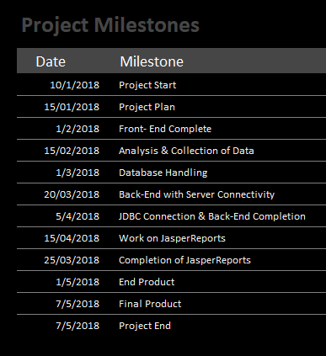
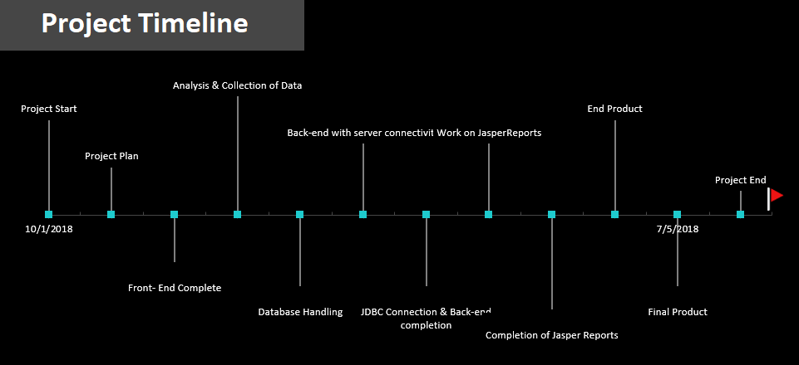
6)Next deliverable:
By our next presentation we aim to develop front-end and simultaneously work on the analysis and collection of data for the database handling and will work on the back-end for the database connection of the Web Application .

