Slide 1

Intelligent Text Summarizer
By
Kashish Banerjee
(B.Tech 4th Year, Enrollment No.:12020002001141 )
Under the Supervision of
Prof. Hriday Banerjee
Dept. of Computer Science & Engineering
University of Engineering & Management, Jaipur

Slide 2
Outlines
Introduction
Literature Review
Objectives
Proposed Model
Experimental Setup
Result Analysis
Conclusion & Future Scope
Reference
Acknowledgement

Slide 3
Introduction
In an era characterized by an unprecedented influx of information, the ability to distill and comprehend vast amounts of text efficiently has become a crucial skill. Recognizing this challenge, we present the Intelligent Text Summarizer, an innovative application designed to revolutionize the way we consume textual content. Whether you're a professional striving to stay abreast of industry trends, a student grappling with extensive research materials, or an avid reader navigating the digital expanse, our intelligent summarizer app is crafted to be your indispensable companion.
The Intelligent Text Summarizer goes beyond conventional text summarization tools, employing cutting-edge natural language processing techniques to understand the nuances of language, context, and key concepts within documents. It is engineered to not only extract pivotal information but also to generate coherent and contextually rich summaries that capture the essence of the original content.

Slide 4
Introduction
In an age where time is a precious commodity, the Intelligent Text Summarizer emerges as a beacon of efficiency, offering users a streamlined pathway to glean insights from lengthy texts swiftly. This introduction provides a glimpse into the transformative capabilities of our app, setting the stage for a closer exploration of its features, customization options, and the seamless integration that makes it an invaluable asset in navigating the information landscape. Embrace the future of text comprehension with the Intelligent Text Summarizer—an application that empowers you to extract knowledge, save time, and stay ahead in a world inundated with information.

Slide 5
Literature Review
A literature review for a text summarizer app would involve examining existing research and publications related to text summarization, natural language processing (NLP), and relevant technologies. Here's an example structure for your literature review:
1. Introduction to Text Summarization:
- Define text summarization and its importance.
- Briefly introduce the types of text summarization, such as extractive and abstractive summarization.
2. Historical Development of Text Summarization:
- Trace the historical evolution of text summarization algorithms.
- Highlight key milestones and breakthroughs in the field.

Slide 6
Literature Review
3. Types of Text Summarization:
- Discuss extractive summarization methods.
- Explore abstractive summarization techniques.
- Compare and contrast the strengths and weaknesses of each approach.
4. Natural Language Processing (NLP) and Machine Learning Techniques:
- Review the role of NLP in text summarization.
- Explore machine learning models and algorithms used for summarization.
- Examine recent advancements in deep learning for text summarization.
5. Evaluation Metrics:
- Discuss the metrics commonly used to evaluate the effectiveness of summarization algorithms (e.g., ROUGE, BLEU).

Slide 7
Objectives
In the age of information abundance, where the digital landscape is saturated with an ever-expanding sea of textual content, the ability to distill crucial insights efficiently has become a paramount necessity. It is within this context that the Intelligent Text Summarizer app project emerges—a groundbreaking initiative designed to revolutionize the way we engage with and extract meaning from voluminous textual information.
The Information Dilemma:
The pervasive growth of digital content across diverse domains, from academic literature to online articles, has given rise to a profound challenge: information overload. As individuals navigate this vast expanse, the Intelligent Text Summarizer seeks to address the fundamental question of how we can transform overwhelming volumes of text into succinct, coherent, and meaningful summaries.

Slide 8
Objectives
Harnessing Technological Advancements:
At the heart of this project lies a fusion of cutting-edge Natural Language Processing (NLP) techniques and machine learning algorithms. These technologies empower the Intelligent Text Summarizer to not only identify key information but also comprehend the contextual intricacies and nuances embedded within the original text. The convergence of these advancements forms the backbone of an intelligent system poised to enhance the efficiency of information consumption.
User-Centric Design Philosophy:
Understanding the varied needs and preferences of our users, the Intelligent Text Summarizer adopts a user-centric design philosophy. Far from offering a one-size-fits-all solution, the app allows customization, ensuring that summarization aligns with individual preferences. This commitment to personalization aims to provide a more meaningful and tailored user experience.

Slide 9
Proposed Model
We have used an spacy model which is a popular open-source library for natural language processing (NLP) in Python. It provides pre-trained models and tools for various NLP tasks, including part-of-speech tagging, named entity recognition, and dependency parsing. When developing a text summarizer app
Flask for web application framework. It is designed to be simple and easy to use, providing the essentials for building web applications without imposing too many constraints or dependencies.
en_core_web_sm model is used. The model is trained on large corpora and come with pre-built statistical models for various NLP tasks, such as part-of-speech tagging, named entity recognition, and dependency parsing.

Slide 10
Experimental Set-up
1. Define Requirements:
Hardware Requirements:
Specify the computing resources required, considering factors like the size of the dataset and the complexity of the summarization model.
Decide whether you'll run the application locally or deploy it on a cloud platform.
Software Requirements:
Choose the programming language (e.g., Python).
Specify the libraries and frameworks you'll use (e.g., Flask, Hugging Face Transformers, spaCy).
Define the dependencies and versions for reproducibility.
2. Set Up Virtual Environment:
# Create a virtual environment python -m venv venv
# Activate the virtual environment
# On Windows venv\Scripts\activate

Slide 11
Experimental Set-up
# On Unix or MacOS source venv/bin/activate
# Install required packages pip install flask transformers torch spacy
3. Get Model and Language Resources:
Hugging Face Transformers Model:
Choose a summarization model from Hugging Face's Model Hub (e.g., BART, T5).
Install the model using the transformers library.
spaCy Language Model:
Download and install a spaCy language model for tokenization and other NLP tasks.
5. Run the Flask App:
# python app.py
Visit http://127.0.0.1:5000/ in your web browser to use the text summarization application.

Slide 12
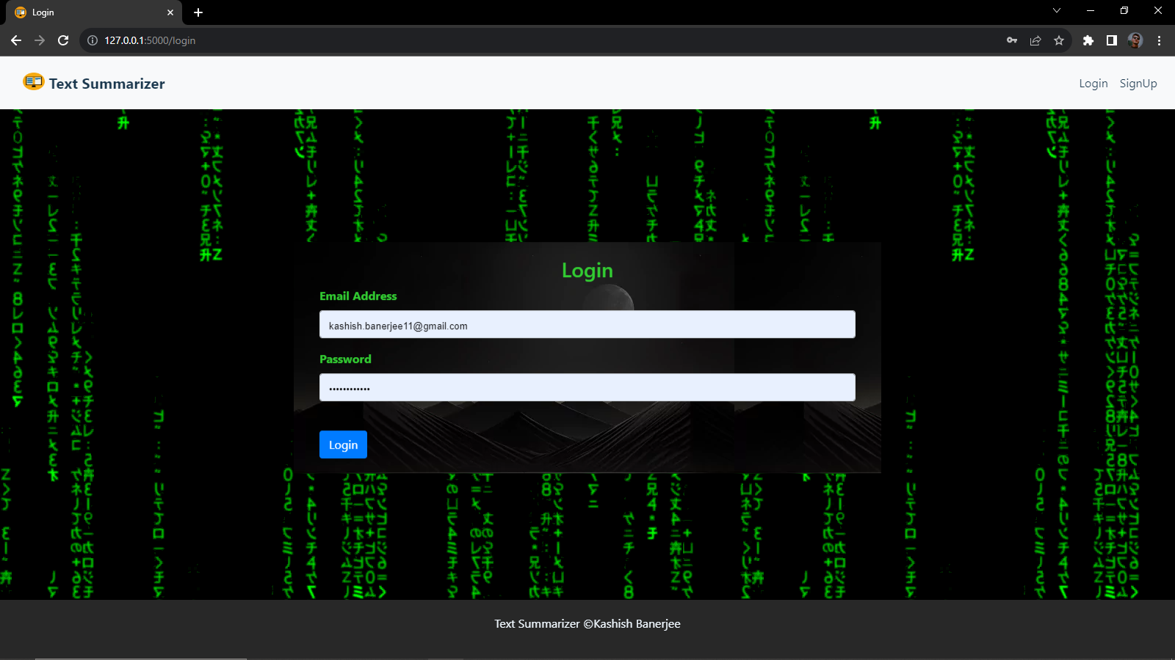
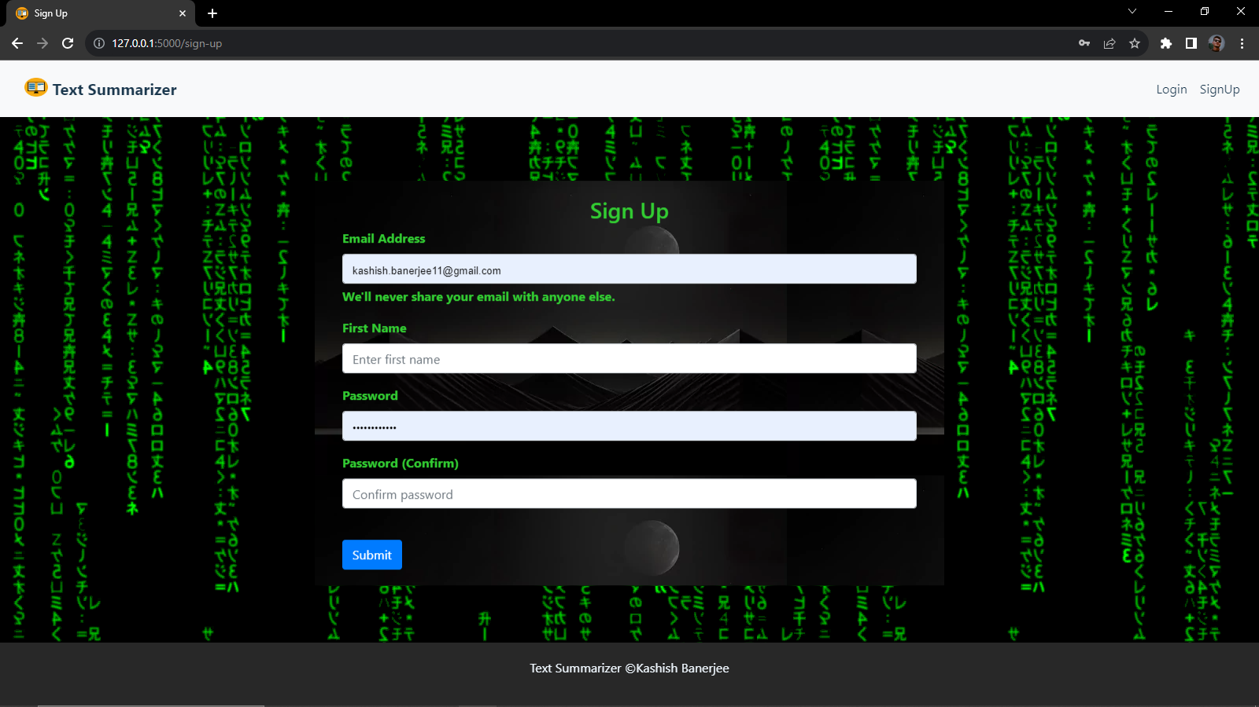
Result: Example
User Side App

Slide 13
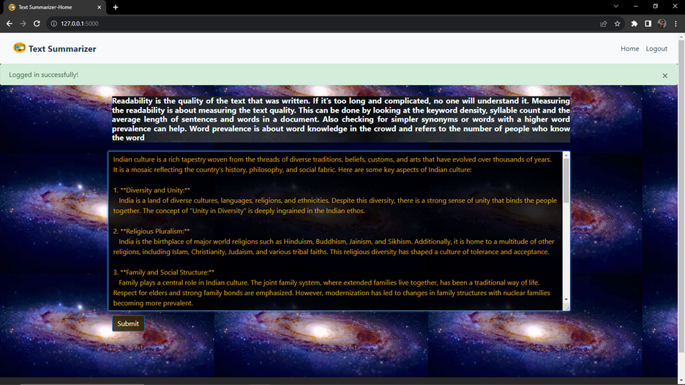
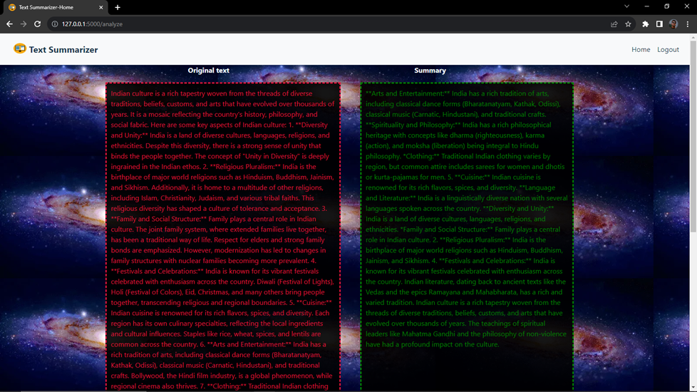
User Side App

Slide 14
Result Analysis
The app has the functionality to summarize text using NLP.
App is having user login and sign-up which gets verified by its own database .
The App is able to summarize text using spacy module in English only.
It is a full stack app which is deployed using flask

Slide 15
Limitation
We do not have a support for other languages.
We do not specific word limit for summarization.
We are unable use application without internet.
We need to automate the driver login procedure to smooth out the experience on the user end.

Slide 16
Conclusions & Future Scope
Text Summarizer App built using Flask, Hugging Face Transformers, and spaCy offers a versatile and accessible solution for summarizing textual content. The combination of these technologies provides a user-friendly web interface, efficient natural language processing, and state-of-the-art pre-trained models for text summarization.
Text Summarizer App provides a practical and accessible solution for users seeking an efficient and accurate summarization tool. With a solid foundation in web development and advanced NLP techniques, the app demonstrates the potential for creating sophisticated, user-centric applications in the field of natural language processing.
The future scope of a Text Summarizer App is promising, with ongoing advancements in natural language processing (NLP) and machine learning

Slide 17
References
Google: www.google.com
Youtube: www.youtube.com
Wikipedia: www.wikipedia.com

Slide 18
Acknowledgement
The endless thanks goes to Lord Almighty for all the blessings he has showered onto us, which has enabled us to write this last note in our research work. During the period of our research, as in the rest of our life, we have been blessed by Almighty with some extraordinary people who have spun a web of support around us. Words can never be enough in expressing how grateful we to those incredible people in our life who made this thesis possible. We would like an attempt to thank them for making time during our research in the Institute a period We will treasure. We are deeply indebted to our research supervisor, Professor Hriday Banerjee such an interesting thesis topic. Each meeting with him added in valuable aspects to the implementation and broadened us perspective. He has guided us with his invaluable suggestions, lightened up the way in my darkest times and encouraged us a lot in the academic life.

Slide 19

Dept. of CSE(AIML), University of Engineering & Management Jaipur

