Slide 1
Web based Project Management Systems for small to midsize businesses
Kashish Harisinghani
Roll Number: 1911016
RDBMS IA1

Slide 2
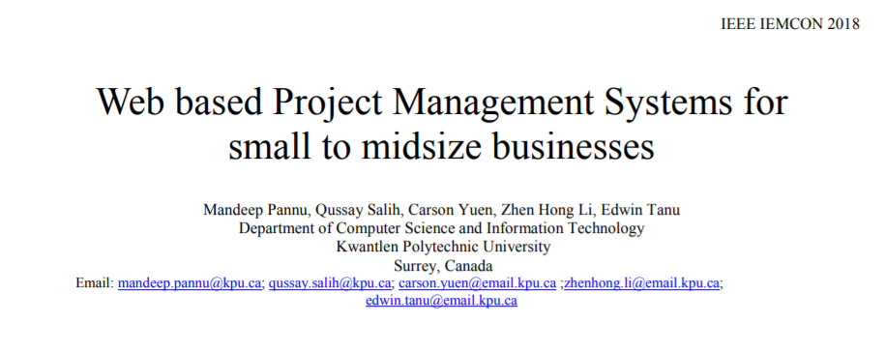

Slide 3
Table of Contents
01
02
03
04
INTRODUCTION
BACKGROUND and REASEARCH
DESIGN and IMPLEMENTATION
ANALYSIS and CONCLUSION

Slide 4
01
INTRODUCTION

Slide 5
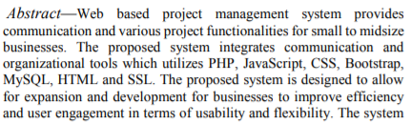
The proposed system is a multi-layered communication style that combines audio, video, and text communication to each individual level of an organization's project, increases transparency horizontally through an organization, improves information clarity, and fosters teamwork between users.

Slide 6
02
BACKGROUND and REASEARCH

Slide 7
A design solution was proposed to handle and solve key weaknesses in the management systems. In this research there were 16 popular project management and communication tools available in the market had been reviewed. Some of them are
Products G Suite
Microsoft Office Suite
WebEx
Skype

Slide 8
According to Tudor’s (2016) analysis, the best managerial communication style was to have upward and downward communication and following problems in the current system were highlighted :
Sufficient tools for
smoot vertical and horizontal communication are not provided
Too many internal policy restrictions regarding usage and functionalities
Limited customization and reporting available throughout all technical systems

Slide 9
Through a quantitative matrix, Tudor could find that the best communication style for managers and employees. Here are the solutions suggested in Tudor’s 2016 paper titled “The influence of the Intranet on Managerial Communication Style”
01
02
vertical collaboration focused on increasing
interpersonal agreement and building relationships
horizontal communication focused on improving the
understanding and clarity of data and information
03
providing the greatest number
of functionalities to give users the tools to work efficiently and
freely

Slide 10
The ideal communication and management tool should have the ability to facilitate real-time communication between all members in an organization, automate user and project management tasks.

Slide 11
03
DESIGN and IMPLEMENTATION

Slide 12
The design of proposed Systems will support the ideal communication style through the implementation of a multi-layered communication structure, automated user reporting and project notification, and various instant communication forms

Slide 13
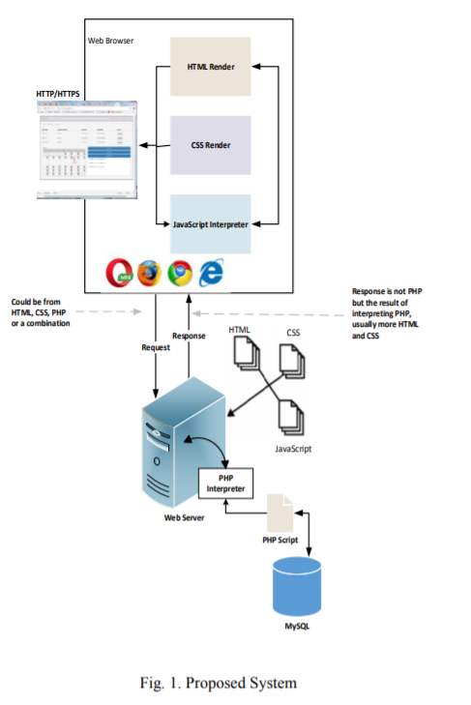

Slide 14


01. Database
The proposed system database uses MySQL which have been integrated with both the communication and management tools. Database designed to manage database relationship uses PHP script as an interpreter for web server communication request and responses.

Slide 15
02. Account and Login
The application platform utilizes the database to handle login, account creation and authentication, and stores all information and data about the user within the database. When login is prompted, the information is checked against the information taken from the database and the server determines the correct route to direct the user.

Slide 16

03. Project Management Design
The general manager can perform all background tasks to handle user and project requirements, as well as generate accounts and roles for each user. These users are assigned the roles of project leader or project member depending on the requirements set by a general manager.

Slide 17
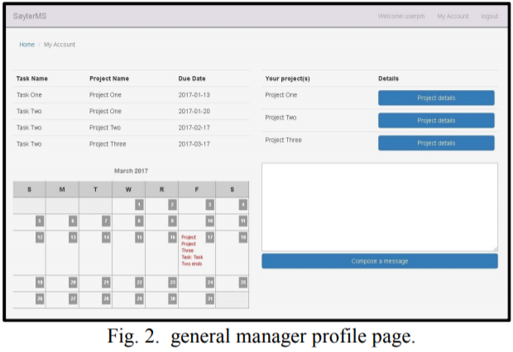

Slide 18
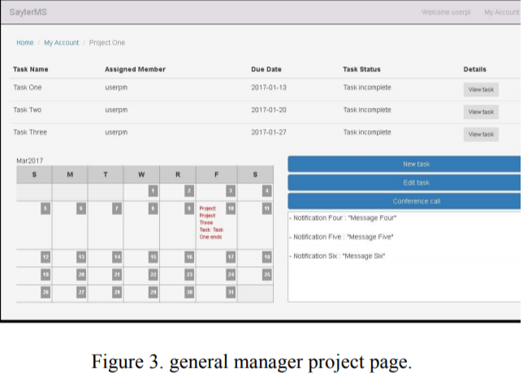

Slide 19

04. Task Creation and Functionality
After a project leader has been assigned to a specific project, they were able to create tasks to complete and contain deliverables. Within the task, the assigned task owner has the ability to upload and download files to the server for all members of a project to review and contribute.

Slide 20
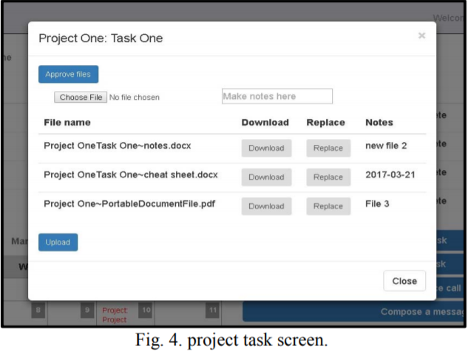

Slide 21

05. Conference Communication Design
By having all real-time communication within a designated communication room, all members can join, communication, and contribute to a project while having full access to all previous conversations topics.

Slide 22
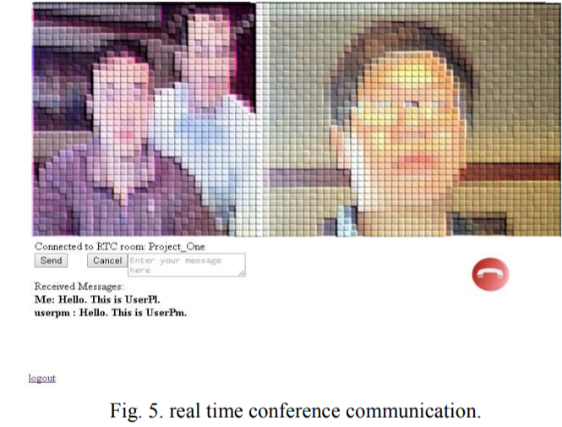

Slide 23
06. Message Communication Design
Outside of project and conference rooms, users can communication with each other in real time, by sending text based messages to the project or members.

Slide 24
04
ANALYSIS and CONCLUSION

Slide 25
Overall, the system provides all major functional capabilities required by users and organizations to plan, develop, and complete projects and tasks without the need for additional software or systems
By providing an application that
functions in an internet server with mobile and desktop support, the system provides a flexible application that can better suit a dynamic business’ social requirements.

Slide 26
Deploying system to a large or established business would require
restructuring and reorganizing of the business, along with training and customization of the software and database to run optimally.
The system must target the limited market of middle to small businesses trying to optimize their business functions during their starting years, and promote itself by providing much needed reporting capabilities and an all-in one application.

Slide 27
Strategy For Implementation

Slide 28
01. Database design
02. Account and Login
03. Project Management and Design

Slide 29
References
https://www.php.net/docs.php
https://www.semanticscholar.org/paper/THE-INFLUENCE-OF-THE-INTRANET-ON-MANAGERIAL-STYLE-Tudor/570ecb6011625c67dc9bbb6fca7c6e0053da04b7
https://www.proofhub.com/articles/project-management-system#:~:text=A%20project%20management%20system%20is%20a%20combination%20of%20methodologies%20and,the%20success%20of%20a%20project.

Slide 30
Thank You ☺

