Slide 1
Ethics in Software Engineering
Harsh Valand - 2301541005
Tanisha Vihol - 2301541006
Aesha Balar – 2401542007
Kashish Ahiri - 2401542008
Shreya Bavaliya - 2401542009
Rudra Bhatt – 2401542010
Rohan Bhoi - 2401542011
Vidhi Bhojak - 2401542012
BTech – Software Engineering
JG University

Slide 2



What is Software Engineering Ethics?
Software Engineering Ethics refers to the moral principles and professional standards that guide software engineers in their work.
It ensures that the systems they build are:
- Reliable
- Fair
- Safe
-
Ethics = moral principles guiding software creation and use.
Ensures safety, fairness, privacy, and social responsibility.

Slide 3
Software Engineering Ethics:
Avoid biases
Data privacy
Software Licensing
General Moral Imperatives
Responsible Development
Client and employers
Professional Responsibilities
Software Accountability
Why Is It Important?
- Avoids harm, builds trust, ensures legal compliance. Guides Tough Decisions
Software Impacts Lives: From banking to healthcare, a single error or unethical decision in code can affect millions.
Maintains Trust: Ethics ensures that users, clients, and society can trust the systems we build.
Prevents Harm: Ethical practices help avoid issues like data breaches, bias in algorithms, and privacy violations.

Slide 4
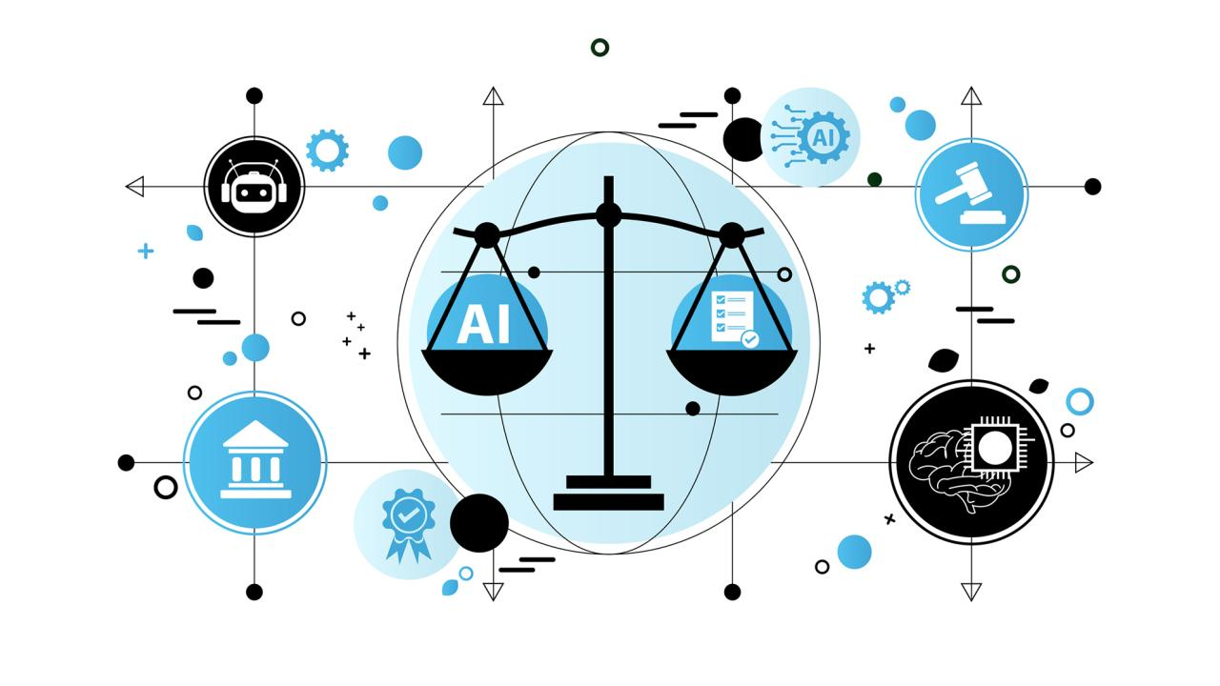


Key Areas of Ethics :
Avoid Biases:
Ensure software does not discriminate or Favor any group unfairly.
Test algorithms for fairness, especially in AI/ML.
Use bias detection tools (e.g., AIF360, Fairlearn).
Promote inclusive design and datasets.
2. Data Privacy:
Collect only necessary user data.
Use encryption and secure storage methods.
Follow regulations like GDPR or HIPAA.
Always get informed user consent.
3. Software Licensing:
Respect terms of open-source and proprietary licenses.
Avoid illegal reuse or modification of licensed code.
Choose appropriate licenses for your own software (e.g., MIT, GPL).
Understand attribution and distribution rights.

Slide 5


4. Responsible Development
Prioritize safety, reliability, and usability.
Ensure accessibility for all users, including those with disabilities.
Minimize environmental impact (e.g., efficient code).Consider long-term effects of software on society.
6. Professional Responsibilities:
Stay updated with current technologies and best practices.
Follow ethical codes (like ACM or IEEE).Promote ethical culture within teams or organizations.
Avoid conflicts of interest.
5. Client and Employers:
Maintain confidentiality of sensitive information.
Deliver quality work that meets expectations.
Communicate risks, costs, and limitations honestly.
Balance employer interests with public good.

Slide 6
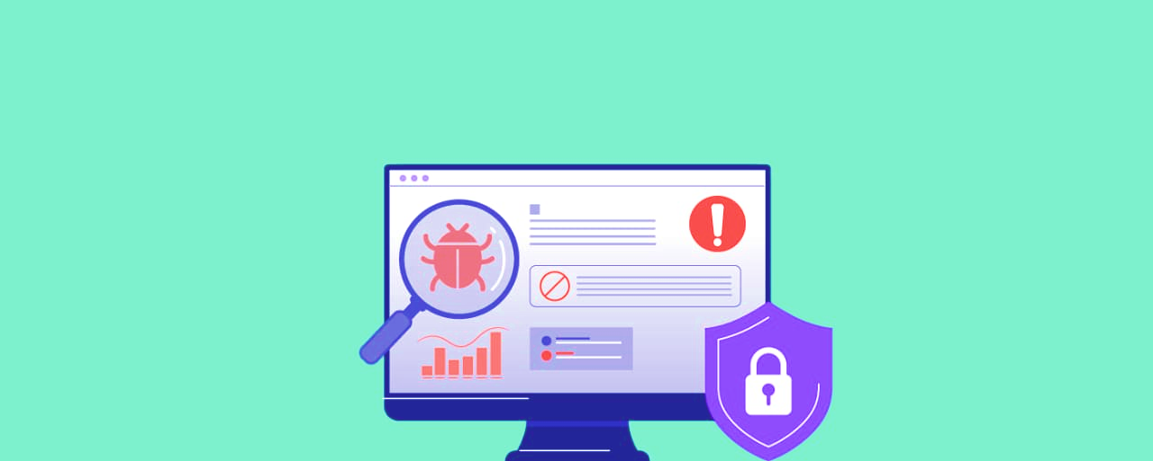
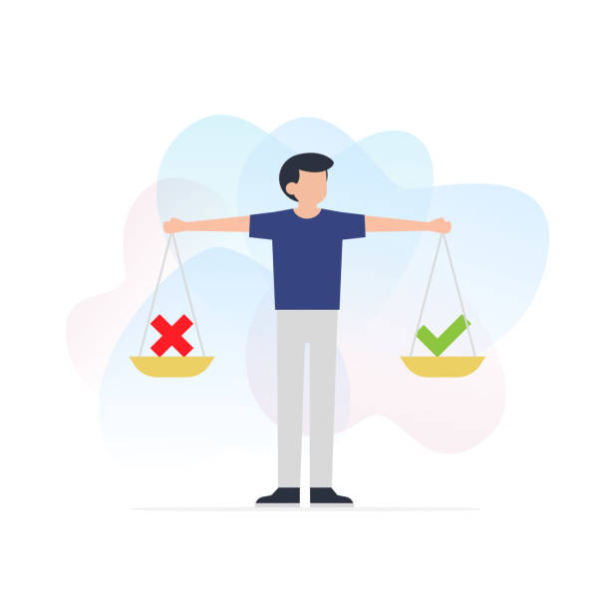
7. Software Accountability:
Take responsibility for the impact of your software.
Fix bugs and vulnerabilities promptly.
Provide documentation and disclaimers where needed.
Be transparent about potential limitations or misuse.
8. General Moral Imperatives:
Contribute to society and human well-being.
Avoid harm and discrimination.
Be honest and trustworthy in all professional dealings.
Respect user autonomy and dignity.

Slide 7

Now that we know what is ethics and It’s Key Area ..!!
How are we gonna achieve it ??
are there any tools or Methods..??

Slide 8


Tools & Methodologies
Git / GitHub:
Enables version control and change tracking for accountability.
Ref: https://github.com
Fairness Tools:
Fairlearn (Microsoft): AI fairness testing
AIF360 (IBM): Bias detection in ML models
Lighthouse (by Google):
Audits accessibility, performance, and best practices in web apps.
Ethics Guidelines (ACM/IEEE Codes):
Refer to professional codes of ethics for decision-making.

Slide 9

GDPR Toolkit or Apache Ranger:
Supports data governance and privacy controls for big data systems.
Agile Ethics:
Involves stakeholders regularly, Encourages transparency.

Slide 10

Real- Word Example:
1. Facebook– Cambridge Analytica Scandal
Issue: Data of 87 million users harvested via quiz app without consent.
Ethical Concern: Data privacy violation, lack of transparency.
Harm/Challenges: Misinformation in elections, loss of user trust.
Solution: Facebook limited third-party access to data, added user privacy controls, paid major fines.
Reference:
https://www.theguardian.com/news/series/cambridge-analytica-files

Slide 11

2. Amazon AI Hiring Tool
Issue: Recruitment AI showed bias against female resumes.
Ethical Concern: Gender discrimination and AI bias.
Harm/Challenges: Reinforced workplace inequality.
Solution: Amazon discontinued the tool and reviewed hiring practices.
Reference: https://www.reuters.com/article/us-amazon-com-jobs-automation-insight-idUSKCN1MK08G

Slide 12

3. Google Photos Labelling Error
Issue: Google Photos mislabelled Black individuals as "gorillas.“
Ethical Concern: AI bias and lack of diverse training data.
Harm/Challenges: Offense and discrimination; algorithmic injustice.
Solution: Google disabled the label, improved dataset sensitivity.
Reference: https://www.theverge.com/2015/7/1/8875273/google-apologizes-photos-tagging-gorillas

Slide 13
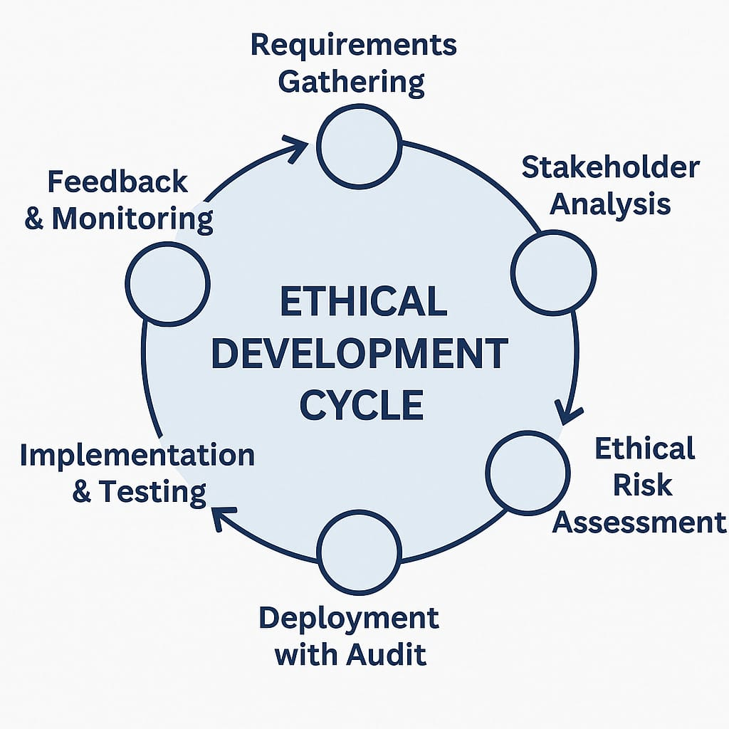
Ethical Development Cycle
Structured approach to embedding ethics at every stage of software development.
ensures that developers think not just about functionality or performance,
but also about user impact, privacy, fairness, and accountability throughout the project.
Why Use It?
To prevent ethical risks before they cause harm.
To build trustworthy and inclusive software.
To align with legal and professional ethical standards.
To support responsible innovation and avoid scandals or misuse.

Slide 14
Key Stages in the Cycle:
Requirements Gathering: Understand user needs and potential risks.
Stakeholder Analysis: Identify all affected parties (users, developers, society).
Ethical Risk Assessment: Evaluate issues like bias, data misuse, accessibility gaps.
Design with Ethics: Build interfaces and features that respect user rights.
Implementation & Testing: Use tools and practices to ensure fairness, privacy, and safety.
Deployment with Audit: Ensure ethical compliance before public release.
Feedback & Updates : Monitor software in real use, adapt based on real-world issues.

Slide 15
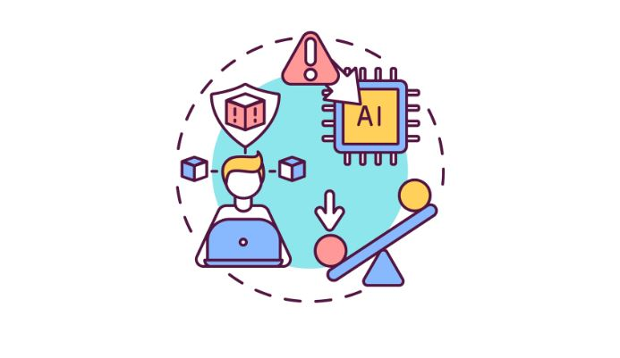

Challenges in Software Ethics
Algorithmic Bias:
Challenge: Sensitive user data is often mishandled, leaked, or exploited.
Solution Use encryption, strict access control, anonymization, and follow regulations like GDPR.
Lack of Ethical Awareness:
Challenge: Developers may not be trained to think ethically.
Solution: Include ethics in tech education and company
onboarding; conduct regular ethics workshops.
Conflicts of Interest:
Challenge: Developers might be pressured to favor business goals
over user rights.
Solution: Establish strong ethical guidelines and empower employees
to raise concerns safely.

Slide 16
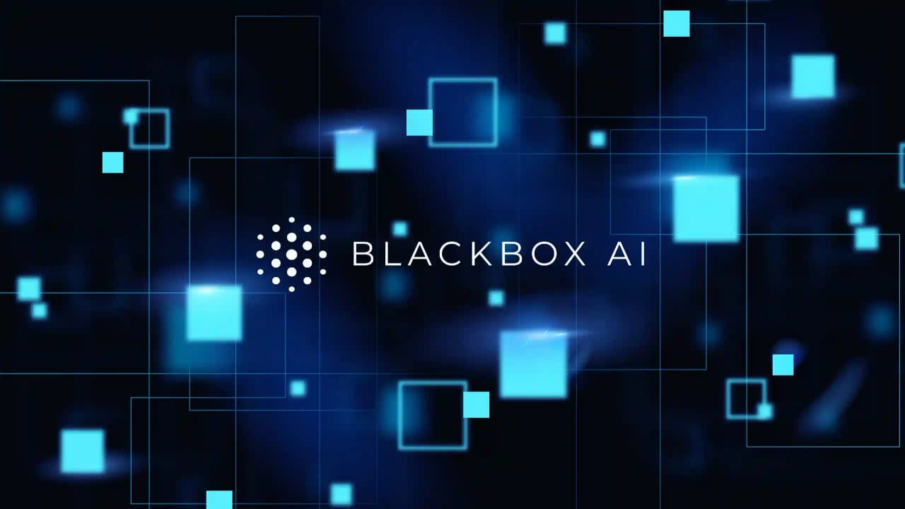
Transparency Issues
Challenge: Many systems, especially AI, function as “black boxes.”
Solution: Use explainable AI models and provide clear user communication about how systems work.
Global Ethical Standards Variance
Challenge: Ethics norms vary across regions (e.g., censorship, data rights).
Solution: Align with international standards (IEEE/UNESCO), and adapt locally with care.

Slide 17

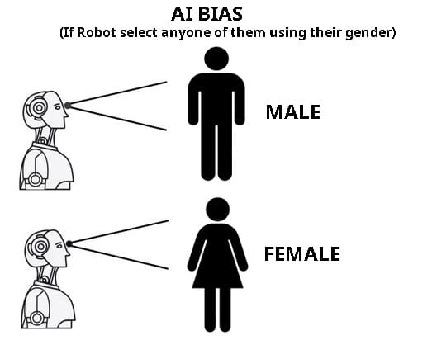
Future of Ethics in Software Engineering
Ethics by Design:
Trend: Ethics will be built into every phase of development—just like testing or security.
Example: Tools like Ethical OS Toolkit help teams predict ethical risks early.
Reference: https://ethicalos.org
Explainable & Transparent AI
Trend: Increasing demand for algorithms that can explain their decisions.
Impact: Users and regulators will expect transparency to reduce AI bias and improve trust.
Reference: https://www.ibm.com/blogs/research/2020/08/trustworthy-ai/

Slide 18



Tools for Ethical Debugging
Trend: Ethical checkers will be added to IDEs and pipelines.
Example: Tools that flag potential bias, privacy leaks, or licensing issues during development.
Public Involvement & Tech Literacy
Trend: Users will become more informed and vocal about tech ethics.
Impact: Companies will need to prioritize ethical design to maintain trust
and market presence.
AI Ethics Committees in Companies
Trend: Large tech firms are forming internal ethics review boards.
Purpose: To evaluate high-impact decisions, like AI deployment or data handling.

Slide 19


Conclusion :
Ethics in software engineering isn’t just about rules—it’s about responsibility.
As future engineers, we shape tools that affect millions of lives.
Whether it's protecting data, avoiding bias, or being transparent, ethical decisions should guide our every step With evolving tech like AI and data systems,
our challenge is not just to code efficiently, but to code responsibly,
Let’s aim not just for innovation—but for innovation with integrity.

Slide 20
References :
https://www.acm.org/code-of-ethics (ethics Intro)
https://www.ieee.org/about/corporate/governance/p7-8.html (ethics protocols )
https://towardsdatascience.com (search for “AI Bias”)
https://fairlearn.org/ (Fairlearn tool)
https://www.theguardian.com/news/series/cambridge-analytica-files (Facebook case)
https://www.reuters.com/article/us-amazon-com-jobs-automation-insight-idUSKCN1MK08G(amazon)
https://www.theverge.com/2015/7/1/8875273/google-apologizes-photos-tagging-gorillas (photo labelling Google)
https://aif360.mybluemix.net/
https://mozilla.github.io/open-leadership-training-series/articles/introduction-to-open-source/open-source-licensing/

Slide 21
Thank You

