Slide 1
MEDSCRAPE
TEAM MEMBERS
Kashish 19BCE1760
Saransh Vats 19BCE1002

Slide 2
ABSTRACT
Medscrape is used to irradicate common medication mistakes people do and not adhering to the medication, People usually consume medicines that is not to be consumed for the symptoms they are facing which may lead to serious health problems and even cost his/her life.
It also tells the patient/user when and in case of what symptoms they should consume the medicine they want to know about.
It can also be used by people who tend to forget about the medicine they have to consume and thus can use our website to upload the image of the medicine that they dont know about it and get the correct information regarding it.
Our project helps in classification of the medicine image that user wants to know about and return him/her the name of the medicine detected and provide the required information about the medicine which is medicine name, introduction, side effect and when to consume. The image classification is done using Transfer Learning model InceptionV3 which processes the medicine image given by the patient/user on our website and provides the user with the correct information which is rendered on the web page.

Slide 3
VIRTUALIZATION / CLOUD SERVICES USED
We will deploy our app using Amazon Elastic Compute Cloud (Amazon EC2), a web service that provides secure, resizable compute capacity in the cloud. It is designed to make web-scale cloud computing easier for developers. Amazon EC2’s simple web service interface allows us to obtain and configure capacity with minimal friction. It provides us with complete control of Amazon vast cloud computing resources.
AWS provides us with both infrastructure as a service(IaaS) and platform as a service (PaaS) enabling us to scale our project on the go as requirements change.
Amazon EC2 offers the broadest and deepest compute platform with choice of processor, storage, networking, operating system, and purchase model. It offers the fastest processors in the cloud, along with 400 Gbps ethernet networking. It has the most powerful GPU instances for machine learning training and graphics workloads, as well as the lowest cost-per-inference instances in the cloud.
Amazon Sagemaker provides us with a fully integrated development environment for building machine learning models which also eases to deploy code to the instance created

Slide 4
DATASET
For now, we have taken 4 medicinal pills:
• Allegra
• Antacid
• Paracetamol
• Statin
For training and we scraped the data from Google Images. 50 images per medicine has been scraped for each medicine and 10 images each for testing.
Requirements
3.1 System Requirements
3.2 Hardware Requirements
• Operating system windows (7 0r later version)
• Ram 8 GB
• Hard disk Space- 100 GB
• Processor- Intel i3 1.8 gHz or newer versions

Slide 5
2.3.3 Software Requirements
Language:
• Python
• Node Js
• Django
• Putty
Enviroment:
• Anaconda Distribution
• VS Code
Packages Used:
• absl-py==0.12.0
• asgiref==3.3.4
• astunparse==1.6.3
• cachetools==4.2.2
• certifi==2020.12.5
• chardet==4.0.0
• Django==3.2.3
• django-cors-headers==3.7.0
• djangorestframework==3.12.4

Slide 6
• flatbuffers==1.12
• gast==0.4.0
• google-auth==1.30.0
• google-auth-oauthlib==0.4.4
• google-pasta==0.2.0
• grpcio==1.34.1
• h5py==3.1.0
• idna==2.10
• keras-nightly==2.5.0.dev2021032900
• Keras-Preprocessing==1.1.2
• Markdown==3.3.4
• numpy==1.19.5
• oauthlib==3.1.0
• opt-einsum==3.3.0
• Pillow==8.2.0
• protobuf==3.17.0
• pyasn1==0.4.8
• pyasn1-modules==0.2.8
• pytz==2021.1

Slide 7
• requests==2.25.1
• requests-oauthlib==1.3.0
• rsa==4.7.2
• six==1.15.0
• sqlparse==0.4.1
• tensorboard==2.5.0
• tensorboard-data-server==0.6.1
• tensorboard-plugin-wit==1.8.0
• tensorflow==2.5.0
• tensorflow-estimator==2.5.0
• termcolor==1.1.0
• typing-extensions==3.7.4.3
• urllib3==1.26.4
• Werkzeug==2.0.0
• wrapt==1.12.1

Slide 8
Module Explanation
1. Front-End
A very basic but unique website has been created for the ease use. This website has two web pages. One for uploading the medicine and as processing the result and another for the users for uploading the details of the medicine for which they want us to display but is not our dataset yet.
2. Backend
This part helps to connect the front end and the transfer learning. Whenever the user inputs the picture, it is then provided to the backend and is then taken as input to the model. The output received by the model is then shown on the website as per the search query.

Slide 9
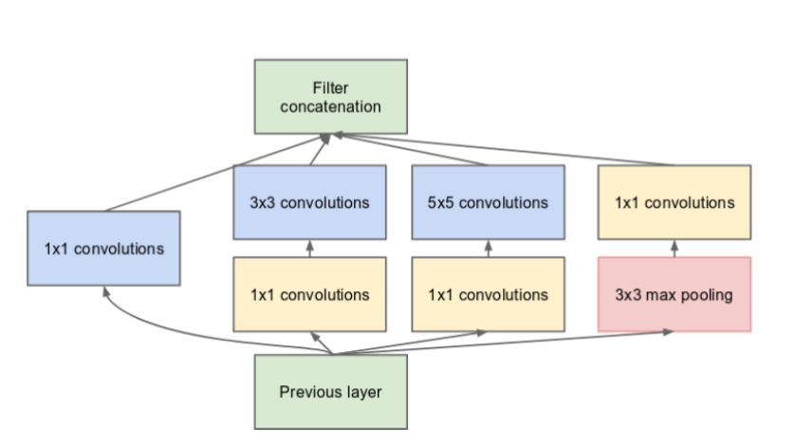
Module Explanation
3. Transfer Learning model: Inception V3

Slide 10
Module Explanation
3. Transfer Learning model: Inception V3
Inception V3 by Google is the 3rd version in a series of Deep Learning Convolutional Architectures. Inception V3 was trained using a dataset of 1,000 classes (See the list of classes here) from the original ImageNet dataset which was trained with over 1 million training images, the TensorFlow version has 1,001 classes which is due to an additional "background' class not used in the original ImageNet. Inception V3 was trained for the ImageNet Large Visual Recognition Challenge where it was a first runner up.
4. Virtualization:
We created a virtual machine on Microsoft Azure where we installed all the libraries, linked with our github repository where put up all our code. We finally held our backend there and were able to run it. The steps for implementation for virtualizing or hosting the application are provided in the next section.

Slide 11
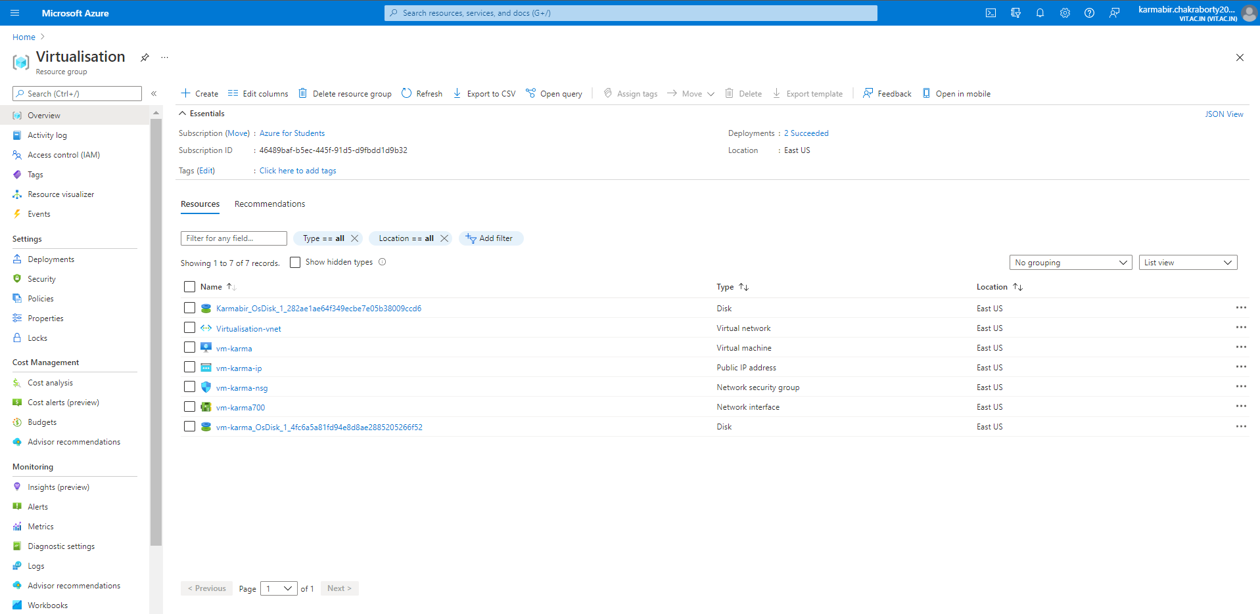
Implementations
1. A whole resource group

Slide 12
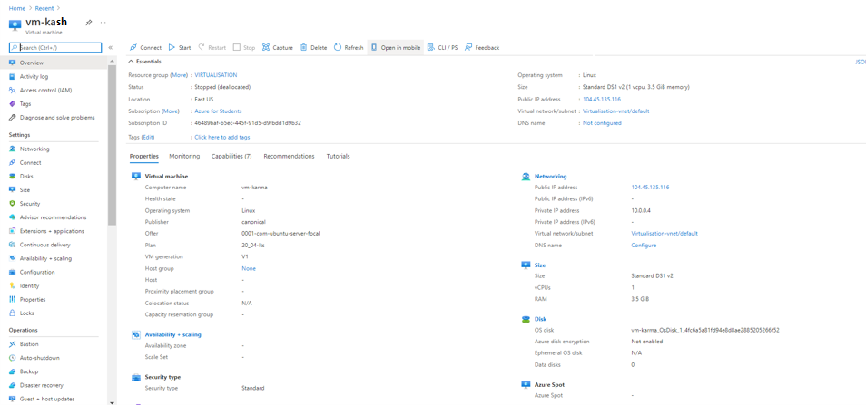
Resources Created:
2. Virtual machine:

Slide 13
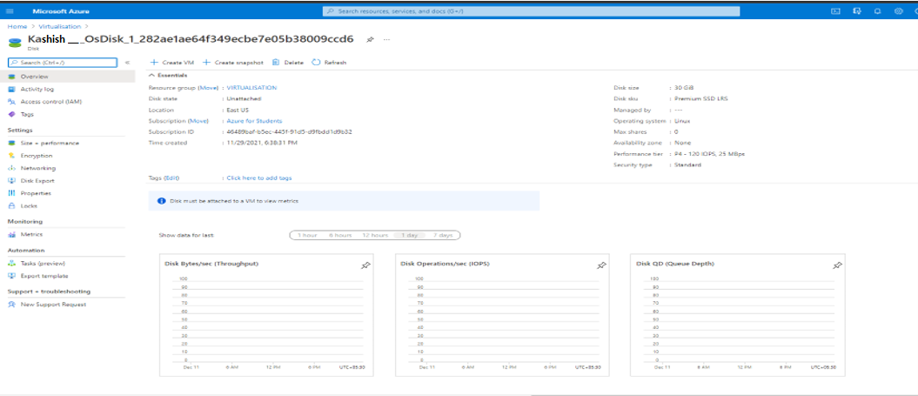
3. OS Disk:

Slide 14
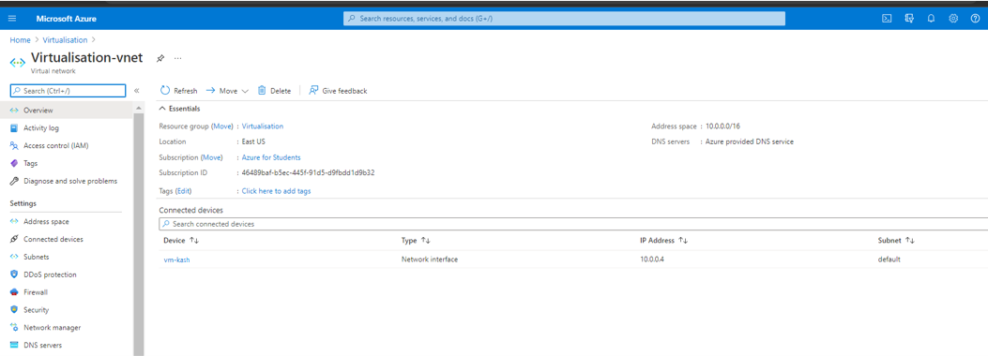
4. Virtual Network:

Slide 15
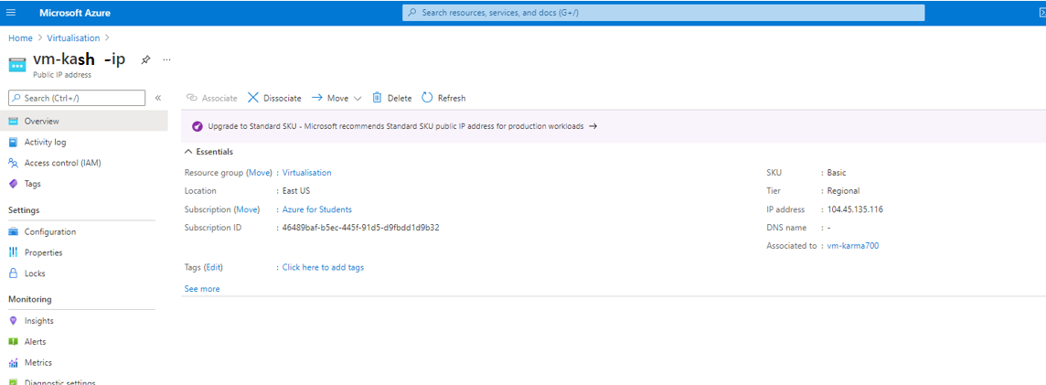
5. Public IP Address:

Slide 16
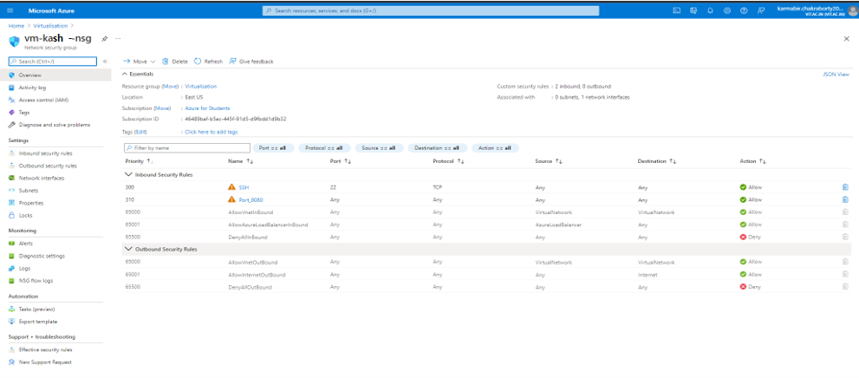
6. Network Security Group:

Slide 17
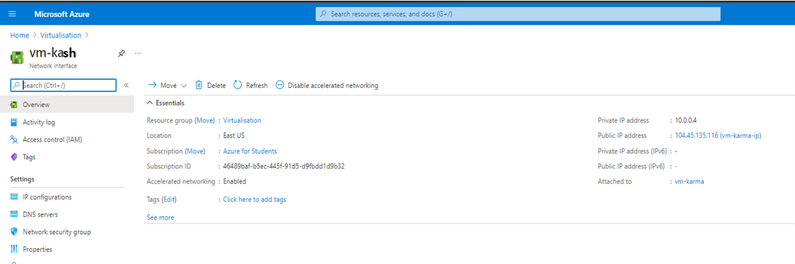
7. Network Interface:

Slide 18
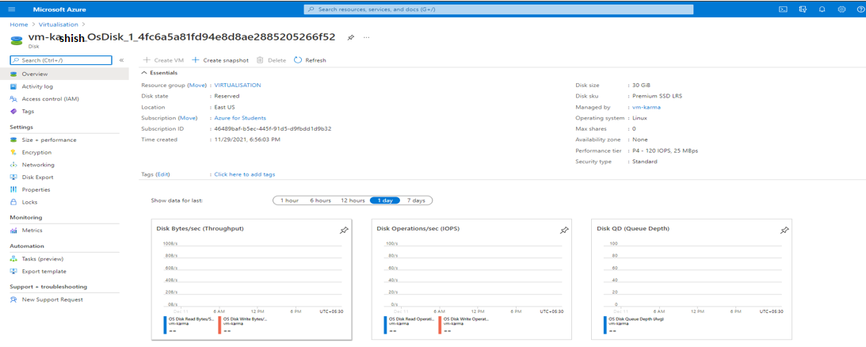
8. OS disk-2 :

Slide 19

9. Network Interface:

Slide 20
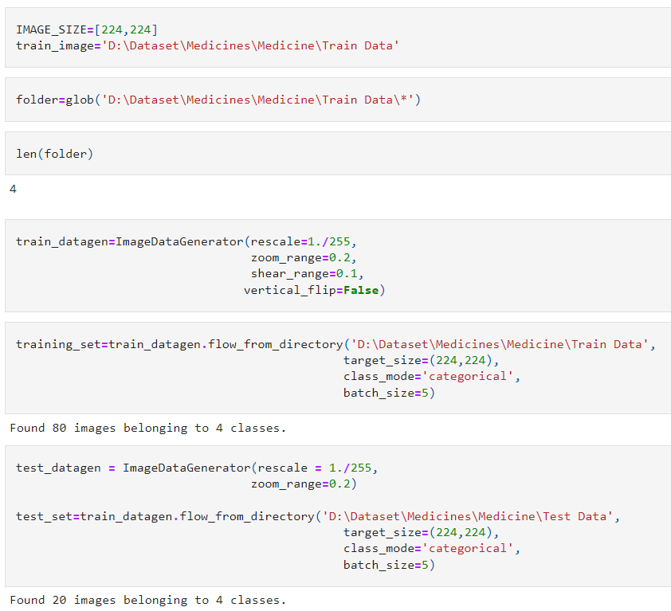
Model

Slide 21
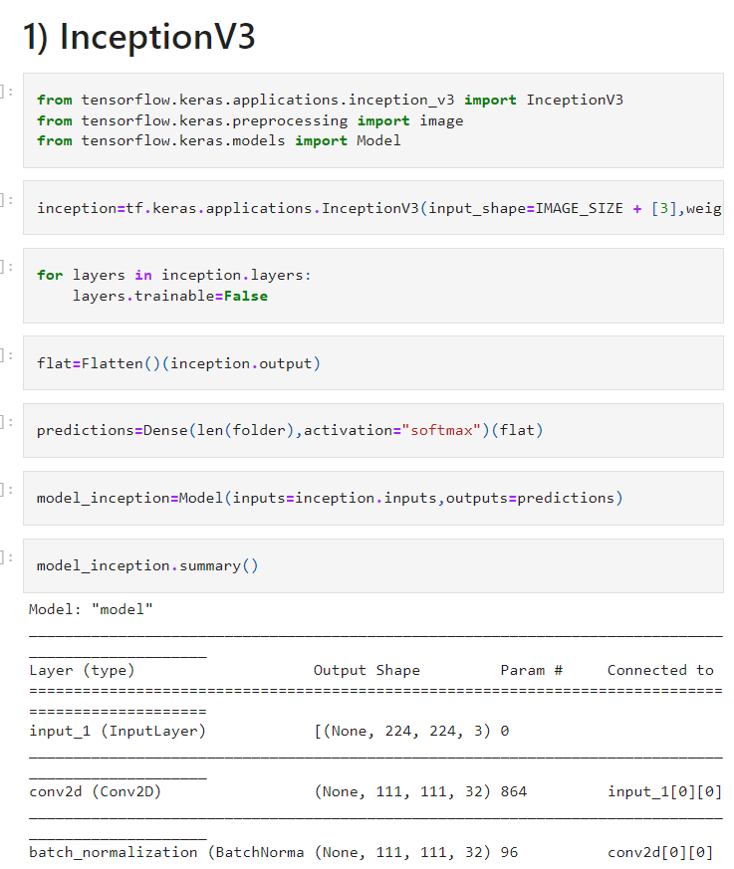
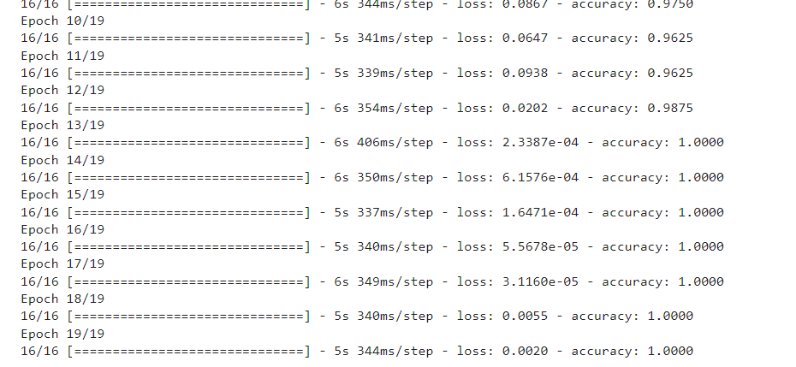
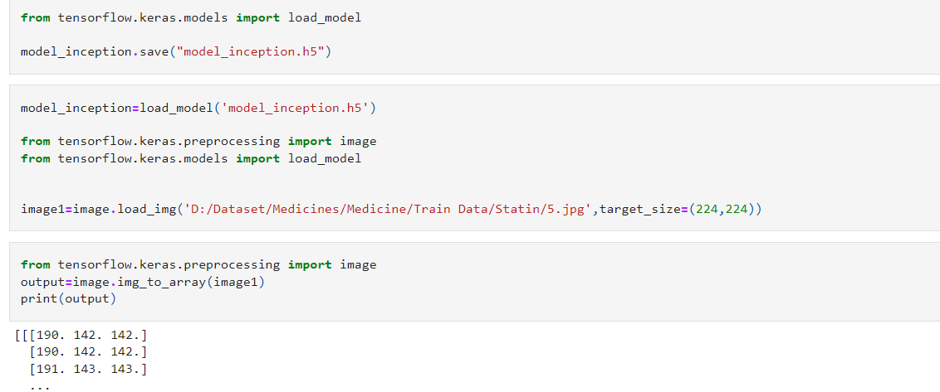

Slide 22
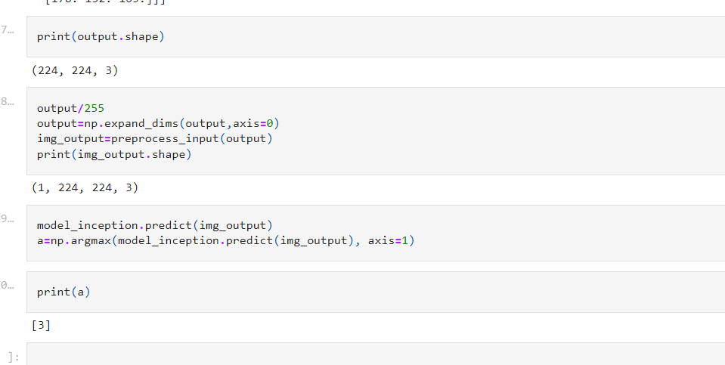

Slide 23
REFERENCES
[1] Pill Image Classification using Machine Learning2019 8th Brazilian Conference.
[2] Natalia Larios Delgado, Naoto Usuyama, Amanda K. Hall, Rebecca J. Hazen, Max Ma, Siva Sahu & Jessica Lundin npj Digital Medicine volume 2, Article number: 10 (2019).
[3] Performance evaluation of a prescription medication image classification model: an observational cohortCorey A. Lester, Jiazhao Li, Yuting Ding, Brigid Rowell, Jessie ‘Xi’ Yang & Raed Al Kontar npj Digital Medicine volume 4, Article number: 118 (2021).
L. T. Kohn, J. Corrigan, M. S. Donaldson et al., To err is human: building a safer health system. National Academy Press Washington, DC, 2000, vol. 6.
J. A. Greene and A. S. Kesselheim, “Why do the same drugs look different? pills, trade dress, and public health,” New England Journal of Medicine, vol. 365, no. 1, pp. 83–89, 2011, pMID: 21732842.

