Slide 1
Analysis And Design Of Algorithms
End Sem paper solution

Slide 2
Quick Sort
Average Case Time Complexity of Quick Sort
O(Nlog(N))
the overall average case for the quick sort is this which we will get by taking average of all complexities

Slide 3
Quick sort
Explanation
lets T(n) be total time taken then for average we will consider random element as pivot lets index i be pivot then time complexity will be T(n) = T(i) + T(n-i) T(n) = 1/n *[\sum_{i=1}^{n-1} T(i)] + 1/n*[\sum_{i=1}^{n-1} T(n-i)] As [\sum_{i=1}^{n-1} T(i)] and [\sum_{i=1}^{n-1} T(n-i)] equal likely functions therefore T(n) = 2/n*[\sum_{i=1}^{n-1} T(i)]

Slide 4
Quick sort
multiply both side by n n*T(n) = 2*[\sum_{i=1}^{n-1} T(i)] ............(1) put n = n-1 (n-1)*T(n-1) = 2*[\sum_{i=1}^{n-2} T(i)] ............(2) substract 1 and 2 then we will get n*T(n) - (n-1)*T(n-1) = 2*T(n-1) + c*n^2 + c*(n-1)^2 n*T(n) = T(n-1)[2+n-1] + 2*c*n - c n*T(n) = T(n-1)*(n+1) + 2*c*n [removed c as it was constant] divide both side by n*(n+1), T(n)/(n+1) = T(n-1)/n + 2*c/(n+1) .............(3) put n = n-1, T(n-1)/n = T(n-2)/(n-1) + 2*c/n ............(4) put n = n-2, T(n-2)/n = T(n-3)/(n-2) + 2*c/(n-1) ............(5)

Slide 5
Quick sort
by putting 4 in 3 and then 3 in 2 we will get T(n)/(n+1) = T(n-2)/(n-1) + 2*c/(n-1) + 2*c/n + 2*c/(n+1) also we can find equation for T(n-2) by putting n = n-2 in (3) at last we will get T(n)/(n+1) = T(1)/2 + 2*c * [1/(n-1) + 1/n + 1/(n+1) + .....] T(n)/(n+1) = T(1)/2 + 2*c*log(n) + C T(n) = 2*c*log(n) * (n+1) now by removing constants, T(n) = log(n)*(n+1) therefore
T(n) = O(n*log(n))

Slide 6
Quick sort
Step by step explanation of quick sort:-
1). Selecting Pivot
The process starts by selecting one element (known as the pivot) from the list; this can be any element. A pivot can be:
Any element at random
The first or last element
Middle element
For this example, we’ll use the last element, 4, as our pivot.
2). Rearranging the Array
Now, the goal here is to rearrange the list such that all the elements less than the pivot are towards the left of it, and all the elements greater than the pivot are towards the right of it.
The pivot element is compared to all of the items starting with the first index. If the element is greater than the pivot element, a second pointer is appended.
When compared to other elements, if a smaller element than the pivot element is found, the smaller element is swapped with the larger element identified before.

Slide 7
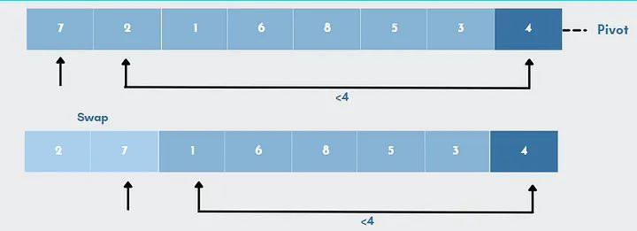
Quick sort

Slide 8
Quick sort
Let’s simplify the above example,
Every element, starting with 7, will be compared to the pivot(4). A second pointer will be placed at 7 because 7 is bigger than 4.
The next element, element 2 will now be compared to the pivot. As 2 is less than 4, it will be replaced by the bigger figure 7 which was found earlier.
The numbers 7 and 2 are swapped. Now, pivot will be compared to the next element, 1 which is smaller than 4.
So once again, 7 will be swapped with 1.
The procedure continues until the next-to-last element is reached, and at the end the pivot element is then replaced with the second pointer. Here, number 4(pivot) will be replaced with number 6.

Slide 9
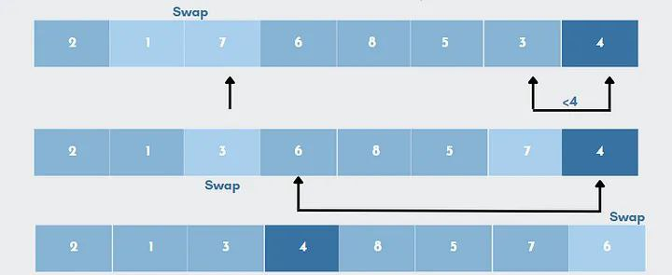
Quick sort

Slide 10
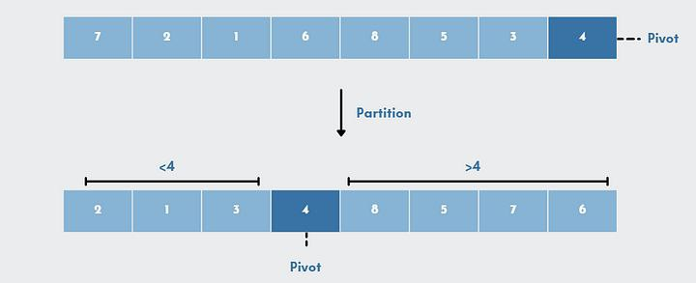
Quick sort

Slide 11
Quick sort
In simple words,the algorithm searches for every value that is smaller than the pivot. Values smaller than pivot will be placed on the left, while values larger than pivot will be placed on the right. Once the values are rearranged, it will set the pivot in its sorted position.
3). Dividing Subarrays
Once we have partitioned the array, we can break this problem into two sub-problems. First, sort the segment of the array to the left of the pivot, and then sort the segment of the array to the right of the pivot.

Slide 12
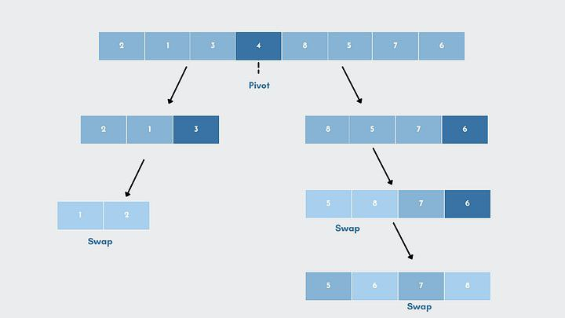
Quick sort

Slide 13
Quick sort
In the same way that we rearranged elements in step 2, we will pick a pivot element for each of the left and right sub-parts individually.
Now, we will rearrange the sub-list such that all the elements are less than the pivot point, which is towards the left. For example, element 3 is the largest among the three elements, which satisfies the condition, hence the element 3 is in its sorted position.
In a similar manner, we will again work on the sub-list and sort the elements 2 and 1. We will stop the process when we get a single element at the end.
Repeat the same process for the right-side sub-list. The subarrays are subdivided until each subarray consists of only one element.
Now At this point, the array is sorted

Slide 14
Strassen’s matrix multiplication
Strassen’s Matrix Multiplication is the divide and conquer approach to solve the matrix multiplication problems. The usual matrix multiplication method multiplies each row with each column to achieve the product matrix. The time complexity taken by this approach is O(n³), since it takes two loops to multiply. Strassen’s method was introduced to reduce the time complexity from O(n³) to O(n^{log 7}).

Slide 15
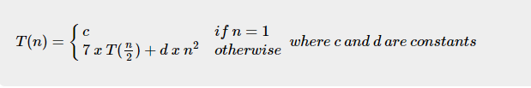
Strasssen’s matrix multiplication
Strassen’s Matrix Multiplication Algorithm
In this context, using Strassen’s Matrix multiplication algorithm, the time consumption can be improved a little bit.
Strassen’s Matrix multiplication can be performed only on square matrices where n is a power of 2. Order of both of the matrices are n × n.
Divide X, Y and Z into four (n/2)×(n/2) matrices.

Slide 16
Strassen’s matrix multiplication
Lets solve the recurrence using the iteration method
T(n)=7T(n/2) + n2
= n2 + 7(7T( n 22 )+(n 2 ) 2)
= n2 + ( 7 22 )n2 + 72T( n 22 )
= n2 + ( 7 22 )n2 + 72(7T( n 23 )+( n 22 ) 2)
= n2 + ( 7 22 )n2 + ( 7 22 ) 2 · n2 + 73T( n 23 )
= n2 + ( 7 22 )n2 + ( 7 22 ) 2n2 + ( 7 22 ) 3n2.... + ( 7 22 ) log n−1n2 + 7log n
= log Xn−1 i=0 ( 7 22 ) i n2 + 7log n
= n2 · Θ(( 7 22 ) log n−1)+7log n

Slide 17
Strassens’s matrix multiplication
= n2 · Θ( 7log n (22)log n )+7log n
= n2 · Θ(7log n n2 )+7log n
= Θ(7log n)
– Now we have the following:
7log n = 7 log7 n /log7 2
= (7log7 n) (1/ log7 2)
= n(1/ log7 2)
= n log2 7 /log2 2
= nlog 7
So the solution is T(n) = Θ(nlog 7) = Θ(n2.81...)

Slide 18
Hamiltonian Cycle
A Hamiltonian cycle is a path in an undirected or directed graph that visits each vertex exactly once and ends at the starting vertex.
Hamiltonian cycles are important in many areas of computer science, including network routing, optimization problems, and scheduling.
One real-life application of Hamiltonian cycles is in the design and planning of delivery routes for companies such as UPS or FedEx.
The goal is to find the shortest path that visits each customer exactly once and returns to the starting point,
which is equivalent to finding a Hamiltonian cycle in a graph representing the delivery locations. By finding such a cycle,
the delivery company can optimize their routes, reducing the amount of time and resources required for each delivery and increasing overall efficiency.

Slide 19
Hamiltonian Cycle
Another application of Hamiltonian cycles is in the design of integrated circuits.
In order to minimize the amount of wiring required and reduce the size of the circuit,
it is important to find a cycle that connects all the components in the circuit.
This problem can be represented as finding a Hamiltonian cycle in a graph representing the components and their connections.
Finally, Hamiltonian cycles are also important in molecular biology, particularly in the study of protein folding.
In order to understand the structure of proteins and their interactions with other molecules,
it is necessary to determine the paths that molecules take as they move through the protein.
This problem can be represented as finding a Hamiltonian cycle in a graph representing the protein structure.

Slide 20
Prims Algorithm
"""
Prim's algorithm is a greedy algorithm that finds a minimum spanning tree for a weighted undirected graph.
Here is the implementation of Prim's algorithm in Python:
"""
import sys
class Graph:
def __init__(self, vertices):
self.vertices = vertices
self.graph = [[0 for _ in range(vertices)] for _ in range(vertices)]
def printMST(self, parent):
print("Edge \tWeight")
for i in range(1, self.vertices):
print(parent[i], "-", i, "\t", self.graph[i][parent[i]])

Slide 21
Prims Algorithm
def minKey(self, key, mstSet):
min_val = sys.maxsize
for v in range(self.vertices):
if key[v] < min_val and not mstSet[v]:
min_val = key[v]
min_index = v
return min_index
def primMST(self):
key = [sys.maxsize] * self.vertices
parent = [None] * self.vertices
mstSet = [False] * self.vertices
key[0] = 0
parent[0] = -1
for _ in range(self.vertices):
u = self.minKey(key, mstSet)
mstSet[u] = True
for v in range(self.vertices):
if self.graph[u][v] > 0 and not mstSet[v] and key[v] > self.graph[u][v]:
key[v] = self.graph[u][v]
parent[v] = u
self.printMST(parent)

Slide 22
Fibonacci
# Iterative:
def fibonacci_iterative(n):
if n <= 1:
return n
fib = [0, 1]
for i in range(2, n+1):
fib.append(fib[i-1] + fib[i-2])
return fib[n]
# Recursive:
def fibonacci_recursive(n):
if n <= 1:
return n
return fibonacci_recursive(n-1) + fibonacci_recursive(n-2)

Slide 23
Fibonacci
The recursive algorithm for computing Fibonacci numbers has an exponential time complexity of O(2^n), where n is the input number.
This is because each recursive call branches into two more recursive calls, resulting in an exponentially increasing number of function calls.
On the other hand, the iterative algorithm has a linear time complexity of O(n), where n is the input number.
This is because each iteration of the loop involves only a few basic arithmetic operations, resulting in a linear number of operations.
Therefore, the iterative algorithm is much more efficient than the recursive algorithm for large values of n,
as the latter quickly becomes unfeasible due to the large number of function calls required.

