Slide 1
Presentation on project
Job Era
By
Team No: 13
Lovish Bhateja: 2210991857
Madhav Garg:2210991863 Kashish Gupta: 2210991768
Kavita Trivedi: 2210991774
Khushi Rana: 2210991793
Supervised by: Prof.
Mr. Rahul
Department of Computer Science and Engineering,
Chitkara University, Punjab
1

Slide 2
Table of Contents
Problem Statement
Objective / Purpose
Main Topics / Sections (Depends on your topic)
Screenshots
Future Scope
Conclusion
References (if applicable)
Q&A / Discussion

Slide 3
Problem statement
The increasing demand for efficient and accessible employment opportunities has highlighted the need for a reliable job portal that ensures a seamless hiring experience for both job seekers and recruiters. Traditional job search methods often face challenges such as lack of transparency, delayed responses, and limited accessibility. A user-friendly job portal can provide a flexible, real-time, and secure environment for job searching and hiring, offering features such as automated job recommendations, real-time application tracking and employer-job seeker feedback mechanisms.

Slide 4
Objective / Purpose
Objective:
A job portal website aims to bridge the gap between job seekers and employers by providing a digital platform where:
Job seekers can find relevant job opportunities, submit applications, and enhance their employability.
Employers can post job openings, screen candidates, and hire suitable employees efficiently.
Purpose:
Facilitate Job Search – Helps job seekers find jobs based on skills, location, and experience.
Streamline Recruitment – Enables companies to post job openings and filter candidates effectively.
Career Development – Provides resume-building tools, interview tips, and skill assessment features.
Networking Opportunities – Connects job seekers with employers, recruiters, and industry professionals.
Remote & Global Hiring – Supports hiring across different locations, including remote jobs.

Slide 5
Main topics
User Authentication & Security
JWT authentication for secure user login.
Role-based access for employers and job seekers.
Data encryption to protect user credentials and sensitive information.
Job Posting & Application Management
Employers can post jobs, set criteria, and manage applications.
Job seekers can search, apply, and track applications in real-time.
Real-Time Notifications & Alerts
Email & SMS notifications for job updates, interview calls, and status changes.
Push notifications for job recommendations and employer messages.
Tech Stack Used
Frontend: React.js, JavaScript, Redux, CSS, Bootstrap.
Backend: Node.js, Express.js.
Database Management: MongoDB & Mongoose.
Authentication & Security: JWT, bcrypt.js, OAuth
API Development: RESTful APIs, CRUD Operations
Deployment: MongoDB Atlas
Version Control: Git, GitHub

Slide 6
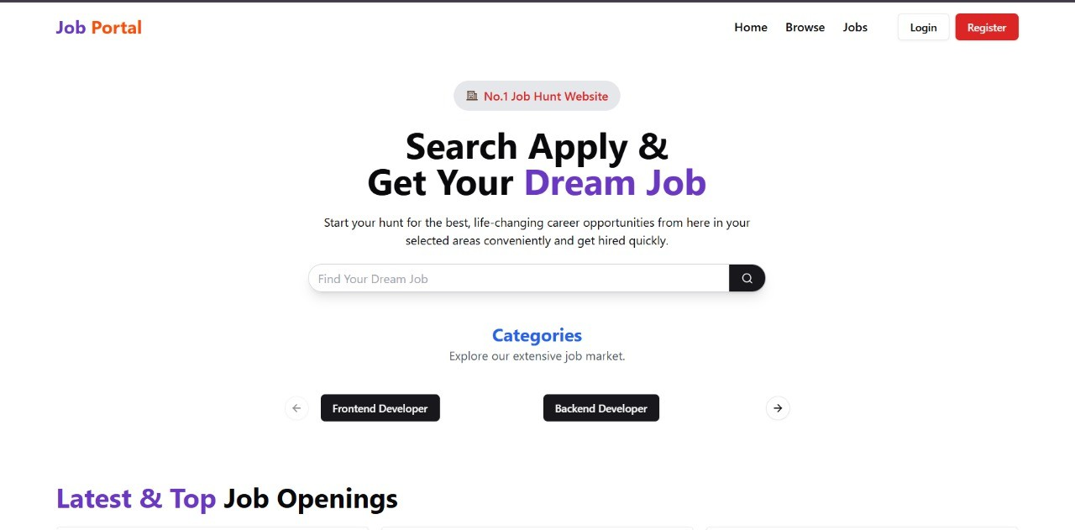

Slide 7
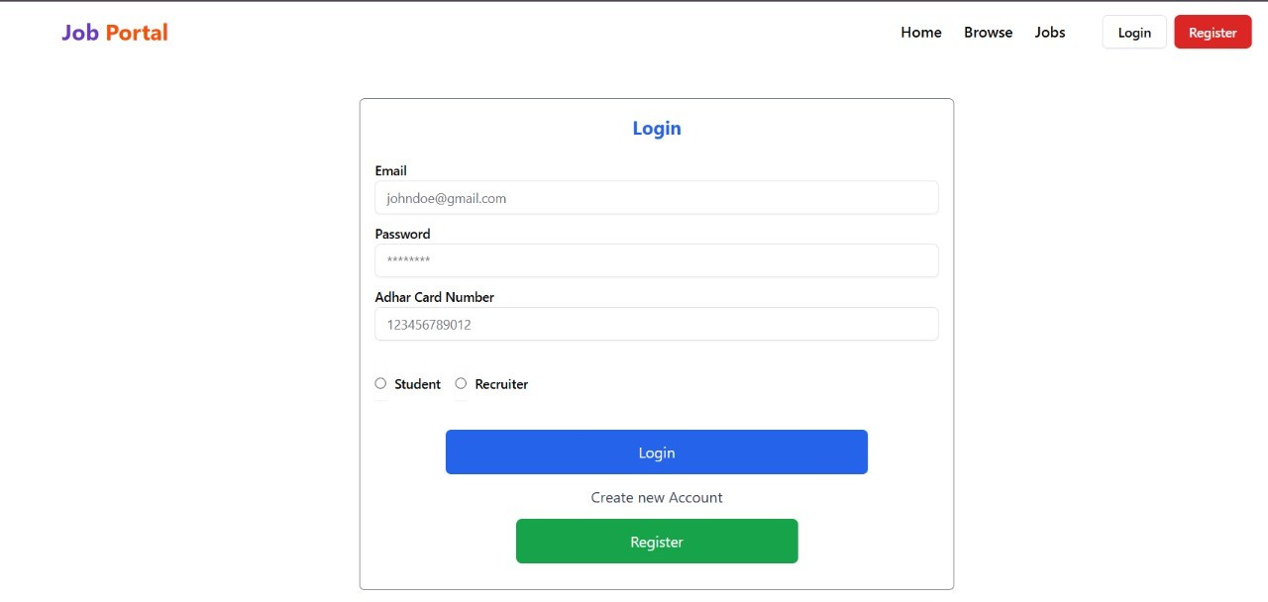

Slide 8
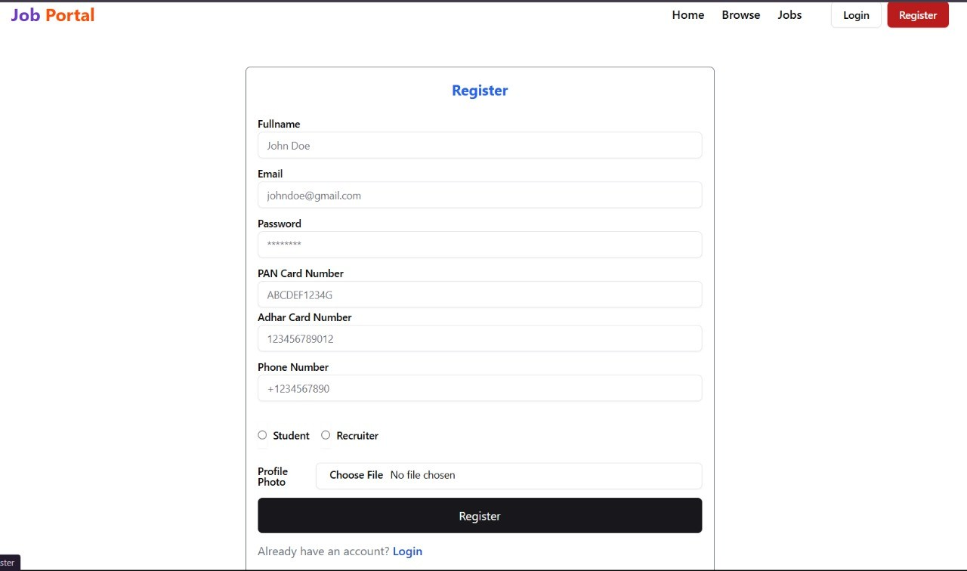
ScreenShots

Slide 9
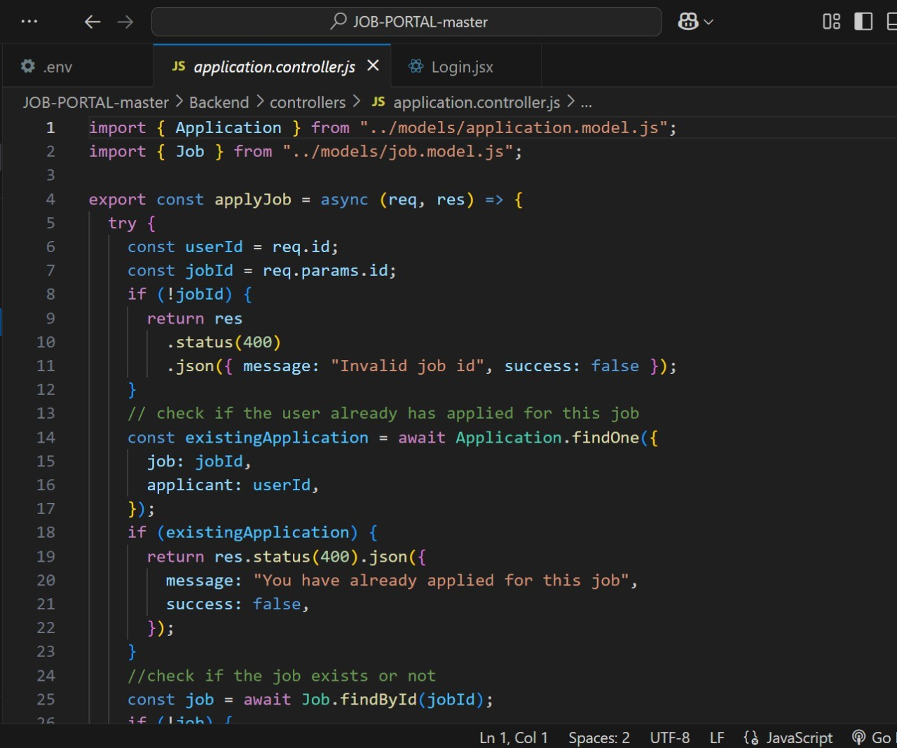

Slide 10
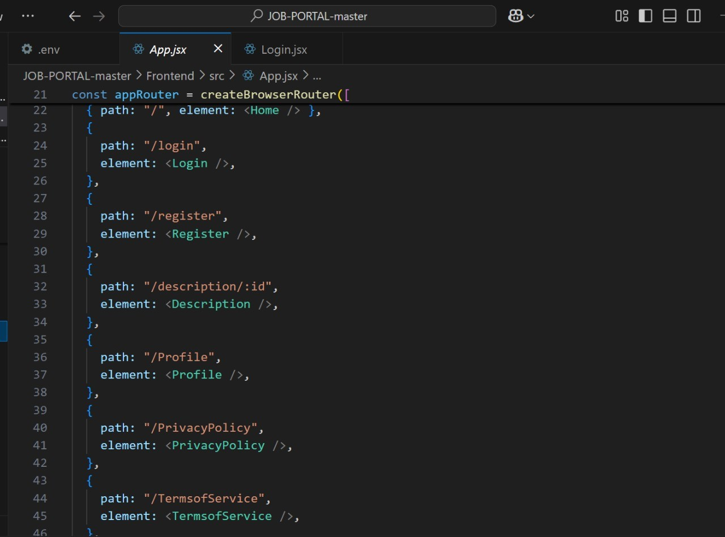
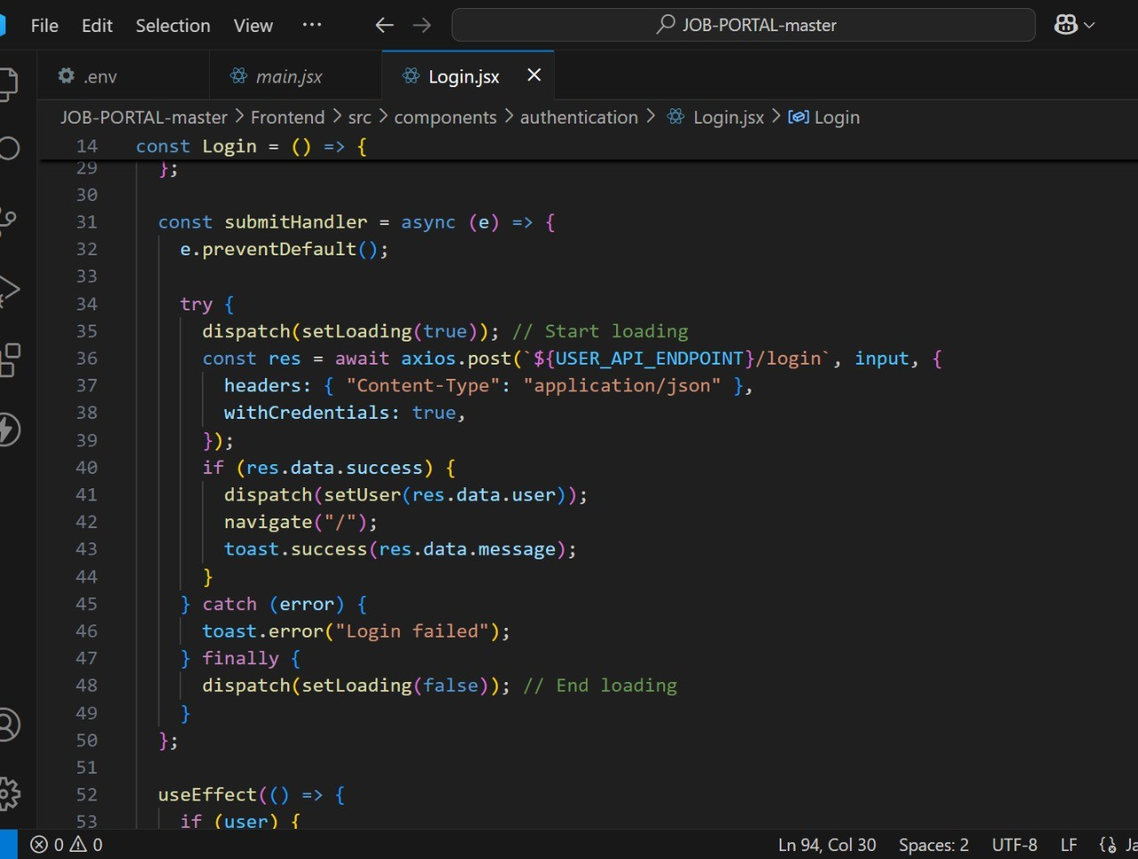

Slide 11
Future Scope
AI-driven Job Matching: Intelligent algorithms can match candidates to jobs based on skills, experience, and preferences.
Resume Screening: AI can automatically analyze resumes and shortlist candidates, reducing recruiter workload.
More users prefer mobile applications, so mobile-optimized job portals will be in demand.
Freemium model: Free access to job listings but paid services for resume boosting, AI- powered job matching, and priority applications.
Recruiter subscriptions: Paid access for recruiters to use advanced filters and AI recommendations.
Detailed company profiles with work culture insights, employee testimonials, and virtual office tours.
AI can suggest peer-recommended jobs based on mutual connections.

Slide 12
Conclusion
Job Portal websites are evolving rapidly with advancements in AI. These platforms play a crucial role in connecting job seekers with the right opportunities while helping employers find the best talent efficiently. Features like AI-powered job matching and skill-based assessments are transforming the recruitment process.
With the rise of remote work and personalized job recommendations, job portals must adapt to changing market trends. Ensuring user-friendly experiences and data security will be key to their long-term success. As technology continues to advance, job portals will become even more intelligent, making hiring faster, fairer, and more effective for everyone.

Slide 13
References
https://www.mongodb.com/resources/languages/mern-stack-tutorial
https://legacy.reactjs.org/docs/getting-started.html
https://www.geeksgorgeeks.org/redux-css/

Slide 14

Q&A / Discussion
•
Any Questions?
Open for discussions and feedback on Job Era implementation and improvements.

