Slide 1

EMPLOYEE ATTRITION ANALYSIS
PROJECT – 1
Submitted By: Kashish Ahluwalia

Slide 2
PROBLEM STATEMENT
XYZ company which was established a few years back is facing around a 15% attrition rate for
a couple of years. And it's majorly affecting the company in many aspects. In order to
understand why employees are leaving the company and reduce the attrition rate XYZ
company has approached an HR analytics consultancy for analyzing the data they have. You
are playing the HR analyst role in this project and building a dashboard which can help the
organization in making data-driven decisions.

Slide 3
TECHNIQUES USED
Used Python Programming Language for Data Manipulation.
Used Numpy Library tot perform numerical operations.
Used Pandas Library for Data Analysis.

Slide 4
Used Libraries like Seaborn, Matplotlib to visualize the Data.
Used Concepts of Statistics to draw inferences from the given Data.
Used Power Point to Prepare Data Analysis Report.

Slide 5
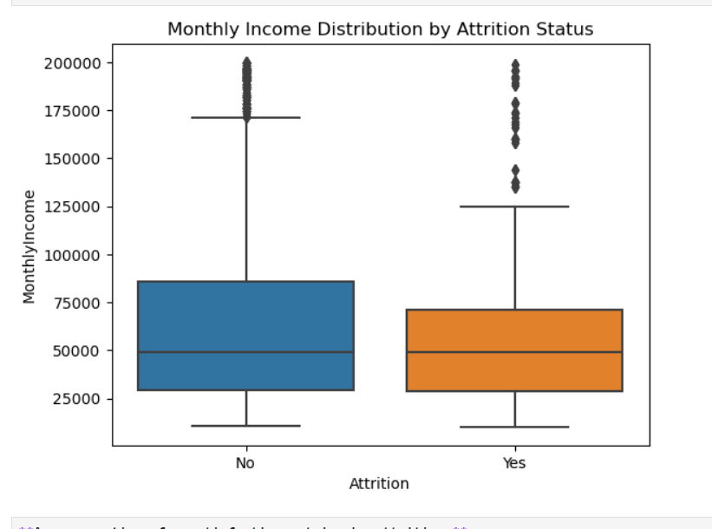
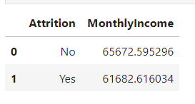
Relation Between Monthly Income & Attrition:
Attrition Comparison:
Employees who have left the company (Attrition = Yes) have a lower average monthly income compared to those who have stayed (Attrition = No).
Income Figures:
Monthly Income for Non-Attrition: $65,672.60
Monthly Income for Attrition: $61,682.62
Difference in Income:
There is a difference of approximately $3,989.98 in the average monthly income between employees who stayed and those who left. Employees who left the company have an average monthly income that is about 6.1% lower.
Potential Implications:
The data suggests a possible relationship where lower monthly income might be associated with higher attrition rates. This could indicate that employees with lower income are more likely to leave the company.

Slide 6
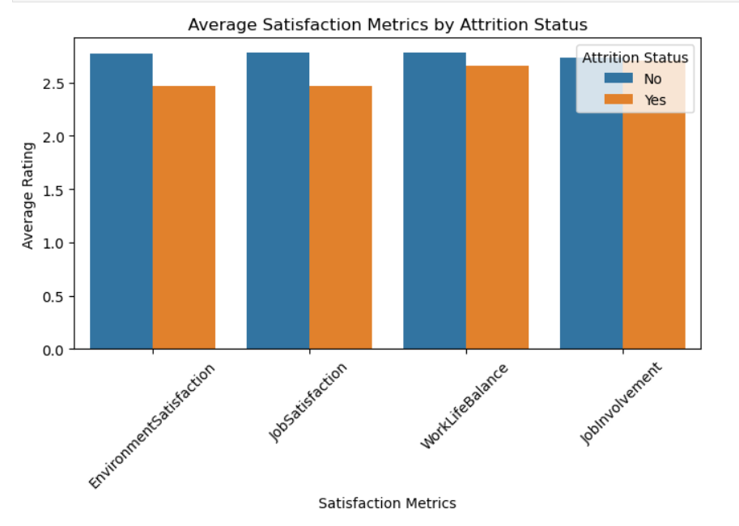
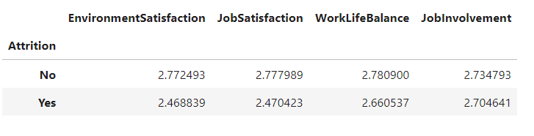
Average Satisfaction Metrics by Attrition Status
Environment Satisfaction:
Non-Attrition: 2.77
Attrition: 2.47
Employees who have left the company rate their environment satisfaction lower than those who have stayed. The difference is about 0.30, suggesting that lower environment satisfaction might be associated with higher attrition.
Job Satisfaction:
Non-Attrition: 2.78
Attrition: 2.47
Similarly, employees who have left the company rate their job satisfaction lower by about 0.31 points compared to those who have stayed. This indicates that lower job satisfaction could be linked to increased likelihood of attrition.
Work-Life Balance:
Non-Attrition: 2.78
Attrition: 2.66
The difference in work-life balance ratings is approximately 0.12, with lower ratings among employees who have left. Although the difference is smaller compared to environment and job satisfaction, it still suggests a potential link between work-life balance and attrition.
Job Involvement:
Non-Attrition: 2.73
Attrition: 2.70
The difference in job involvement ratings is about 0.03. This is the smallest difference among the metrics, indicating that job involvement may have a less pronounced effect on attrition compared to other factors.
General Trend:
Employees who have left the company generally report lower scores in environment satisfaction, job satisfaction, and work-life balance compared to those who stayed.
The metrics with the largest differences (environment satisfaction and job satisfaction) might be more influential in understanding attrition patterns.
Average Satisfaction Metrics by Attrition Status
:

Slide 7
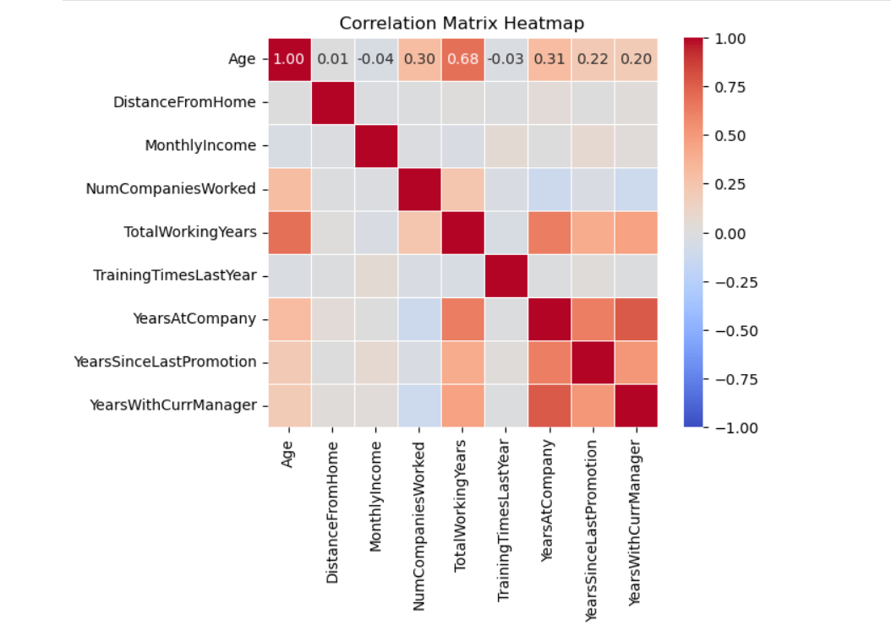
Age and TotalWorkingYears are strongly positively correlated, indicating that older employees often have more total working years.
YearsAtCompany shows strong positive correlations with TotalWorkingYears, YearsSinceLastPromotion, and YearsWithCurrManager, suggesting that employees with more tenure at the company also have more total working years, longer time since their last promotion, and more time with their current manager.
MonthlyIncome has very weak relationships with other variables, indicating that income may not be strongly influenced by factors like total working years or tenure at the company.
DistanceFromHome and TrainingTimesLastYear have very weak correlations with other variables, suggesting minimal impact or influence.
This data helps identify potential areas for deeper analysis, especially focusing on factors with stronger correlations like age, total working years, and tenure at the company.
Correlation between various factors and Attriation:

Slide 8
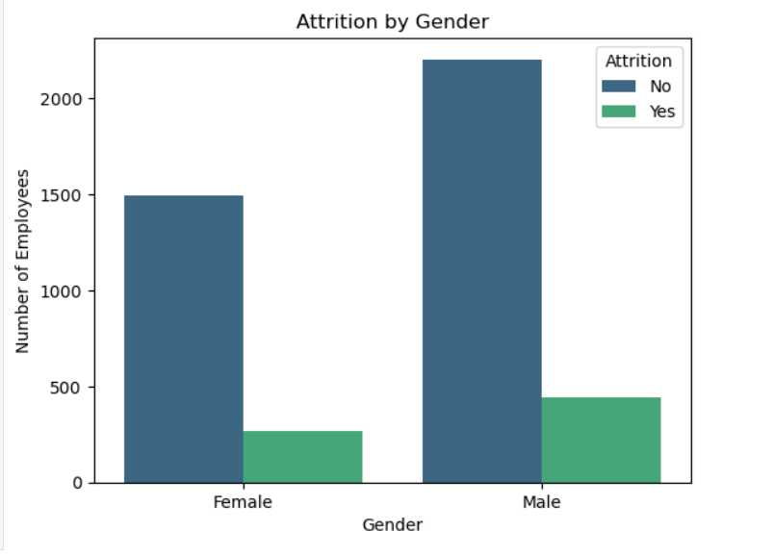
Observations:
Higher Male Representation: There are significantly more male employees than female employees overall, as indicated by the higher total number of male employees (sum of both attrition and non-attrition groups).
Attrition by Gender:
Female Employees: A smaller proportion of female employees have left the company compared to those who have stayed.
Male Employees: A higher proportion of male employees have left the company compared to those who have stayed.
Attrition Rate Comparison:
Although the total number of male employees who have left the company is higher than females, the ratio of employees leaving to staying is similar between genders. However, the absolute numbers suggest that attrition is more prevalent among males simply because there are more male employees.
Possible Implications:
Gender Imbalance: The organization might have a gender imbalance with more male employees than female employees. This could imply a need for policies promoting gender diversity.
Retention Strategies: Given that a higher absolute number of males are leaving the company, it could be useful to investigate if there are specific factors affecting male employees' job satisfaction or if the trend is due to the higher number of male employees.
Tailored Interventions: If further analysis shows different reasons for attrition between genders, the company might need to develop gender-specific retention strategies.
Diversity and Inclusion Efforts: The organization might want to assess if their current policies and work environment are equally supportive of both genders and if there are particular challenges faced by one gender more than the other.
Relation between Gender & Attrition:

Slide 9
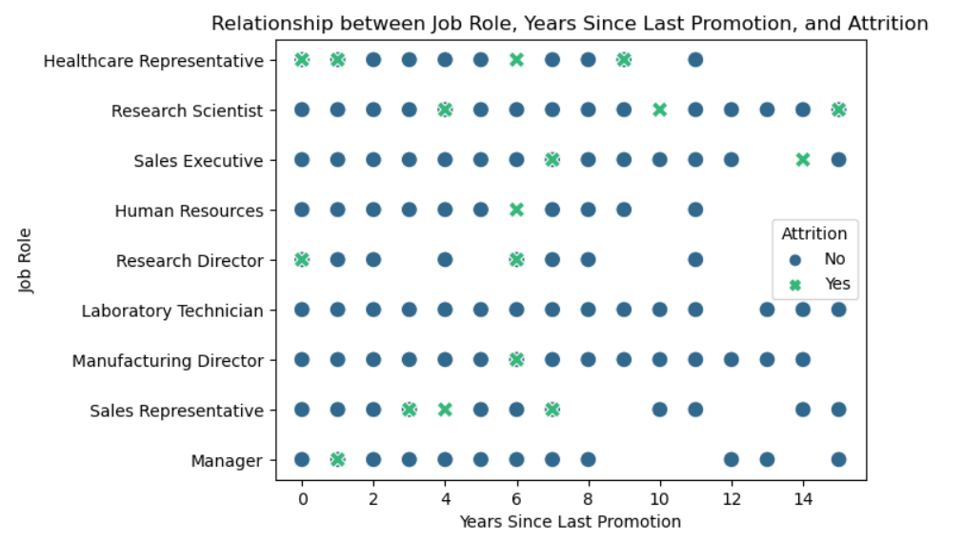
Observations:
Higher Male Representation: There are significantly more male employees than female employees overall, as indicated by the higher total number of male employees (sum of both attrition and non-attrition groups).
Attrition by Gender:
Female Employees: A smaller proportion of female employees have left the company compared to those who have stayed.
Male Employees: A higher proportion of male employees have left the company compared to those who have stayed.
Attrition Rate Comparison:
Although the total number of male employees who have left the company is higher than females, the ratio of employees leaving to staying is similar between genders. However, the absolute numbers suggest that attrition is more prevalent among males simply because there are more male employees.
Possible Implications:
Gender Imbalance: The organization might have a gender imbalance with more male employees than female employees. This could imply a need for policies promoting gender diversity.
Retention Strategies: Given that a higher absolute number of males are leaving the company, it could be useful to investigate if there are specific factors affecting male employees' job satisfaction or if the trend is due to the higher number of male employees.
Tailored Interventions: If further analysis shows different reasons for attrition between genders, the company might need to develop gender-specific retention strategies.
Diversity and Inclusion Efforts: The organization might want to assess if their current policies and work environment are equally supportive of both genders and if there are particular challenges faced by one gender more than the other.
Relationship between Job Role, Years Since Last Promotion, and Attrition

Slide 10
SUPERMART GROCERY SALES ANALYSIS
PROJECT – 2
Submitted By: Kashish A hluwalia

Slide 11
INTRODUCTION:
This project focuses on using a dataset containing information about grocery sales at
a supermart. The dataset includes columns such as Order ID, Customer Name,
Category, Sub Category, City, Order Date, Region, Sales, Discount,
Profit, State, month_no, Month, and year. We’ll explore this data, perform
feature engineering, and build a machine learning model to predict sales or profit.

Slide 12
TECHNIQUES USED:
Used Python Programming Language for Data Manipulation.
Used Numpy Library tot perform numerical operations.
Used Pandas Library for Data Analysis.

Slide 13
Used Libraries like Seaborn, Matplotlib to visualize the Data.
Used Concepts of Statistics to draw inferences from the given Data.
Used Power Point to Prepare Data Analysis Report.

Slide 14
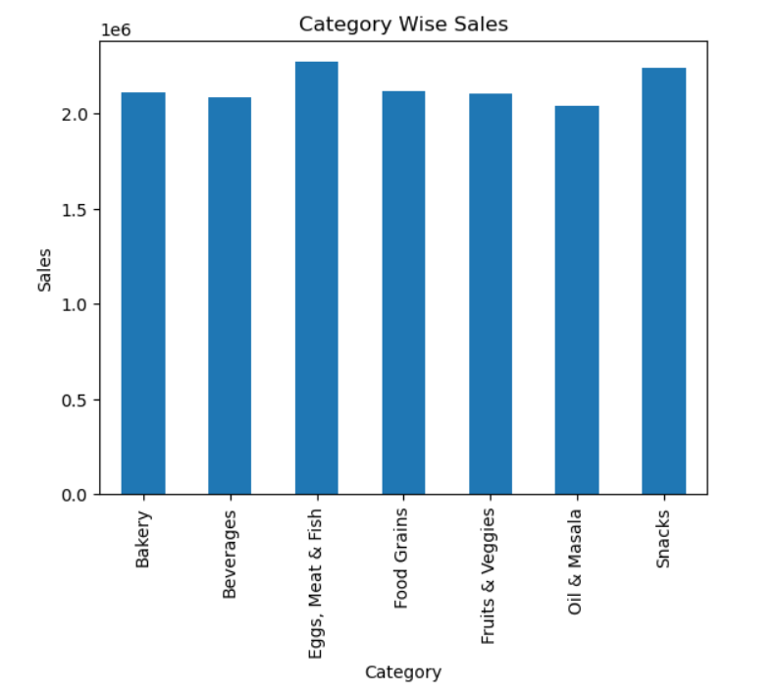
Category Wise Sales Analysis:
Analysis:
Eggs, Meat & Fish has the highest sales, accounting for approximately 29.5% of the total sales. Food Grains follows closely, contributing around 29.1% to the overall sales. Beverages and Fruits & Veggies also play significant roles, with approximately 28.9% and 28.7% of the total sales, respectively.
Suggestions:
Given the strong performance of the Eggs, Meat & Fish category, consider expanding its product range or promoting related items. Monitor the performance of Beverages and Fruits & Veggies, as they are close contenders. Adjust marketing strategies or pricing if needed. Ensure consistent availability and quality for all categories to maintain customer satisfaction.

Slide 15
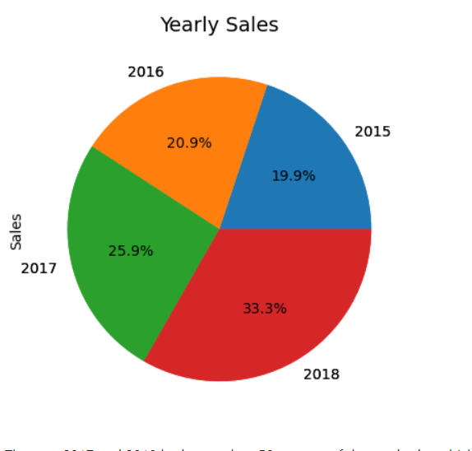
Yearly Growth in Contribution:
Increasing Share Over Time: The pie chart would show that the share of total sales is increasing year by year. The area representing 2018 would be the largest, indicating significant growth over time.
Relative Growth: By comparing the slices, you can visually see how much each year's contribution has increased relative to previous years. For instance, the portion for 2018 would dominate, highlighting the highest growth compared to earlier years.
2. Proportional Contribution:
2018's Dominance: The year 2018 would likely occupy a large portion of the pie, indicating it contributed the most to the overall sales from 2015 to 2018. This suggests that 2018 was a particularly strong year.
2015’s Smaller Slice: Conversely, 2015 would occupy the smallest portion of the pie, indicating it contributed the least to the total sales over these four years. This might be expected as it's the earliest year and the business may have grown since then.
3. Growth Trends:
Steady Increase: Each subsequent year’s slice in the pie chart would be larger than the previous, indicating a steady and continuous increase in sales over the four years. This suggests positive growth momentum for the business or metric being analyzed.
Acceleration of Growth: The substantial increase from 2017 to 2018 might suggest that the growth is accelerating, not just steady. This could be due to various factors such as successful business strategies, market expansion, or product launches.
4. Strategic Implications:
Focus on Expansion: The significant growth observed, especially in 2018, could imply that the strategies or conditions that led to this increase should be further explored and leveraged in future planning.
Investment Opportunities: The growth trend could indicate that it might be a good time to invest in the business or area being analyzed, as the upward trajectory suggests continued potential.
Yearly Sales Analysis

Slide 16
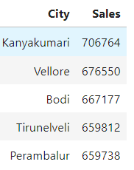
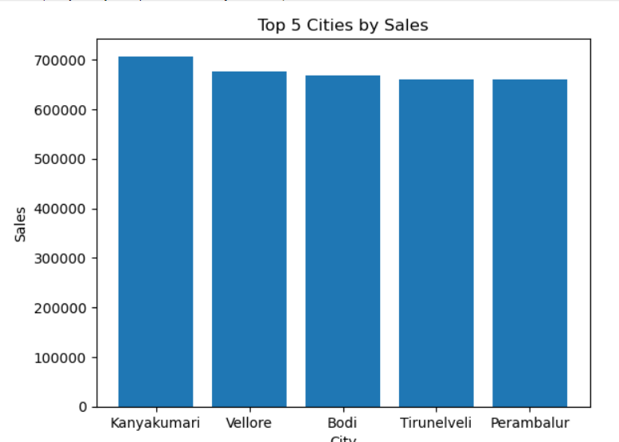
City Wise Sales Analysis:
1. Kanyakumari Leads in Sales:
Highest Sales: Kanyakumari has the highest sales among the five cities, with 706,764. This suggests that Kanyakumari might be a key market for the business, possibly due to a larger population, higher demand, or successful marketing and sales strategies in the region.
Strategic Importance: Given its leading sales figures, Kanyakumari should be a focal point for continued or increased investment in marketing, inventory, and customer engagement efforts.
2. Close Competition Among Other Cities:
Narrow Gaps in Sales: The sales figures for Vellore (676,550), Bodi (667,177), Tirunelveli (659,812), and Perambalur (659,738) are relatively close to each other, with differences in the range of tens of thousands. This suggests that these cities are nearly equal in terms of sales performance.
Opportunity for Growth: Since these cities have similar sales figures, small improvements in customer service, targeted marketing, or product offerings could potentially lead to one city outpacing the others. A focused strategy might help in boosting sales in any of these cities to surpass Kanyakumari.
3. Potential for Equal Distribution:
Balanced Sales Distribution: The relatively close sales figures across these cities might indicate a balanced market distribution. The business is not overly reliant on one city, which could be advantageous in mitigating risks associated with market-specific downturns.
Expansion Opportunities: With such close figures, there may be opportunities to further penetrate these markets by identifying and addressing specific needs or preferences in each city.
4. Targeted Marketing and Sales Strategies:
Customization: Each city might have specific customer preferences that slightly differentiate it from others. By understanding these nuances, the business could implement more customized marketing strategies tailored to each city, further boosting sales.
Promotions and Campaigns: The narrow difference in sales could also mean that promotional campaigns or discounts could easily shift the balance, making one city outperform others in the next period.

Slide 17
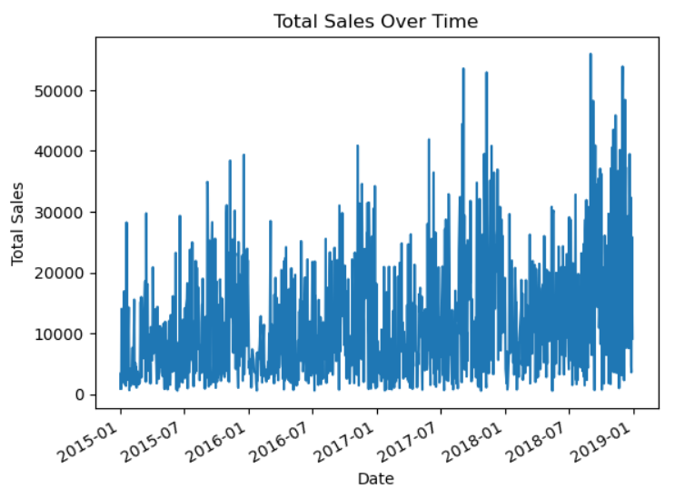
1. Increasing Trend in Sales:
Steady Growth: Sales have consistently increased from 2015 to 2019, indicating steady business growth.
Rising Peaks: Sales peaks become progressively higher, especially from 2017 onward, suggesting successful expansions or marketing efforts.
2. Seasonal/Cyclical Patterns:
Recurring Spikes: Regular sales spikes at year-end and beginning suggest seasonal patterns, likely tied to holidays or promotions.
Strategic Planning: Identifying these patterns aids in optimizing inventory, marketing, and workforce planning during high-demand periods.
3. Sales Fluctuations:
High Volatility: Frequent fluctuations in sales may reflect market variability or external economic factors.
Risk Management: The volatility indicates a need for robust risk management, such as portfolio diversification and flexible pricing.
4. Significant Post-2017 Growth:
Sharp Increase: Noticeable spikes in sales post-2017 suggest rapid growth due to strategic initiatives or market expansion.
Scaling Investments: Likely driven by investments in scaling operations and expanding the customer base.
5. Peak Sales in Late 2018 - Early 2019:
Record Highs: The highest sales peaks occurred in late 2018 and early 2019, indicating the company's peak performance.
Sustaining Growth: Future challenges include maintaining this high level of sales through continued innovation and operational efficiency.
Trend of Sales Over Time

Slide 18
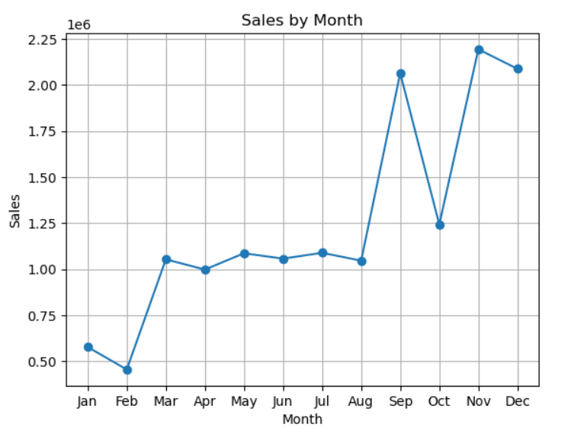
Month Wise Sales Analysis
1. Strong Sales in Q4 (September to December):
Peak Sales: November has the highest sales at 2,193,924, followed closely by December (2,088,076) and September (2,064,266).
Q4 Dominance: The last quarter of the year shows a significant sales surge, likely driven by holiday shopping, seasonal demand, or year-end promotions.
2. Moderate Performance in Mid-Year (March to August):
Consistent Sales: Sales during March to August are steady, with May (1,086,920) and July (1,089,385) performing well.
Mid-Year Consistency: This period likely reflects steady consumer demand without the influence of major seasonal events.
3. Lower Sales in Early Year (January to February):
Slow Start: January (577,972) and February (456,102) have the lowest sales, indicating a slower start to the year.
Potential Post-Holiday Slump: This could be due to reduced consumer spending after the holiday season.
4. Notable Sales in September and October:
Pre-Holiday Increase: Sales begin to rise significantly in September (2,064,266) and October (1,243,289), possibly due to early holiday shopping or promotions.
5. Strategic Insights:
Maximize Q4: Focus on maximizing sales efforts during Q4, leveraging the high demand.
Boost Early Year Sales: Consider targeted promotions or new product launches in the early months to boost sales during the slower periods.
Maintain Mid-Year Momentum: Continue to engage customers during mid-year to sustain steady sales before the peak season.

Slide 19
THANK YOU!

