Slide 1

Team Members:
1.Paras Saini(2330754)
2.Anchal(2330241)
3.Kashish Jindal(2330735)
4.Harsh(2330722)

Slide 2
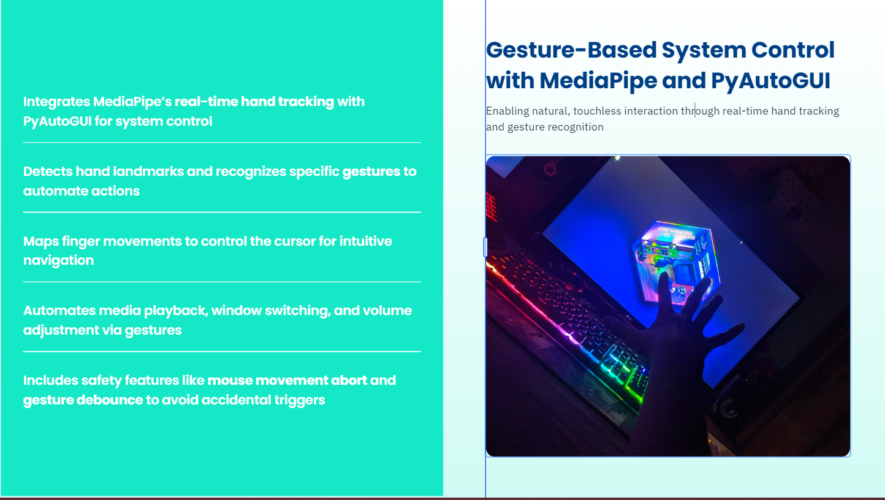

Slide 3
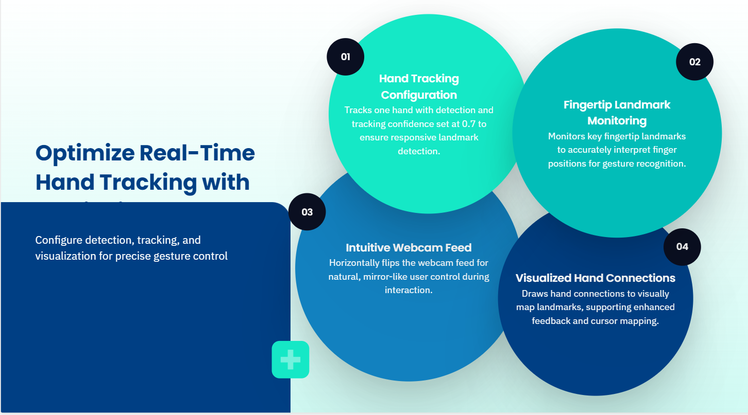

Slide 4
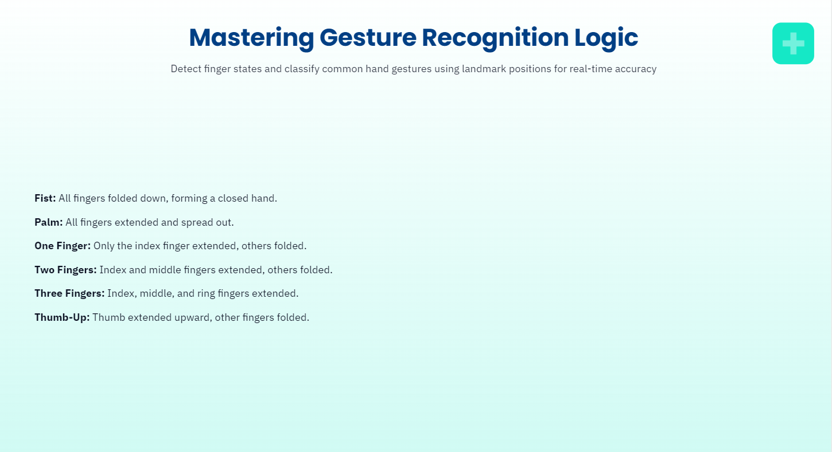

Slide 5
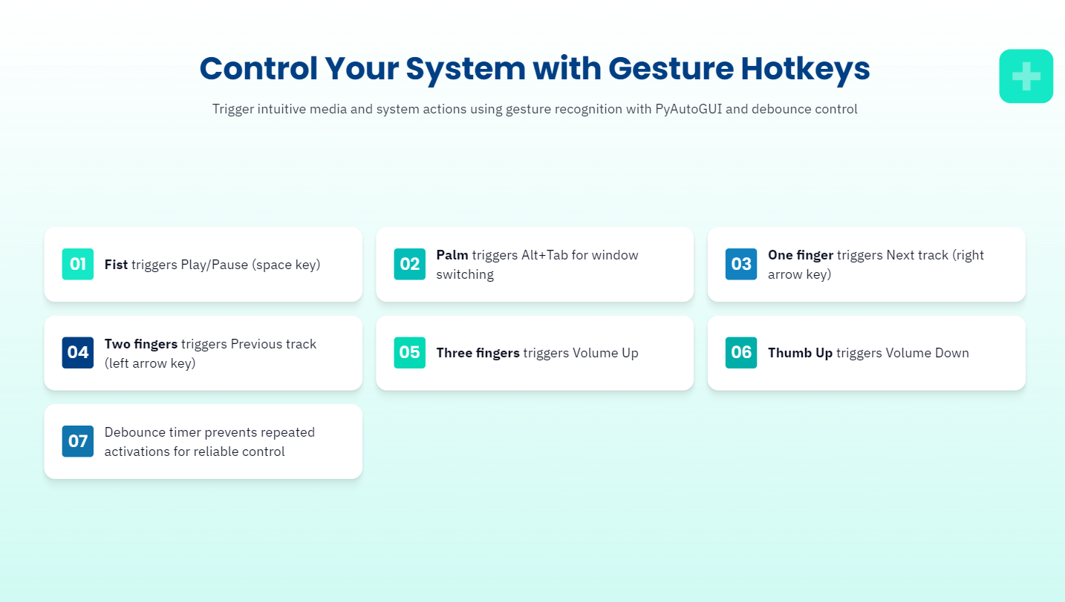

Slide 6
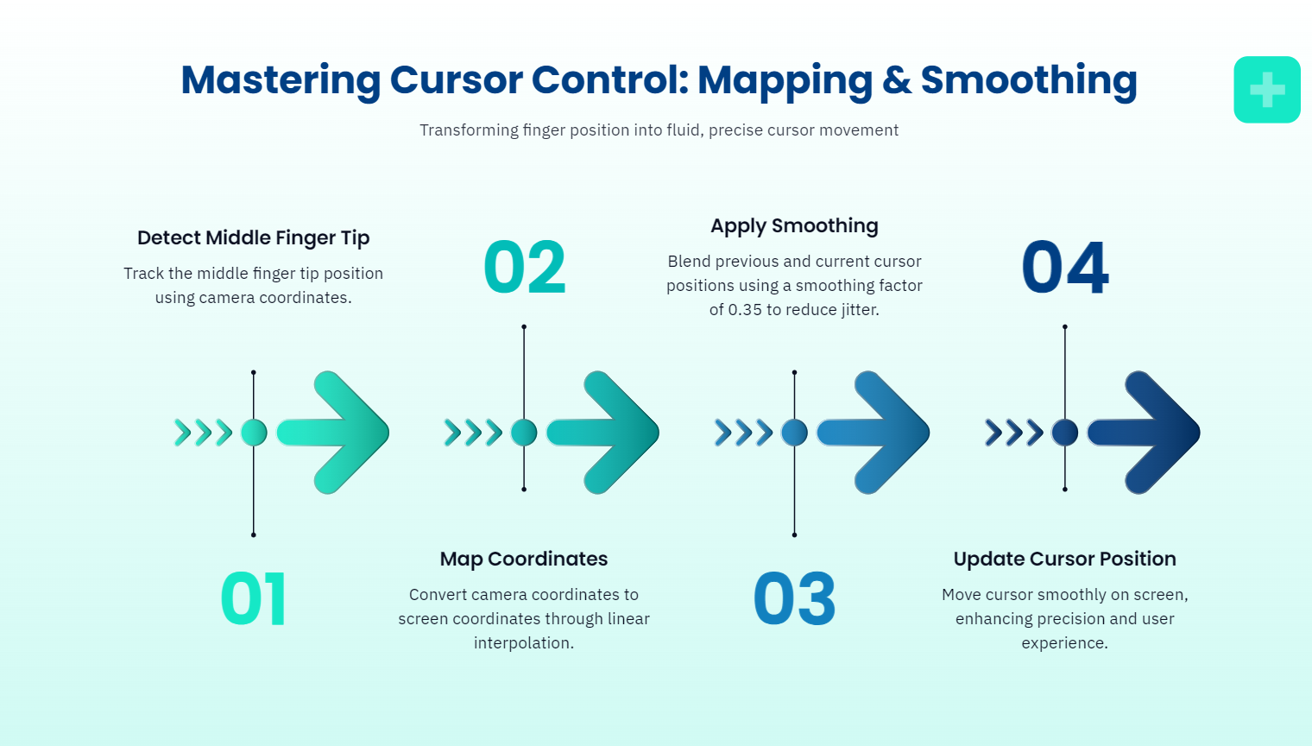

Slide 7
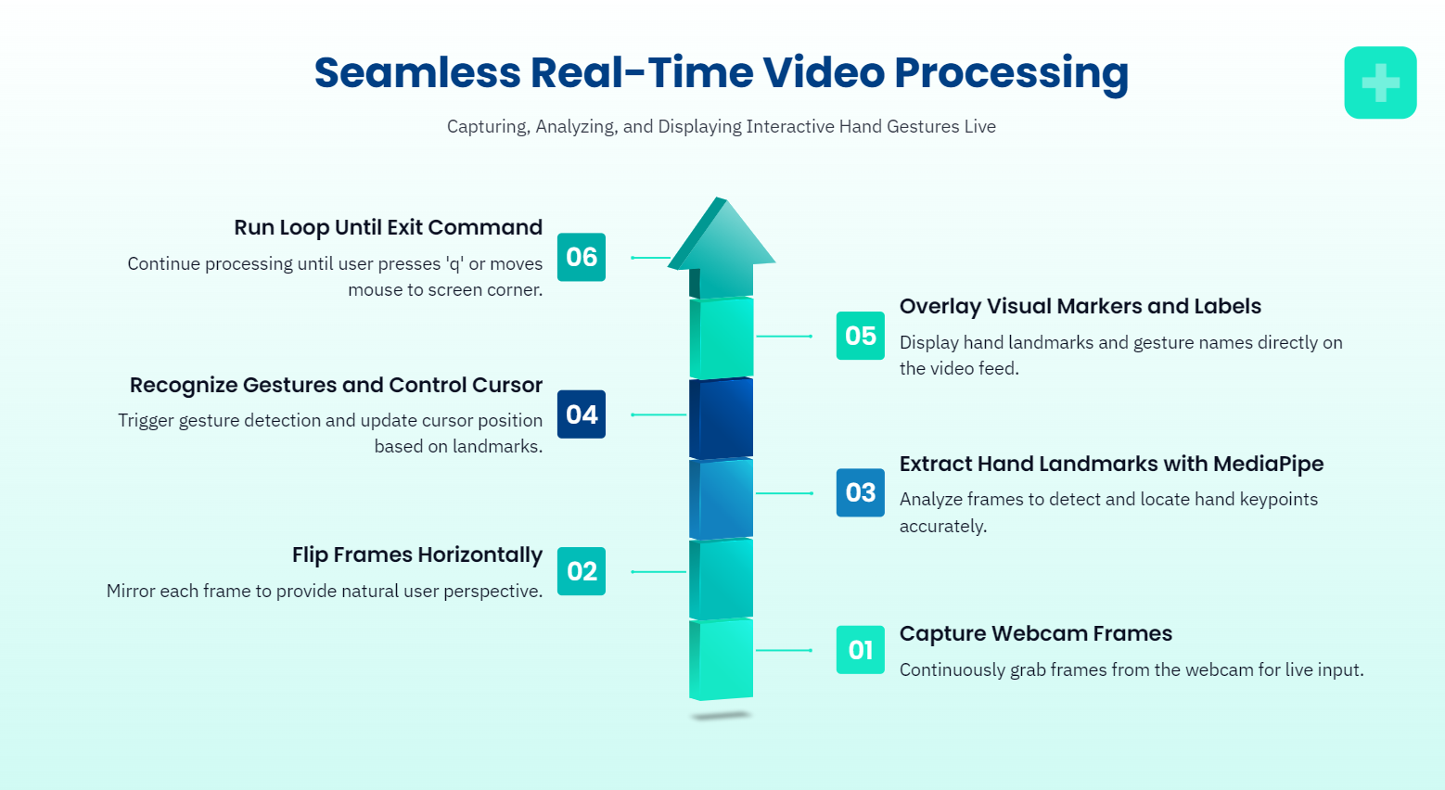

Slide 8
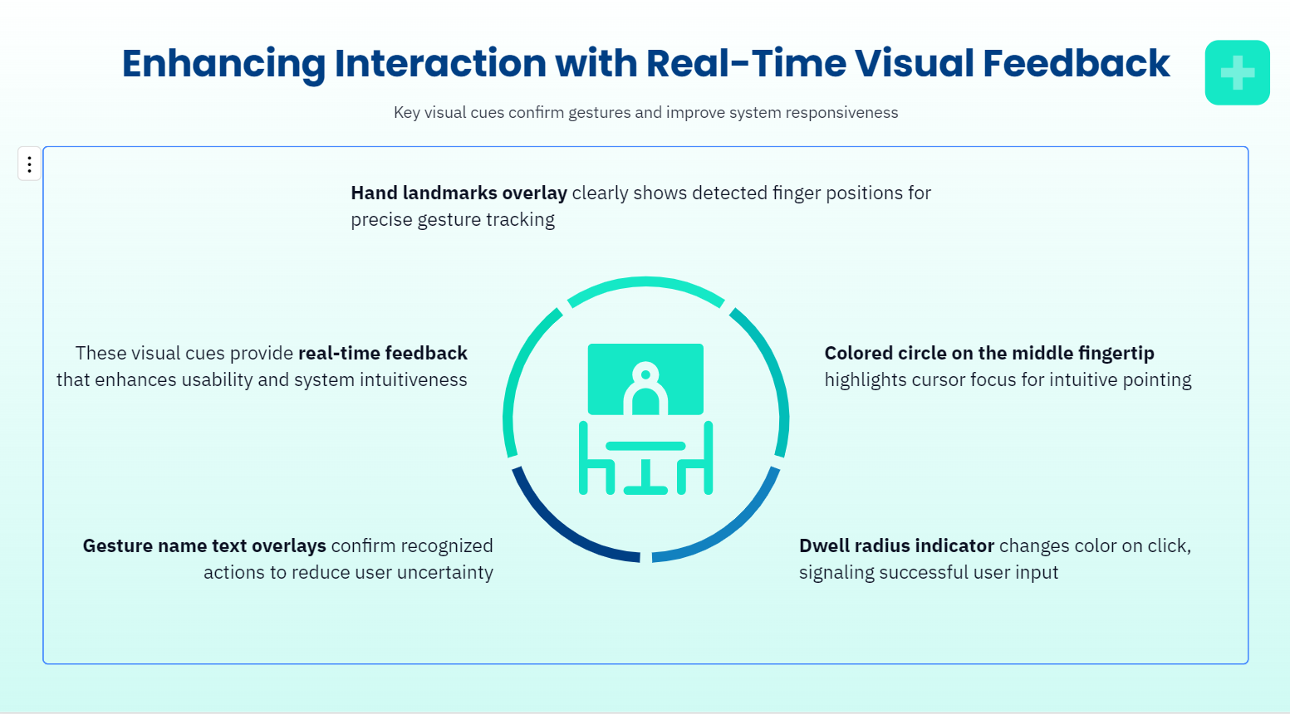

Slide 9
