Slide 1
Resource Management System
By : Kashish Agarwal
Sasnkriti Agarwal
Anmol Jain
Saksham Jain
Aditya Joshi

Slide 2
Introduction
This document is the presentation of the project based on HR management system . In this there is detailed information of the project and also description of overview and list of all the requirements.

Slide 3
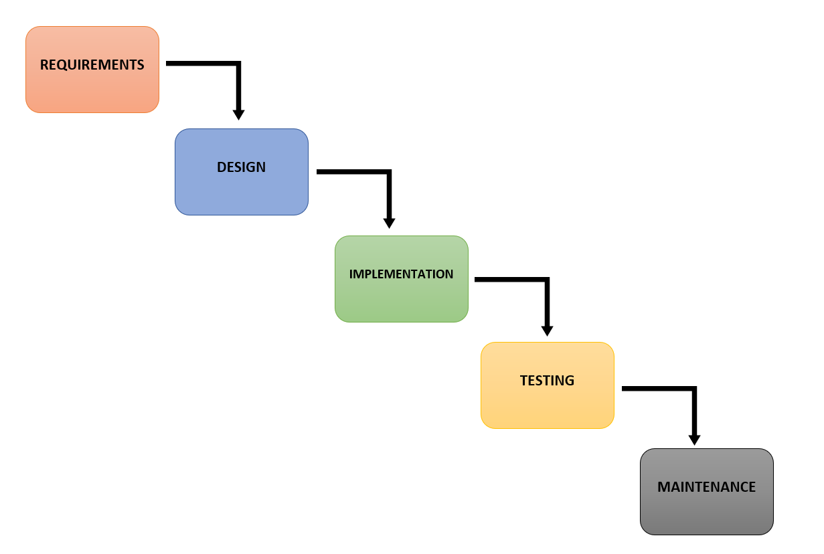
Planning
Processing Model :

Slide 4
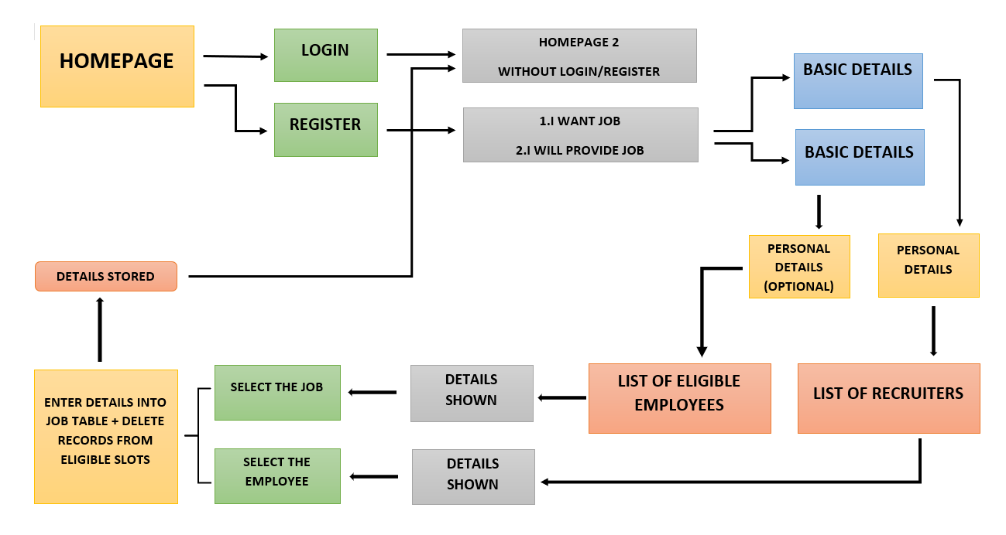
Requirements

Slide 5
Functional Requirements
Authentication :
Login : User can login to the HRMS system with his/her email id and password.
Logout : User can logout from the HRMS system.
Login Failure : If the user does not exist in the database or the user did not get authorized by the HRMS admin yet.
Authorization :
User role check : After logging in, the user role will be checked from the database and the user interface will be created according to that role/roles.
Process Data :
Display : User with defined roles can display the content of the database. Being more specific, employee can only view his/her personal information. Manager can see not only his/her personal information but also employees’ information who are working under his/her coverage. Admin and Employer can display their personal information and all employees’ information.
Edit : A user with employee role can edit his/her specific personal information. Manager can only edit his personal information that is under his/her coverage except user role type. Admin can edit all information related to all employees’ including their user role type.

Slide 6
Functional Requirements
Process Data :
Search : User with manager role type can search the content of database for the employees who are under his/her coverage. Admin roles can search all the employees’ information in the database. Search feature works on specific keywords showing employees’ characteristics, peculiarities, skills, features, and etc. For example, Employer wants to find employees who are well trained in “Java Programming Language”. He/she will write the specific keyword in the search bar and press the available search button. Afterwards, he/she will find a list of all the employees’ who know “Java Programming Language”.
Report : This feature is basically used to filter the contents of the search mechanism. For instance, as we mentioned in the above search feature. The HR wants to get a report of some specific employees who know “java programming Language”. The list of employees obtained from the result of search feature he/she can get the specific report by selecting the corresponding checkbox available for each employee. Or a manager role type can get a report of some or all employees’ who are working under his/her coverage by selecting the checkbox. Except employee role type, all other role types such as admin, HR, and manager can use this feature.
Update Authentication : This feature can be used only by the admin role type . Admin can update the role type of the specific user . For example, an employee got promotion and his role type will be changed from employee role to manager role . Admin will be able to update this authentication mechanism .

Slide 7
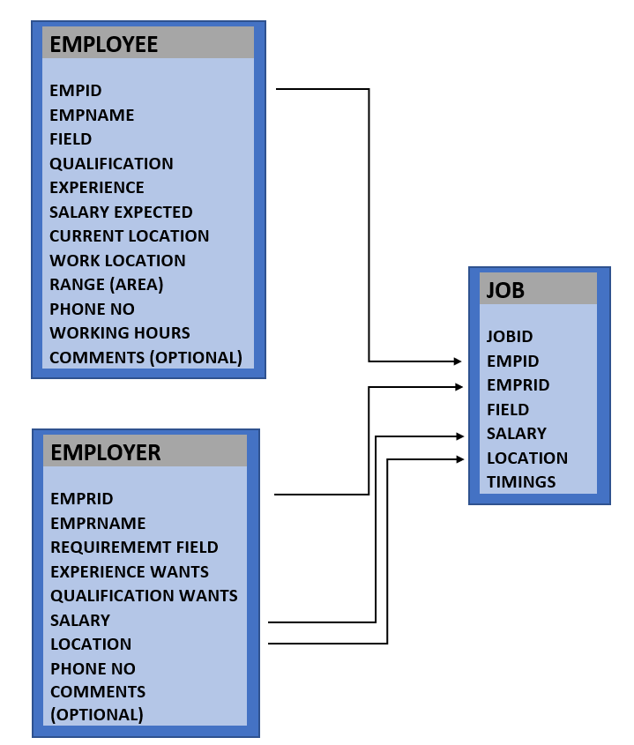
Relationship between employee and employer

Slide 8
Description of relationship
After entering state, each user sees the same interface with different tabs related to their role type/s (manager, Employer, admin, employee). At this stage:
Manager can
Search employees under his responsibility or search all the users he/she desires, i.e a manager can search rows of the database.
Get report of information related to the employees he/she desires to learn, i.e. a manager can search columns of the database.
Employees can
Edit their personal data
See their data editable form
Employer can
Search employees who has the properties he/she desires.
Get report about an employee, or employees.
Administrator can
Edit any user' s (manager, admin, Employer, employee) data
Add user, in other words create a valid account to login
Edit role properties, for example there can be a need to change the attributes of each role type such that the type of tabs each user sees may change. For that kind of situation there may be need to change the properties of each role type.
Add a new role type to the system. Since, our HRMS is going to be a generic program there can be an addition to the role types and our system will perfectly welcome that kind of need.
Search the users who have the desired capabilities or properties specified.

Slide 9
Working
All the users will see the same page when they enter SERENE JOB Portal. This page asks the users either to register or if they already have an account then to login.
After first page if the user clicked on register then a page will be displayed which will ask for their details and then the user will submit its details according to the page.
After second page if the user clicked on login then a page will be displayed which will ask for their username/email id and password, password is that one which is already confirmed in the register page.
After third page one more page will be shown in which the user has to select either they want a job or they want to provide a jo and then submit.
After selecting an option(I want Job ) a page will open which will ask for personal details of employee and in the form the details will be filled.
After the option is selected (I provide Job) a page will be opened in which the details of the employer will be filled those are optional in case of employer.

Slide 10
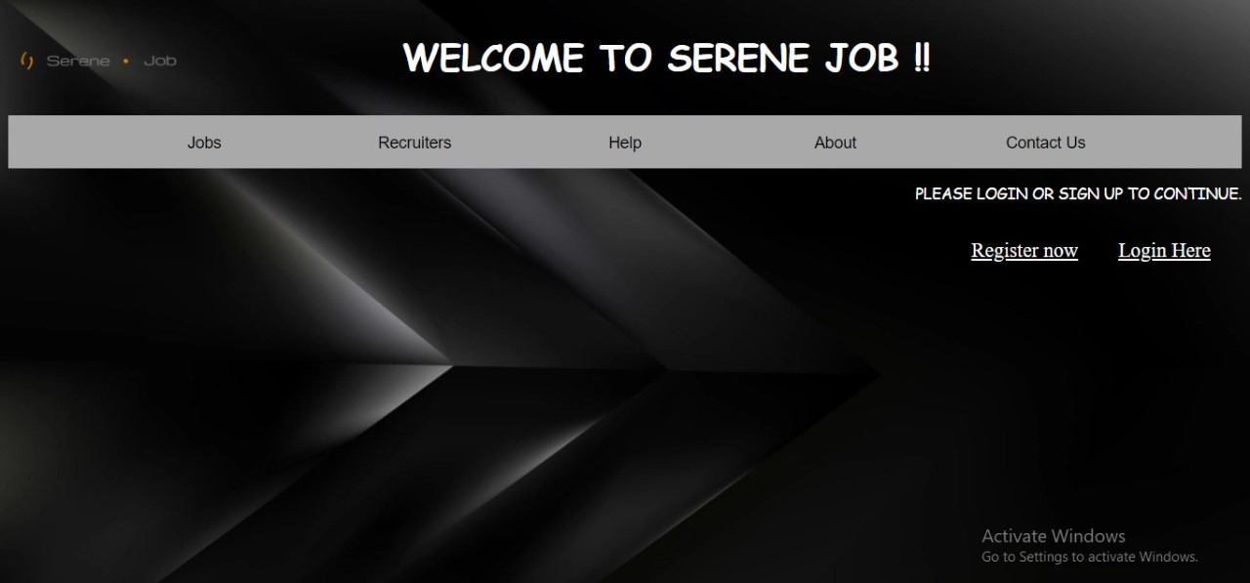
Screenshots of websites

Slide 11
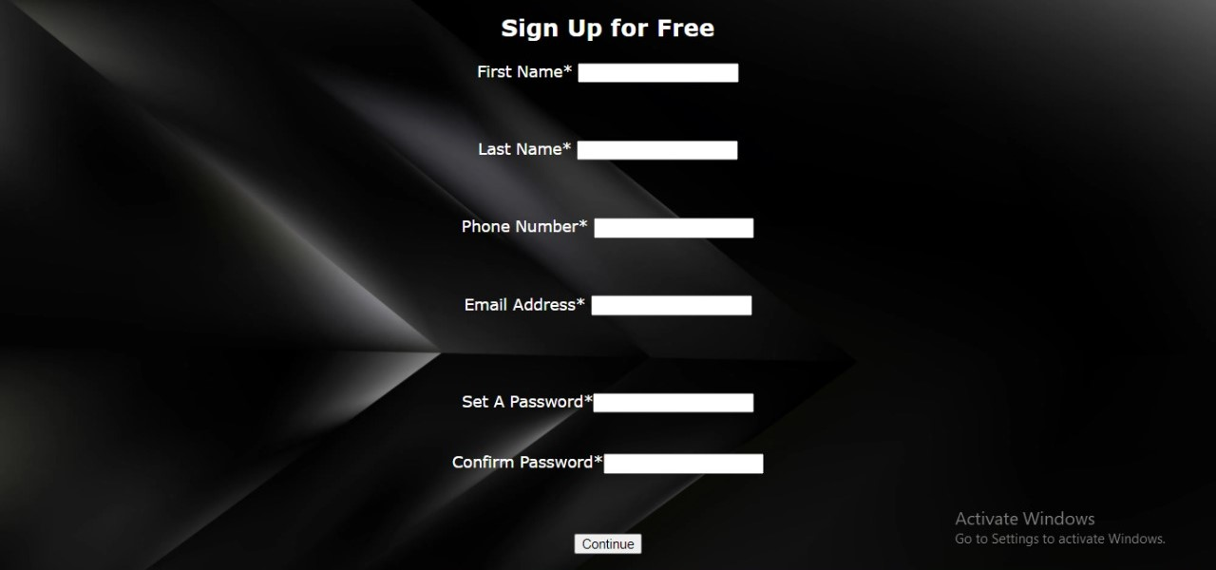

Slide 12


Slide 13
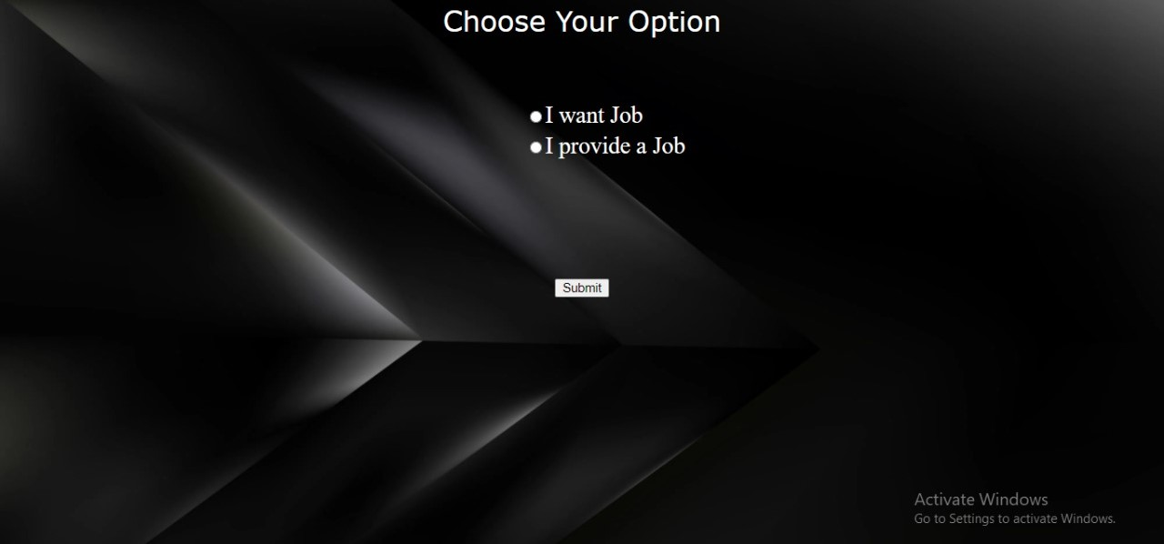

Slide 14
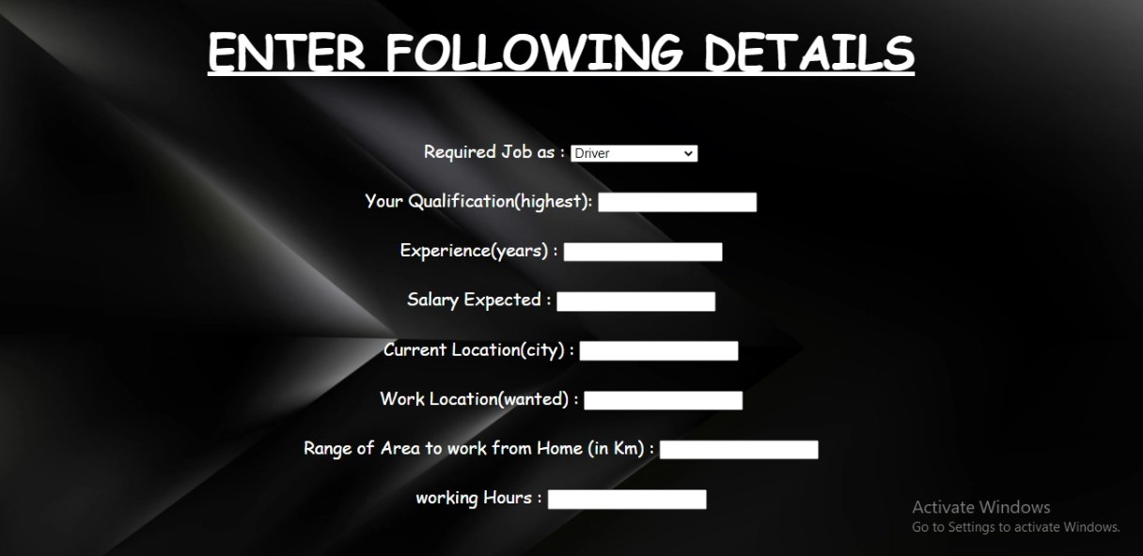

Slide 15
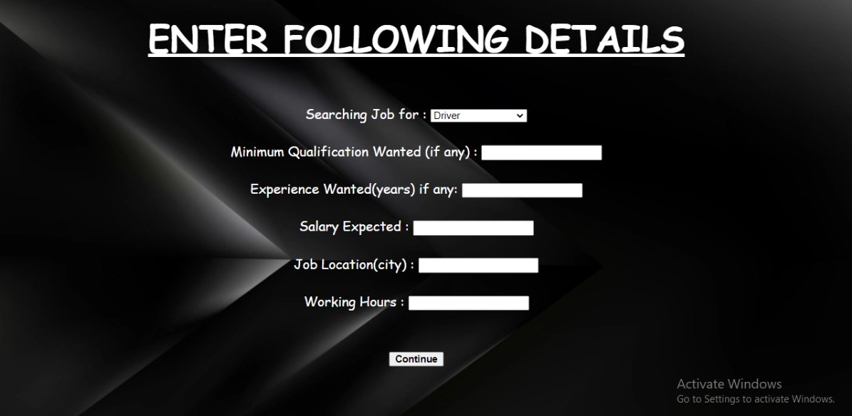

Slide 16
Description of website
Homepage Tab : With the help of this tab, the user is able to register or login on the website and can save his/her details for the further process. In the homepage tab the user is able to see what he/she can do on this website and if he/she is interested in this then they can register or if they already have an account on this website then they can directly login from this page.
Register Tab : This tab is used to save the user details in the database by entering the proper information in the given textbox and these textboxes will save the information in the database. In the first textbox the user will enter his/her first name and in the next textbox their Last name and after that their phone no., Email id and in this page only the user will set and confirm a password according to them and these information will be saved in the database which will be used at the time of login.
Login Tab : With this tab the user is able to access the further processing once they enter the email id and password and after entering the details as in first textbox user has to enter their email id and in the second textbox user has to enter their password created on the register page. If both the details are correct and matched from the database the there is a successful login but in case if the password doesn’t match then the person can reset their password by clicking on the forgot password link otherwise there will be a continuous login failure.

Slide 17
Description of website
Select Option Tab : With the help of this tab the user is able to confirm either he/she wants a job or wants to provide a job. If the user clicks on want a job then a page will be shown in which the user has to enter more details after which the details will be saved. If the user clicks on provide a job then also a page will be shown in which the user has to enter some basic details after which the details will be compared with the users who entered their details for the requirement of job and if the requirements meet then the job offer will be sent to that person who has applied for that job and after both agrees then the job will be confirmed.
Basic Details Tab : With this tab the page will be reflected in which the user has to enter their basic details in which they have to enter the details like work experience, working hours, qualifications etc. And the same thing will happen in both the cases either in I want job or I provide Job but just a simple difference like in case of I want job the user have to enter that how much work experience the person is having or for how many hours the person will work but in the case of I Provide job the user have to enter their qualification he wants for job and the experience needed for that job.
Personal Details Tab : With this tab the page will be reflected in which the user has to enter their personal details after choosing the option from the option tab the page will reflected according to the user’s choice. In case of I want Job there is a compulsion of entering personal details but in the case of I provide Job It is optional depends on the person who wants to enter their personal details or not.

Slide 18
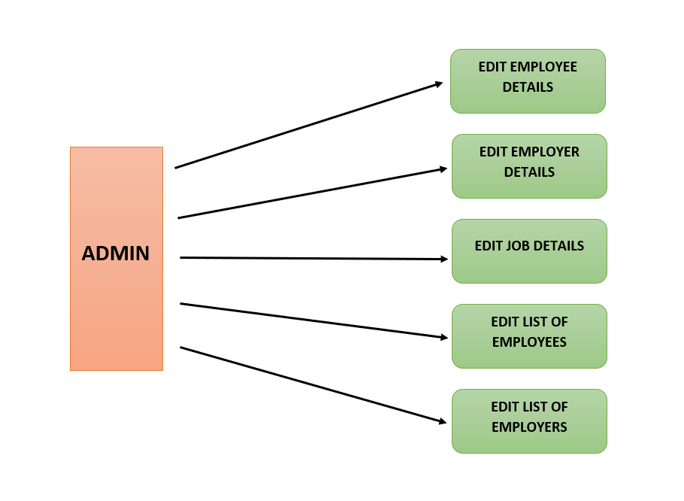
Some important flowcharts

Slide 19
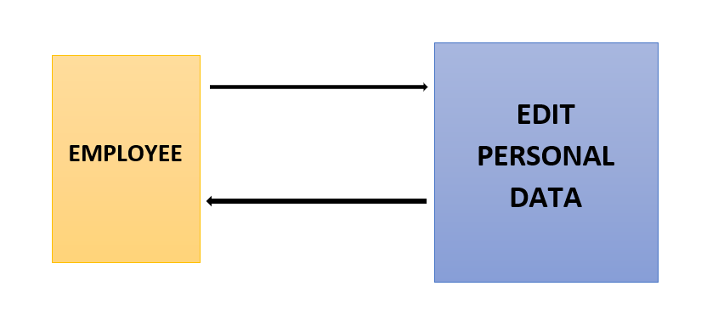
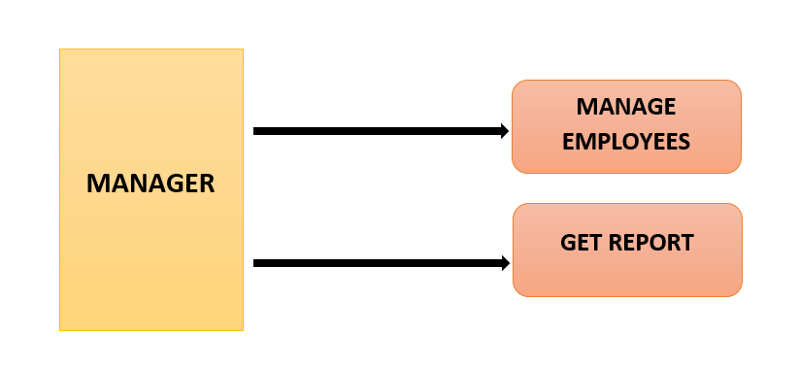

Slide 20
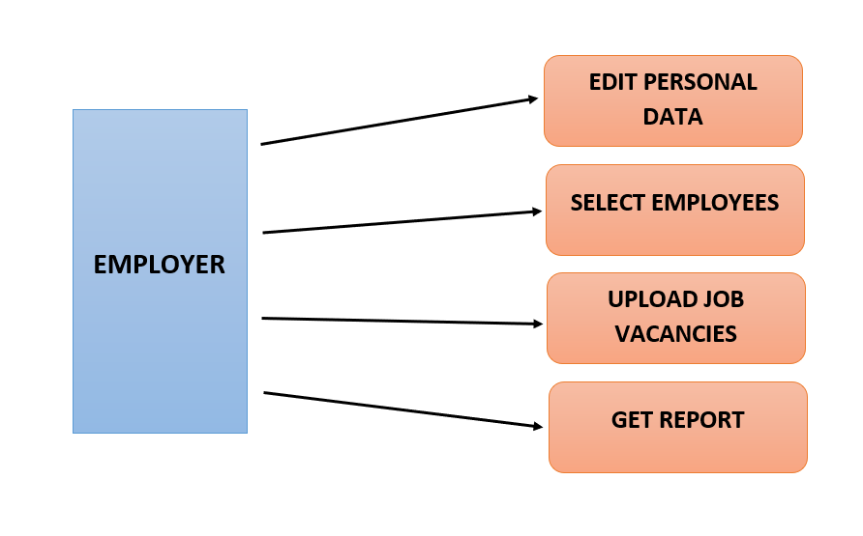

Slide 21
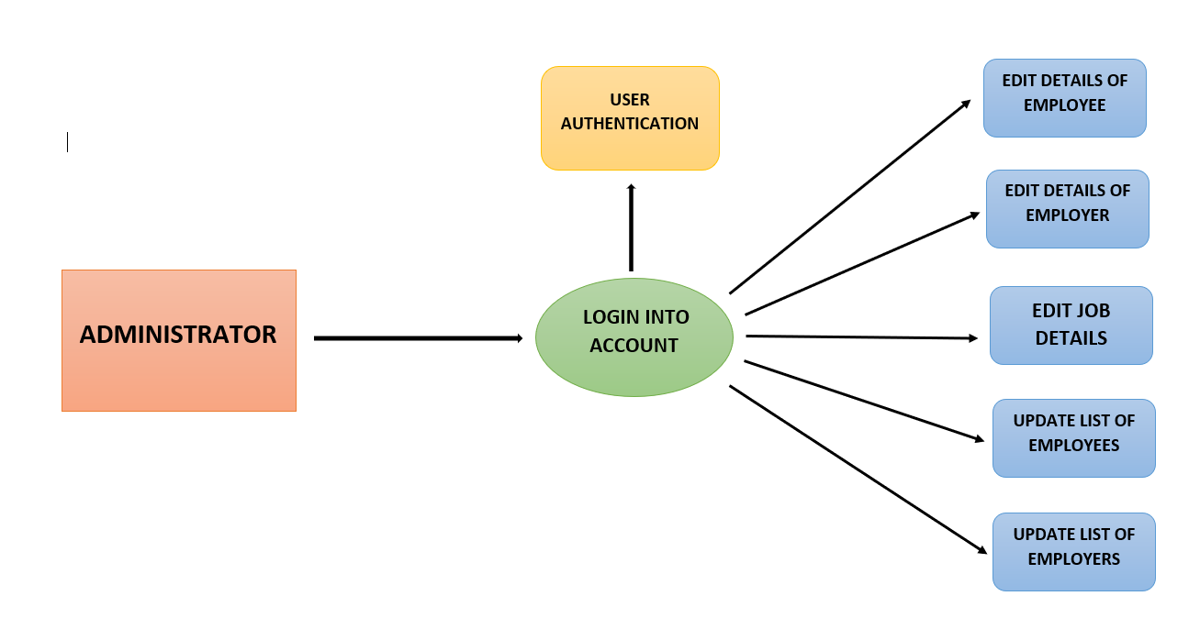

Slide 22
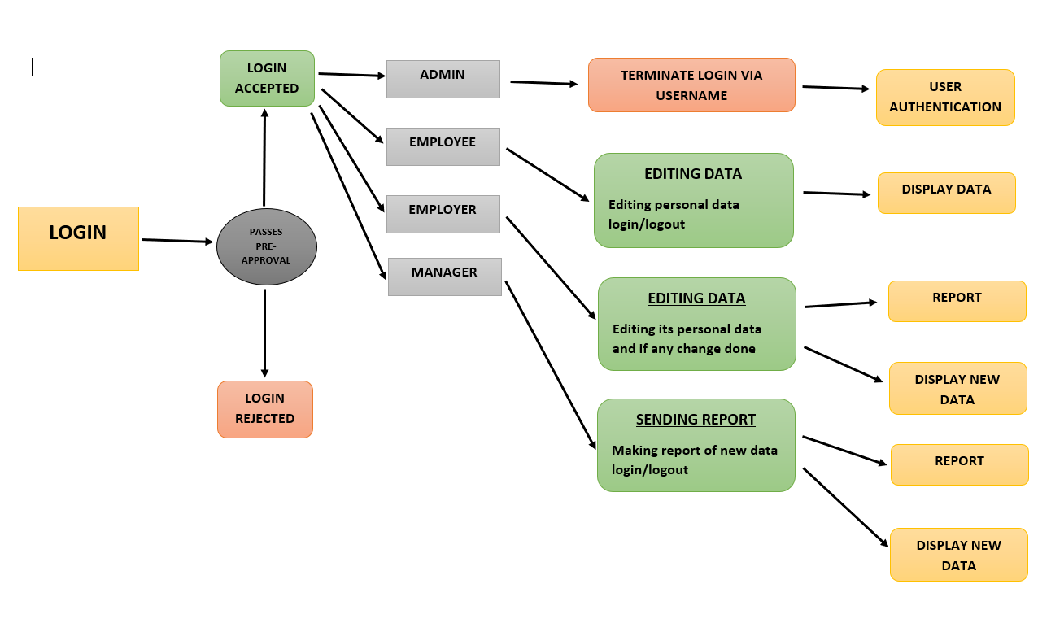

Slide 23
Conclusion
This presentation states the design level approach taken by the HCL Innovation Geeks Team for the project HRMS. After giving a basic information about what the HRMS is, the presentation briefly describes the problem and the solution we proposed to the problem with the figures to visualize better and steps taken to solve the problem. In other words this document introduces the technical details of the HRMS.
In the first part of the technical design, the major functions needed to develop an HRMS are introduced. Later on, these major functions and their sub-functions are visualized with the use case diagrams. In the second part, user interfaces are described in a detailed manner with figures. Lastly, data modules and their relationships are discussed.
To conclude, this presentation constitutes a base for the development of an HRMS.

Slide 24
Thank You…………

