Slide 1
RemediKonnect: A Full-Stack Doctor Appointment Booking System
Developed using MERN Stack (MongoDB, Express.js, React.js, Node.js)
Presented by: Rishabh Giri & Kashish Arora
Institution: Dr. Akhilesh Das Gupta Institute of Professional Studies, New Delhi
Under the guidance of: Dr. Suman Bhatia

Slide 2
Introduction
Overview:
RemediKonnect is a doctor appointment booking system developed to simplify healthcare interactions.
The platform supports patients, doctors, and administrators, ensuring a seamless experience.
Objective:
Enhance healthcare efficiency by providing a secure, real-time appointment scheduling system.
Technologies Used:
MERN Stack: MongoDB, Express.js, React.js, Node.js.

Slide 3
Motivation
Why RemediKonnect?
Traditional appointment booking is time-consuming and error-prone.
Patients face difficulty accessing real-time information on doctor availability.
Manual scheduling increases administrative workload.
Opportunity:
Leverage technology to streamline the process for patients and providers.
Provide a centralized platform for real-time healthcare management.

Slide 4
Problem Statement
Challenges in Existing Systems:
Lack of real-time updates on doctor availability.
Long queues and manual appointment scheduling.
High administrative burden on healthcare providers.
Impact on Patients and Providers:
Patients face delays and inconvenience.
Providers struggle with inefficient resource utilization and scheduling conflicts.

Slide 5
Features Overview
Key Features of RemediKonnect:
Role-Based Access:
Patients: Book appointments, manage profiles.
Doctors: Manage schedules and view patient details.
Admins: Oversee doctors, appointments, and system data.
Appointment Booking:
Real-time scheduling with doctor availability updates.
Online Payment Integration:
Secure and seamless payment gateway.
Secure Authentication:
Role-based access using JWT (JSON Web Tokens).

Slide 6
Technology Stack
Frontend:
Developed using React.js for interactive and responsive user interfaces.
Includes React Router for seamless navigation.
Backend:
Node.js and Express.js handle server-side logic and RESTful APIs.
Middleware ensures security and validation.
Database:
MongoDB for flexible, document-oriented data storage.
Collections: Users, Doctors, Appointments, Admins.
Deployment:
Hosted on Vercel for reliable and scalable performance.

Slide 7
User Roles and Functionalities
Patient:
Register and log in securely.
Browse doctors by specialty or availability.
Book, view, reschedule, or cancel appointments.
Make payments online.
Doctor:
Log in to manage schedules and appointments.
View and update patient details.
Approve or reject appointment requests.
Admin:
Manage user data (patients and doctors).
Oversee appointment records.
Access analytics and system settings for efficient management.

Slide 8
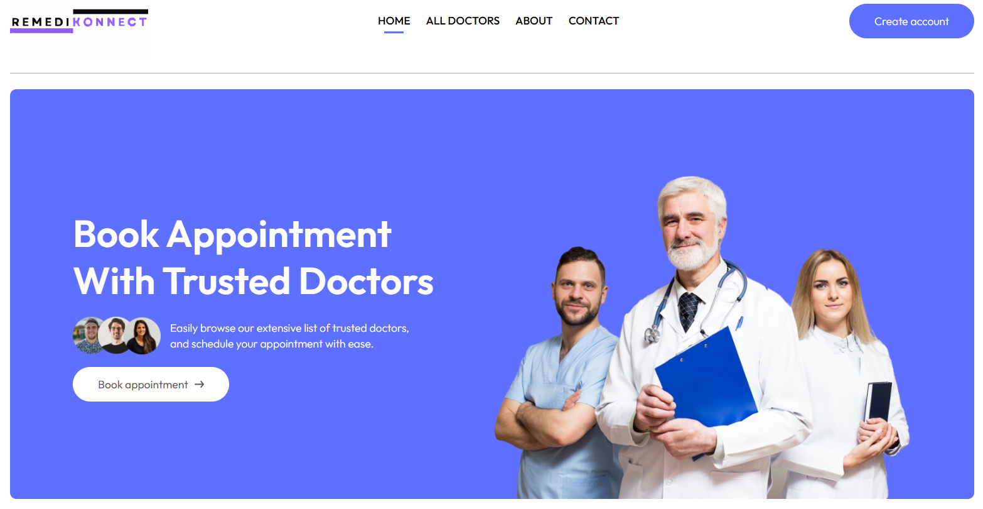
Landing Page

Slide 9
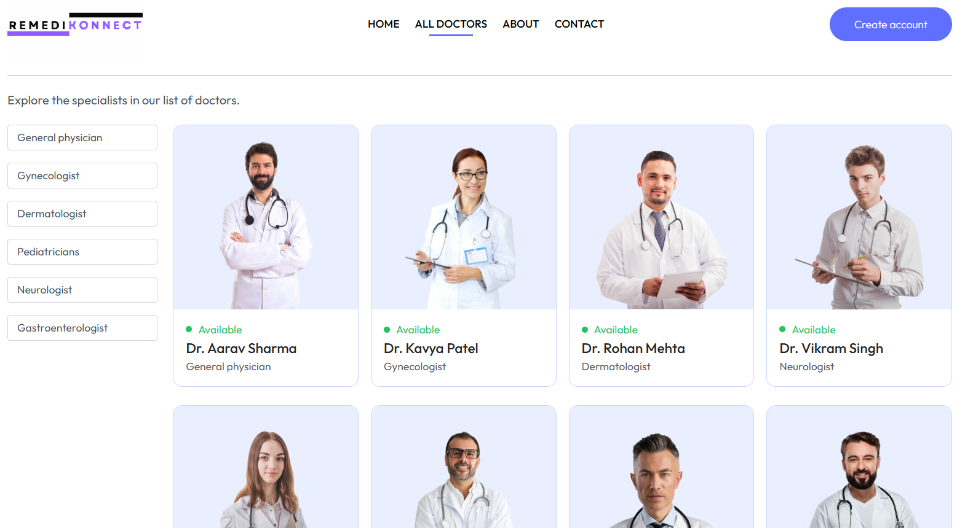
Doctor Search Page

Slide 10
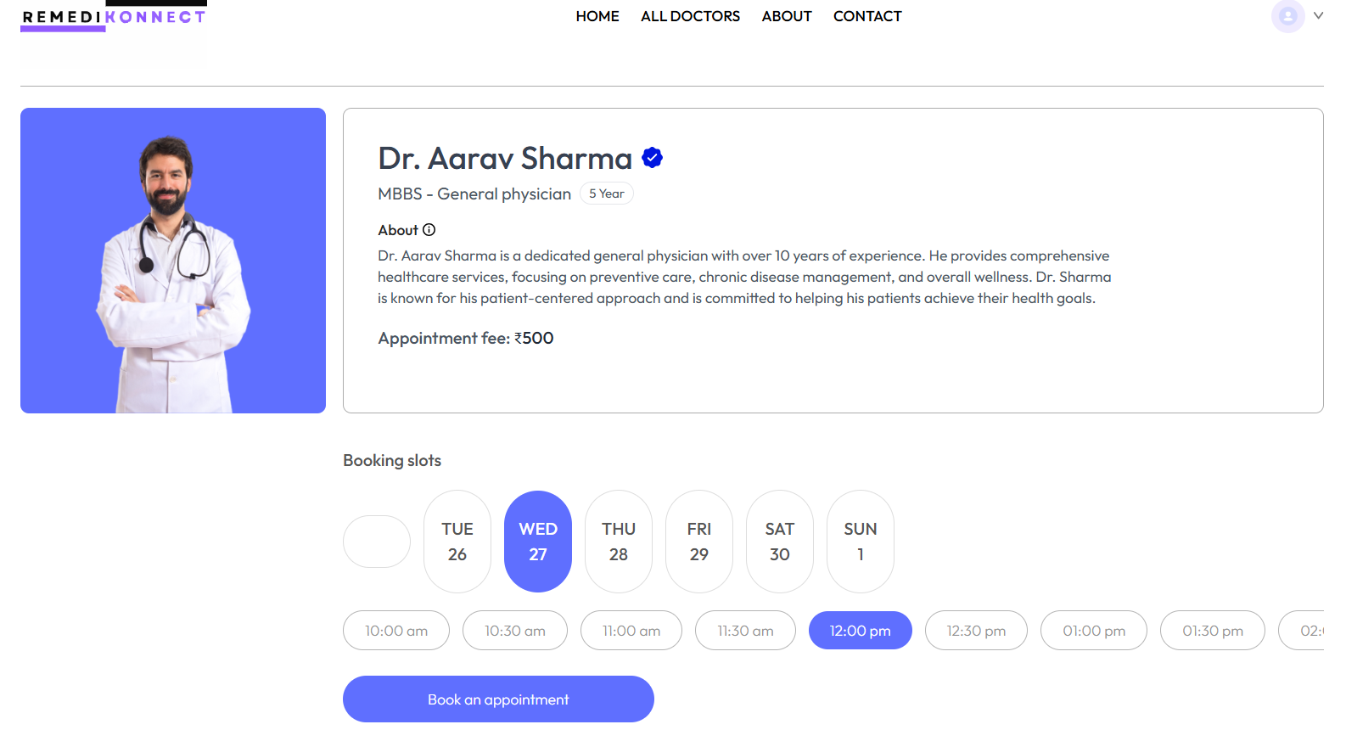
Doctor Profile & Appointment Booking

Slide 11
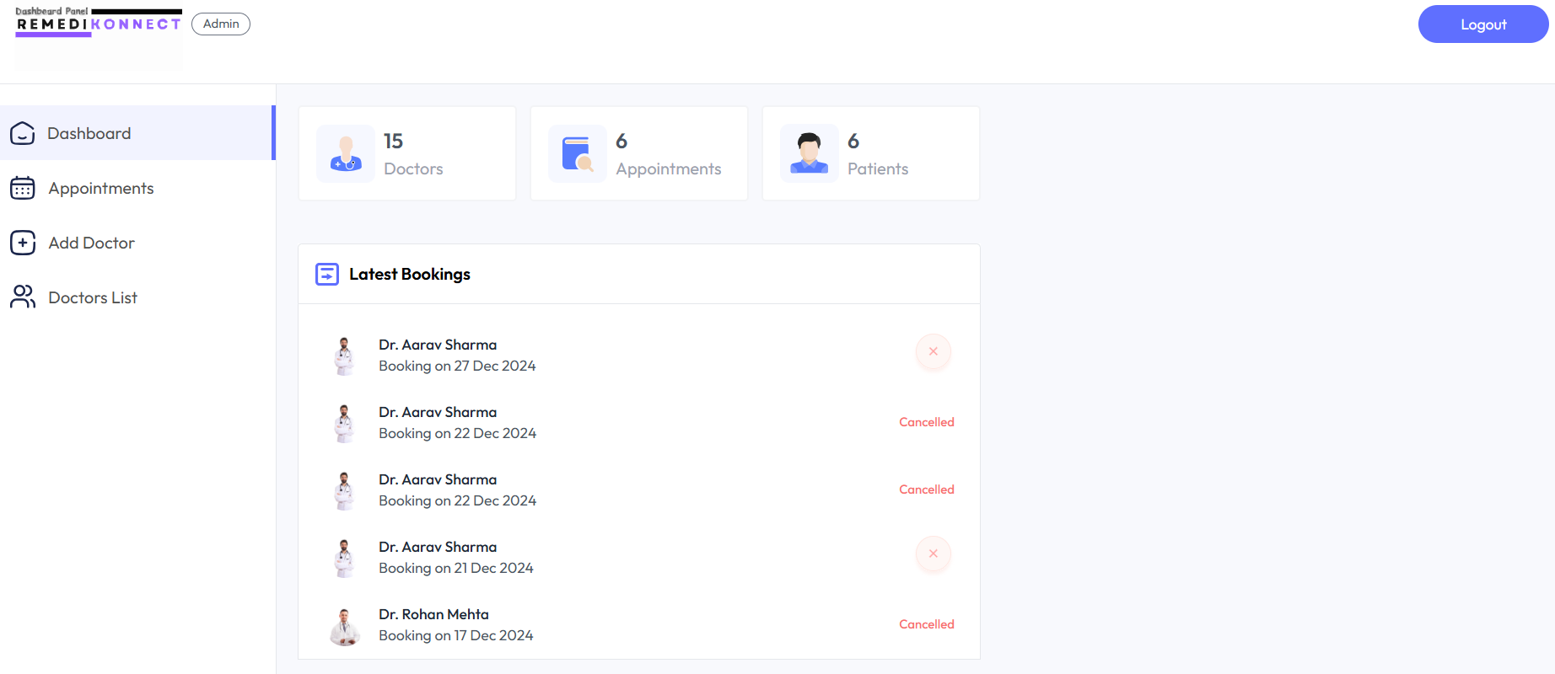
Admin Dashboard

Slide 12
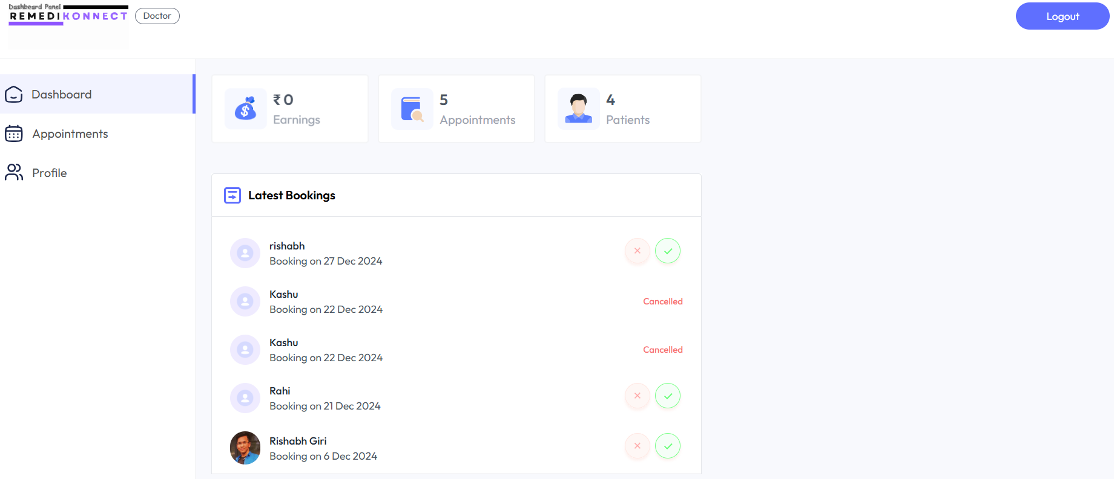
Doctor Dashboard

Slide 13
Future Enhancements
Telemedicine Integration:
Enable video consultations to provide healthcare access remotely.
Mobile Application:
Develop a dedicated app for Android and iOS platforms to enhance usability.
Notification System:
Automated reminders for appointments via email/SMS to reduce no-shows.
Health Records Management:
Expand the system to include patient health records for a comprehensive solution.
Payment Gateway Expansion:
Incorporate multiple payment options for flexibility.

Slide 14
Real-World Applications
Hospitals and Clinics:
Streamline appointment booking and reduce administrative workload.
Efficiently manage schedules for multiple doctors.
Telemedicine Services:
Facilitate remote consultations for patients in rural or underserved areas.
Multi-Specialty Centers:
Simplify complex scheduling across departments and specialties.
Healthcare Networks:
Centralized platform to manage multiple branches and provide unified analytics.
Home Healthcare Services:
Organize at-home visits for doctors and healthcare professionals.

Slide 15
THANK YOU

