Slide 1
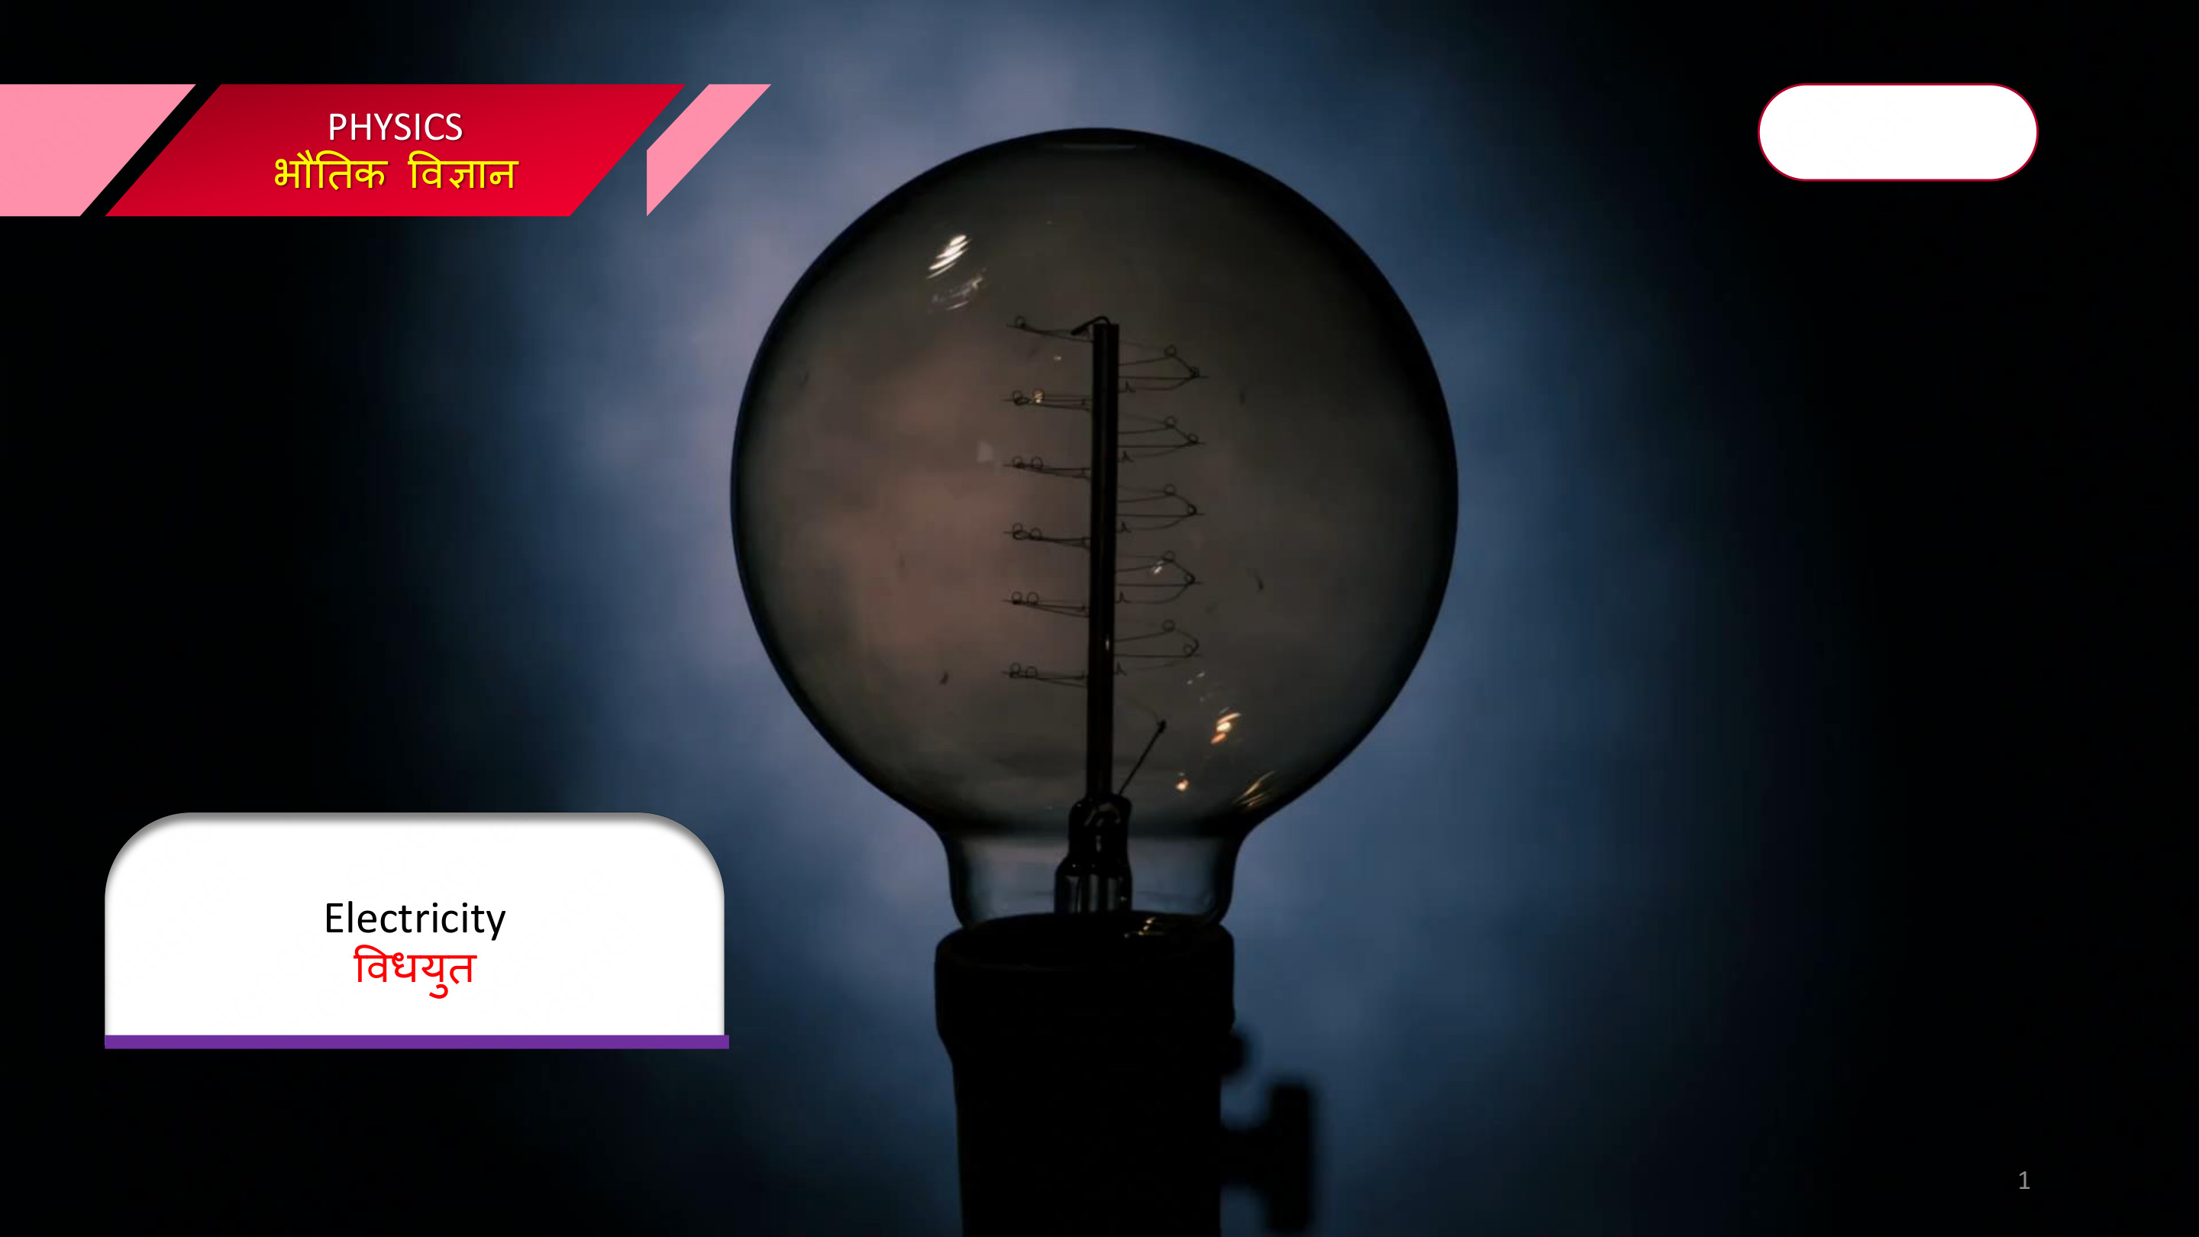
KASHISH
CHAUDHARY

Slide 2
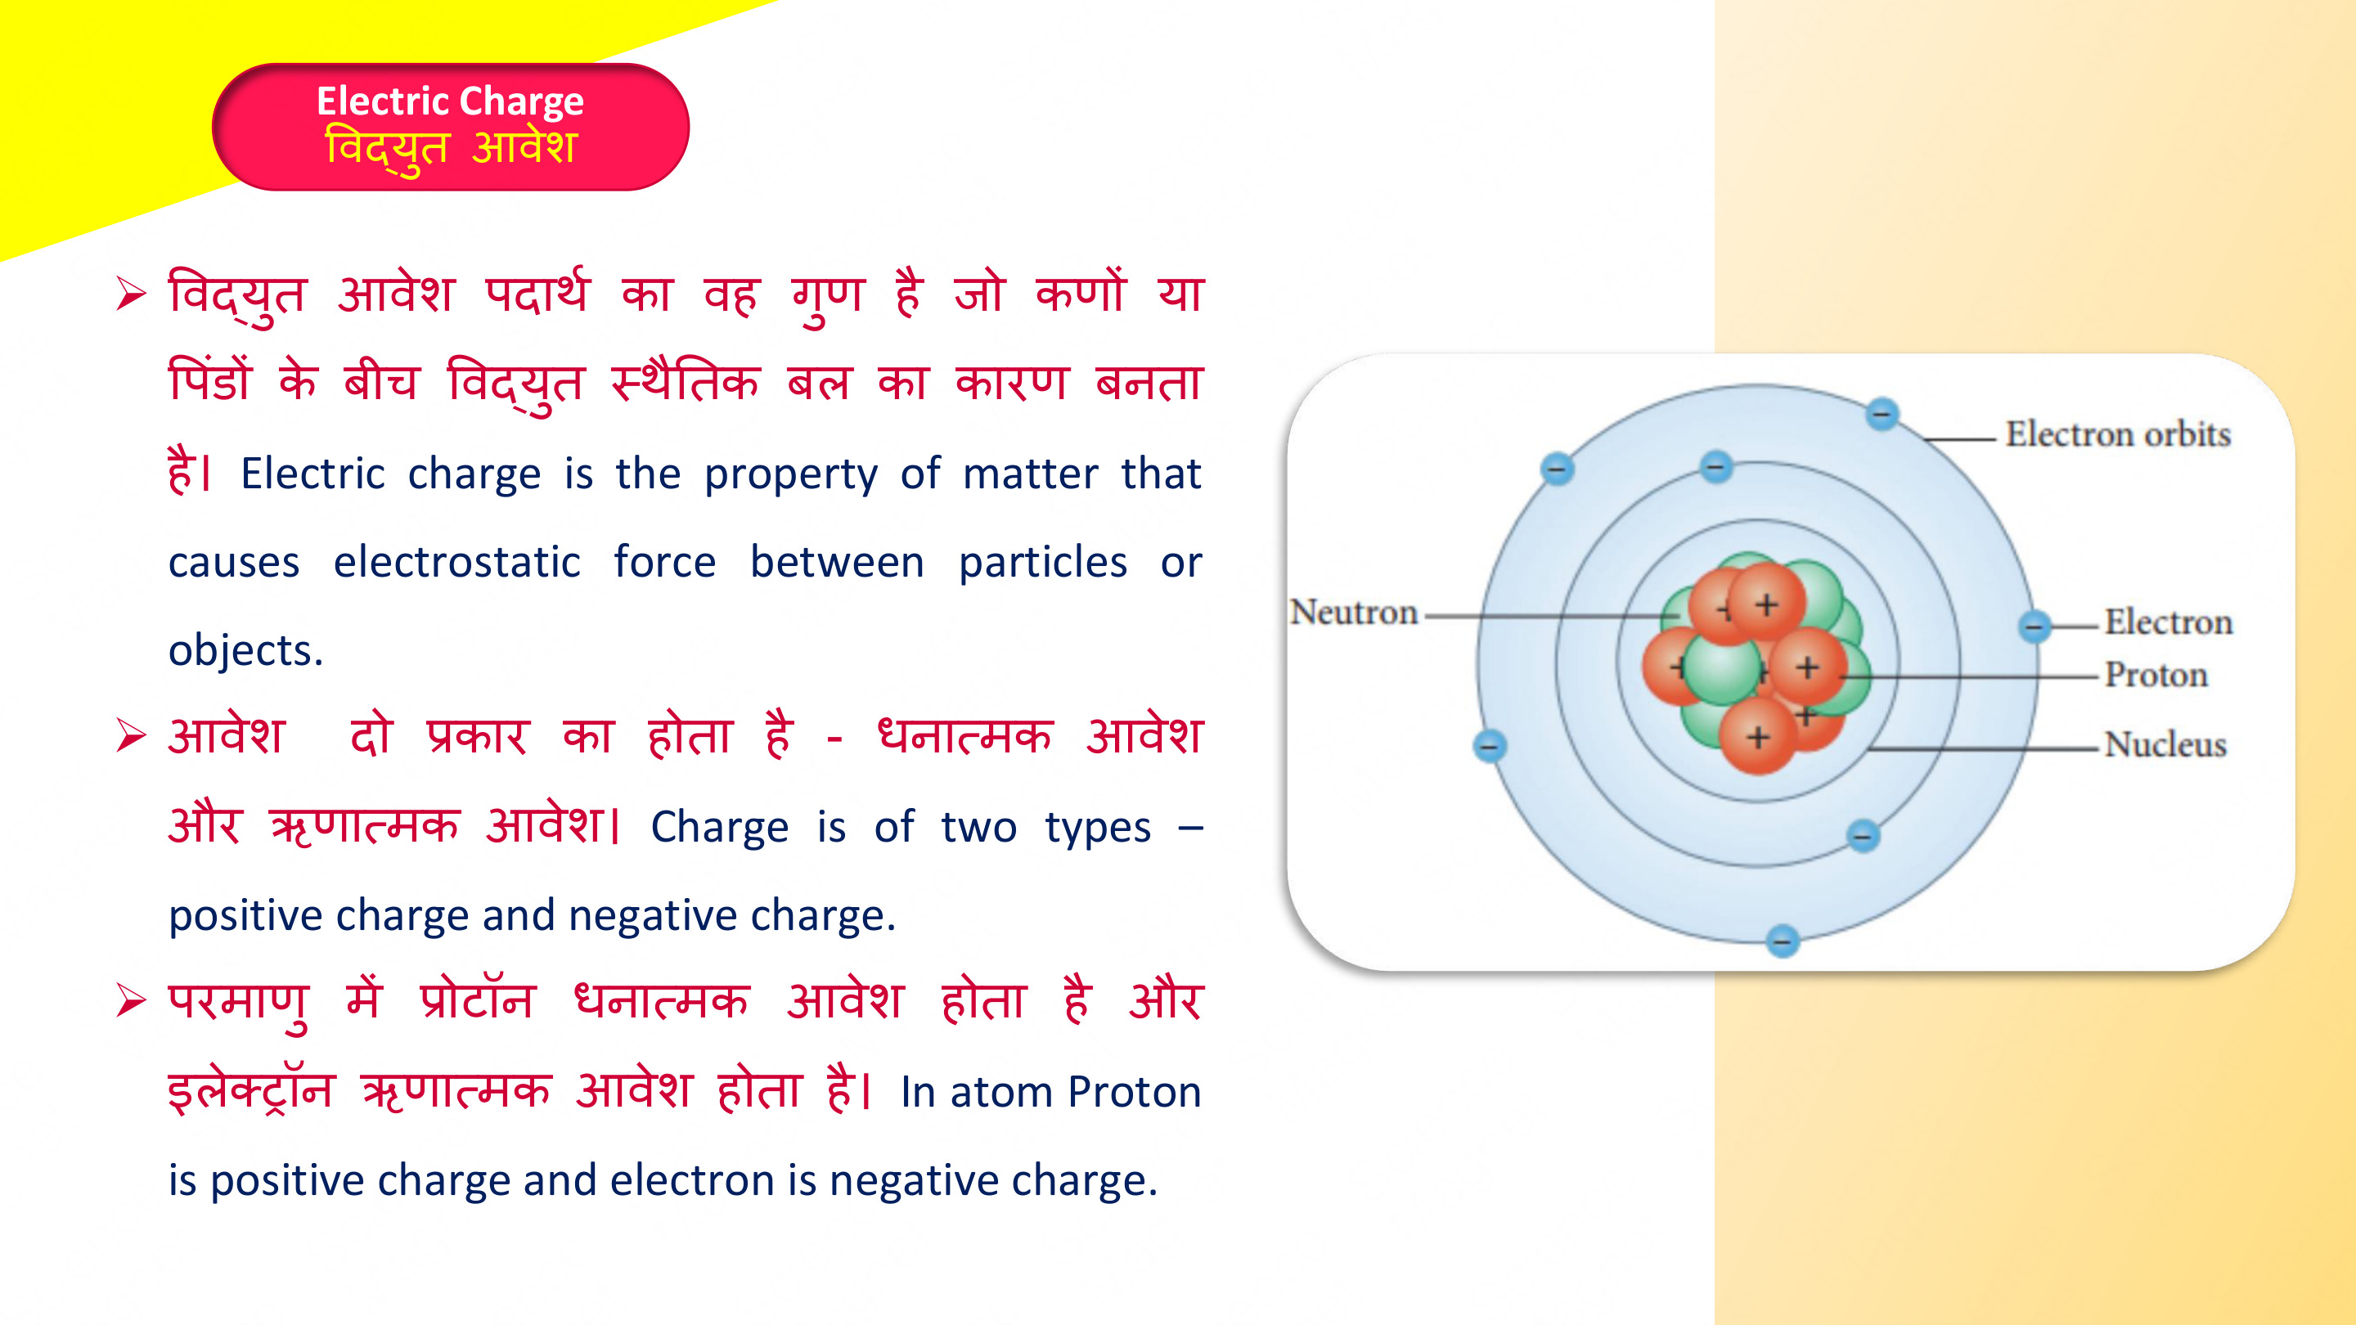
KASHISH
CHAUDHARY

Slide 3
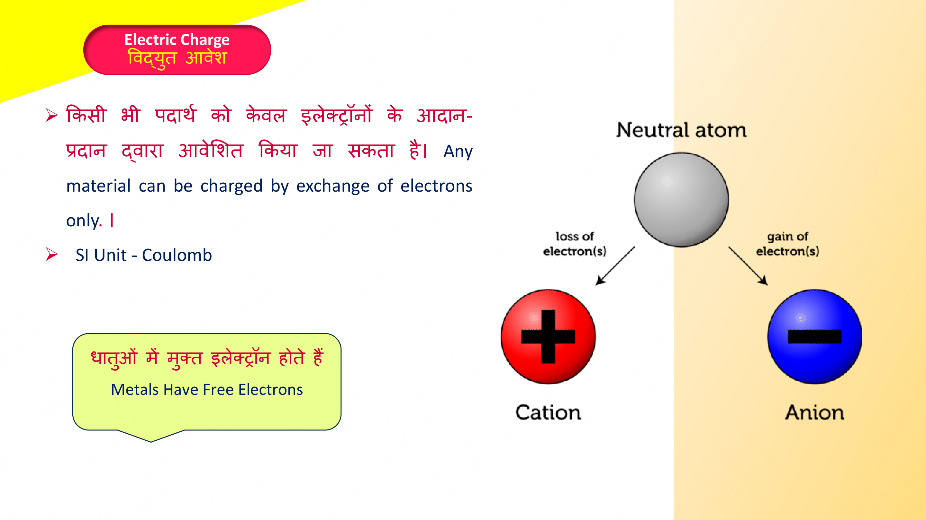
KASHISH
CHAUDHARY

Slide 4

KASHISH
CHAUDHARY

Slide 5
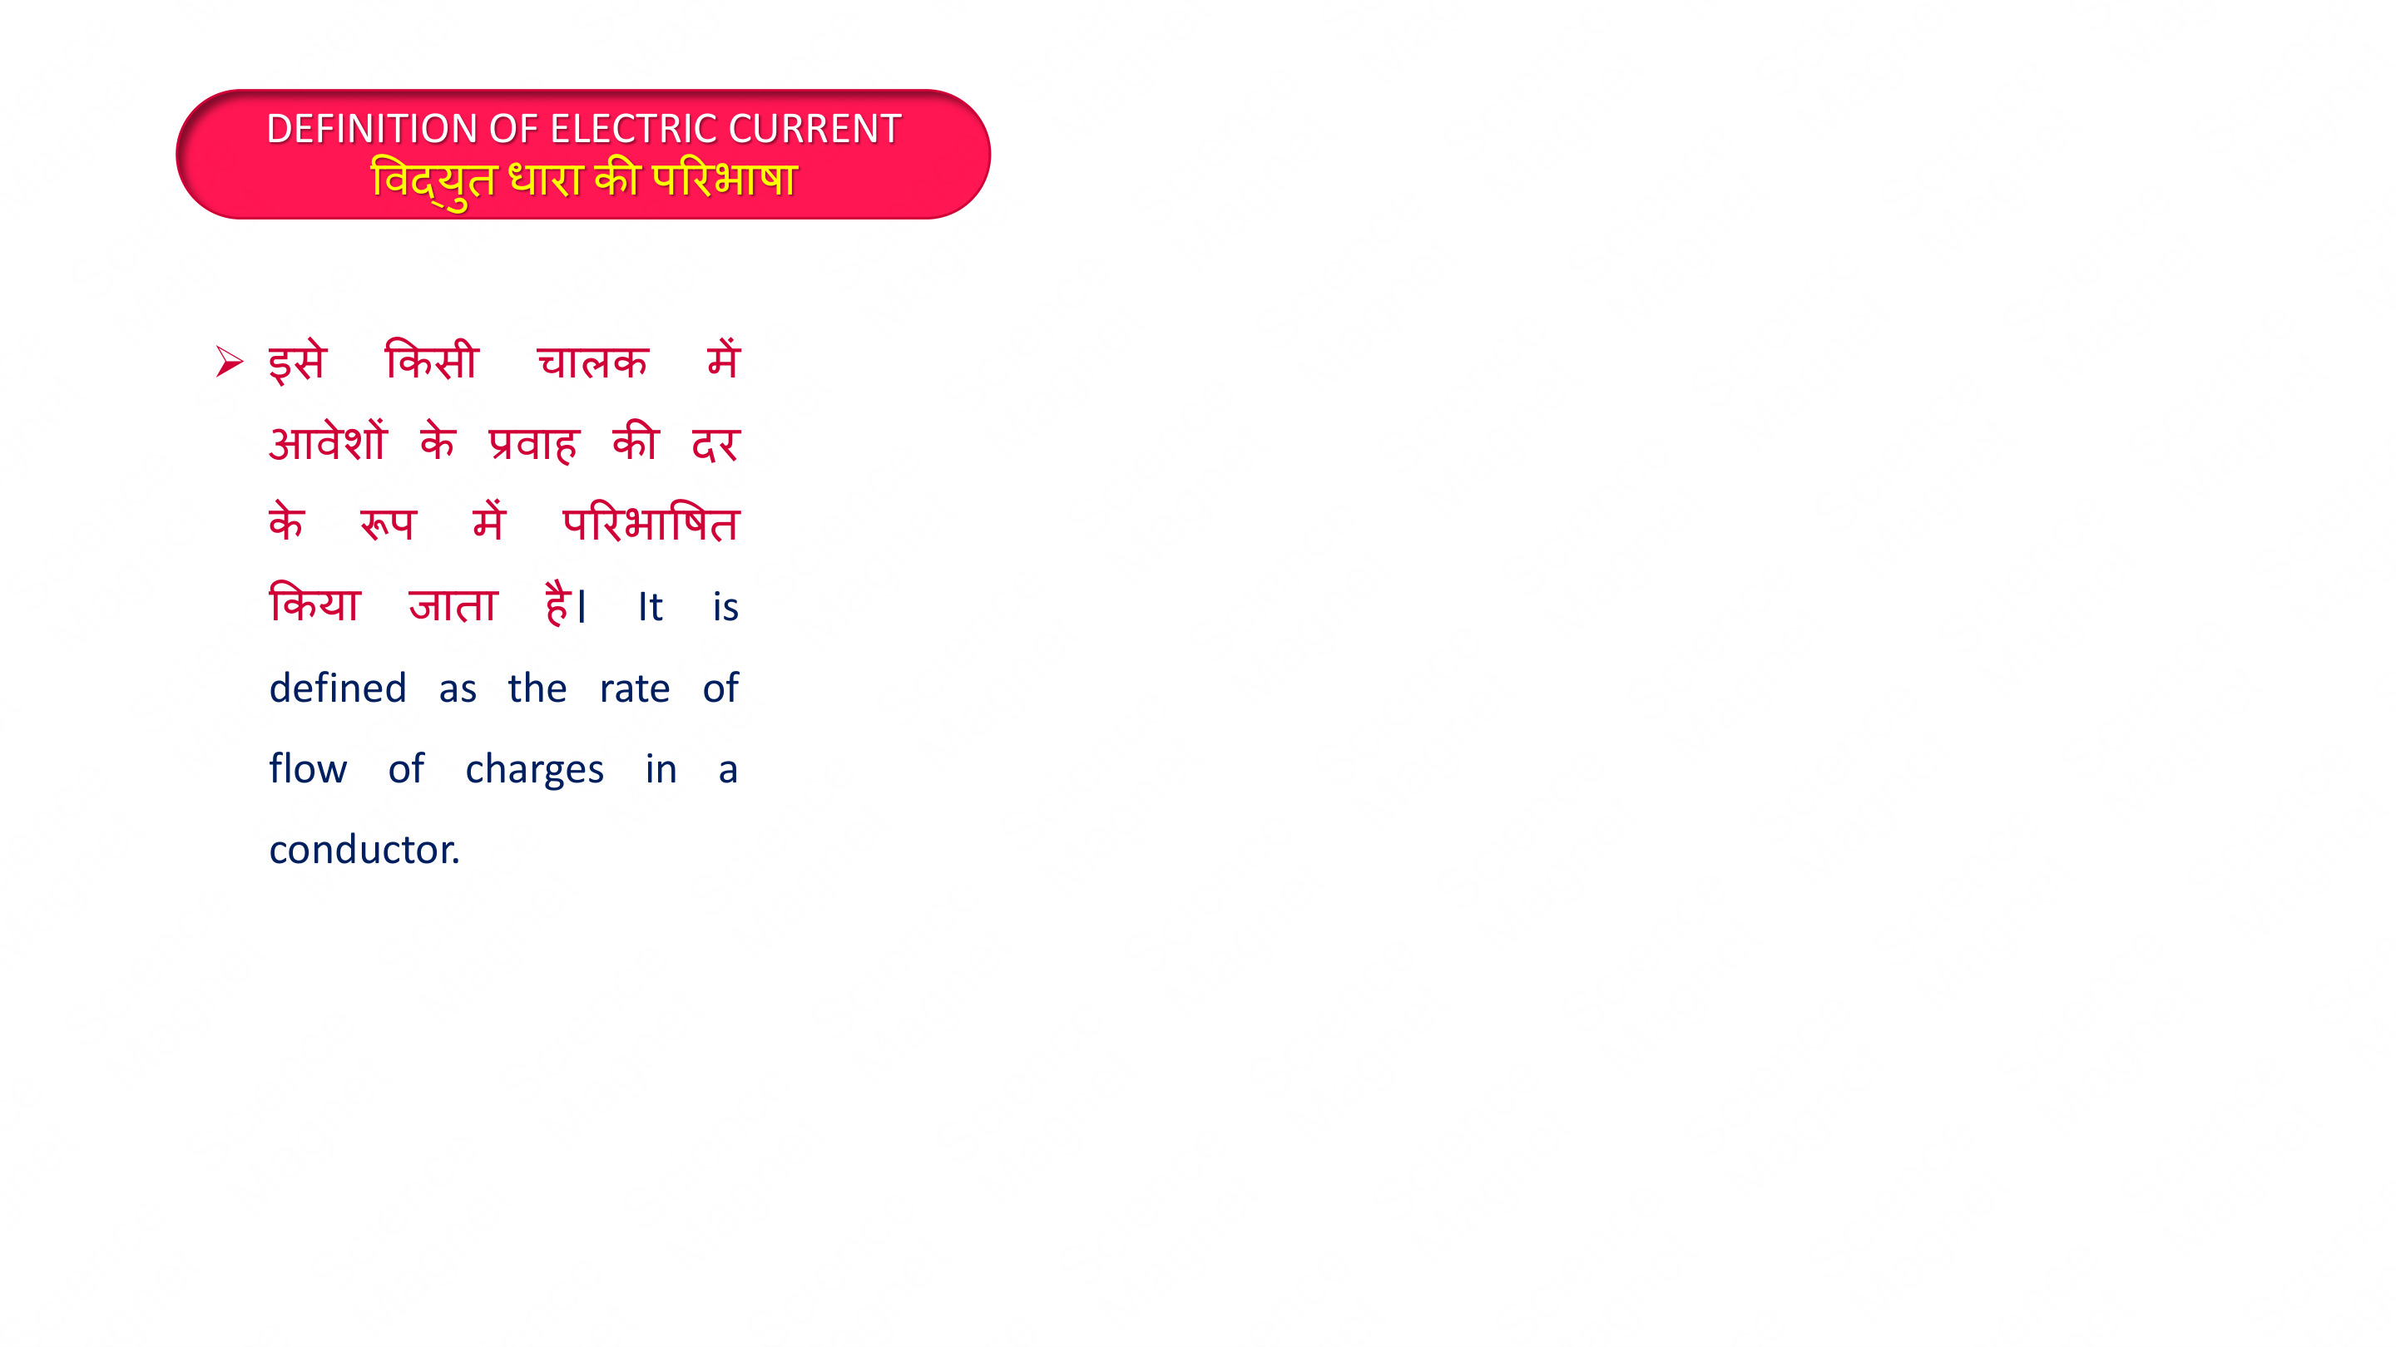
KASHISH
CHAUDHARY

Slide 6
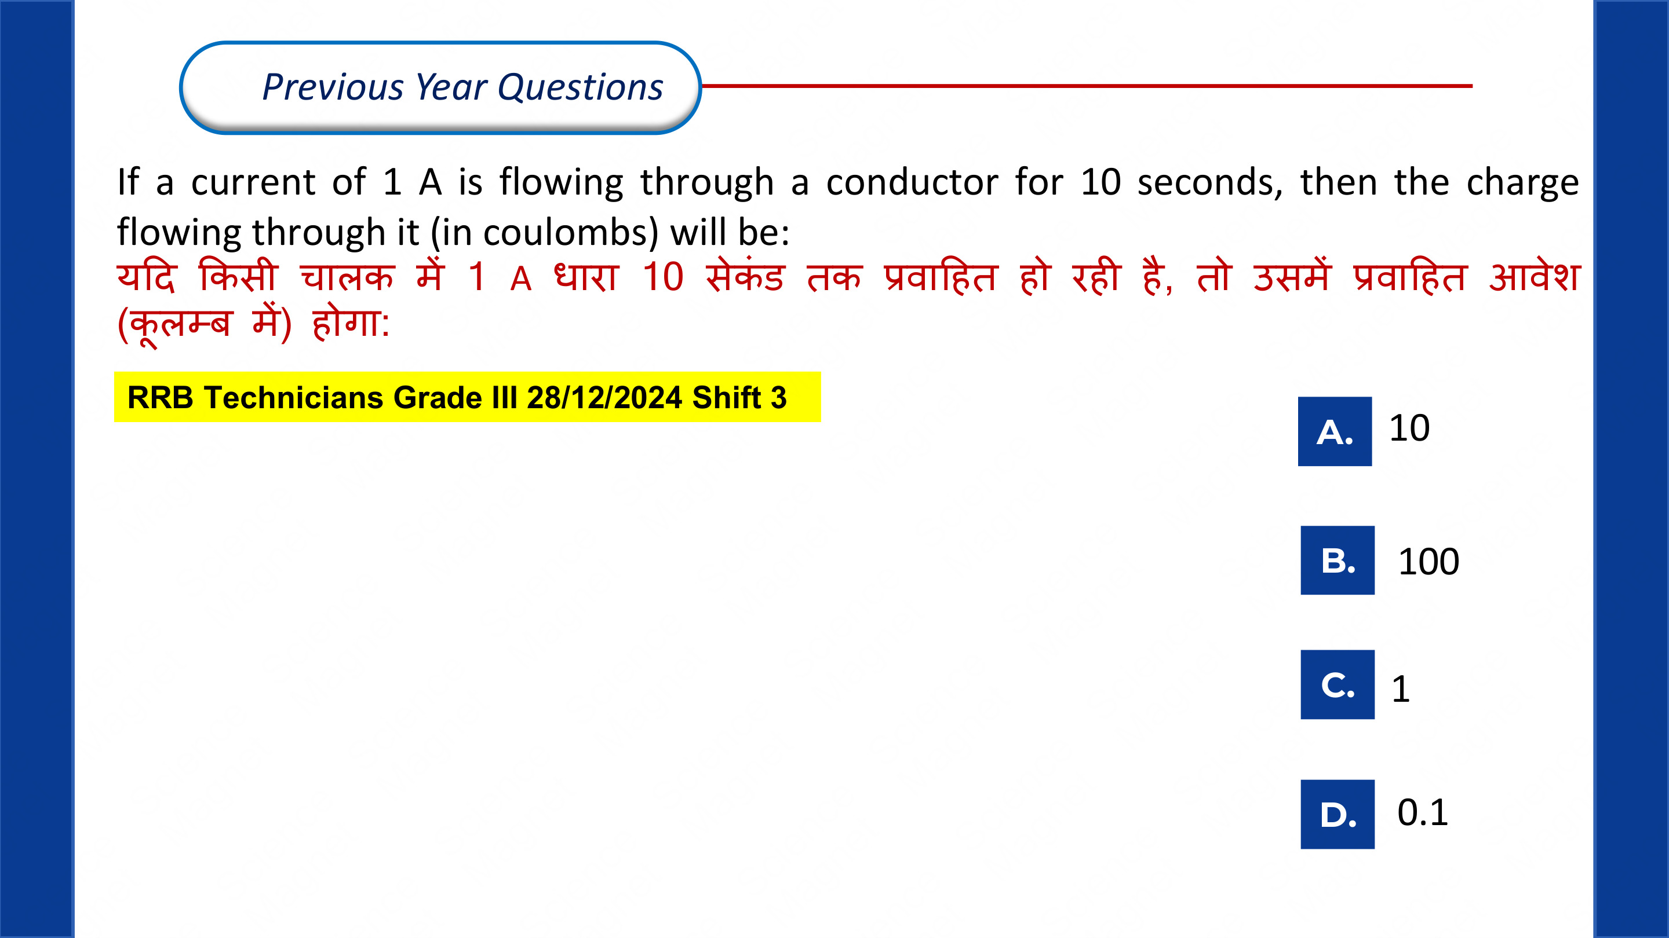
KASHISH
CHAUDHARY

Slide 7
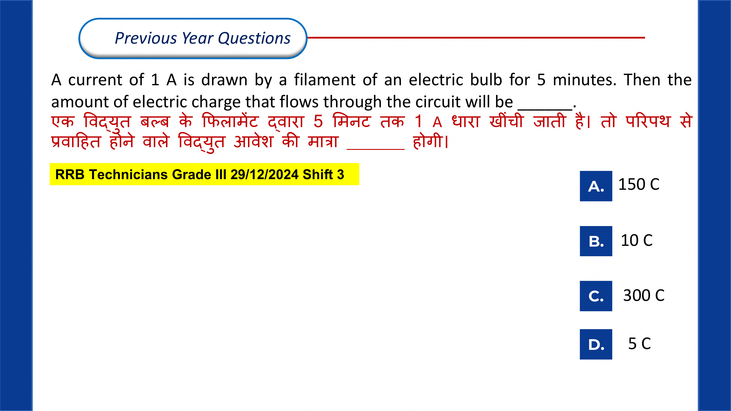
KASHISH
CHAUDHARY

Slide 8
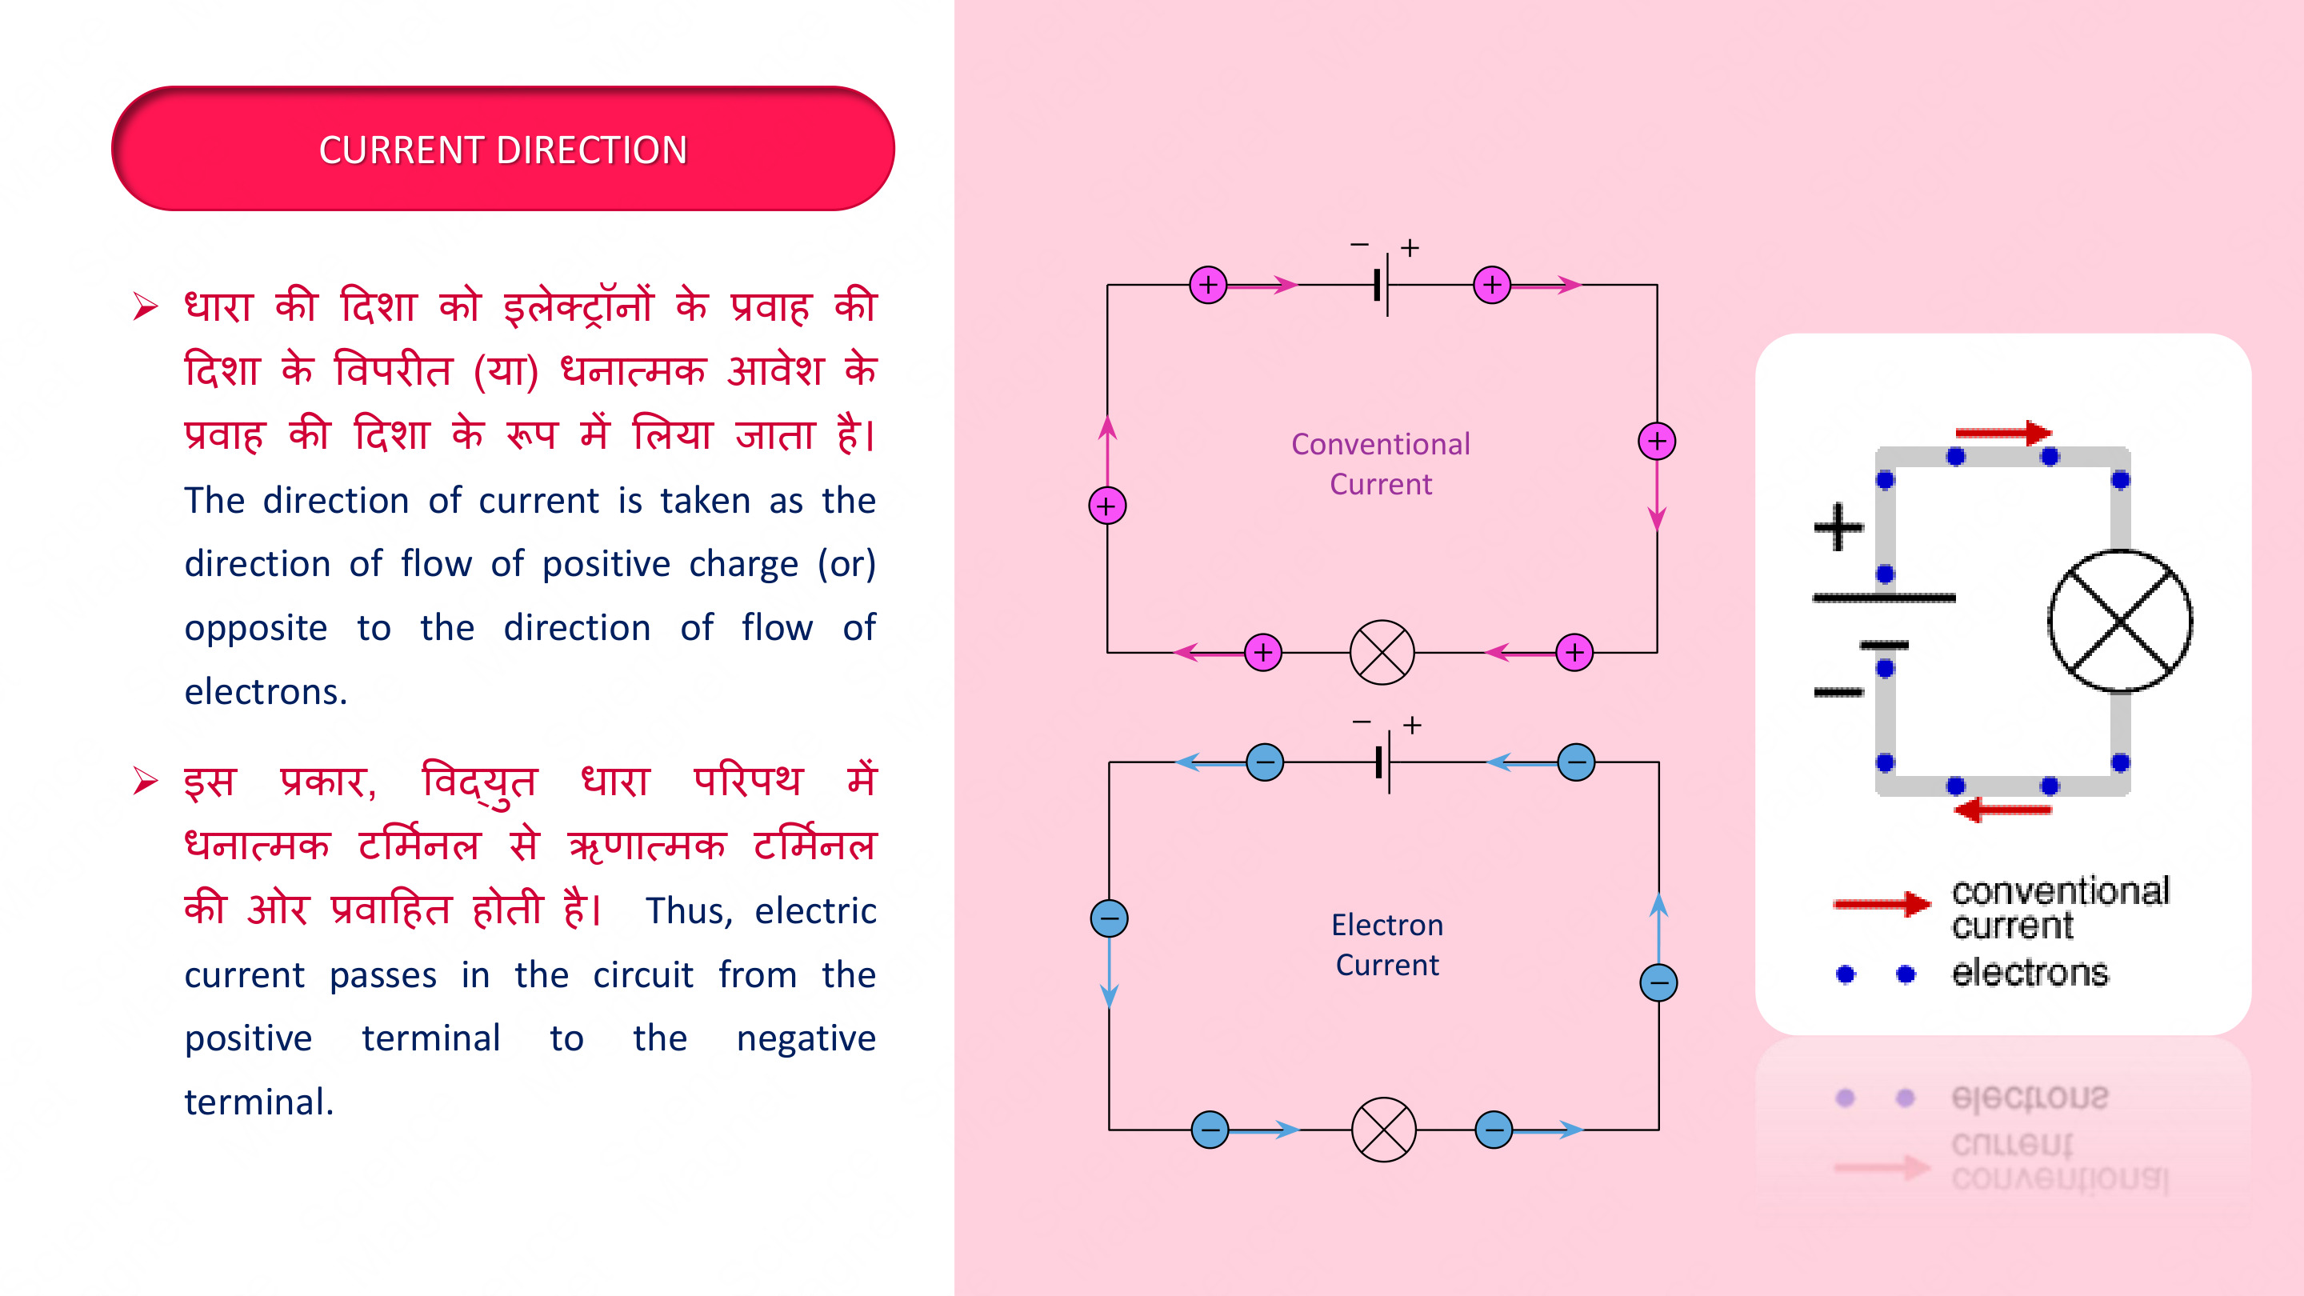
KASHISH
CHAUDHARY

Slide 9
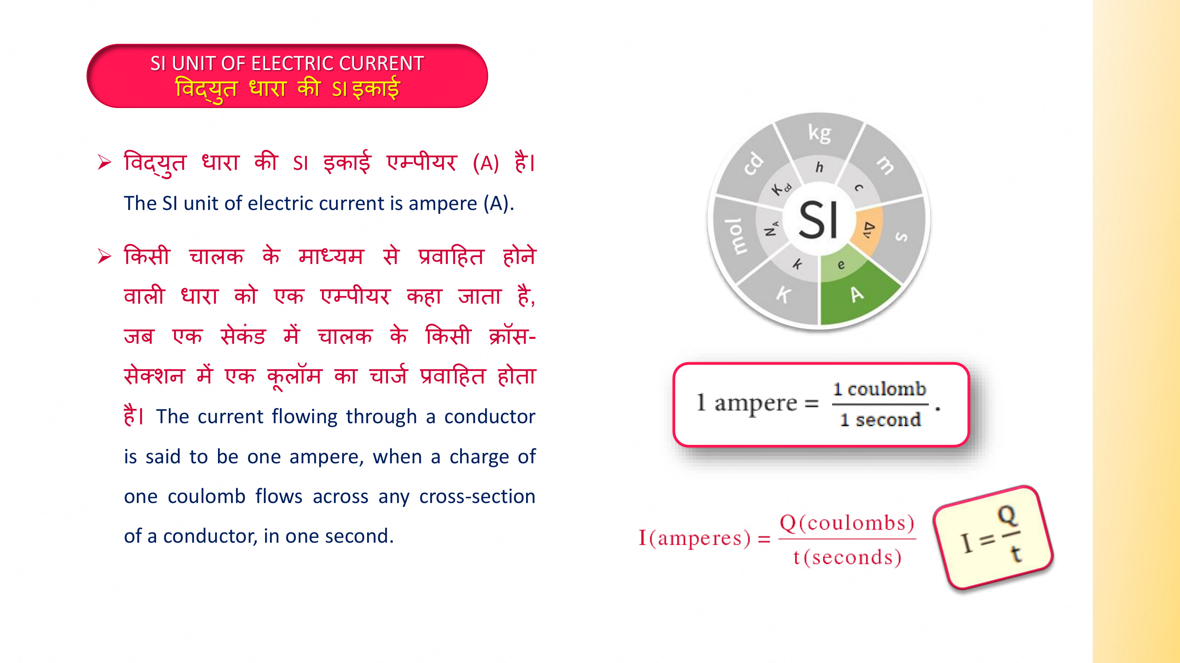
KASHISH
CHAUDHARY

Slide 10
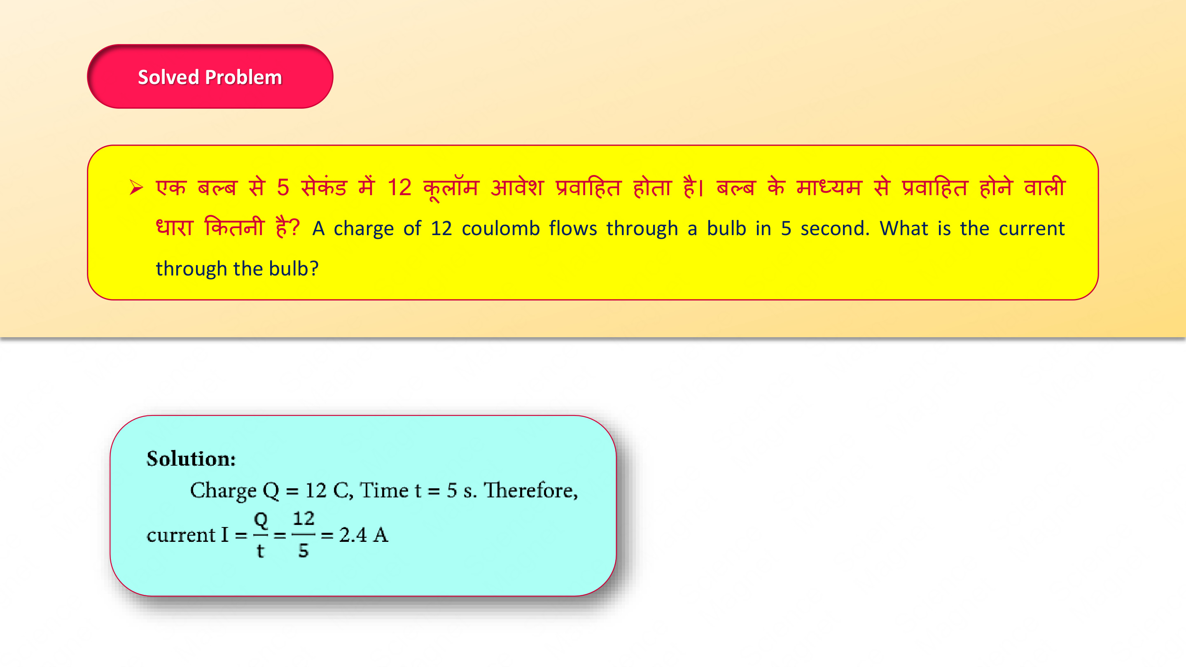
KASHISH
CHAUDHARY

Slide 11
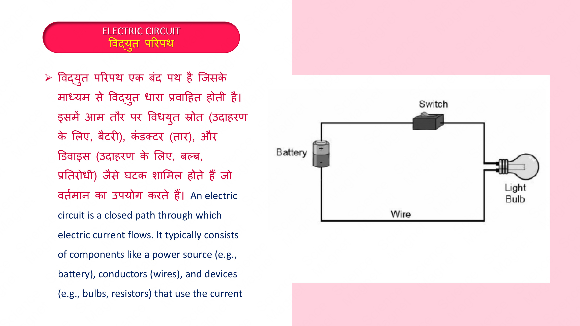
KASHISH
CHAUDHARY

Slide 12
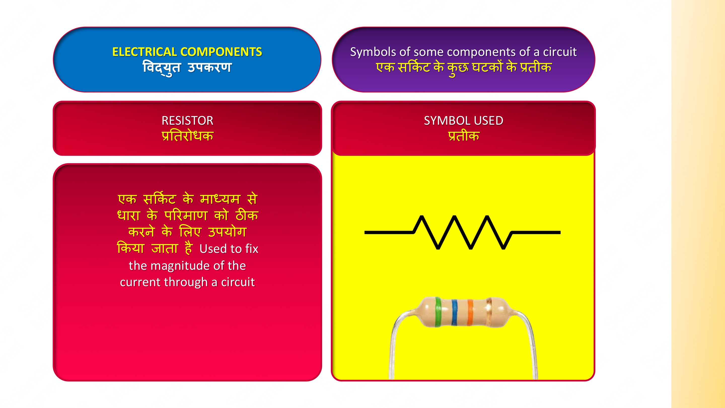
KASHISH
CHAUDHARY

Slide 13
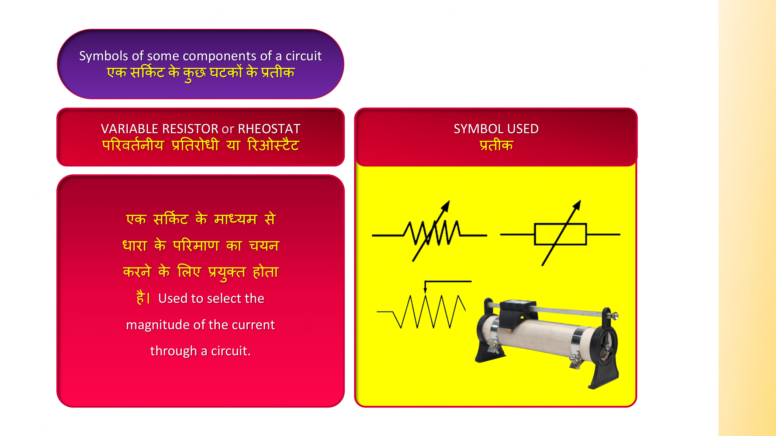
KASHISH
CHAUDHARY

Slide 14
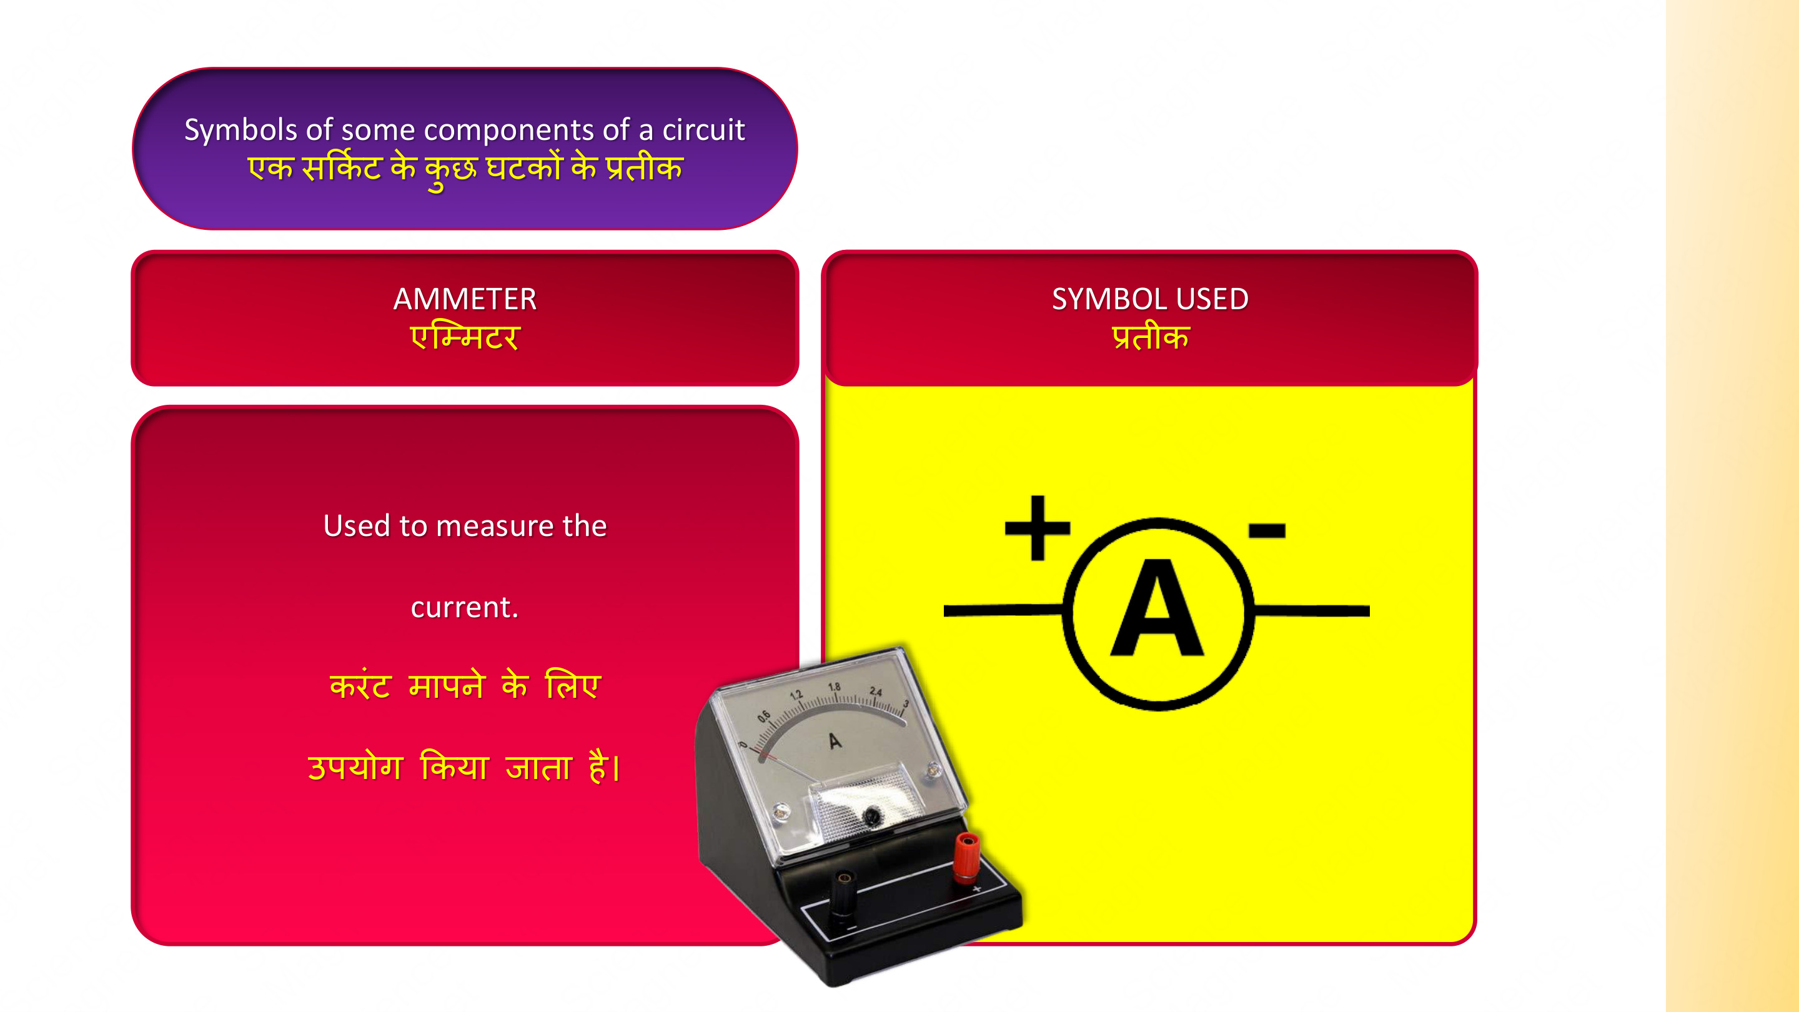
KASHISH
CHAUDHARY

Slide 15
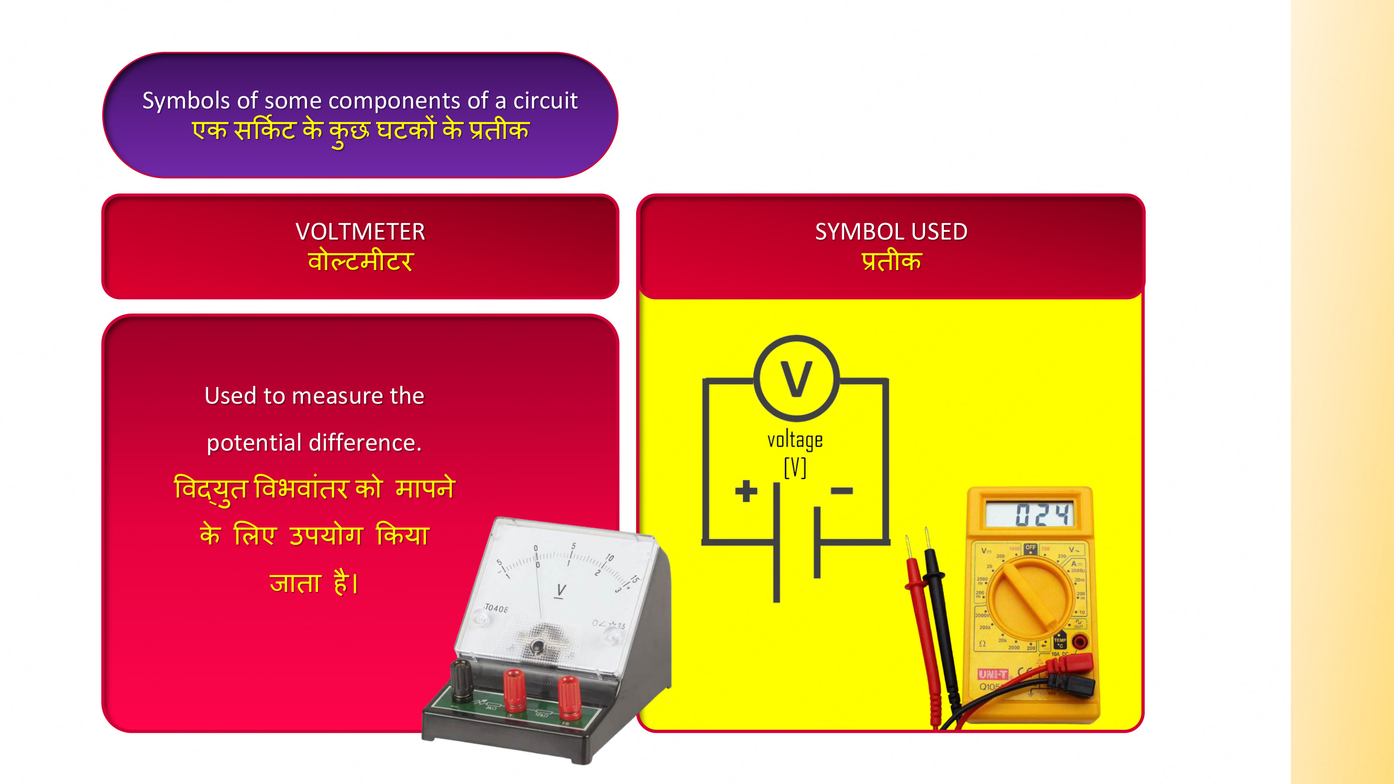
KASHISH
CHAUDHARY

Slide 16
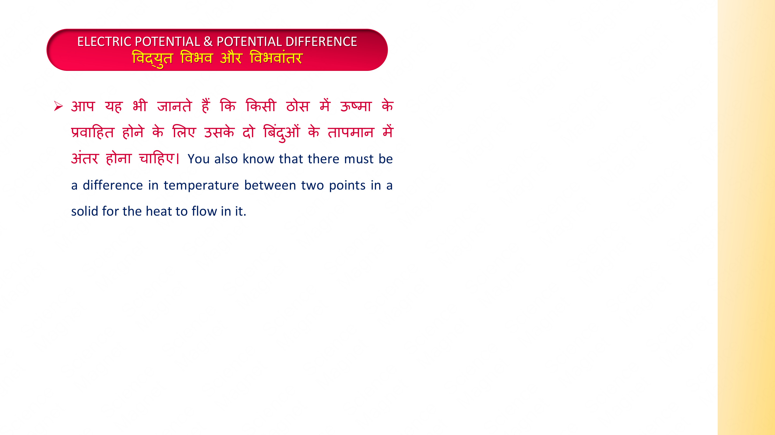
KASHISH
CHAUDHARY

