Slide 1
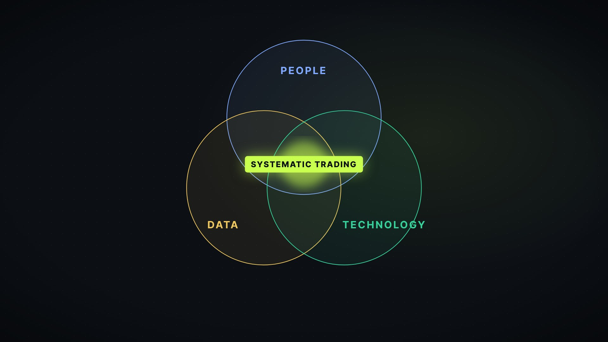
HINGLISH EXPLAINER
The Mathematician's
Edge
Jim Simons ka Trading Approach — math, data aur discipline se trading ko samjhein
Sirf educational content · Historical performance future results ki guarantee nahi hai
Notes:
Intro: Namaste! Aaj hum samjhenge Jim Simons ka trading approach — ek mathematician ne markets ko math aur data se kaise dekha. Is presentation ke har slide ke notes mein video ki Hinglish script hai, video timecode ke saath.

Slide 2

COLD OPEN
Ek number jo sab kuch shuru karta hai
~66%
Average annual return · fees se pehle · reportedly
Medallion Fund — 30+ saal tak
Gut feeling ya market stories se nahi — mathematics, data aur scientific discipline se.
Video frame · Scene S02
2
Notes:
[Video 00:00 · Scene S01]
66 percent. Yeh lagbhag woh average annual return hai, jo Jim Simons ke Medallion Fund ne reportedly fees se pehle generate kiya — aur woh bhi 30 saal se zyada tak.
[Video 00:15 · Scene S02]
Aur yeh kisi gut feeling, market stories, ya kisi star trader ke instinct se nahi aaya. Yeh aaya mathematics, data aur scientific discipline se.

Slide 3
IS VIDEO MEIN
Hum kya samjhenge — aur kya nahi
01
The approach
Simons ne markets ko kaise approach kiya
02
The edge
Unki edge ke peeche asli wajah kya thi
03
Aap kya use kar sakte ho
Kaunse principles ek retail trader realistically use kar sakta hai
04
…aur kya nahi
Kya copy karna possible hi nahi hai
3
Notes:
[Video 00:30 · Scene S03]
Is video mein hum dekhenge ki Simons ne markets ko kaise approach kiya, unki edge ke peeche asli wajah kya thi — aur sabse important, unke kaunse principles ek retail trader realistically use kar sakta hai. Aur kaunse nahi.

Slide 4
CHAPTER 01 · MARKETS AS A MATH PROBLEM
1982: Renaissance Technologies
1982
PHOTO SLOT
Jim Simons ki real photo yahan lagayein
Licensed image hi use karein (Getty / AP) ya Wikimedia Commons ki CC photo — attribution ke saath. Is box ko delete karke photo drag-and-drop karein.
Founder: Jim Simons ne Renaissance Technologies ki foundation rakhi
Background: Mathematician aur former signals analyst
Nazariya: Market ko dekhne ka tareeka traditional traders se bilkul alag
4
Notes:
Is slide par Jim Simons ki licensed photo lagayein (photo slot).
[Video 00:55 · Scene S05]
1982 mein, Jim Simons ne Renaissance Technologies ki foundation rakhi. Simons ek mathematician aur former signals analyst the — aur market ko dekhne ka unka nazariya traditional traders se bilkul alag tha.

Slide 5
CORE IDEA
Data mein persistent, predictable patterns
→ Financial market data mein persistent aur predictable patterns ho sakte hain
Formula: Right people + right data + right technology
→ In patterns ko identify karke systematically trade kiya ja sakta hai
Kehna simple, execute karna mushkil
People · Data · Technology → Systematic trading
5
Notes:
[Video 01:16 · Scene S06]
Unka core idea kehne mein simple tha, lekin execute karna mushkil: financial market ke data mein persistent aur predictable patterns ho sakte hain. Agar right people, right data aur right technology ko combine kiya jaye — to in patterns ko identify karke systematically trade kiya ja sakta hai.

Slide 6
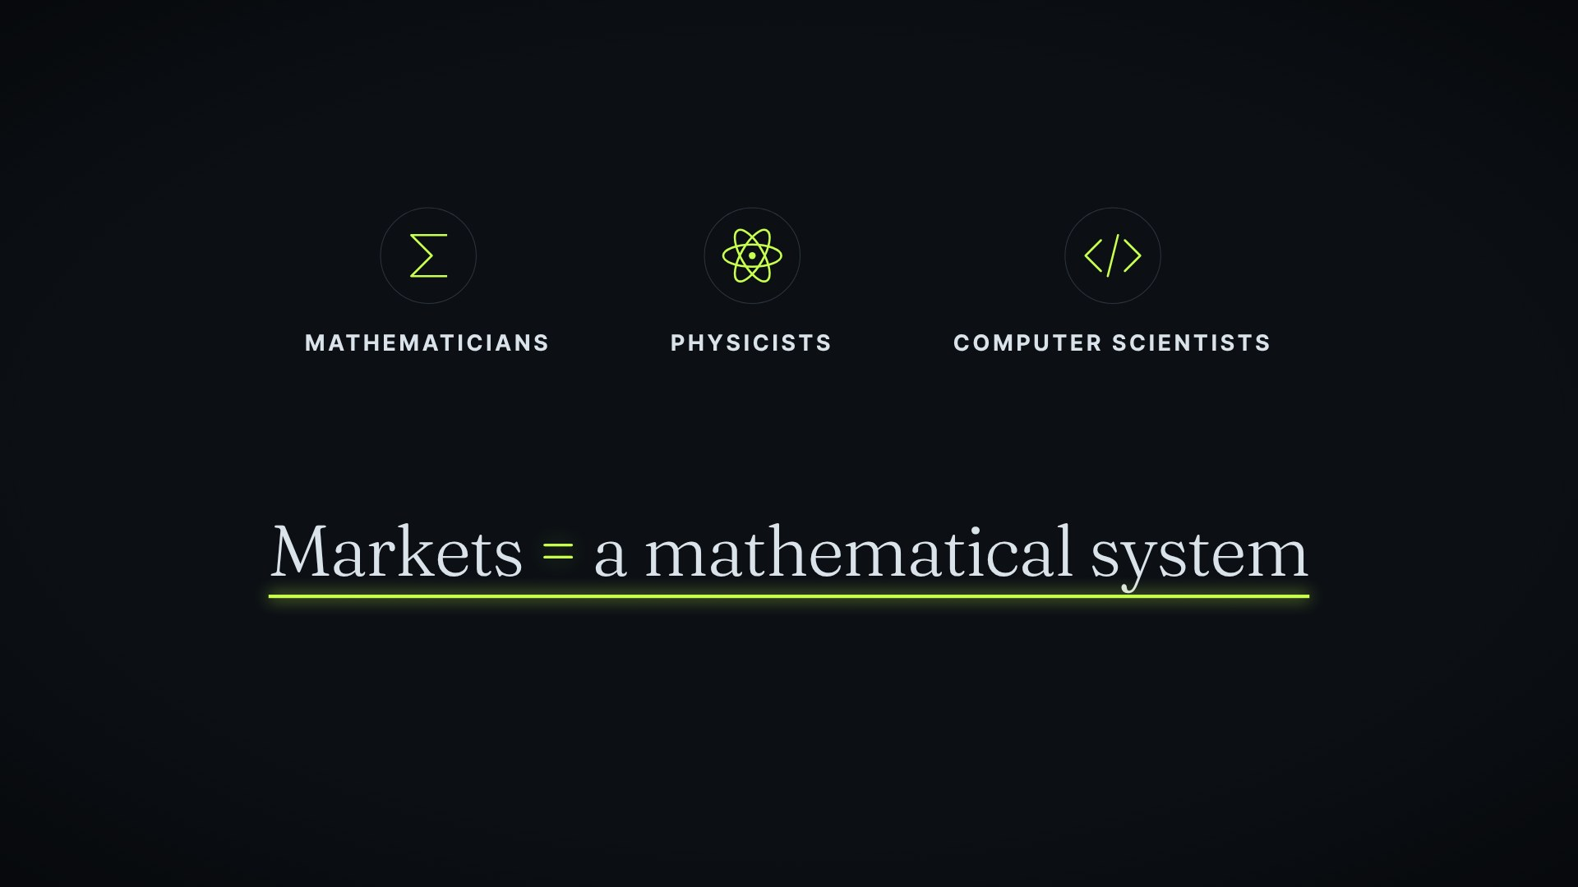
APPROACH
Stories nahi — statistical pattern recognition
Nahi: traditional, qualitative market analysis
Balki: statistical pattern recognition
→ Team: mathematicians, physicists aur computer scientists
→ Belief: markets ko ek mathematical system ki tarah study kiya ja sakta hai
6
Notes:
[Video 01:40 · Scene S07]
Isliye Renaissance ne apna approach traditional, qualitative market analysis par build nahi kiya. Unhone use build kiya statistical pattern recognition par. Firm mein mathematicians, physicists aur computer scientists kaam karte the — aise log jo maante the ki markets ko ek mathematical system ki tarah study kiya ja sakta hai, jahan scientific discipline hidden patterns ko saamne la sakta hai.

Slide 7
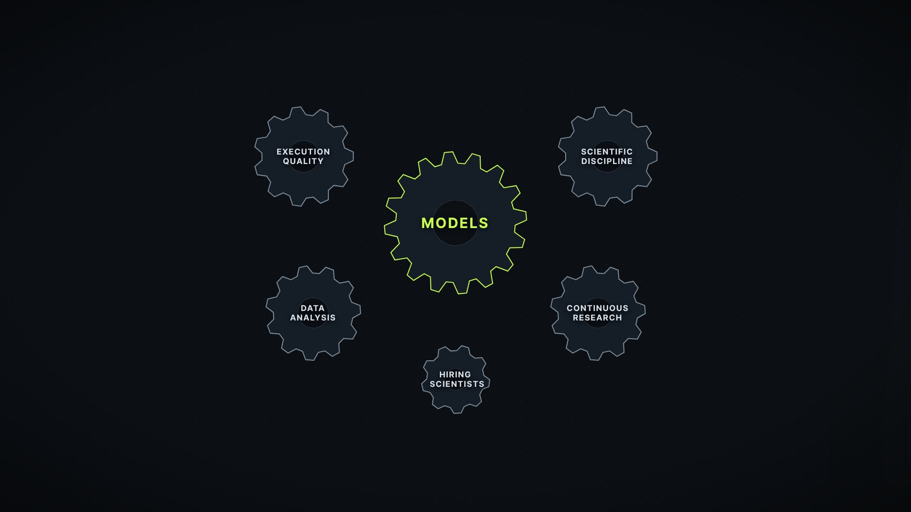
CHAPTER 02 · THE MACHINE BEHIND THE EDGE
Performance sirf models ki wajah se nahi thi
1
Execution quality
2
Scientific discipline
3
Data analysis
4
Continuous research
5
Scientists ki hiring
7
Notes:
[Video 02:12 · Scene S08]
Lekin yahan ek baat hai, jo zyada log miss kar dete hain: Renaissance ki performance sirf models ki wajah se nahi thi. Kai factors ek saath kaam kar rahe the — execution quality, scientific discipline, data analysis, continuous research, aur scientists ki hiring. Chaliye, inme se chaar ko break down karte hain.

Slide 8
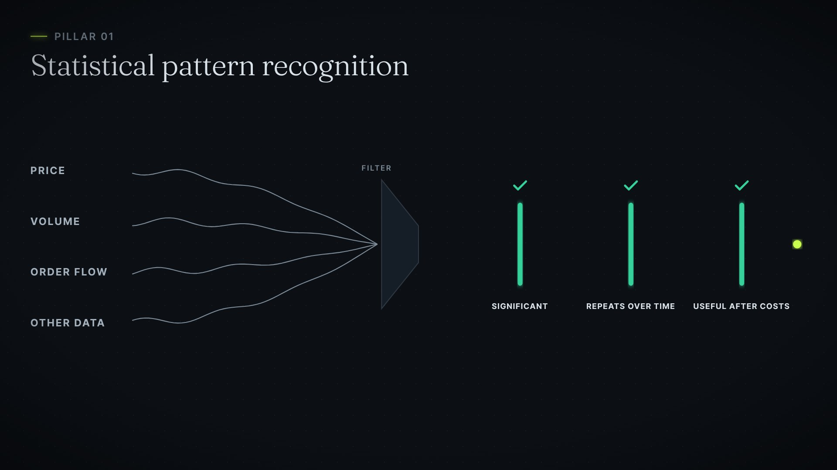
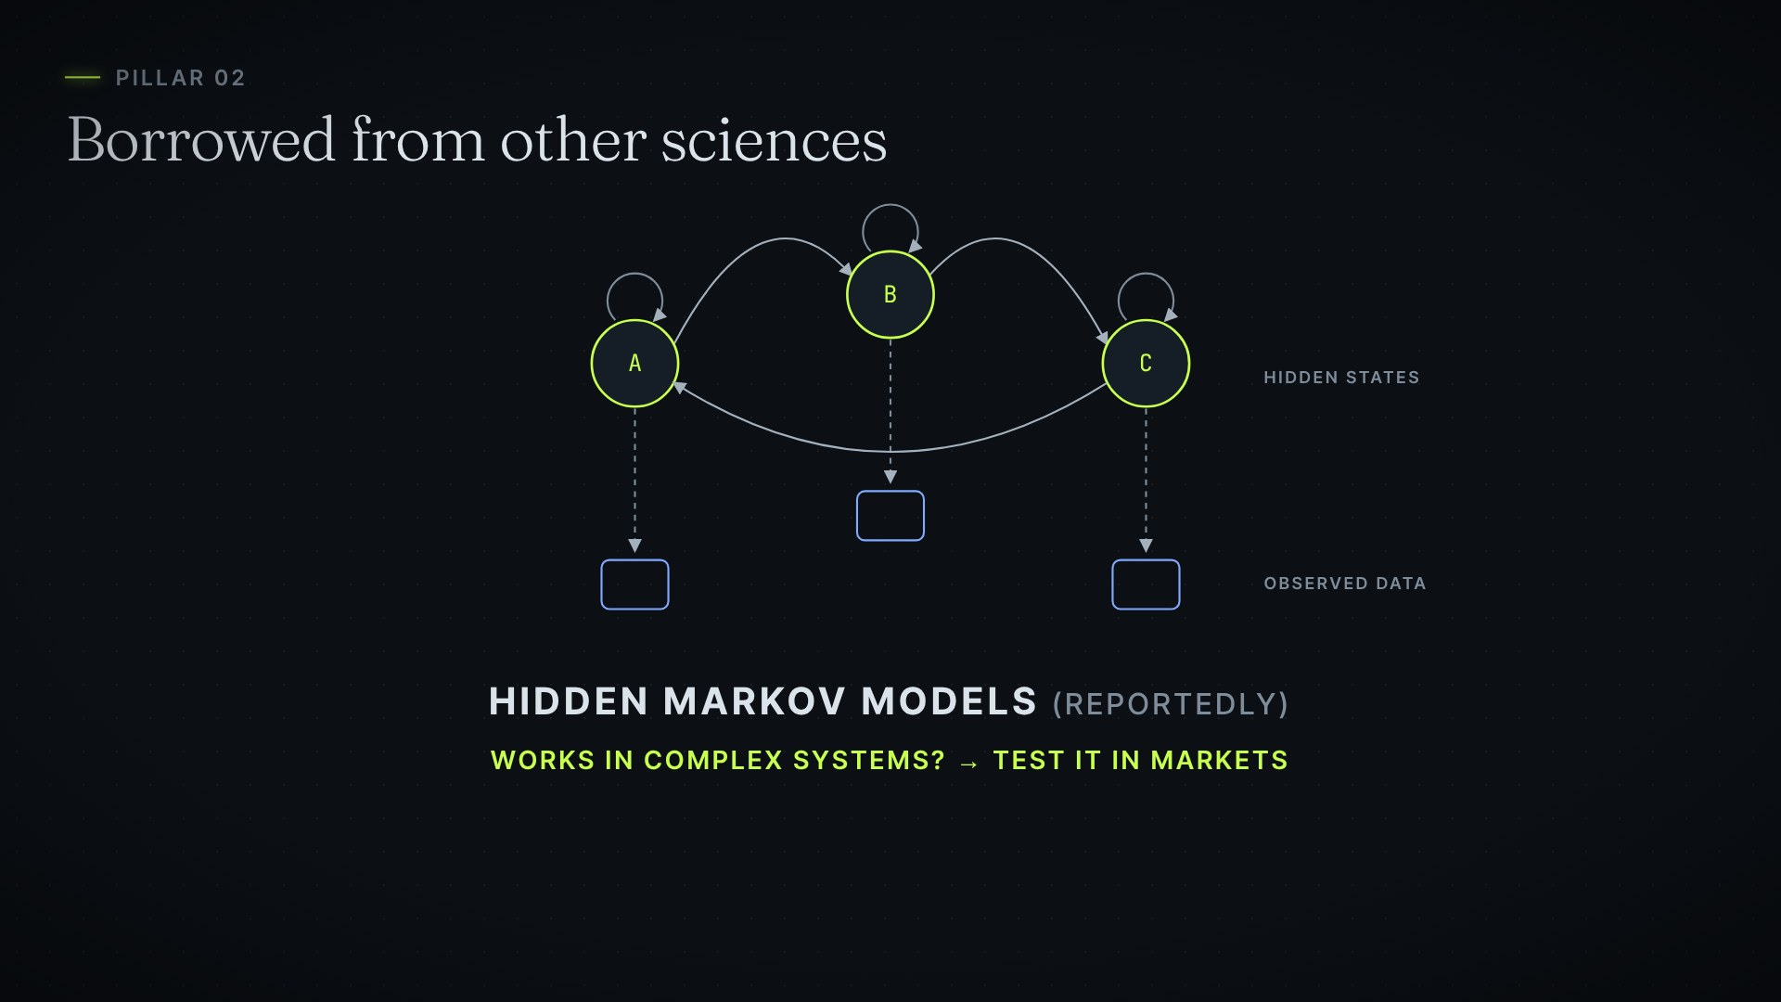
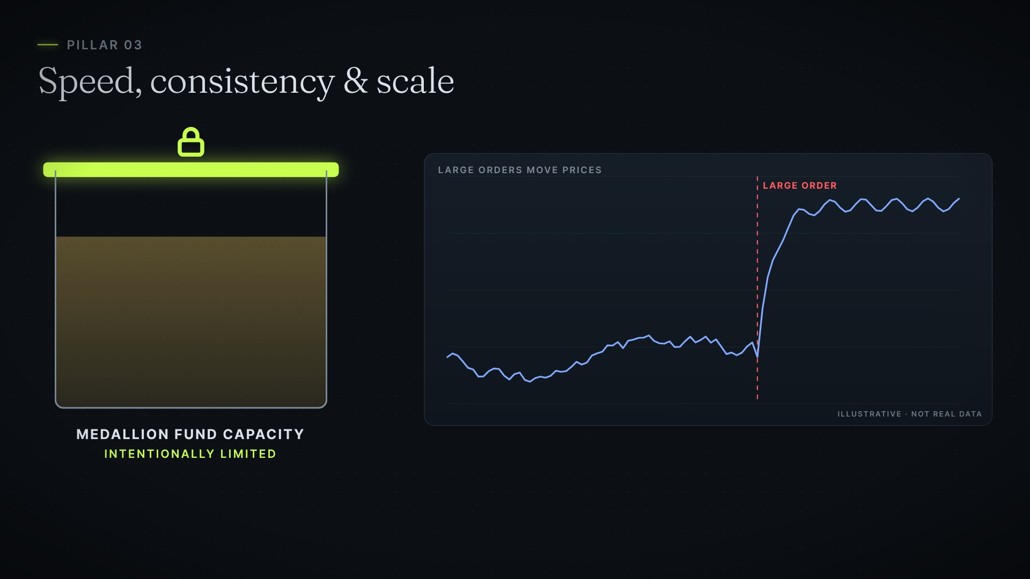
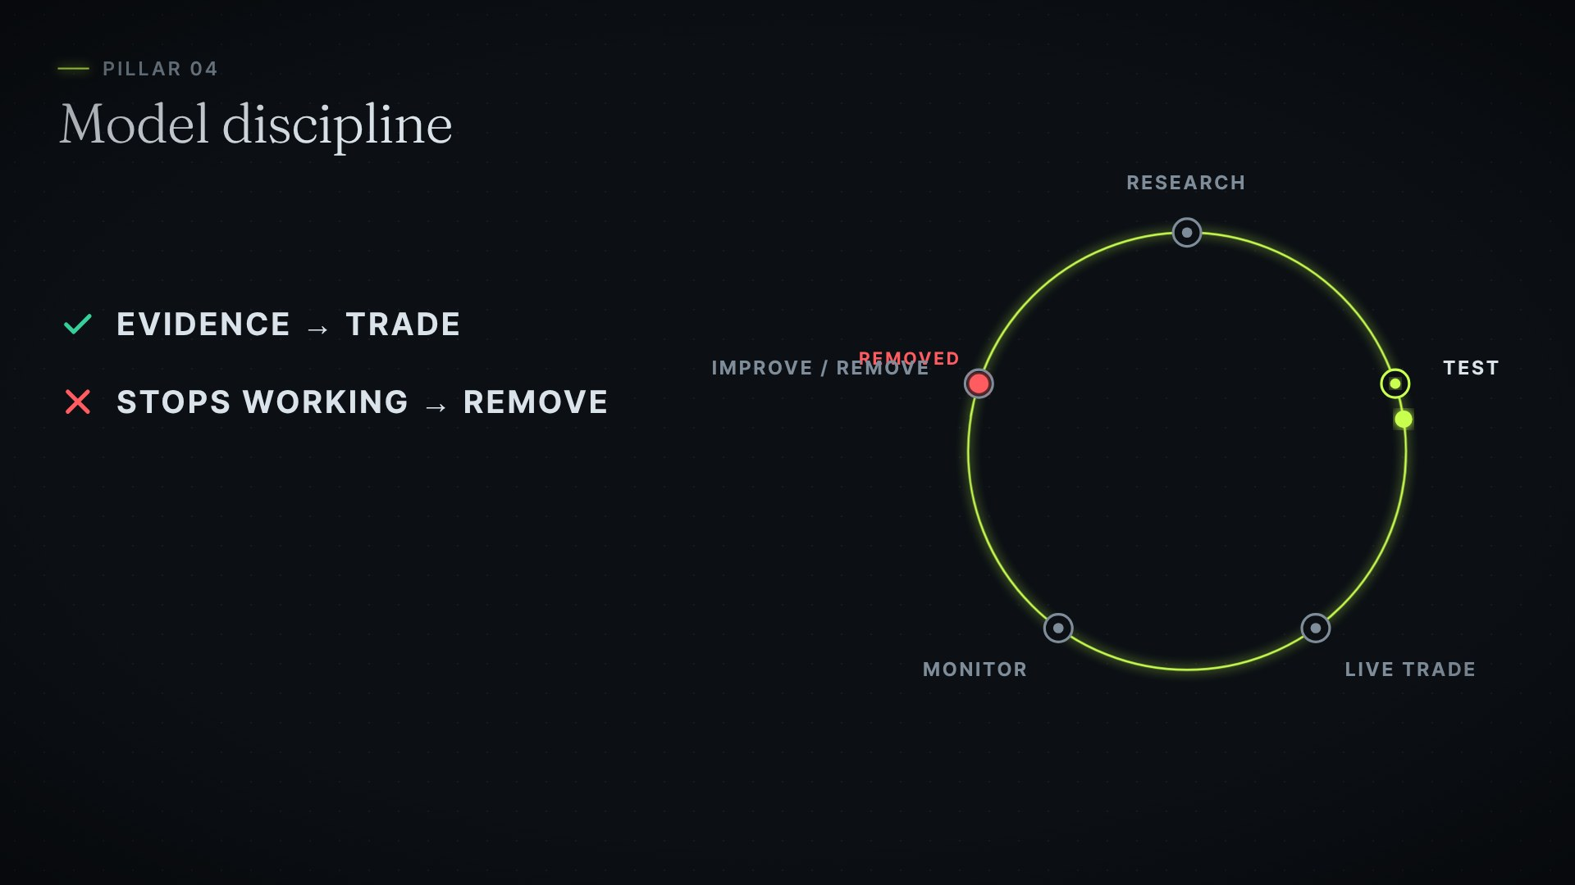
CHAPTER 02
Edge ke 4 pillars
1 · Statistical pattern recognition
2 · Doosri sciences se seekhna
Significant, repeat hone wale, costs ke baad bhi useful signals
Physics, signal processing; Hidden Markov Models (reportedly)
3 · Speed, consistency, scale
4 · Model discipline
Medallion ki capacity intentionally limited rakhi gayi
Evidence ho to trade; kaam band kare to remove
8
Notes:
[Video 02:37 · Scene S09]
Pehla: statistical pattern recognition. Team price, volume, order flow aur doosre market data ko process karti thi. Goal tha aise signals dhoondhna, jo statistically significant hon, time ke saath repeat hote hon — aur trading costs ke baad bhi useful rahen.
[Video 02:59 · Scene S10]
Doosra: doosri sciences se seekhna. Kuch mathematical techniques finance ke bahar ke fields — jaise physics aur signal processing — se adapt ki gayi thi. Hidden Markov Models jaise techniques ka use reportedly financial pattern recognition mein kiya gaya. Logic simple tha: agar koi technique doosre complex systems mein kaam karti hai, to test karo ki kya woh markets mein bhi kaam karti hai.
[Video 03:31 · Scene S11]
Teesra: speed, consistency aur scale. Sirf ek profitable signal dhoondh lena kaafi nahi hai. Use quickly, consistently aur large scale par execute karna padta hai. Aur khaas baat — Renaissance ne Medallion Fund ki capacity ko intentionally limited rakha, taaki unke large orders market prices ko zyada affect na karein.

Slide 9
PILLAR 4 · MODEL DISCIPLINE
Process kabhi rukta nahi tha
1
Research
2
Test
3
Live trade
4
Monitor
5
Improve ya remove
9
Notes:
[Video 03:56 · Scene S12]
Chautha: model discipline. Koi signal tabhi trade kiya jata tha, jab uske support mein statistically significant evidence ho. Agar signal kaam karna band kar de, to use hata diya jata tha. Aur yeh process kabhi rukta nahi tha: research, test, live trade, monitor — phir improve, ya remove.

Slide 10
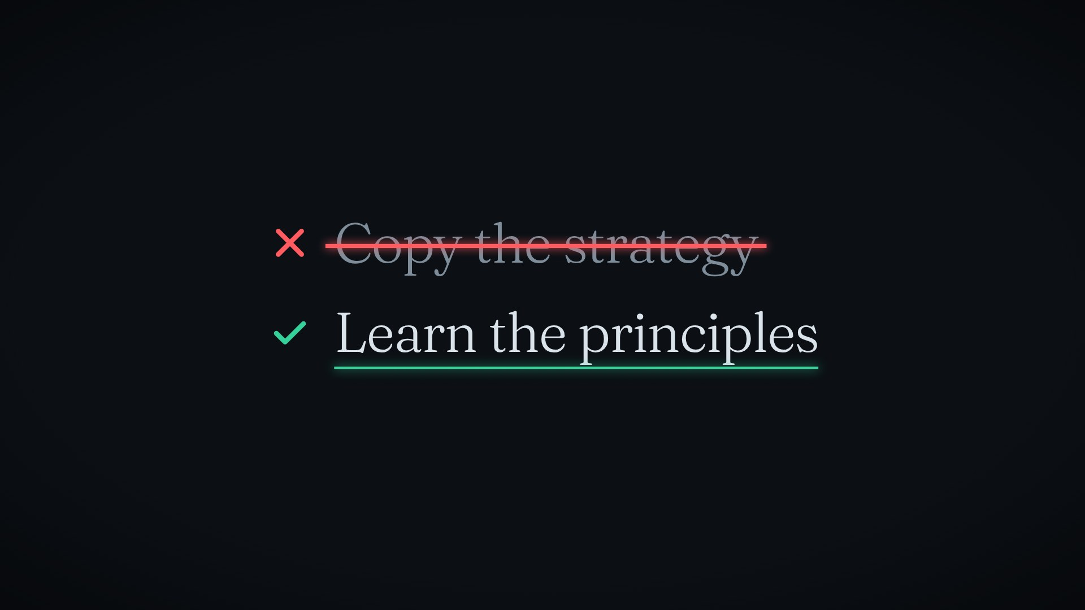
CHAPTER 03 · REALITY CHECK
Medallion ko copy nahi kiya ja sakta
→ Retail trader Medallion ki performance replicate nahi kar sakta
→ Models proprietary hain — publicly available nahi
→ Renaissance ke paas technology, scale aur highly skilled researchers the
Takeaway: principles ko learning framework ki tarah dekho, copy karne wali strategy ki tarah nahi
10
Notes:
[Video 04:19 · Scene S13]
Ab, ek reality check. Ek retail trader Medallion Fund ki performance ko replicate nahi kar sakta. Uske models proprietary hain, aur publicly available nahi hain. Renaissance ke paas technology thi, scale tha, aur highly skilled researchers the. Isliye Simons ke principles ko ek learning framework ki tarah dekho — copy karne wali trading strategy ki tarah nahi.

Slide 11
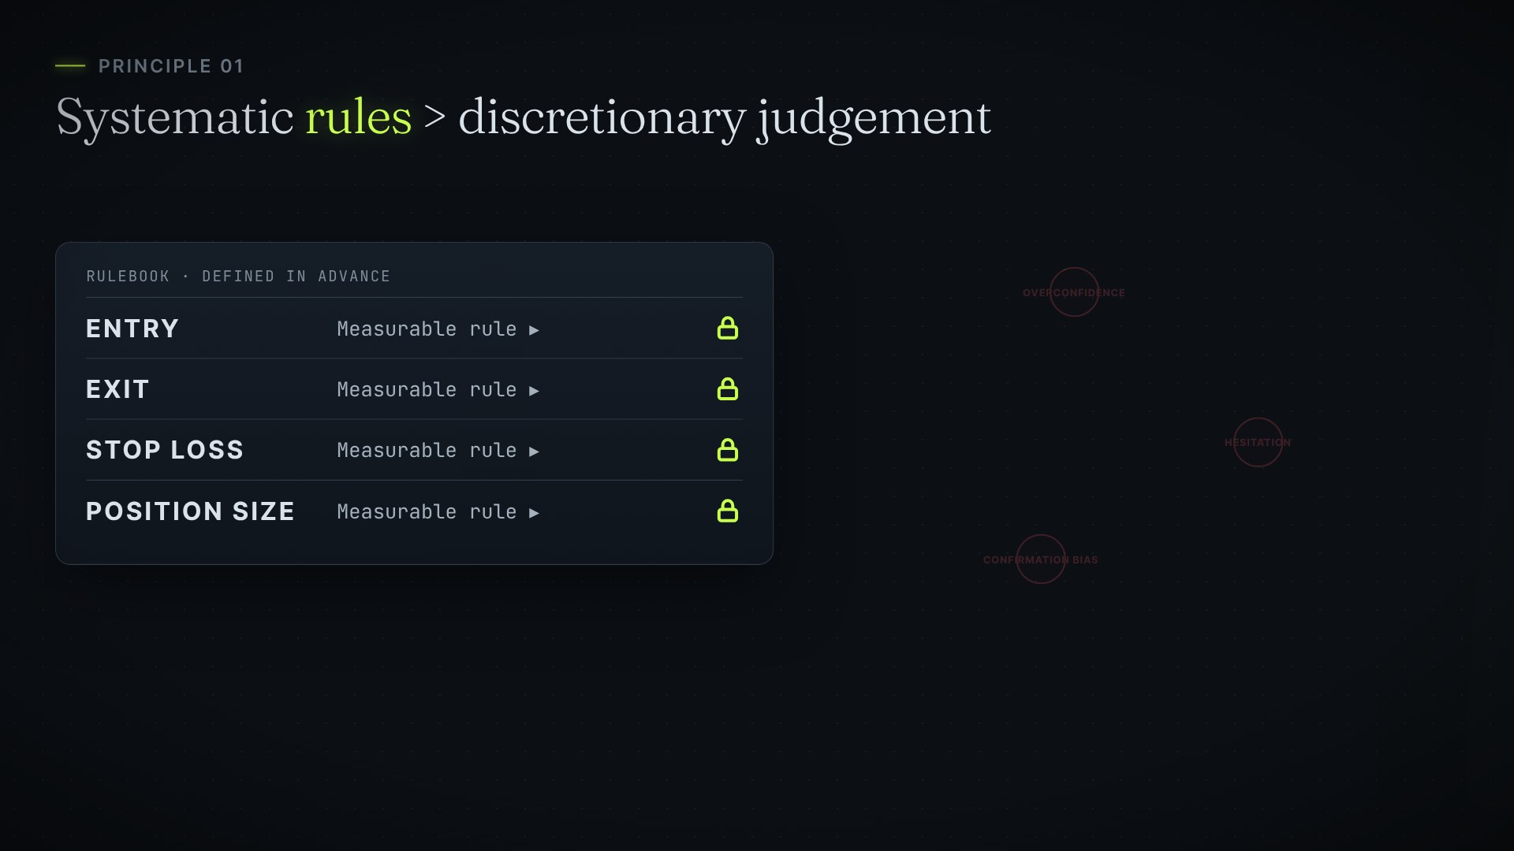
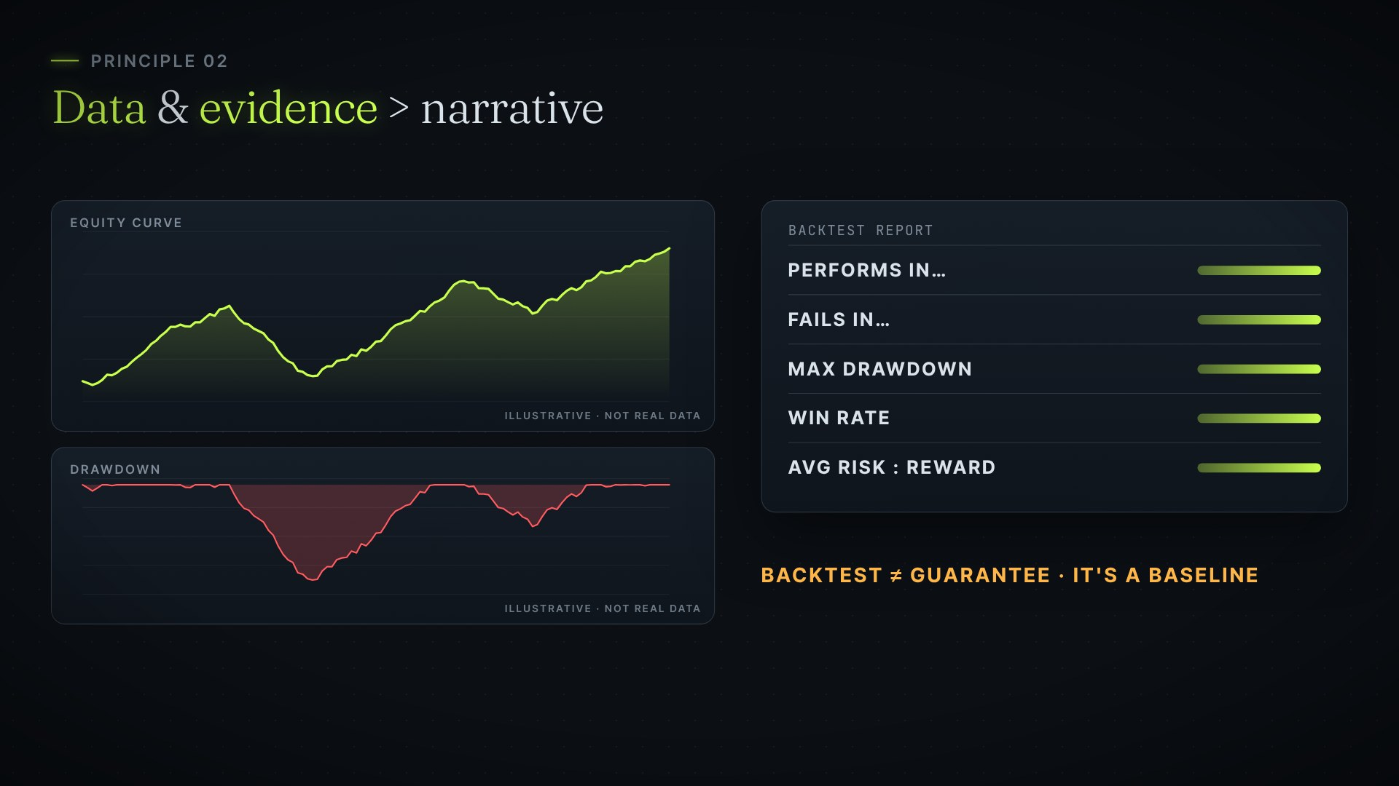
CHAPTER 04 · PRINCIPLES YOU CAN USE
Rules aur evidence
1 · Rules > judgement
2 · Data & evidence > narrative
Entry, exit, stop loss, position size pehle se define karo
Backtest karo — lekin backtest guarantee nahi, baseline hai
11
Notes:
[Video 04:51 · Scene S14]
To aap actually kya apply kar sakte ho? Principle one: discretionary judgement ke bajay systematic rules. Apni entry, exit, stop loss aur position size pehle se define karo. Measurable conditions se overconfidence, hesitation aur confirmation bias jaise behavioural mistakes kam ho sakte hain.
[Video 05:18 · Scene S15]
Principle two: narrative se upar data aur evidence ko rakho. Apni strategy ko historical data par backtest karo. Samjho ki woh kahan perform karti hai, kahan fail hoti hai, uska historical drawdown kya raha, win rate kya raha, aur average risk-to-reward kya raha. Backtest future profit ki guarantee nahi deta — lekin yeh samajhne ka baseline zaroor deta hai ki strategy ne ab tak kaise behave kiya hai.

Slide 12
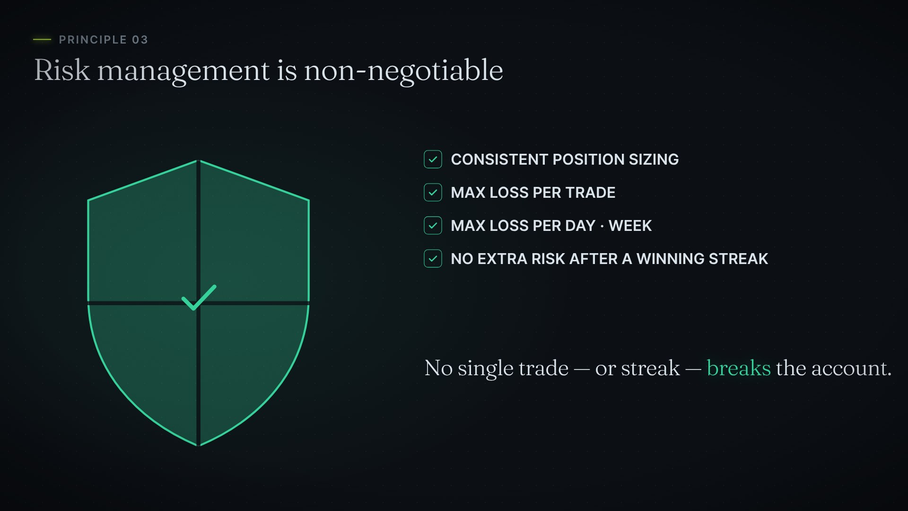
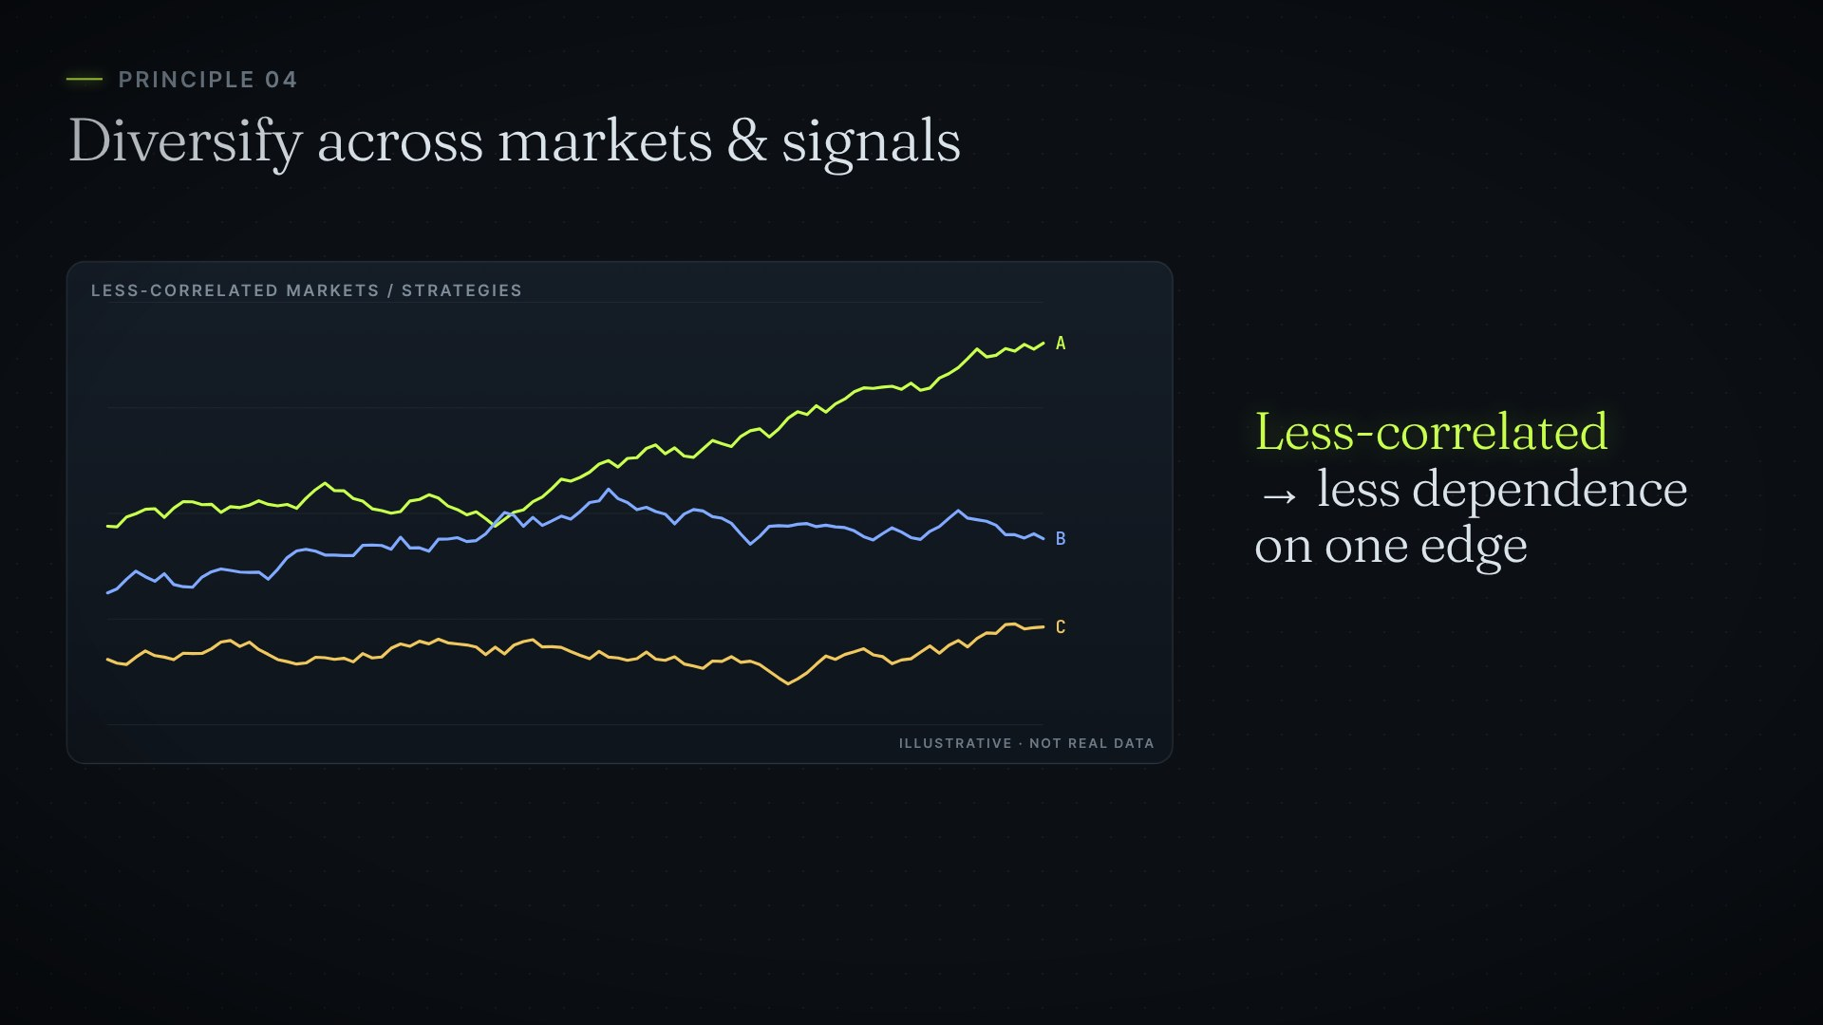
CHAPTER 04 · PRINCIPLES YOU CAN USE
Risk aur diversification
3 · Risk management non-negotiable
4 · Diversify karo
Har trade + daily/weekly max loss; winning streak mein risk mat badhao
Ek instrument ya ek strategy par poori tarah dependent mat raho
12
Notes:
[Video 05:51 · Scene S16]
Principle three: risk management non-negotiable hai. Position sizing consistent rakho. Har trade par maximum loss define karo. Daily aur weekly maximum loss bhi define karo. Aur sirf isliye risk mat badhao, kyunki aap winning streak par ho. Goal yeh hai: koi ek trade — ya trades ka sequence — aapke account ko seriously damage na kare.
[Video 06:22 · Scene S17]
Principle four: markets aur signals mein diversify karo. Medallion ne reportedly hundreds of instruments mein trade kiya — equities, bonds, currencies, commodities aur derivatives. Retail level par iska broad lesson yeh hai: kisi ek instrument ya ek strategy par poori tarah dependent mat raho. Less-correlated markets mein diversify karne se, kisi ek edge par aapki dependence kam ho sakti hai.

Slide 13
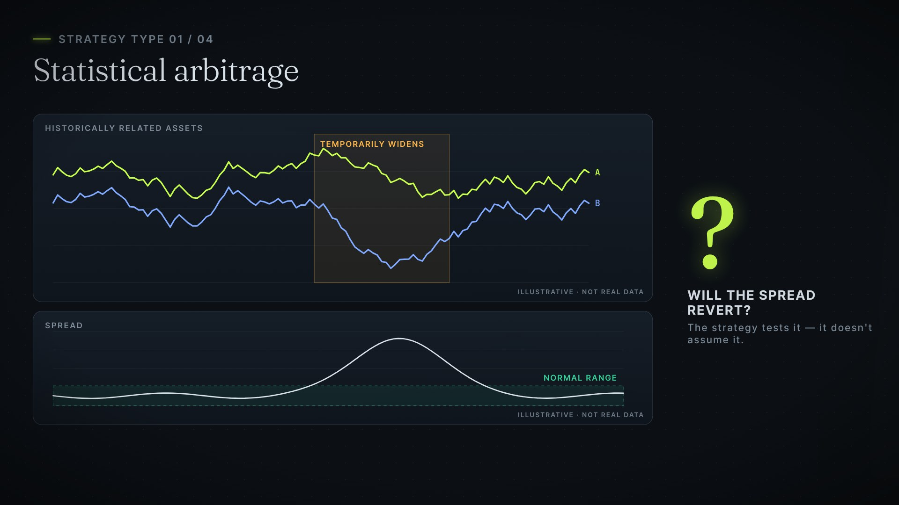
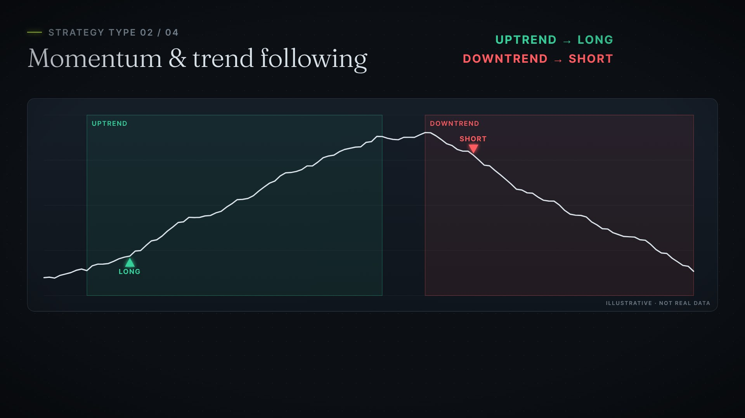
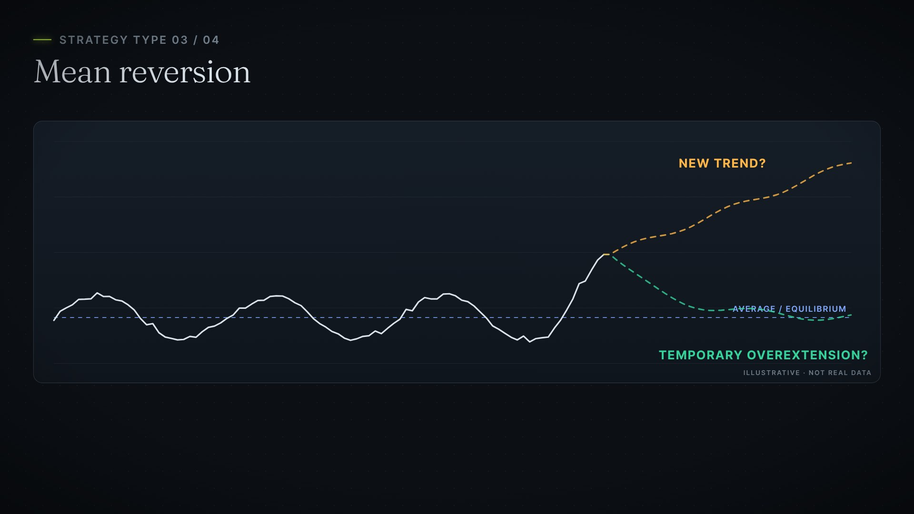
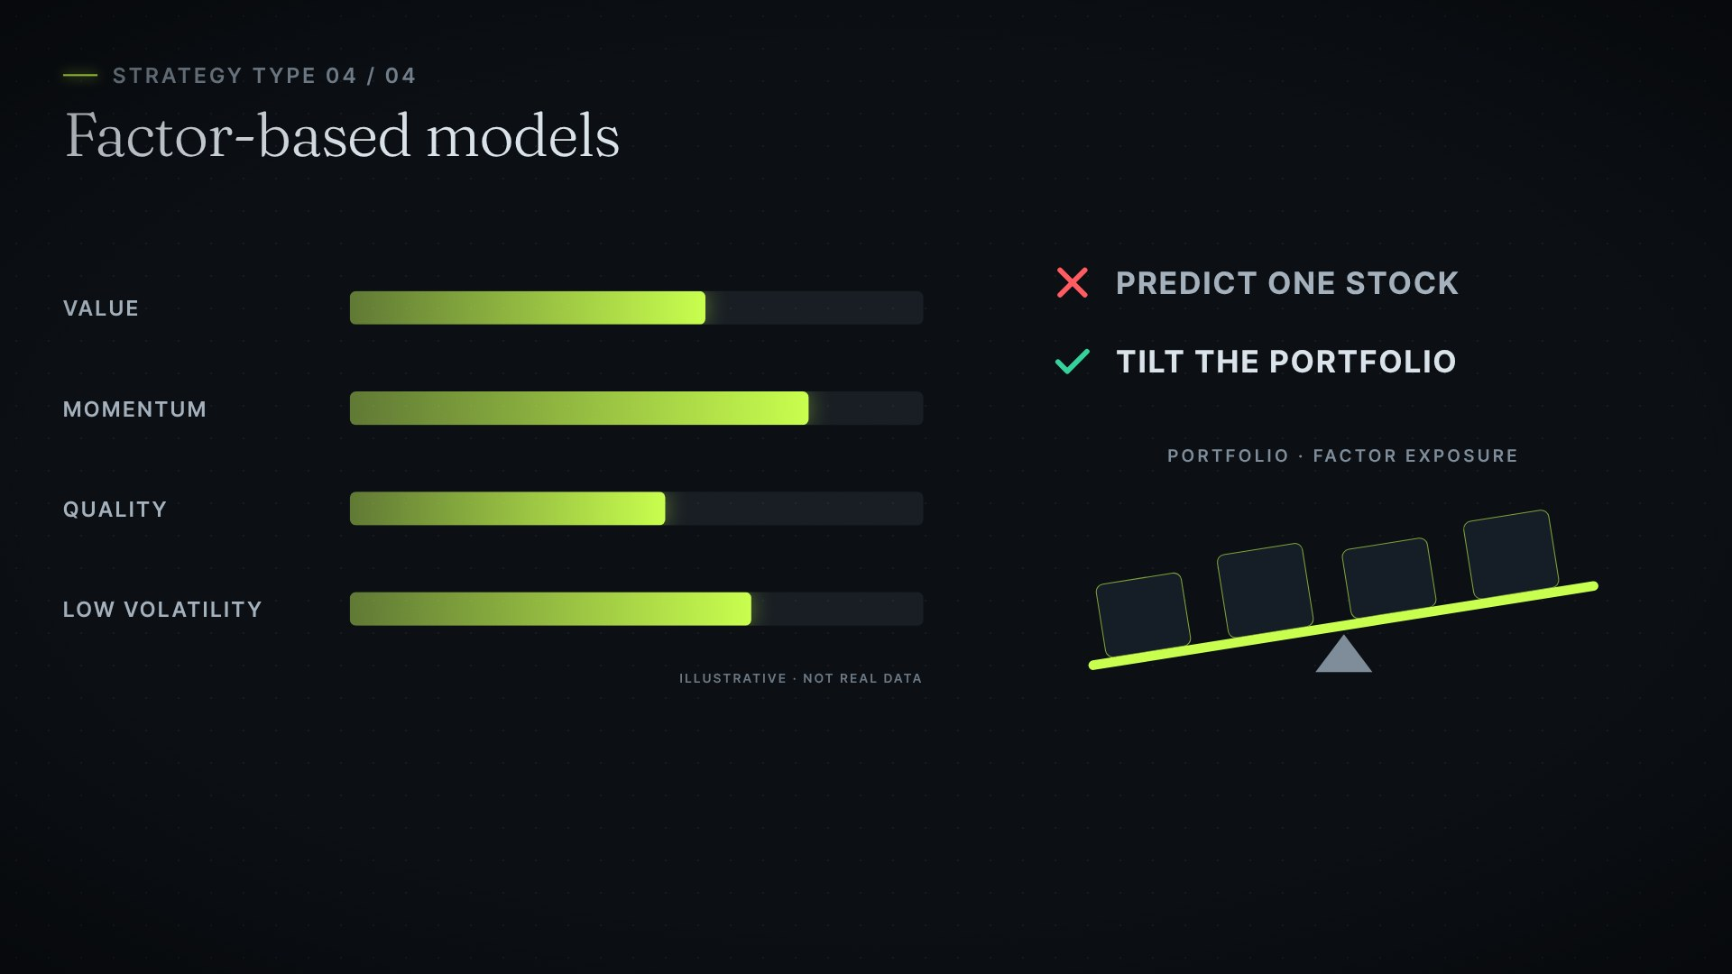
CHAPTER 05 · THE QUANT TOOLKIT
Quantitative strategies ke 4 types
Statistical arbitrage
Momentum & trend
Related assets ka spread normal range ki taraf revert karega?
Uptrend mein long, downtrend mein short
Mean reversion
Factor-based models
Temporary overextension hai ya new trend?
Stock predict nahi — portfolio ko tilt karo
13
Notes:
[Video 06:56 · Scene S18]
Quantitative strategies kuch broad types ki hoti hain. Statistical arbitrage mein historically related assets ke price relationship ko study kiya jata hai. Agar yeh relationship temporarily kisi unusual level tak widen ho jaye, to strategy test karti hai ki kya spread wapas apni normal range ki taraf revert karega.
[Video 07:22 · Scene S19]
Momentum aur trend following ka idea hai — is possibility ko systematically capture karna, ki recent strength aage bhi continue ho sakti hai. Jaise rules: uptrend mein long, aur downtrend mein short.
[Video 07:40 · Scene S20]
Mean reversion mein yeh idea test kiya jata hai ki price apne average ya equilibrium level ki taraf wapas aa sakta hai. Short-term trading mein yeh relevant ho sakta hai — lekin challenge yeh pehchanna hai ki yeh temporary overextension hai, ya ek new trend ki shuruaat.
[Video 08:01 · Scene S21]
Aur factor-based models value, momentum, quality aur low volatility jaise characteristics ko analyse karte hain. Kisi ek stock ki direction predict karne ke bajay, portfolio ko specific factor exposures ki taraf tilt kiya jata hai.

Slide 14
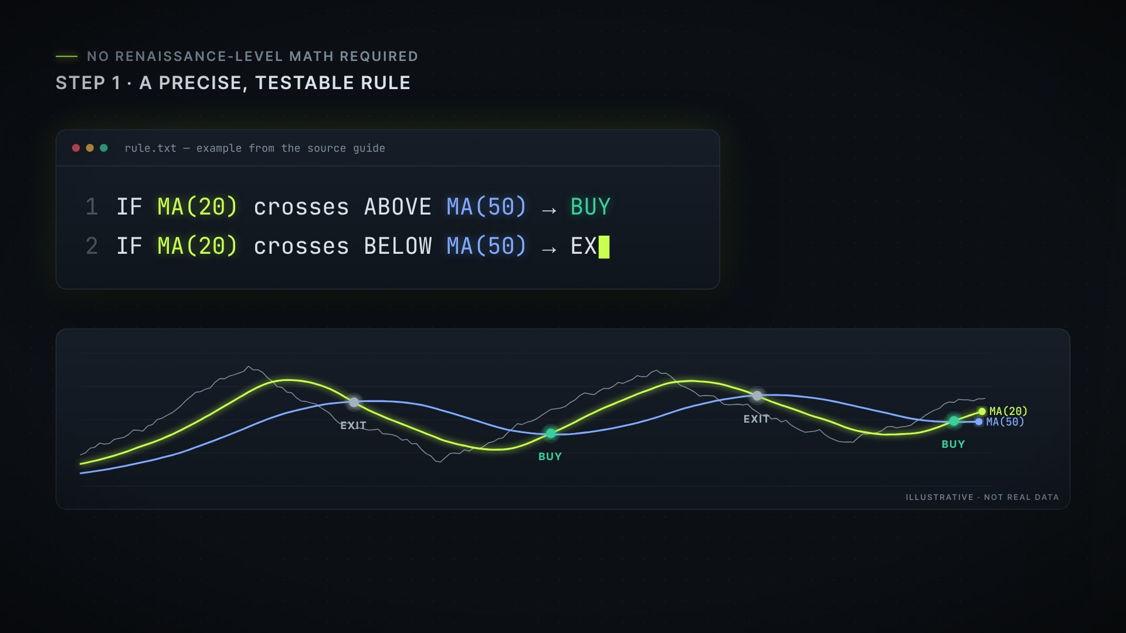
CHAPTER 06 · YOUR FIRST TESTABLE RULE
Ek precise, testable rule se shuru karo
BUY: 20-day MA, 50-day MA ke upar cross kare
EXIT: 20-day MA wapas 50-day ke neeche cross kare
Phir backtest mein check karo:
→ Win rate
→ Drawdown
→ Average risk-to-reward
→ Alag-alag market conditions
14
Notes:
Note: yeh example rule source guide ka hai — koi result claim nahi kiya gaya.
[Video 08:21 · Scene S22]
Achhi khabar yeh hai: quantitative approach ke liye Renaissance-level mathematics ki zarurat nahi hai. Shuruaat hoti hai ek precise, testable rule se. Example: Main tab buy karunga, jab 20-day moving average, 50-day moving average ke upar cross karega. Aur jab 20-day moving average wapas 50-day ke neeche cross karega, tab exit karunga.
[Video 08:49 · Scene S23]
Ab is rule ko historical data par backtest kiya ja sakta hai — win rate, drawdown, average risk-to-reward, aur alag-alag market conditions mein iska behaviour check karte hue.

Slide 15
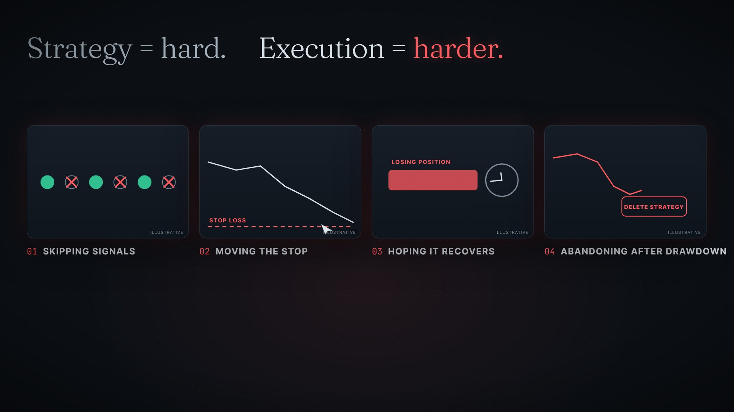
CHAPTER 07 · THE HARDEST PART
Execute karna sabse mushkil hai
1
Kuch signals lena, kuch skip karna
2
Stop loss ko move karna
3
Losing trade ko recover hone ki ummeed mein hold karna
4
Drawdown ke baad strategy abandon karna
15
Notes:
[Video 09:04 · Scene S24]
Strategy banana ek challenge hai. Lekin use consistently execute karna, usse bhi bada challenge hai. Yahi woh jagah hai, jahan traders apne hi systems tod dete hain: kuch signals par trade lena, aur kuch ko skip kar dena. Stop loss ko move karna. Losing trade ko is ummeed mein hold karna, ki woh recover ho jayega. Aur drawdown ke baad strategy ko abandon kar dena.

Slide 16
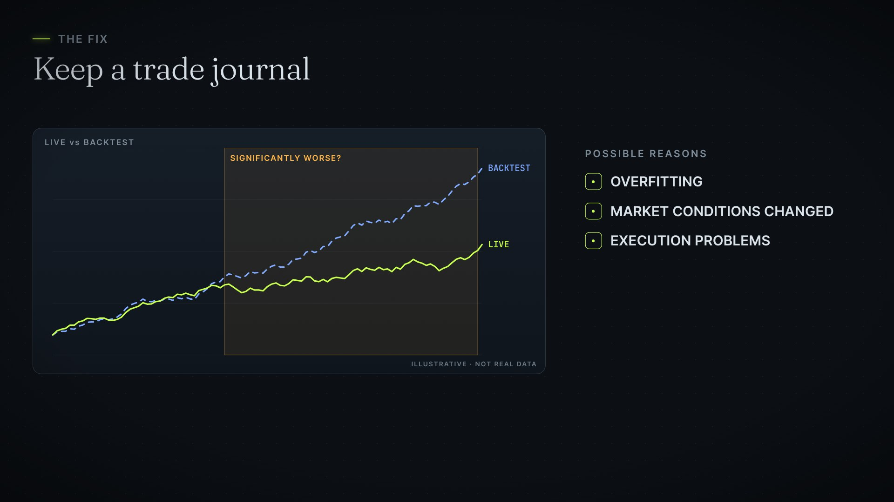
THE FIX
Trade journal maintain karo
Log karo: entry condition, entry price, exit price, stop loss, take profit, market condition, result
Compare karo: kya live performance backtest jaisi hai?
Agar kaafi worse hai: overfitting, market conditions ka badalna, execution problems, ya edge ka degrade hona
16
Notes:
[Video 09:39 · Scene S25]
Iska solution hai ek trade journal. Entry condition, entry price, exit price, stop loss, take profit, market condition aur result — sab log karo. Phir compare karo: kya aapki live performance backtest ke behaviour jaisi hai? Agar live performance significantly worse hai, to possible reasons ho sakte hain overfitting, market conditions ka badal jaana, execution problems — ya strategy ki edge ka degrade hona.

Slide 17
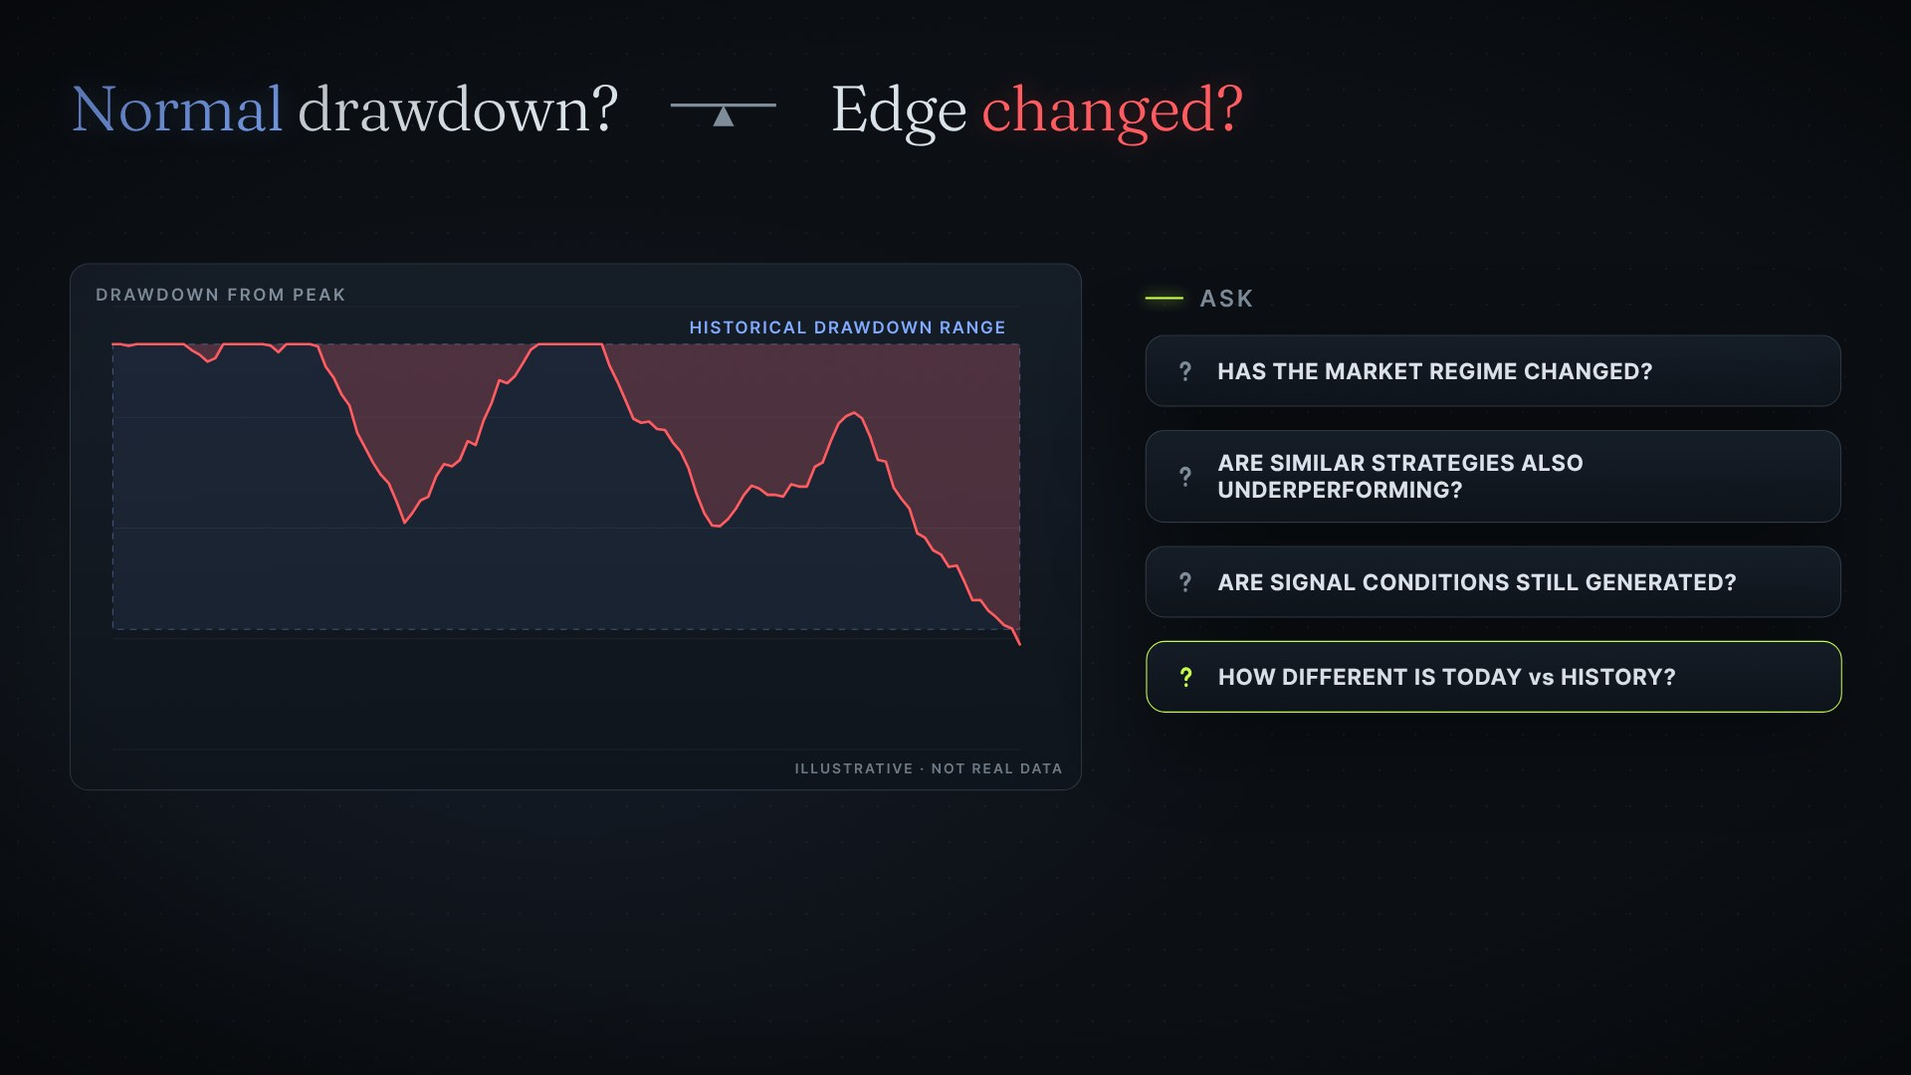
CHAPTER 08 · WHEN IT STOPS WORKING
Normal drawdown — ya edge badal gayi?
?
Market regime change hua?
?
Similar strategies bhi underperform kar rahi hain?
?
Signal conditions abhi bhi generate ho rahi hain?
?
Current market history se kitna different hai?
Properly backtested strategy ho to evidence se evaluate karo — feeling se nahi.
17
Notes:
[Video 10:15 · Scene S26]
Systematic strategies bhi drawdown periods se guzarti hain. Important sawaal sirf yeh nahi hai ki "kya mujhe loss hua?" — balki yeh hai ki kya yeh ek normal historical drawdown hai, ya strategy ki edge genuinely badal gayi hai. Khud se poocho: Kya market regime change hua hai? Kya similar strategies bhi underperform kar rahi hain? Kya signal conditions abhi bhi generate ho rahi hain? Aur current market historical conditions se kitna different hai?
[Video 10:52 · Scene S27]
Recent losses ke baad aisa lag sakta hai ki strategy permanently fail ho gayi hai. Lekin agar strategy properly backtested aur validated hai, to historical evidence drawdown ko objectively evaluate karne ka ek better basis deta hai.

Slide 18
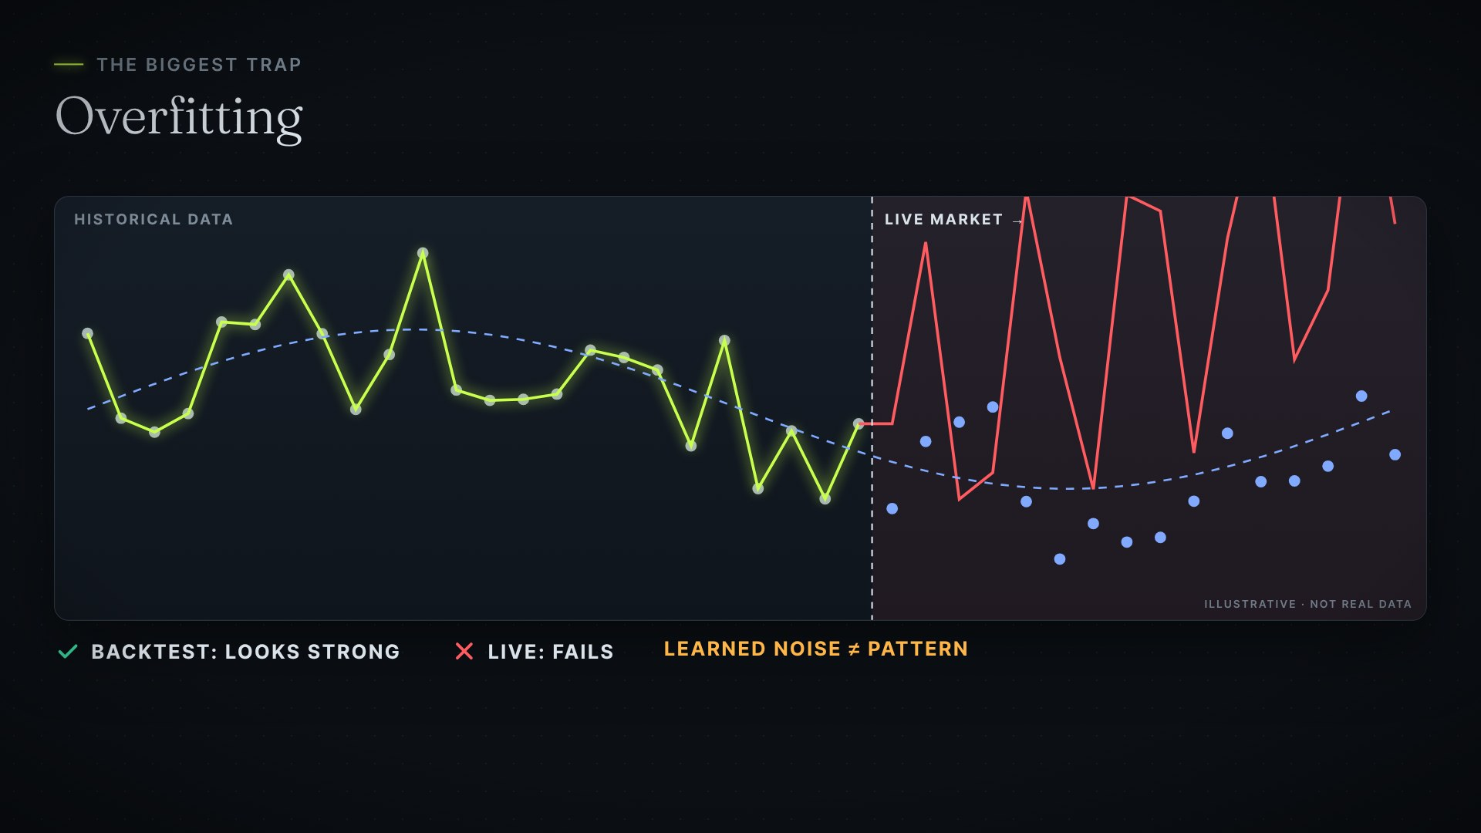
CHAPTER 09 · THE TRAPS
Sabse bada trap: overfitting
→ Strategy ko historical data ke hisaab se itna optimize karna ki backtest strong dikhe
→ Lekin live market mein fail ho jaye — strategy noise seekh rahi thi
Defence: out-of-sample testing — alag data par test karo jo develop karne mein use nahi hua
18
Notes:
[Video 11:11 · Scene S28]
Ab baat karte hain advanced traps ki. Sabse bada trap: overfitting — strategy ko historical data ke hisaab se itna optimize kar dena, ki backtest strong dikhe, lekin live market mein strategy fail ho jaye. Ho sakta hai strategy asli market pattern ke bajay, historical noise seekh rahi ho.
[Video 11:36 · Scene S29]
Iska ek defence hai: out-of-sample testing — yaani strategy ko aise alag data par test karna, jo use develop karne mein use nahi hua.

Slide 19
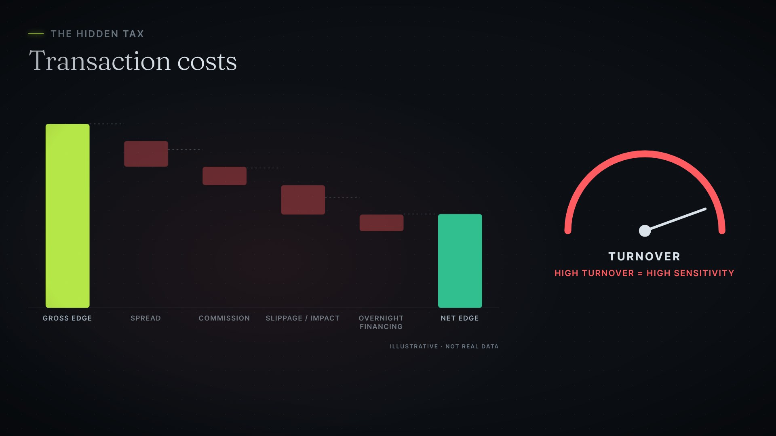
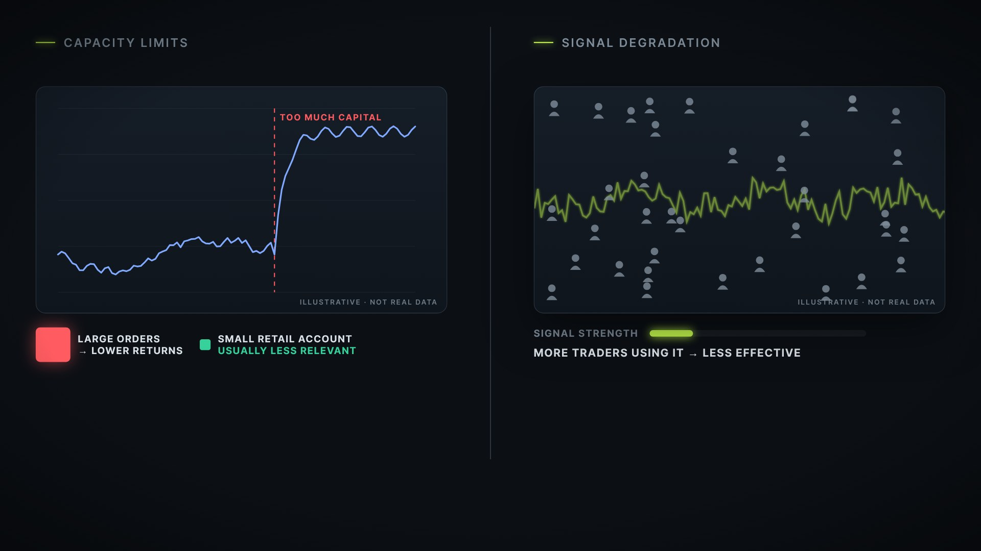
CHAPTER 09 · THE TRAPS
Hidden costs aur fading edge
Transaction costs
Capacity & signal degradation
Spread, commission, slippage, overnight financing — high-turnover mein zyada asar
Zyada capital market move karta hai; zyada traders use karein to pattern kam effective
19
Notes:
[Video 11:50 · Scene S30]
Phir aate hain transaction costs. Trading ka actual cost sirf entry aur exit price nahi hota. Spread, commission, slippage ya market impact, aur overnight financing — yeh sab aapki edge ko kam kar sakte hain. High-turnover strategies inke liye khaas taur par sensitive hoti hain.
[Video 12:14 · Scene S31]
Capacity limits: agar bahut zyada capital ek hi strategy ko follow kare, to large orders market ko move kar sakte hain aur returns kam kar sakte hain — haalanki small retail accounts ke liye yeh usually utna relevant nahi hota. Aur signal degradation: jo intraday pattern pehle kaam karta tha, woh time ke saath kam effective ho sakta hai — khaas kar tab, jab bahut saare traders use pehchan kar use karne lagein.

Slide 20
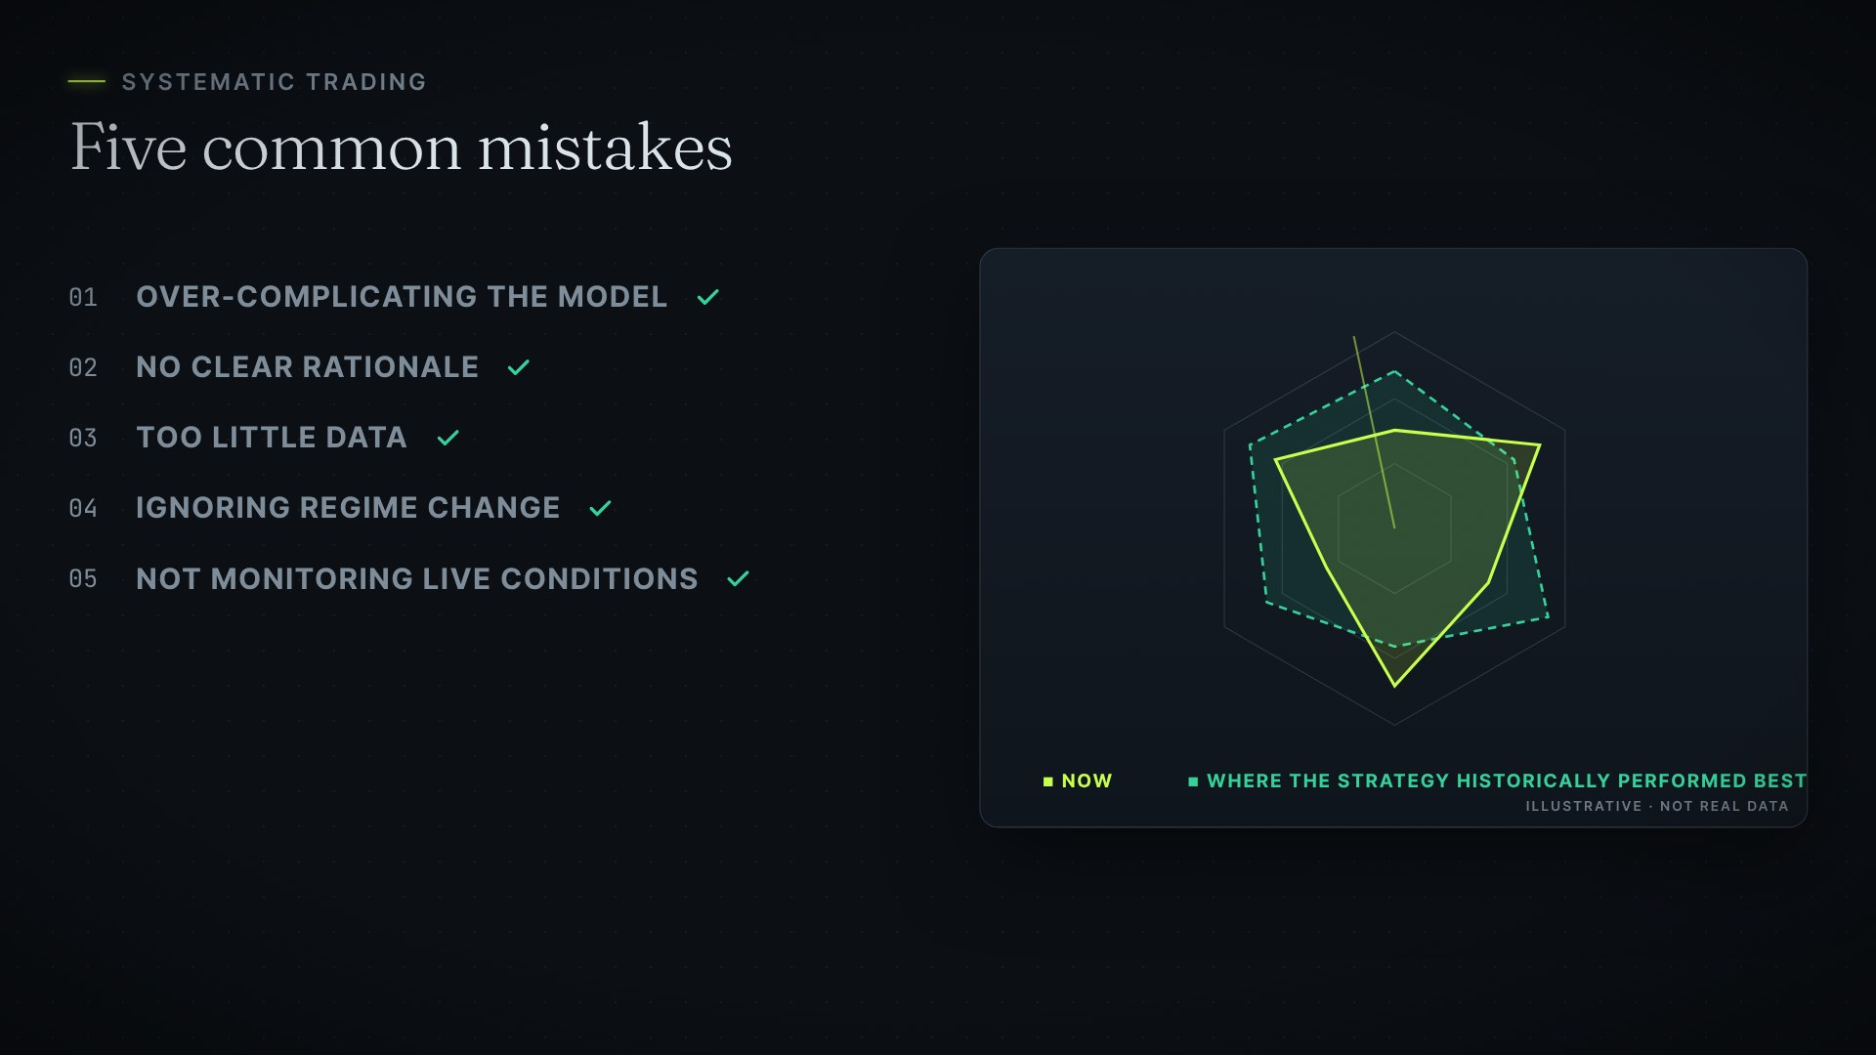
SYSTEMATIC TRADING
Paanch common mistakes
01
Model ko over-complicate karna
02
Bina clear rationale ke signals
03
Bahut kam data par testing
04
Market regime change ignore karna
05
Live conditions monitor na karna
20
Notes:
[Video 12:48 · Scene S32]
Aur aakhir mein, systematic trading ki paanch common mistakes. Ek: model ko over-complicate karna. Zyada complexity ka matlab automatically better strategy nahi hota; simple aur robust models overfitting ke liye kam vulnerable ho sakte hain. Do: bina clear rationale ke signals use karna. Sirf statistical pattern mil jana kaafi nahi hai; yeh samajhna bhi zaroori hai ki woh pattern exist kyun kar sakta hai. Teen: bahut kam data par testing. Short backtest misleading ho sakta hai. Strategy ko high aur low volatility, trending aur range-bound markets, aur alag-alag macro environments mein test karo. Chaar: market regime change ko ignore karna. Policy, volatility, liquidity aur trader behaviour — sab badalte rehte hain, aur sab performance ko affect kar sakte hain. Aur paanch: live conditions ko monitor na karna. Check karo ki aaj ka market un conditions jaisa hai ya nahi, jahan aapki strategy historically best perform karti thi.

Slide 21
CLOSING
Aap Medallion ko copy nahi kar sakte.
Lekin uska discipline zaroor copy kar sakte hain.
Evidence dhoondho → test karo → discipline se trade karo → monitor karo → jo kaam na kare, remove karo
21
Notes:
[Video 13:59 · Scene S33]
Renaissance ki performance sirf models ka result nahi thi. Yeh ek process se aayi: evidence dhoondho, use test karo, discipline ke saath trade karo, monitor karo — aur jo kaam karna band kar de, use remove karo. Aap Medallion ko copy nahi kar sakte. Lekin aap uska discipline zaroor copy kar sakte hain.

Slide 22
DISCLAIMER
Sirf educational purpose ke liye
→ Yeh presentation aur video sirf education ke liye hain — investment advice nahi
→ Historical performance future results ki guarantee nahi hoti
→ Medallion ke proprietary models ko replicate karne ka koi claim nahi
→ Medallion ke returns "reportedly", "approximately" aur "fees se pehle" hain — jaise source guide mein
→ Charts illustrative hain — real market ya fund data nahi
22
Notes:
[Video 14:23 · Scene S34]
Yeh video sirf educational purpose ke liye hai. Historical performance future results ki guarantee nahi hoti — aur yahan Medallion ke proprietary models ko replicate karne ka koi claim nahi kiya gaya hai.

