Slide 1
Sequence Diagrams

Slide 2
A First Look at Sequence Diagrams
Illustrates how objects interacts with each other.
Emphasizes time ordering of messages.
Can model simple sequential flow, branching, iteration, recursion and concurrency.
Sequence Diagrams

Slide 3
How different parts of system interact over time
Who talks whom
In what order
What messages are sent
Visual story of the interaction
Sequence Diagrams

Slide 4
Basic Components
Customer (Actor)-> atm->bank server-> bank account
Lifelines (existence over time)
Message (information, function call) – arrow
Activation bar (shows when object is active/ executing)
Sequence Diagrams

Slide 5
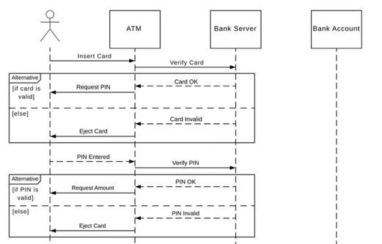
Sequence Diagrams

Slide 6
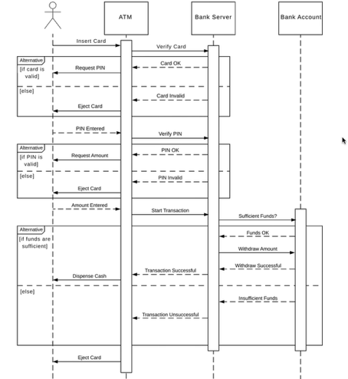

Slide 7
A Sequence Diagram
member:
LibraryMember
book:Book
:Book
Copy
borrow(book)
ok = mayBorrow()
[ok] borrow(member)
setTaken(member)
Sequence Diagrams

Slide 8
Object
Object naming:
  syntax: [instanceName][:className]
  Name classes consistently with your class diagram (same classes).
  Include instance names when objects are referred to in messages or when several objects of the same type exist in the diagram.
The Life-Line represents the object’s life during the interaction
myBirthdy
:Date
Sequence Diagrams

Slide 9
Messages
An interaction between two objects is performed as a message sent from one object to another (simple operation call, Signaling, RPC)
If object obj₁ sends a message to another object obj₂ some link must exist between those two objects
Sequence Diagrams

Slide 10
Messages (Cont.)
A message is represented by an arrow between the life lines of two objects.
  Self calls are also allowed
  The time required by the receiver object to process the message is denoted by an activation-box.
A message is labeled at minimum with the message name.
  Arguments and control information (conditions, iteration) may be included.
Sequence Diagrams

Slide 11
Return Values
Optionally indicated using a dashed arrow with a label indicating the return value.
  Don’t model a return value when it is obvious what is being returned, e.g. getTotal()
  Prefer modeling return values as part of a method invocation, e.g. ok = isValid()
  Model a return value when you need to refer to it elsewhere, e.g. as a parameter passed in another message.
Sequence Diagrams

