Slide 1
Chapter 3 – Agile Software Development

Slide 2
Topics covered
Agile methods
Agile development techniques
Agile project management
Scaling agile methods

Slide 3
Aspect | Plan-Driven Approach | Agile Approach
Development Philosophy | Predictive, plan-centric development | Adaptive, change-centric development
Requirements | Fully defined and frozen early in the project | Evolve continuously throughout the project
Change Handling | Changes are costly and formally controlled | Changes are welcomed, even late in development
Process Structure | Sequential and highly structured | Iterative and incremental
Documentation | Extensive and comprehensive documentation | Lightweight, just-enough documentation
Customer Involvement | Limited, mainly at requirement and acceptance stages | Continuous and active collaboration
Delivery Style | Single or few major releases | Frequent, small, working increments
Risk Management | Risks addressed early through detailed planning | Risks reduced through early and continuous delivery
Testing | Performed after implementation phase | Integrated continuously with development
Team Structure | Hierarchical, role-specialized teams | Self-organizing, cross-functional teams
Project Control | Milestone- and plan-based tracking | Time-boxed iterations (sprints) and reviews
Suitability | Stable, well-understood, large-scale or safety-critical systems | Dynamic, uncertain, rapidly changing environments

Slide 4
Rapid software development
Rapid development and delivery is now often the most important requirement for software systems
  Businesses operate in a fast –changing requirement and it is practically impossible to produce a set of stable software requirements
  Software has to evolve quickly to reflect changing business needs.
Plan-driven development is essential for some types of
system but does not meet these business needs.
Agile development methods emerged in the late 1990s whose aim was to radically reduce the delivery time for working software systems

Slide 5
Agile development
Program specification, design and implementation are inter-leaved
The system is developed as a series of versions or increments with stakeholders involved in version specification and evaluation
Frequent delivery of new versions for evaluation
Extensive tool support (e.g. automated testing tools) used to support development.
Minimal documentation – focus on working code

Slide 6
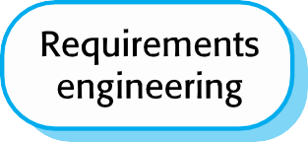
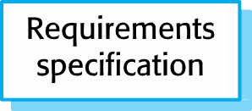
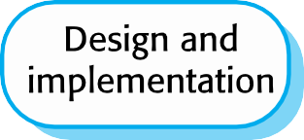



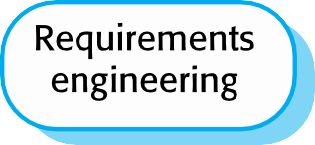
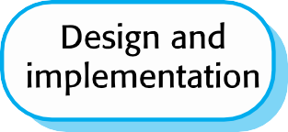
Plan-driven and agile development

Slide 7
Plan-driven and agile development
Plan-driven development
  A plan-driven approach to software engineering is based around separate development stages with the outputs to be produced at each of these stages planned in advance.
  Not necessarily waterfall model – plan-driven, incremental development is possible
  Iteration occurs within activities (going through several cycles of refinement or improvement within a single phase, but without stepping back to earlier phases in the overall process)
Agile development
  Specification, design, implementation and testing are inter- leaved and the outputs from the development process are decided through a process of negotiation during the software development process.

Slide 8
Agile methods

Slide 9
Agile methods
Dissatisfaction with the overheads involved in software design methods of the 1980s and 1990s led to the creation of agile methods. These methods:
  Focus on the code rather than the design
  Are based on an iterative approach to software development
  Are intended to deliver working software quickly and evolve this
quickly to meet changing requirements.
The aim of agile methods is to reduce overheads in the software process (e.g. by limiting documentation) and to be able to respond quickly to changing requirements without excessive rework.

Slide 10
Agile manifesto
We are uncovering better ways of developing software by doing it and helping others do it. Through this work we have come to value:
  Individuals and interactions over processes and tools
  Working software over comprehensive documentation
  Customer collaboration over contract negotiation
  Responding to change over following a plan
That is, while there is value in the items on the right, we value the items on the left more.

Slide 11
The principles of agile methods
Principle | Description
Customer involvement | Customers should be closely involved throughout the development process. Their role is provide and prioritize new system requirements and to evaluate the iterations of the system.
Incremental delivery | The software is developed in increments with the customer specifying the requirements to be included in each increment.
People not process | The skills of the development team should be recognized and exploited. Team members should be left to develop their own ways of working without prescriptive processes.
Embrace change | Expect the system requirements to change and so design the system to accommodate these changes.
Maintain simplicity | Focus on simplicity in both the software being developed and in the development process. Wherever possible, actively work to eliminate complexity from the system.

Slide 12
Agile method applicability
Product development where a software company is developing a small or medium-sized product for sale.
  Virtually all software products and apps are now developed
using an agile approach
Custom system development within an organization, where there is a clear commitment from the customer to become involved in the development process and where there are few external rules and regulations that affect the software.

Slide 13
Agile development techniques

Slide 14
Extreme programming
A very influential agile method, developed in the late 1990s, that introduced a range of agile development techniques.
Extreme Programming (XP) takes an ‘extreme’ approach
to iterative development.
  New versions may be built several times per day;
  Increments are delivered to customers every 2 weeks;
  All tests must be run for every build and the build is only accepted if tests run successfully.

Slide 15
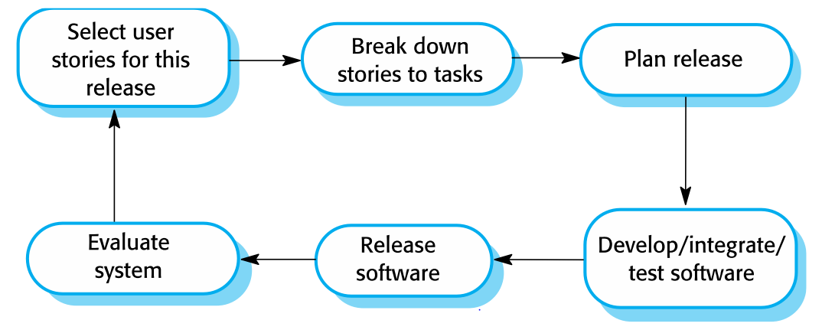
The extreme programming release cycle

Slide 16
Extreme programming practices (a)
Principle or practice | Description
Incremental planning | Requirements are recorded on story cards and the stories to be included in a release are determined by the time available and their relative priority. The developers break these stories into development ‘Tasks’. See Figures 3.5 and 3.6.
Small releases | The minimal useful set of functionality that provides business value is developed first. Releases of the system are frequent and incrementally add functionality to the first release.
Simple design | Enough design is carried out to meet the current requirements and no more.
Test-first development | An automated unit test framework is used to write tests for a new piece of functionality before that functionality itself is implemented.
Refactoring | All developers are expected to refactor the code continuously as soon as possible code improvements are found. This keeps the code simple and maintainable.

Slide 17
Extreme programming practices (b)
Pair programming | Developers work in pairs, checking each other’s work and providing the support to always do a good job.
Collective ownership | The pairs of developers work on all areas of the system, so that no islands of expertise develop and all the developers take responsibility for all of the code. Anyone can change anything.
Continuous integration | As soon as the work on a task is complete, it is integrated into the whole system. After any such integration, all the unit tests in the system must pass.
Sustainable pace | Large amounts of overtime are not considered acceptable as the net effect is often to reduce code quality and medium term productivity
On-site customer | A representative of the end-user of the system (the customer) should be available full time for the use of the XP team. In an extreme programming process, the customer is a member of the development team and is responsible for bringing system requirements to the team for implementation.

Slide 18
XP and agile principles
Incremental development is supported through small, frequent system releases.
Customer involvement means full-time customer
engagement with the team.
People not process through pair programming, collective ownership and a process that avoids long working hours.
Change supported through regular system releases.
Maintaining simplicity through constant refactoring of code.

Slide 19
Influential XP practices
Extreme programming has a technical focus and is not easy to integrate with management practice in most organizations.
Consequently, while agile development uses practices from XP, the method as originally defined is not widely used.
Key practices
  User stories for specification
  Refactoring
  Test-first development
  Pair programming

Slide 20
User stories for requirements
In XP, a customer or user is part of the XP team and is responsible for making decisions on requirements.
User requirements are expressed as user stories or
scenarios.
These are written on cards and the development team break them down into implementation tasks. These tasks are the basis of schedule and cost estimates.
The customer chooses the stories for inclusion in the next release based on their priorities and the schedule estimates.

Slide 21
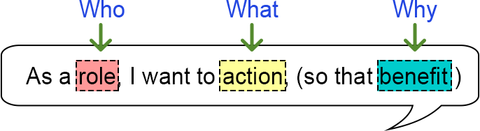
User Story
As a [customer], I want [shopping cart feature] so that [I can easily purchase items online].
As a [manager], I want to [generate a report] so that [I can understand which departments need more resources].
As a [customer], I want to [receive an SMS when the item arrives] so that [I can go pick it up right away]

Slide 22

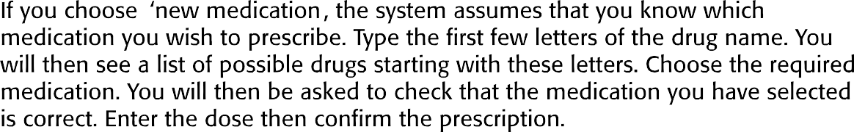
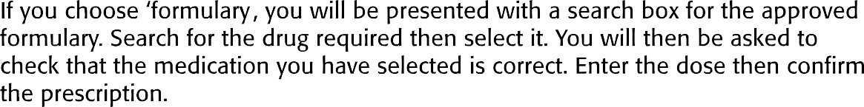
A ‘prescribing medication’ story

Slide 23
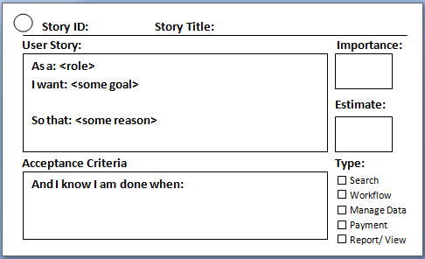

Slide 24


























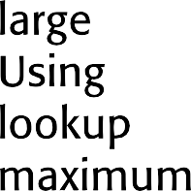

















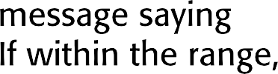

Examples of task cards for prescribing medication

Slide 25
Refactoring
Conventional wisdom in software engineering is to design for change. It is worth spending time and effort anticipating changes as this reduces costs later in the life cycle.
XP, however, maintains that this is not worthwhile as changes cannot be reliably anticipated.
Rather, it proposes constant code improvement (refactoring) to make changes easier when they have to be implemented.

Slide 26
Refactoring
Programming team look for possible software improvements and make these improvements even where there is no immediate need for them.
This improves the understandability of the software and so reduces the need for documentation.
Changes are easier to make because the code is well-
structured and clear.
However, some changes requires architecture refactoring and this is much more expensive.

Slide 27
Examples of refactoring
Re-organization of a class hierarchy to remove duplicate code.
Tidying up and renaming attributes and methods to make
them easier to understand.
The replacement of inline code with calls to methods that have been included in a program library.

Slide 28
Test-first development
Testing is central to XP and XP has developed an approach where the program is tested after every change has been made.
XP testing features:
  Test-first development.
  Incremental test development from scenarios.
  User involvement in test development and validation.
  Automated test harnesses are used to run all component tests each time that a new release is built.

Slide 29
Test-driven development
Writing tests before code clarifies the requirements to be implemented.
Tests are written as programs rather than data so that they can be executed automatically. The test includes a check that it has executed correctly.
  Usually relies on a testing framework such as Junit.
All previous and new tests are run automatically when new functionality is added, thus checking that the new functionality has not introduced errors.

Slide 30
Customer involvement
The role of the customer in the testing process is to help develop acceptance tests for the stories that are to be implemented in the next release of the system.
The customer who is part of the team writes tests as development proceeds. All new code is therefore validated to ensure that it is what the customer needs.
However, people adopting the customer role have limited time available and so cannot work full-time with the development team. They may feel that providing the requirements was enough of a contribution and so may be reluctant to get involved in the testing process.

Slide 31

















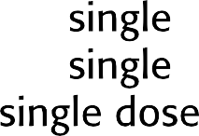
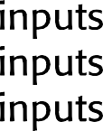




















Test case description for dose checking

Slide 32
Test automation
Test automation means that tests are written as executable components before the task is implemented
  These testing components should be stand-alone, should simulate the submission of input to be tested and should check that the result meets the output specification. An automated test framework (e.g. Junit) is a system that makes it easy to write executable tests and submit a set of tests for execution.
As testing is automated, there is always a set of tests that can be quickly and easily executed
  Whenever any functionality is added to the system, the tests can be run and problems that the new code has introduced can be caught immediately.

Slide 33
Problems with test-first development
Programmers prefer programming to testing and sometimes they take short cuts when writing tests. For example, they may write incomplete tests that do not check for all possible exceptions that may occur.
Some tests can be very difficult to write incrementally. For example, in a complex user interface, it is often difficult to write unit tests for the code that implements the ‘display logic’ and workflow between screens.
It difficult to judge the completeness of a set of tests. Although you may have a lot of system tests, your test set may not provide complete coverage.

Slide 34
Pair programming
Pair programming involves programmers working in pairs, developing code together.
This helps develop common ownership of code and spreads knowledge across the team.
It serves as an informal review process as each line of code is looked at by more than 1 person.
It encourages refactoring as the whole team can benefit from improving the system code.

Slide 35
Pair programming
In pair programming, programmers sit together at the same computer to develop the software.
Pairs are created dynamically so that all team members
work with each other during the development process.
The sharing of knowledge that happens during pair programming is very important as it reduces the overall risks to a project when team members leave.
Pair programming is not necessarily inefficient and there is some evidence that suggests that a pair working together is more efficient than 2 programmers working separately.

Slide 36
Agile project management

Slide 37
Agile project management
The principal responsibility of software project managers is to manage the project so that the software is delivered on time and within the planned budget for the project.
The standard approach to project management is plan- driven. Managers draw up a plan for the project showing what should be delivered, when it should be delivered and who will work on the development of the project deliverables.
Agile project management requires a different approach, which is adapted to incremental development and the practices used in agile methods.

Slide 38
Scrum
Scrum is an agile method that focuses on managing iterative development rather than specific agile practices.
There are three phases in Scrum.
  The initial phase is an outline planning phase where you establish the general objectives for the project and design the software architecture.
  This is followed by a series of sprint cycles, where each cycle
develops an increment of the system.
  The project closure phase wraps up the project, completes required documentation such as system help frames and user manuals and assesses the lessons learned from the project.


Slide 39
Scrum terminology (a)
Scrum term | Definition
Development team | A self-organizing group of software developers, which should be no more than 7 people. They are responsible for developing the software and other essential project documents.
Potentially shippable product increment | The software increment that is delivered from a sprint. The idea is that this should be ‘potentially shippable’ which means that it is in a finished state and no further work, such as testing, is needed to incorporate it into the final product. In practice, this is not always achievable.
Product backlog | This is a list of ‘to do’ items which the Scrum team must tackle. They may be feature definitions for the software, software requirements, user stories or descriptions of supplementary tasks that are needed, such as architecture definition or user documentation.
Product owner | An individual (or possibly a small group) whose job is to identify product features or requirements, prioritize these for development and continuously review the product backlog to ensure that the project continues to meet critical business needs. The Product Owner can be a customer but might also be a product manager in a software company or other stakeholder representative.

Slide 40
Scrum terminology (b)
Scrum term | Definition
Scrum | A daily meeting of the Scrum team that reviews progress and prioritizes work to be done that day. Ideally, this should be a short face-to-face meeting that includes the whole team.
ScrumMaster | The ScrumMaster is responsible for ensuring that the Scrum process is followed and guides the team in the effective use of Scrum. He or she is responsible for interfacing with the rest of the company and for ensuring that the Scrum team is not diverted by outside interference. The Scrum developers are adamant that the ScrumMaster should not be thought of as a project manager. Others, however, may not always find it easy to see the difference.
Sprint | A development iteration. Sprints are usually 2-4 weeks long.
Velocity | An estimate of how much product backlog effort that a team can cover in a single sprint. Understanding a team’s velocity helps them estimate what can be covered in a sprint and provides a basis for measuring improving performance.

Slide 41
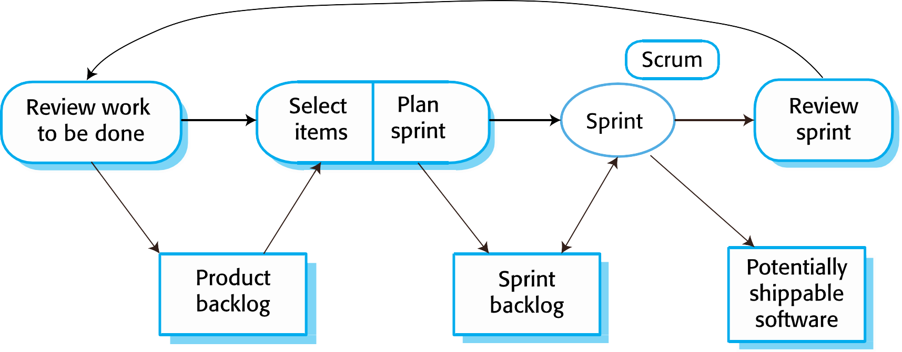
Scrum sprint cycle

Slide 42
The Scrum sprint cycle
Sprints are fixed length, normally 2–4 weeks.
The starting point for planning is the product backlog, which is the list of work to be done on the project.
The selection phase involves all of the project team who work with the customer to select the features and functionality from the product backlog to be developed during the sprint.

Slide 43
The Sprint cycle
Once these are agreed, the team organize themselves to develop the software.
During this stage the team is isolated from the customer and the organization, with all communications channelled through the so-called ‘Scrum master’.
The role of the Scrum master is to protect the
development team from external distractions.
At the end of the sprint, the work done is reviewed and presented to stakeholders. The next sprint cycle then begins.

Slide 44
Teamwork in Scrum
The ‘Scrum master’ is a facilitator who arranges daily meetings, tracks the backlog of work to be done, records decisions, measures progress against the backlog and communicates with customers and management outside of the team.
The whole team attends short daily meetings (Scrums) where all team members share information, describe their progress since the last meeting, problems that have arisen and what is planned for the following day.
  This means that everyone on the team knows what is going on and, if problems arise, can re-plan short-term work to cope with them.

Slide 45
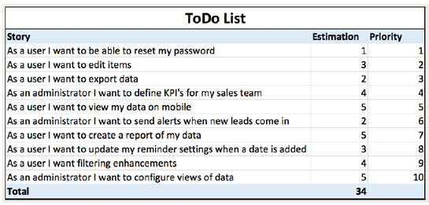
Sample Product Backlog

Slide 46
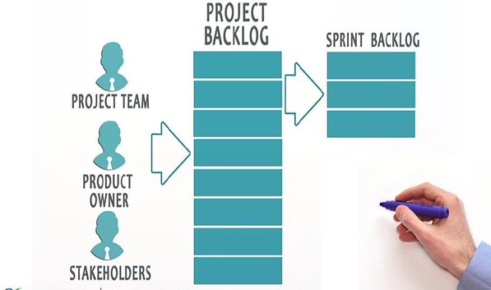

Slide 47
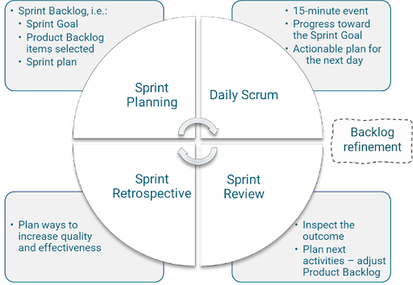
Scrum Framework

Slide 48
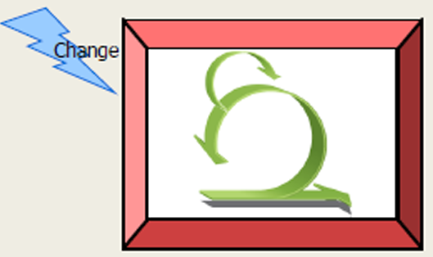
No Changes During Sprint

Slide 49
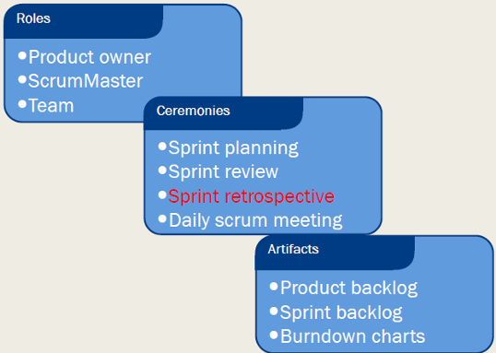
Scrum Framework

Slide 50
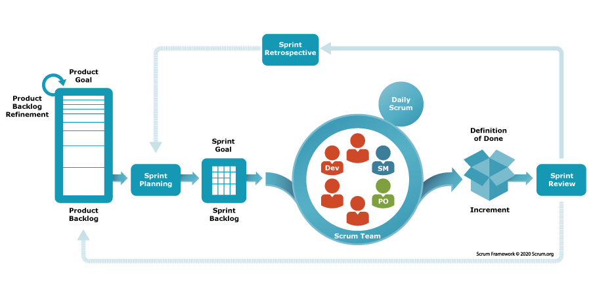
Putting it all together

Slide 51
Sprint Planning

Slide 52
Sprint Velocity
By looking at the amount of work your team completed in previous sprints, you should be able to estimate how much work they can do in future sprints. In Agile development, this estimate is known as sprint velocity

Slide 53
How to estimate sprint velocity
Step 1: Count how many user story points are completed in each sprint
At the end of a sprint, add up how many story points the team completed. For example, if:
In sprint one:
The team committed to completing five user stories. Each user story had eight story points for a total of 40 story points. The team completed three of the five user stories.
In sprint two:
The team committed to seven user stories (including the two that were not completed in sprint 1). Each user story had eight story points for a total of 56 story points. The team completed four of the seven user stories.
In sprint three:
The team committed to nine user stories. Each user story had eight story points for a total of 72 story points.The team completed five of the nine user stories.

Slide 54
How to estimate sprint velocity
Step 2: Calculate the average of completed story points
Simply add up the total of story points completed from each sprint, then divide by the number of sprints.
Sprint one: 3 user stories x 8 story points = 24
Sprint two: 4 user stories x 8 story points = 32
Sprint three: 5 user stories x 8 story points = 40
Total = 96
So, your average sprint velocity is 96 ÷ 3 = 32.

Slide 55
How to estimate sprint velocity
You can now base the amount of work to be done in future sprints on an average of 32 story points. If you have 160 story points remaining to be completed in the project, you can assume that your team will need another five sprints to complete the project.
If your team is new to Agile development, you won’t have any previous sprints to look at. As part of your sprint velocity estimation to-do list, you’ll have to complete a couple of sprints while tracking how many story points are completed in each. Then you will have some useful data that will help calculate an average.

Slide 56
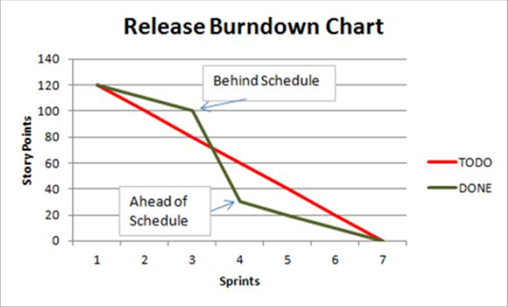

Slide 57
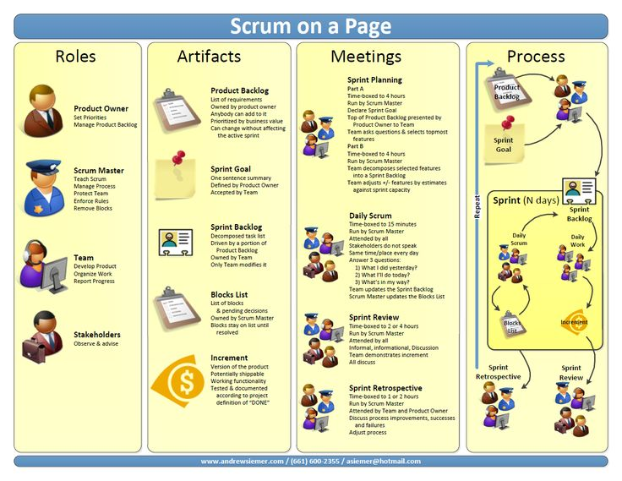

Slide 58
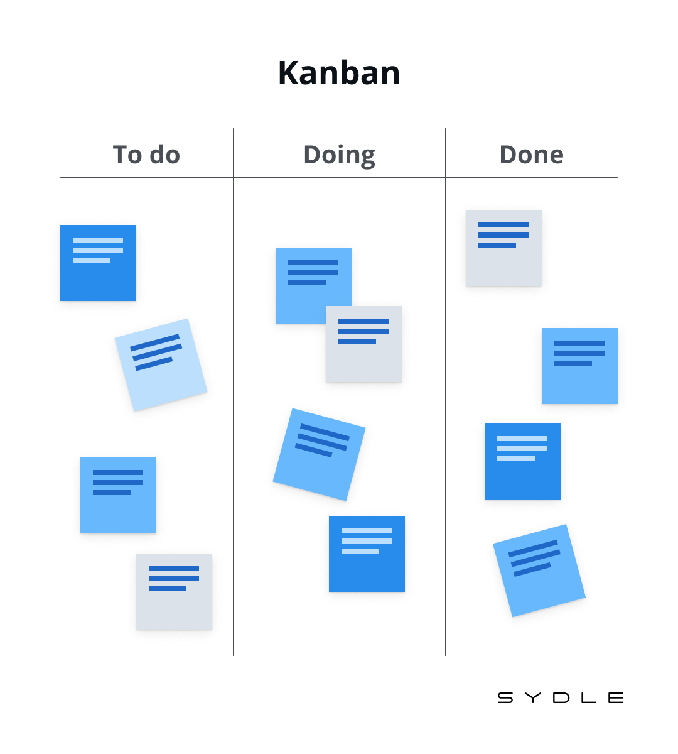
Kanban Board
Visual signal
Increase visibility

Slide 59
Scrum benefits
The product is broken down into a set of manageable and understandable chunks.
Unstable requirements do not hold up progress.
The whole team have visibility of everything and consequently team communication is improved.
Customers see on-time delivery of increments and gain
feedback on how the product works.
Trust between customers and developers is established and a positive culture is created in which everyone expects the project to succeed.

Slide 60
Summary
Scrum is an agile method that provides a project management framework.
  It is centred round a set of sprints, which are fixed time periods
when a system increment is developed.
Many practical development methods are a mixture of plan-based and agile development.
Scaling agile methods for large systems is difficult.
  Large systems need up-front design and some documentation and organizational practice may conflict with the informality of agile approaches.

Slide 61
Process Models (Recap)
Waterfall model
  Classical
  V model
Incremental Models
  Phased development in increment
Evolutionary Models
  Prototyping model
  Spiral model
Agile methods
  XP
  Scrum
Notes:
Evolutionary= allows the software to evolve over time through iterative and incremental processes
Prototyping: Prototyping is considered evolutionary because it involves the creation of a partial, functional system prototype early in the development process. Feedback from users and stakeholders is used to refine and enhance the system in subsequent iterations.
Spiral Model: The Spiral Model is evolutionary because it combines the idea of iterative development (repeating cycles) with the concept of risk management. Each spiral represents a cycle of planning, risk analysis, engineering, and evaluation, allowing the software to evolve while addressing potential risks at each iteration.

Slide 62
Reference
How to Estimate Sprint Velocity | Lucidchart Blog

